Slide 1


Birds of Girinagara
-Meghavarna
Notes:
lololol

Slide 2
Objectives
To document birds found in the area.
To analyse the condition in the area
DSLR Camera with 300mm lens
Digital Camera
Binoculars
Material Used

Slide 3
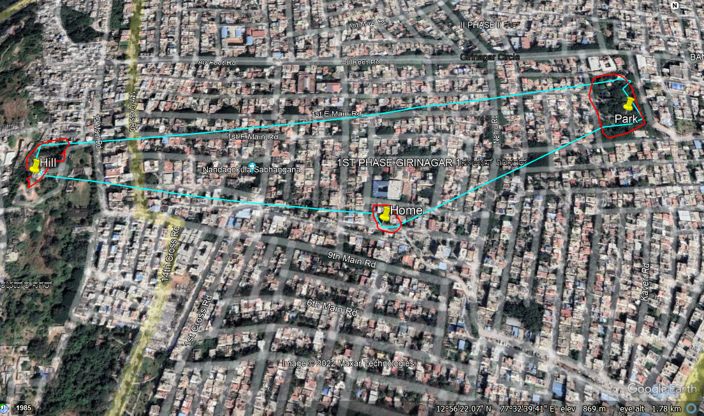
Study area
Latitude:12°56'25.28"N
Longitude: 77°32'31.07"E
Area-Home: 0.45 acre
Park: 2.40 acre
Hill: 0.90 acre

Slide 4
Common name | Scientific name | IUCN Status | Resident/ Migratory | Activity | Observation
Pale Billed Flowerpecker | Dicaeum erythrorhynchos | Least concern | Migratory Long distance | Moving from tree to tree
Common Tailorbird | Orthotomus sutorius | Least Concern | Resident | Feeding on insects | Hunts for insects on ground,tree and flying
Cinereous Tit | Parus cinereus | Least concern | Resident | Perching
Purple Rumped Sunbird | Leptocoma zeylonica | Least concern | Resident | Feeding on nectar | Very active
Red Whiskered Bulbul | Pycnonotus jocosus | Least concern | Resident | Singing a song | In trees it moves to the branch above by a jumps and a flatter of its wings.

Slide 5
Common name | Scientific name | IUCN Status | Resident/ Migratory | Activity | Observation
White Cheeked Barbet | Megalaima viridis | Least Concern | Resident | Feeding on Insects | Pecks the the husk of seeds while holding them with their legs to eat the inside.
Rose ringed Parakeet | Psittacula krameri | Least Concern | Resident | Feeding on Fruits | In fruits like mango,often only leaves the seed hanging on the tree.
Common Myna | Acridotheres tristis | Least Concern | Resident | Perching
House Crow | Corvus splendens | Least Concern | Resident | Perching

Slide 6
Common name | Scientific name | IUCN Status | Resident/ Migratory | Activity | Observation
Large Billed Crow | Corvus macrorhynchos | Least Concern | Resident | Feeding on rat | Fights with kites for food
Rock Pigeon | Columba livia | Least Concern | Resident | Feeding on Fruits | It is a ground feeder
Eurasian Sparrowhawk | Accipiter nisus | Least Concern | Resident | Watching its prey
Black Kite | Milvus migrans | Least Concern | Resident | Perching

Slide 7
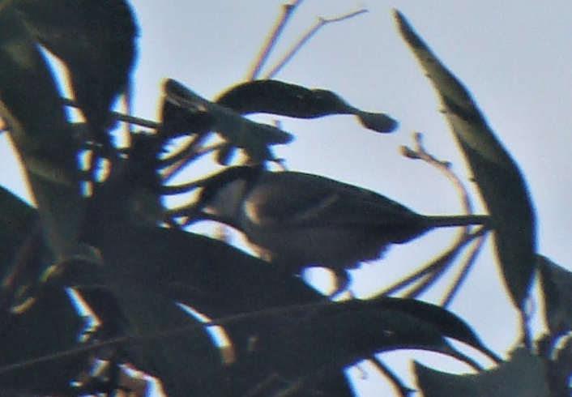
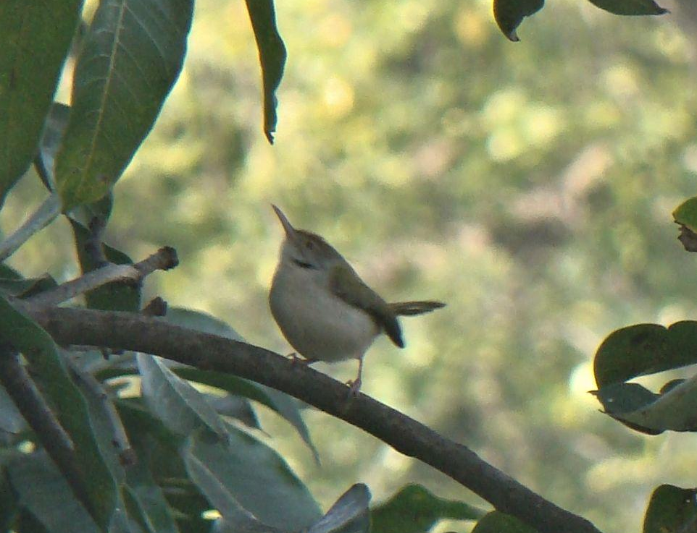
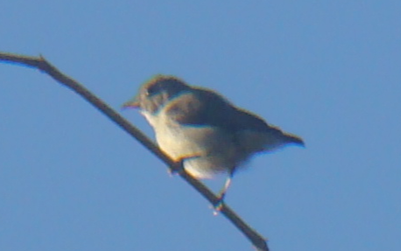
Gallery
Cinereous Tit
Common Tailorbird
Pale billed Flowerpecker

Slide 8
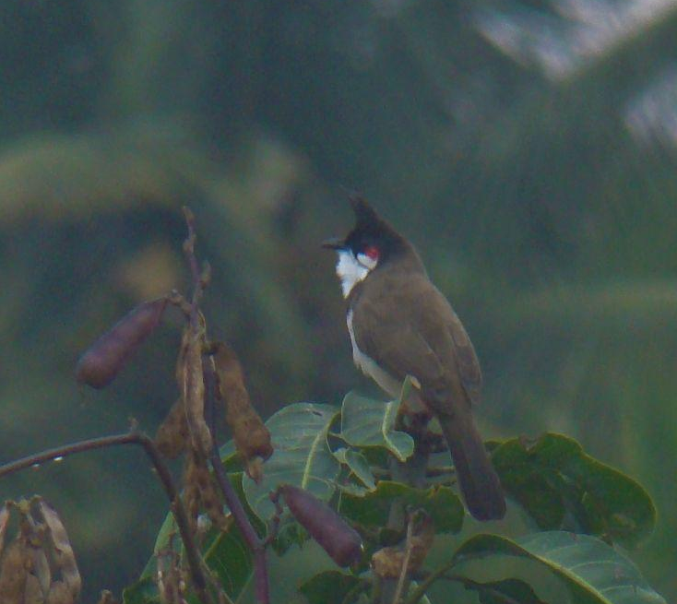
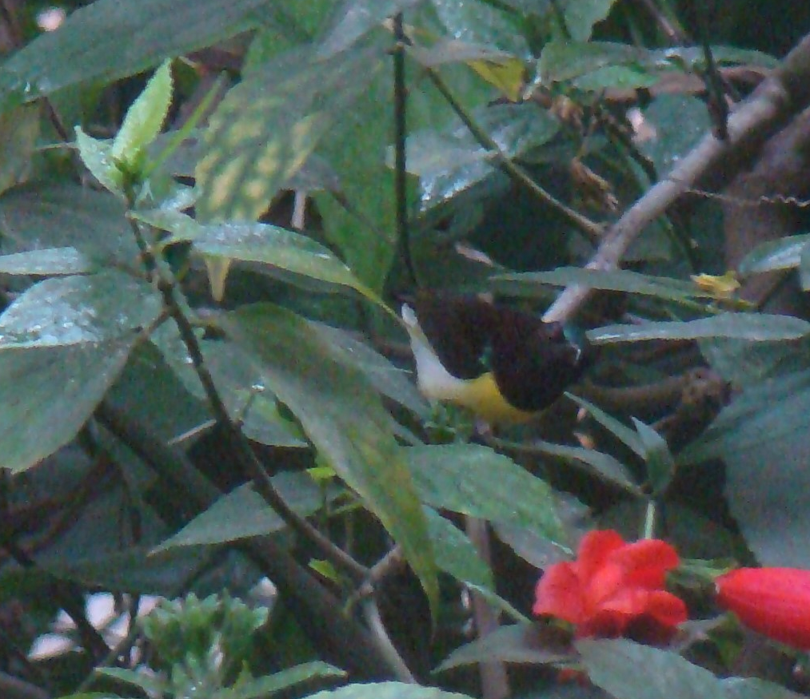
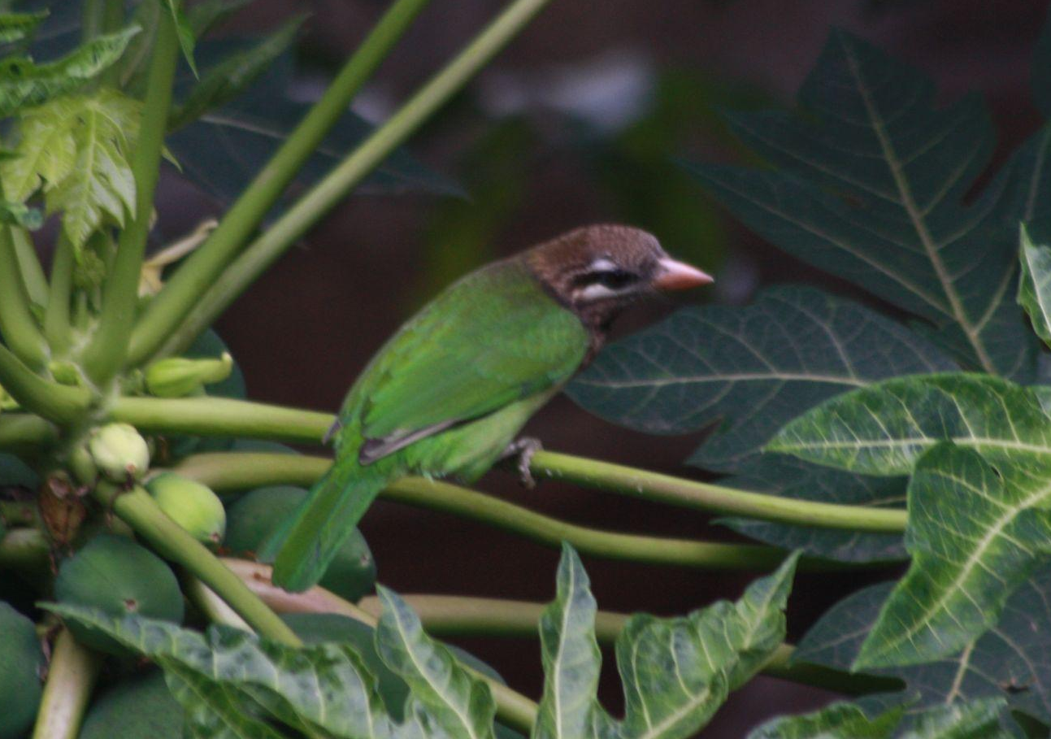
Gallery
Red Whiskered Bulbul
Purple Rumped Sunbird
White Cheeked Barbet

Slide 9
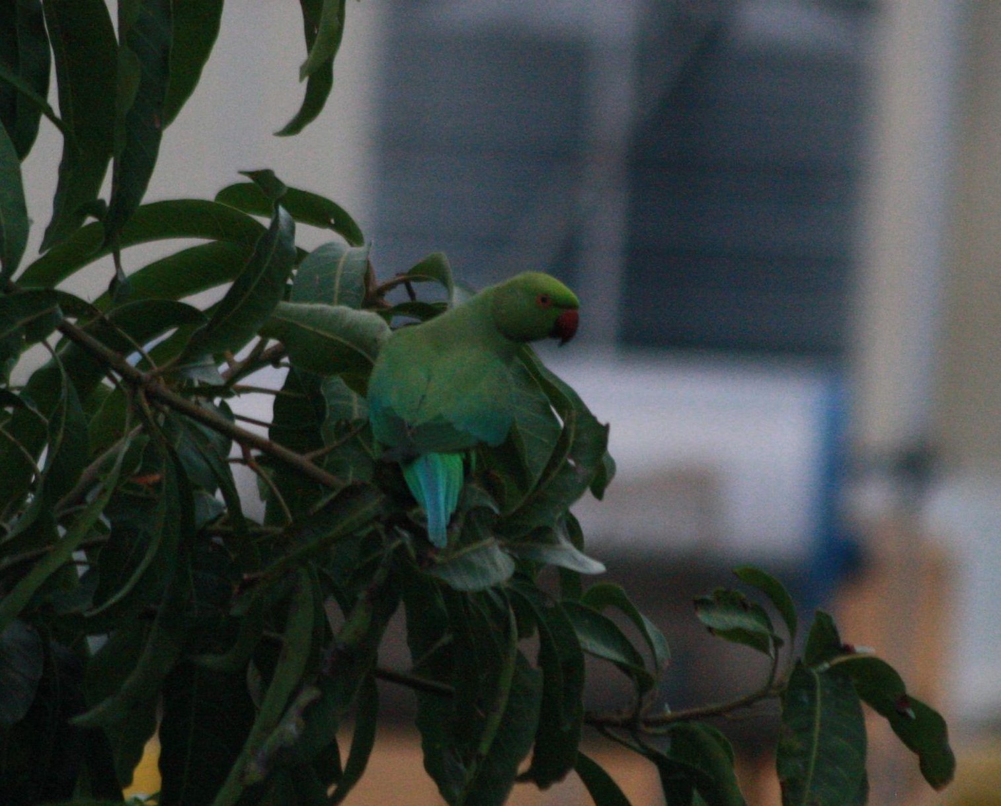
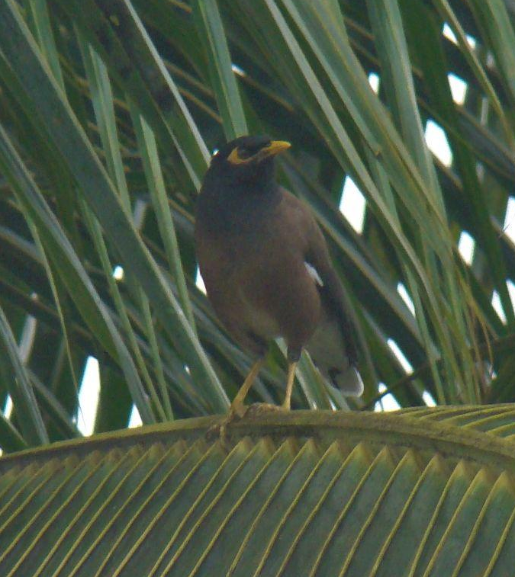
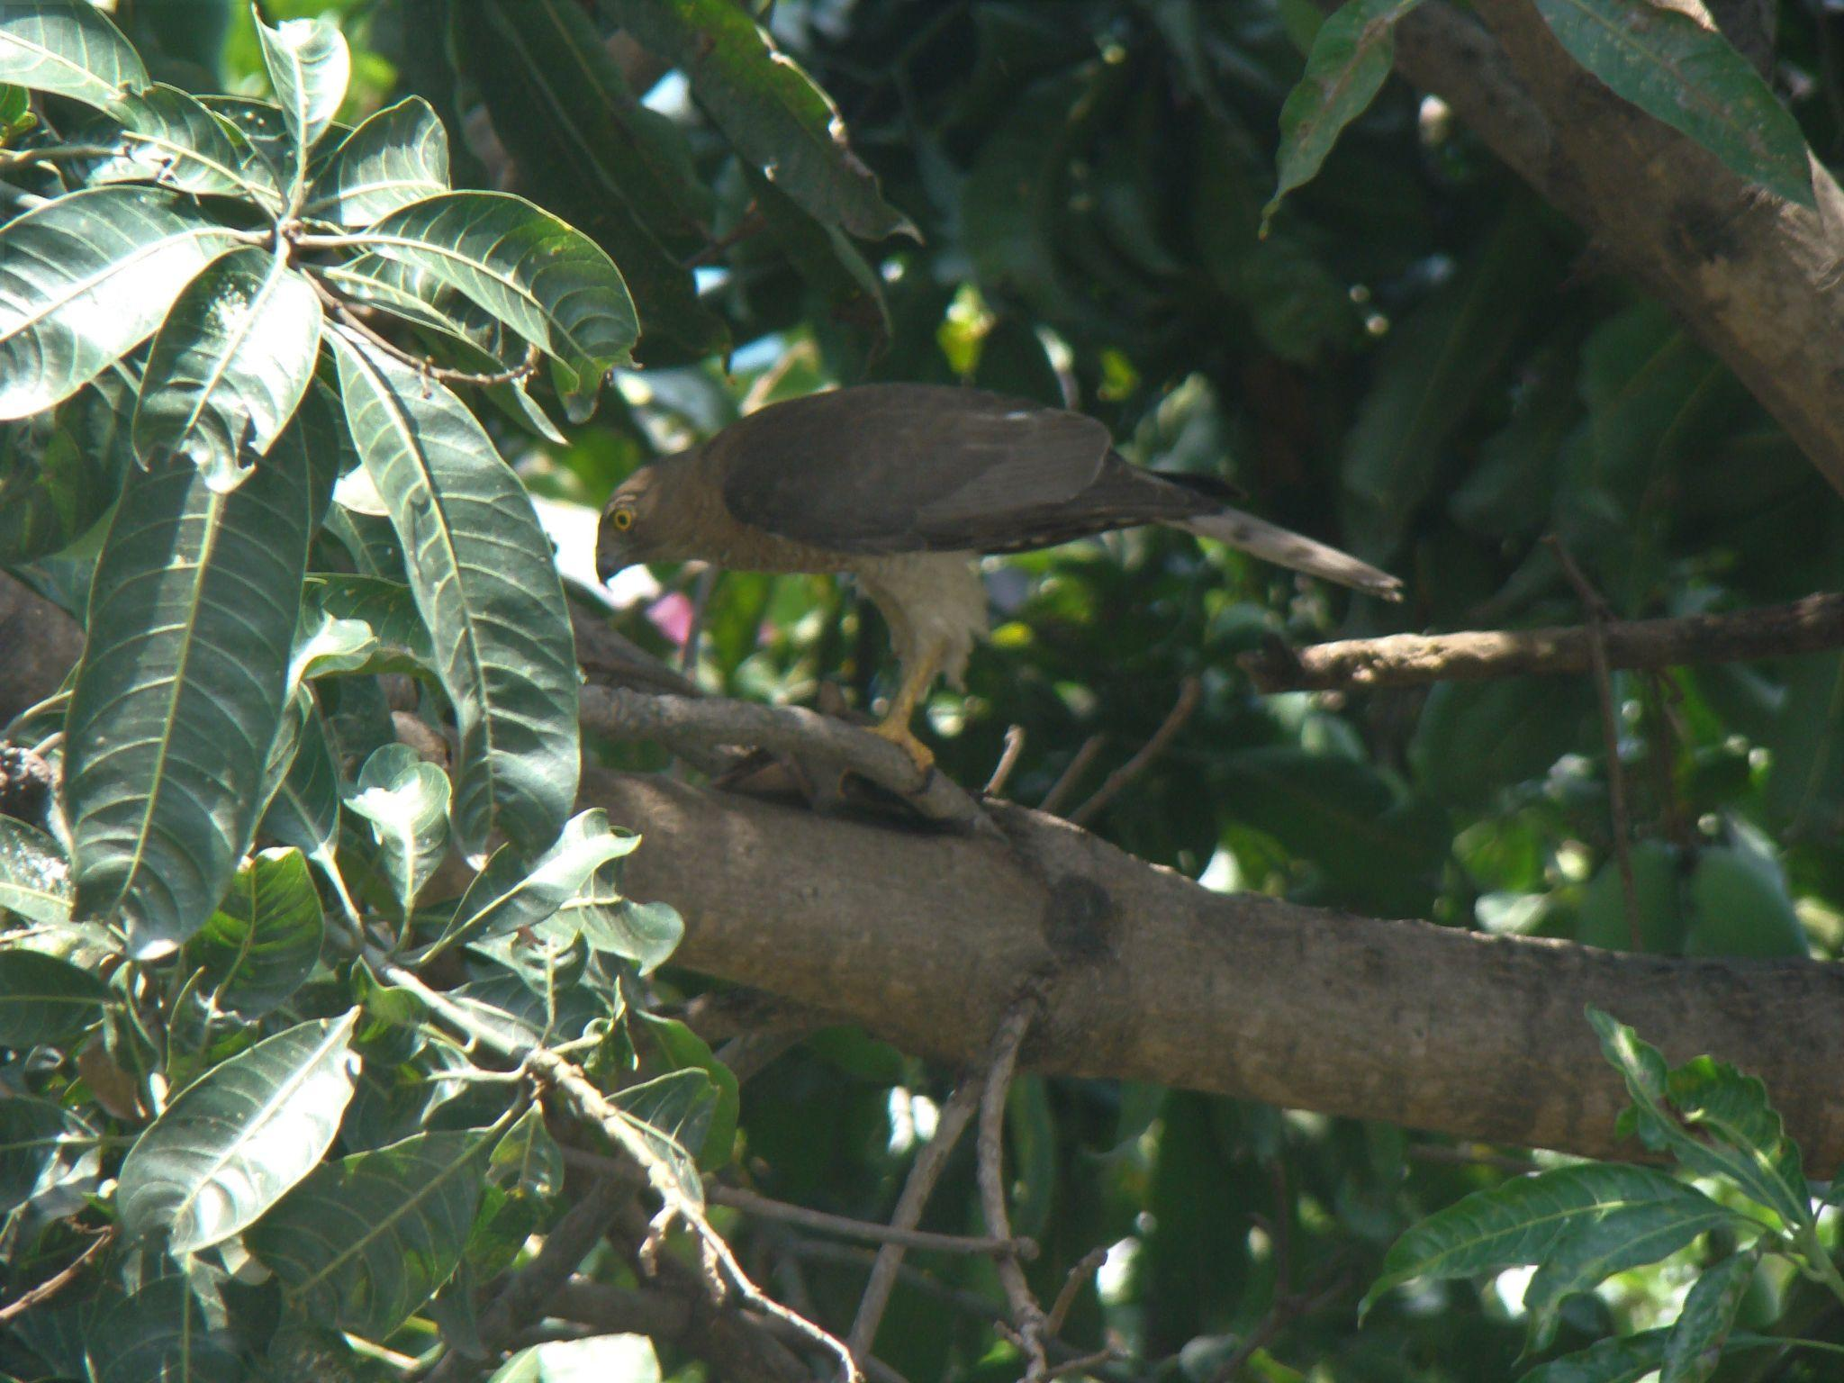
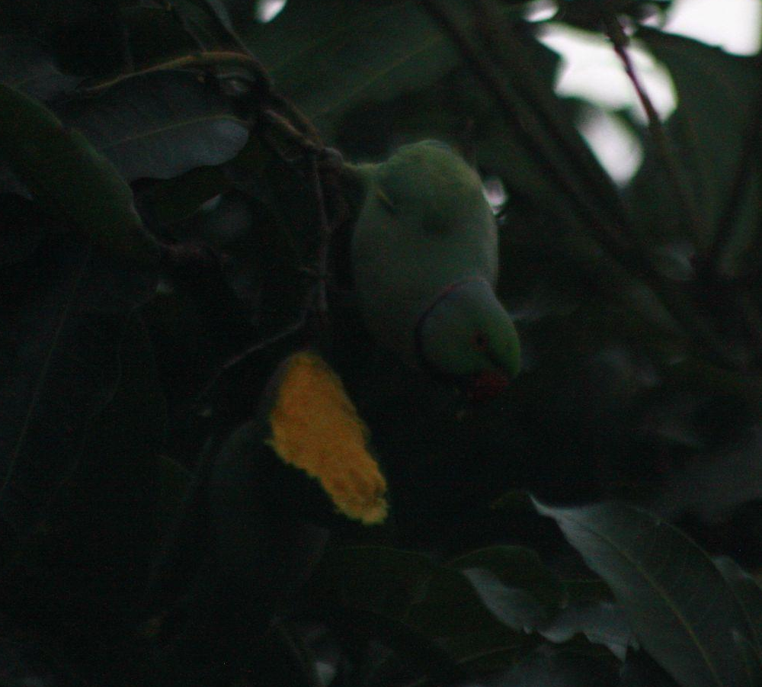
Gallery
Rose Ringed Parakeet
Common Myna
Eurasian Sparrowhawk

Slide 10
Conclusion
Birds of prey may watch both while gliding and while sitting.
Every bird is unique,Sunbird does not sit on the same plant barbet sits.
Small birds usually are insectivorous and comparatively more active than larger birds

Slide 11
Thank You

