Slide 1



Lake conference
Birds of RR Nagar
By - Hrishikesh . Gangoor
Class - 8th
School - Purnapramati
By - Prabhanjan . Desai
Class - 10th
School - Purnapramati

Slide 2
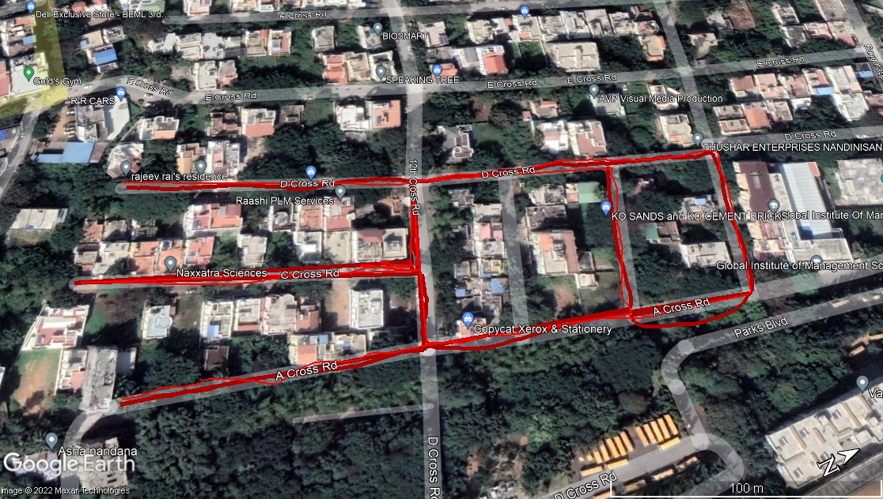
Study Area Details
Duration- 7th , 10th ,11th , 12th , 13th December.
Almost during sunset time

Slide 3
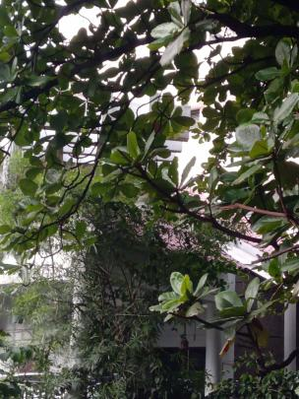
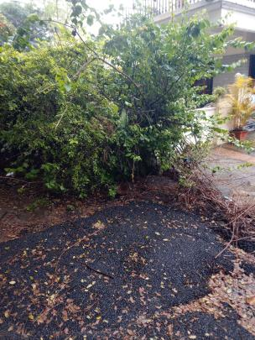
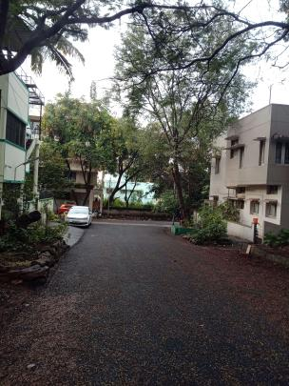
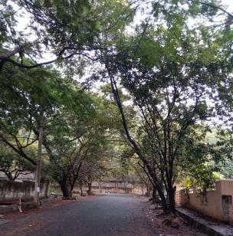
AREA
RR Nagar
DETAILS
STUDY

Slide 4
Objectives
To identify the most common birds.
To find out if this habitat is suitable for the birds to live in.
To study the behaviour of these birds

Slide 5
Materials & Methods
Transect method of survey
Nikon 330D , with 300mm lens
Book
Pencil

Slide 6
RESULTS
Common name | Scientific name | Diet | IUCN Status
Scaly breasted munia | Lonchura punctulata | Omnivore | Last concern
Yellow billed Babbler | Turdoides affinis | Omnivore | Least concern
Black Drongo | Dicrurus macrocercus | Insectivore | Least concern
Common myna | Acridotheres tristis | Omnivore | Least concern
White cheeked barbet | Psilopogon viridis | Omnivore | Not extinct
Common Tailorbird | Orthotomus sutorius | Omnivore | Least concern

Slide 7
RESULTS
Common Name | Scientific name | Diet | IUCN Status
Blue-capped rock thrush | Monticola cinclorhynchus | Omnivore | Least concern
Spotted Dove | Spilopelia chinensis | Omnivore | Least concern
Asian Koel | Eudynamys scolopaceus | Omnivore | Least concern
Red Whiskered bulbul | Pycnonotus jocosus | Omnivore | Least concern
Purple sunbird | Cinnyris asiaticus | Nectar+insectivore | Least concern
Black kite | Milvus migrans | Carnivore + scavenger | Least concern
Brahminy kite | Haliastur indus | Carnivore+scavenger | Least concern

Slide 8
Results
Common name | Scientific name | Diet | IUCN Status
Crow | Corvus splendens | Omnivore | Least concern
Pigeon | Columba livia domestica | Omnivore | Least concern
Asian Coucal | Eudynamys scolopaceus | Omnivore | Least concern
White browed Wagtail | Motacilla maderaspatensis | Omnivore | Least concern
Rose ringed parakeet | Psittacula krameri | Granivore+frugivore | Least concern
Cattle egret | Bubulcus ibis | Carnivore | Least concern

Slide 9
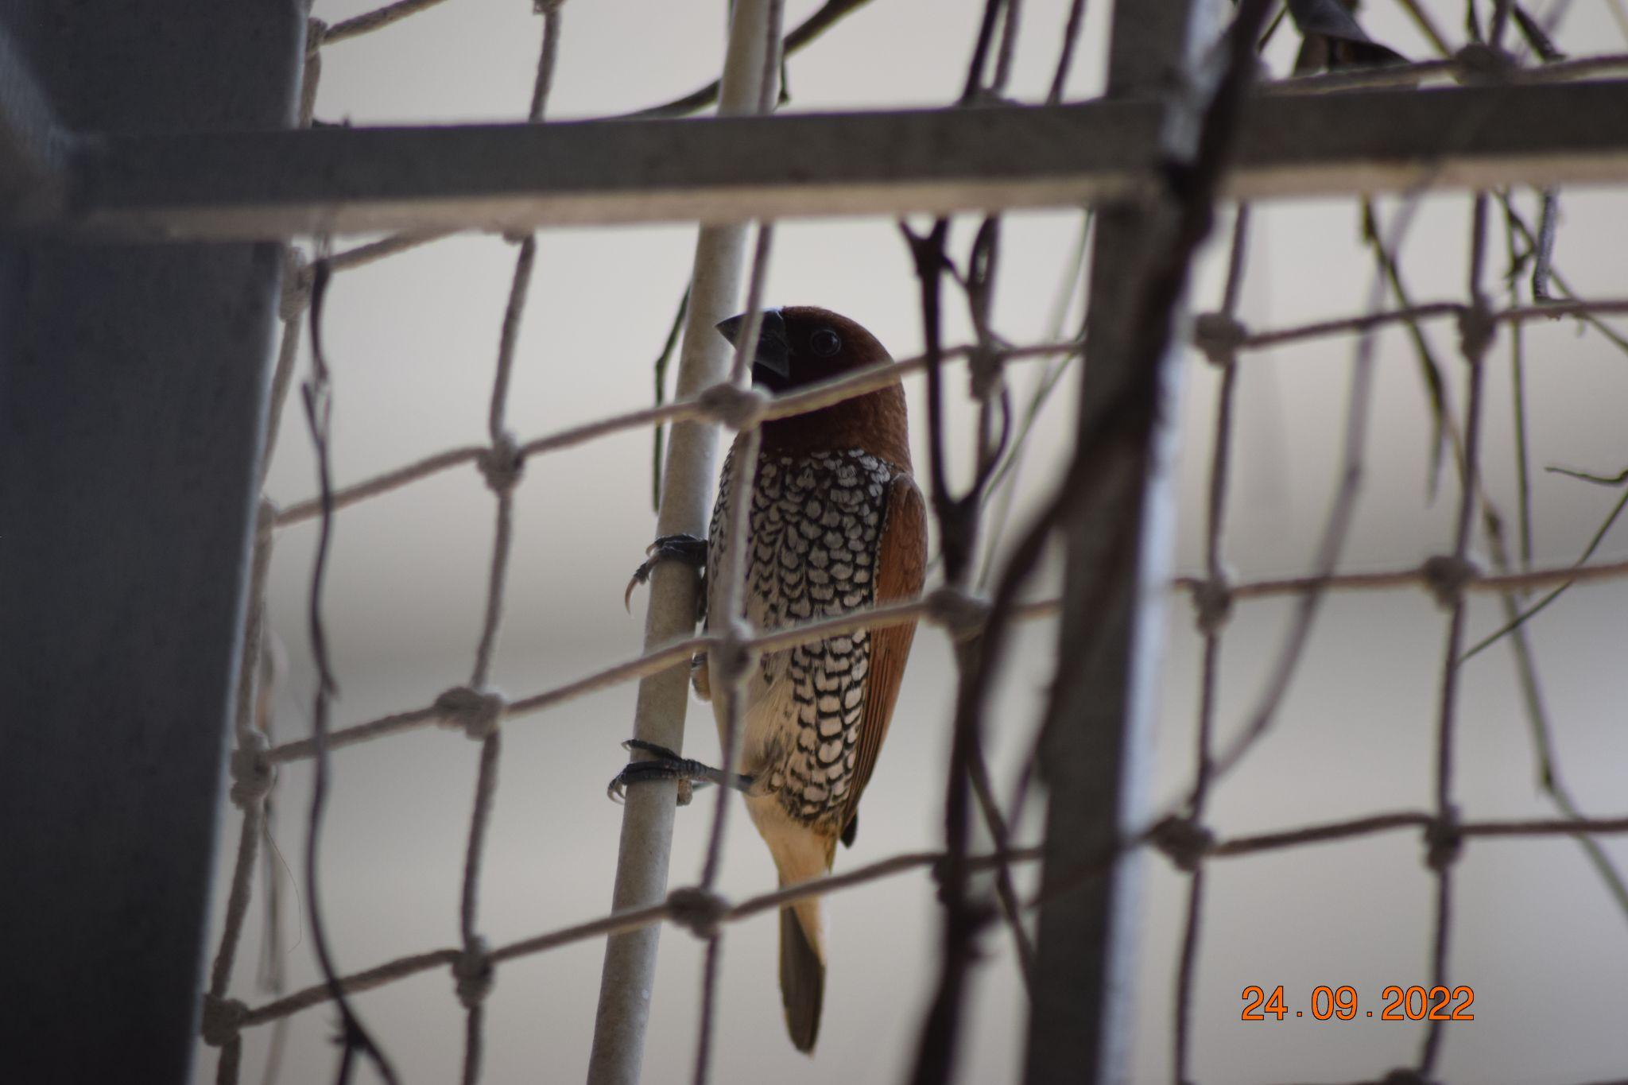
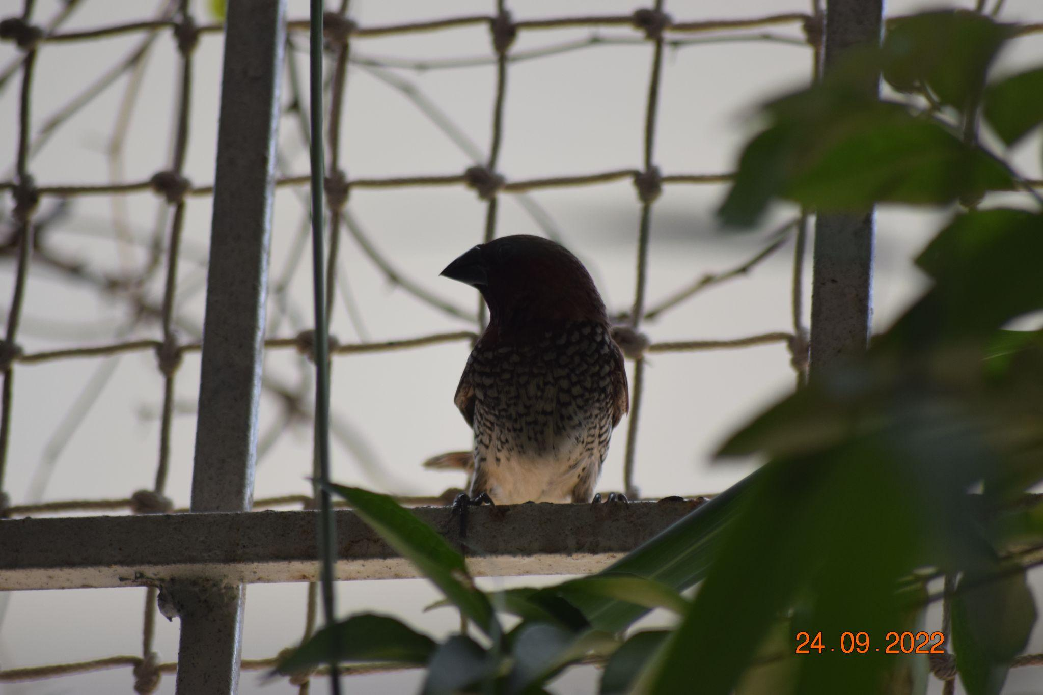
Scaly Breasted Munia
A sparrow sized Bird

Slide 10
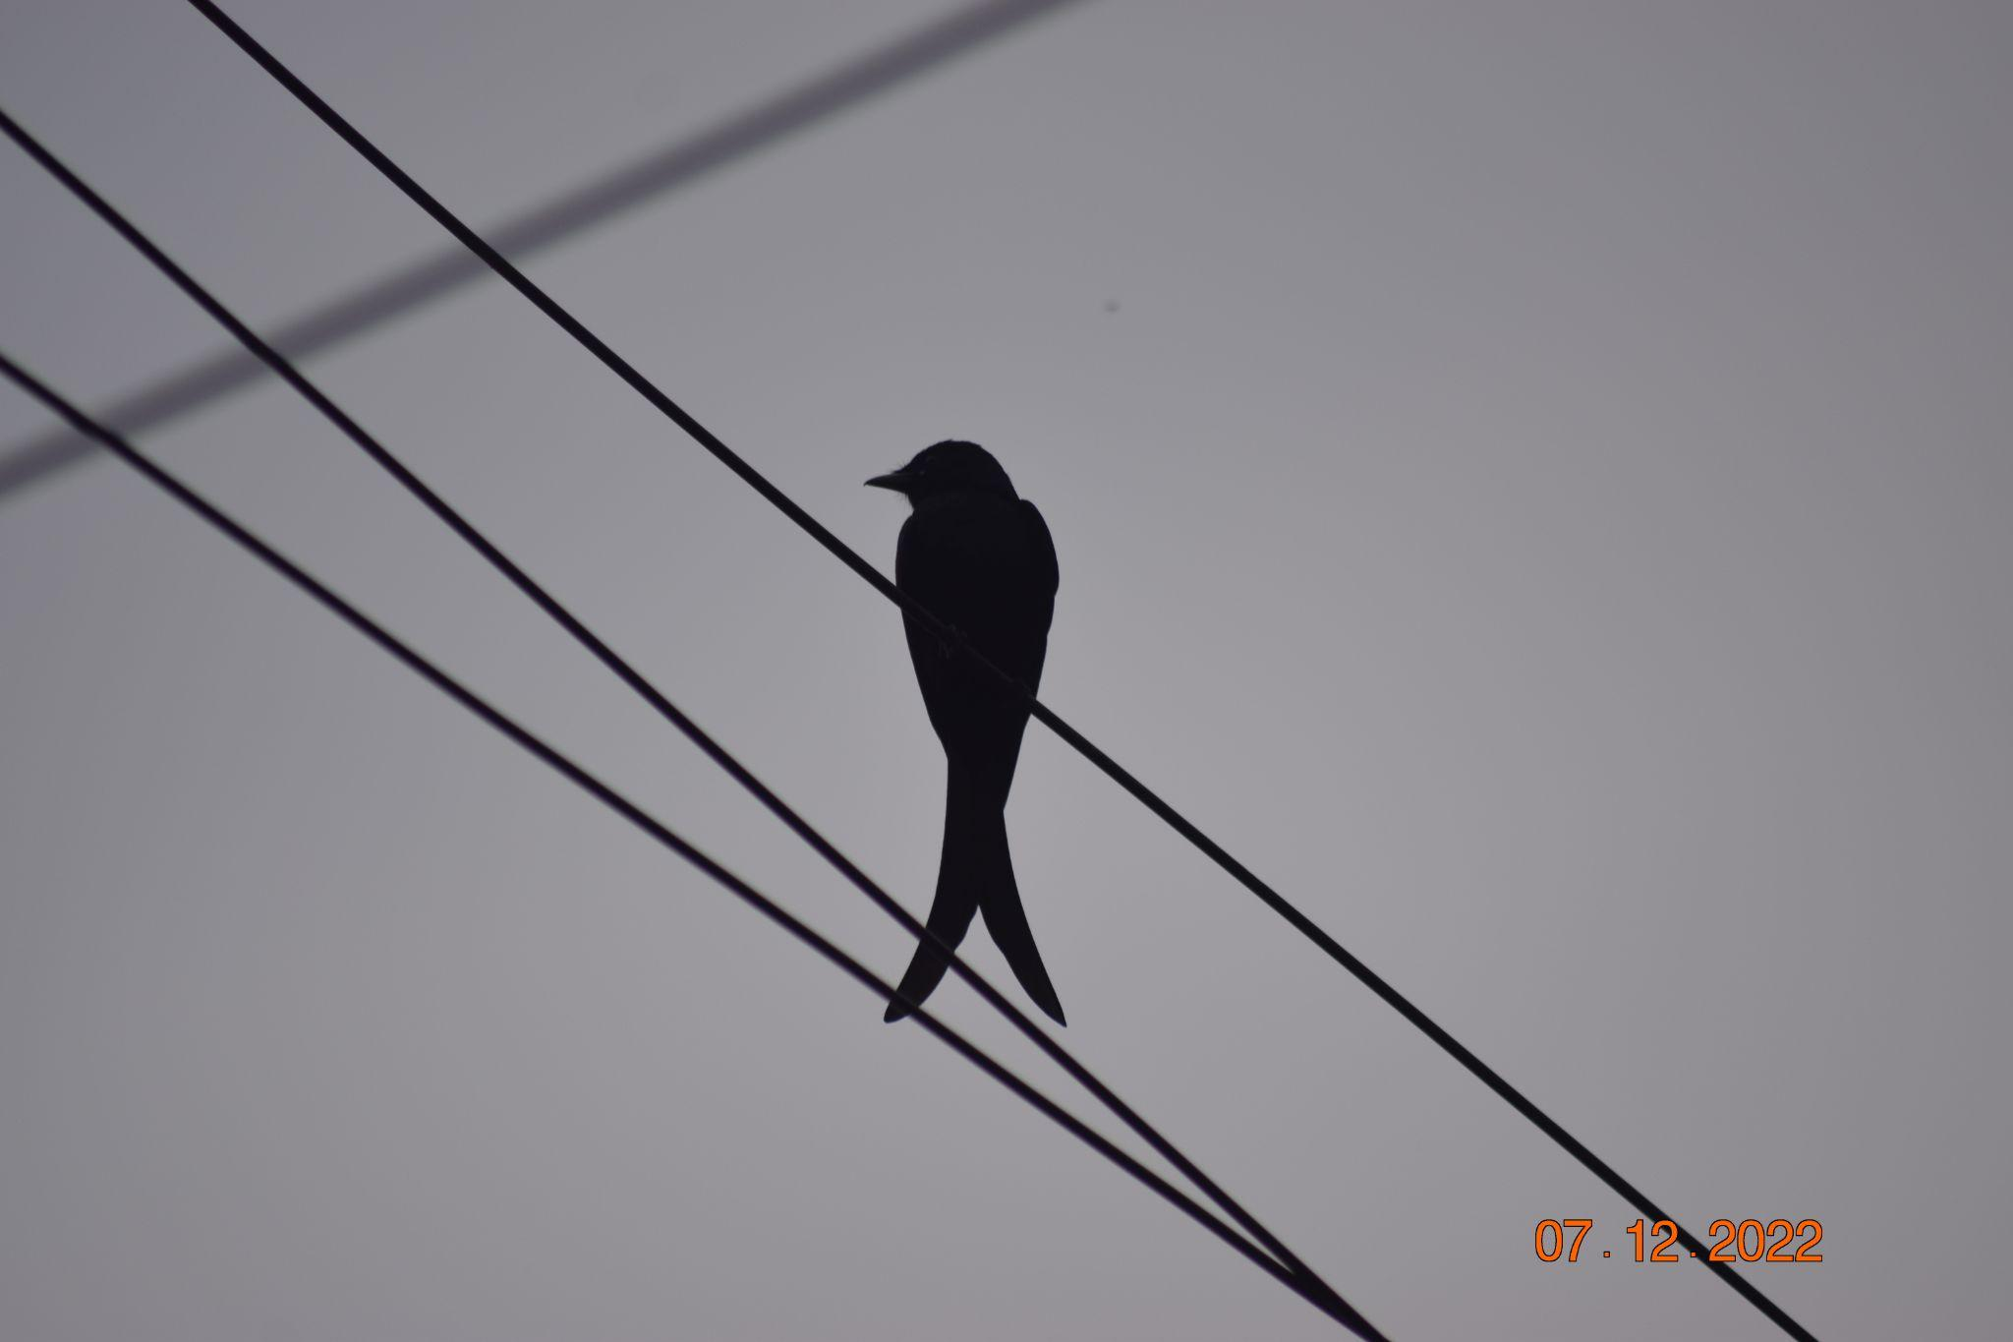
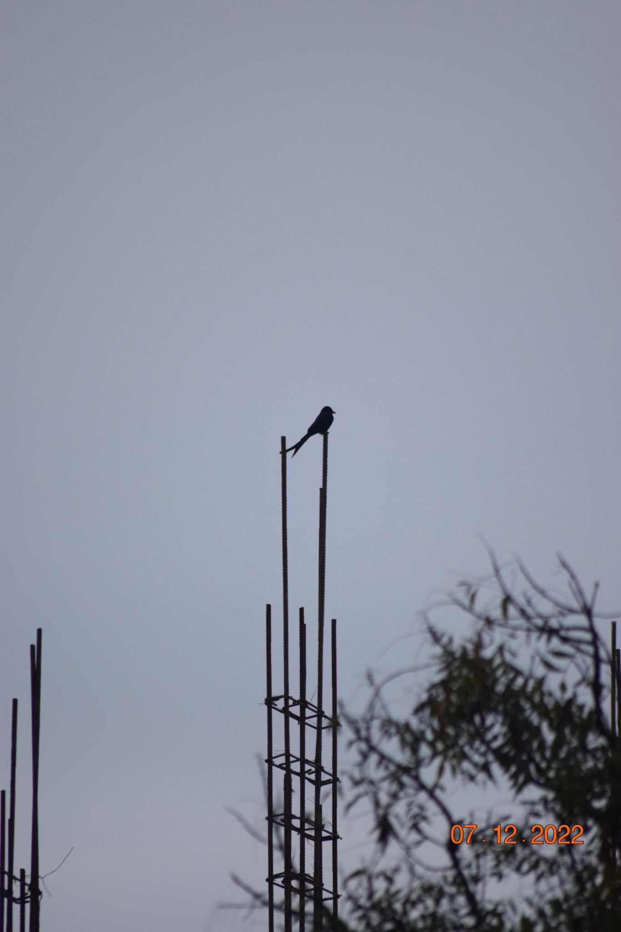
Black Drongo
A myna sized bird

Slide 11
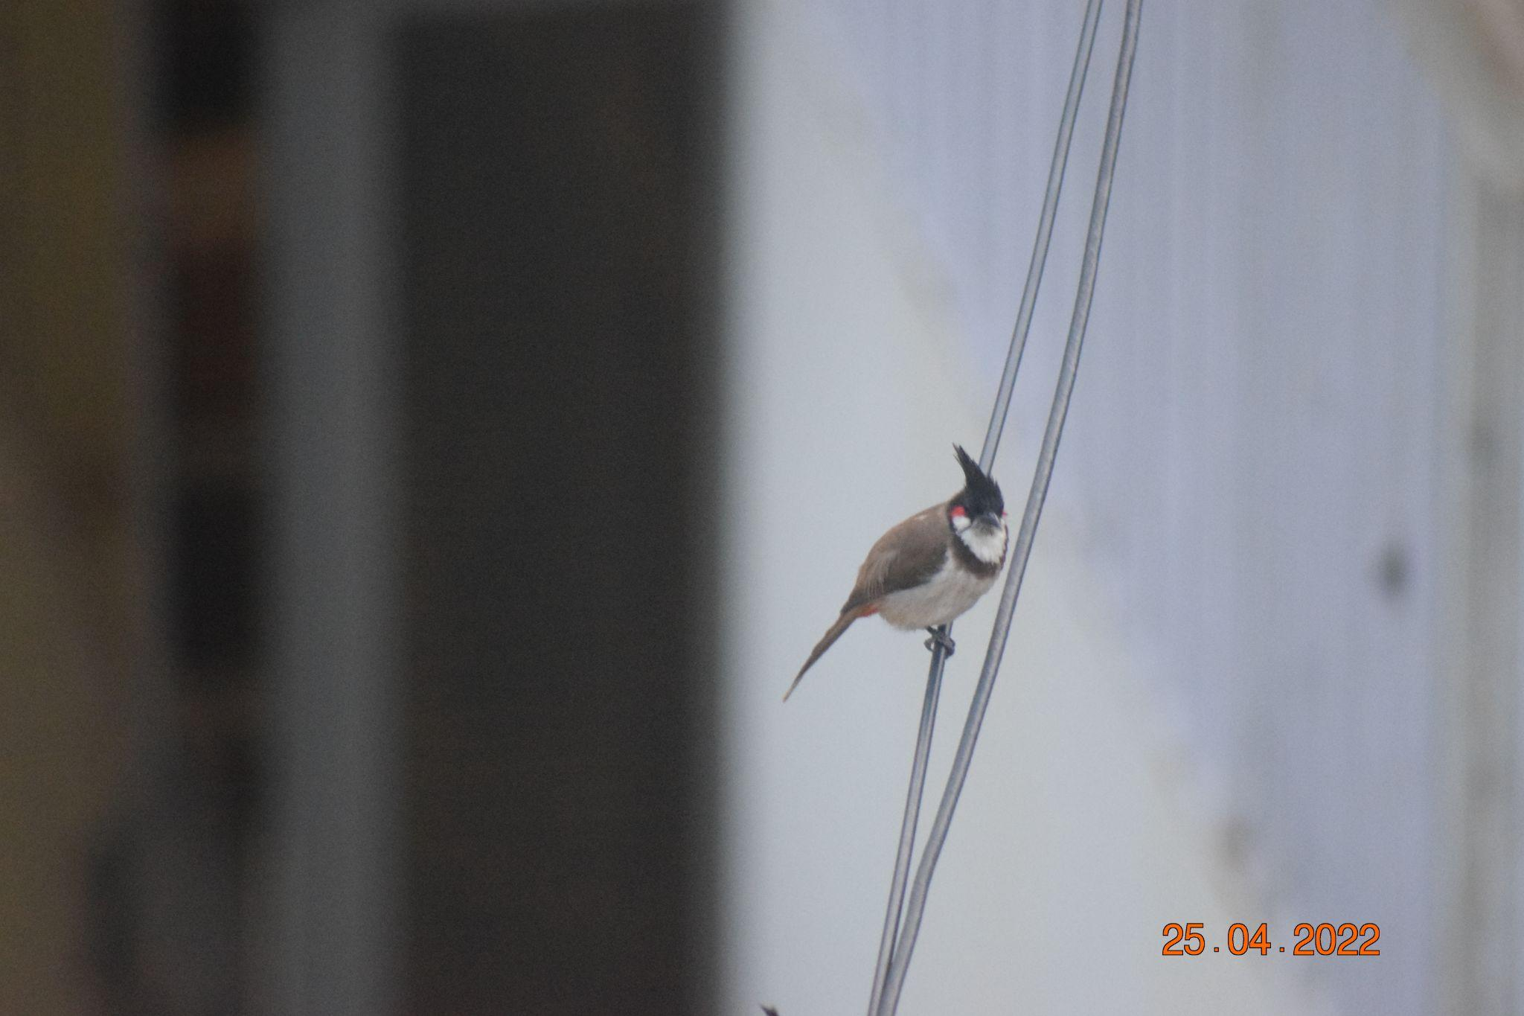
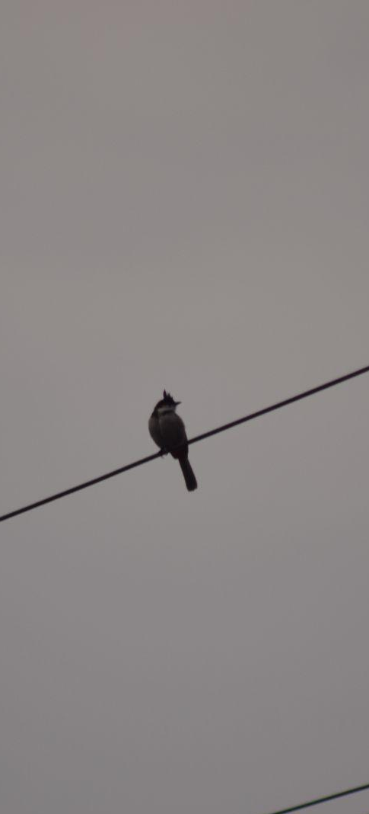
Red Whiskered Bulbul
A myna Sized bird

Slide 12
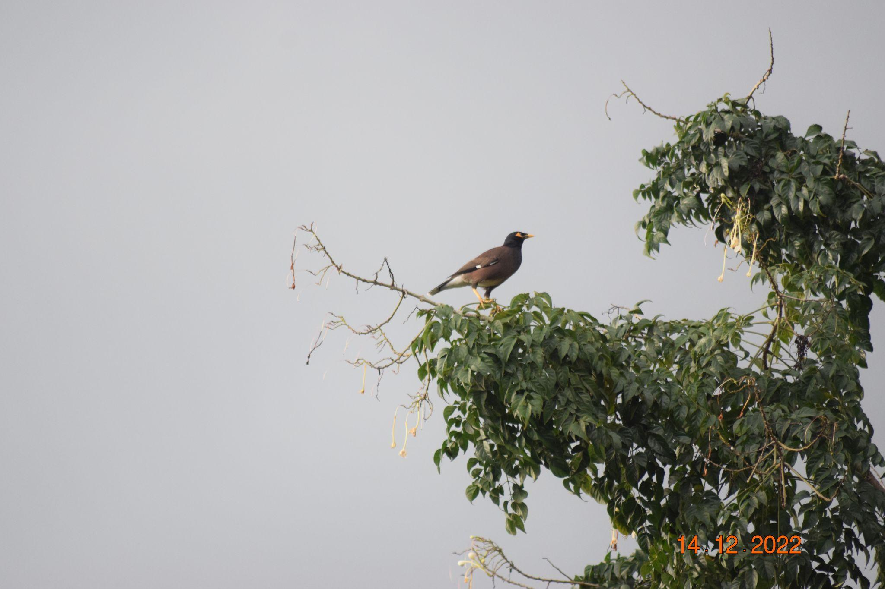
Common myna
Myna has Its own size - so myna size

Slide 13
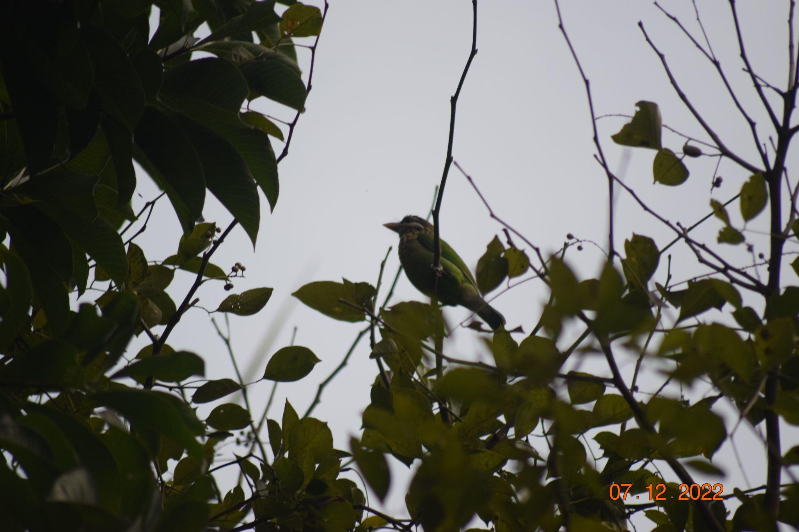
White Cheeked Barbet
Slightly smaller than myna

Slide 14
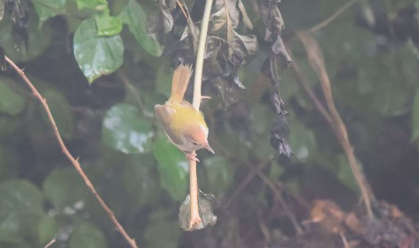
Common Tailorbird
Smaller than sparrow

Slide 15
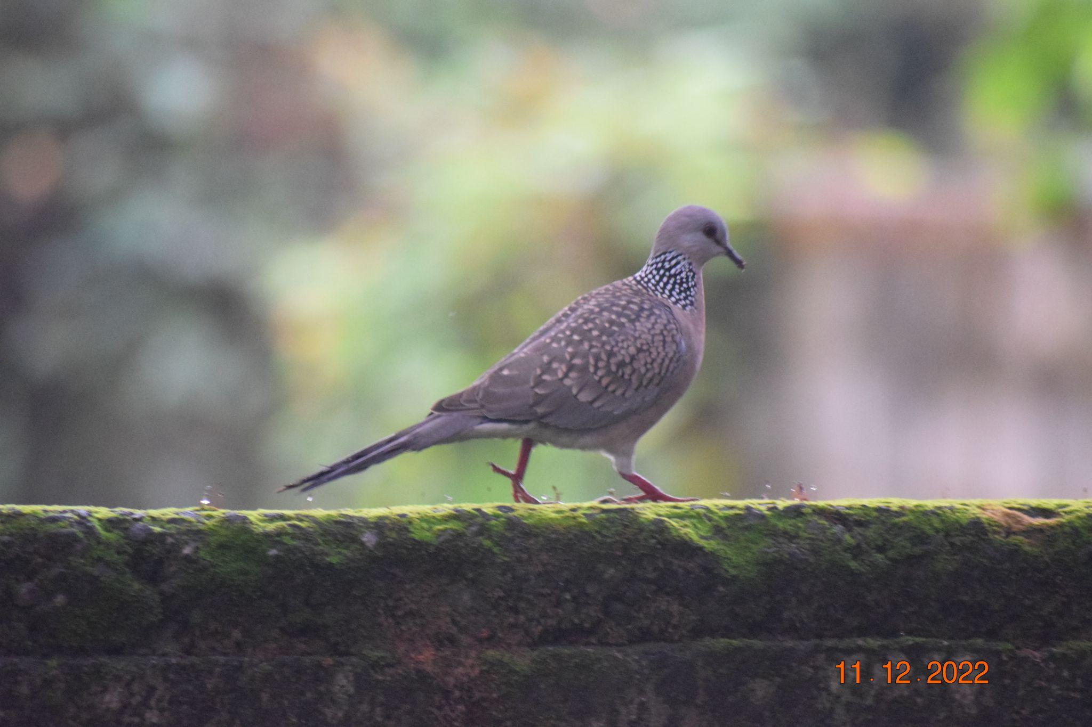
Spotted Dove
Smaller than Crow

Slide 16
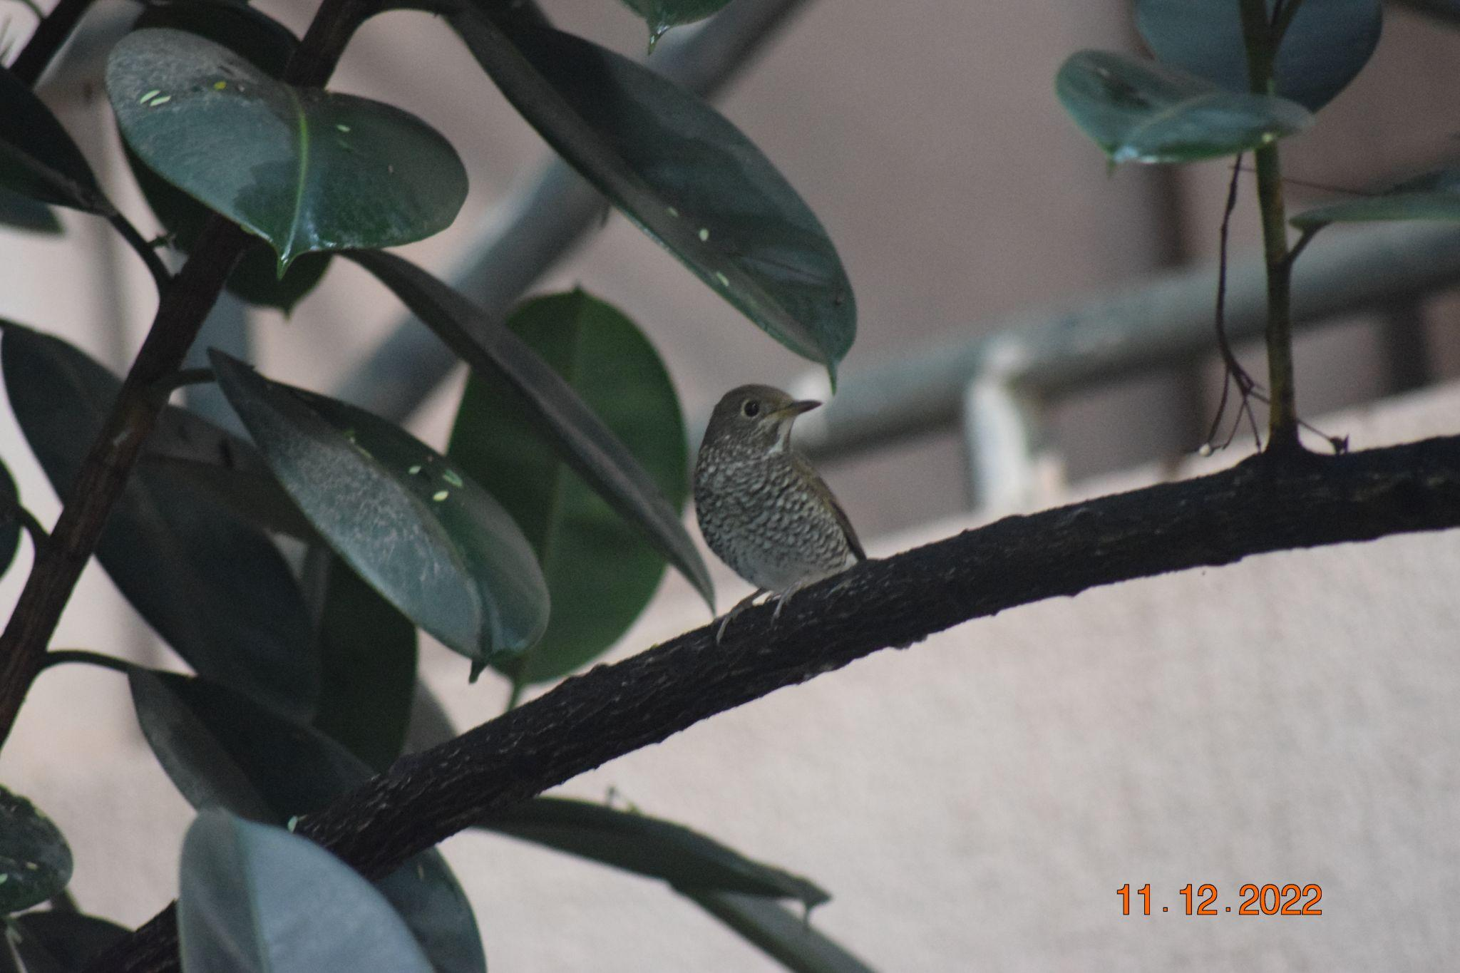
Blue-Capped Rock Thrush
Smaller than myna , bigger than sparrow
Female

Slide 17
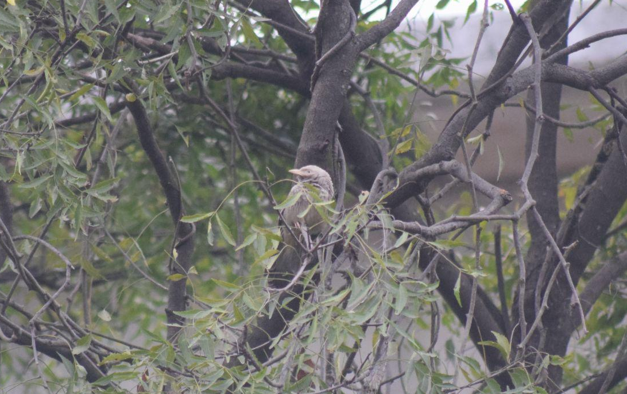
Yellow Billed Babbler
Crow sized Bird

Slide 18
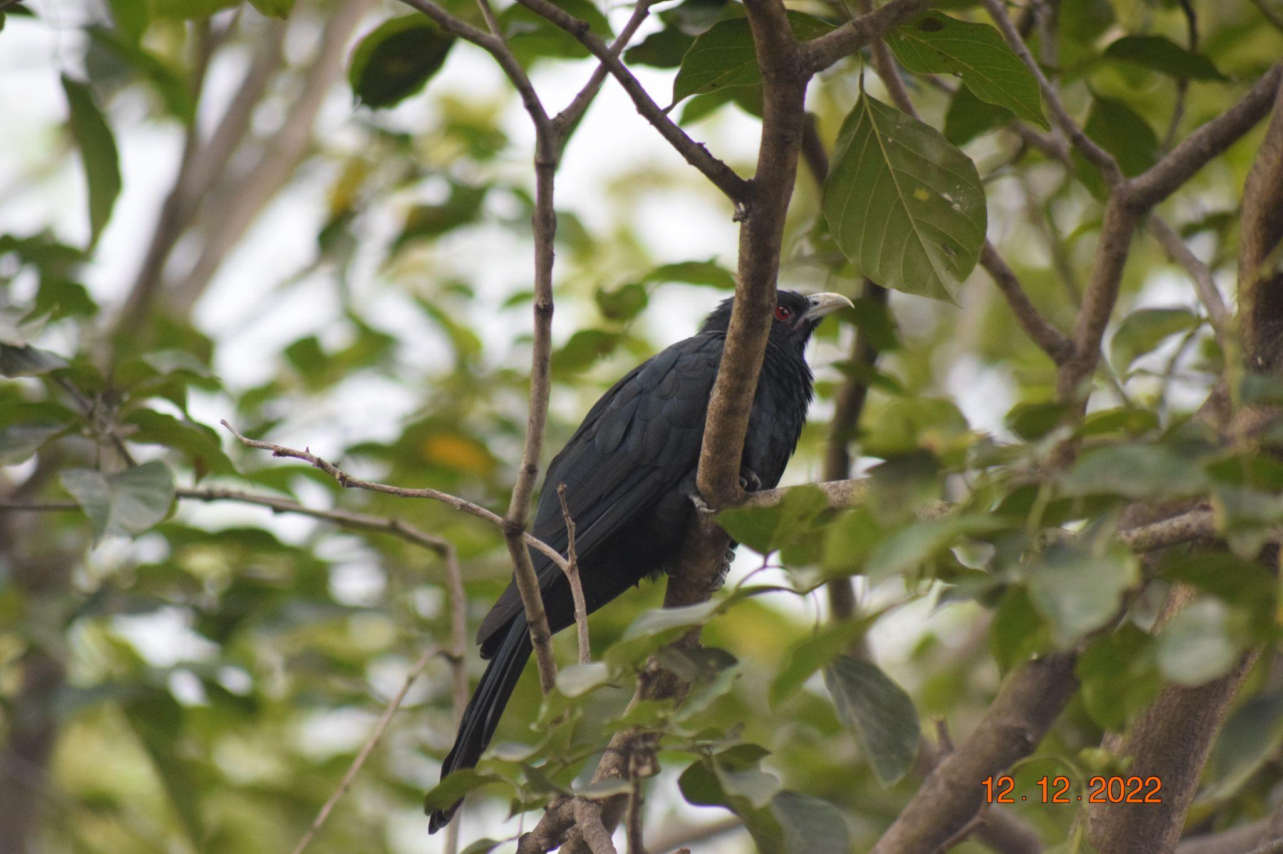
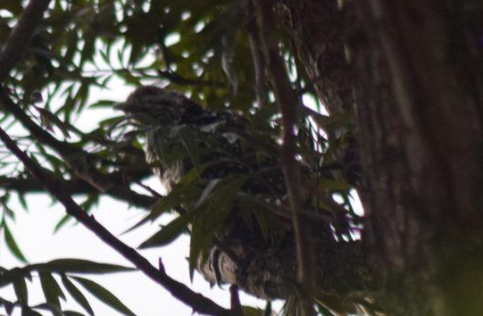
Female
Asian Koel
A Crow sized bird

Slide 19
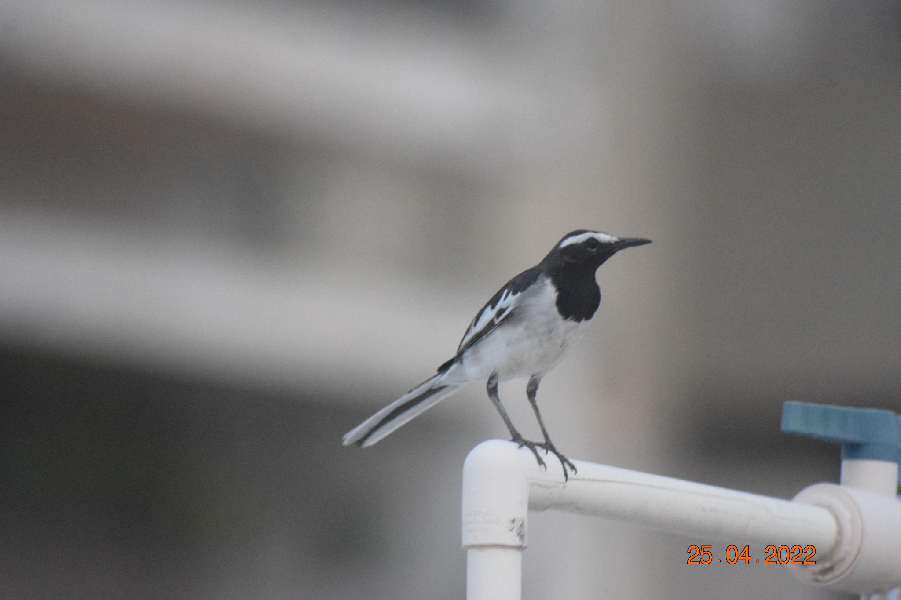
White Browed Wagtail
Myna Sized bird

Slide 20
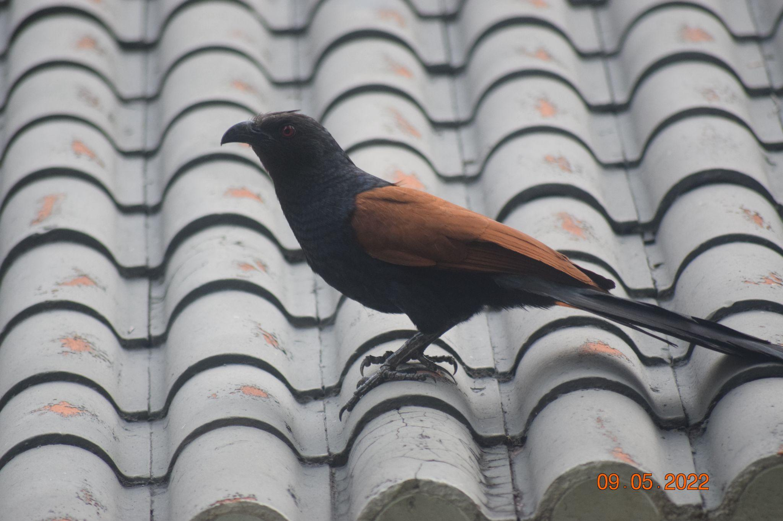
Asian Coucal
Crow sized Bird

Slide 21
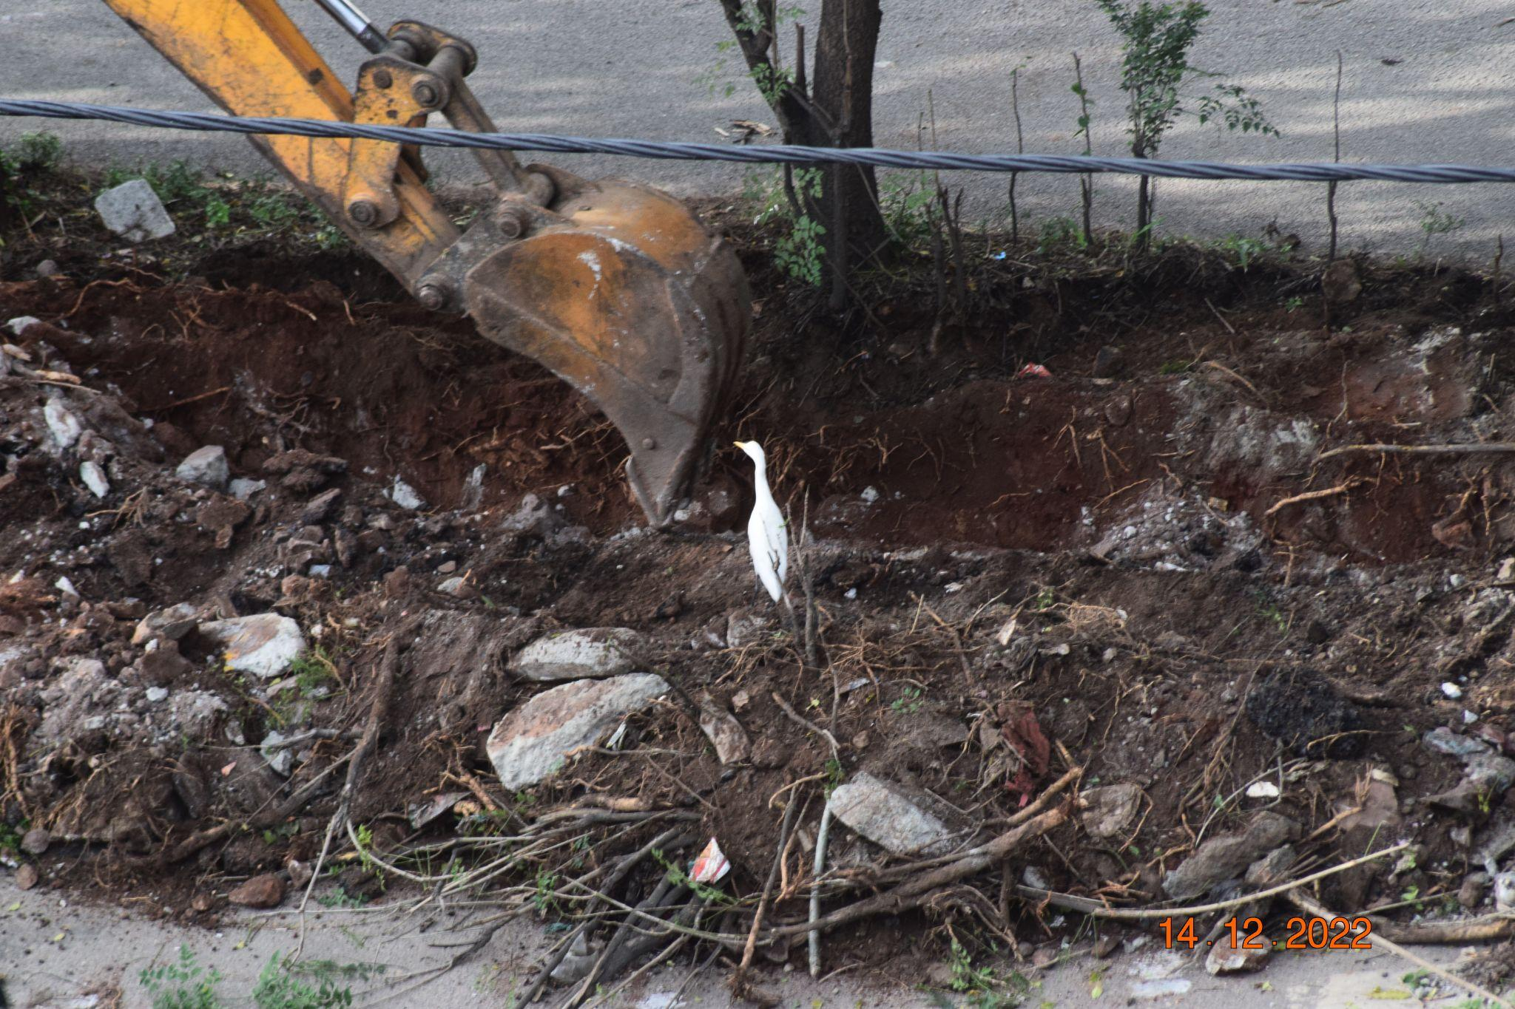
Cattle egret
Eagle sized bird

Slide 22
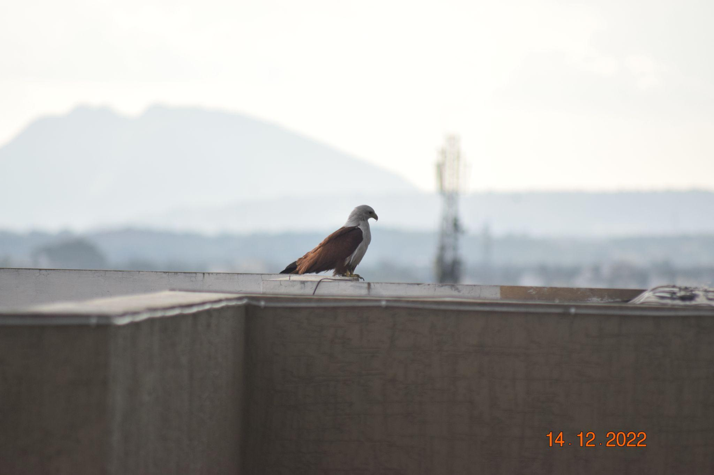
Brahminy Kite
Slightly smaller than bald eagle.

Slide 23
Discussions & Conclusions
Most of the urban birds are least concerned on the IUCN Red List
Most of the birds are omnivores.
Birds are one of the main part of the food chain in the ecosystem.
Birds are usually named after its appearances or behaviour.
The smallest bird we observed was the common tailorbird , And the largest we observed was the brahminy kite.
The least observed bird was the Blue-capped rock thrush.
The most observed bird was the Yellow billed babbler.

Slide 24
Special Observations
Asian coucal and the Asian koels eyes are red
Birds which are smaller than a sparrow or sparrow sized , they are the most active birds.
Birds usually like to sit on the top of the tree or inside the tree.

Slide 25
Acknowledgements & References
References -
1. Google lens
2. Ebird.org
3. Birdsoftheworld.org
4. Birds of the indian subcontinent (book)
Teachers -
1. Vaishali akka
2. Raghuram anna

Slide 26
Thank you purnapramati for giving us this opportunity to learn and present our favorite topic
Thank you IISC for conducting this lake conference program.
Thanks to my father for teaching me how to use camera in the past few years.
Thank you all for listening to our presentations.

Slide 27

THANK YOU
All photos taken by
Hrishikesh.Gangoor

