Slide 1


BUTTERFLY DIVERSITY IN ANANDAVANA
Akshobhya.J.C , 9th
Dhatri Guttal , 8th
Anandavana ( Purnapramati )

Slide 2
INTRODUCTION
Great presence of butterflies .
Seen very commonly .
Have important role in pollination .
They make the nature more beautiful .

Slide 3
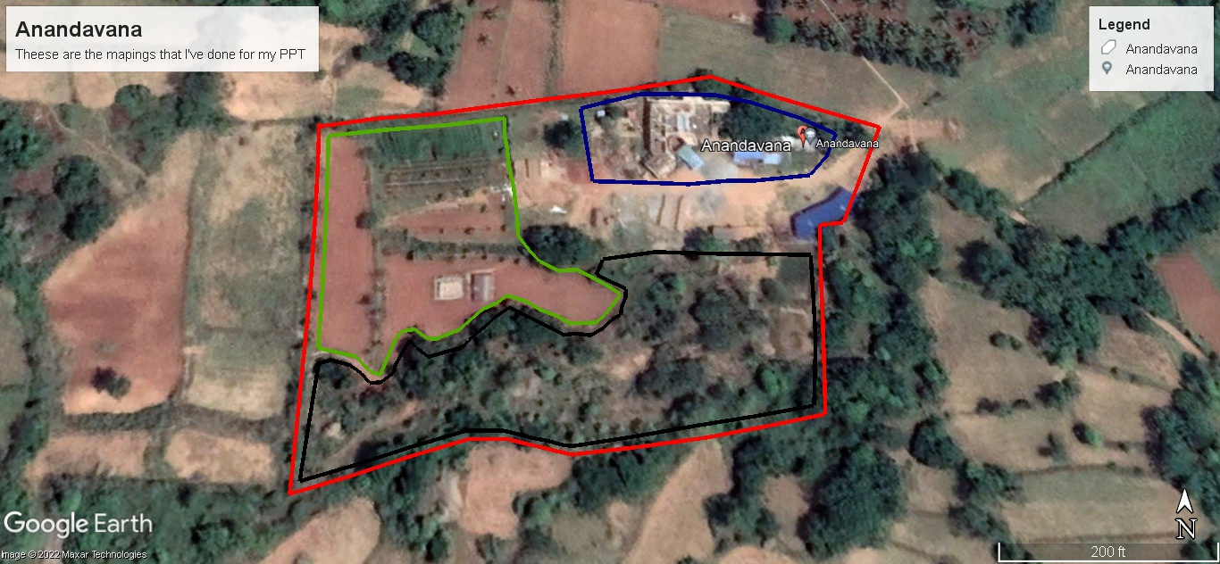
STUDY AREA
Agricultural Field
Forest Area
Human Settlement
Coordinates :-
12°.95’12” N, 77°.30’60” E
Location :-
Magadi road Bachenahatti
Near foothills of Savandurga

Slide 4
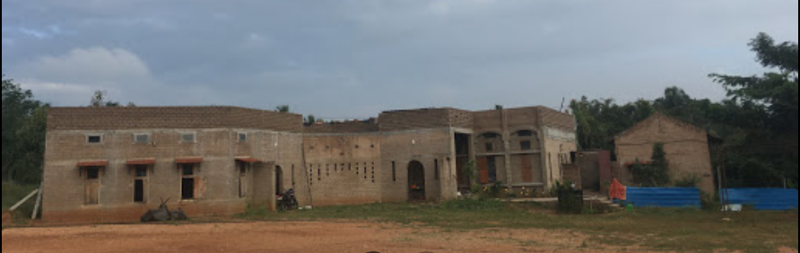
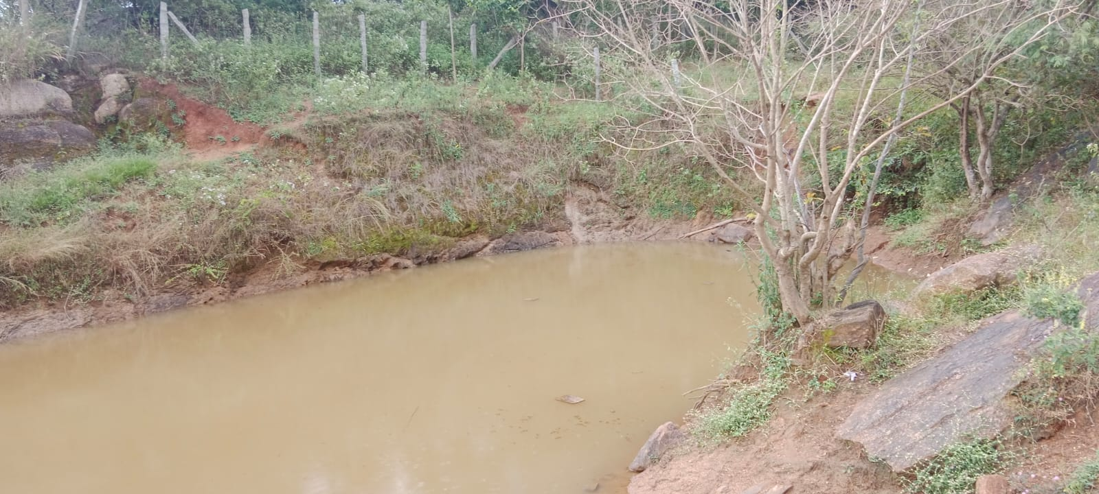
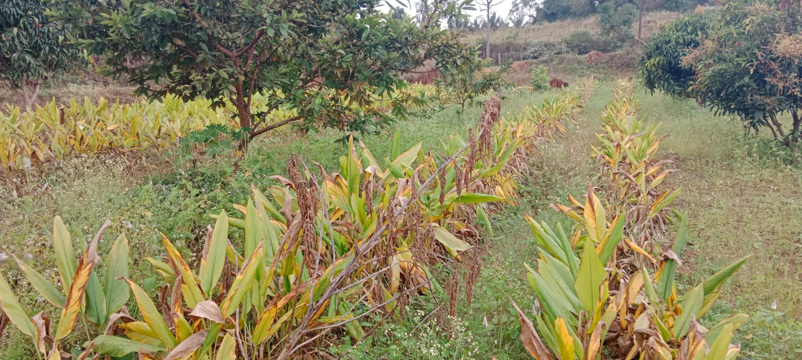
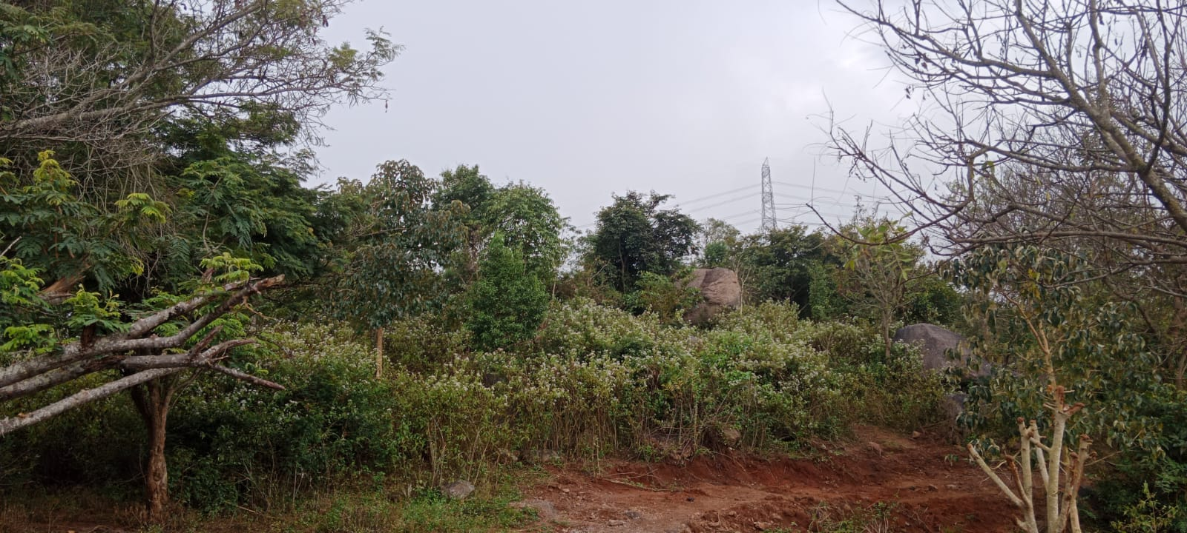
STUDY AREA
Human Settlement
Water Body
Agricultural Field
Forest Area

Slide 5
OBJECTIVES
  To assess diversity of butterflies of Anandavana
  To know the IUCN status of butterflies in Anandavana
Why We Chose This Topic
They have varieties of beautiful colours
They have very interesting life cycle.

Slide 6
METHODS
MATERIALS
MATERIALS AND METHODS
Electronic Devices :- Lenovo (Laptop) , Dell (Laptop) , Redmi (Mobile)
Books :- Butterflies of Bengaluru
Random sampling
Collection of 2 year’s data
Survey timings - 10:00 - 12:30
10 Surveys till date
15/08/21 | 30/08/21 | 12/11/21 | 21/12/21 | 23/12/21 | 11/01/22 | 29/01/22 | 28/05/22 | 20/08/22 | 15/09/22

Slide 7
RESULTS
Family Chart
Butterfly Diversity
Family name | No of species
Brush Foots | 27
Whites and Yellows | 12
Swallowtails | 9
Blues And Hairstreaks | 6
Skippers | 2
No. of species | 56
No. of families | 5

Slide 8
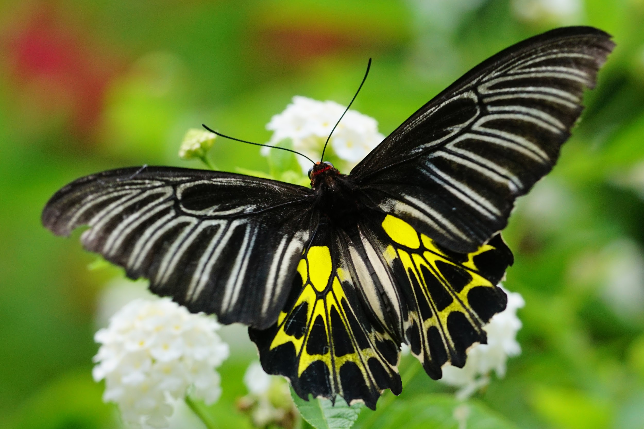
Checklist

Slide 9
Sl no | Common name | Scientific name | Family
1 | Plain Tiger | Danaus chrysippus | Brush Foots
2 | Striped Tiger | Danaus genutia | Brush Foots
3 | Glassy Tiger | Parantica aglea | Brush Foots
4 | Blue Tiger | Tirumala gautama | Brush Foots
5 | Dark Blue Tiger | Tirumala septentrionis | Brush Foots
6 | Common Crow | Euploea core | Brush Foots
7 | Double Branded Crow | Euploea sylvester | Brush Foots
8 | Common Leopard | Phalanta phalantha | Brush Foots
9 | Common Sailor | Neptis hylas | Brush Foots
10 | Common Baron | Euthalia aconthea | Brush Foots

Slide 10
Sl no | Common name | Scientific name | Family
11 | Angled Castor | Ariadne ariadne | Brush Foots
12 | Common Castor | Ariadne merione | Brush Foots
13 | Great Eggfly | Hypolimnas bolina | Brush Foots
14 | Danaid Eggfly | Hypolimnas misippus | Brush Foots
15 | Chocolate Pansy | Junonia iphita | Brush Foots
16 | Lemon Pansy | Junonia lemonias | Brush Foots
17 | Blue Pansy | Junonia orithya | Brush Foots
18 | Indian Nawab | Polyura athamas | Brush Foots
19 | Common Evening Brown | Melanitis leda | Brush Foots
20 | Tailed Palmfly | Elymnias caudata | Brush Foots

Slide 11
Sl no | Common name | Scientific name | Family
21 | Common Bush Brown | Mycalesis perseus | Brush Foots
22 | Dark Branded Bushbrown | Mycalesis mineus | Brush Foots
23 | Long Branded Bushbrown | Mycalesis visala | Brush Foots
24 | Bamboo Tree brown | Lethe europa | Brush Foots
25 | Common Three Ring | Ypthima asterope | Brush Foots
26 | Common Four Ring | Ypthima huebneri | Brush Foots
27 | Common Five Ring | Ypthima baldus | Brush Foots
28 | Lemon Emigrant | Catopsilia pomona | Whites and Yellows
29 | Three Spot Grass Yellow | Eurema blanda | Whites and Yellows
30 | Common Grass Yellow | Eurema hecabe | Whites and Yellows

Slide 12
Sl no | Common name | Scientific name | Family
31 | Small Grass Yellow | Eurema brigitta | Whites and Yellows
32 | Great Orange Tip | Hebomoia glaucippe | Whites and Yellows
33 | Psyche | Leptosia nina | Whites and Yellows
34 | Indian Wanderer | Pareronia valeria | Whites and Yellows
35 | Pioneer | Belenois aurota | Whites and Yellows
36 | Common Gull | Cepora nerissa | Whites and Yellows
37 | Common Jezebel | Delias eucharis | Whites and Yellows
38 | Little Orange Tip | Colotis etrida | Whites and Yellows
39 | Plain Orange Tip | Colotis aurora | Whites and Yellows
40 | Common Banded Peacock | Papilio crino | Swallowtails

Slide 13
Sl no | Common name | Scientific name | Family
41 | Common Jay | Graphium doson | Swallowtails
42 | Common Mime | Papilio clytia | Swallowtails
43 | Tailed Jay | Graphium agamemnon | Swallowtails
44 | Lime Swallowtail | Papilio demoleus | Swallowtails
45 | Blue Mormon | Papilio polymnestor | Swallowtails
46 | Common Rose | Pachliopta aristolochiae | Swallowtails
47 | Crimson Rose | Pachliopta hector | Swallowtails
48 | Southern Birdwing | Troides minos | Swallowtails
49 | Apefly | Spalgis epius | Blues and Hairstreaks
50 | Slate Flash | Rapala manea | Blues and Hairstreaks

Slide 14
Sl no | Common name | Scientific name | Family
51 | Red Pierrot | Talicada nyseus | Blues and Hairstreaks
52 | Pea Blue | Lampides boeticus | Blues and Hairstreaks
53 | Pale Grass Blue | Pseudozizeeria maha | Blues and Hairstreaks
54 | Common Cerulean | Jamides celeno | Blues and Hairstreaks
55 | Suffused Snow flat | Tagiades gana | Skippers
56 | Common Snow flat | Tagiades japetus | Skippers

Slide 15
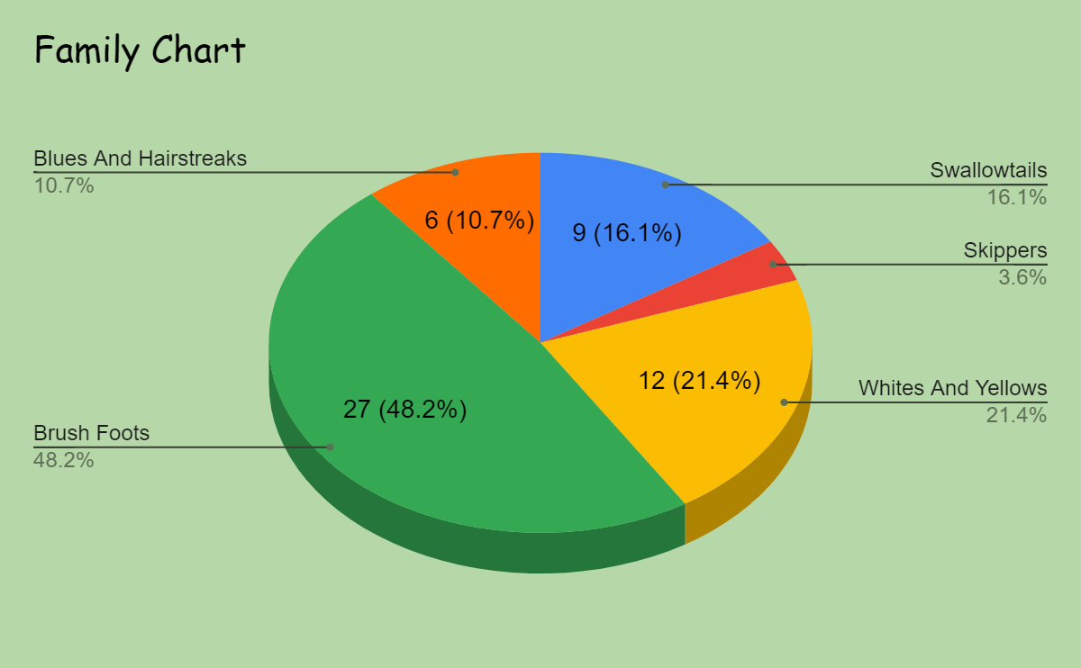
DISCUSSION

Slide 16
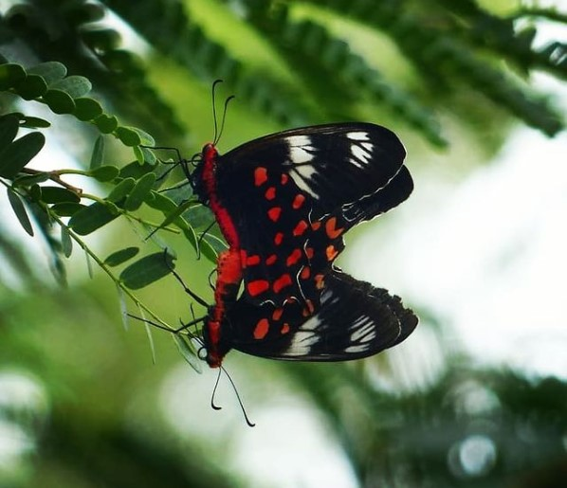
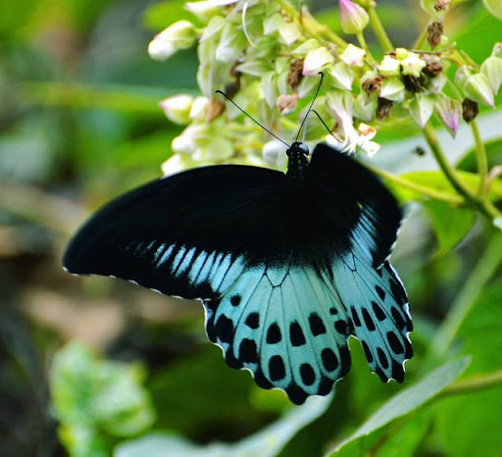
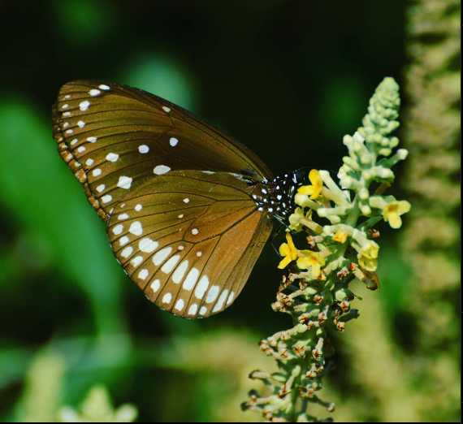
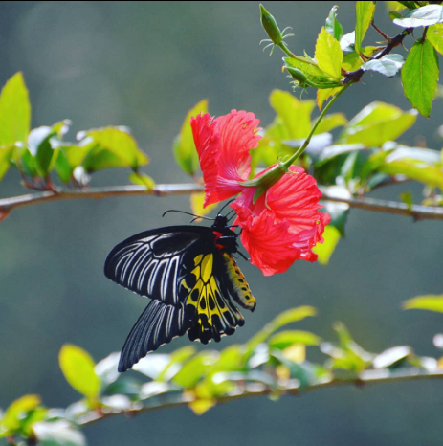
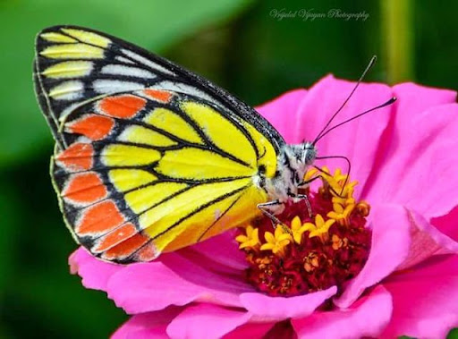
OTHER PHOTOS
By Vrijulal.M.V
Blue Mormon
Crimson Rose ( Mating )
Common Crow
Common Jezebel
Southern Birdwing

Slide 17
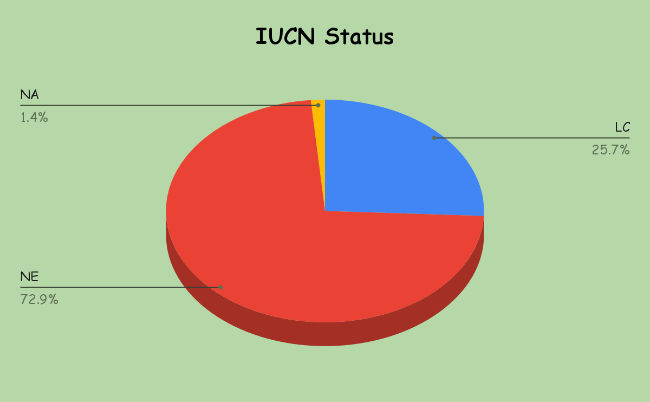
IUCN RED LIST
NA - Not Applicable
NE - Not Evaluated
LC - Least Concerned

Slide 18
OUR NEXT GOAL
Will try to collect the photos of all the butterflies
To find butterfly host plants in next 1 year
To conduct surveys in places other than Anandavana
Our next goal is to create a butterfly park in Anandavana

Slide 19
Conclusion & What We have learnt
Conclusion & What We have learnt
Observations
Butterfly’s taste buds are on their legs
Butterflies have four wings not two .
Wider the wingspan , Higher it flies .
Wider the wingspan , Higher it flies .
Now we are able to identify 56 species of butterflies
Now we are able to identify 56 species of butterflies
Conclusion
Conclusion
Rescued Some Butterflies
Rescued Some Butterflies
Total of 56 species belonging to 5 families

Slide 20
ACKNOWLEDGEMENT
Thank You …
Vrijulal sir , Chaturved sir and Raghuram sir helping us in doing this project .
IISc , Purnapramati & Anandavana for giving us this golden opportunity.
Vedesha anna and Aniruddha kadiri for helping in each step of this project.
Our friends and parents for supporting us .

Slide 21
REFERENCES
Websites -
I Found Butterflies - https://www.ifoundbutterflies.org/node/14
Slides go - https://slidesgo.com/
Freepik - https://www.freepik.com/
Google Earth Pro - https://www.google.com/intl/en_in/earth/versions/
Butterfly Photos - Vrijulal sir
Presentation from Lake 2020
App -
Indian Butterflies
Book -
Butterflies Of Bengaluru

Slide 22
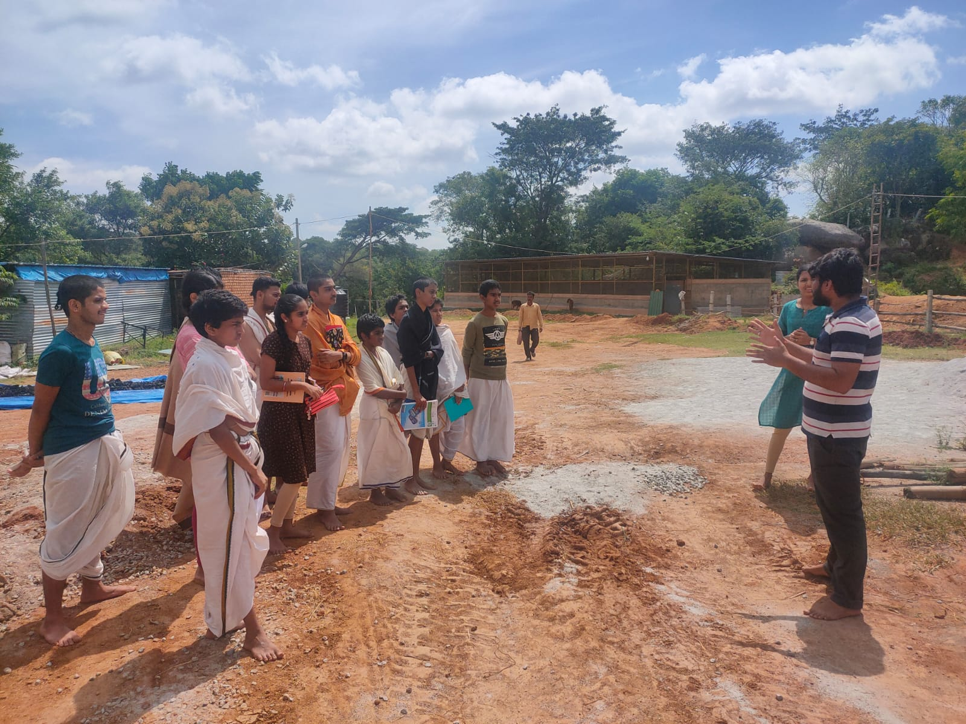
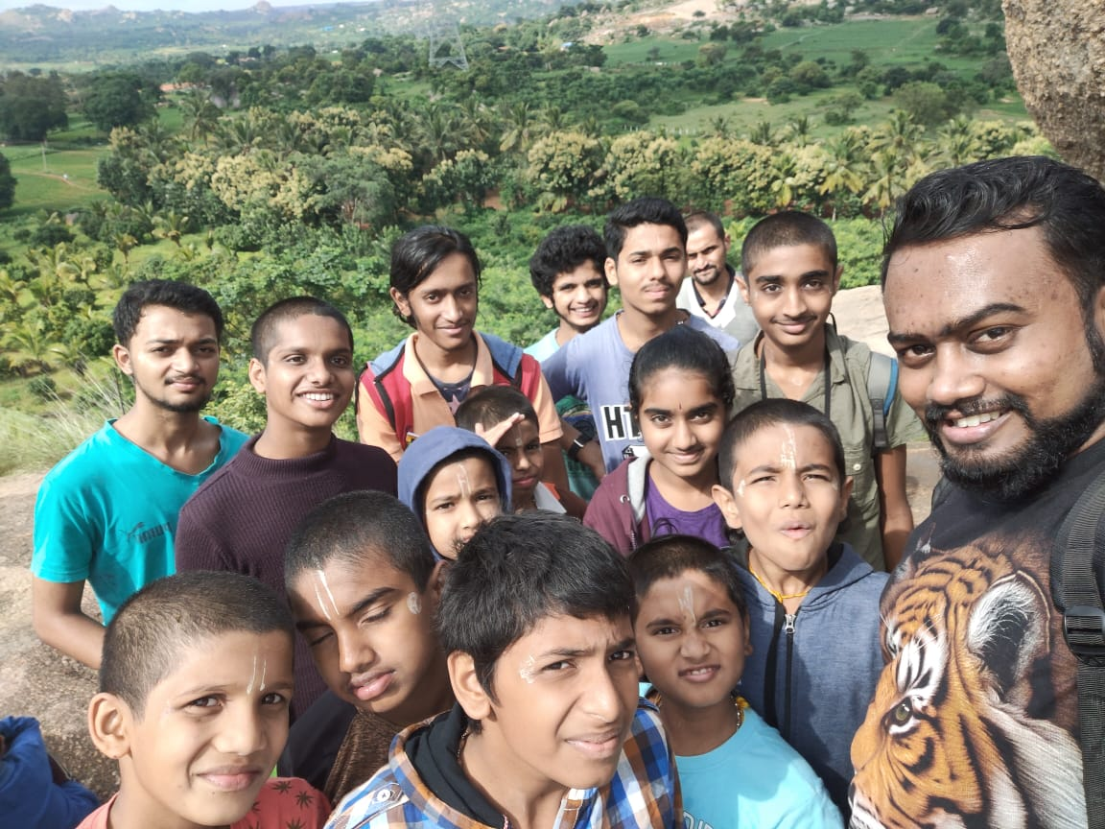
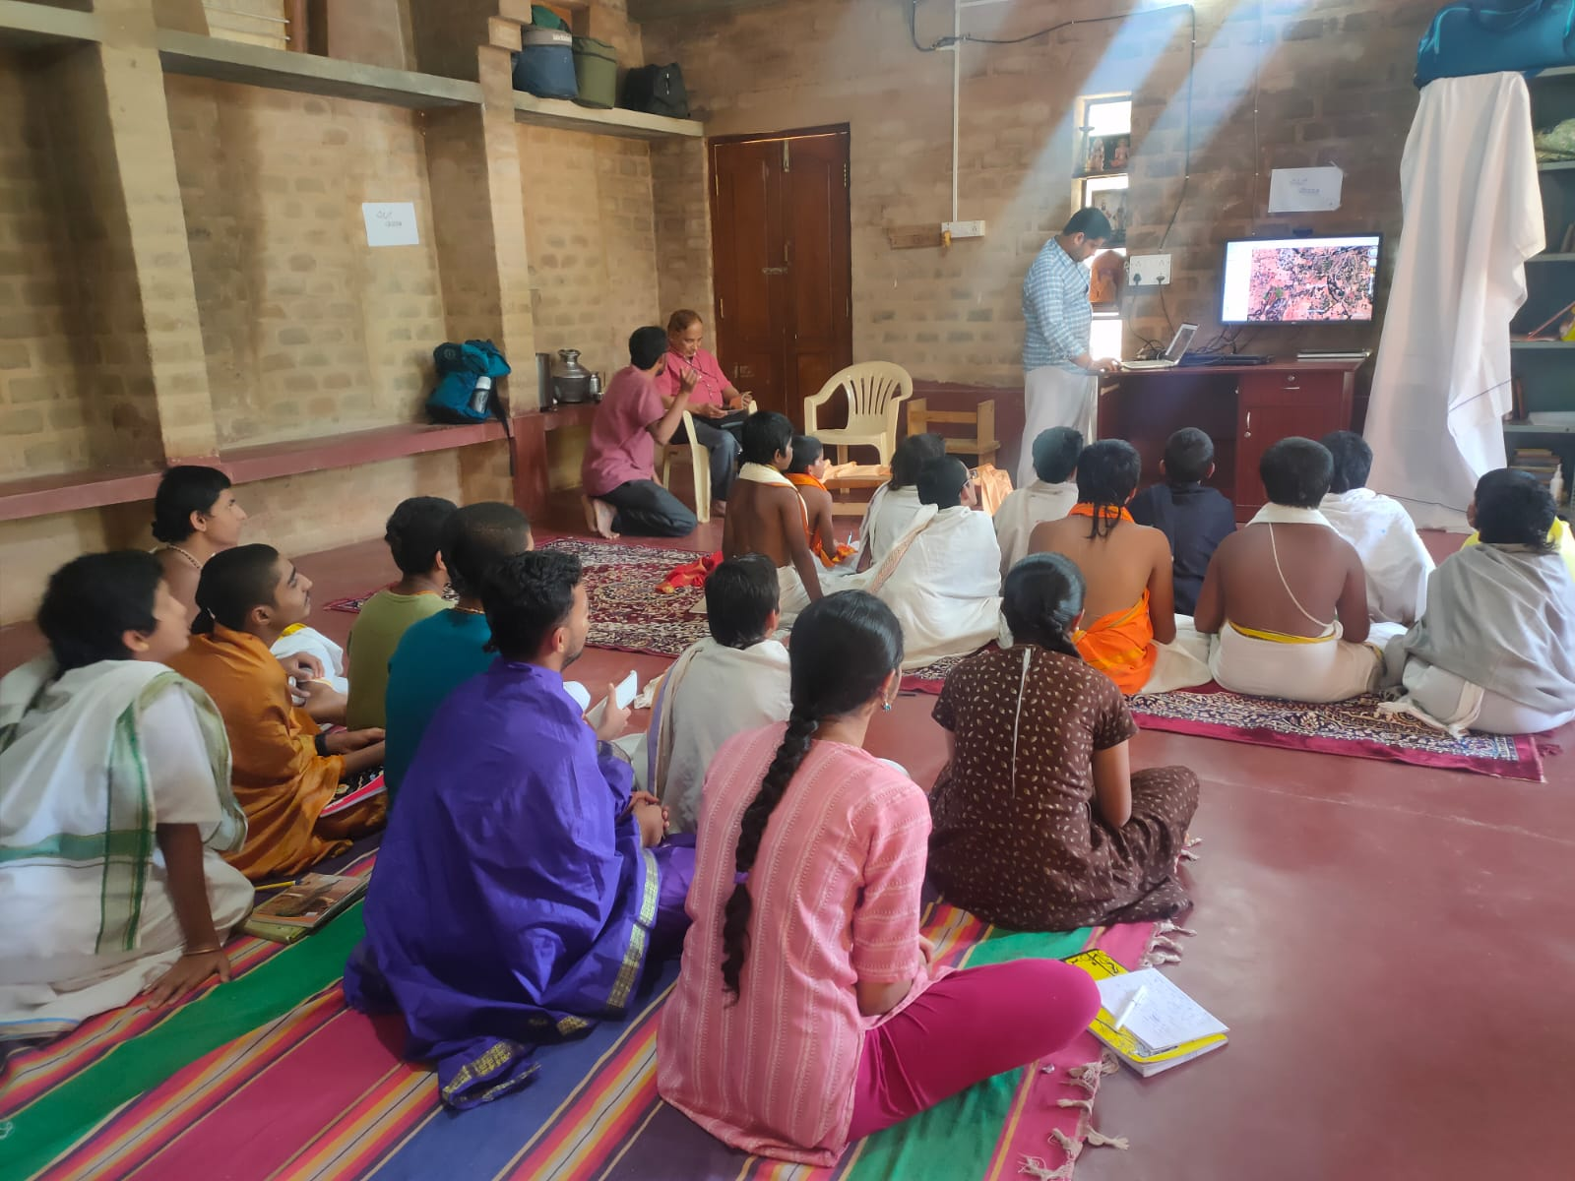
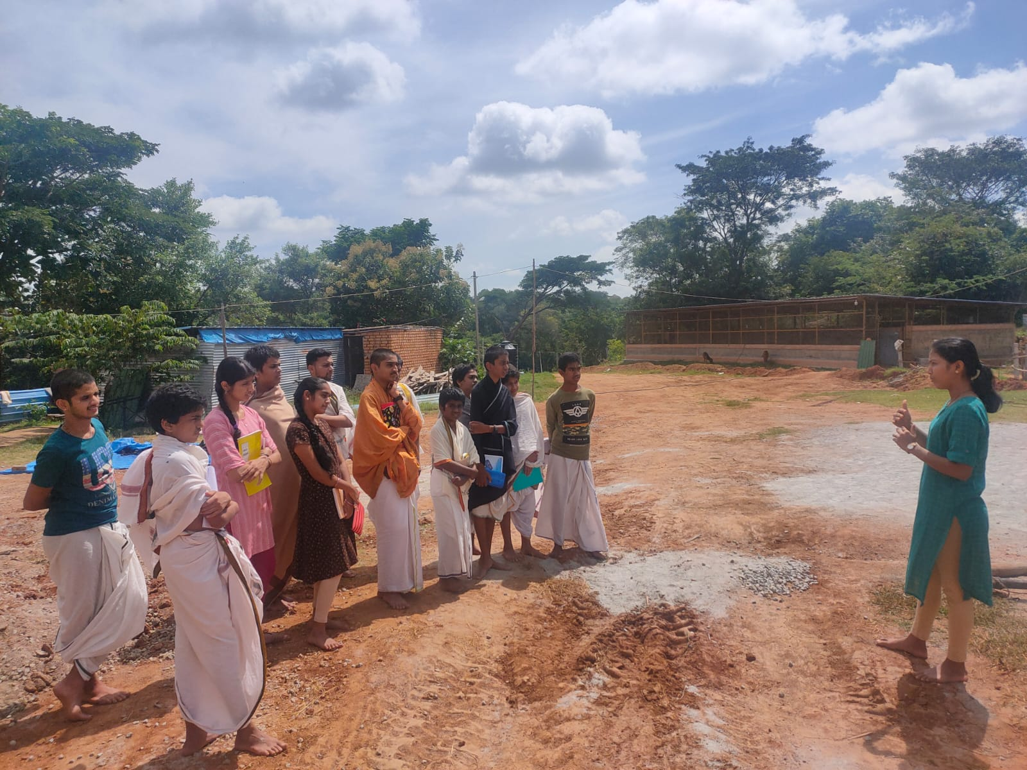
MEMORIES
Pictures from our surveys

Slide 23
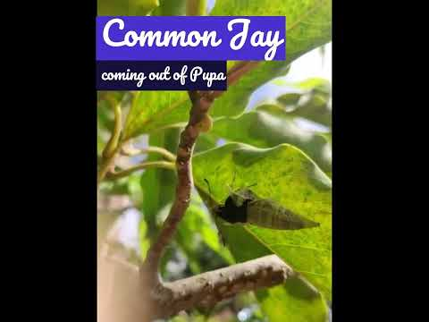

Slide 24
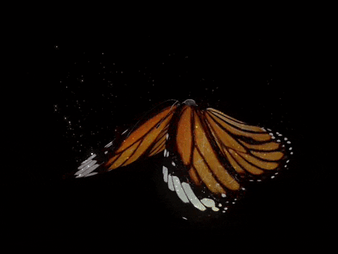
Thank You
All ………………

