Slide 1


BUTTERFLIES and moths
IN MYTHRI GRAMA
By - Aditi Goolur
and Siri Krishnapur
Class - 9
School - Purnapramati

Slide 2
INTRODUCTION
About butterflies and moths found in a gated community near the outskirts of Magadi.
Why we chose this topic ;
We wanted to analyse the ecosystem of Maitri Grama with the help of these indicators and improve the ecosystem or propose new ideas to improve diversity in urban cities
Furthermore-
We were curious to get to know more about them
Notes:
This years theme being conservation of wetlands, we thought it best to come up with a presentation that would help us analyse the ecosystem of mytrhigrama (study area) and try to come up with ways to improve the ecosystem. We immediately thought of butterflies as they were natural indicators of a healthy ecosystem. This presentation is based on the idea to survey the most common pollinators, that are butterflies, present in the area and to come up with a conclusion about the healthiness/biodiversity of the ecosystem. If the results point to a fertile environment abundant with a variety of species of living organisms, like we expect it to, then we plan to come up with ideas to help urban cities such as banglore become slowly like Mytrhigrama. If the result says otherwise, then we plan to help make Mytrhigrama a luscious garden to provide a home to the many diverse organisms residing on earth today.

Slide 3
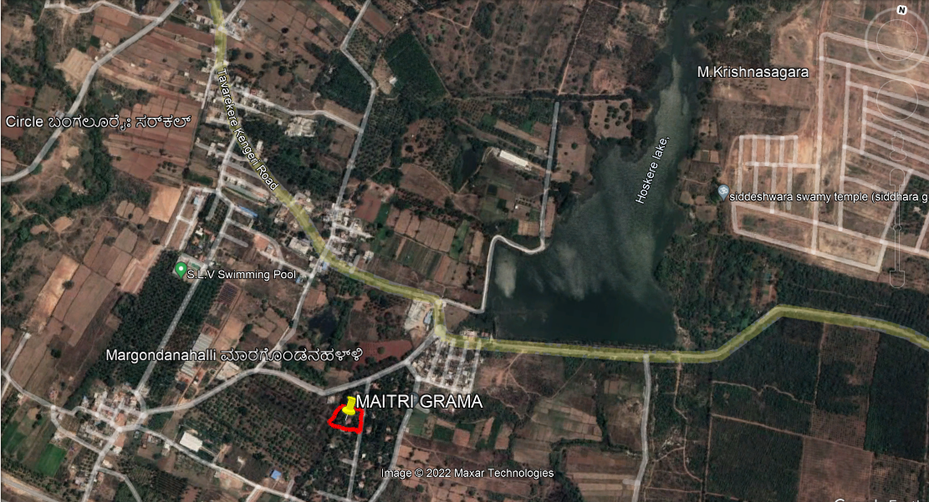

Slide 4
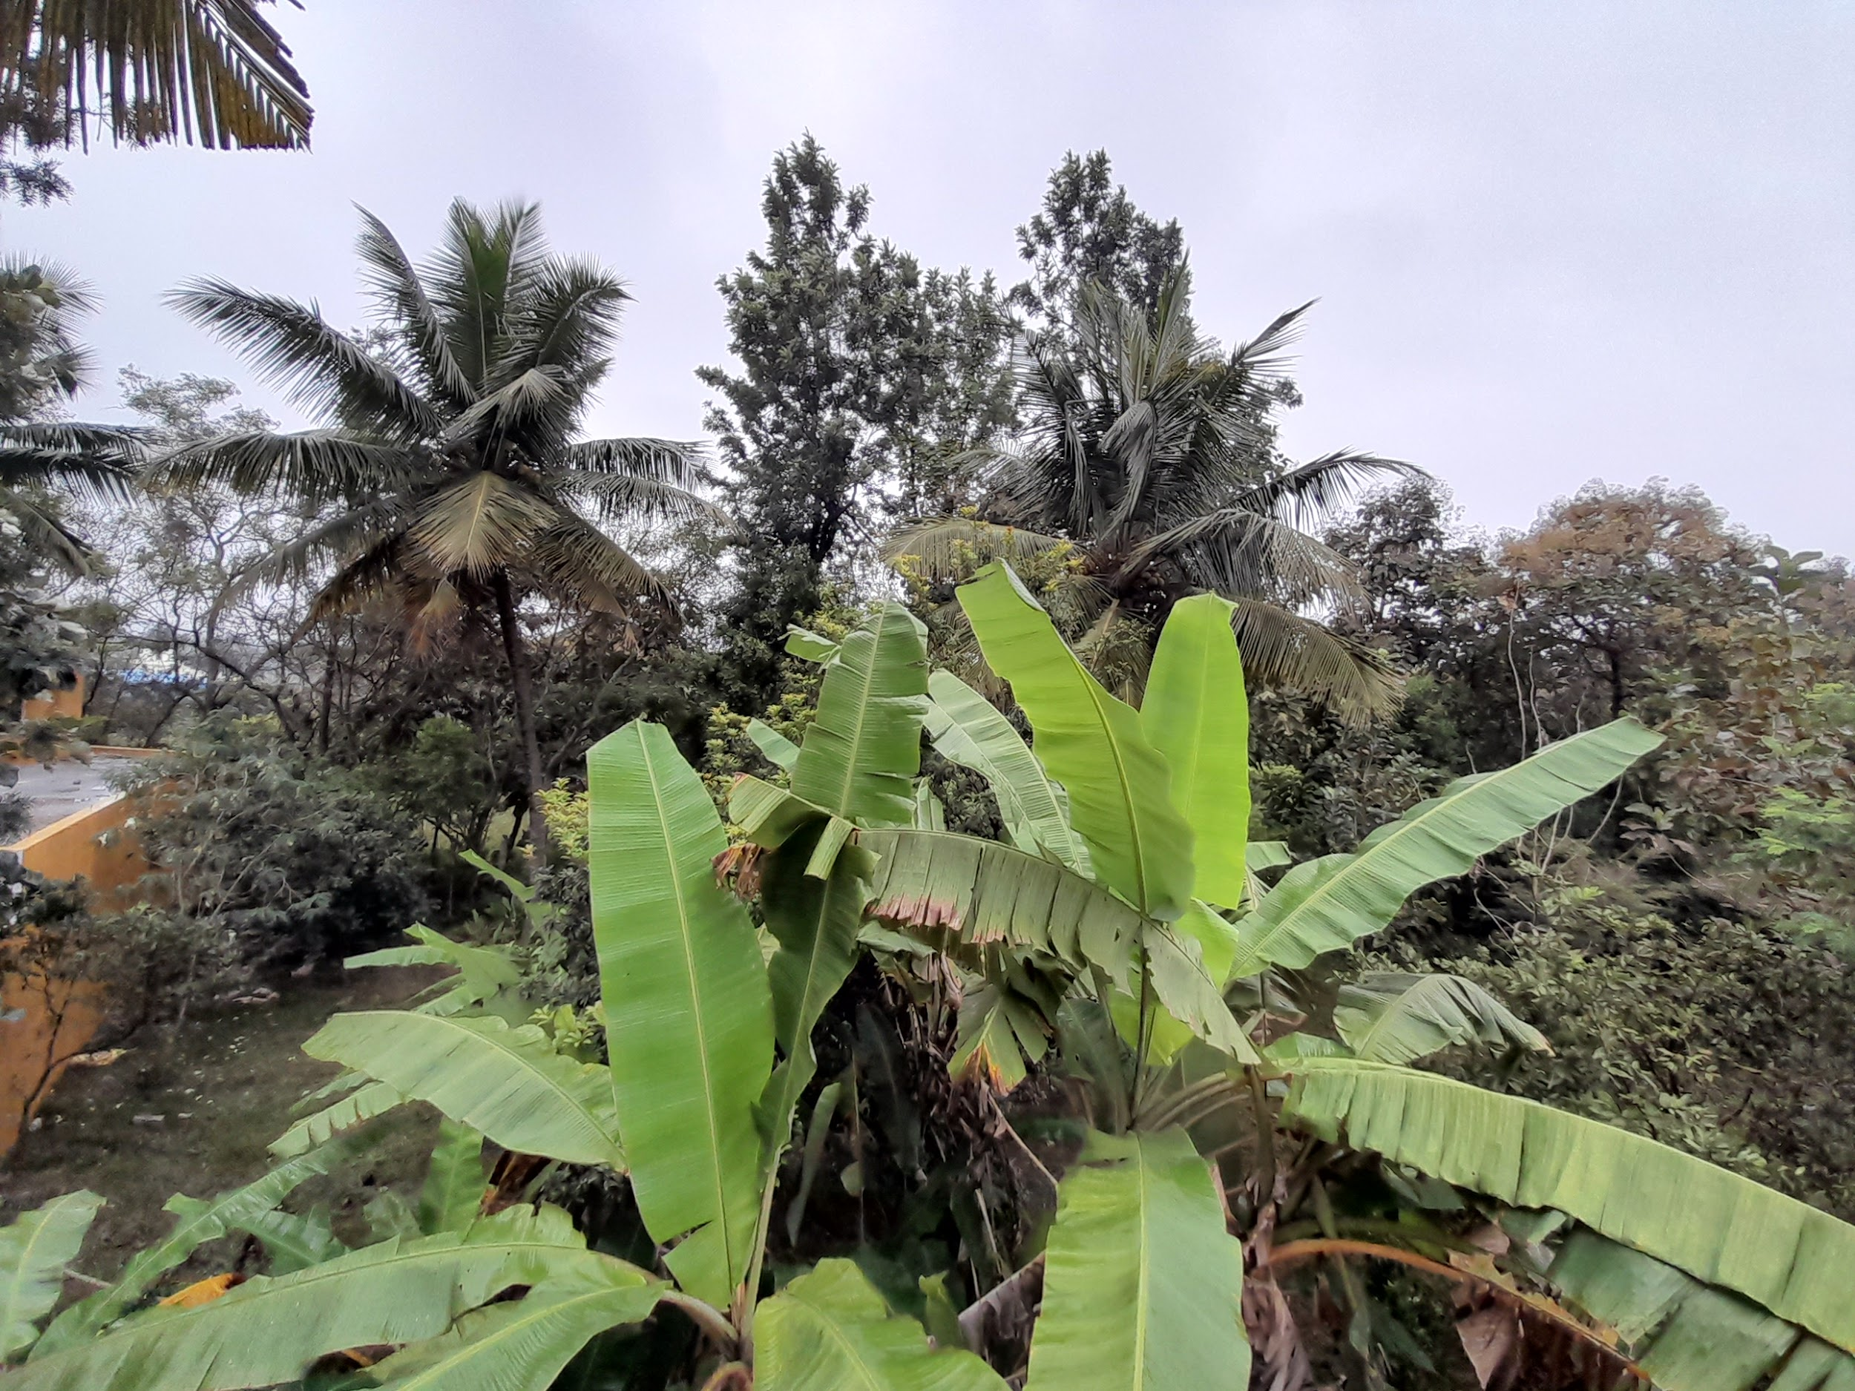
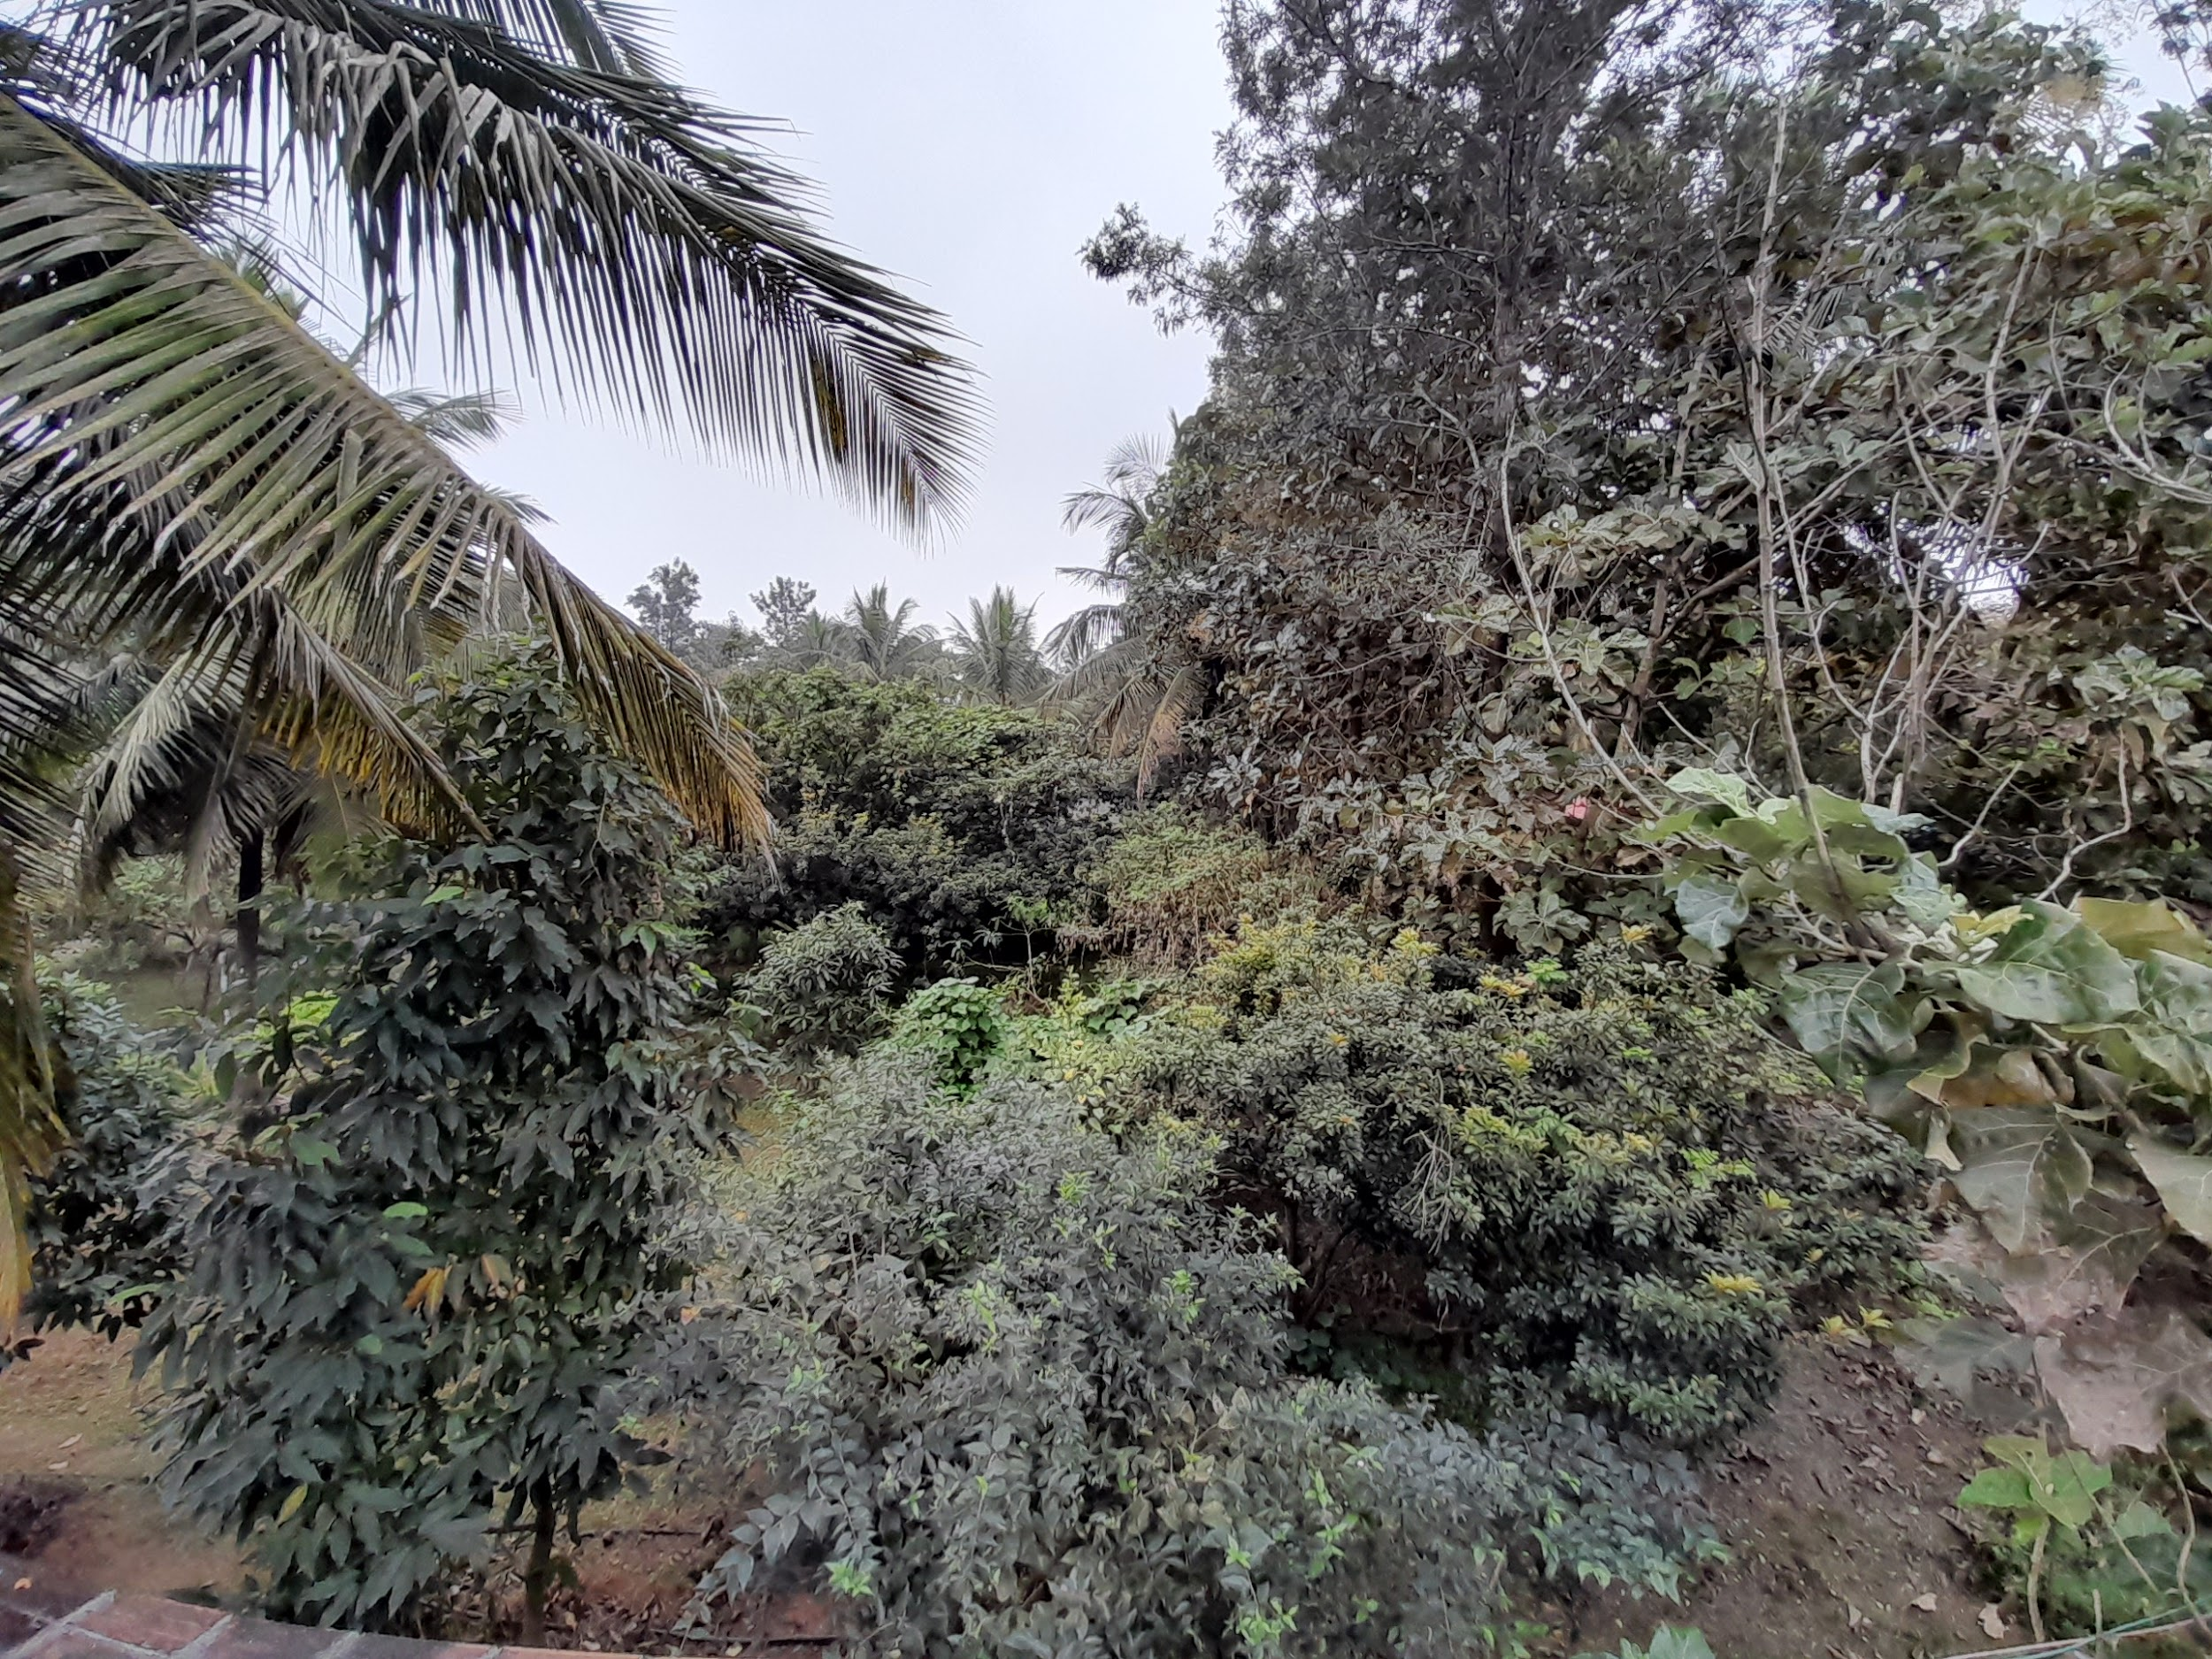
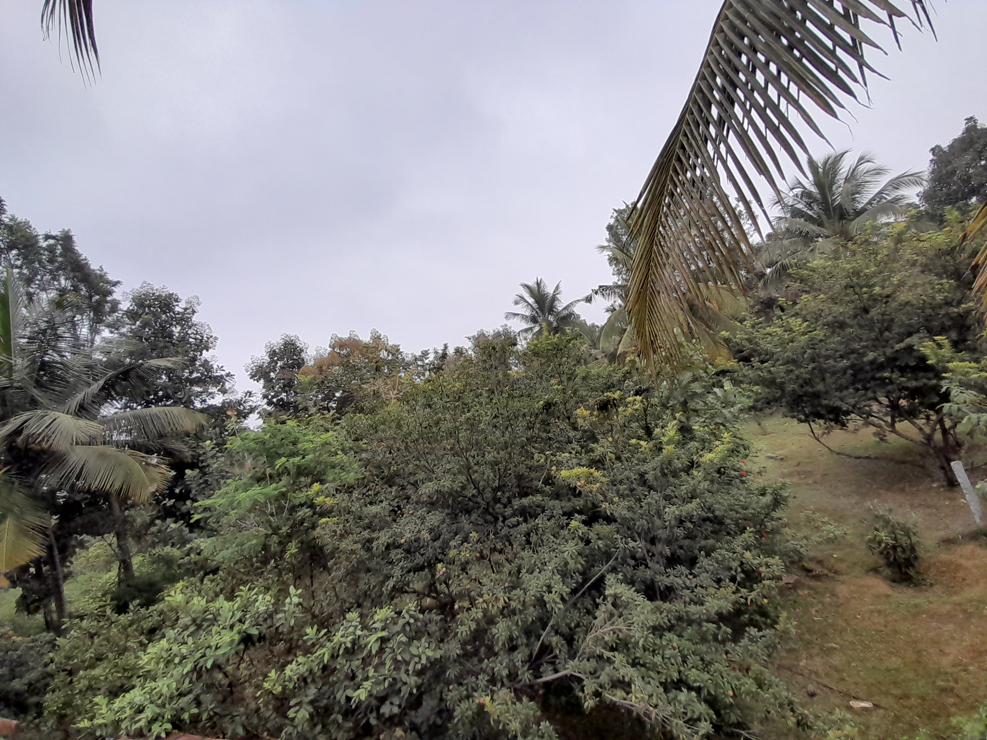
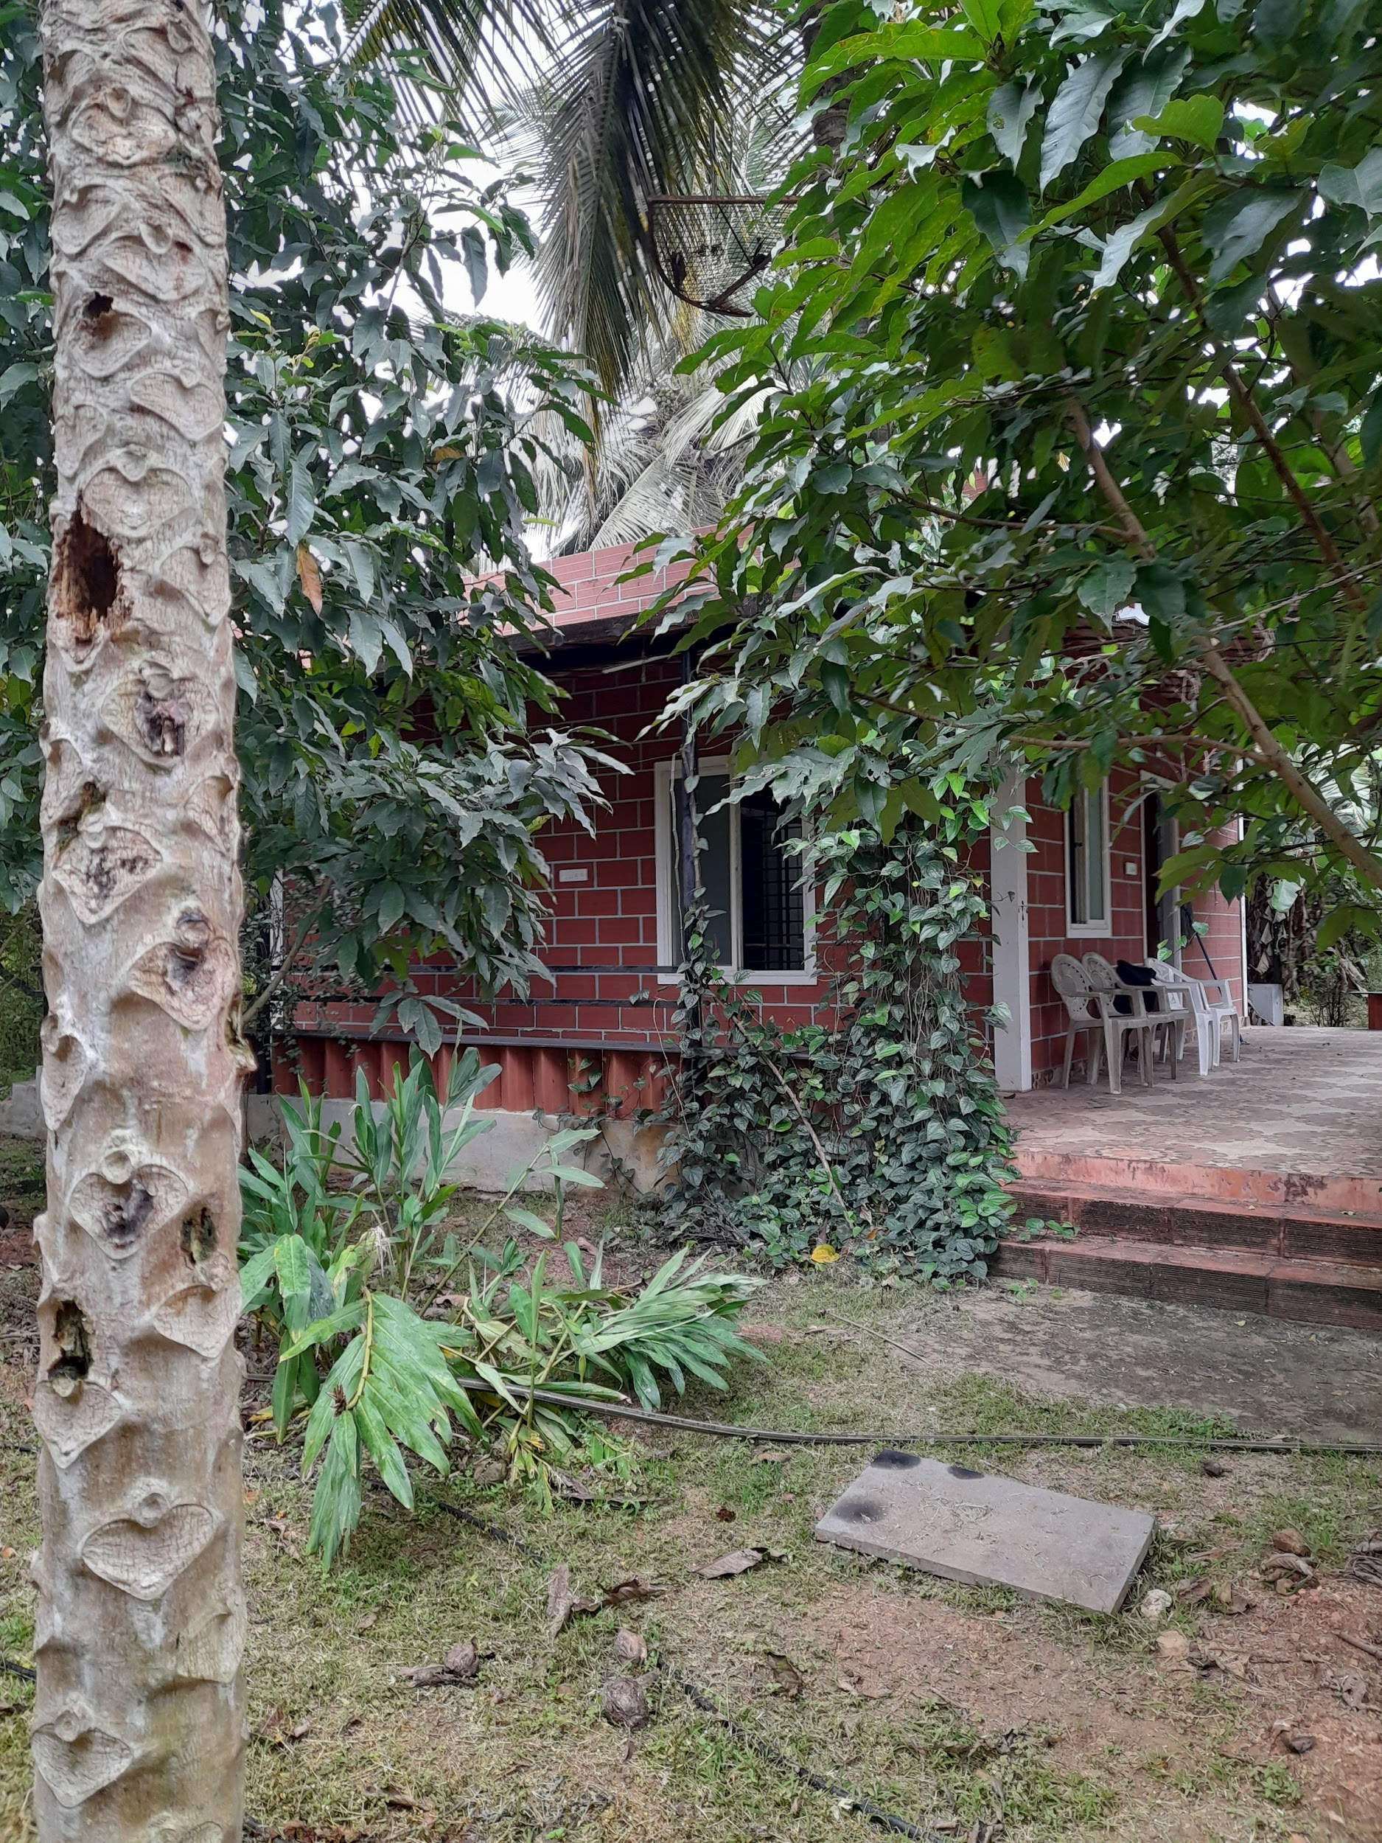
STUDY AREA - DETAILS
Plants in Mythrigrama
Chicku - 4
Coconut palm - 4
Guava - 4
Hibiscus - 1
Night jasmine - 2
Champak - 2
Duration ; October 29th - till date
Timings ; 8:00 am - 9:00 am
& 12:00 pm - 1:00 pm
4pm - 5pm

Slide 5
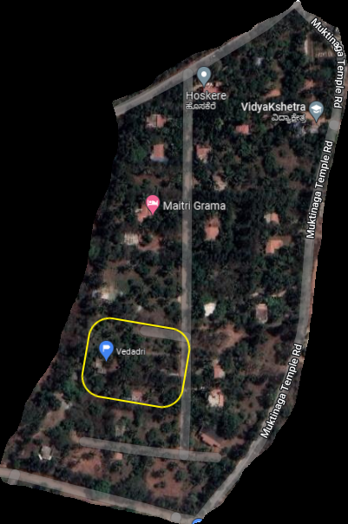
16 km from Girinagar Bengaluru
Near Hoskere lake
Longitude | Latitude | Elevation | ID number
12°55’57.69”N | 77°25’47.31”E | 813 m | WCMH+3W5

Slide 6
Our
objectives
To survey the butterflies and moths in Maitri Grama
To study the life cycle of butterflies and moths
To observe the behaviours of butterflies and moths
To find the benefits of butterflies and moths to the ecosystem
To determine how changes in the ecosystem affect the butterflies and moths

Slide 7
Methods and materials
Mobile
Pencil and paper
Transect method of survey

Slide 8

BUTTERFLIES
Kingdom - Animalia
Phylum - Arthropoda
Class - Insecta
Order - Lepidoptera

Slide 9
BRUSH FOOTED
Name | Scientific name | Host plant | common/ rare/ moderatory
Great eggfly | Hypolimnas misippus | Chinese Violet | Rare
Blue tiger | Tirumala limniace | Chitrak | Rare
Common sailer | Neptis hylas | Red silk cotton tree | Common
Common evening brown | Melanitis leda | Fountain grass | Moderatory
Common crow | Euploea core | Karal fig | Moderatory
Common four ringed | Ypthima huebneriKirby | Indian goosegrass | Common
Common five ringed | Ypthima avanta Moore | Grasses | Moderatory

Slide 10
Name | Scientific name | Host plant | Common / moderate/ rare
Chocolate pansy | Junonia iphita | Philippine violet | Common
Gaudy baron | Euthalia lubentina | Long leaved mistletoe | Rare
Common tiger | Danaus genutia | Dog Strangling Vine | Moderatory
Dakhan common bush brown | Mycalesis perseus | Cockspur grass

Slide 11
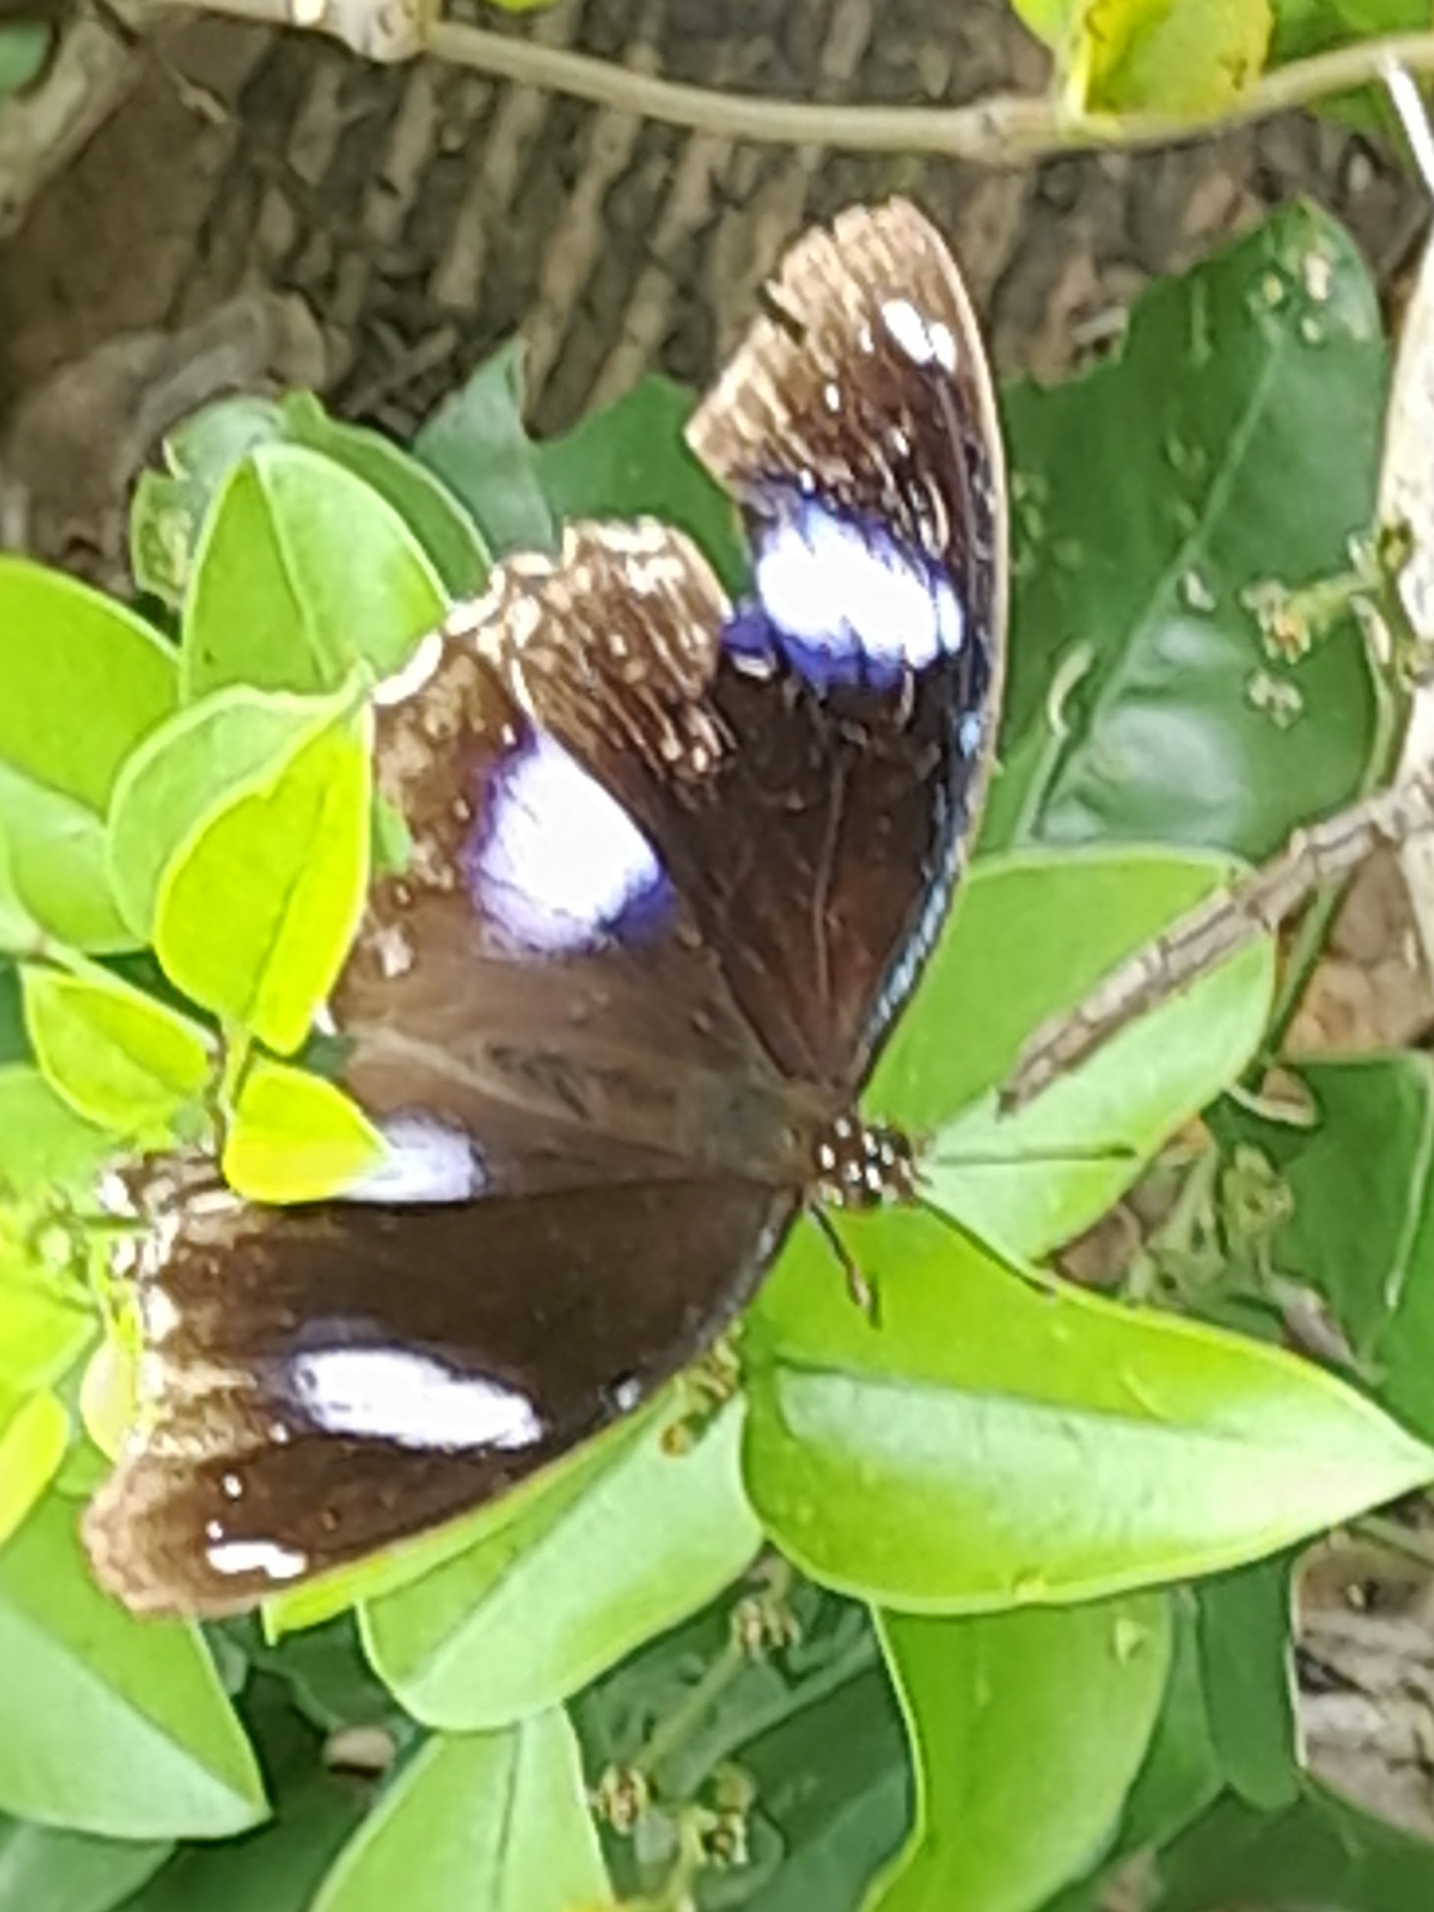

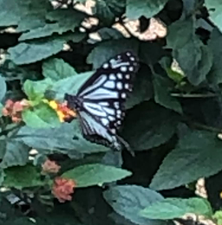
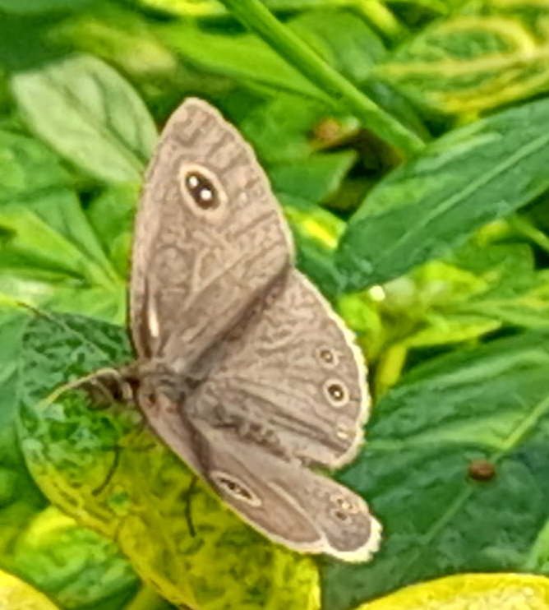
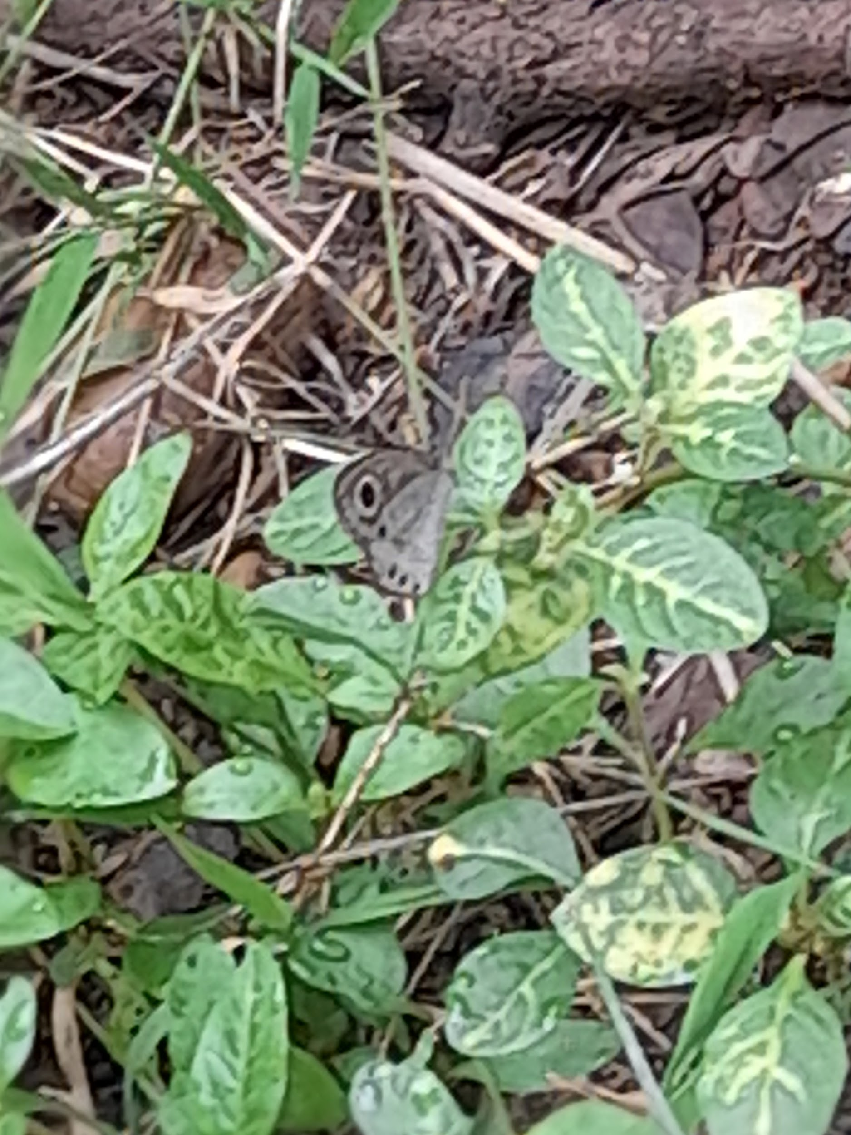
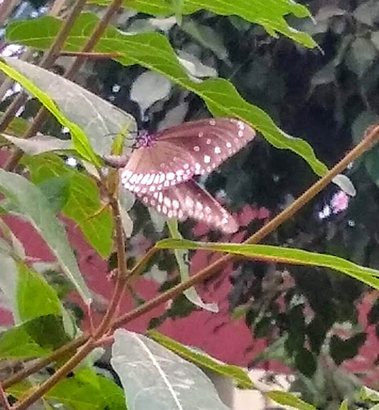
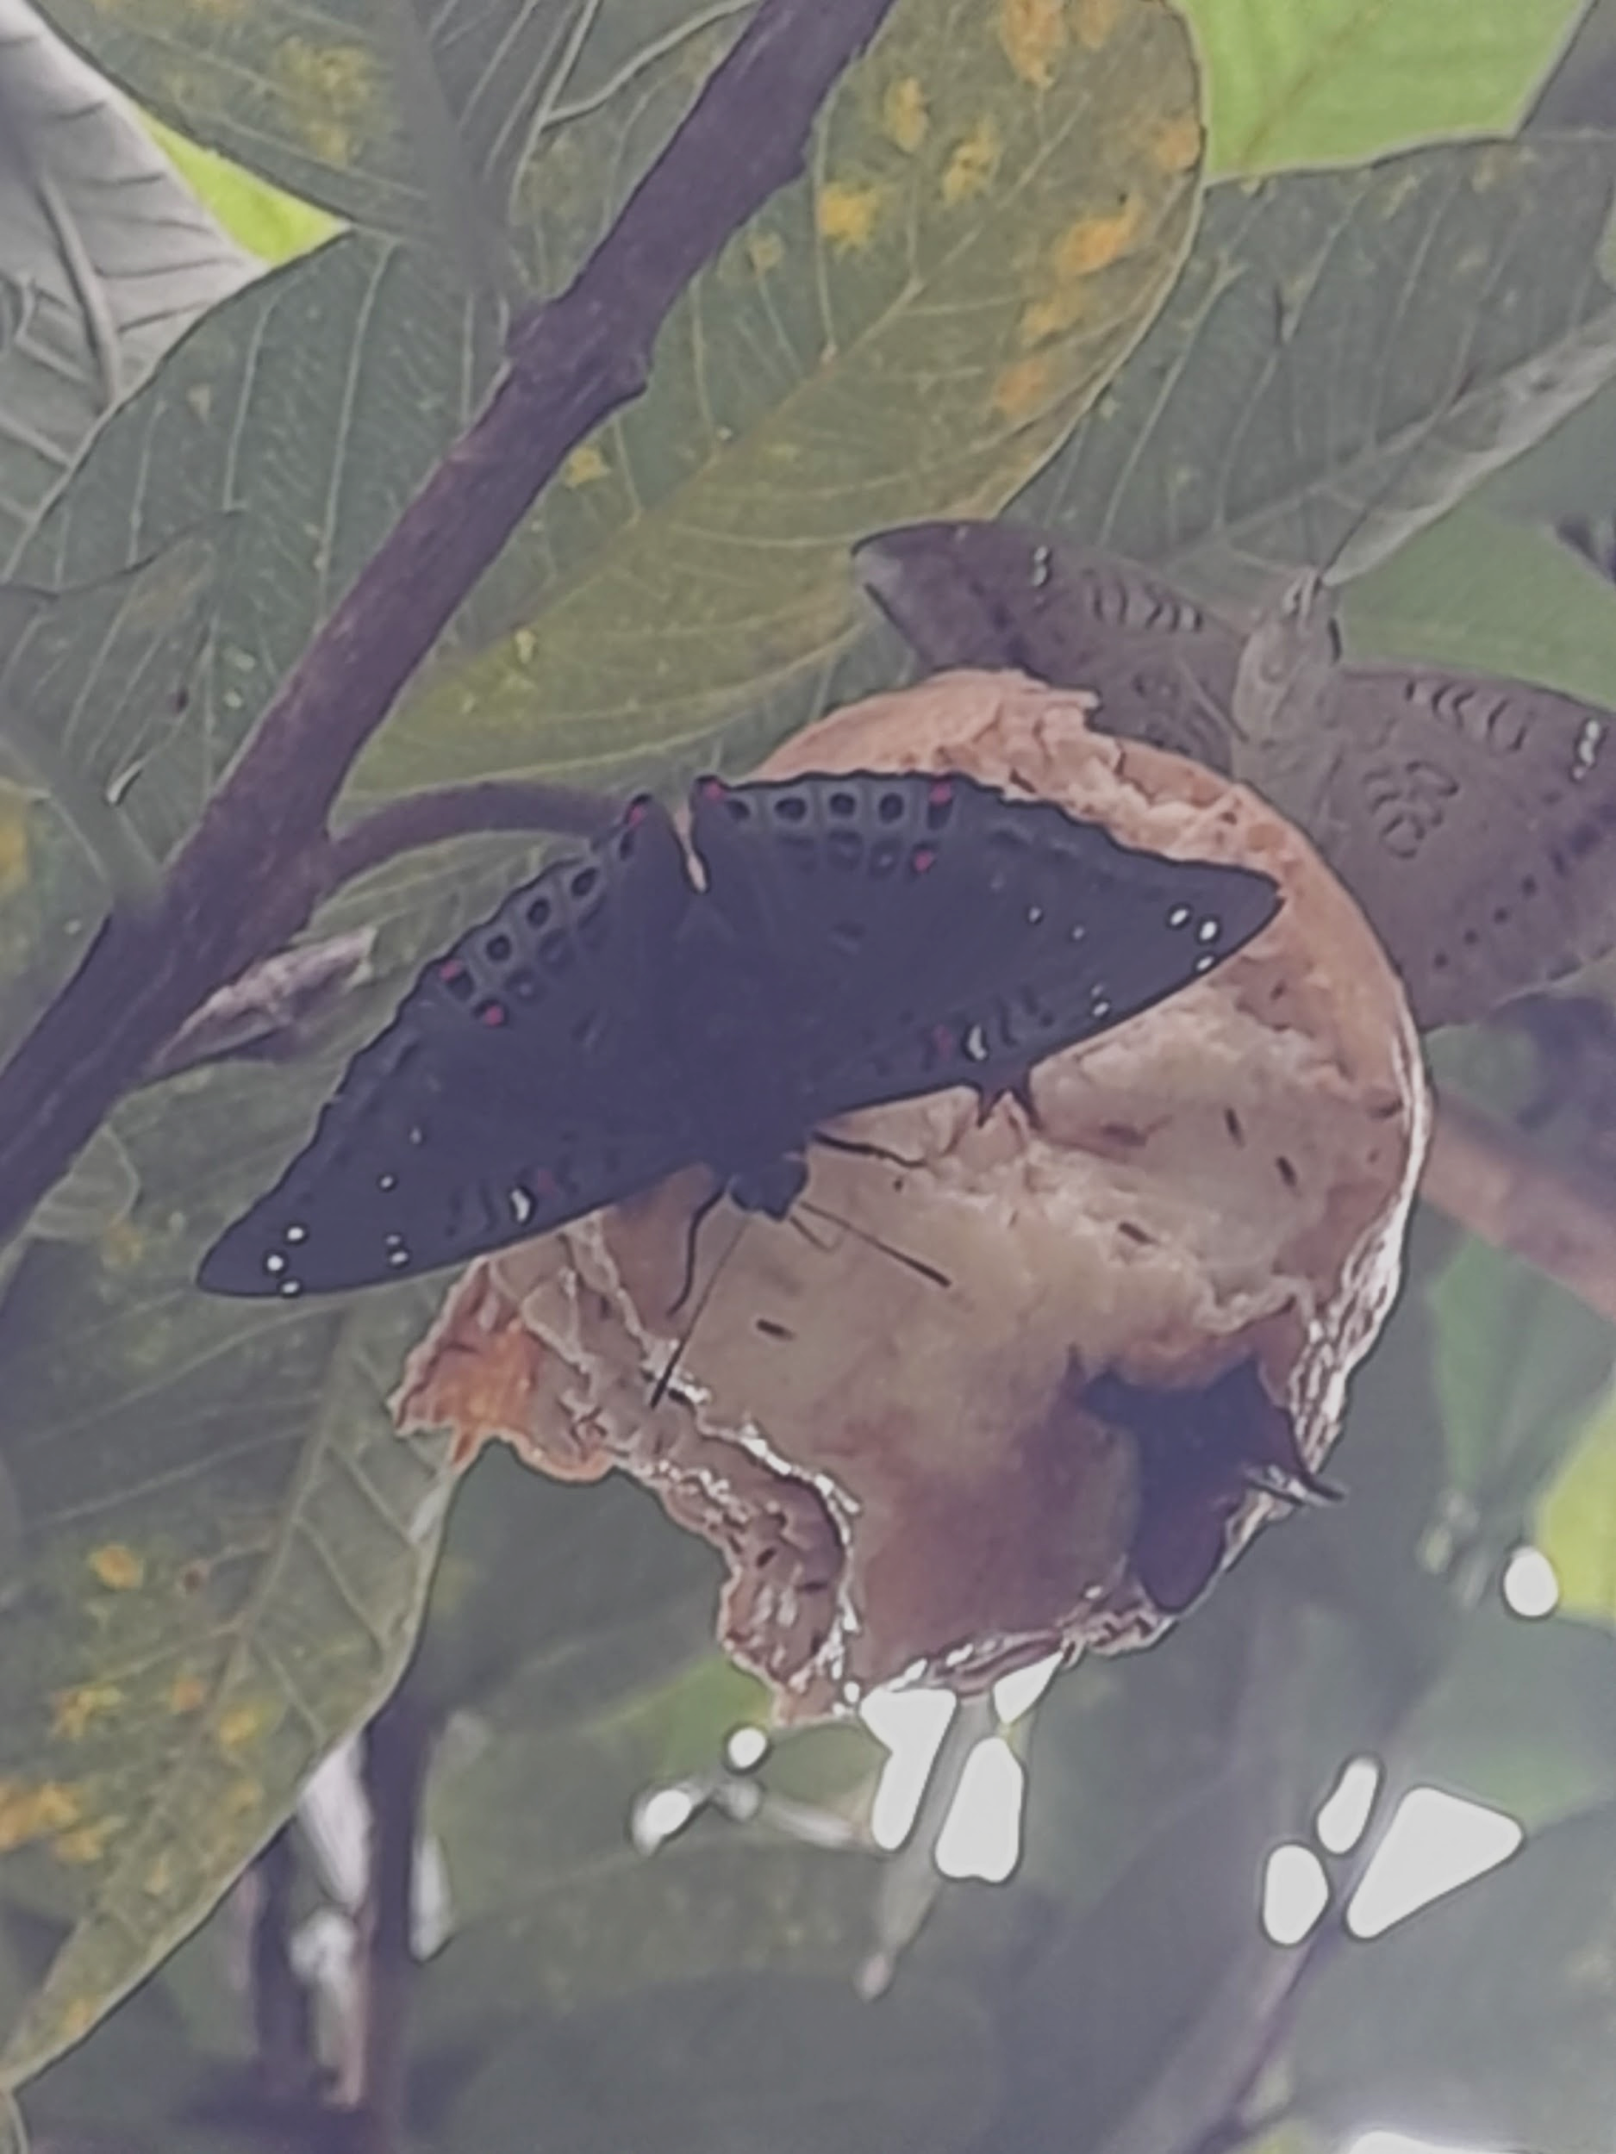
Common sailer
Blue tiger
Great eggfly
Common five ring
Common four ring
Common crow
Gaudy baron

Slide 12
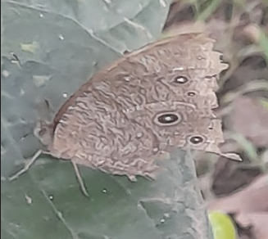
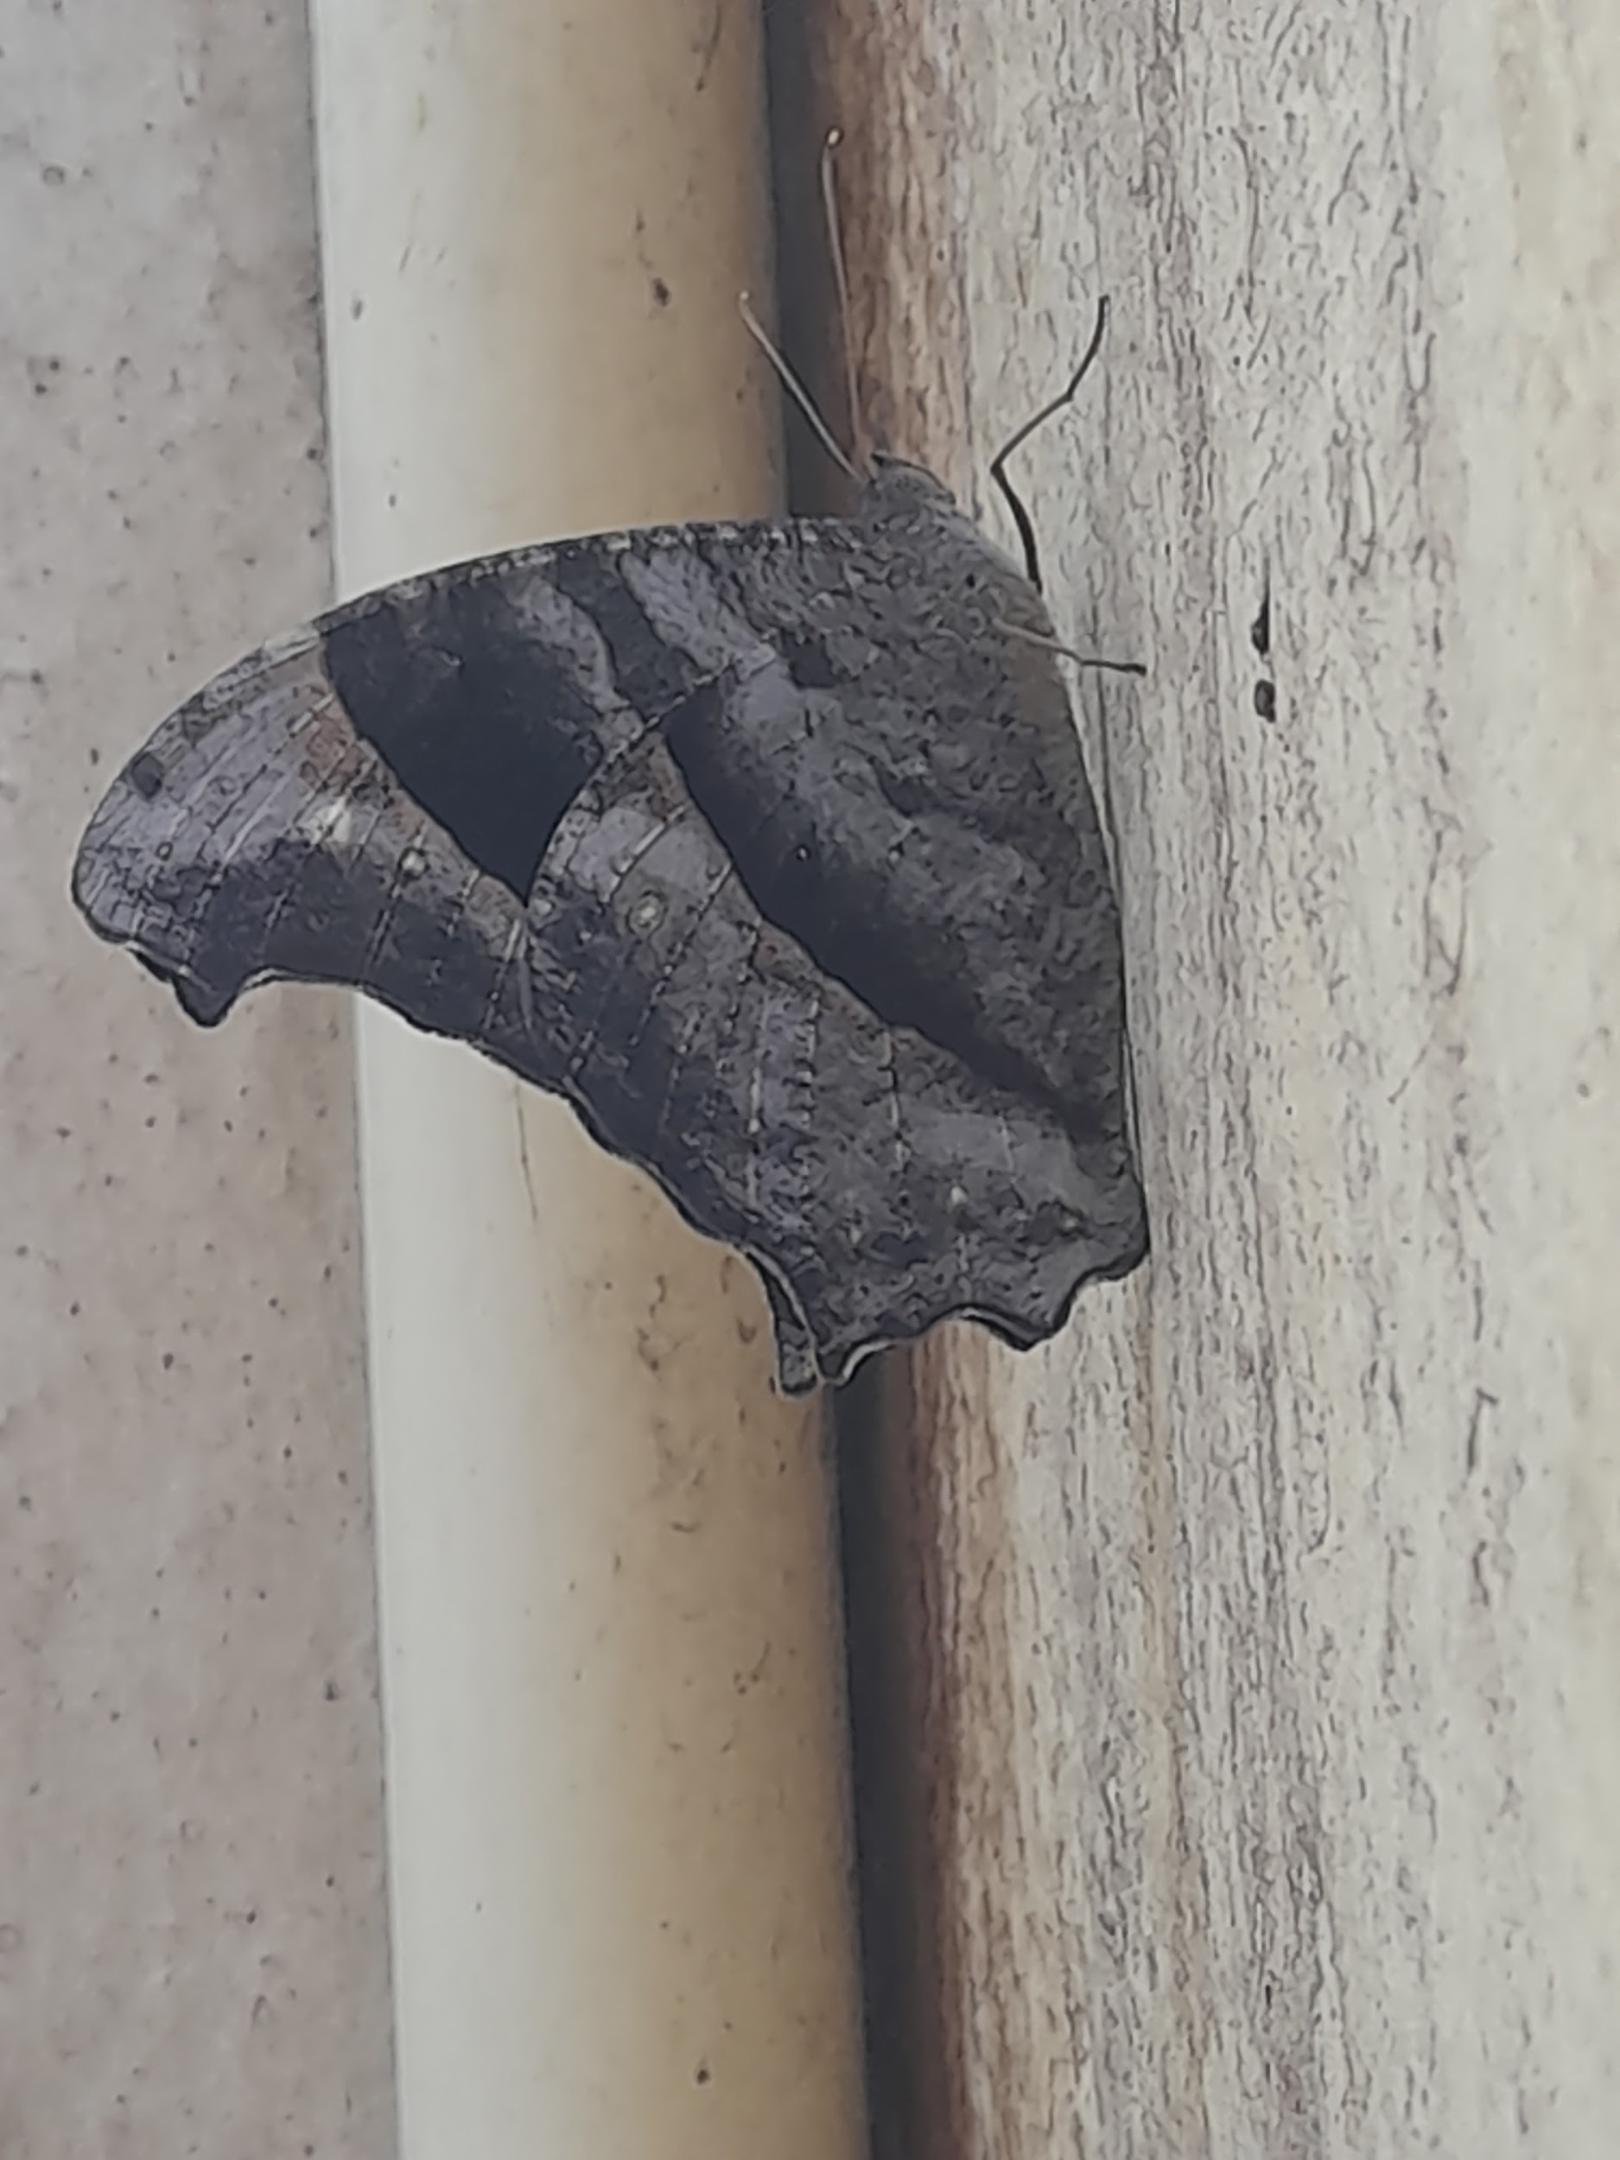
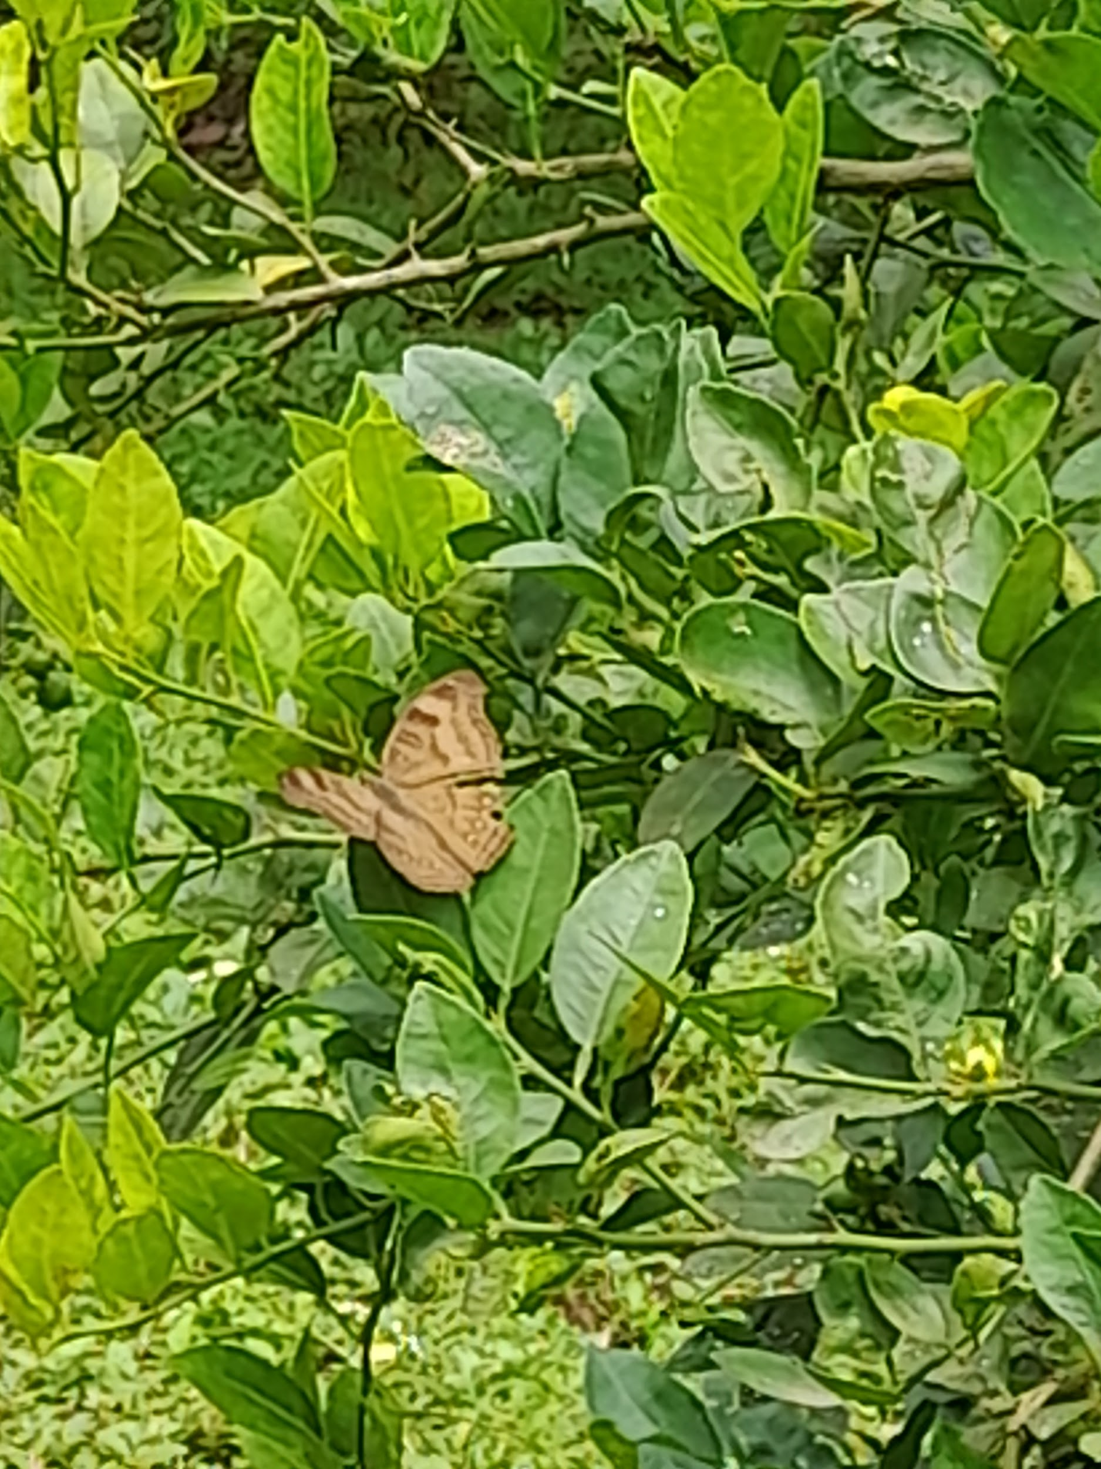
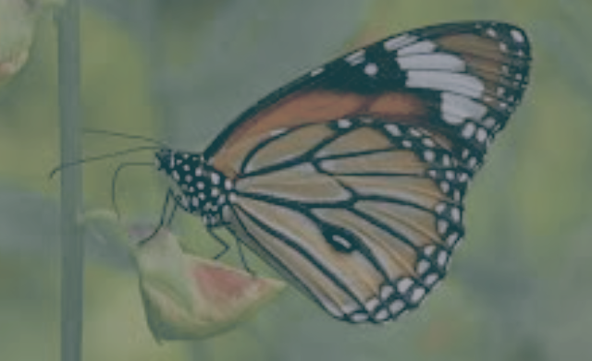
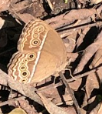
Common evening
brown
Chocolate pansy
Common tiger
Common bush brown

Slide 13
YELLOWS AND WHITES
Common name | Scientific name | Host plant | common/ rare/ moderatory
Common grass yellow | Eurema hecabe | American joint vetch | Moderatory
Common Jezebel | Delias eucharis | Wedge leaf mistletoe | Moderatory
Indian Wanderer | Pareronia hippia | Capparis baducca | Common
Psyche | Leptosia nina | Capparis | Common
One spot grass yellow | Eurema andersonii | Ventilago goughi | Common
Common emigrant | Catopsilia pomona | Bastard teak | Moderatory

Slide 14
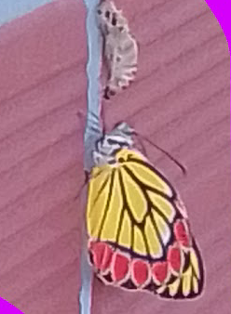
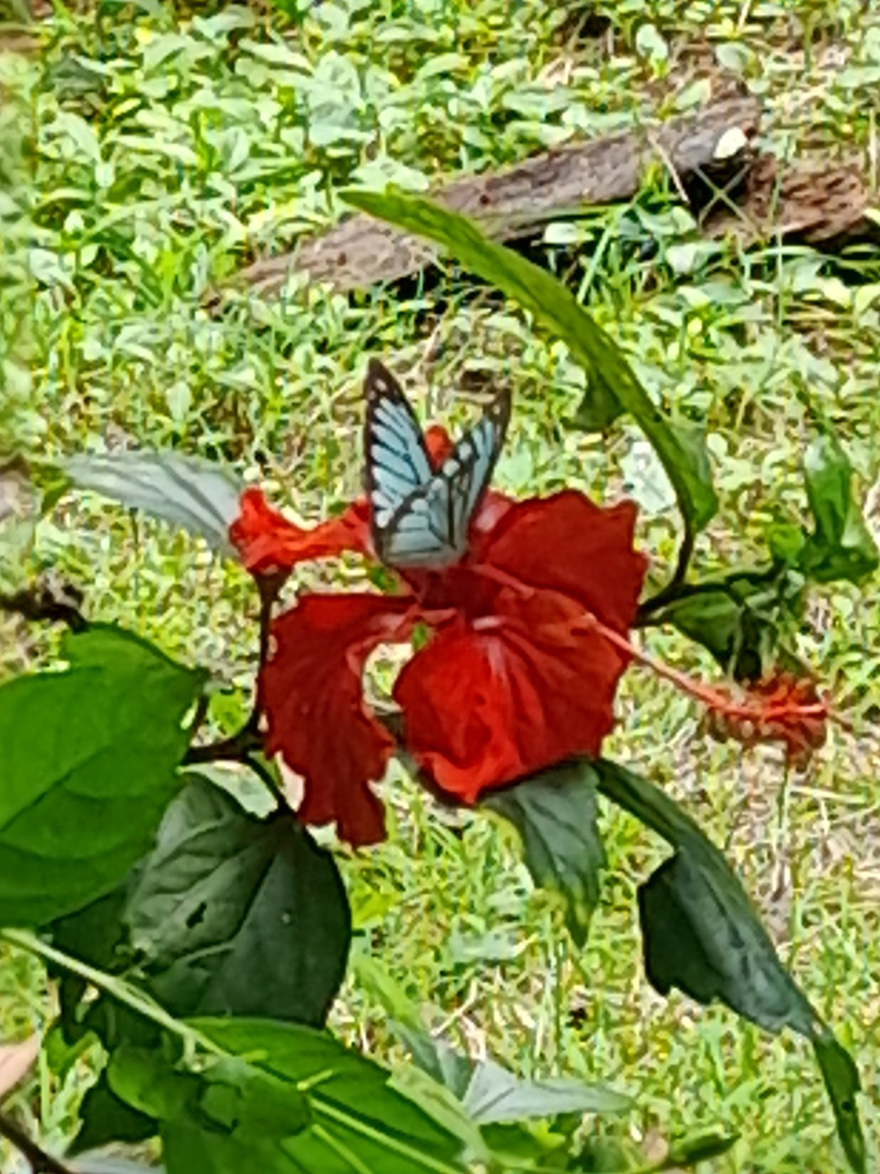
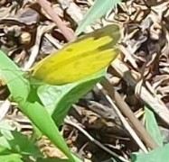
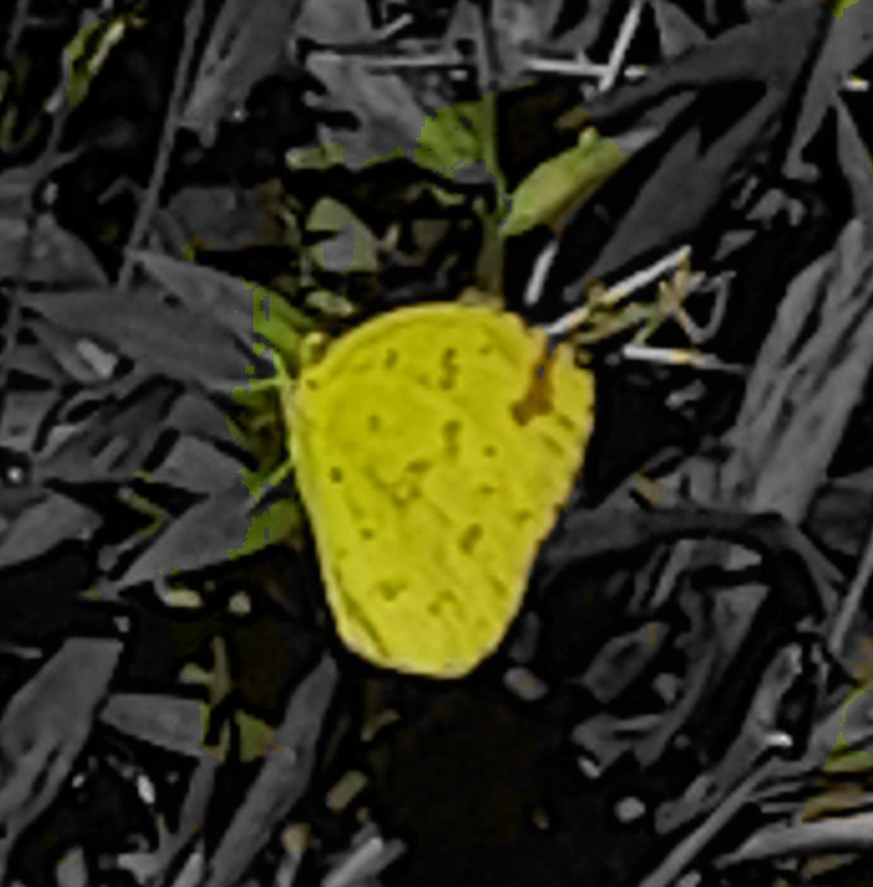
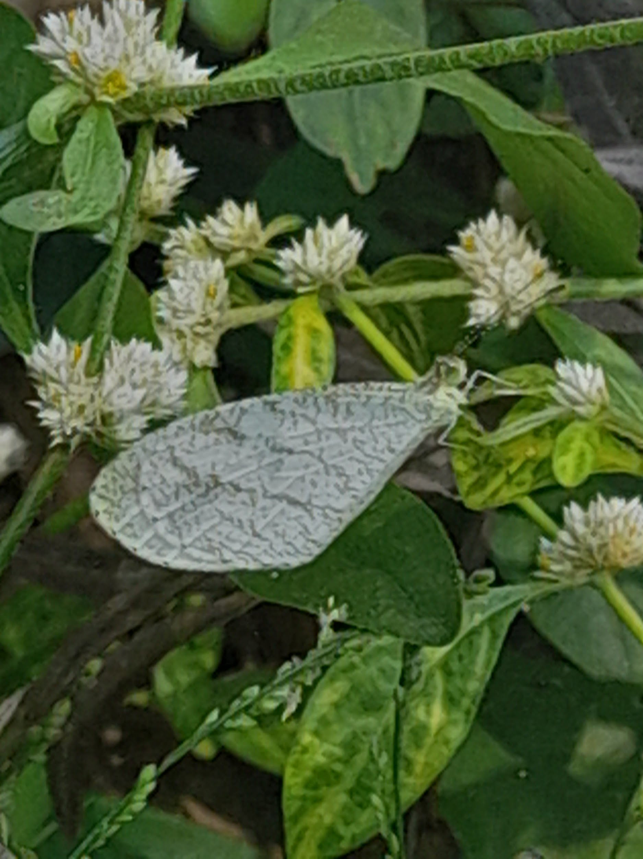
Common Jezebel
Indian Wanderer
Common grass yellow
One spot grass yellow
Psyche
Notes:
Wanderer - male mimics blue tiger. Female mimics glassy tiger.

Slide 15
Swallow tail
Common name | Scientific name | Host plant | common/ moderatory/ rare
Tailed Jay | Graphium agamemnon | False ashoka | Moderatory
Blue mormon | Papilio polymnestor | Malabar tamarind | Rare
Crimson rose | Pachliopta hector | Calico flower | Moderatory
Common mormon | Papilio polytes romulus | Curry leaf tree | Moderatory

Slide 16
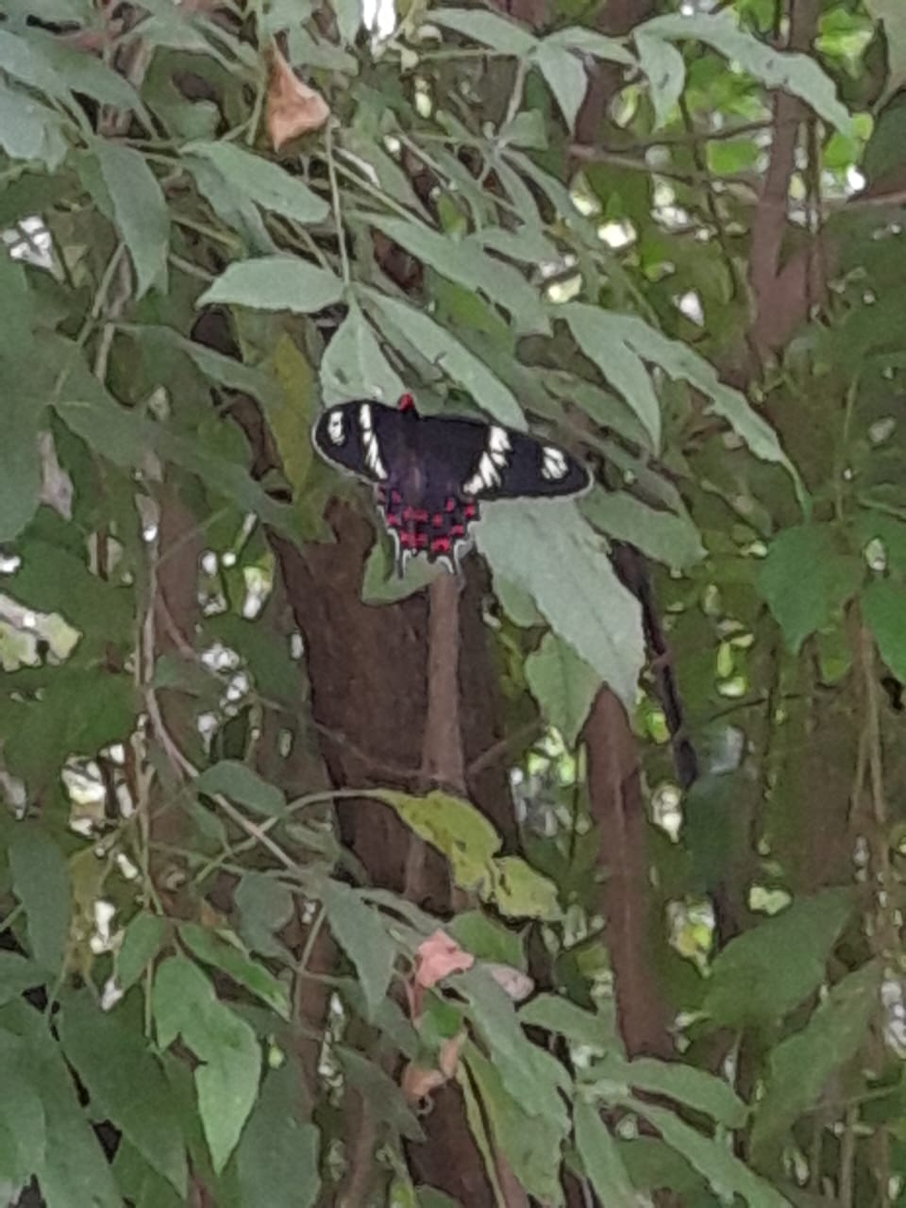
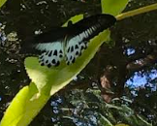
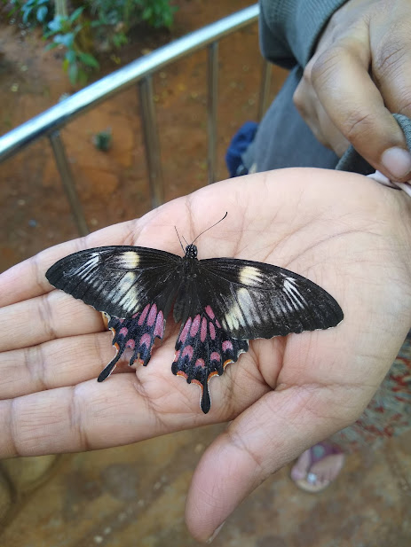
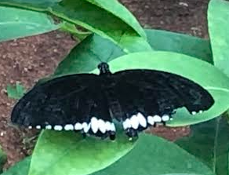
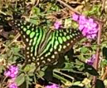
Crimson rose
Blue mormon
Common mormon
(Female)
Common mormon (male)
Tailed jay

Slide 17
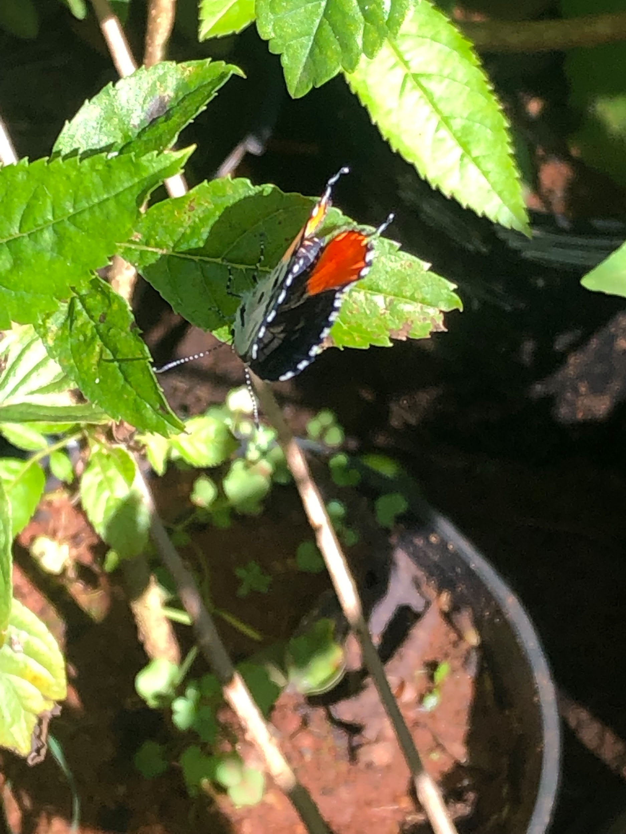
Blue butterflies
Red Pierrot

Slide 18
Blue butterflies
Red Pierrot | Talicada nyseus | Air plant | Rare
Dark grass blue | Zizeeria karsandra | Spiny pigweed | Common

Slide 19

Moths
Kingdom - Animalia
Phylum - Arthropoda
Class - Insecta
Order - Lepidoptera
Saturn has several rings

Slide 20
Moths
Common name | Scientific name | Host plant | common/ rare/ moderatory
Large lace border | Scopula limboundata | Apple, blueberry, clover, etc | Common
Asian spotted swallow tailed moth | Micronia aculeata | ------------------ | Rare
Beet web moth | Arctiidae lithosiinae |  | Common

Slide 21
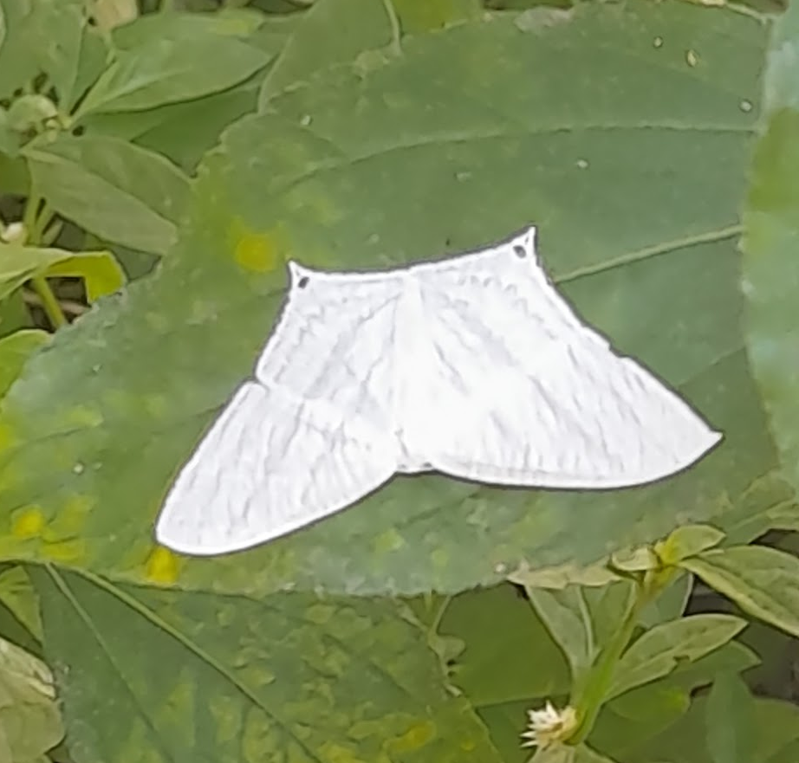
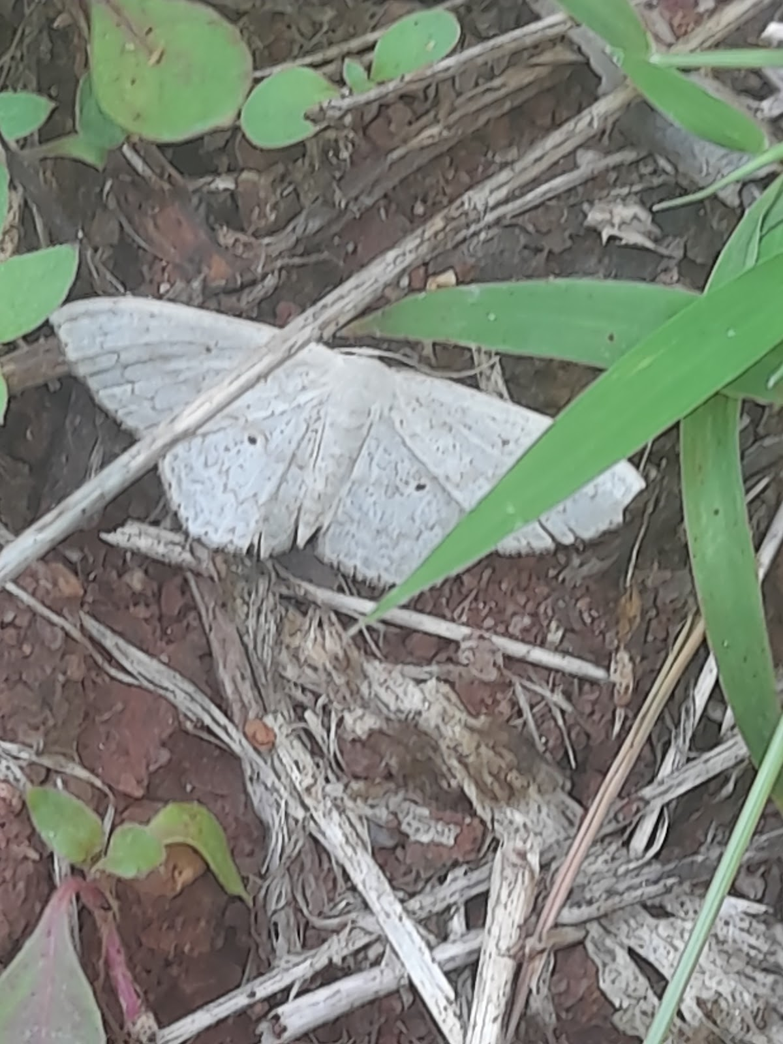
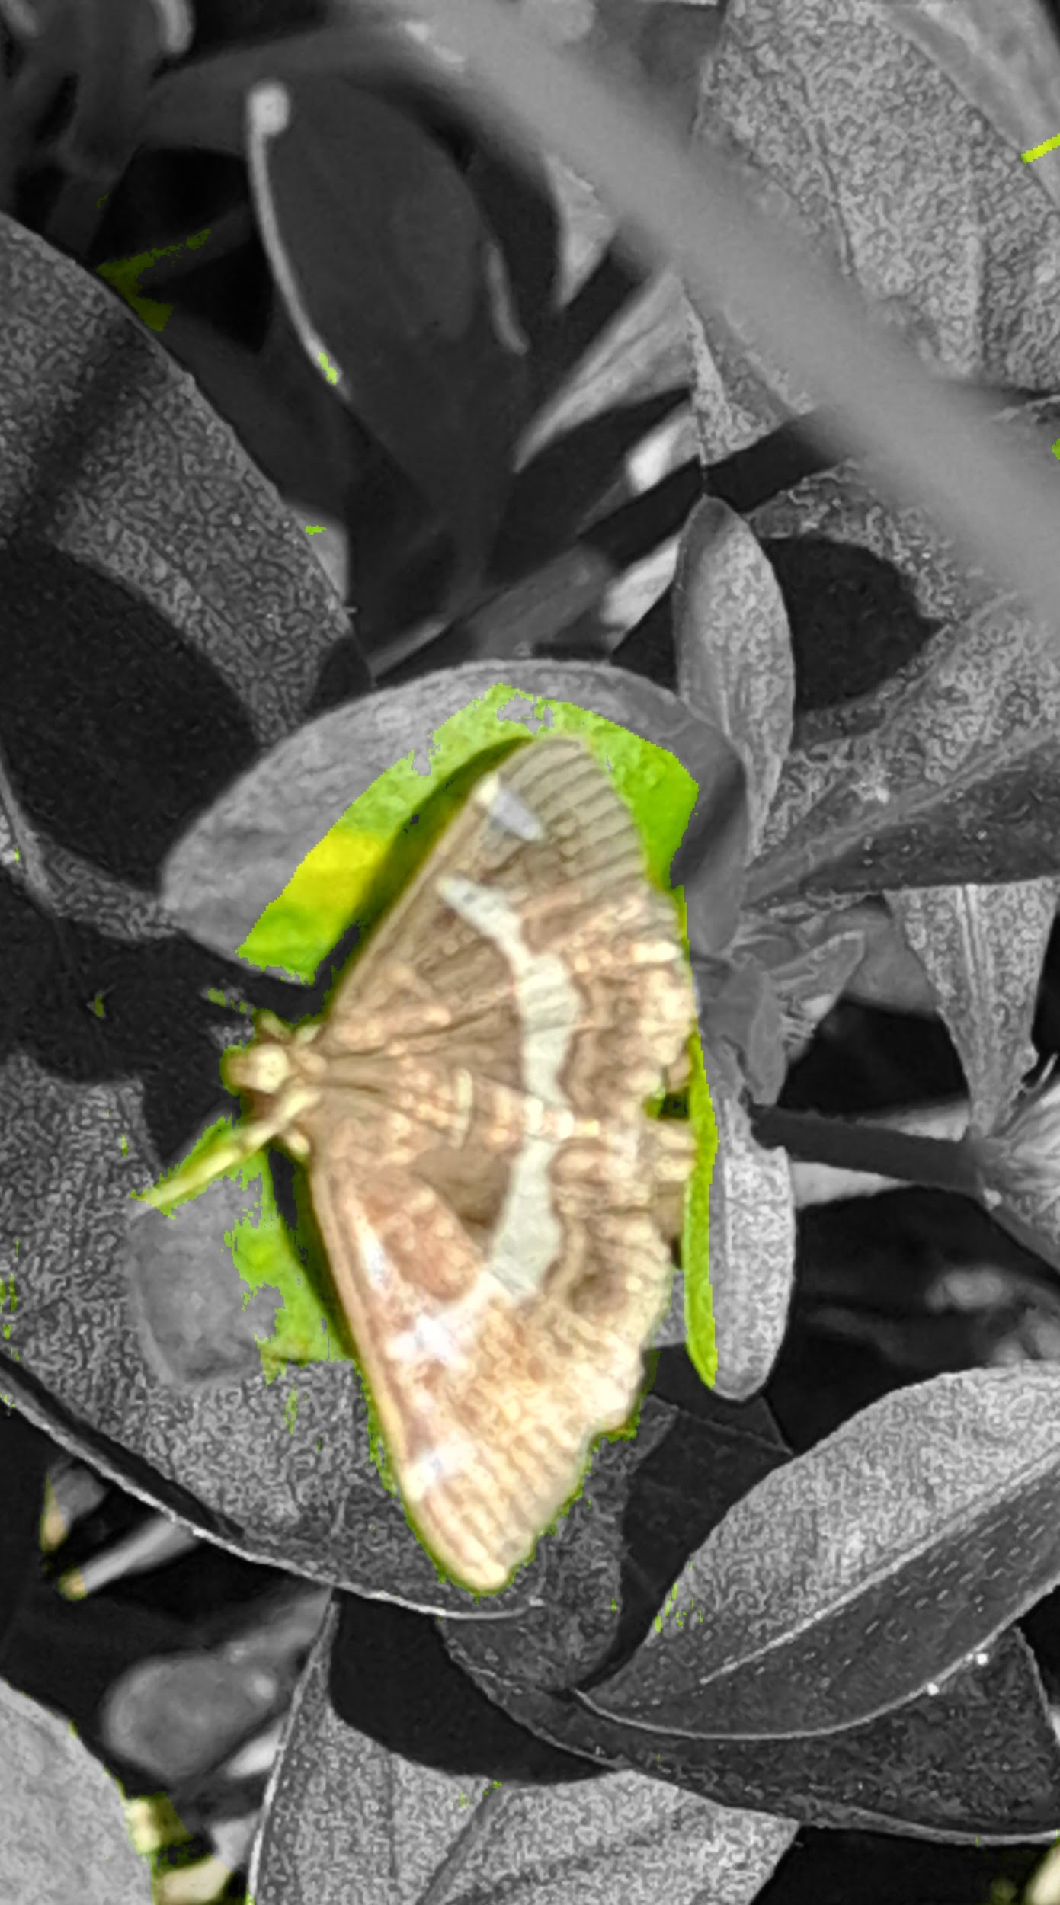
Asian spotted swallow tailed moth
Large lace border
Beet web moth
Notes:
Beet web moth always sitting under the leaf.

Slide 22
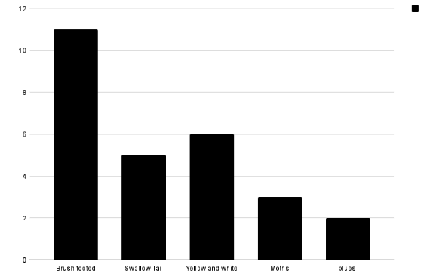
Comparison

Slide 23
Conclusion -
Biggest butterfly - blue mormon
Smallest
Common jezebel eating caterpillar
Common castor near lemon plant, though lemon plant is not the host plant of common castor
Crimson red was always flying. It never rested.
Largest butterfly - blue mormon
Smallest butterfly - dark grass blue
Smallest moth - beet web moth (10-12mm)
Common - common four ring butterfly
Common category - brush footed
Developments seen in hibiscus and chicku plants due to pollination
Short terms
Common - common four ring butterfly
Moth- laid resting. Did not move only when we touched it jumped. Did not fly
The most common category is brush footed
Chicku, hibiscus, and guava plants have increased due to pollination
Special observations -
Very few butterflies found on a rainy day.
Moth laid resting, did not fly even after disturbed
Common jezebel sucking on caterpillar
Chocolate pancy always near lemon plant
Crimson rose never rested.
Beet web moth always sitting under a leaf

Slide 24
References
Ifoundbutterflies.org
Indian butterflies app by Raju kasambe
“Butterflies of bangalore” A book written by Kunte, K., and N. Ravikanthachari.

Slide 25

Acknowledgements
We would like to thank ;
our school Purnapramati and the IISC professors
Sunitha akka , and Raghuram anna
Ananda anna
Our friend Vaishnavi
Thank you

Slide 26

“Feed on knowledge like butterflies feed on nectar ”

