Slide 1
Sch

Slide 2
INTRODUCTION :
Vitamin D is a group of fat soluble Vitamin responsible for increasing intestinal absorption of calcium, magnesium and phosphate and many other biological effects. Vitamin D also has a role in our nerve muscle and immune systems.

Slide 3
Importance of Vitamin D :
Vitamin D is one of the vitamins our body needs to stay healthy. It plays an important role in maintaining the balance of calcium in our blood and body.
We need Vitamin D so that our body can use calcium and phosphorus to build bones so that it can support healthy tissues. It also helps nerves and muscles function properly. It also plays an important role in maintain bone structure.

Slide 4
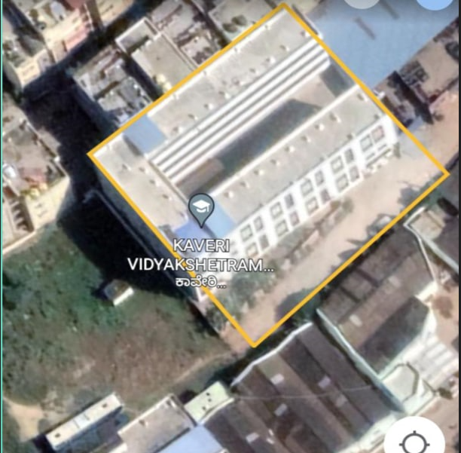
STUDY AREA :
Longitude : - 12° 52’32”N
Latitude :- 12° 39”06”N
Perimeter :- 160M

Slide 5
Objective :
This topic is to bring awareness in people about vitamin D because the symptoms of deficiency of vitamin D are very difficult to observe because many of them don’t appear from many months & years. So, we have decided to do this topic and bring awareness in people.
Materials & Methods :
We have completed methodology by questionnaire and we have conducted surveys on vitamin D deficiency.

Slide 6
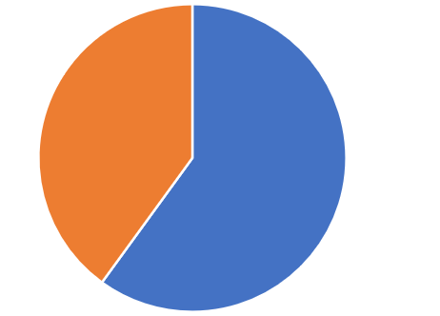
Results :
These are the results of the conducted questionnaire.
Do you know about Vitamins ?

Slide 7
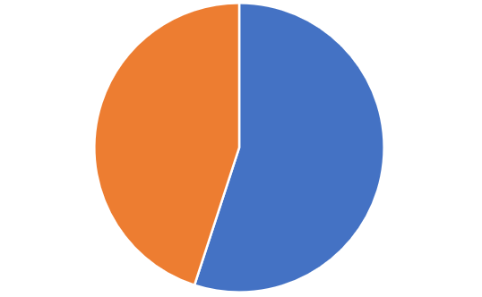
Do you know the importance of Vitamins ?

Slide 8
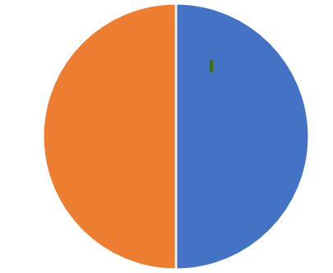
Do you know about Vitamin D ?

Slide 9
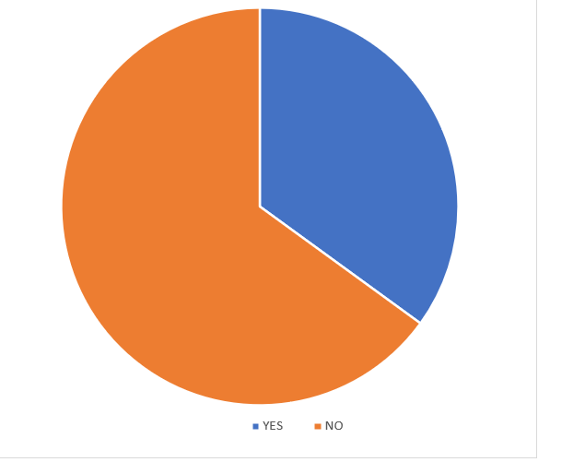
Is your mood changing very easily ?

Slide 10
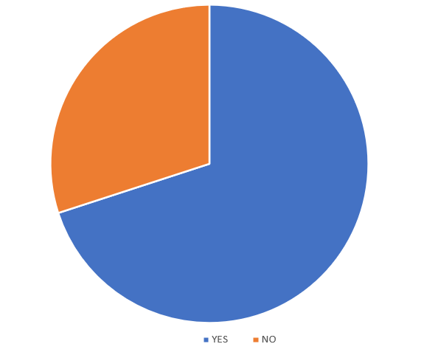
Are you getting sick more often :

Slide 11
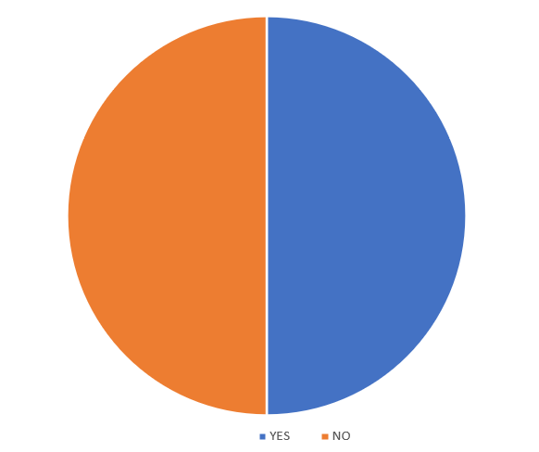
Is your hair falling more than usual :

Slide 12
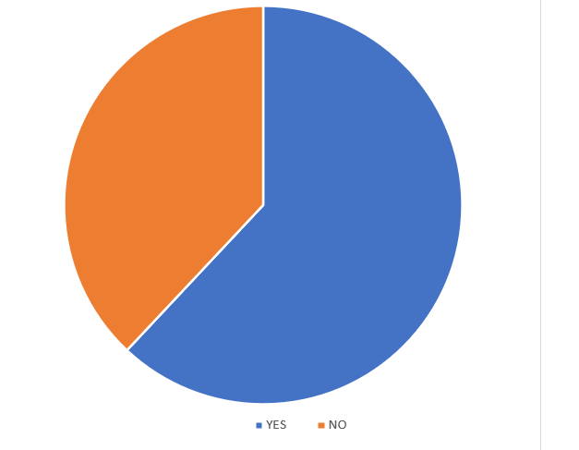
Do you exercise daily :

Slide 13
Do you have bone and muscle pain :

Slide 14
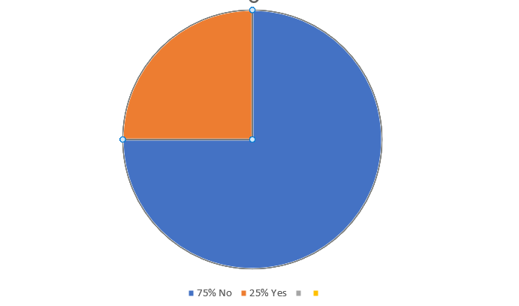
Do you have vitamin D deficiency :

Slide 15
Discussion and conclusion :
Vitamin D Deficiency :
Vitamin D deficiency means that our body doesn’t have enough Vitamin D. Vitamin D causes issues in muscles and bones.
Vitamin D deficiency can be difficult to notice because many symptoms may not occur for several months or years.
Any one can have Vitamin D deficiency including infants, children and adults. Vitamin D deficiency may be more in people with higher melanin and who are wearing cloths with extensive skin coverage, particularly in middle eastern countries.
A lack of Vitamin D can lead to bone deformities such as rickets in children and bone pain by a condition called Osteomalacia in adults.

Slide 16
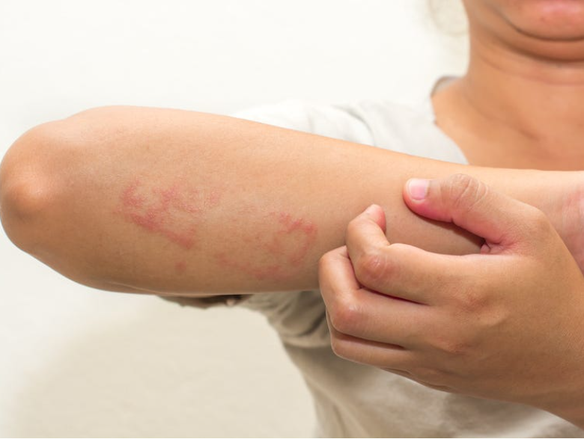
Signs and symptoms of Vitamin D Deficiency :
Frequent illness or infections : One of the most important roles of Vitamin D is supporting immune system, which helps us to ward off viruses and bacteria that cause illness. Vitamin D directly interacts with the cells that are responsible for addressing infections. If you often become sick especially with colds or the flu, low vitamin D levels may be a contributing factor.

Slide 17
Fatigue and tiredness :
Feeling tired can seen from a number of causes, one of which may be a vitamin D deficiency. Unlike more visible causes like stress, depression and insomnia, Vitamin D deficiency is often overlooked as a potential cause of fatigue.

Slide 18
Bone and back pain :
Vitamin D helps maintain bone health by improving our body’s absorption of calcium bone and lower back pain may be symptoms of inadequate Vitamin D levels.
Impaired wound healing :
slow wound healing after surgery or injury may be a sign that our vitamin D levels are low.

Slide 19
Bone loss :
Vitamin D plays a crucial role in calcium absorption and bone metabolism, low bone mineral density is an indication that bones have lost calcium and other minerals. This places order adults, especially women at an increased risk of fractures.
Hair loss :
Many foods and nutrients may effect hair health. Hair loss in women is linked to low Vitamin D levels.

Slide 20
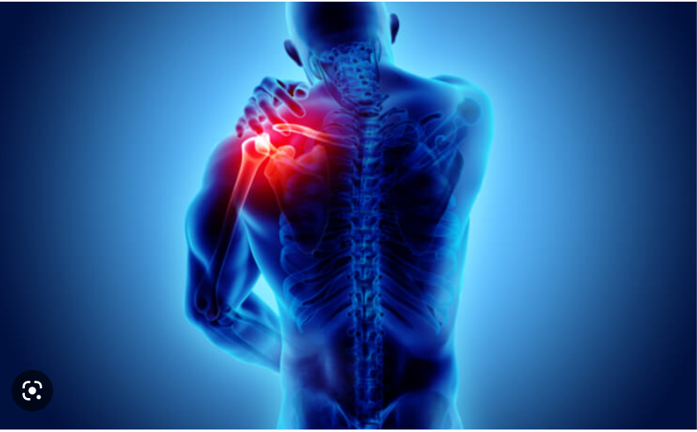
Muscle Pain :
The causes of muscle pain are often difficult to pinpoint. However evidence suggests that Vitamin D deficiency is a potential cause. People with vitamin D deficiency are more likely to have more muscle pain during morning.

Slide 21
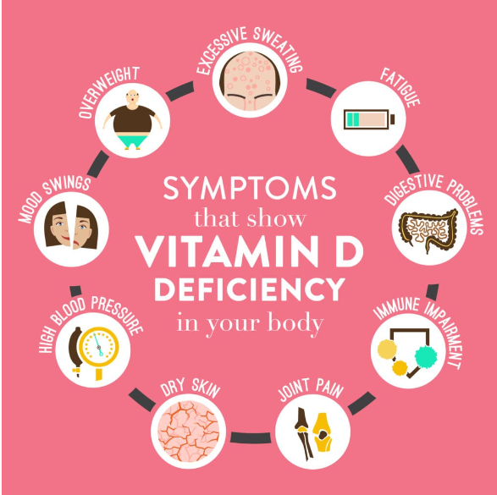

Slide 22
Causes of Vitamin D deficiency :
Diet : People who do not eat enough Vitamin D rich foods, including fortified dairy products and cereals may have low levels of Vitamin D.
Lifestyle factors : Some people spend tittle time outdoors due to work, ill health, a lack of outdoor space in their neighborhood or other factors. These people have less opportunity to expose their skin to sunlight. Those who wear clothes that cover all their body may also have a higher risk of a deficiency.

Slide 23
Pollution : Particles in the air can block UVB rays and prevent them from reaching the skin. People who live in highly polluted areas may also be more likely to avoid spending time outside.
Skin type : People with darker skin need more sunlight exposure to produce Vitamin D than those with lighter skin.
Kidney and liver health : People with liver diseases and kidney disease tend to have lower Vitamin D levels. These diseases can affect the body’s ability to synthesize Vitamin D or turn it into its active from.

Slide 24
Geographical factors : People living in certain parts of the world, Northern Canada and Alaska for example, may have less access to the sun’s UVB Rays, especially in winter. People who live in hot climate may also be at risk, as they often try to avoid the heat and strong sunlight by staying indoors.
Age : The ability to convert Vitamin D to calcitriol may decline with age due to decreased kidney functions. As a result, calcium absorption will fall.
Breastfeeding infants : Human milk is low in Vitamin D, which means that breastfeeding infants are at a risk.

Slide 25
Treatments of Vitamin D deficiency :
Supplements : Some people may need to take supplements, but it is best to talk to a doctor before doing so, as some can have adverse effects. The doctor will also provide on a suitable dosage.

Slide 26
Food Sources :
Good dietary sources of Vitamin D include only fish such as mackerel, salmon and tuna.
Cheese
Cod Liver Oil
Mushrooms
Egg Yolks
Fortified foods including some breakfast cereals, orange Juice, milk, soy drinks etc.,
Vegetables like spinach, Kale, Okra.
Spend time in sun : It is recommended to spend at least 10 – 15 minutes in the sun every day, cycling, running, football can help getting a daily dose.

Slide 28
Prevention :
The best way to prevent Vitamin D deficiency are to eat foods that are rich in this nutrients and to spend some time outside each day.
Some tips for avoiding a deficiency include :
Maintaining a healthy body weight cycling or walking can provide both exercise and exposure to sunlight.
Treating medical conditions : people with health conditions that affect the absorption of nutrients may find that treating the underlying condition help boost their levels of certain nutrients including Vitamin D.

Slide 29
Vitamin D importance in aquatic Animal :
It is well known that fishes such as mackerel, Salmon, tuna etc., have vitamin D but many other animals also have Vitamin D in them.
Fishes don’t get vitamin D from the sun because they are never exposed to the sun, fishes get vitamin D from Foods such as blank ton and they store it in their liver and fat tissues.
Not only fish, but there are also many other aquatic animals that have vitamin D content in them, such as Oyster, Shrimp, bubbler whale, seal etc.,
As told earlier, aquatic animals are so useful to us. But now a days fishes and other aquatic animals are becoming less in number because of water pollution. We are polluting lakes, rivers, oceans and seas so the aquatic animals are becoming less in number. Not only aquatic animals other animals like cows will drink water from lakes, reivers etc., It is harmful for them also. So we should not pollute lakes and create awareness about it.

Slide 31
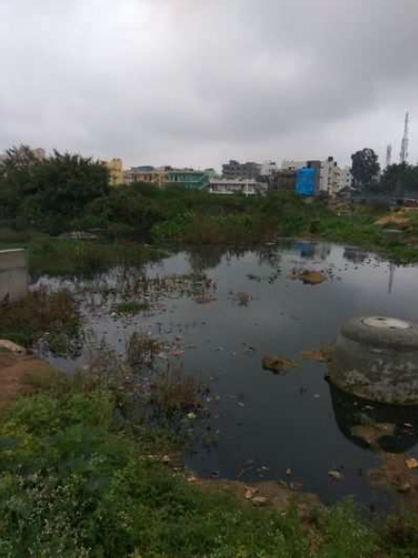

Slide 32
Conclusion :
Treatment of vitamin D by increasing vitamin D naturally has less risks of death. We must take proper supplements on time. We must expose ourselves to the sun for at least some time because it is very necessary. We all must be aware of the physical and mental problems which we are facing because few of us are not aware about it. It may lead to a very big problem / death. Vitamin D is also very important if not cured now, may be we can face lot problems like rickets etc.,

Slide 33
Acknowledgment :
We would like to express our special thanks of gratitude to our teachers Mrs. Jyotsna Mishra, Aruna Mam and our school management who gave us the golden opportunity to do this wonderful project, who also helped us in completing our project. We came to know about so many new things and we are really thankful to them. Secondly we would like to thank our parents and friends who helped us a lot in finalizing this project.
Reference :
Books :
Vitamin D and Human health
Vitamin D
Google

