Slide 1


School name :- Kaveri Vidhyakshetram
Standard :- 9th
Topic :- Flora found in school campus
Team :- Yamuna J V
Trupti S Shebannavar

Slide 2
OBJECTIVE
To find the trees present in our school campus and medicinal values of them

Slide 3
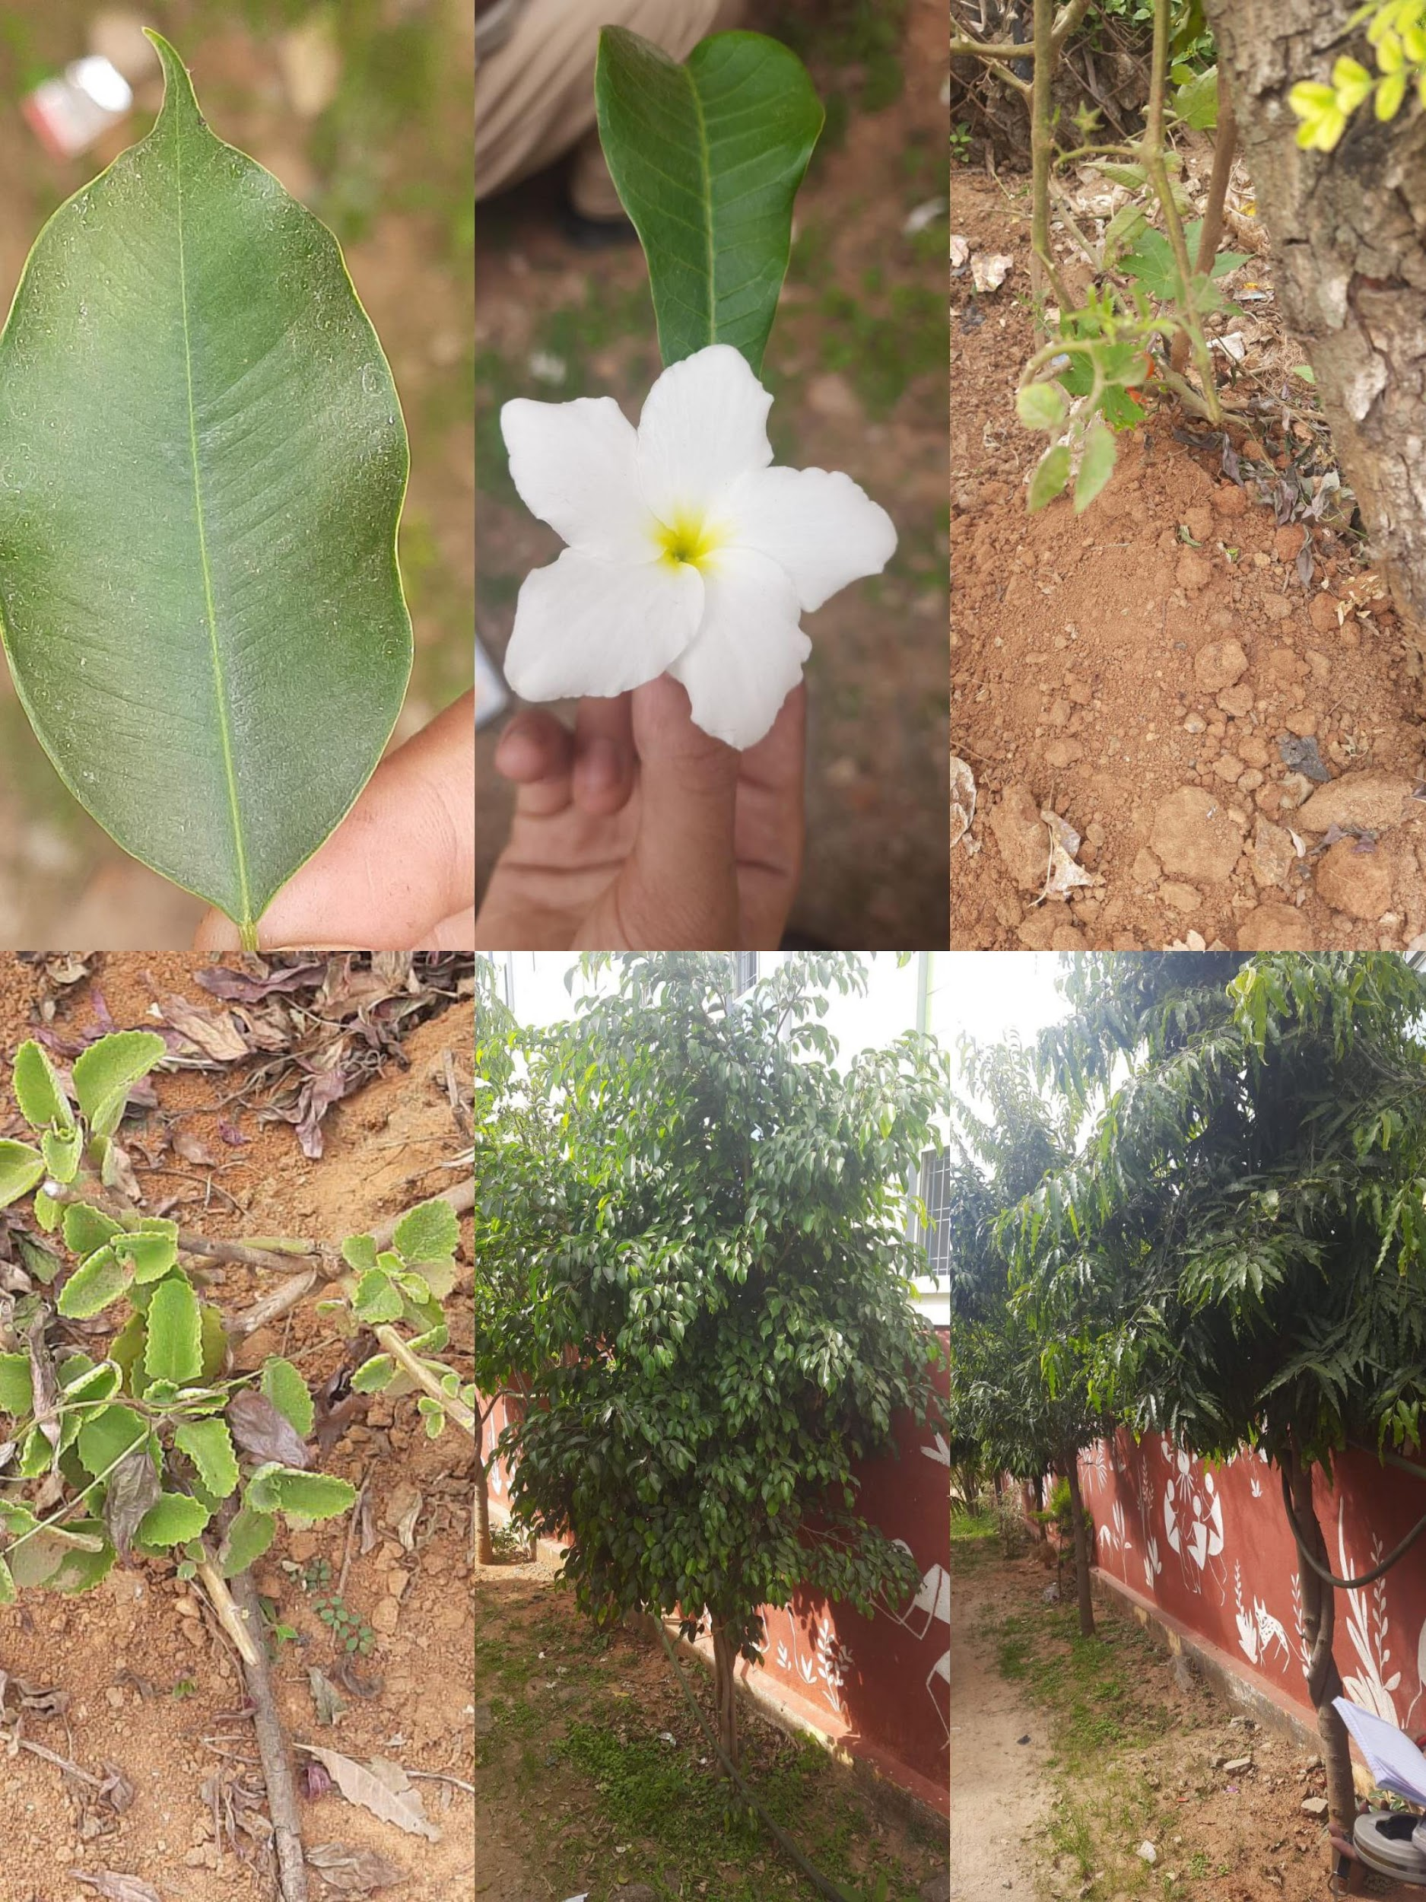
INTRODUCTION
Flora is all the plant life present in a particular region or time naturally occurring (indigenous) native plants.

Slide 4
IMPORTANCE OF TREES
Trees play an important role in the ecosystem
Trees take in carbon dioxide and give out oxygen during photosynthesis
Trees provide shelter and food for both humans and animals
Trees are also important source of medicine
Trees also play an important role in preventing soil erosion and floods
Tress also provide us pleasure.

Slide 5
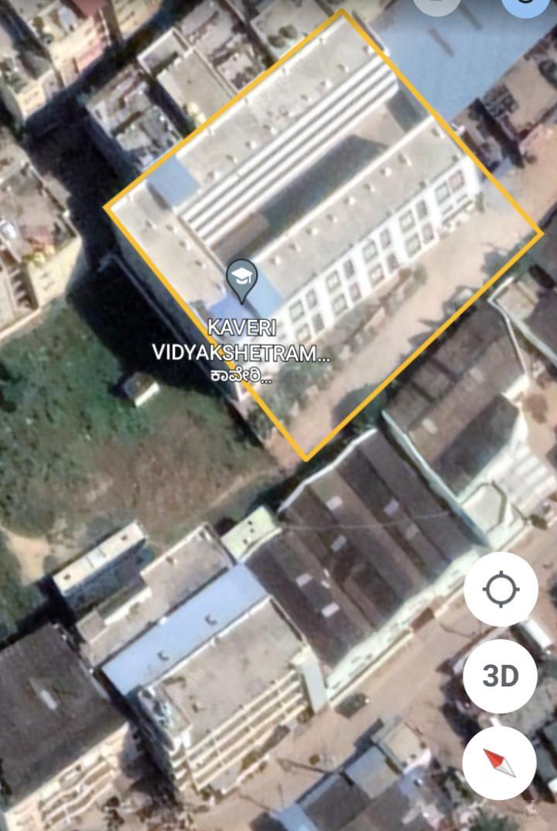
STUDY AREA
Longitude :- 12°52’32’’N
Latitude :- 77°39’06” E
Perimeter :- 160M

Slide 6
MATERIALS AND METHODS
MATERIALS
MOBILE
MEASURING TAPE
PEN
ROUGH BOOK
METHODS
we used mobile to click photos of plants to identify it using google lens
we used measuring tape to measure the height and girth of the tree
we used to pen and rough book to note down the tree’s height and girth which we got by measuring

Slide 7
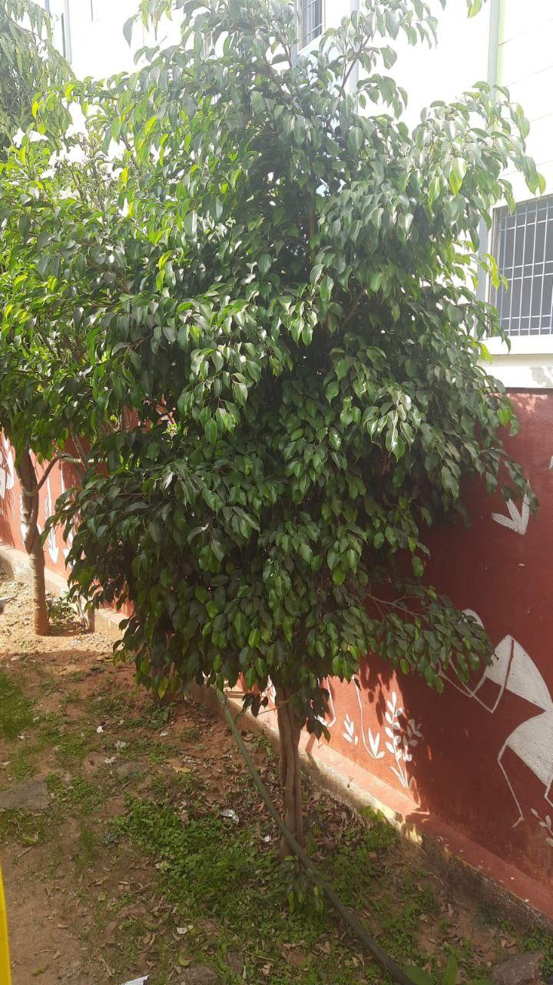
FLORA IN SCHOOL CAMPUS
WEEPING FIG
Height :- 1M 77 TO 80 CM
Girth:- 13 Cm
Species Found :- 3
Scientific Name :-Ficus Benjamina
Medicinal Uses :- Used to Treat Skin Disorders, Inflammation, Piles, Vomiting, Leprosy, Malaria, Nose-diseases And Cancer

Slide 8
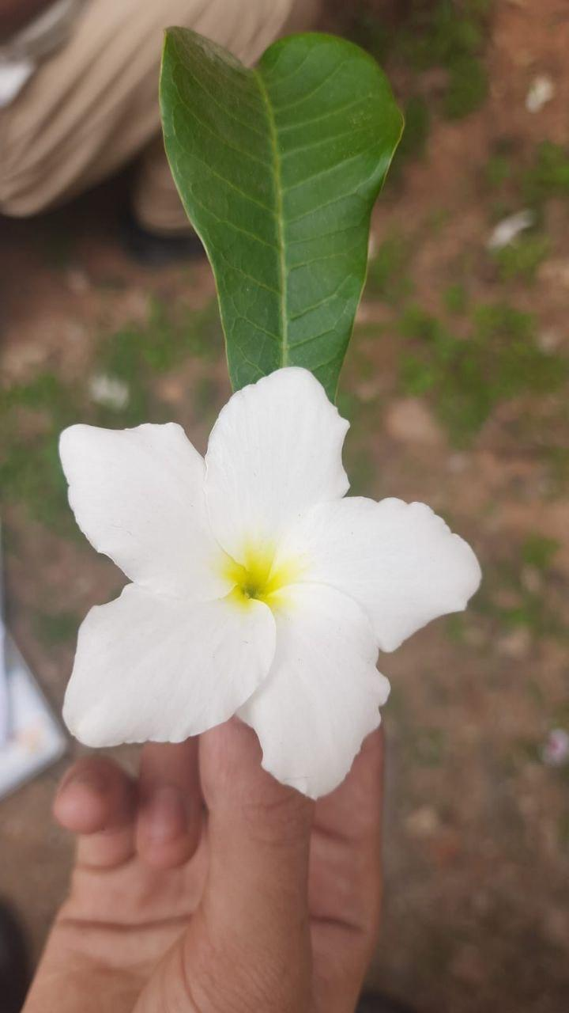
FLORA IN SCHOOL CAMPUS
BRIDAL BOUQUET
Height :-2m 80cm To 3m
Girth:-12cm To 15 Cm
Species Found :-4
Scientific Name :- Plumeria Pudica
Medicinal Uses :- Used To Treat Blennorrhagia,, Herpes And Syphilius, Ulcers,dartre

Slide 9
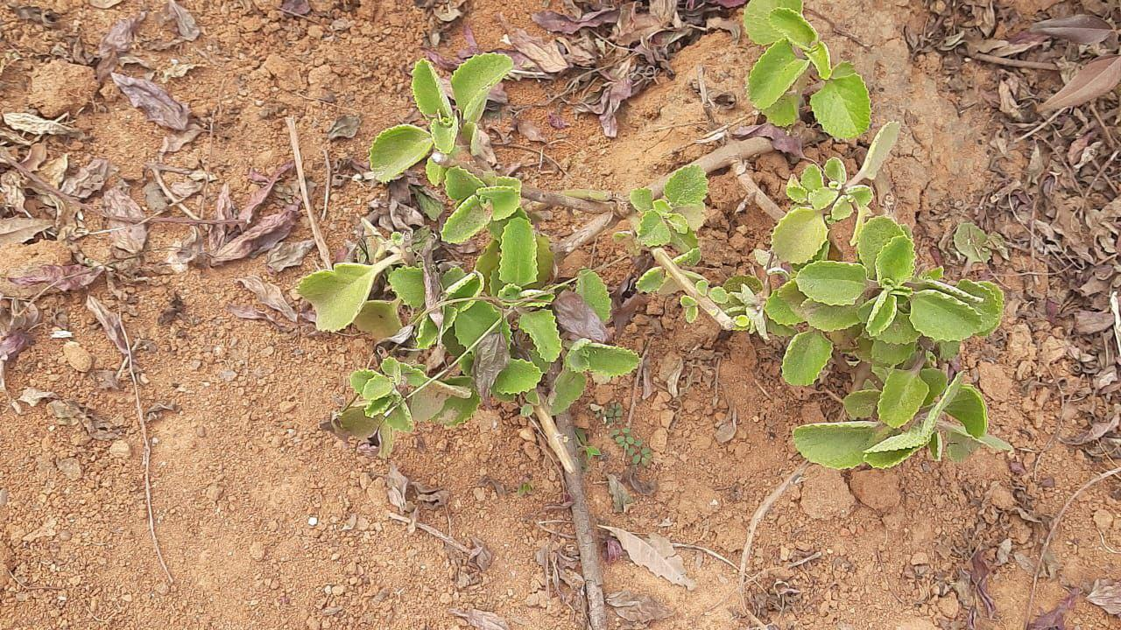
FLORA IN SCHOOL CAMPUS
MEXICAN MINT
Height :-35 To 40 Cm
Girth :- 1 To 2 Cm
Species Found :-1 Scientific Name:- Coleus Amboinicus
Medicinal Uses :- Used To Treat Cold, Asthma, Constipation, Headache, Cough, Fever And Skin Diseases.

Slide 10
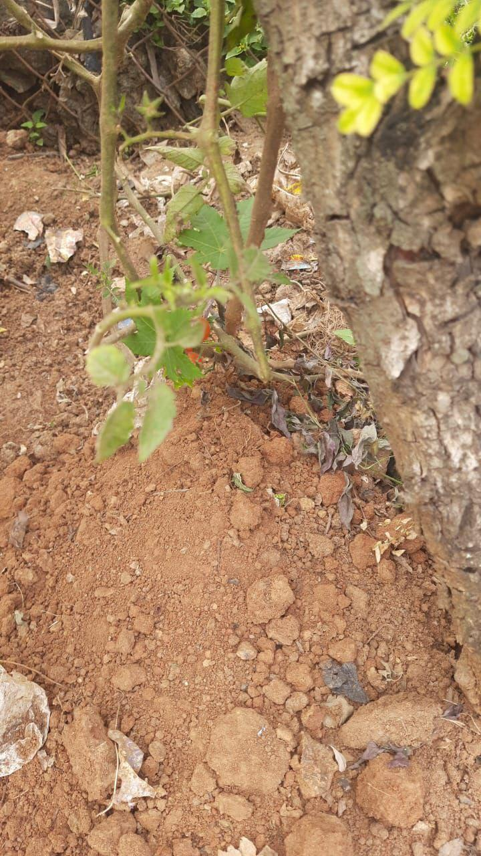
FLORA IN SCHOOL CAMPUS
TOMATO
Height :- 1 M 40 To 50 Cm
Girth:- 1.5 To 2 Cm
Species Found :- 1
Scientific Name :- Solanum Lycopersicum
Medicinal Uses :- Used to prevent Eye problems , Skin diseases.

Slide 11
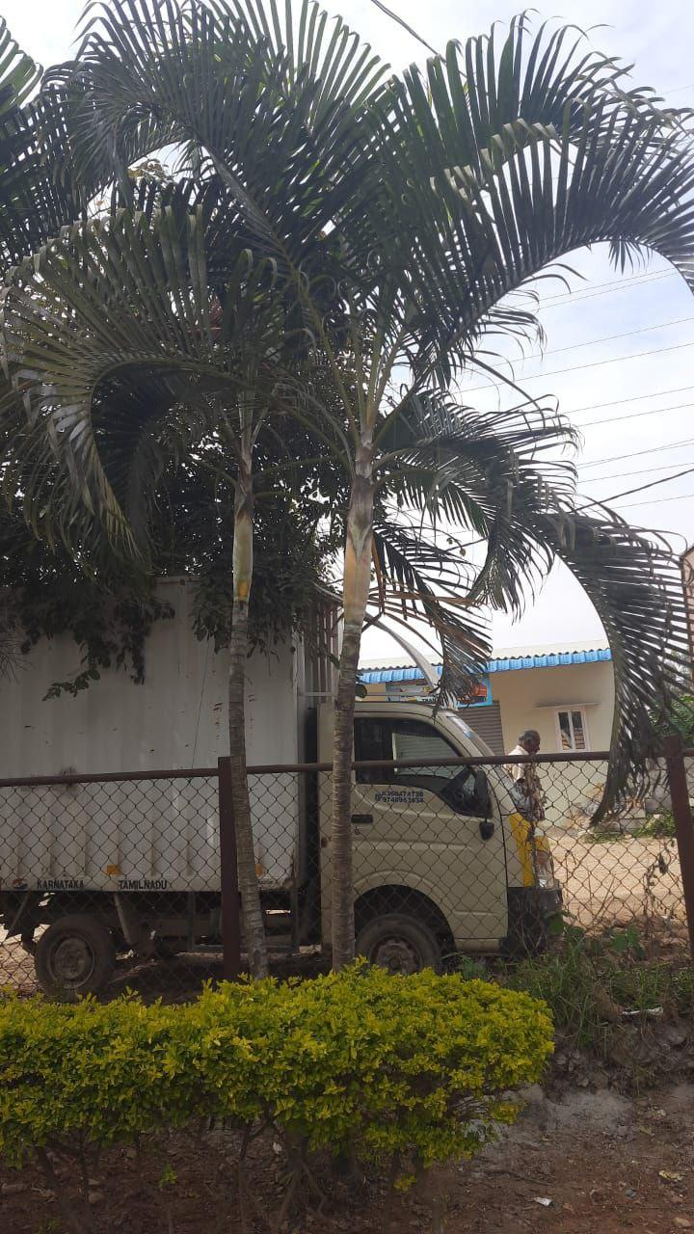
FLORA IN SCHOOL CAMPUS
ELITE GREEN ARECA PALM
Height :- 5m 10 To 30 Cm
Girth :- 25 Cm To 30 Cm
Species Found :- 15
Scientific Name :- Dypsis Lutescens
Medicinal Uses :-Used for treatment of a mental Disorder Called Schizophrenia and an eye disorder called glaucoma; as a mild stimulant; and as a digestive aid

Slide 12
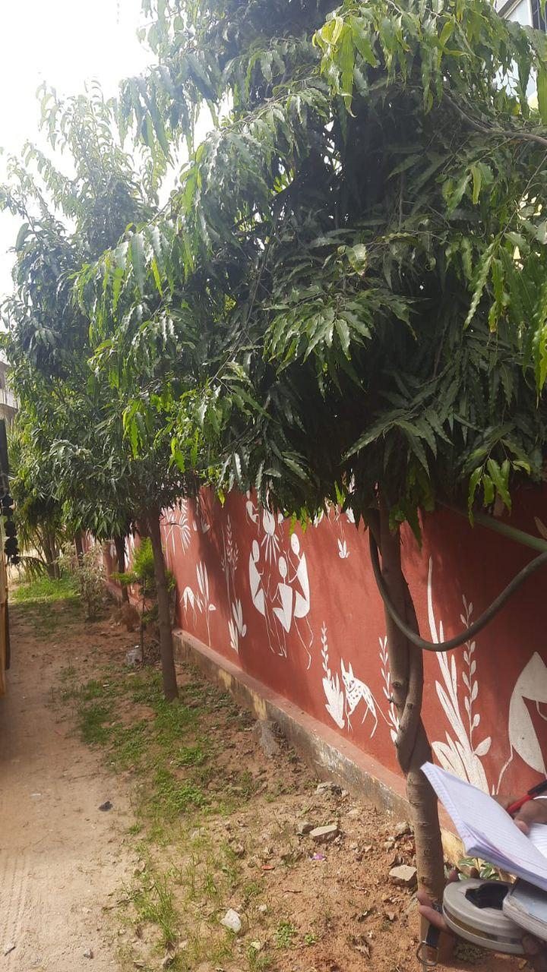
FLORA IN SCHOOL CAMPUS
FALSE ASHOKA
Height :- 3m 70 Cm To 4m
Girth:- 33 To 35 Cm
Species Found :- 15
Scientific Name :-Polyathia Longifolia
Medicinal uses :- Used as an antipyretic agent in Indigenous systems of medicine.

Slide 13
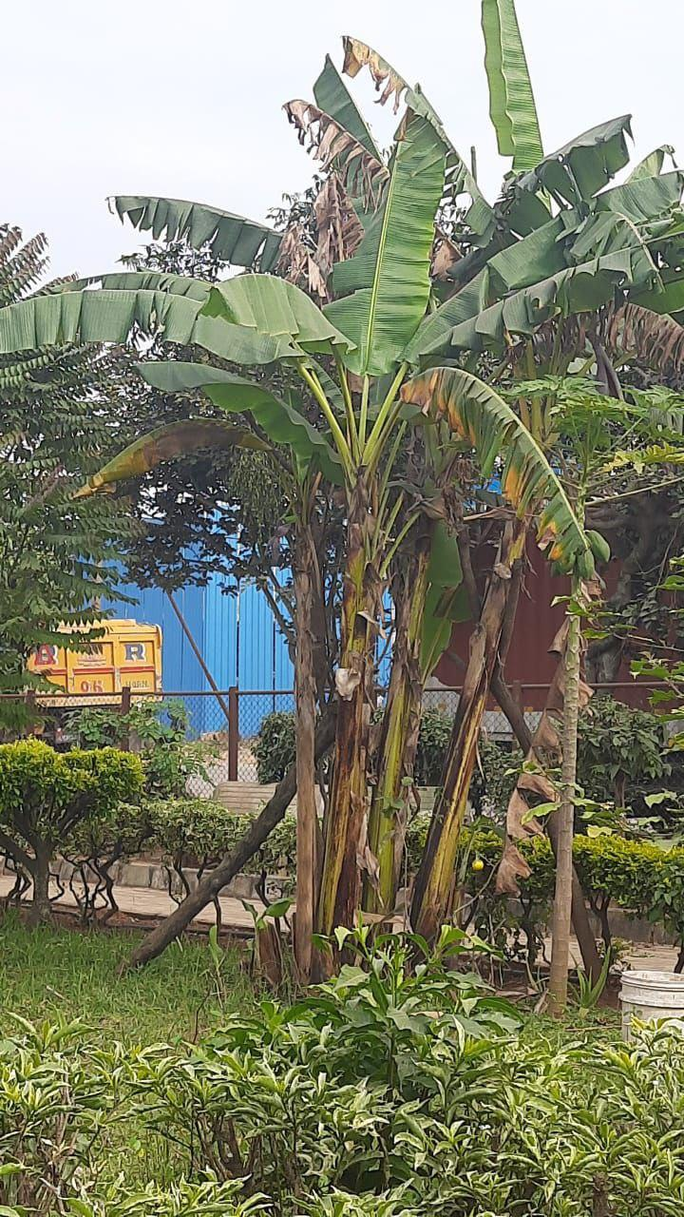
FLORA IN SCHOOL CAMPUS
BANANA
Height :- 3m To 3m 40 Cm
Girth 48 To 45 Cm
Species Found :- 7
Scientific Name :- Musa Acuminata
Medicinal Uses:- its various parts like the flowers in bronchitis and dysentery and on ulcers; cooked flowers are given to diabetics; the astringent plant sap in cases of hysteria, epilepsy, leprosy, fevers, hemorrhages, acute dysentery and diarrhea, and it is applied on hemorrhoids, insect

Slide 14
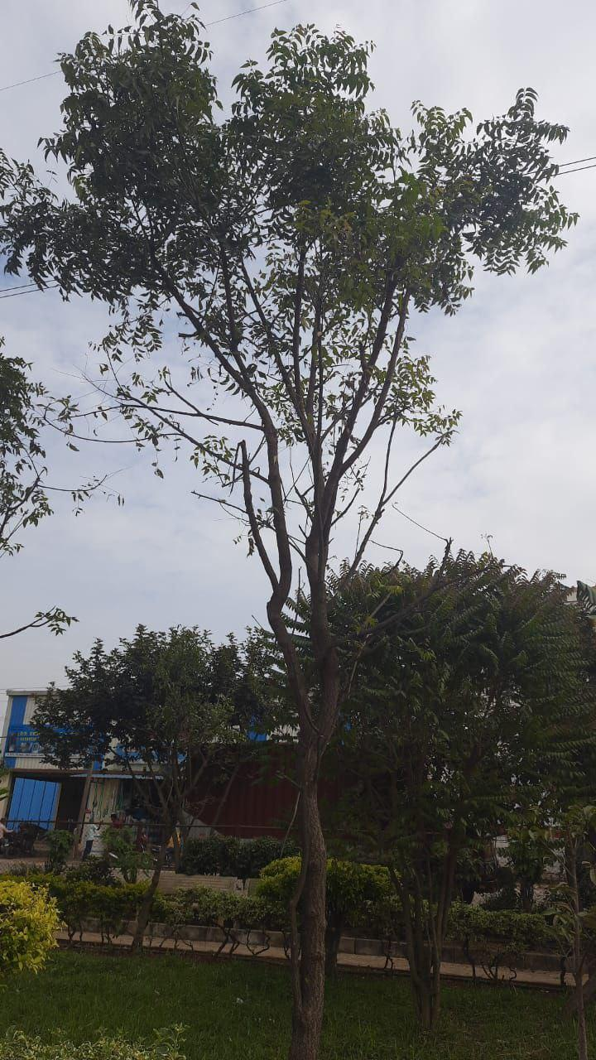
FLORA IN SCHOOL CAMPUS
NEEM TREE
Height :- 6 To 7m
Girth :- 45 To 48 Cm
Species Found :- 2
Scientific Name :-Azadirachta Indica
Medicinal Uses :- Used as Antifungal, Antidiabetic, Antibacterial, Antiviral, Contraceptive and Sedative.

Slide 15
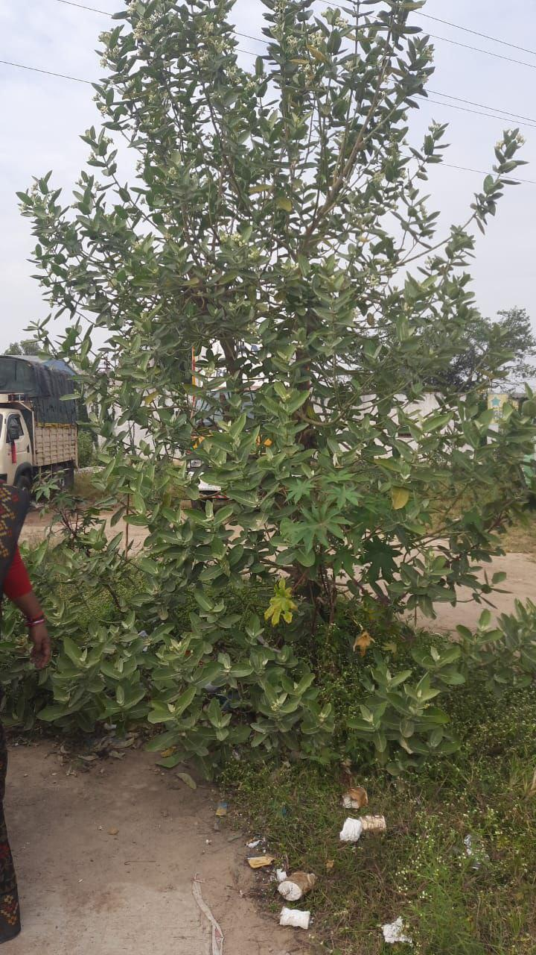
FLORA IN SCHOOL CAMPUS
GIANT CALOTROPE
Height :- 4m 50 Cm To 5m
Girth:- 40 To 45cm
Species Found :-1
Scientific Name :- Calotropis Gigantea
Medicinal Uses :- used as Antidote for Snake Bite, Sinus Fistula, Rheumatism, Mumps, Burn Injuries, And Body Pain.

Slide 16
CHECK LIST
Common name | Number of Species found. | Scientific name | Family
Weeping fig | 3 | Ficus benjamina | Moraceae
Bridal bouquet | 4 | Plumeria pudica | Apocynaceae
Mexican mint | 1 | Coleus amboinicus | Lamiaceae
Tomato | 1 | Solanum lycopersium | Solanaceae
Elite green areca palm | 15 | Dypsis lutescens | Arecaceae
False ashoka | 15 | Polyathia longifolia | Annonaceae
Banana | 7 | Musa acuminata | Musaceae
Neem tree | 2 | Azadiractha indica | Meliaceae
Giant calotrope | 1 | Calotropis gigantea | Apocynaceae

Slide 17
RESULT
We found 49 trees in our school campus all have some medicinal value

Slide 18
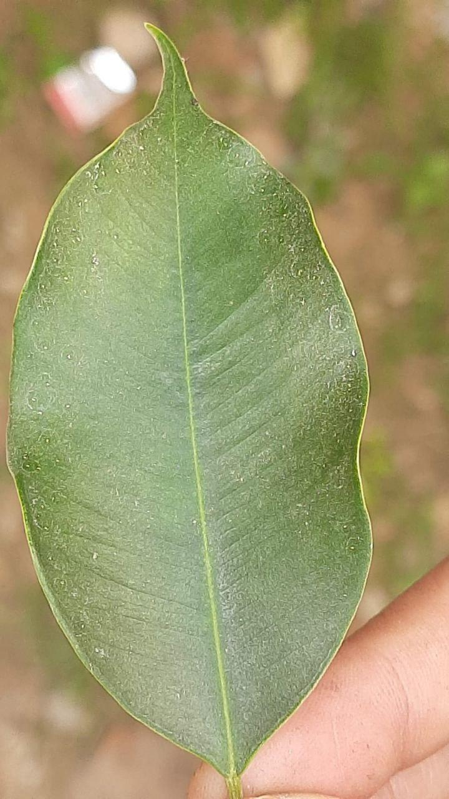
CONCLUSION
We found 49 trees in our school campus out of 49 there were 9 varieties and they also have medicinal uses
We conclude the project by informing that most of the trees have the medicinal value . so we should plant more and more number of trees to stay connected with the mother nature

Slide 19
ACKNOWLEDGEMENT
We would like to thank the iis_{c} committee for giving this great opportunity for representing our project
We would like to thank our principal and our headmistress for encouraging us to do with this project
We would like to thank our teachers aruna ma’am and jyostana ma’am forguiding through out the project

Slide 20
REFERENCE
Science textbooks found in our library

