Slide 1


TREES OF K.K.ENGLISH SCHOOL
SADIYA IQBAL &KORNANA CHYTANYA
CLASS:9

Slide 2
INTRODUCTION
Unplanned urbanization
Loss of bio-diversity
Traffic congestion

Slide 3
OBJECTIVE
To understand the different species of plants
Measures taken to conserve bio-diversity
Importance of conserving bio-diversity

Slide 4
IMPORTANCE OF PLANTS
Primary source of food
Maintain gaseous balance.
Prevent soil erosion
Maintain water cycle
Many drugs are derived either directly or indirectly from plants
A single tree provides food and shelter to many species
Plants are important in retaining good soil condition
Maintains atmospheric temperature
Carbon sequestration

Slide 5
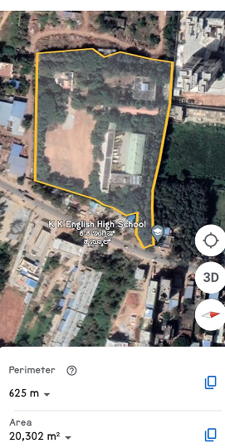
STUDY AREA

Slide 6
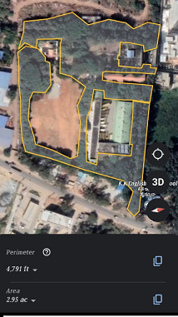
GREENERY OF OUR SCHOOL

Slide 7
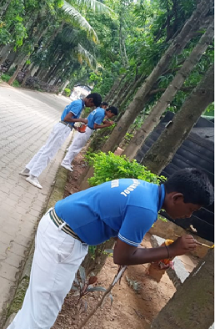
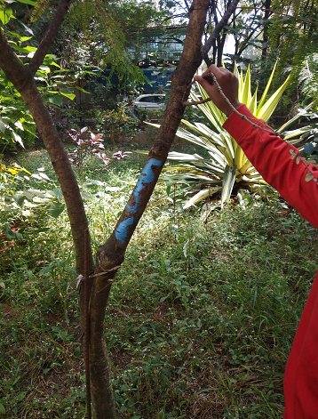
NUMBERING OF TREES

Slide 8
LIST OF TREES
SL.NO | COMMON NAME | SCIENTIFIC NAME | FAMILY | TOTAL NUMBER
1. | Mango plant | Mangifera indica | Anacardiaceae | 15
2. | False ashoka | Polyalthia longifolia | Annonaceae | 91
3. | Neem tree | Azadirachta indica | Meliaceae | 20
4. | Drum stick plant | Moringa oleifera | Moringaceae | 4
5. | Desi badam | Terminalia catappa | Combretaceae | 21
6. | Tamarind tree | Tamarindus indica | Fabaceae | 9
7. | Guava tree | Psidium guajava | Myrtaceae | 9
8. | Coconut tree | Cocos nucifera | Arecaceae | 18
9. | Singapore cherry tree | Muntingia calabura | Muntingia | 2

Slide 9
10. | Banyan tree | Ficus benghalensis | Moraceae | 5
11. | Jack fruit tree | Artocarpus heterophyllus | Moraceae | 18
12. | Sandal wood tree | Santalum album | Santalaceae | 10
13. | Custard apple | Anona squamosa | Annonaceae | 3
14. | Pomegranate tree | Punica granatum | Punicaceae | 2
15. | Lakshman phal tree | Annona muricata | Annonaceae | 2
16. | Cotton plant | Gossypium herbaceum | Malvaceae | 1
17. | Amla tree | Phyllantus aemblic | Phyllanthaceae | 4
18. | Avocado tree | Persea americana | Lauraceae | 8
19. | Simarouba | Simarouba glauca | Simaroubaceae | 1
20. | Nerium | Nerium oleander | Apocynaceae | 3
21. | Cypress | Cupressus | Cupressaceae | 6

Slide 10
22. | Pongamia | Pongamia pinnata | Leguminoceae | 25
23. | Chikoo tree | Manilkara zapota | Sapotaceae | 5
24. | Teak wood tree | Tectona grandis | Verbenaceae | 19
25. | Rain tree | Samanea saman | Fabaceae | 21
26. | Albizia | Albizia lebbeck | Leguminoceae | 21
27. | Silver oak tree | Grevillea robusta | Proteaceae | 50
28. | Red sandal wood tree | Pterocarpus santania | Santalaceae | 1
29. | African tulip | Spathodia companulata | Bignoniaceae | 14
30. | Goose berry | Phyllanthus acidus | Phyllanthaceae | 5
31. | Peepal tree | Ficus religiosa | Moraceae | 8
32. | Tabubia | Tabebuia species | Bignoniaceae | 3
33. | Peacock flower | Caesalpinia pulcherrima | Fabaceae | 2
34. | Indian tulip | Thespesia populnea | Malvaceae | 1
35. | Citrus species | Citrus species | Rutaceae | 25

Slide 11
36. | Pannerale | Syziygium jambos | Myrtaceae | 1
37. | Cinnammon | Cinnammon verum | Lauraceae | 1
38. | Trumpet tree | Tabubia aurea | Bignoniaceae | 12
39. | Date palm tree | Phoenix dactylifers | Arecaceae | 2
40. | Mahogany | Swietenia mahogany | Meliaceae | 20
41. | Camel foot tree | Bauhinia purpurea | Fabaceae | 30
42. | Lemon plant | Citrus limon | Rutaceae | 9
43. | Jamun tree | Syzygium cumini | Myrtaceae | 15
44. | Ram phal | Annona recticulate | Annonaceae | 2
45. | Champak | Michelia champaca | Magnoliaceae | 2
46. | Phalsa | Grewia asiatica | Malvaceae | 1
47. | Starfruit | Averrhoa carambola | Oxalidaceae | 1
48. | Silk cotton tree | Bombax ceiba | Malvaceae | 2

Slide 12
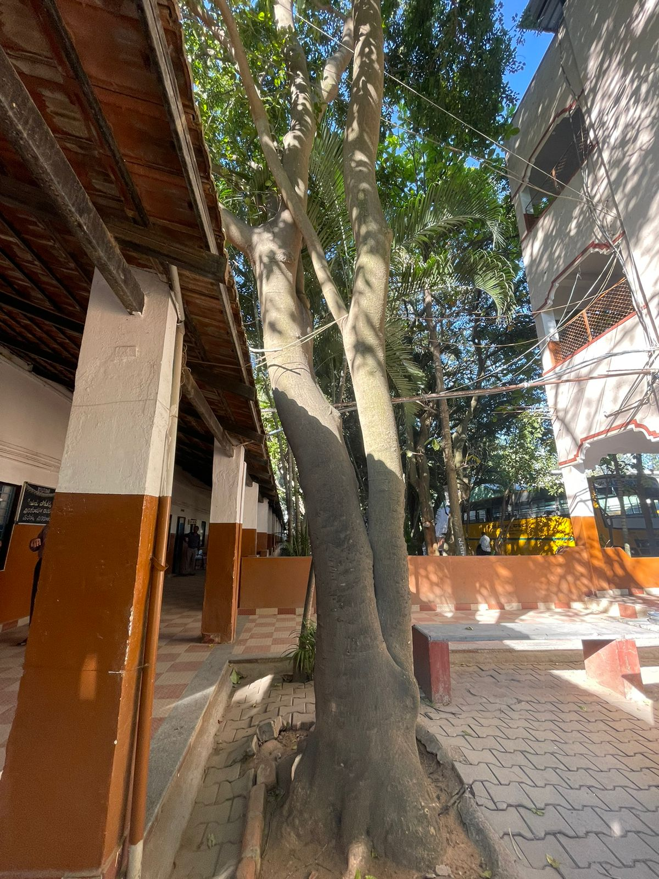
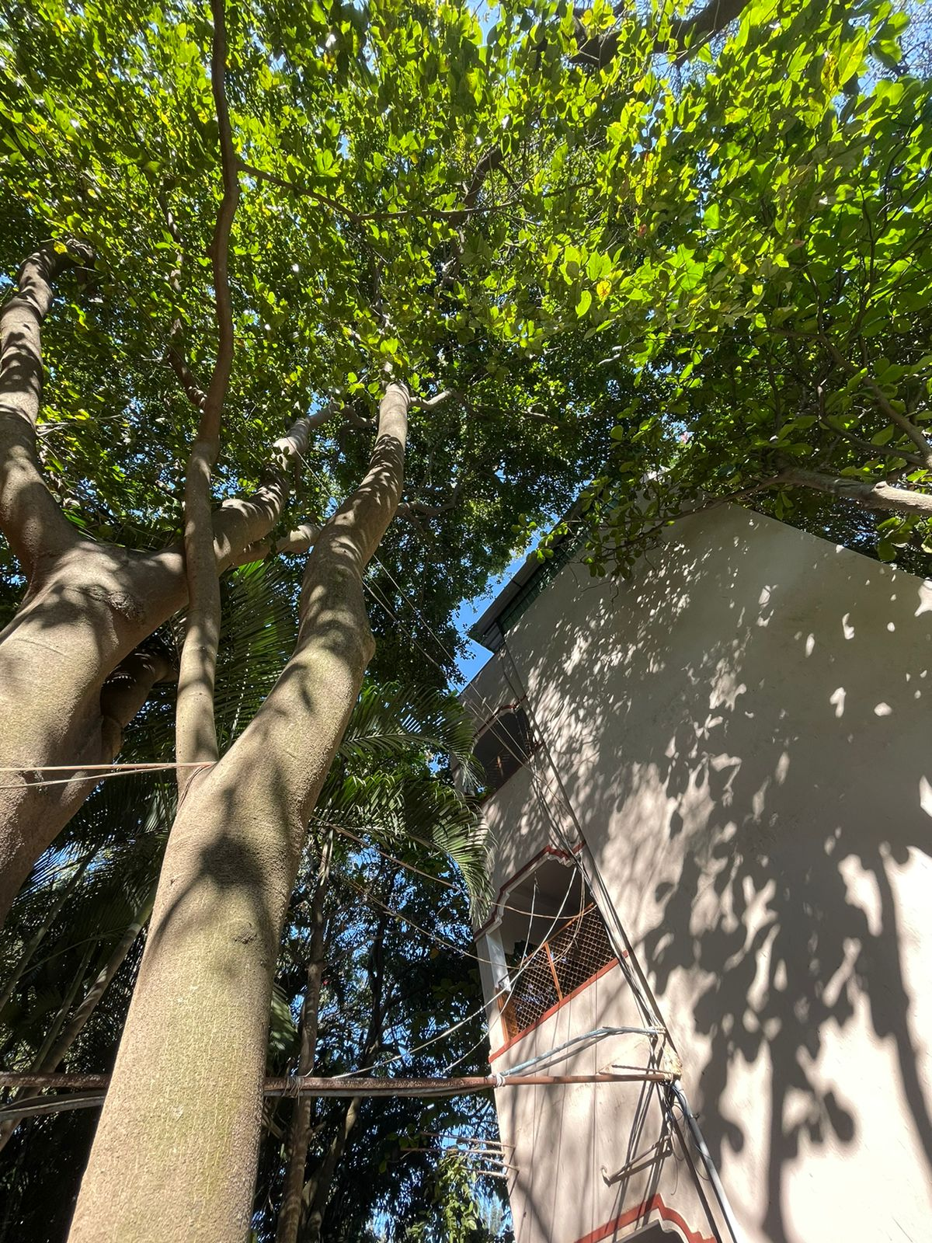
PONGAMIA TREE

Slide 13
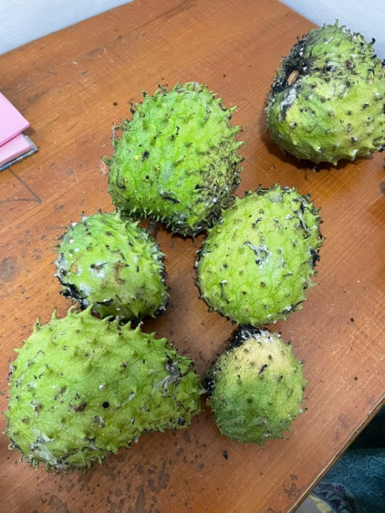
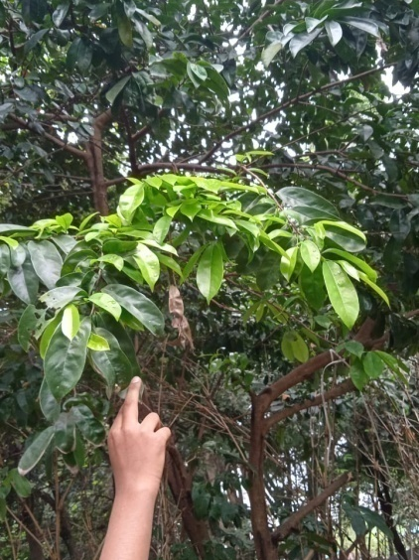
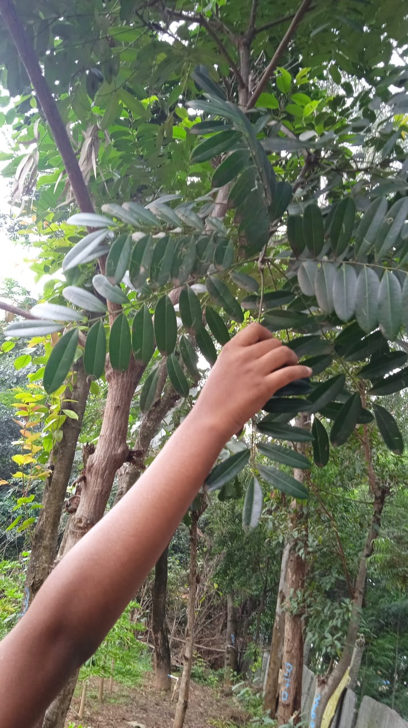
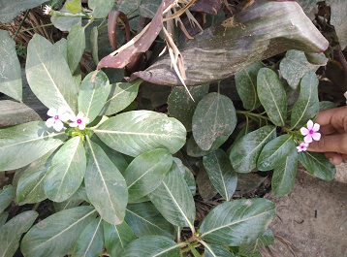
MEDICINAL PLANTS
Lakshman fruit Simarouba glauca
Vinca rosea

Slide 14
PARTS OF THE PLANT USED AS MEDICINE
PLANT | PART USED | AILMENT
Lakshman fruit | Leaves | Treatment of cancer
Simarouba | Leaves | Treatment of cancer
Vinca rosea | Leaves | Treatment of cancer
Camel foot | Bark | Treatment of stomach ailments
Guava | Leaves | Diabetes , healing of wound
Hibiscus | Flower and leaves | To lower blood pressure,dry cough, hair growth
Neem | Leaf, fruits | Treats fungal infection, control diabetes

Slide 15
RARE PLANTS

Slide 16
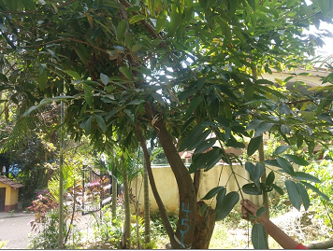
CINNAMON

Slide 17
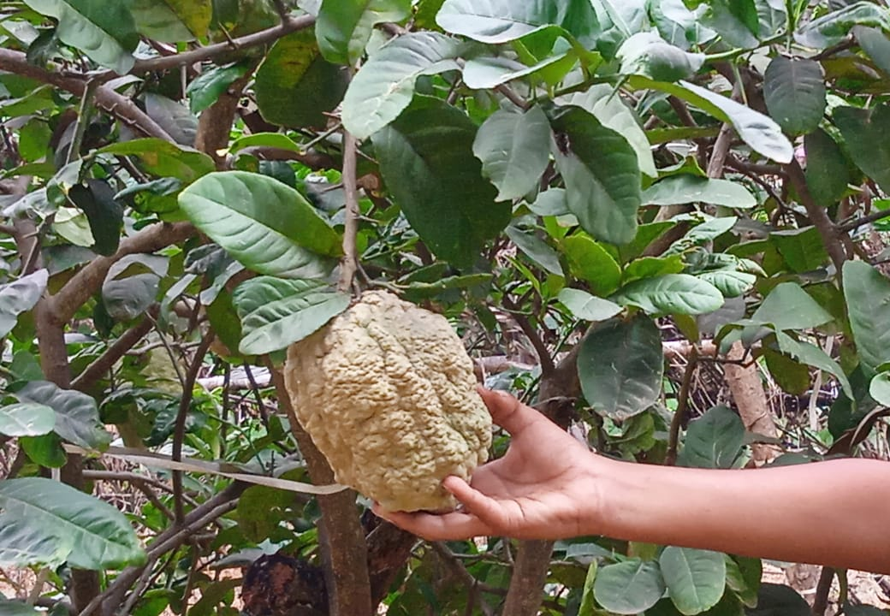
GIANT LEMON

Slide 18
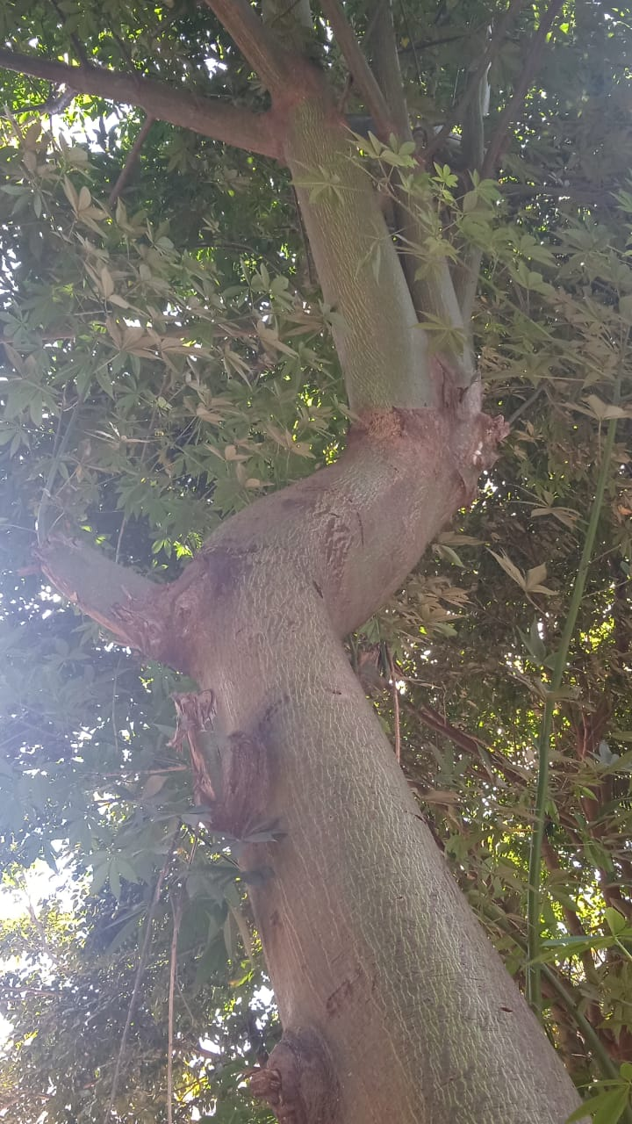
SILK COTTON TREE

Slide 19
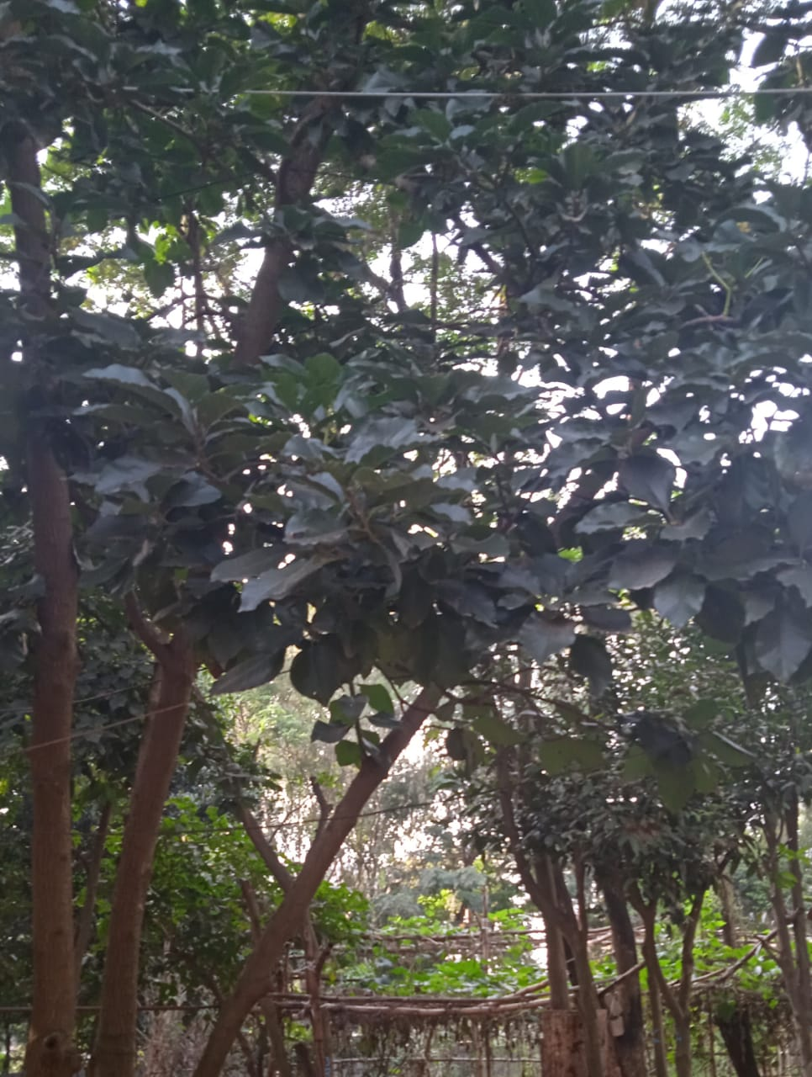
BUTTER FRUIT

Slide 20
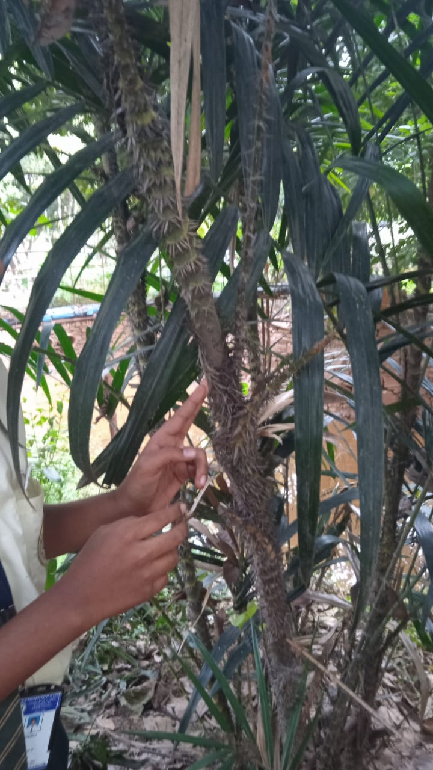
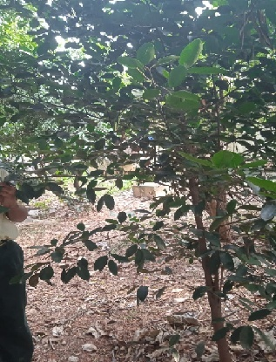
RED SANDAL WOOD CANE RATTEN
PLANT

Slide 21
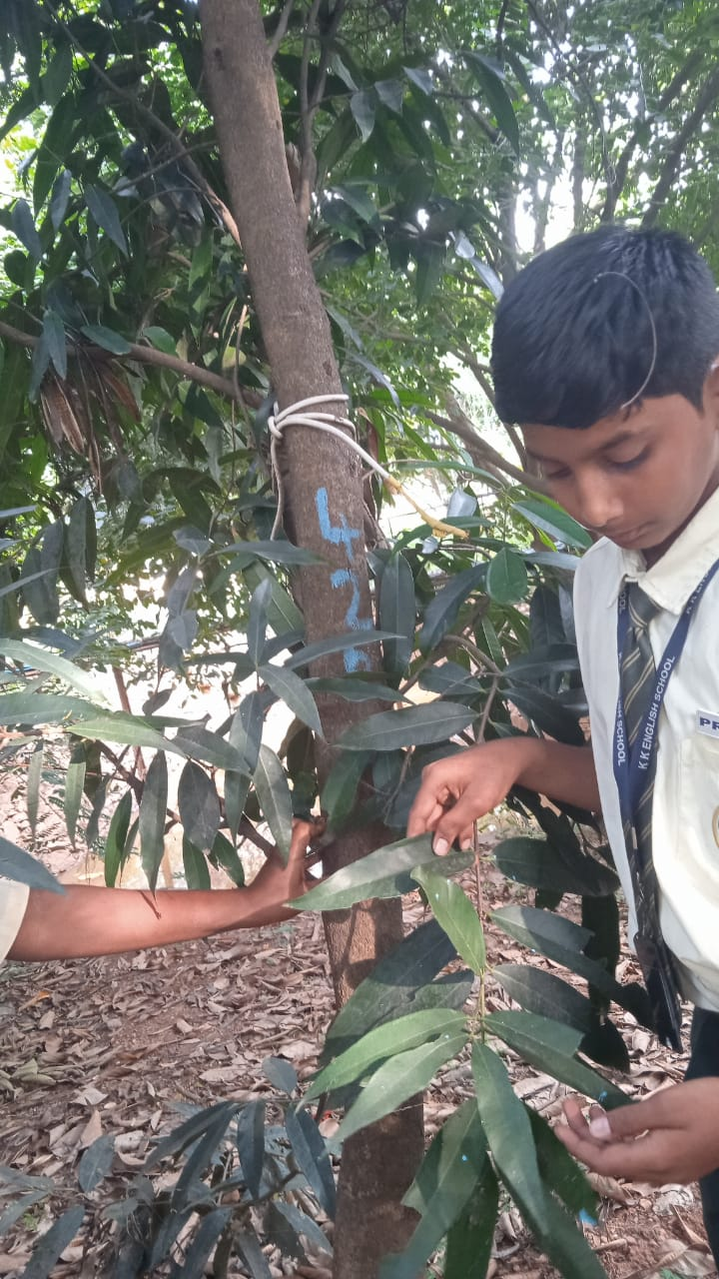
PANNERALE (Syzygium jambos)

Slide 22
CONSERVATION MEASURES
No cutting of plants
We plant and water the saplings till they grow
Eco-club members

Slide 23
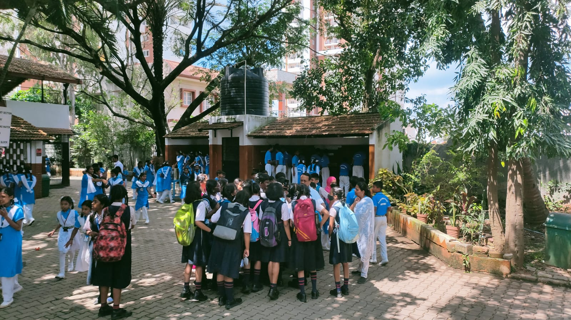
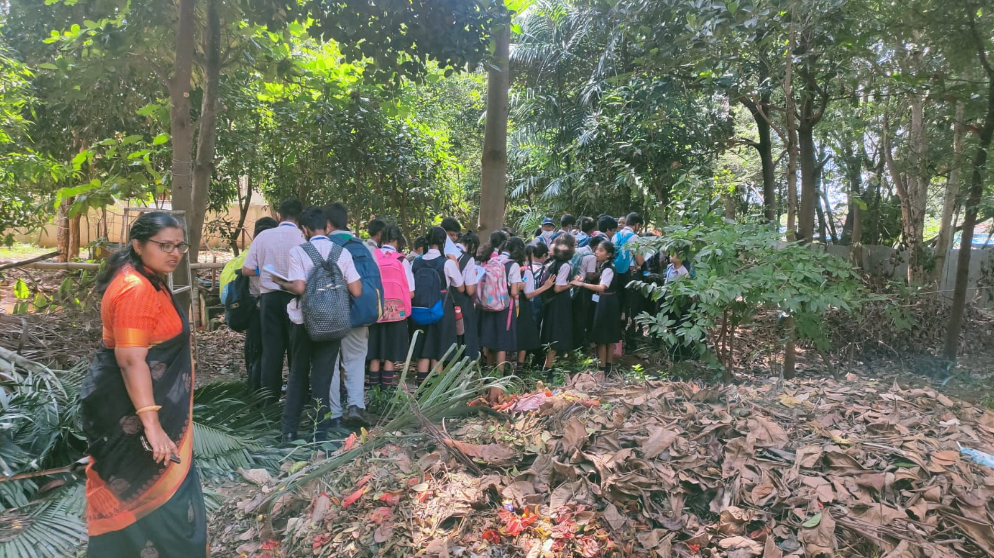
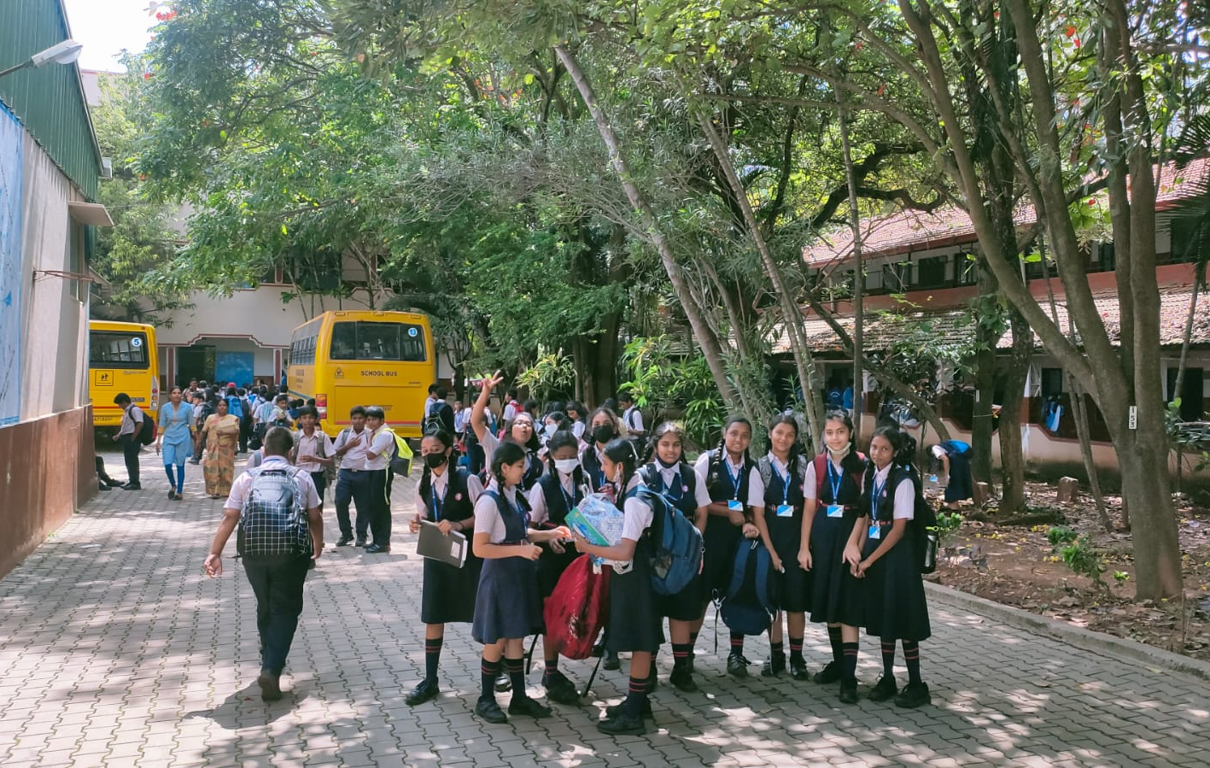
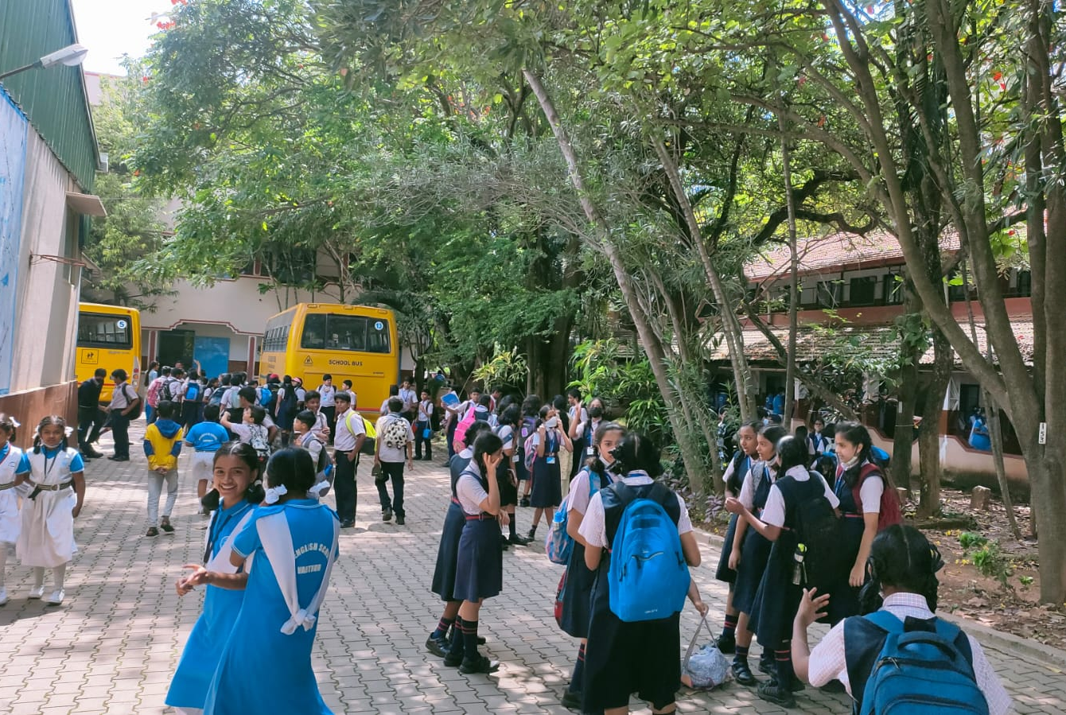
VISIT OF R V SCHOOL

Slide 24
CONCLUSION
Our school premises is much cooler
Bore-well of depth 600ft
We used to buy water during summer in the early years of our school .
Have water year through even during summer.

Slide 25
THANK YOU

