Slide 1
DIVERSITY IN ECOSYSTEM
LAVANYA G & RAMYASHREE T
9th STD, BLUEBELL PUBLIC SCHOOL ,Hosaroad, Bangalore-100

Slide 2
INTRODUCTION
Our topic is about the study of ecosystem of venkatadri lake.lts located near central jail of Bengaluru South, Parappana agrahara in hosaroad, near electronic city.
Our aim is to analyse the physical diversity in ecosystem and to analyse the variety of birds and plants and changes in the lake
Venkatadri lake is situated near central jail of Bengaluru South, in Parappana agrahara, Hosaroad , Bangalore
Lake has the foot path of 3-4m wide across its boundaries which allows us to view the lake
It’s perimeter is approximately 1.185km
The lake has the area of about 8-10 acres
It also behaves as a home for many aquatic creatures, plants , birds and many other tiny creatures
At the centre lake has the 12’52’42N longitude and 77’39’40” E latitude

Slide 3
OBJECTIVES
To study the diversity in Ecosystem of Venkatadri lake .
To analyse birds present in the lake and to study the features and habitat of birds
To analyse plants growing in the lake
To analyse the changes in venkatadri lake

Slide 4
MATERIALS AND METHODS
MATERIALS
Materials used for this project was phone to capture the images of birds and plants
We used phone to search all the requirements
METHODS
We used to go daily early in the morning around 7am to 8am we used find plenty of birds repeatedly daily sometimes we used to see new species than regular then we used to note click photographs and note down the features of birds
We used to get bad smell then we got to know about the direct underground connection there then we raised a complain and we gave awareness to BBMP People to work on it

Slide 5
MAPPING OF VENKATADRI LAKE longitude : 12'52’42 M latitude : 77°39’40” E

Slide 6
BIRD ANALYSIS
We have identified a birds by their structure, beak, feathers, wings etc . We have identified Eigh different breeds in venkatadri lake
The five different birds are :
The grey headed swamphen ( Porphyrio poliocephales)
Indian pond heron ( Ardeola Ralloides)
The Eurasian coot ( fuluca atra )
Cattle egret ( Bublucus ibis )
Green sandpaper ( Tringa ochropus)
Red wattled lapwing ( various indicus)
The black headed ibis. ( Threskiorins melanocephalus )
Black winged kite ( Elanus caeruleus )

Slide 7
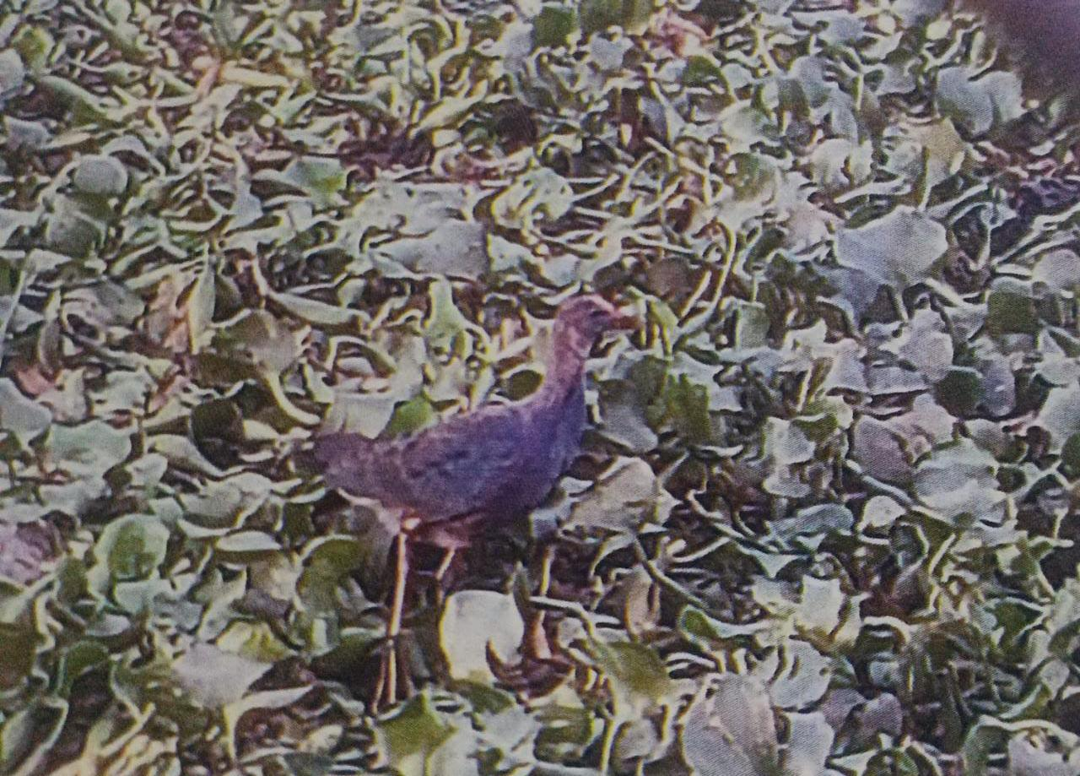
Grey headed swamphen
very large bluish-purple waterbird with a red bill and forehead shield, as well as red legs and feet with long toes.
The tail is flicked up often, revealing fluffy white “underpants.” Juveniles are duller than adults and lack the red bill and shield.

Slide 8
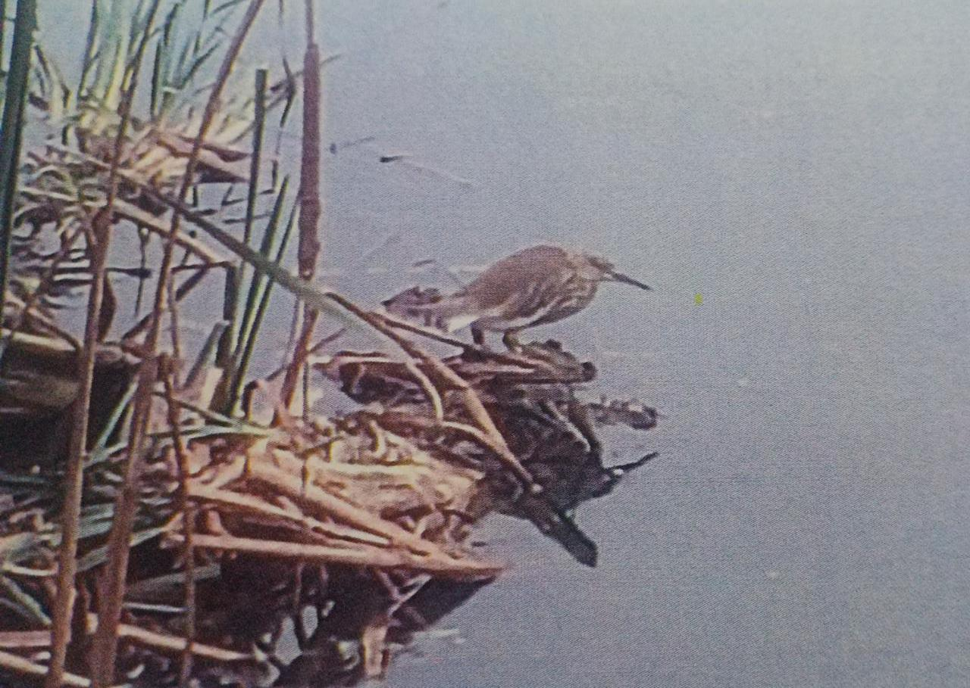
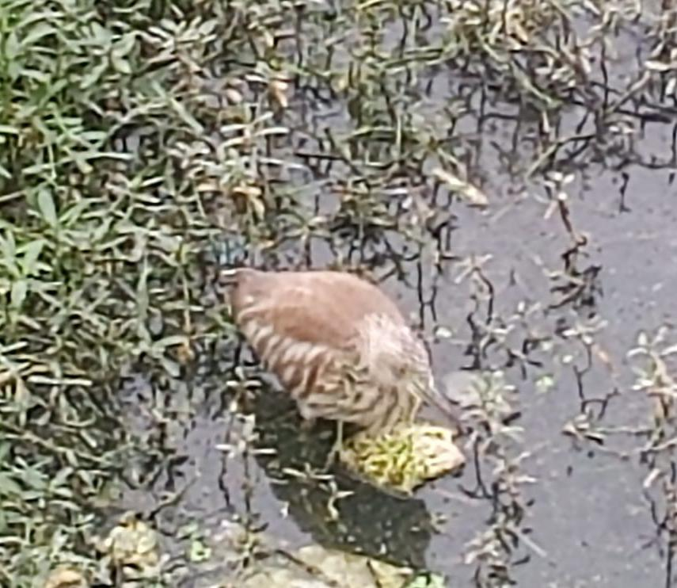
Indian pond heron
The Squacco Heron is a tawny buff brown heron with a streaked head and back, and in breeding a black and white

Slide 9
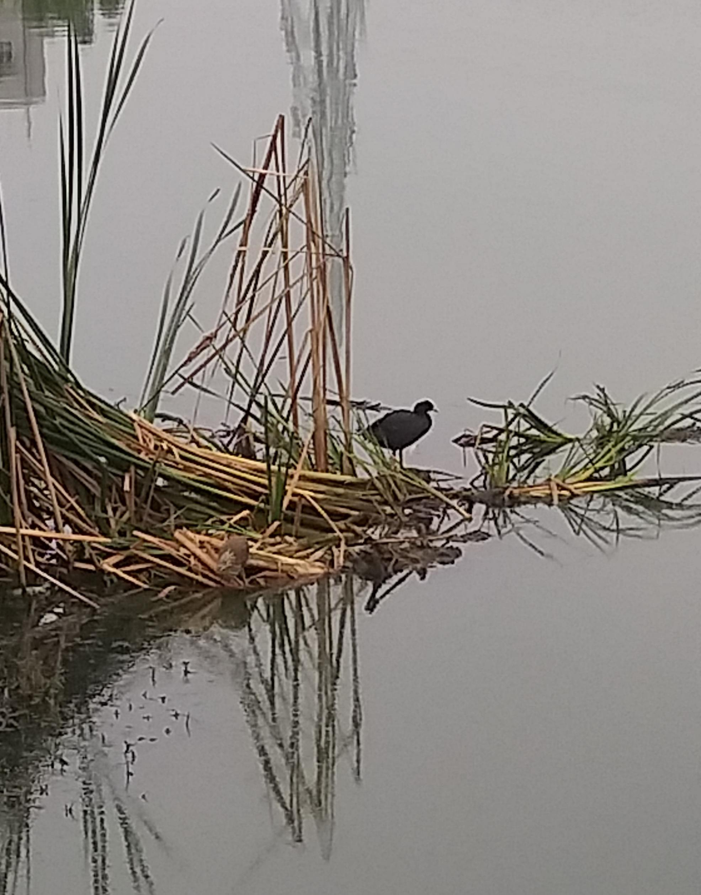
The Eurasian Coot
Distinctive stocky waterbird. Adult is dark gray overall with a white bill and forehead shield.
Immature has a pale breast and a duller bill that becomes brighter white with age.
When walking on shore, note big feet with lobed toes.
Inhabits both freshwater and brackish marshes, lakeshores, and riverways

Slide 10
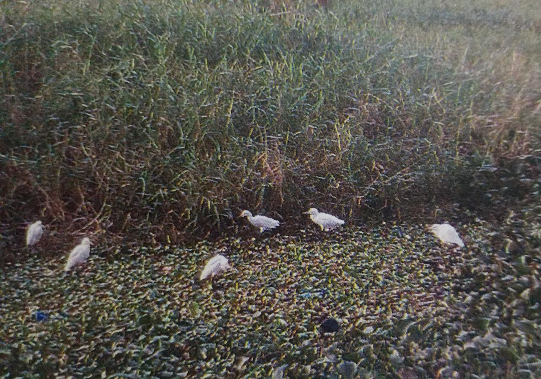
Cattle Egret
compact white heron with relatively short yellow bill.
More frequently seen in dry habitats than other egrets; rarely gets its feet wet.
In breeding season, look for pale salmon color on head and breast.
Leg color varies from reddish or yellow during the breeding season to black during the nonbreeding season.

Slide 11
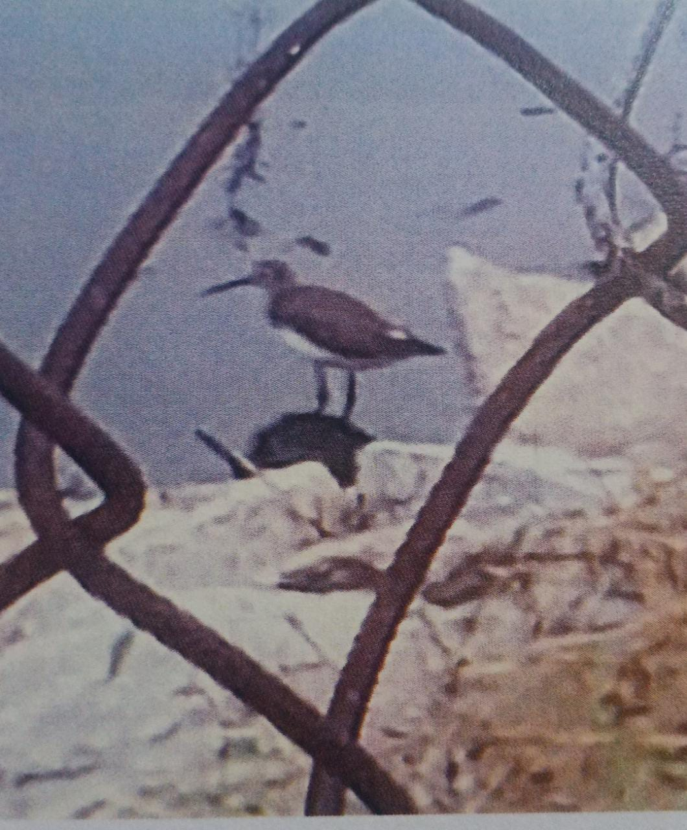
Green Sandpiper
Dark brown sandpiper with a snowy white belly.
In flight looks black above with boldly contrasting white rump.
Bobs tail when nervous, but not habitually like Common Sandpiper.
Often climbs steeply when flushed and flies quickly with deep wingbeats, swooping around a little like a swallow.

Slide 12
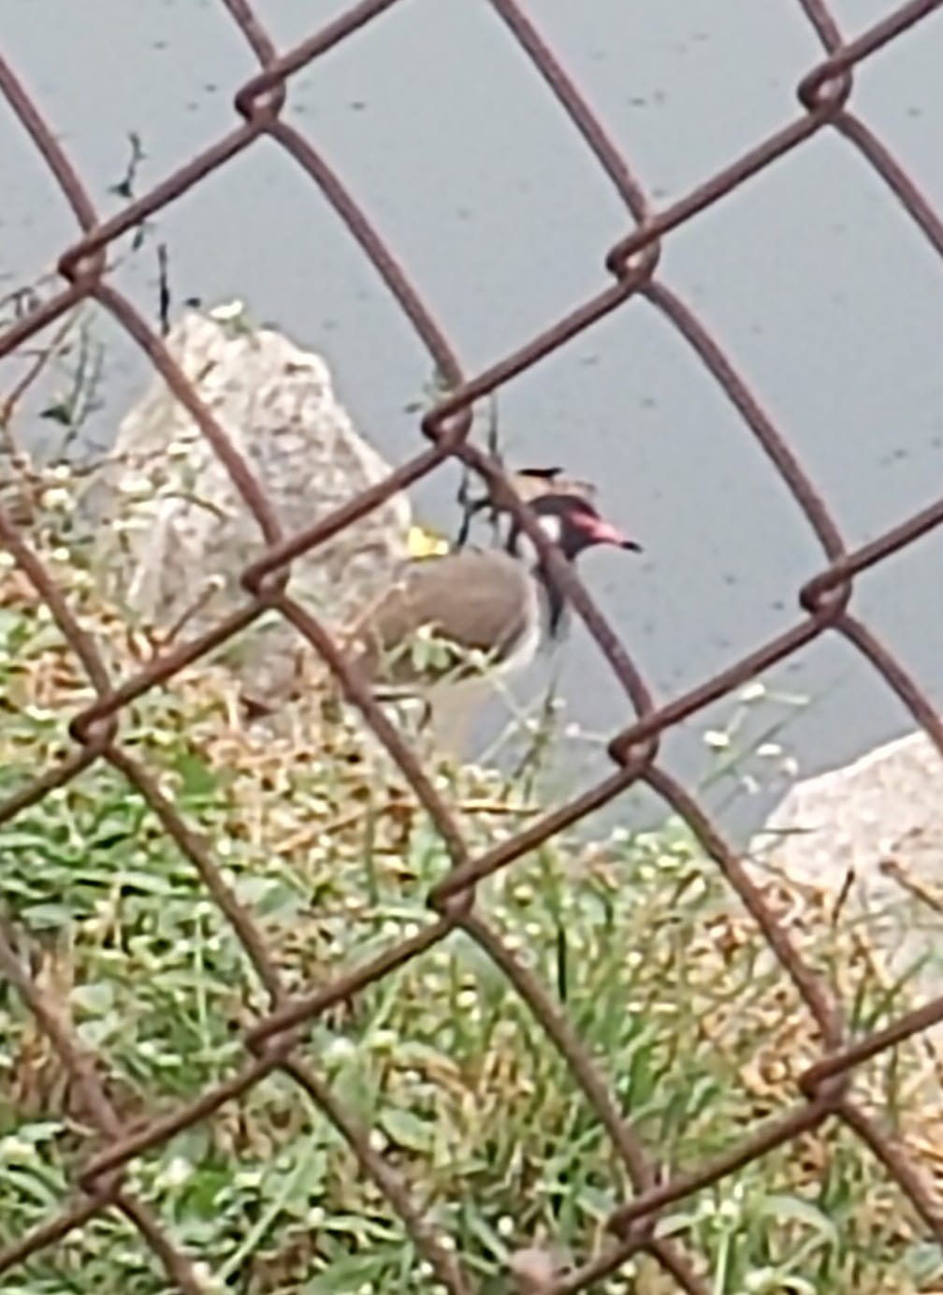
Red battled lapwing
The red-wattled lapwing is an Asian lapwing or large plover
A wader in the family Charadriidae.
Like other lapwings they are ground birds that are incapable of perching.
Their characteristic loud alarm
The cryptically patterned chicks hatch and immediately follow their parents to feed.

Slide 13
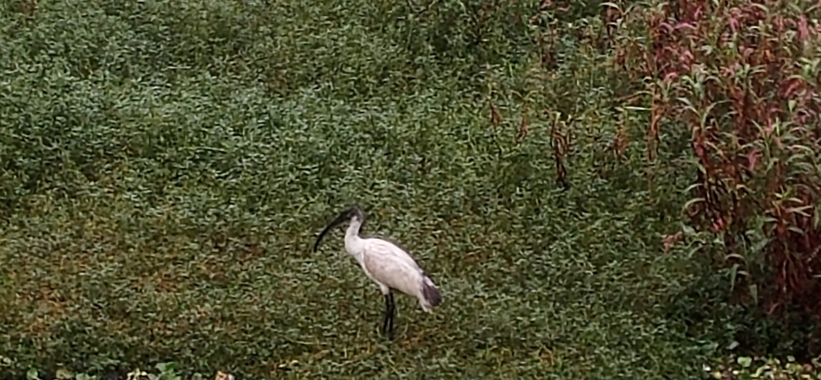
The black headed ibis
The black-headed ibis is one of several large water bird species in south and south-east Asia, with adults measuring 65–76 cm in length.
The white plumage is starkly contrasted against a conspicuous naked black neck and head, and black down-curved beak.
Tails of adults bear light grey ornamental feathers that turn jet black during the breeding season.
During the breeding season, bare patches under the wing turn blood-red. The head of some breeding adults gain a blueish tinge, or very rarely have a pink or bright red patch behind the neck

Slide 14
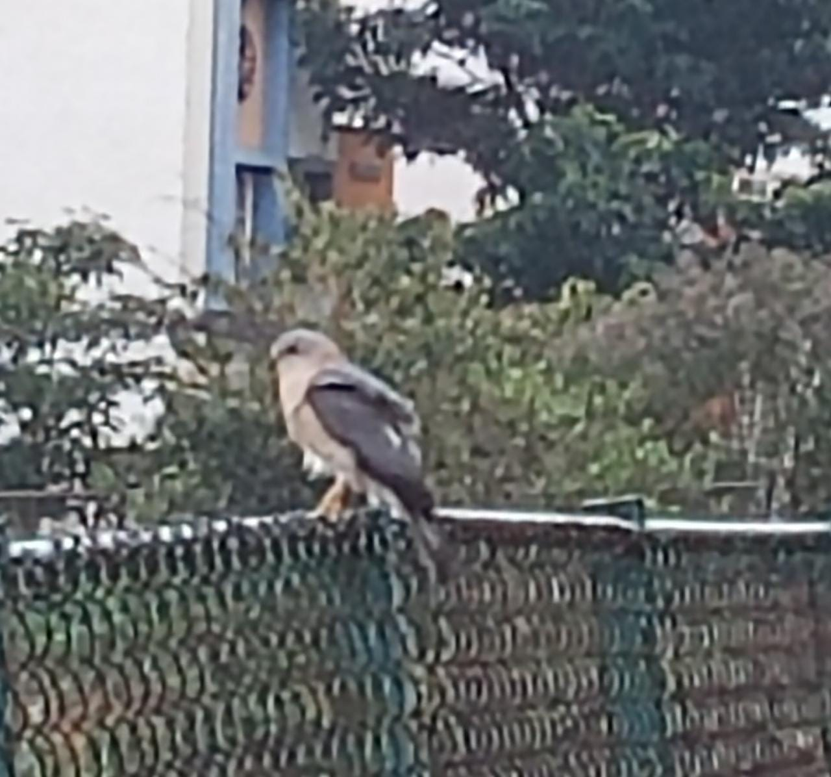
Black winged kite
The black-winged kite species primarily inhabit open savanna grasslands with scattered bushes and small trees and semi-deserts areas. They have been also seen at higher altitudes in Sikkim, Nilgiris and Nagaland.
The black-winged kite feeds on small mammals like rodents, shrews, bats and also small birds. These kites also prey upon grasshoppers, crickets and other large insects.
The black-winged kite breeding season is between February to August in the Palearctic region and in Africa and India breeding begins at the end of the wet season

Slide 15
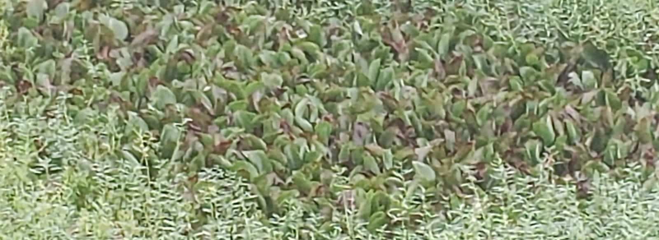
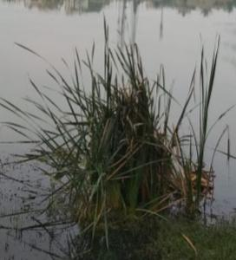
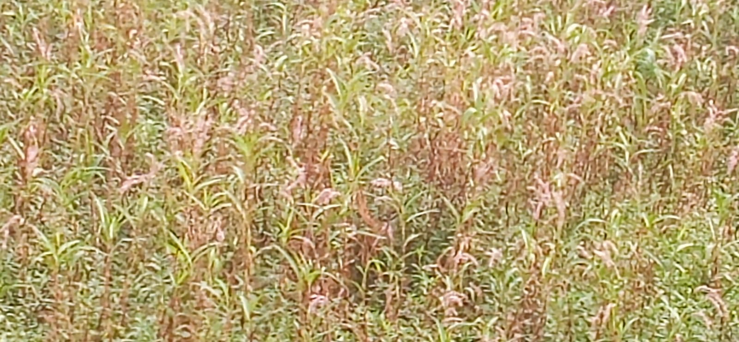
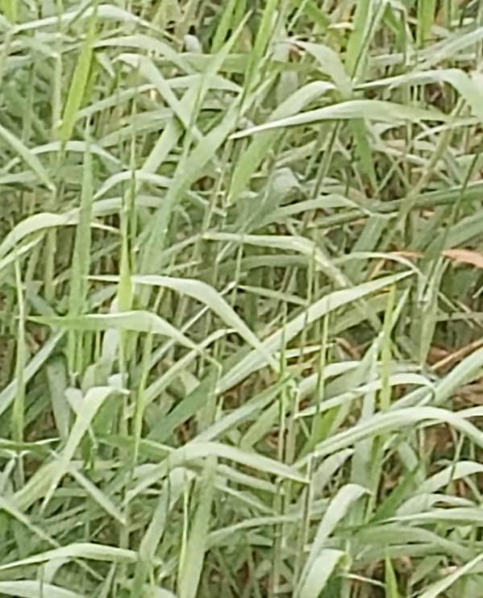
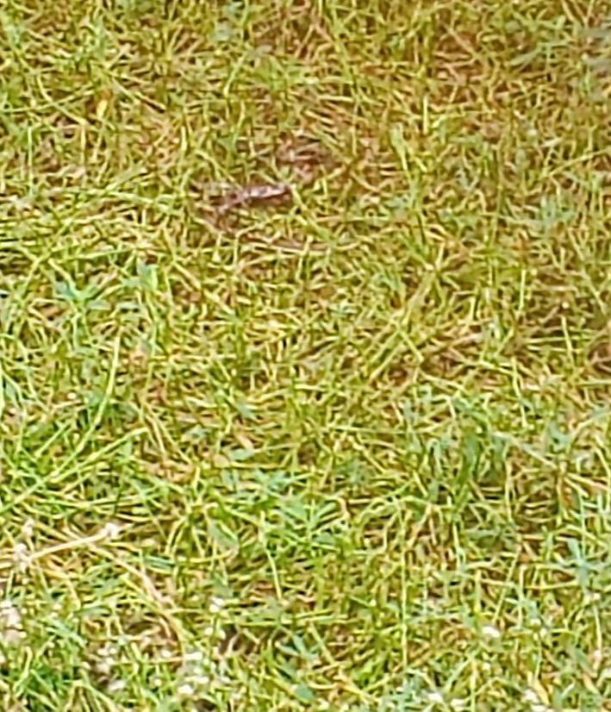
PLANTS ANALYSIS
We went to venkatadri lake to analyse some plants growing in the water we saw many different types of plants, but we were able to identify few types of aquatic plants
Pontederia Crassipes [ Eichhornia Crassipes]
Paragrass [ Brachiaria Murcia]
Polygonum glabrum willd [ Ploygonaceae ]
Ammophila breviligulata
Waternaaldkruid [ crassula hemsi ]

Slide 16
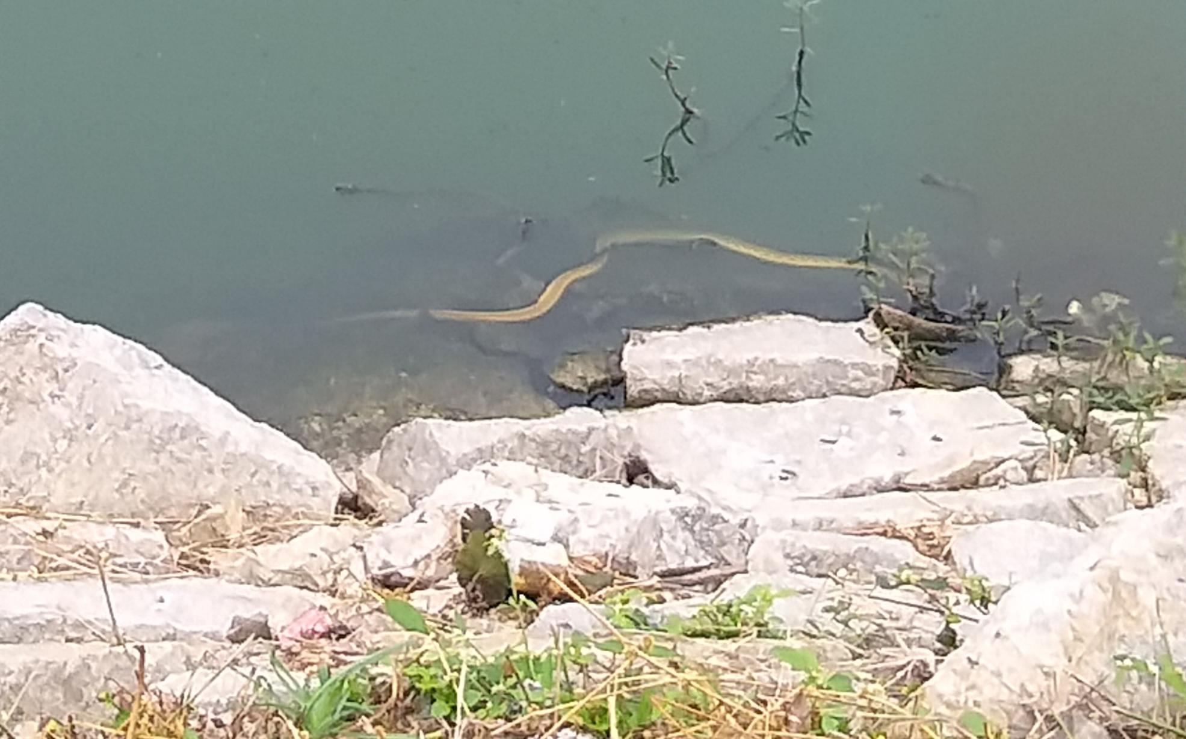
SNAKE INSECTS
We found one breed of snake during our project in venkatadri lake
The snake we found and identified was THE CHECKERED KEEL BACK
The Checkered keelback is a medium-sized nonvenomous snake coloration is very variable; it consists of dark spots arranged and often separated by a whitish network, or of black longitudinal bands on a pale ground, or of dark crossbands, with or without whitish spots.
We have found one unique type of insect which was 30% of the lake was completely filled with this . The insect was water striders
Water striders are small insects that are adapted for life on top of still water, using surface tension to their advantage so they can “walk on water.”

Slide 17
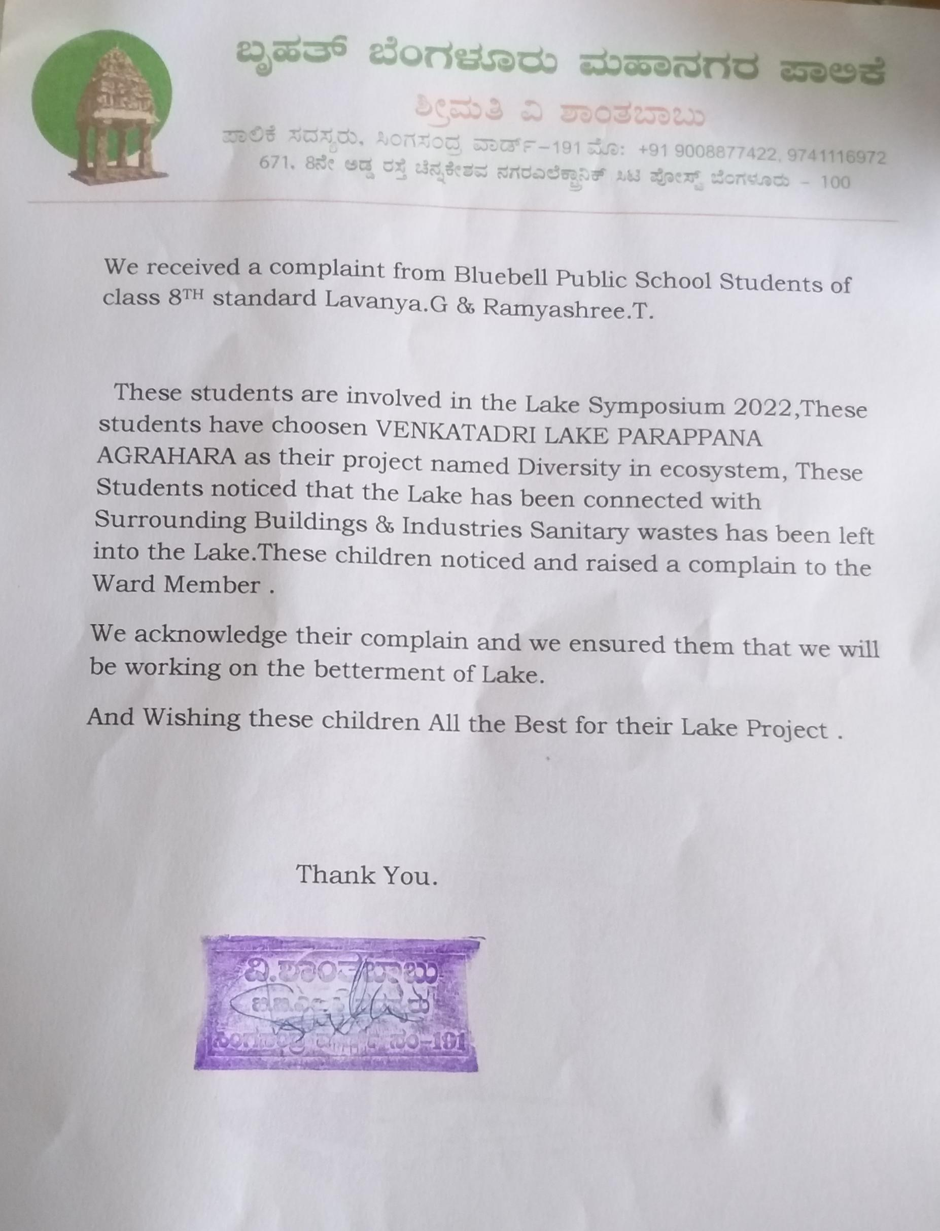
RESULT
We got to study and knew about 8 birds their features and habitats and especially name of the birds were interesting.
And we analyse and studied about 5 plants and their growth and habitat
1 Insect & 1 snake and their features.
BBMP CORPORATOR ensured us about the betterment of lake.
By this project we gained much knowledge

Slide 18
CONCLUSION
We gained much knowledge while doing this project and our mind used to be fresh whole day because frequently we used to go to lake and have a walk
Different types of birds and plants that we analysed in the venkatadri lake made us surprised and we came to know about the wide varieties of plants birds insects snakes with their habitats and also by this project we came to know that the lake is polluted we used to get bad smell near the lake when we visit lake during morning and evening hours then we noticed that few buildings and industries are directly connected with underground connection to the lake such that the lake is polluted
Then we raised the complain to the BBMP ward Corporator they analysed and assured us that they will work on the betterment of lake
Let us join our hands in and work to save the lake and the nature

Slide 19
ACKNOWLEDGEMENT
We thank our Principal and Headmistress and teachers of our school who helped us and guided us in this project successfully and supported our project
Our special thanks to our guide teachers Sonia Maam and Vaibhavi maam and our friend Deepthi Das and our Parents
We whole heartedly thank IISc team for giving us this opportunity to work on this project

Slide 20
REFERENCES
We used Google lens to identify birds and plants
Inaturalist page
Ebird. Org
wikipedia
flowerofindia

Slide 21
THANK YOU

