Slide 1

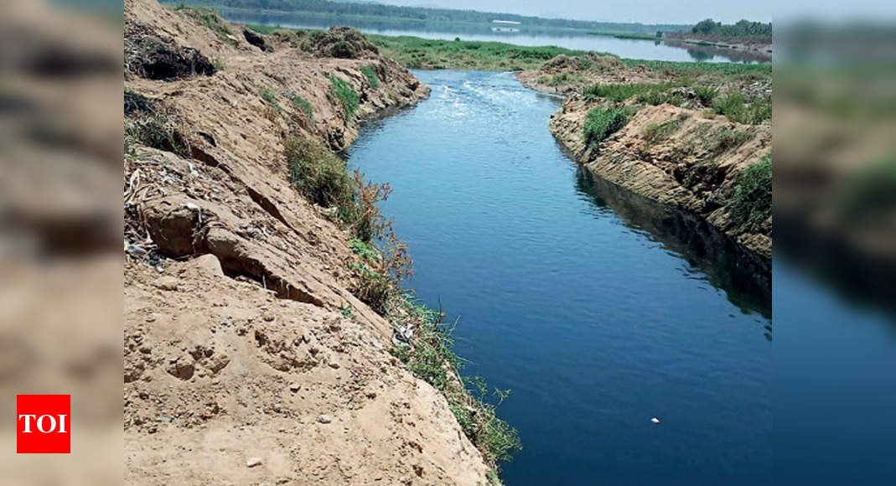


The Vrishabhavathi and bore well water quality 2014-2022
By :- Madhavi.M.G, X Std

Slide 2
INTRODUCTION
The Vrishabhavathi is a tributary of the river Arkavathi which flows in a small stretch in North Bengaluru.
It is said that the river was so clean once upon a time that it was used in temples and for drinking. But now, it has turned polluted because of the industrial and domestic pollutants dumped in it. It has turned dark and smelly because of the untreated sewage that goes into it.
The river carries domestic sewage from Bengaluru city and industrial effluents from Peenya,Yeshwanthpura, Kumbalgodu, Bidadi and Harohalli Industrial areas.

Slide 3
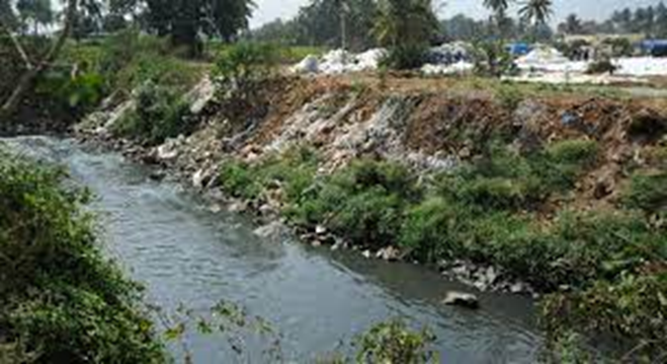
Bore wells are one of the resources for water. The water in bore wells is contributed by the percolation of rain water and other water bodies. If the water bodies near the bore-well are polluted, the chemicals may seep in the ground and affect the quality of ground water.
The bore well quality affects the health of the people. My family is experiencing the stench for the past 16 odd years. In our areas, none of the residents uses bore well water for cooking. However, the intensity of the stench has come down marginally of late.

Slide 4
OBJECTIVES
To find out how concerned the authorities are about the Vrishabhavati
To understand various activities of restoration undertaken by the authorities
To know if there is any major change after the restoration works, in bore-well water quality .

Slide 5
RESTORATION WORK SINCE 2014
Since I did not get a proper list, I just copied some headlines of articles appeared in online news. All the below articles show that there are umpteen number of concerns raised from all sectors about the river.
“The state government missed the deadline of Dec. 2020 for commissioning of Sewage treatment plants in the valley”
“KSPCB has set up a committee that is working towards safeguarding Vrushabhavathi valley from pollution. The committee is headed by the KSPCB member-secretary and includes a representative from CREDAI, a wastewater engineering expert and Namami Vrishabhavathi Foundation member, Niveditha Sunkad”

Slide 6
“In July 2021, Minister for Environment and Tourism C P Yogeeshwara announced a Rs. 1500 crores scheme for the rejuvenation of the river. The scheme aims to treat 1,500 MLD of waste water scientifically in three stages to fill tanks and lakes in the area so it can be used for agricultural purposes by the farmers.24-Feb-2022”
“16-Jun-2021 — In order to rejuvenate the river, the two main issues like disposal of effluent, both domestic and industrial waste water, and solid waste ..”
“The Karnataka State Pollution Control Board (KSPCB) has warned against illegal dumping and discharge of industrial waste into the river. Shiva Kumar, an official from the KSPCB said, “there has been illegal entry of sewage from the city and a few industries are not abiding by the regulations of KSPCB and are dumping their untreated waste into the river water.”

Slide 7
“September 27 2022- The Bangalore Water Supply and Sewage Board (BWSSB) has invested Rs 500 crores for new Sewage Treatment Plants(STPs) that will ensure that no sewage discharge flows into the Vrishabhavathi river by 2024.”
“A PIL has been filed vide no. W.P. No. 6961/2020 dated 12.10.2020 by Honourable High Court of Karnataka in respect of pollution caused to Vrishabhavathi River Valley in the jurisdiction of Bengaluru city.”
“Honourable High Court of Karnataka had given directions to appoint CSIR-National Environmental Engineering Research Institute (NEERI) to study the causes/reasons of pollution to Vrishabhavathi River Valley and methodology to be adopted for its protection, restoration and rejuvenation.”
“There are 3,304 industries along the river area out of which, 1396 are violating the KSPCB treatment schemes norms by discharging untreated waste into the stream. So far action has been taken against 1476 factories and criminal action against 77 factories.”

Slide 8

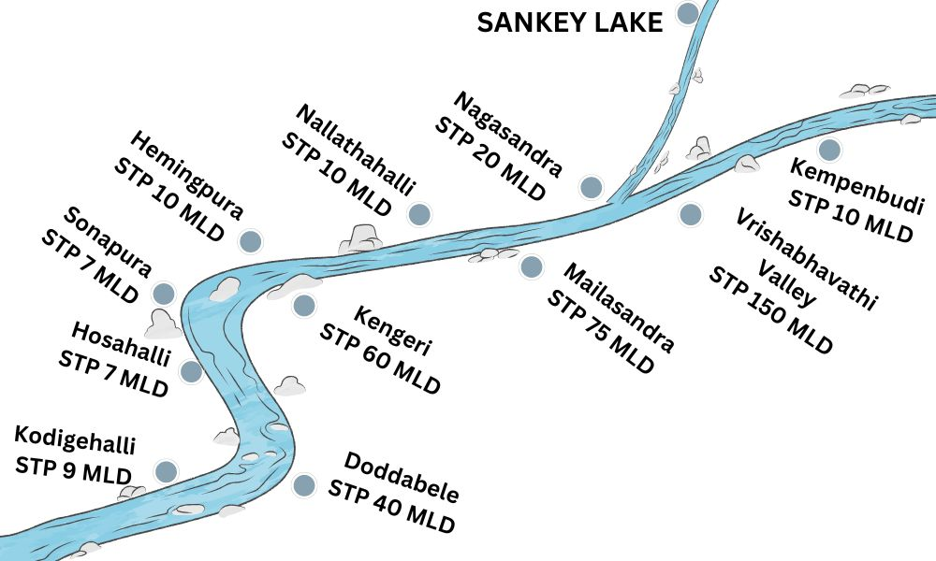
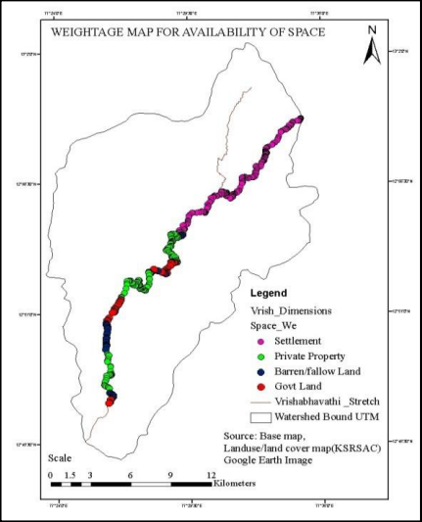
STPs
Map of Vrishabhavathi

Slide 9
MATERIALS AND METHODS
COLLECTED BOREWELL WATER SAMPLES FROM 13 DIFFERENT HOUSES
CONDUCTED A SURVEY AMONG THE RESIDENTS (DETAILS ARE GIVEN IN SLIDE-)
USED WATER TESTING KIT (NICE CHEMICALS) FOR THE ESTIMATION OF NITRATE, NITRITE AND AMMONIUM.
CONDUCTED TEST IN THE SCIENCE LAB (USED NITRATE REAGENT 1 AND 2, NITRITE REAGENT 1, AMMONIUM REAGENT 1)
COMPARED THE RESULTS WITH THE COLOUR CHART GIVEN ALONG WITH THE KIT.

Slide 10
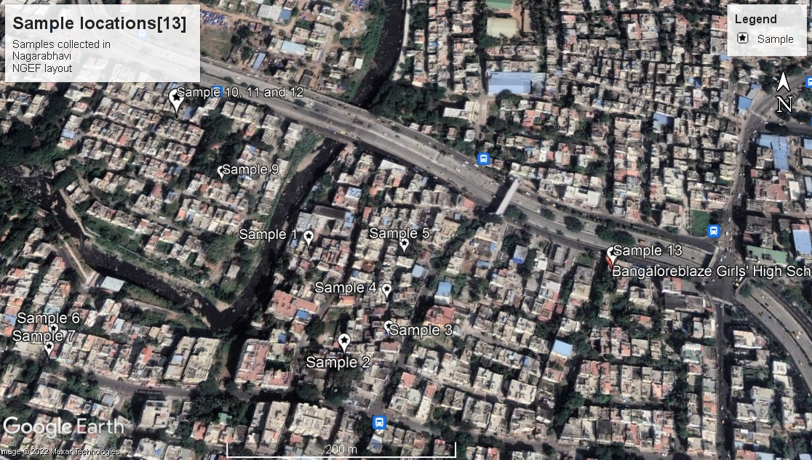
Locations of the samples collected [13 samples]

Slide 11
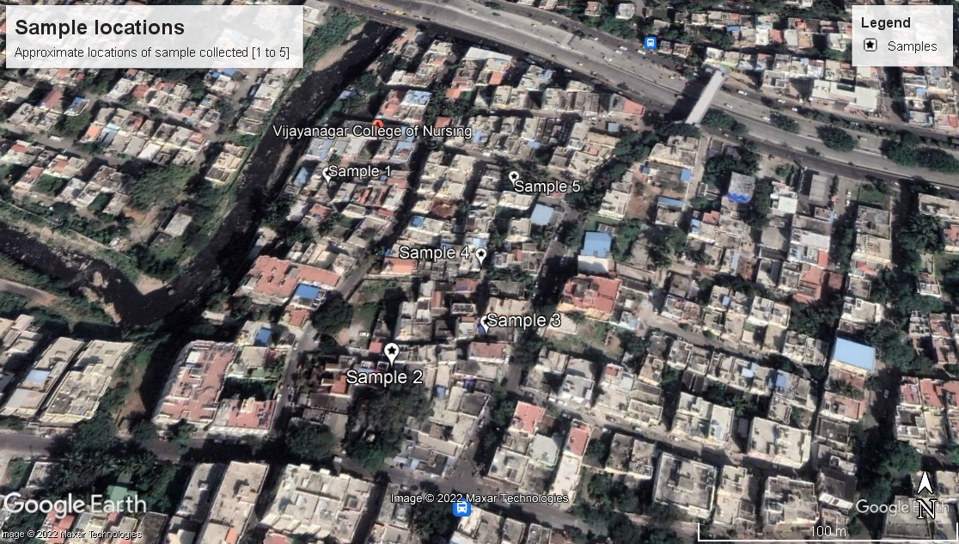
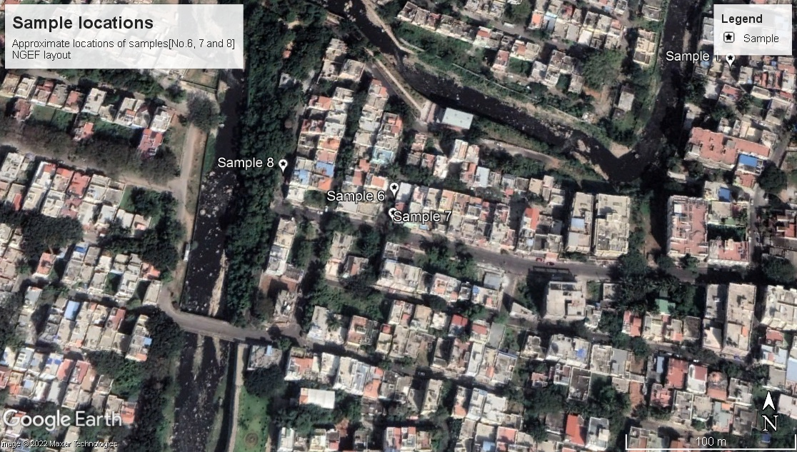
Nagarabhavi
NGEF layout

Slide 12
Procedure for testing Nitrates
Step 1- Take 10 ml of water sample in a test tube
Step 2- Add a pinch of nitrate reagent 1 (NA1) to this sample and agitate the solution for 5 minutes
Step 3- Allow the stirred sample for few minutes and decant the supernatant solution (about 5 ml) to another test tube
Step 4- Add 3 drops of nitrate reagent to (NA2) to the supernatant solution and mix well. Wait for 5 minutes withy occasional shaking. The final colour that forms is compared with the nitrate colour chart and the value is recorded.

Slide 13
Procedure for testing Nitrites
Step 1- Take 5ml of water sample in a test tube.
Step 2- Add 3 drops of nitrite reagent 1 (NI 1) and mix well. Wait for 1 minute with occasional shaking. The final colour that forms is compared with nitrite colour chart and value is recorded.

Slide 14
Procedure for testing Ammonia
Step 1- Take 5ml of water sample in a test tube.
Step 2- Add 5 drops of ammonium reagent1 (NH1) and mix well. The colour that forms is compared with ammonium colour chart immediately and value is recorded.

Slide 15
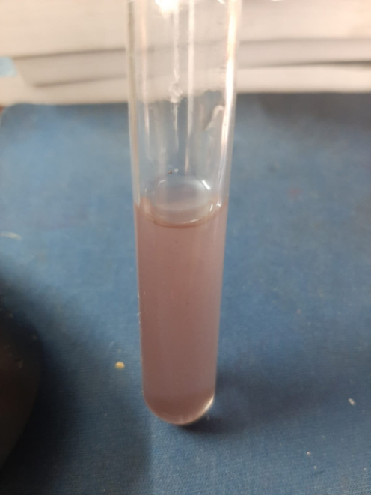
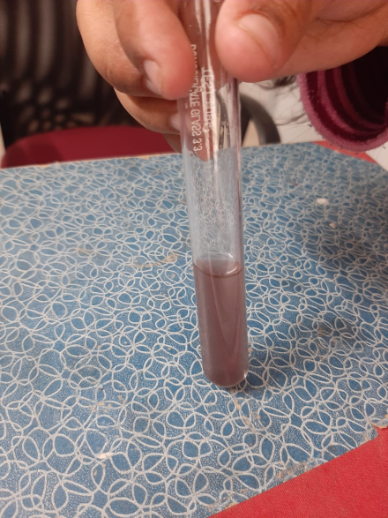
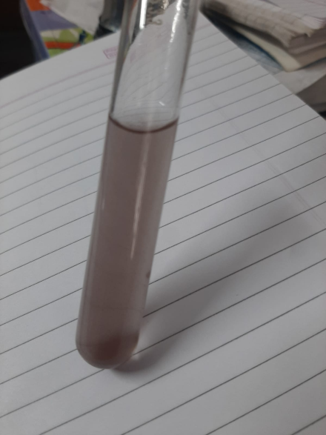
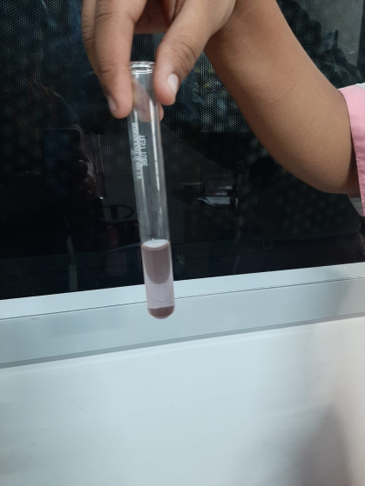
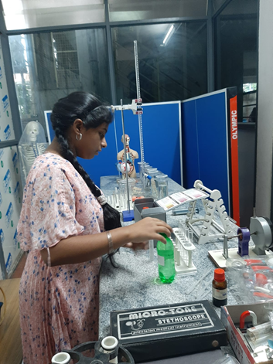
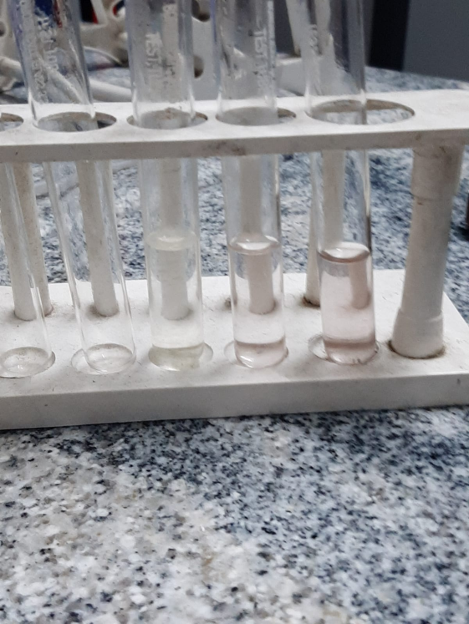
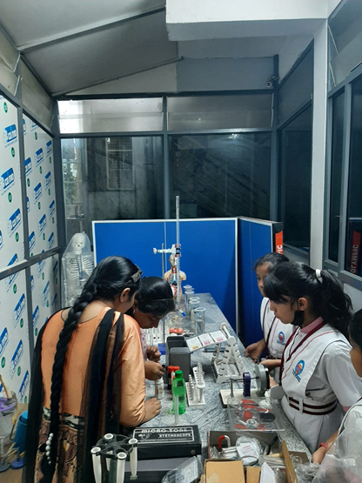
Sample 10
NI-0.5ppm
Sample 11
NI- 0.7 ppm
Sample 5
NA- 5ppm
Sample 8
NI- 0.4 ppm

Slide 16
Summary of the study conducted (by our seniors) on bore-well water quality near the Vrishabhavati - 2014
TOTAL NUMBER OF SAMPLES STUDIED-17
SAMPLE CHECKED FOR:17 | NITRATE | NITRITE | AMMONIUM
0-3 ppm | 3 | - | -
4-5 ppm | 10 | - | -
10 ppm | 2 | - | -
11-20 ppm | 1 | - | -
21-50 ppm | 1 | - | -
0.1-0.3 ppm | - | 11 | 15
0.4-0.5 ppm | - | 6 | 2
0.5+ ppm | - | 0 | 0
0.10 + ppm | - | 0 | 0

Slide 17
Summary of the study conducted on bore-well water quality near the Vrishabhavathi - 2022
TOTAL NUMBER OF SAMPLES STUDIED-13
SAMPLE CHECKED FOR:1 | NITRATE | NITRITE | AMMONIUM
0-3 ppm | 11 | - | -
4-5 ppm | 2 | - | -
10 ppm | 0 | - | -
11-20 ppm | 0 | - | -
21-50 ppm | 0 | - | -
0.1-0.3 ppm | - | 6 | 9
0.4-0.5 ppm | - | 7 | 4
0.5+ ppm | - | 0 | 0
0.10 + ppm | - | 0 | 0

Slide 18
COMPARISON OF RESULTS
NITRATE |  | NITRITE |  | AMMONIUM
2014 | 2022 | 2014 | 2022 | 2014 | 2022
0-3 ppm - 3 | 0-3 ppm -11 | 0.1-0.3 ppm -11 | 0.1-0.3 ppm -6 | 0.1-0.3 ppm -15 | 0.1-0.3 ppm -9
4-5 ppm -10 | 4-5 ppm -2 | 0.4-.5 ppm -6 | 0.4-0.5 ppm -6 | 0.4-0.5 ppm -2 | 0.4-0.5 ppm -4
10 ppm -2 | 10 ppm - 0 | 0.5+ ppm -0 | 0.5+ ppm -1 | 0.5+ ppm - 0 | 0.5+ ppm -0
11-20 ppm -1 | 11-20 ppm -0 | 0.10 + ppm -0 | 0.10 + ppm -0 | 0.10 + ppm -0 | 0.10 + ppm -0
21-50 ppm -1 | 21-50 ppm -0
OBSERVARTION :- 1. REDUCTION IN THE CONCENTRATION OF NITRATE. 2. MARGINAL INCREASE IN NITRITE (0.4-0.5), (0.5-1) (2014-35%, 2022- 53%) 3. MARGINAL INCREASE IN AMMONIUM - (0.4- 0.5) (2014- 11%, 2022 -30%)

Slide 19
QUESTIONNAIRE
Area &House number:
Name of the resident:
Educational background:
No.of members in the family:
Residing in the area since ________months/years
Reason for shifting to the present address is- water scarcity in previous place / job / personal
Have bore well / well / others as water source for drinking
Have bore well/ well / others as water source for bathing
Well unusable since________months / years
Reason for not using well:
Changes observed in colour / taste / smell-(specify)
Water related illness (if any):
Water supply available 24 hours: Yes/no
Well / bore well / tank / pond/ river as source of water for cooking.
Have terrace garden: yes/no
Have vegetable garden: yes/no

Slide 20
Rainwater harvesting/ bore well recharge done:
Have noticed the increase in a particular type of insect: yes/no
If yes, specify:
Have noticed the increase in a particular type of plant: yes/no
If yes, specify:
Was /is depending on the river water for agriculture
No.of trees in the premise:
No of trees outside the premise :
Kind of trees abundant:
Type of birds spotted:
Located more cats / dogs / in the location
No. of industries / factories in the vicinity: (specify)
Distance from Vrushabhavathi river:_________ m/km
Any kind of mental illness/congenital disorder reported: yes / no
Water sample collected with specimen number: yes/no. If yes, specimen number____
Signature of the resident:

Slide 21
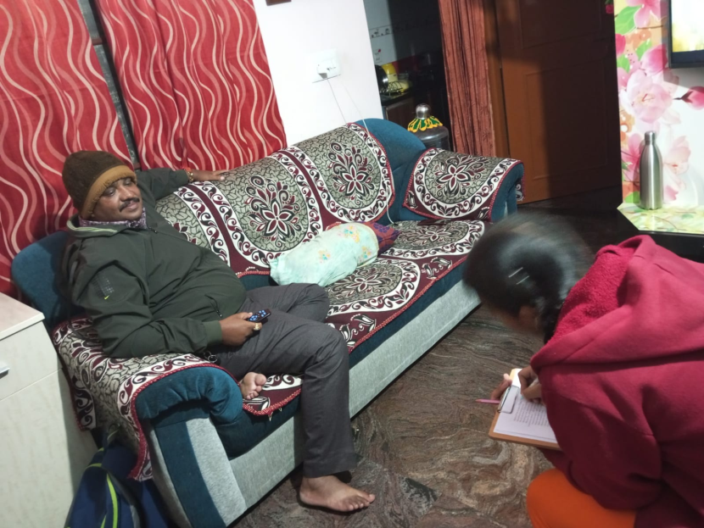
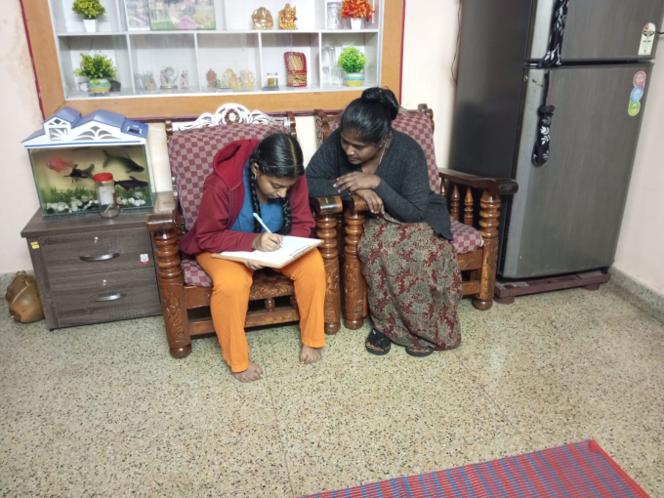
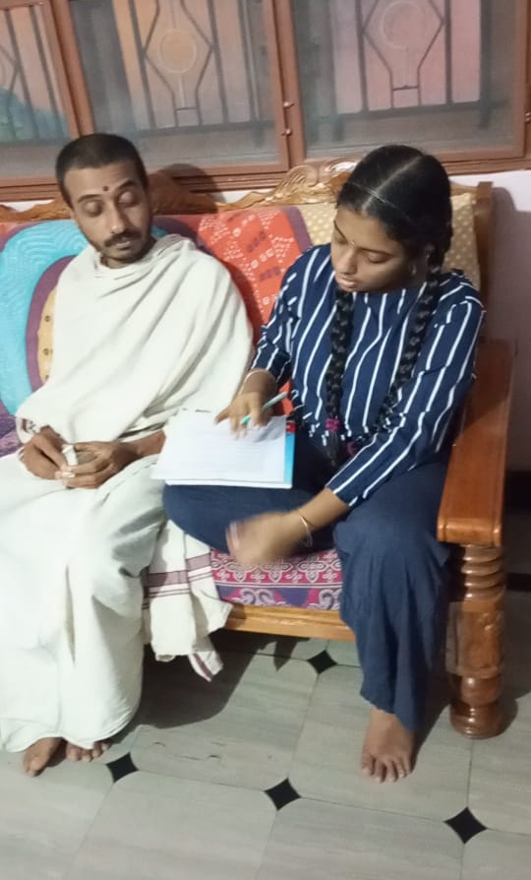
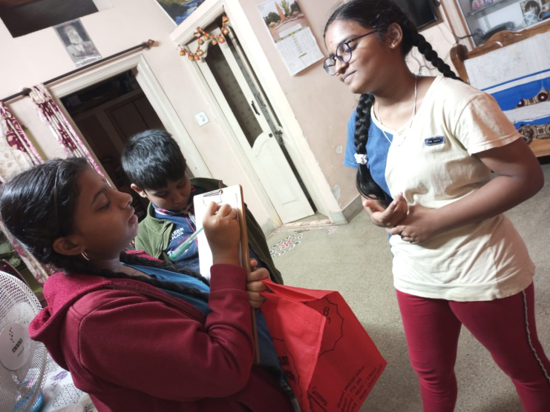
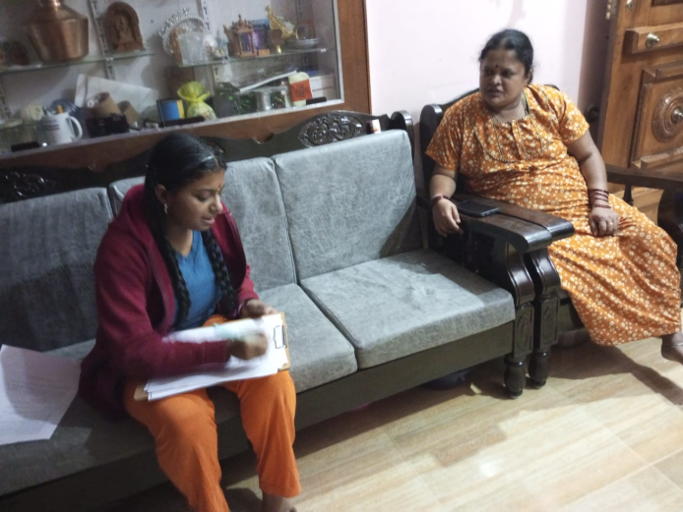
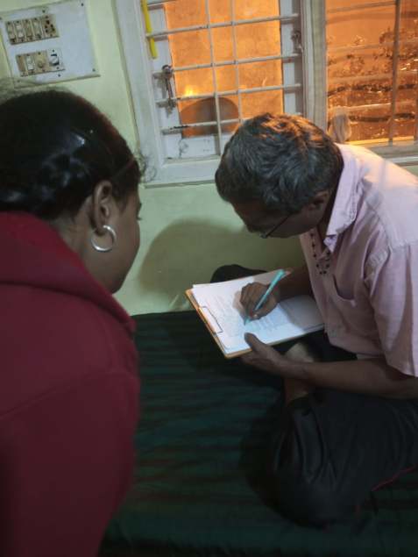
Conducting survey

Slide 22
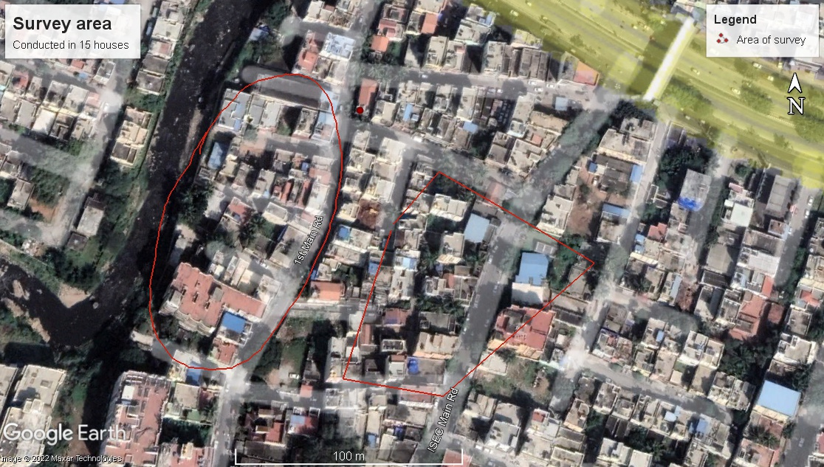
Survey location
Conducted in Nagarabhavi Village

Slide 23
SURVEY REPORT - 2014
Observation
Difference in colour of water- 1
Difference in taste – 5
Increase in a particular insect- mosquitoes and cockroaches (an indication of unhygienic surroundings)
Animals found in abundance- dogs
Birds found in the locality- egrets, crow, pigeons, kites
Depending on corporation water for daily chores like bathing and washing- 4 houses (13 houses depend on borewell /well)
Depending on corporation water for drinking cooking- 4 houses (13 houses depend on borewell/ well)

Slide 24
SURVEY REPORT – 2022 (total 15 houses)
Observation
Difference in colour of water- not noticed
Difference in taste – not noticed
Increase in a particular insect- mosquitoes (an indication of stagnant water in surroundings)
Animals found in abundance- dogs
Birds found in the locality- eagle, crow, pigeons, kites, red whiskered bulbul, cuckoo
Depending on corporation water for daily chores like bathing and washing- 9 houses (6 houses depend on borewell /well)
Depending on corporation water for drinking and cooking- 12 houses (3 houses depend on borewell/ well)

Slide 25
Comparison of the surveys
Reduction in cockroaches
Birds like cuckoo, red whiskered bulbul were not recorded in the previous survey. And, egrets were not reported in the present survey. Urbanization can be one of the reasons for the decrease in the population of birds.
Those who have bore-well still uses the water for bathing and washing but use corporation water for cooking
Major complaint was that number of plants reduced over these years. But, they found the area cleaner compared to previous years

Slide 26
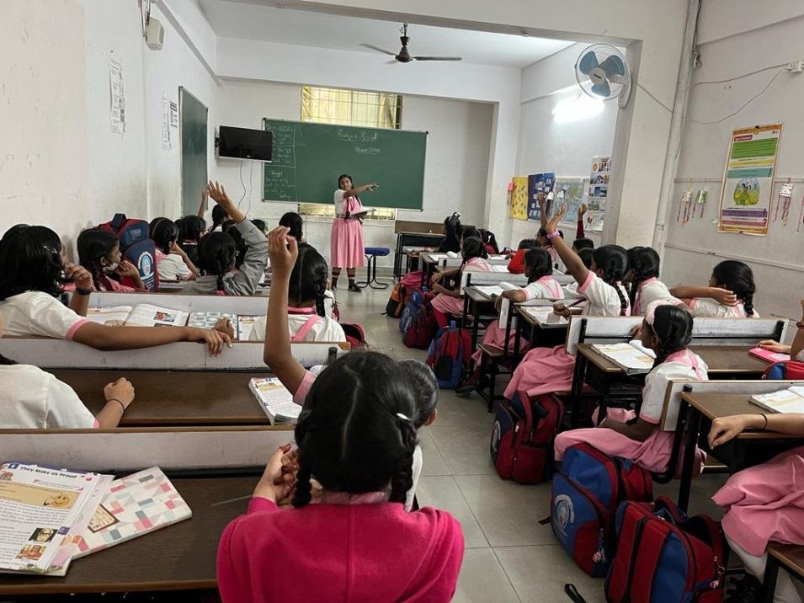
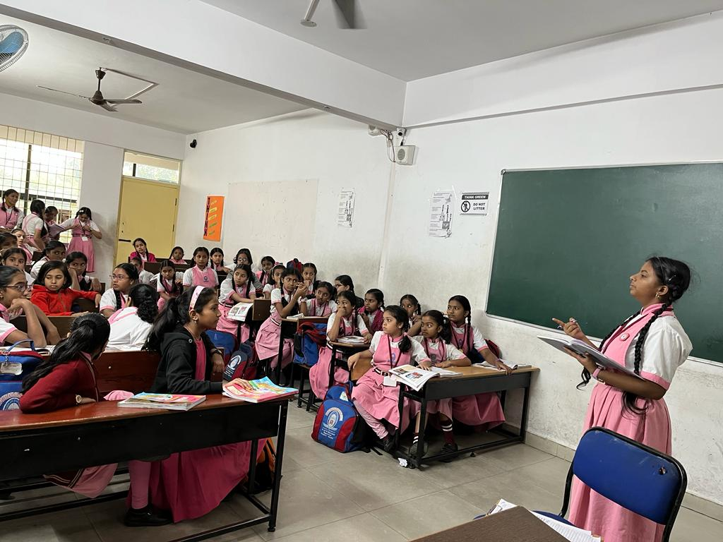
SURVEY CONDUCTED IN SCHOOL (V TO X STD= 220)
NUMBER OF STUDENT LIVING NEAR VRISHABHAVATHI RIVER – 55
HOW MANY OWN THE HOUSE MORE THAN 10 YEARS – 19
HOW MANY USE BOREWELL- 11

Slide 27
CONCLUSION
There are indeed some kind of work happening but at a very slow pace
The higher levels of ammonia and nitrites indicate that the river is still getting polluted with sewage and agricultural run off.
Nitrates were found less. This could be because poor oxygen level in water which hinders the growth of nitrifying bacteria, such as nitrobacter, that converts nitrites to nitrates.
Due to the poor quality, people are abandoning resources like bore-well available in their premises and opting for Cauvery water supply system.
Egret population became less in the area probably because of the reduction in natural vegetation.

Slide 28
Red-whiskered Bulbul population increased. These birds are associated with human habitation so the increase in urban areas, including parks, suburban gardens could be behind this reason.

Slide 29
Suggestions
Many people living near the river have complained about garbage collectors throwing garbage in and near the river. The workers must be warned not to do this as this may hinder the progress of cleaning the river.
The names of blacklisted industries, that pollute the river, should be published and prosecuted or environmental compensation should be charged.
A massive propaganda should be arranged jointly by the Bangalore University and near by schools involving all the students, parents, environmentalists' and residents so that the issue gets National attention.

Slide 30
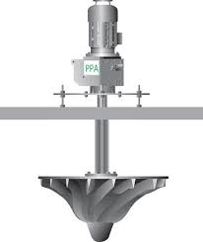
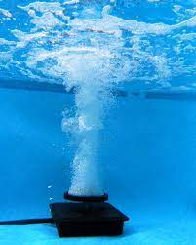
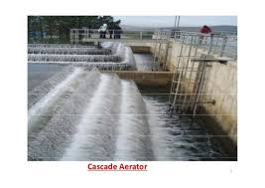
Different aerators should be placed down the course of the river.
a. Where natural down flow happens, cascade aerators could be done by arranging boulders randomly
b. Where the river flows flat and shallow, surface spray aerator could be used (using rotors)
c. Where the river is deep, subsurface aerators could be used (as used in aquariums with suction pump)
cascade aerator
surface spray aerator
subsurface aerators

Slide 31
References
(:https//wgbis.ces.iisc.ernet.in/energy/water/paper/ETR122/vrishabhavathi.html [ENVIS Technical Report: 122, September 2017])
No money to revive Vrishabhavathi - The Softcopy
http://thesoftcopy.in › City
Karnataka directed to start survey of Vrishabhavathi valley
https://www.newindianexpress.com › bengaluru › jun
Rejuvenation Blueprint for Lakes in Vrishabhavathi Valley - IISc
https://wgbis.ces.iisc.ernet.in › paper › ETR122 › content
Submission of Interim Report - National Green Tribunal
https://greentribunal.gov.in › files › news_updates
http://thesoftcopy.in/2022/09/27/vrishabhavathi-river-to-be-cleaned-by-2024/

Slide 32

Acknowledgement
The entire team of CES dept, IISC, for providing an opportunity to present the project
School Principal and teachers for the guidance
My classmates and friends for helping in the project
My neighbours and all the residents who cooperated with the survey
By :- Madhavi.M.G, X Std

