Slide 1



FLORAL WASTE MANAGEMENT
Project by – Rajashree – VI std

Slide 2
OBJECTIVES 1. To find a simple alternative for soil for growing plants
To learn about the kind of plants which grow well in flower waste
To create awareness about waste management at source.
Waste management is one of the major problems we face in today’s world. All kinds of pollution are linked to waste accumulation. Domestic and industrial wastes are already choking the cities. Since flowers used for decoration and in temples are an easy and cleaner source of waste, I selected this project.

Slide 3
METHODS AND MATERIALS
Collected flower waste from the near by temples with the help of our school drivers and helpers
Selected a small area in the cellar of school building for making the flower pit
Arranged waste tyres of our school vans instead of creating a mud pit to put the flower waste
Filled the interior of the tyres with flowers and sowed coriander seeds
Conducted a survey in school to find out what is the average generation of flower waste per day
Encouraged my classmates and other students to bring the flower waste from home to save it from going along with garbage.

Slide 4
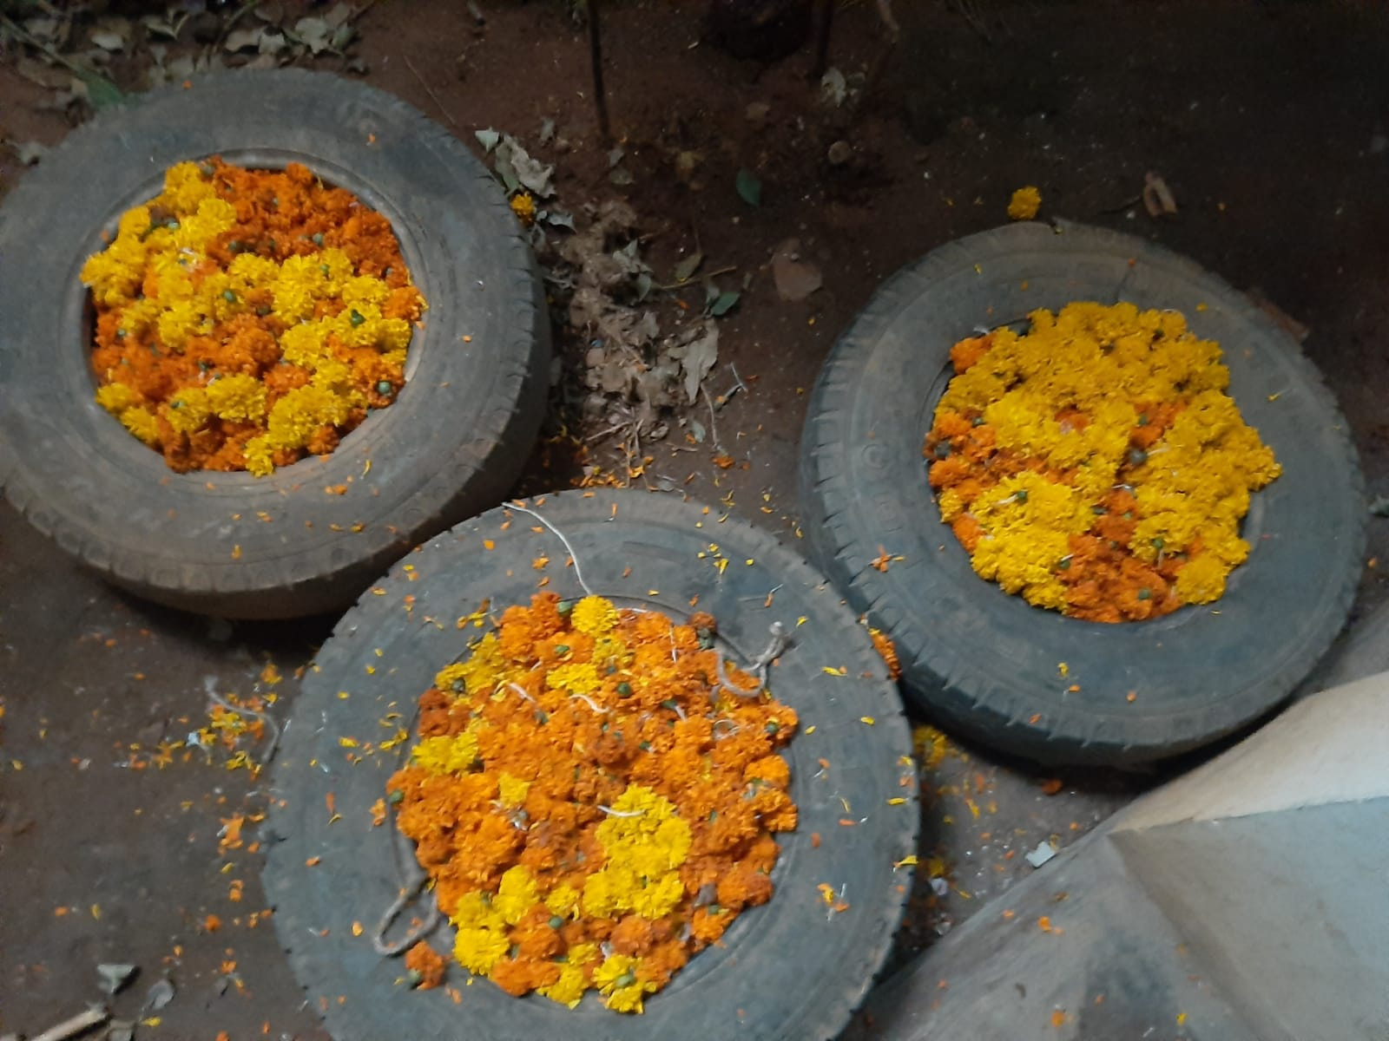
SETTING THE MATERIALS

Slide 5

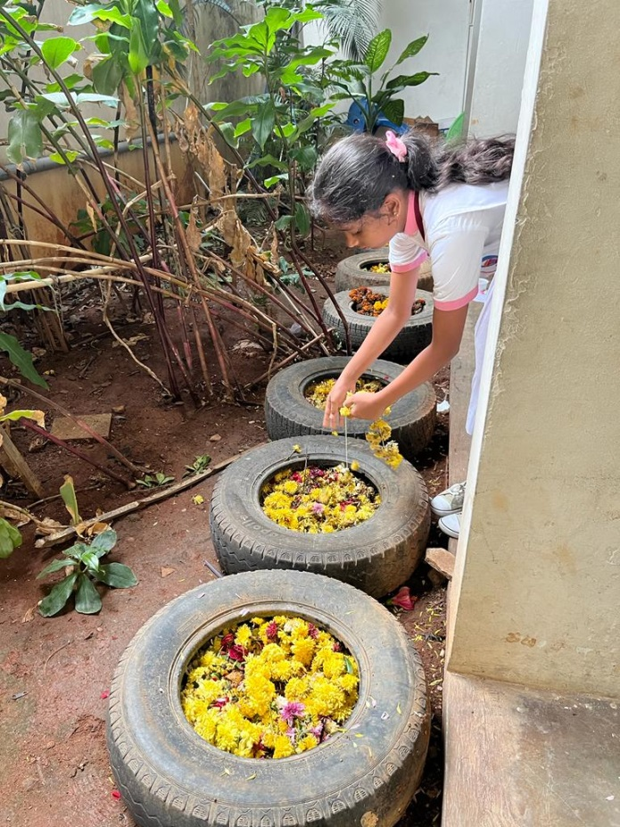
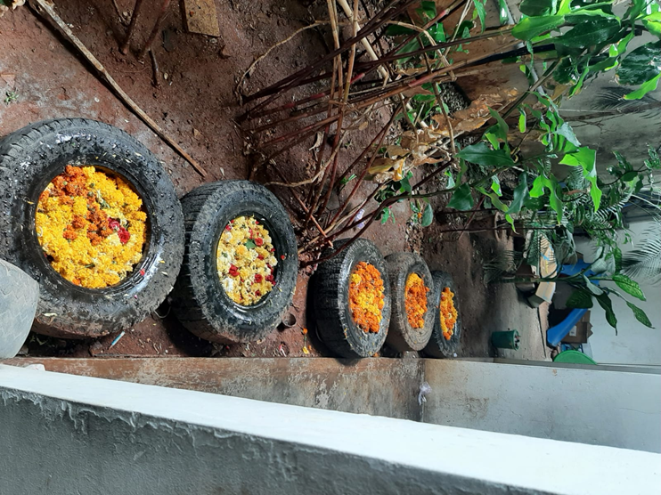
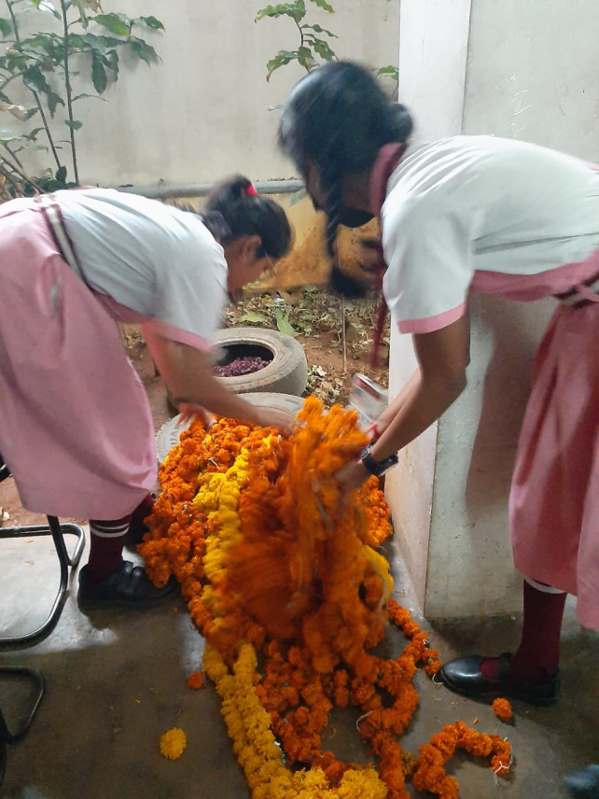

Slide 6
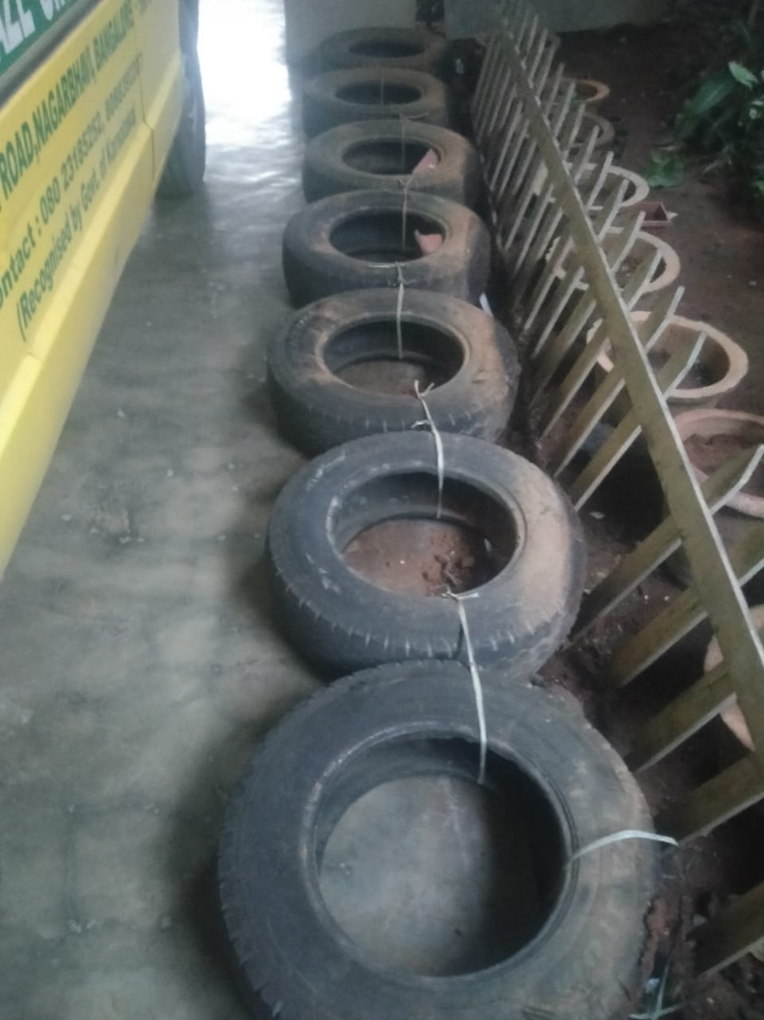
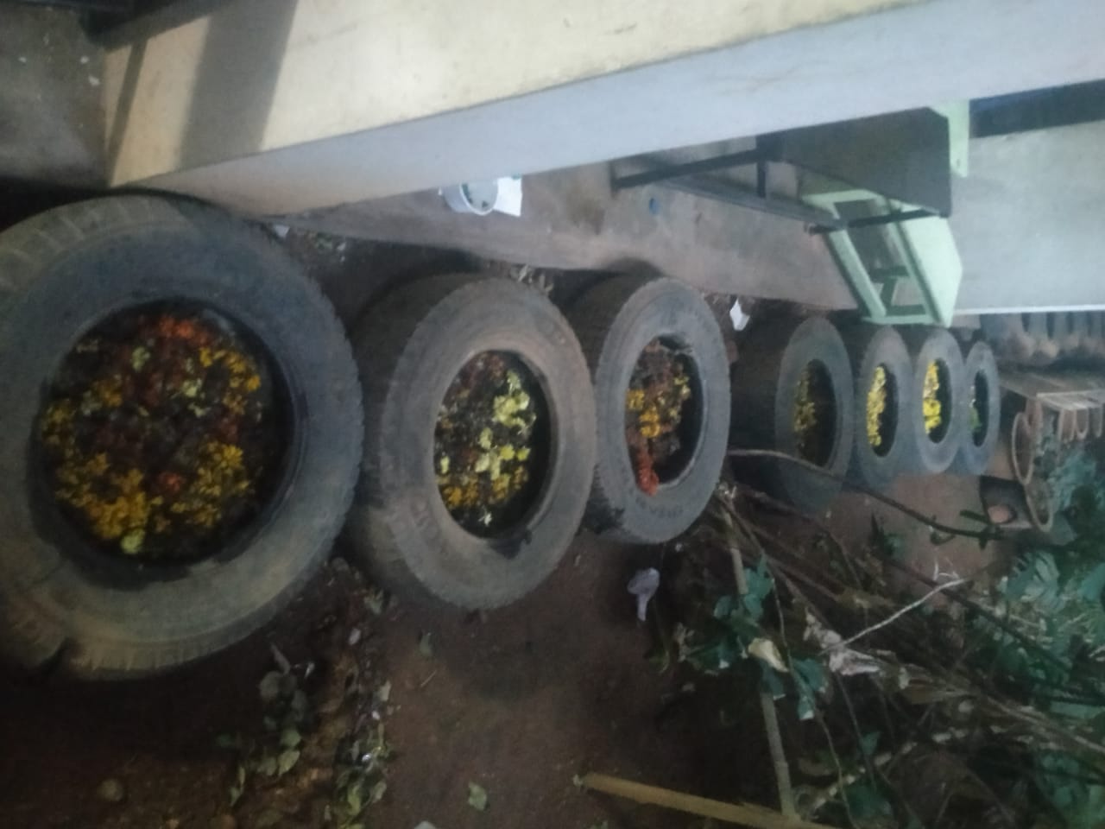
TYRES KEPT READY TO COLLECT THE WASTE FLOWERS EVERY DAY

Slide 7
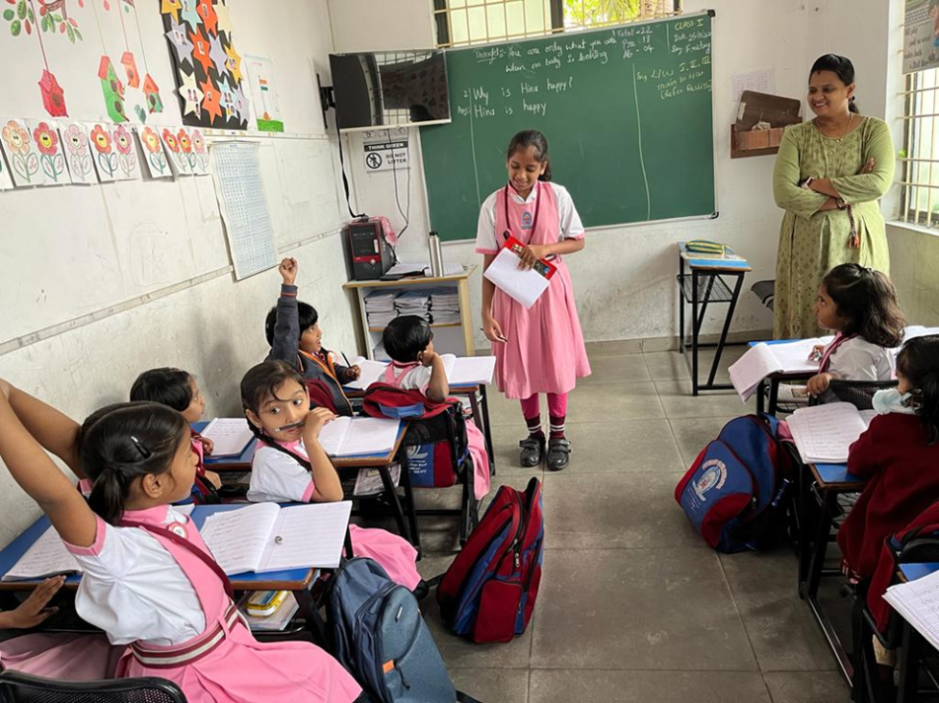
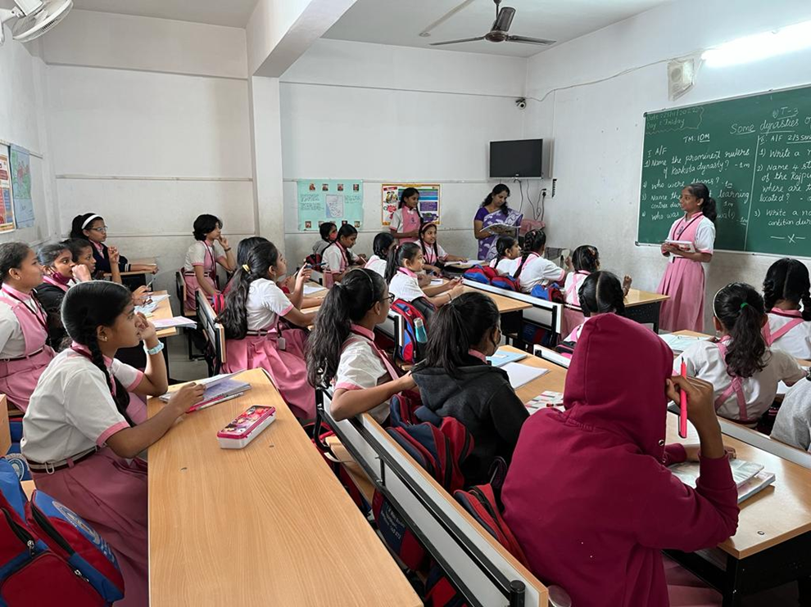
AWARENESS CAMPAIGN

Slide 8
SURVEY RESULT CONDUCTED IN SCHOOL
NUMBER OF HOUSES THAT USE FLOWERS FOR PUJA - 170
AVERAGE QUANTITY PER DAY - 170 X 20 g (minimum per house) = 3400g=3.4 kg
DISPOSAL METHOD:
a. IN DUST BIN- 126 ( 126 x 20 = 2520 g= 2.5 kg/day and 912.5 in a year )
b. IN POTS- 30 (30 x 20 = 600g = 0.6 kg and 219 kg in a year)
There is a difference of nearly 693 Kg /year which ends up in land fills along with garbage

Slide 9
ESTIMATED WASTE GENERATION FROM FLOWERS ALONE - (domestically)
Almost 45% of our school parents use flowers and in that only 17% use the floral waste for plants.
My goal
Creating awareness in students about this waste generation and to prevent Floral waste going into garbage bins.

Slide 10
A ROUGH ESTIMATION OF FLORAL WASTE GENERATED BY TEMPLES
Quantity of flowers collected from temples (2 temples)
Average quantity – 5 kg / day X 2 = 10 Kg / day
Average quantity of waste flowers / year = 365 x 10 = 3650 Kg
There are more than 1000 temples in Bangalore alone. Even if a minimum of 1 Kg floral waste per day is calculated, it would reach 1000 Kg / day. Annual waste generation will be around 365000 Kg!! ( 1 Kg is the least calculation. The real quantity is in hundreds )

Slide 11
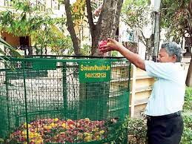
Among these, more than 40 temples have been using the composters to turn floral and kitchen waste into compost.
That means nearly 960 temples are still contributing to the garbage menace.
Very few temples contribute floral waste for Incense sticks making.
Picture courtesy- google)

Slide 12
If floral compost pits are made , this waste going to the land fill can be avoided.
And, it would also encourage people to grow plants as the flowers do not make much mess like vegetable waste or mud.
What are we planning?
Me and my friends are planning to continue the collection of floral waste from homes and the two nearby temples. One advantage is that the floral waste pits can be kept on filling every alternate day. The quantity of waste seems reducing day by day when the flowers decompose.

Slide 13
What do we expect?
A platform like this can spread our message and any school students can take up initiative to use a small area of their campus for floral waste compost. I heard that floral waste can also be used for making soaps and incense sticks as well. But, I find floral compost a better solution as it can be a base for plant growth.

Slide 14
Problems we faced
Appearance of fungi due to dampness which will damage the seeds. (My first two attempts to grow palak seeds failed as they were spoilt by fungi in the decomposing floral waste. I have sown coriander seeds to check if the growth happens)
Insects and stench
Remedy
Dry the flowers so that they could be compressed.

Slide 15
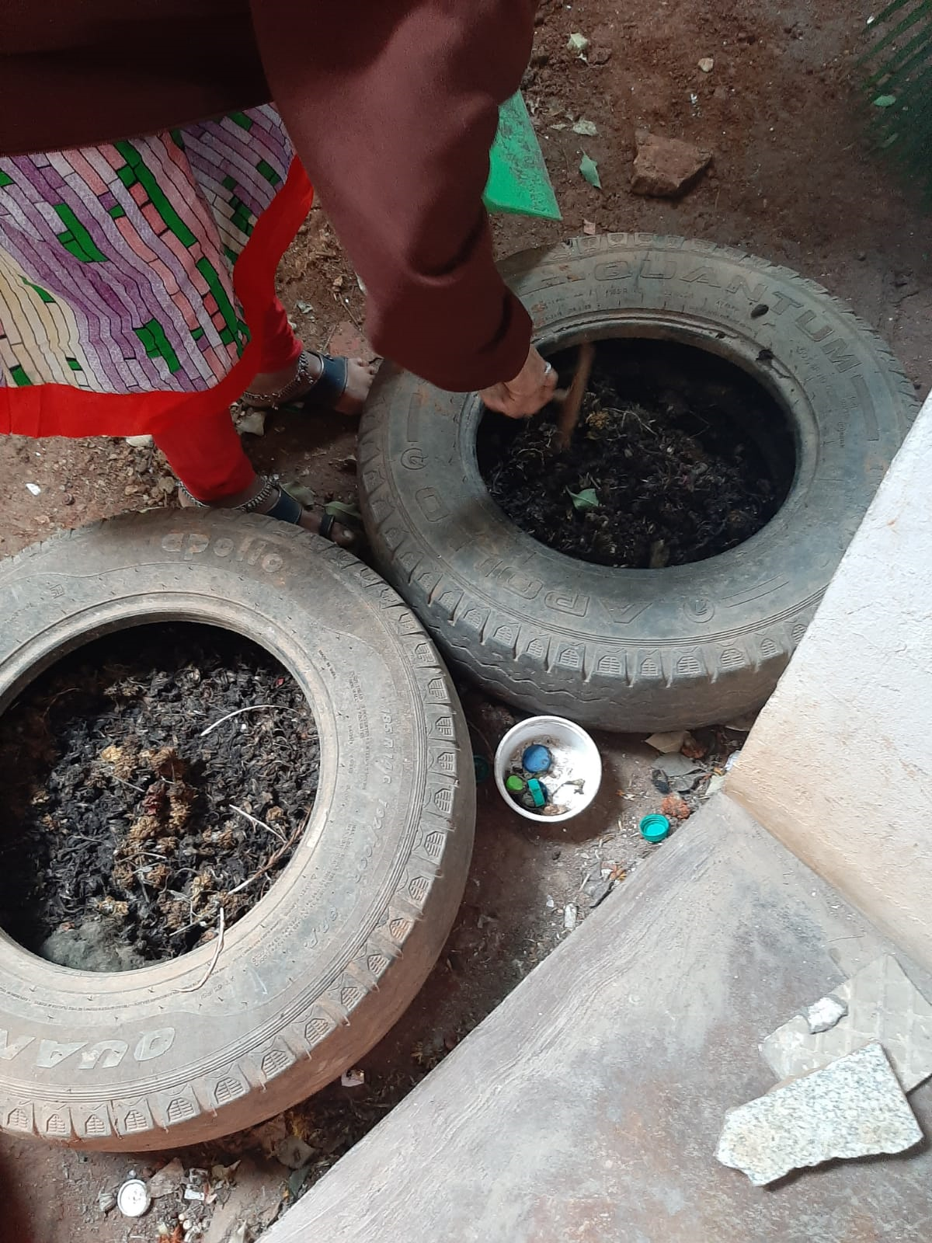
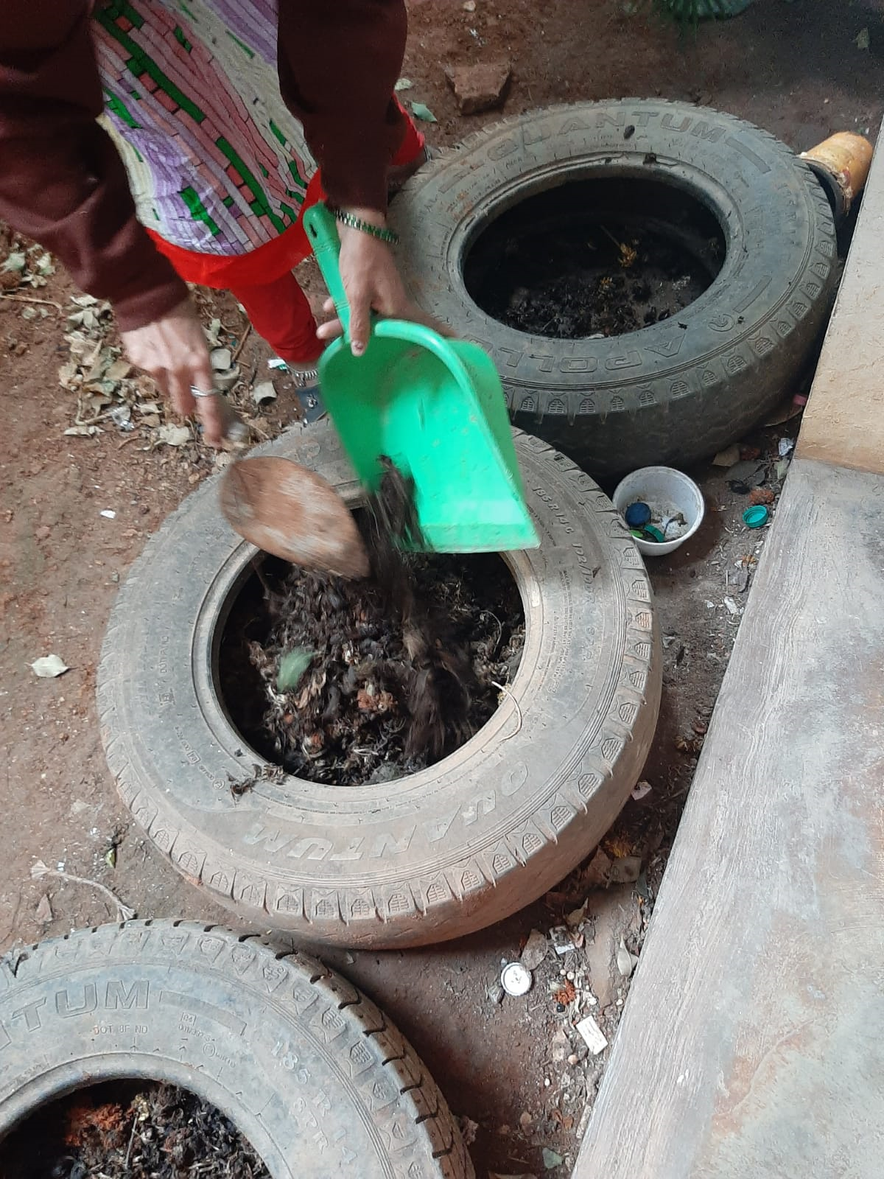
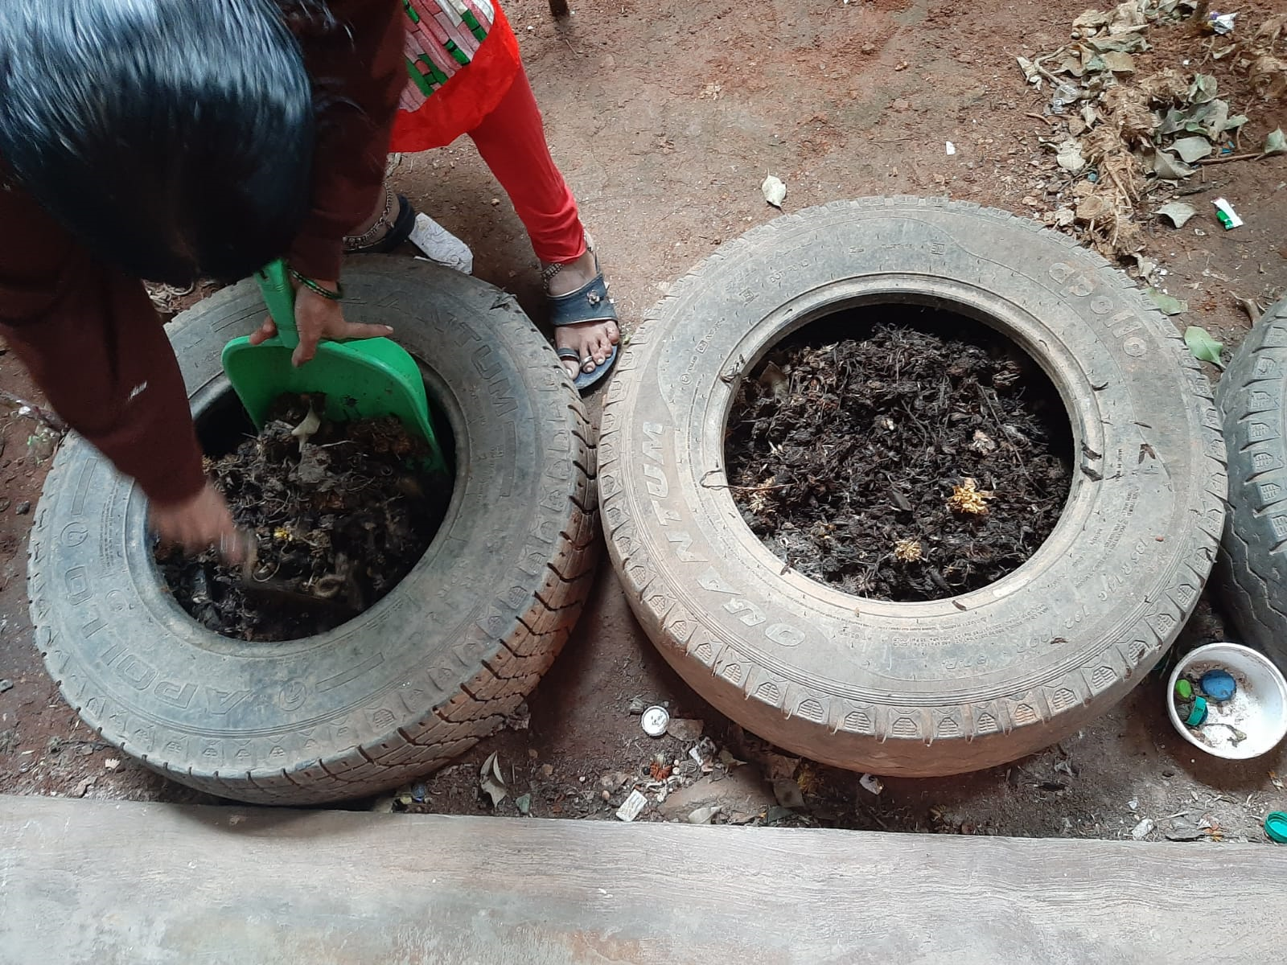
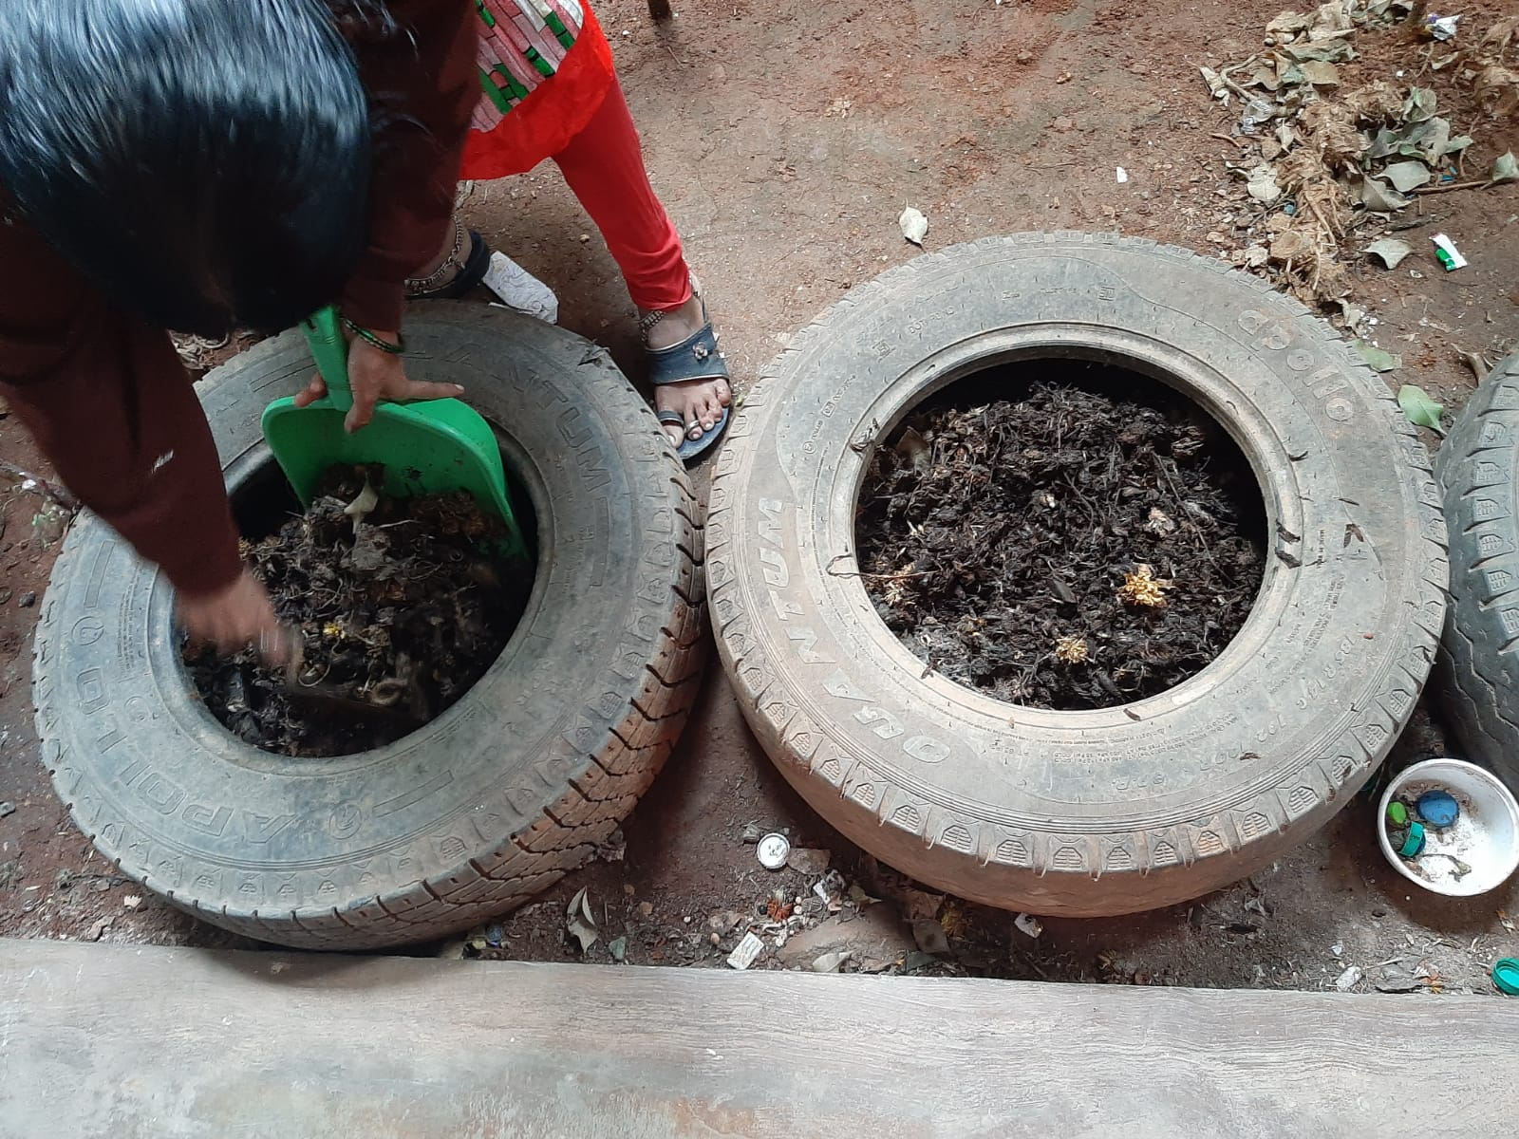


Before
Almost 75% of the total flowers collected and kept in various tyres now fitted into one tyre.
No stench
Now

Slide 16
Conclusion
Flower waste is easy to maintain as it is easy to dry and less messy unlike the other wet wastes.
If put along with garbage, it adds to the volume of landfill
From 8 kg flower waste, we could generate nearly 2 kg compost.

Slide 17
Suggestion
Flower compost should be made separately because the herbicides or pesticides used to grow the flowers will be hazardous to other beneficial composting organisms such as snails, beetles, ants and earthworms.
For the same reason, flower compost is best suited for garden plants rather than for edible varieties.
Caution
Flower waste should be handled with caution as the pollen could lead to allergies.

Slide 18
Acknowledgement
I sincerely thank my classmates, teachers , the Principal and also the drivers and helpers of our school for the cooperation.
I also thank the entire team of CES, IISC for providing me a chance to present my project.

Slide 19
References
Moving to compost: Floral waste turns fertile ground for ...
https://economictimes.indiatimes.com
Parimala Shivaprasad - Assistant Professor - LinkedIn
https://uk.linkedin.com
(PDF) Mycobiota of decomposing floral waste materials
https://www.researchgate.net ›
Composting of floral waste by using indigenously ... - Zenodo
https://zenodo.org
Can You Compost Flowers? (And Dead Flowers Too?)
https://www.conserve-energy-future.com
Plants To Grow For The Compost Pile
https://www.gardeningknowhow.com

Slide 20
Thank You
Project by – Rajshree – VII std

