Slide 1



ONLINE SHOPPING AND ECOLOGICAL PROS AND CONS
Bibi Kathija Taiba – X STD

Slide 2
Introduction
My last project , in Lake Symposium 2018, was about wet waste management. The encouragement I received from parents and friends made me think about the waste hazard of dry wastes, especially those created by the packages of online goods.
I felt this was an area less studied on priority basis. There are no estimates about the amount of e-commerce packaging or the disposal of waste, as no organisation has bothered to investigate the same.
It is true that the companies try substituting plastic packaging with cardboard, it again raises ecological alarm because wood pulp is the main raw material for making packaging cardboard.

Slide 3
OBJECTIVES
TO UNDERSTAND THE IMPACT OF ONLINE SHOPPING COMPANIES ON ENVIRONMENT
TO UNDERSTAND THE POSSIBILITY OF REDUCTION OF PLASTIC USE
TO CREATE AWARENESS ABOUT HAZARDOUS PRACTICES OF WASTE MANAGEMENT AMONG STUDENTS
TO LEARN MORE ABOUT HOW ONLINE SHOPPING HELPS TO REDUCE CARBON FOOTPRINT
TO UNDERSTAND THE PROS AND CONS OF BLIND CONSUMERISM AND ITS CONTRIBUTION TO POLLUTION

Slide 4
METHODS AND MATERIALS
COLLECTED INFORMATION ABOUT PACKAGING MATERIALS OF 7 ONLINE SHOPPING PLATFORMS
CONDUCTED A COMPARATIVE STUDY OF DIFFERERENCE IN PACKAGING OF VARIOUS ITEMS
CALCULATED AVERAGE SUPPLY OF GOODS PER DAY/ANNUM
ANALYSED THE IMPROVISATION IN PACKING OF GOODS
CONDUCTED A SURVEY IN OUR SCHOOL ABOUT THE VARIOUS PRODUCTS OF ONLINE PURCHASE AND THE WASTE DISPOSAL METHOD
CALCULATED THE CARBON FOOT PRINT OF VARIOUS COMPANIES

Slide 5
Some of the hazardous substances found in online packaging materials
Material | Use | Health Hazard
Brominated flame retardants (BFRs) | To make the substances less flammable | Bioaccumulative, and toxic to both humans and the environment . Suspected of causing neurobehavioral effects and endocrine disruption.
Polyvinyl chloride (PVC) | Used in packaging because it is light, cost-effective, transparent, tough and does not affect the taste of the packaged food. | Can severely impact the central nervous system causing headaches and dizziness.

Slide 6
Material | Use | Health Hazard
Bisphenol A | Widely used in containers that store food and beverages, such as water bottles. | Possible link between BPA and increased blood pressure, type 2 diabetes and cardiovascular disease.
Styrofoam | Used as a common filler | Long-term exposure to even small quantities of Styrofoam can cause fatigue, nervousness and sleep disorders.

Slide 7
COMPARATIVE STUDY (Selected only the major items they deal with)
COMPANY | ITEM AND PACKAGING MATERIAL
 | Clothing | Gadgets | Vegetables/fruits/ Perishable items | Egg | Non perishable groceries (pulses, grains) | Food items from restaurants
AMAZON | SOFT PLASTIC, SELF ADHESIVE POLYTHENE BAGS | CARDBOARD, PLASTIC | - | - | PLASTIC | -
BIG BASKET | - | - | PLASTIC, PAPER, | PAPER/ PLASTIC | PLASTIC | -
DUNZO | - | - | PLASTIC, PAPER | PAPER/ PLASTIC | PLASTIC | -
FLIPKART | SOFT PLASTIC, SELF ADHESIVE POLYTHENE BAGS | CARDBOARD, PLASTIC | - | - | - | -

Slide 8
COMPANY | ITEM AND PACKAGING MATERIAL
 | Clothing/COSMETICS | Gadgets | Vegetables/fruits/ Perishable items | Egg | Non perishable groceries (pulses, grains) | Food items from restaurants
SWIGGI | - | - | - | - | - | PLASTIC, ALUMINIUM FOIL, PAPER
MESHO | SOFT PLASTIC, SELF ADHESIVE POLYTHENE BAGS | CARDBOARD, PLASTIC | - | - | - | -
NYKAA | CARDBOARD, PLASTIC | - | - | - | - | -
ZOMATO | - | - | - | - | - | PLASTIC, ALUMINIUM FOIL, PAPER

Slide 9
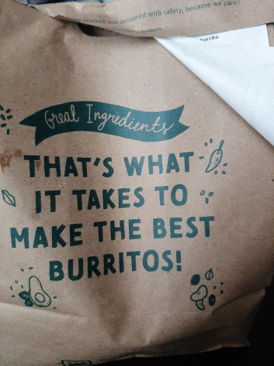
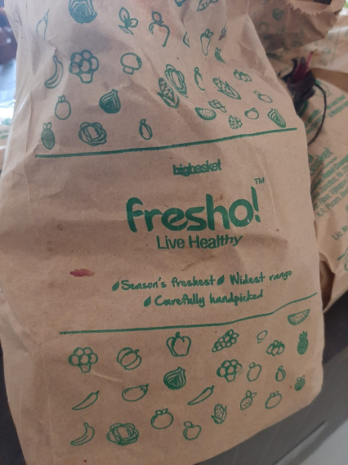
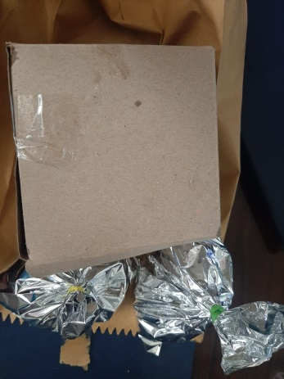
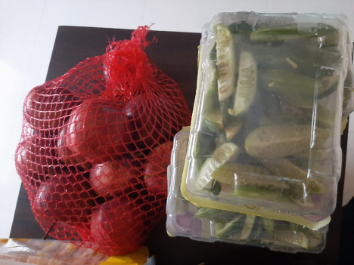
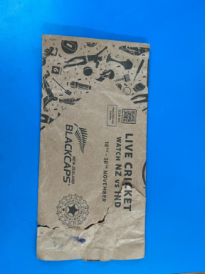
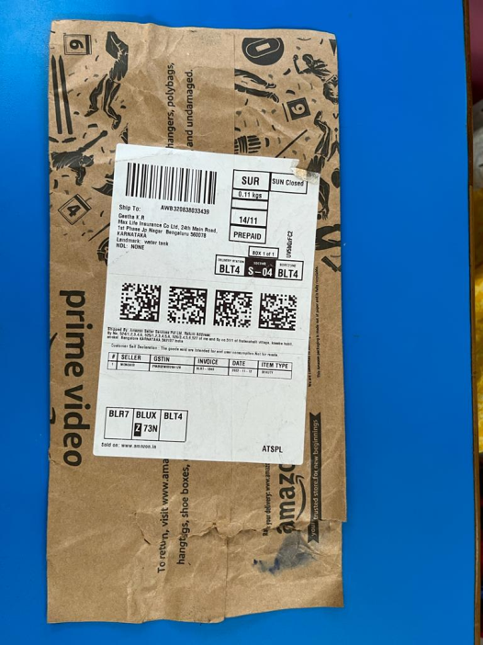
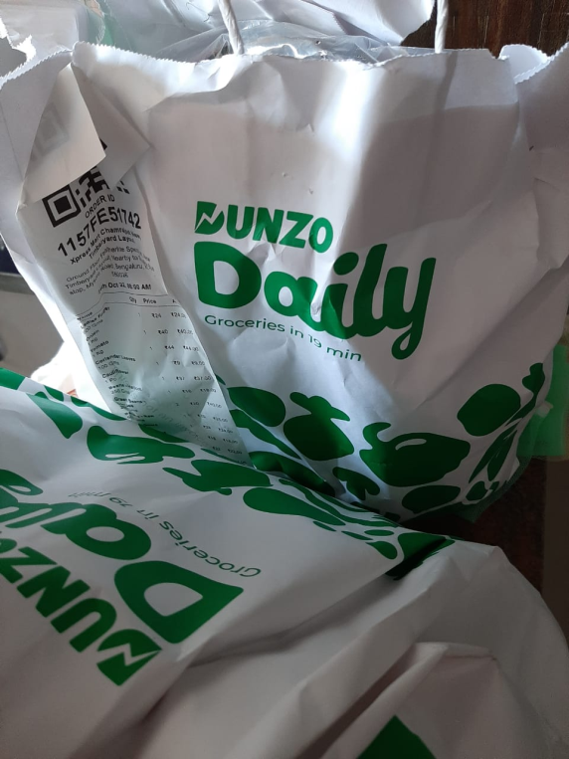
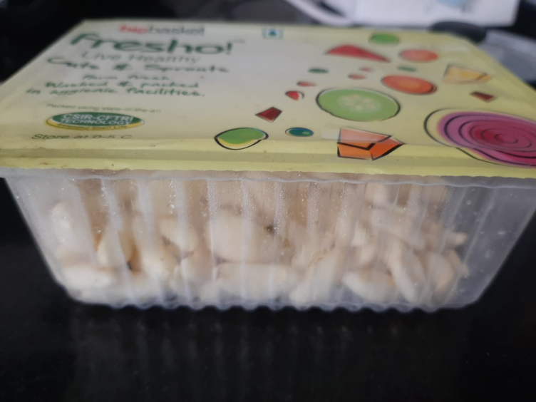
SOME OF THE PACKING MATERIALS

Slide 10
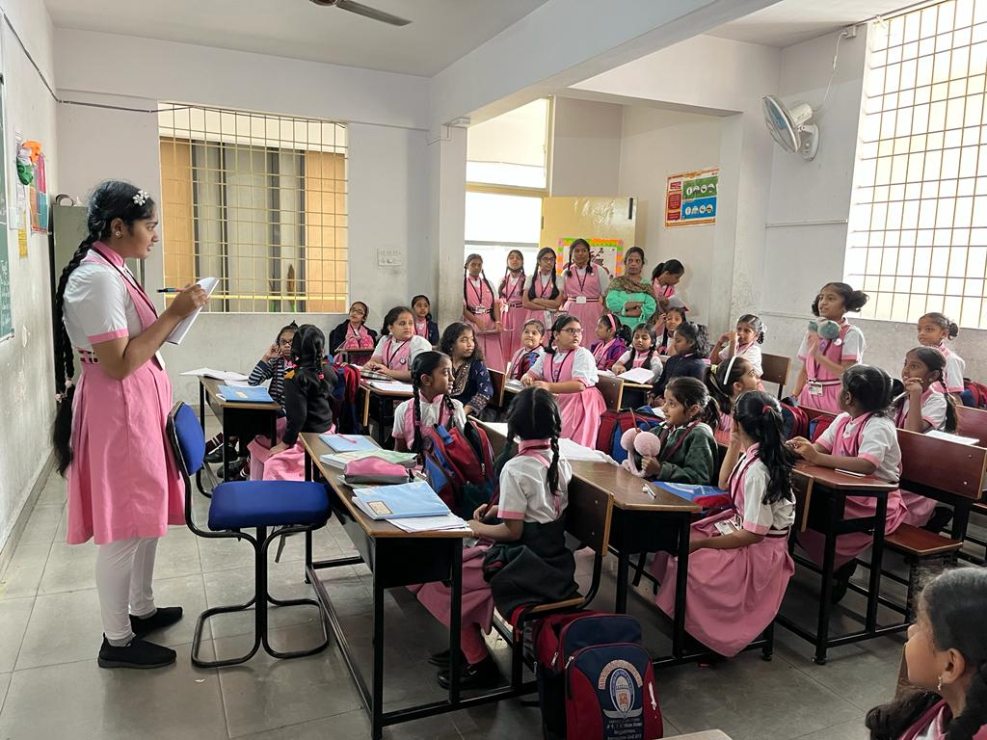
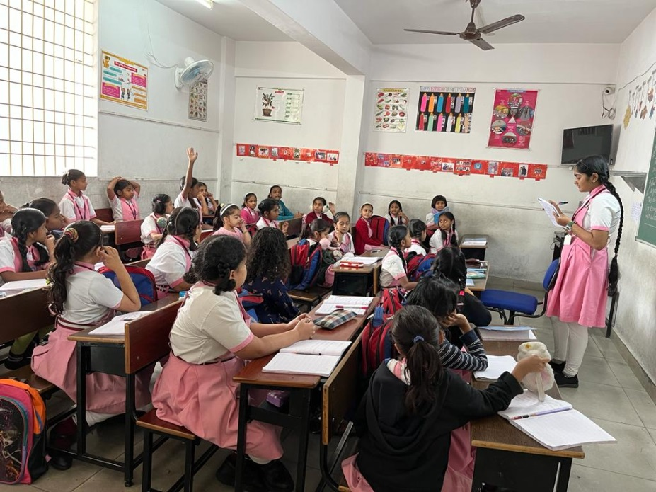
CONDUCTED A SURVEY TO KNOW THE TREND ABOUT ONLINE SHOPPING
Total number of students surveyed= 256 (from IV STD to X STD)

Slide 11
SURVEY RESULT (CONDUCTED FROM IV STD TO X STD, INCLUDING TEACHERS)- A total of
Most used online shopping platform | Most purchased item | Most seen packing material | Average frequency of order / month | Mode of disposal of the waste
Swiggi ( 62 / 235) = 26% | Food | Paper, plastic, aluminium foil | 11 | Dustbin
Zomato (43 / 235) = 18% | Food | Paper, plastic, aluminium foil | 7 | Dustbin
Bigbasket ( 35/ 235) = 14% | Groceries | Plastic and cardboard/corrugated boxes | 5 | Dustbin
Dunzo ( 28 / 235) = 11% | Vegetables and fruits | Paper cover, plastic | 4 | Dustbin
Amazon ( 23 /235) = 9.7% | Clothing | Plastic and cardboard/corrugated boxes | 2 | Dustbin

Slide 12
Most used online shopping platform | Most purchased item | Most seen packing material | Average frequency of order | Mode of disposal of the waste
Flipkart ( 20 / 235) = 8.5% | Clothing | Mostly plastic and cardboard/corrugated boxes | 2 | Dustbin
Mesho 19 / 235) = 8% | Clothing | Mostly plastic and cardboard/corrugated boxes | 2 | Dustbin
Nykaa (5 /235) = 2% | Cosmetics | Cardboard, plastic | 1 | Dustbin
100 % plastic waste ends up in dustbin.

Slide 13
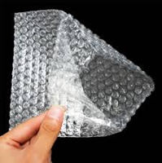
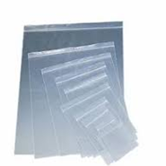
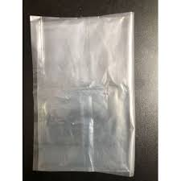
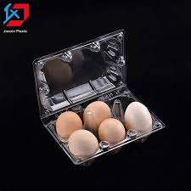
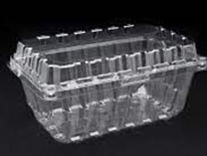
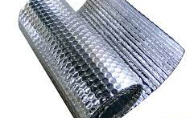
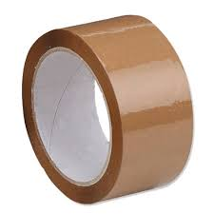
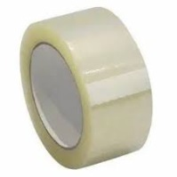
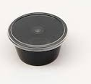
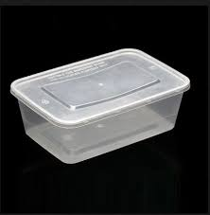
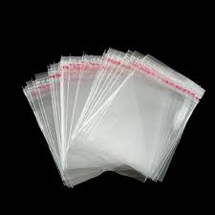
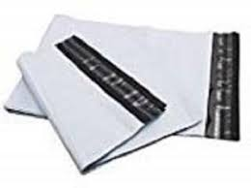
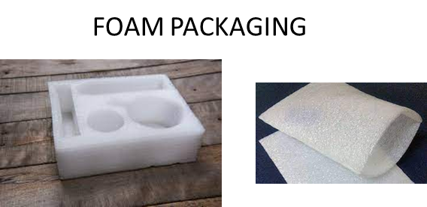
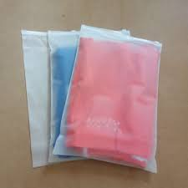
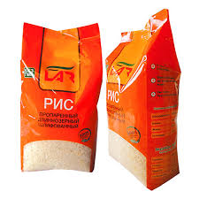
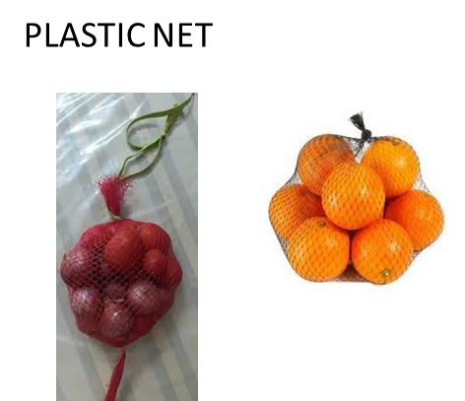
TYPES OF PLASTIC FORMS USED FOR PACKAGING
BUBBLE FOAMS
POLYMER- 50 MICRONS
CLAMSHELL PACKAGES
BOPP TAPES
SELF ADHESIVE BAG S
REUSABLE FOOD CONTAINER-PLASTIC-
WATER PROOF POLYTHENE BAGS
PLASTIC NET
(Most of the packaging is made by LDPE (Low density poly ethylene and Biaxially oriented polypropylene (BOPP). Non recyclable plastic s are marked in red)

Slide 14
What happens to these plastics?
Around 60 per cent is collected and recycled, mainly by the informal sector of waste pickers, while the rest ends up in landfills.
What are the substitutes in packaging?
There are some innovations happening in the packaging sector, but none of them is economically viable, environmentally 100% safe and withstand rough handling while transporting.

Slide 15
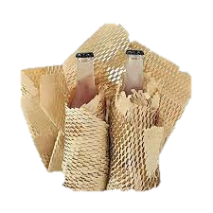
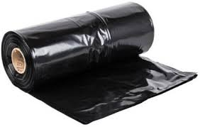
Some of the existing alternatives for plastic wrap
Substitute for plastic wrap | Raw materials | Advantage | Disadvantage
Honeycomb paper wrap | Kraft paper | They are a viable, lightweight alternative to wood and plastic because they are easy to handle and will not splinter. | Poor resistance to breakage, folding resistance and puncture resistance.
Biodegradable compostable garbage bags | Orange peels, corn oil, soybeans, micro-organisms or starch | Easy to Recycle , Consume Less Energy During Their Manufacture, can degrade when exposed to the sun’s ultra-violet radiation, enzymes, bacteria, water, or wind abrasion. | Expensive to produce, Tend to tear easily and can leave microplastics behind

Slide 16
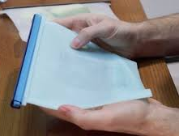
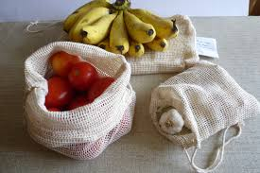
Substitute for plastic wrap | Raw materials | Advantage | Disadvantage
Silicone food bags | Food-grade silicone | Extremely durable and significantly more ocean-friendly than plastic, highly reusable | Not biodegradable, expensive compared to plastic
Cotton produce bags | Cotton | Soft, smooth texture, long-lasting, biodegradable, readily available, and simple to clean. | Expensive, not moisture resistant

Slide 17
Some of the hazardous substances found in online packaging materials
Material | Use | Health Hazard
Brominated flame retardants (BFRs) | To make the substances less flammable | Bioaccumulative, and toxic to both humans and the environment . Suspected of causing neurobehavioral effects and endocrine disruption.
Polyvinyl chloride (PVC) | Used in packaging because it is light, cost-effective, transparent, tough and does not affect the taste of the packaged food. | Can severely impact the central nervous system causing headaches and dizziness.

Slide 18
Material | Use | Health Hazard
Bisphenol A | Widely used in containers that store food and beverages, such as water bottles. | Possible link between BPA and increased blood pressure, type 2 diabetes and cardiovascular disease.
Styrofoam | Used as a common filler | Long-term exposure to even small quantities of Styrofoam can cause fatigue, nervousness and sleep disorders.

Slide 19
How can we find a solution?
To find a solution, we need to know why people opt for online shopping. So, I conducted another survey among my teachers, relatives and neighbours.
Questionnaire prepared for the survey
Why do you prefer online shopping?
Do you get 100% satisfaction on the items purchased online?
Do you think materials purchased online are of higher quality ?
Do you like physical shopping? Why?
Have you ever returned goods purchase online? If yes, why?
Have you ever thought about the waste generated by the packaging materials?

Slide 20
Survey result
People are abandoning physical shopping due to the following reasons
Time consuming
Lack of proper parking space
Lack of suitable company to go for shopping
Distance to certain places of choice
Crowded streets
Non friendly attitude of shop owners
Lack of wide range of choice, design and size.
2. None of the participants acknowledged that he/she had given a thought to the waste generated.
3. In general, a slightly larger percentage of women than men opted online shopping.

Slide 21
Conclusion
The main reason behind this pile up of e commerce waste is due to No Accountability
The Solid Waste Management Rules, 2016, states that producers of packaging products such as plastic and corrugated boxes must take up the responsibility of collection, recycling and disposal of such waste in accordance with environmentally sound principles.
I did not come across any such system in place.

Slide 22
In almost all the packaging, plastic is used (either to wrap the product or to wrap the entire package)- mostly LDPE (low density poly ethylene)
3. Though LDPE is considered less hazardous or ‘safer plastic’ , it ‘s waste accumulation is still a concern as it’s recycling is not viable and not financially efficient.
4. Adhesive tapes of these packages are made of BOPP films (Biaxially oriented polypropylene). These too are non biodegradable and end up in waste fills or oceans.

Slide 23
5. Substituting materials have been invented after the ban of plastics of low thickness. One such item is honey comb paper wrap. But, these can be used only for small, light weighted items like medicines.
6. Online shopping has increased the demand for international goods and international shipping is at the coast of environment.
7. Online shopping affects local economy.

Slide 24
Suggestions
5 day working system to be implemented- Environmental conservation comes at some cost. One of the major excuses for not opting physical shopping was ‘lack of time’. Most of the working women prefer online shopping as even Saturdays are working days. There could be a difference if weekly two days off they get so as to manage the purchase of essential items.
Strict implementation of law where producers remain accountable for the waste they generate.

Slide 25
3. Incentives in the form of gift vouchers or concession in the next purchase for consumers who promptly return the packaging materials.
4. Awareness about local economy being affected should reach all.
5. Authorities must ensure proper, accessible roads and parking space. After all, saving environment is not the responsibility of only consumers.

Slide 26
7. Schools can come forward to make a change. Let students and staff be aware about the waste contribution they make unknowingly or unintentionally. Someone SHOULD BE HELD ACCOUNTABLE AT THE END.
8. Develop local ecommerce for groceries. This also ensures more job opportunities and solve menace of packaging waste to an extent. Start-ups like ‘doorstep online mart’ should be encouraged.

Slide 27



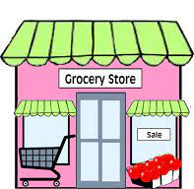
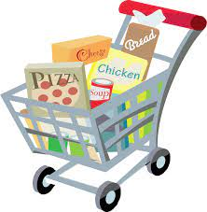
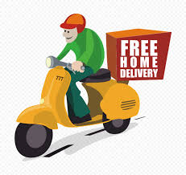
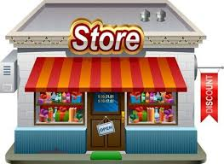
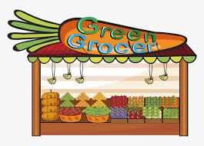
The module I suggest for e groceries
5 KM RADIUS
Order received
CUSTOMER
DELIVERY PERSON

Slide 28
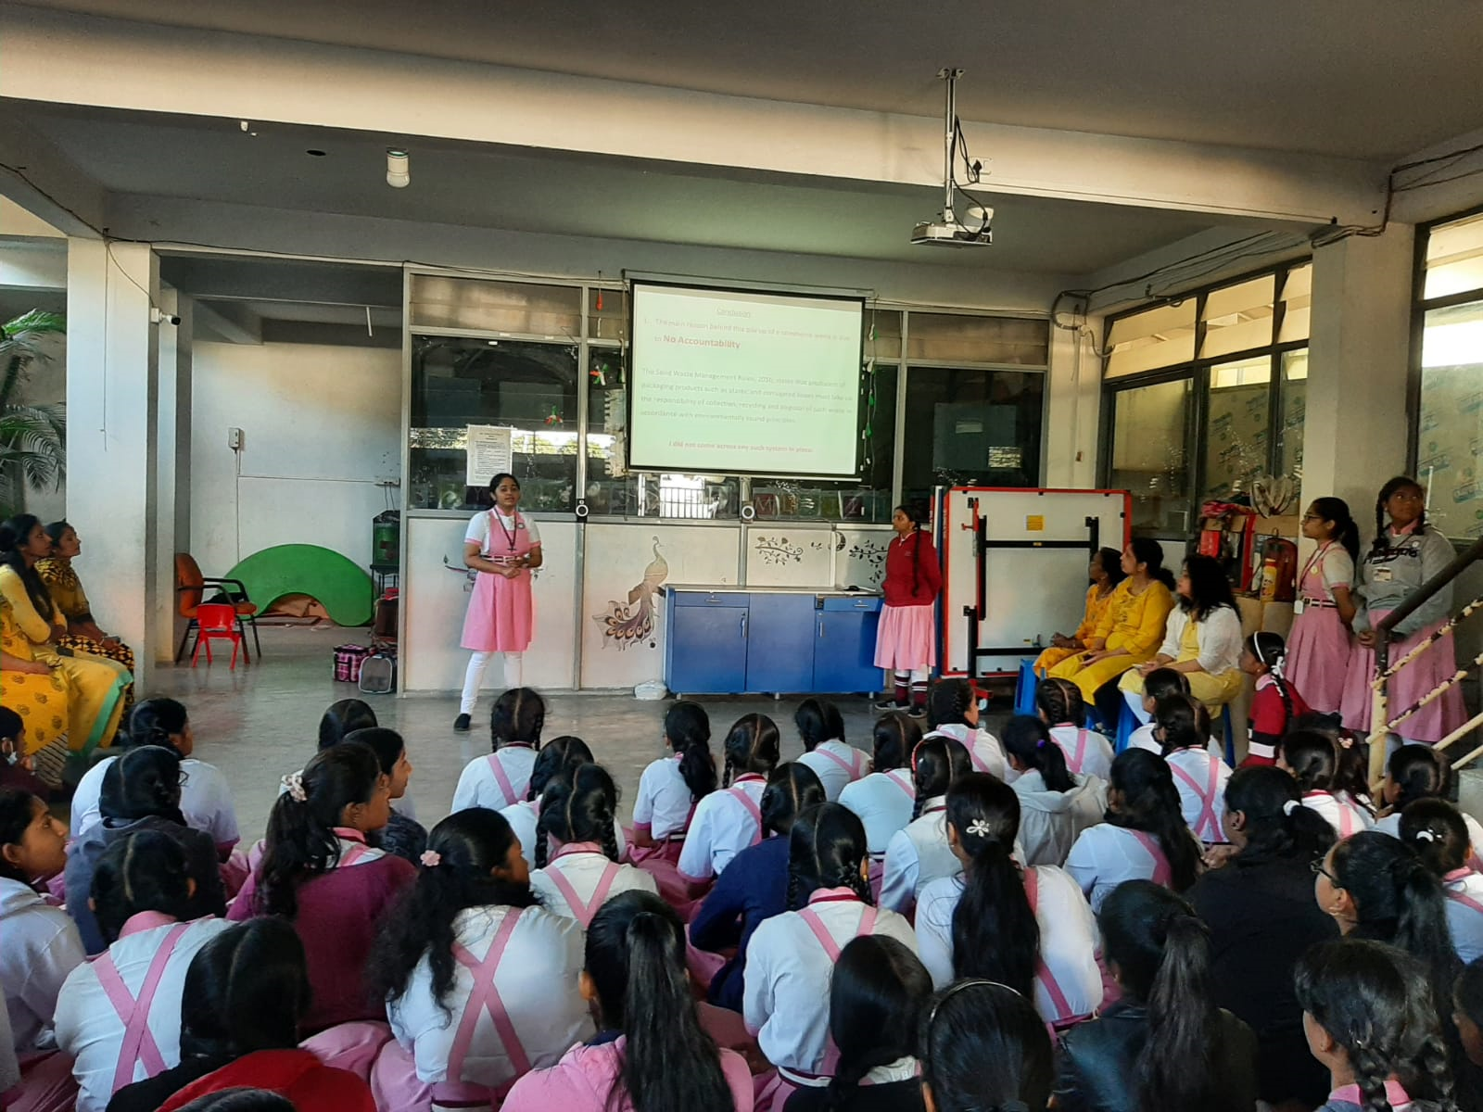

Sharing my observations and suggestions with the teachers and students

Slide 29
ACKNOWLEDGEMENT
I would like to thank the team of CES, IISC for giving me an opportunity to present my project. I am also thankful to my teachers, classmates and Principal for helping me with necessary information and suggestions.
The following are some of the websites I referred.

Slide 30
REFERENCES
BOPP films | Biaxially Oriented Polypropylene Films
https://www.cosmofilms.com
Calculating your carbon footprint - Just Energy
https://justenergy.com
Bubble Foam Sensory Activity - Busy Toddler
https://busytoddler.com
Online shopping means cutting billions of trees - Down To Earth
https://www.downtoearth.org.in
https://www.packworld.com
https://www.pollybarks.com
The Pandemic and Pollution: Handling the packaging waste of ...
https://en.gaonconnection.com
The Truth About Online Shopping and its Environmental Impact
https://earth.org

Slide 31
Thank You
Project by
Bibi Kathija Taiba – X STD

