Slide 1




AIR QUALITY IN
CLASS ROOMS
By :- Mouna Shankar, IX Std

Slide 2
Introduction
We, the students, started bothering about air quality during covid-19 related restrictions. Wearing masks throughout the day and maintaining social distance provided a suffocative atmosphere in classrooms. I felt classroom air quality might be perhaps a less studied topic.
Google search showed that as per the familiar fresh air ventilation guidelines, CO₂ in indoor spaces should be maintained below 1000 ppm to control people-related pollutants.
I wanted to check what would be the CO2 level in classrooms and how things could be made better.

Slide 3
OBJECTIVES
1. TO UNDERSTAND HOW CO2 LEVEL VARIES IN DIFFERENT CLASSROOMS AND IN THE SAME CLASSROOM IN DIFFERENT TIMES OF THE DAY.
2. TO UNDERSTAND HOW EFFECTIVE PLANTS ARE IN REDUCING CO2
3. TO CHECK THE UTILITY OF DIFFERENT INDOOR PLANTS
4. ENCOURAGING STUDENTS TO MAINTAIN A GREEN CLSSROOM
5. TO CHECK THE POSSIBILITY OF HYDROPONICS IN CLASSROOMS

Slide 4
MATERIALS AND METHODS
GREENLOOP PURE HYDROPONIC NUTRIENTS
PLASTIC BOTTLES
COTTON
CORIANDER SEEDS
THREAD
INKBIRDPLUS-AIR QUALITY DETECTOR
COMMON INDOOR PLANTS – PHILODENDRON SPECIES

Slide 5
WORK DONE
VISITED DIFFRERENT CLASSROOMS DURING LUNCH BREAK TO CHECK CO2 READING
SET UP A SIMPLE HYDROPONIC SYSTEM WITH PLASTIC BOTTLES IN THE CLASSROOM
TAKEN COUNT OF ALL THE PLANTS IN THE PREMISES INCLUDING POTTED PLANTS
SELECTED OUR CLASSROOM AS STUDY AREA AND KEPT INDOOR PLANTS TO CHECK THE DIFFERENCE CO2 LEVEL.
CONDUCTED AN AWARENESS CLASS FOR OTHER STUDENTS

Slide 6
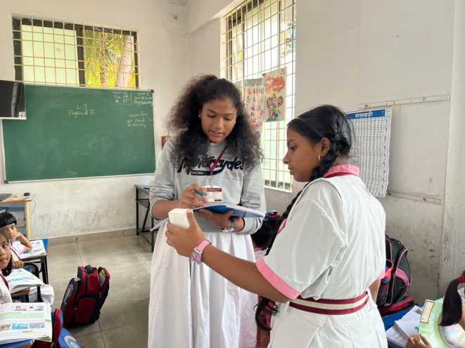
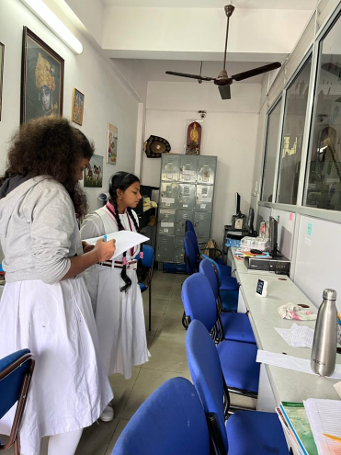
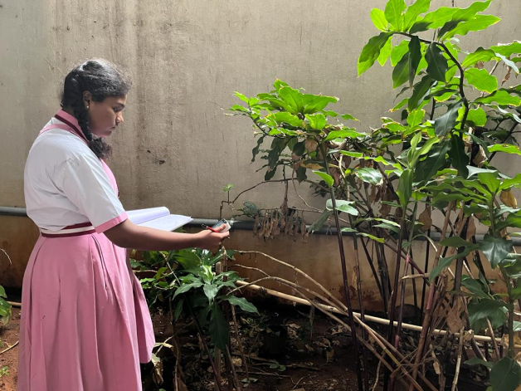
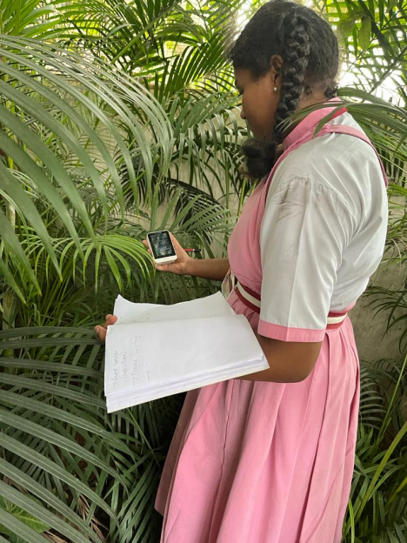
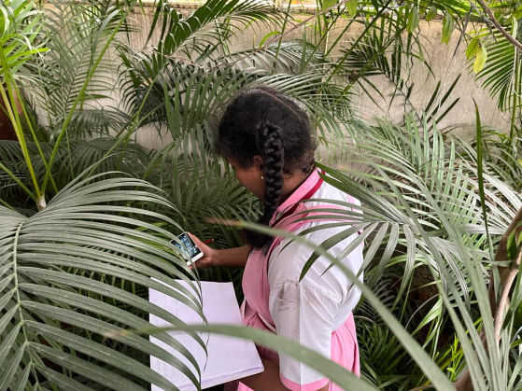
Recording CO2 level in different areas of the school building

Slide 7
CO2 LEVEL BEFORE SETTING UP CLASSROOM GARDEN (TVOC and HCHO also recorded in ppm)
CLASS | STRENGTH | DAY 1 |  |  | DAY 2 |  |  | DAY 3 |  |  | DAY 4 |  |  | DAY 5
 |  | CO2 | TVOC | HCHO | CO2 | TVOC | HCHO | CO2 | TVOC | HCHO | CO2 | TVOC | HCHO | CO2 | TVOC | HCHO
I | 22 | 780 | o.172 | 0.03 5 | 640 | 0.102 | 0.013 | 143 0 | 0.7 65 | 0.147 | 550 | 0.072 | 0.01 | 4 60 | 0.052 | 0.01
II | 34 | 904 | 0.275 | 0.042 | 1100 | o.42 9 | 0.072 | 532 | 0.07 | 0.01 | 94 0 | 0.32 | 0.06 | 1120 | 0.43 | 0.07
III | 36 | 700 | 0.1 | 0.031 | 1090 | 0.44 | 0.07 8 | 42 0 | 0.024 | 0.014 | 880 | 0.27 0 | 0.05 | 1010 | 0.2 | 0.057
IV | 35 | 92 6 | 0.223 | 0.852 | 854 | 0.249 | 0.049 | 900 | 0.22 8 | 0.034 | 92 0 | 0.2 84 | 0.05 | 1190 | 0.448 | 0.08
V | 41 | 1050 | 0.3 88 | 0.068 | 103 0 | 0.3 9 | 0.07 | 93 0 | 0.2 60 | 0.045 | 1060 | 0.3 69 | 0.065 | 990 | 0.3 | 0.05

Slide 8
CLASS | STRENGTH | DAY 1 |  |  | DAY 2 |  |  | DAY 3 |  |  | DAY 4 |  |  | DAY 5
 |  | CO2 | TVOC | HCHO | CO2 | TVOC | HCHO | CO2 | TVOC | HCHO | CO2 | TVOC | HCHO | CO2 | TVOC | HCHO
VI | 34 | 650 | o.17 6 | 0.03 2 | 1000 | 0.33 0 | 0.052 | 67 0 | 0.14 | 0.027 | 950 | 0.3 0 | 0.032 | 1215 | 0.555 | 0.1
VII | 39 | 93 8 | 0.31 | 0.055 | 97 0 | o.337 | 0.05 | 760 | 0.1 | 0.02 5 | 910 | 0.2 5 | 0.04 8 | 1080 | 0.409 | 0.073
VIII | 40 | 950 | 0.290 | 0.54 | 800 | 0.17 5 | 0.045 | 7 50 | 0.14 0 | 0.024 | 950 | 0.2 84 | 0.05 | 1110 | 0.429 | 0.077
IX | 34 | 92 0 | 0.2 90 | 0.05 | 1010 | 0.3 9 | 0.072 | 980 | 0.2 0 | 0.05 | 900 | 0.3 | 0.06 | 1200 | 0.4 5 | 0.085
X | 32 | 92 0 | 0.2 90 | 0.05 | 410 | 0.022 | 0.011 | 515 | 0.054 | 0.012 | 940 | 0.2 6 | 0.05 | 4 8 5 | 0.004 | 0.007

Slide 9
OTHER AREAS | NUMBER OF PLANTS | KIND | CO2 LEVEL-
FRONT CORRIDOR | 25 | HERBS- POTTED | 408 – O.O56-0.025
CELLAR- LEFT SIDE | 12 | HERB-13 SHRUB-7 TREES-2 | 440- 0.02, 0.13
CELLAR- RIGHT SIDE | 21 | HERB-1 SHRUB-5 TREES-15 | 405- 0.25, 0.11
TERRACE | 0 | - | 411 – 0..05 – 0.012
STAFF ROOM | 0 | - | 801 -
LAB | 0 | - | 640
LIBRARY | 0 | - | 583

Slide 10
AVERAGE READING
CLASS | CO2 | TVOC | HCHO
I | 772 | O.232 | O.O43
II | 929 | 0.30 | 0.05
III | 820 | 0.20 | 0.046
IV | 958 | 0.29 | 0.21
V | 1012 | 0.34 | 0.29
AVERAGE READING
CLASS | CO2 | TVOC | HCHO
VI | 897 | 0.30 | 0.04
VII | 931 | 0.28 | 0.05
VIII | 912 | 0.27 | 0.14
IX | 1003 | 0.32 | 0.06
X | 654 | 0.12 | 0.02
REFERENCE TABLE
QUALITY OF AIR | CO2 | TVOC | HCHO
EXCELLENT | ≤ 800 | ≤ 0.6 | ≤ 0.08
GOOD | 800 - 1200 | 0.6 – 1.6 | 0.08 – 0.12
POOR | ˃1200 | ˃ 1.6 | ˃ 0.12

Slide 11
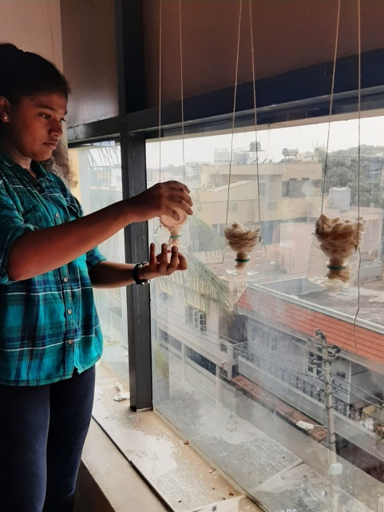
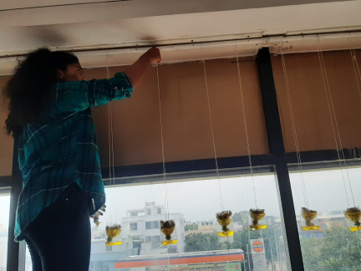
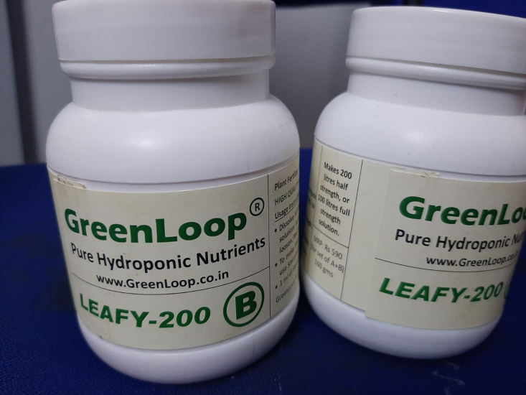
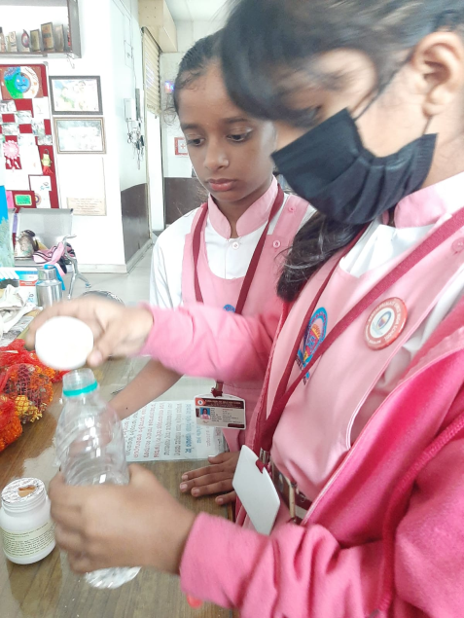
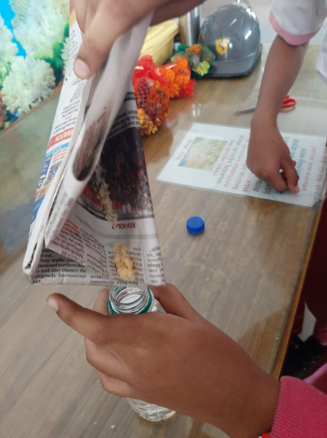
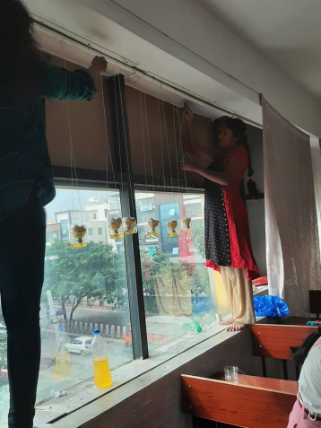
SETTING UP A HYDROPONIC SYSTEM IN THE CLASSROOM

Slide 12
OBSERVATIONS
ASSUMPTIONS
HIGHER CO2 LEVEL DURING
COLD WEATHER CONDITION -The density of CO2 increases as temperatures get colder.
HIGHER CO2 LEVEL DURING MID DAY
IN TWO CLASSROOMS- (8TH AND 9TH STD) - Poor ventilation
LOWER CO2 LEVEL IN CLASSES WITH
HIGHER STRENGTH BUT LARGER CLASSROOM AREA. - Good ventilation
LOWER CO2 LEVEL IN CELLAR WHERE
THERE WERE MORE PLANTS BUT
HCHO LEVEL WAS FOUND HIGHER -
Automobile exhaust is a common source of formaldehyde in our environment. Since the staff’s vehicles and school vans are parked in the cellar, HCHO might have gone higher

Slide 13
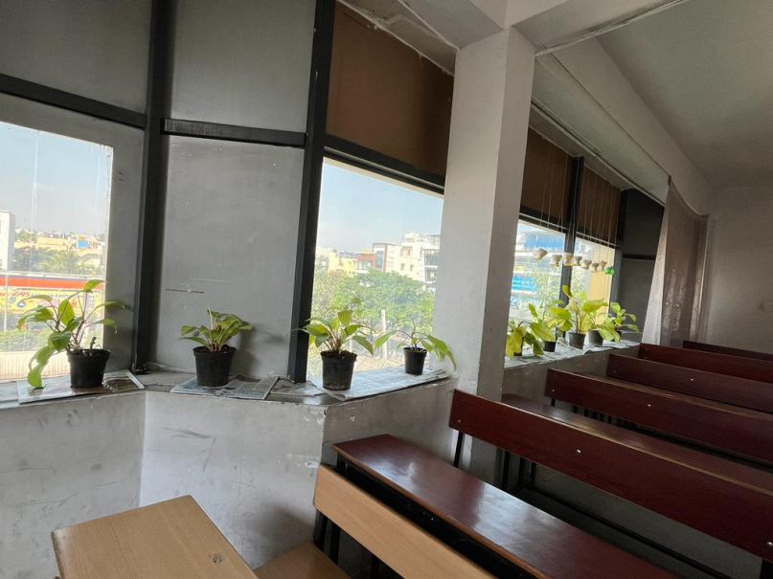
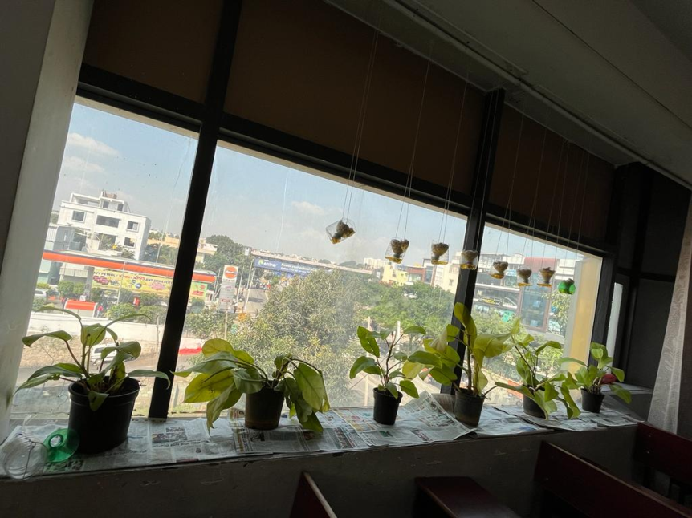
Arranged indoor plants in IX std

Slide 14
ANALYSIS OF CHANGES AFTER SETTING UP INDOOR PLANTS
CLASS | TYPE OF PLANTS | NUMBER | DIFFERENCE IN CO2 READING COMPARED TO THE PREVIOUS ONES
IX | PHILODENDRON- WITH BROAD LEAVES | 20 | A MARGINAL DECREASE
Initially, the experiment was with 10 plants. The result was not satisfactory. So, added the number of plants (another 10) and repeated the measuring.
Regularly monitored the levels for five days (3 times a day- morning before the classes start, during lunch break and during school leaving time)
Even though the weather was cool due to the cyclone effect, CO2 level showed a marginal reduction.

Slide 15
SIDE EFFECTS OF CO2 MORE THAN 1000PPM IN A CLASSROOM
RESTLESSNESS
INCREASED HEART RATE
DIFFICULTY IN BREATHING
LACK OF CONCENTRATION
FATIGUE
SLEEPINESS
REDUCED COGNITIVE FUNCTION RESULTING IN POOR LEARNING, THINKING, REASONING, REMEMBERING, PROBLEM SOLVING, DECISION MAKING, AND ATTENTION.

Slide 16
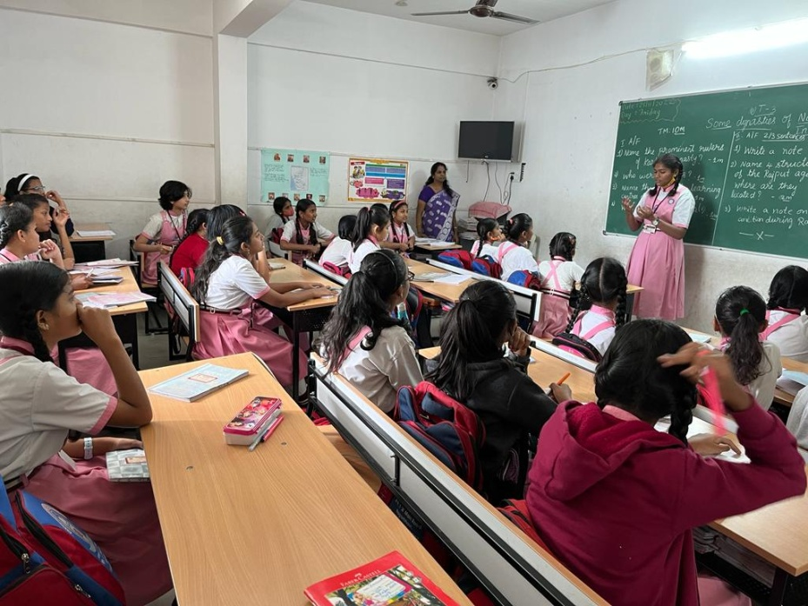
AWARENESS CAMPAIGN FOR OTHER CLASS STUDENTS AND TEACHERS
EXPECTED OUTCOME
REDUCING CARBON DIOXIDE LEVEL IN THE PREMISES
ENCOURAGING ALL STUDENTS TO TAKE PART IN MAINTAINING HEALTHY CLASSROOMS
MAKING A HEALTHY ATMOSPHERE INSIDE THE CLASSROOM FOR SCORING GOOD GRADES AND FOR GOOD HEALTH

Slide 17
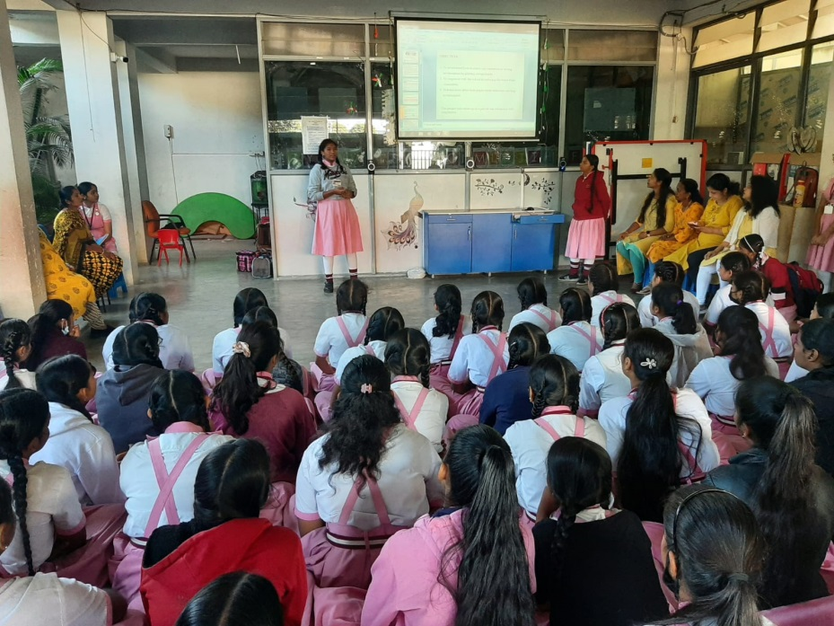
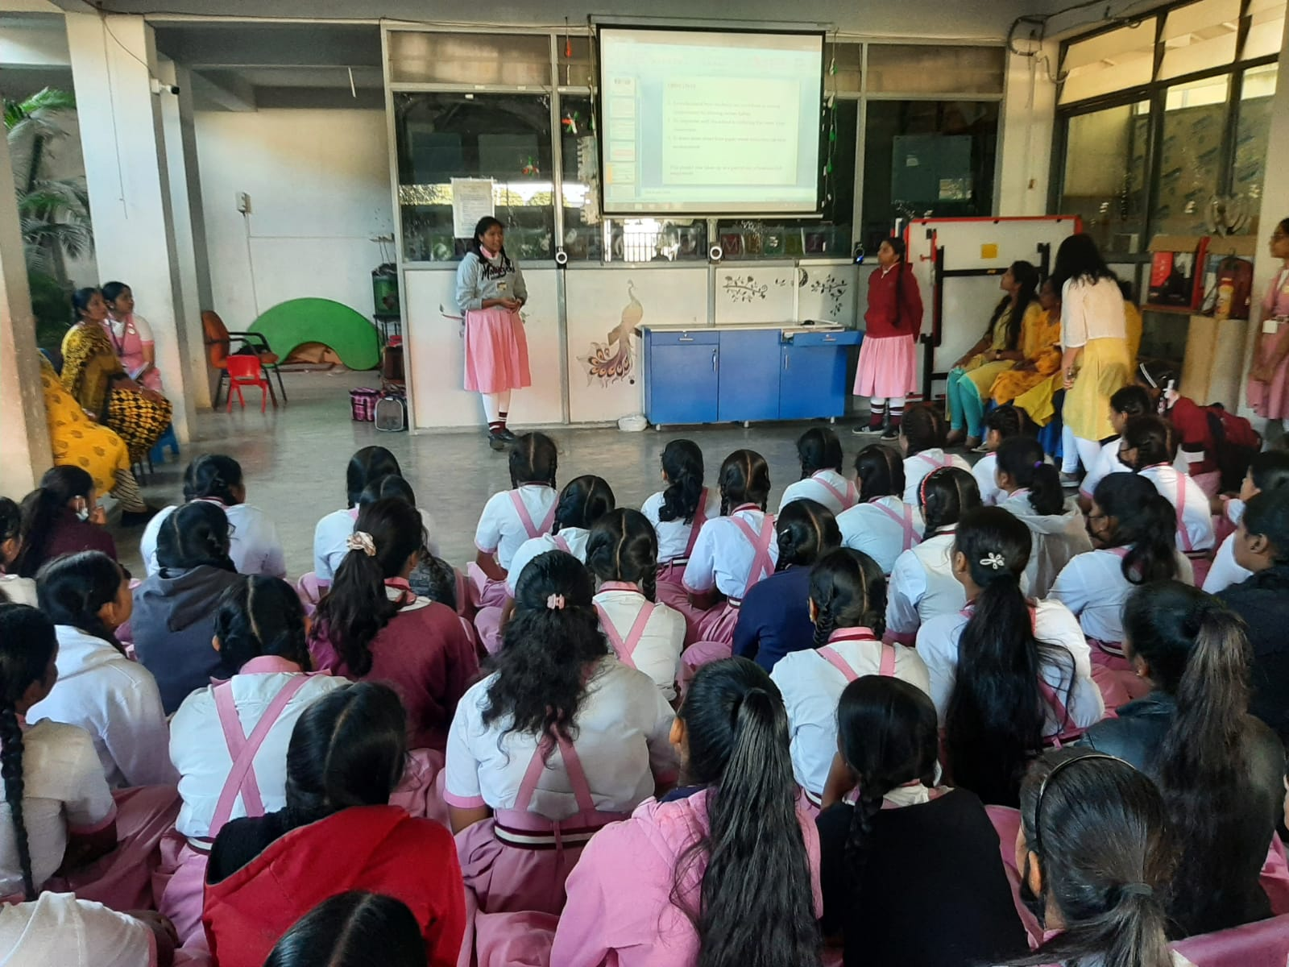
PHOTO

Slide 18
CHANGES MY STUDY COULD MAKE
ASSURANCE FROM THE MANAGEMENT TO FIX AN AIR PURIFIER IN THE TWO CLASSROOMS WHICH SHOWED HIGHER LEVELS OF CO2
MORE CLASSROOMS TURNING CO2 SENSITIVE AND GROWING INDOOR PLANTS
STUDENTS UNDERSTOOD ABOUT THE IMPORTANCE OF GOOD VENTILATION AND HOW IT REDUCES VOC LEVEL.
MANY TEACHERS ADMITTED THAT THEY WERE NOT KNOWING HOW CO2 AFFECTS THE LEARNING OF A STUDENT. I THINK NOW THEY WILL BE MORE CONSIDERATE TOWARDS THE STUDENTS.

Slide 19
ACKNOWLEDGEMENT
I SINCERELY THANK MY PARENTS , TEACHERS, CLASSMATES AND THE PRINCIPAL FOR EXTENDING ALL THE COOPERATION NEEDED FOR THE PROJECT.
A SPECIAL THANKS TO MADHAVI OF X STD FOR HELPING ME IN DOCUMENTING THE FINDINGS
I WOULD ALSO LIKE TO THANK CES DEPT OF IISC FOR GIVING ME AN OPPORTUNITY TO PRESENT MY PROJECT.

Slide 20
REFERENCES
1.
Climate Change: Atmospheric Carbon Dioxide
https://www.climate.gov
2.
Nutrient Solution for Hydroponics - IntechOpen
https://www.intechopen.com
3.
Need to reduce indoor pollution? House plants will help ... - ABC
https://www.abc.net.au
4.
Cognitive Functioning - an overview | ScienceDirect Topics
https://www.sciencedirect.com
5.
The Impact of CO2 on Children's Learning | SAV Systems
https://www.sav-systems.com
6
https://www.advsolned.com

Slide 21

Project by:- Mouna Shankar, IX Std

