Slide 1
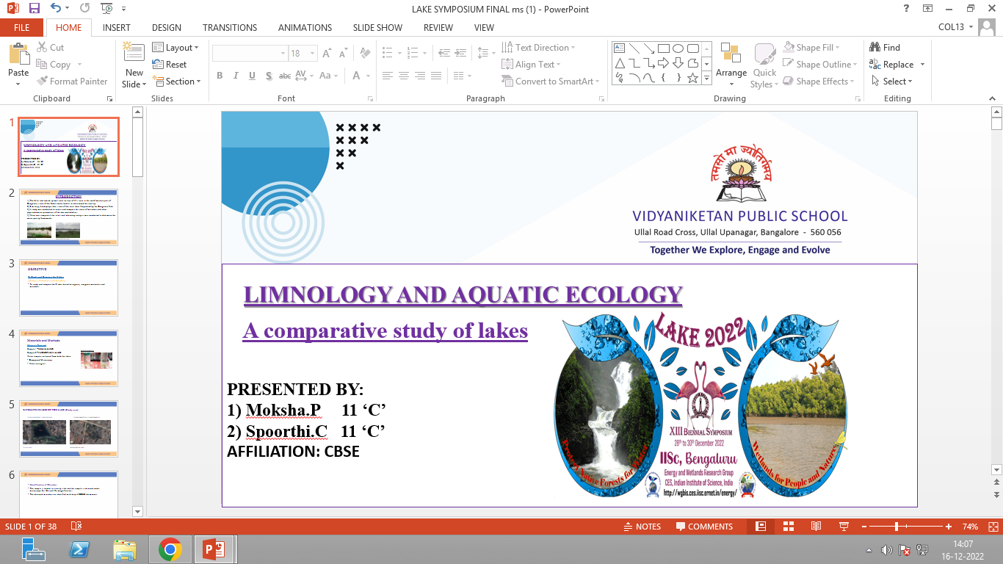

Title :LIMNOLOGY AND AQUATIC ECOLOGY A comparative study of lakes
1) Moksha.P 11 ‘C’
2) Spoorthi.C 11 ‘C’
Affiliations : CBSE
Put here
School Logo
12/1/2022
LAKE 2022: Conservation of wetlands: ecosystem-based adaptation of climate change, December 28-30, 2022
1

Slide 2
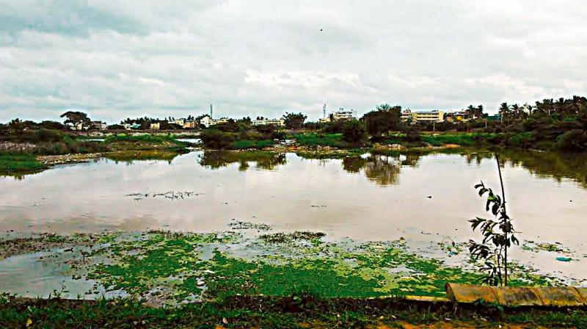
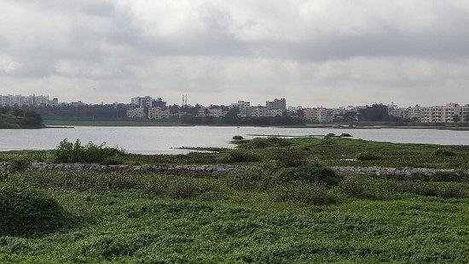
INTRODUCTION
1) The Ullal lake which sprawls over an area of 31.1 acre in the south-western part of Bangalore is one of the fewest water bodies in and around the locality.
2) Similarly, Anchepalya lake is one of the rural lakes frequented by the Bangalore folk.
3) A study was conducted to access and compare the status of microbes and other physiochemical parameters of the two waterbodies.
4) Water was sampled at the inlets and laboratory analysis was conducted to determine the water quality framework.
ULLAL LAKE
ANCHEPALYA LAKE

Slide 3
OBJECTIVE
To Study and Compare the 2 lakes
(Analysis of chemicals and microbes)
To study and compare the 2 lakes based on organic, inorganic molecules and microbes.

Slide 4
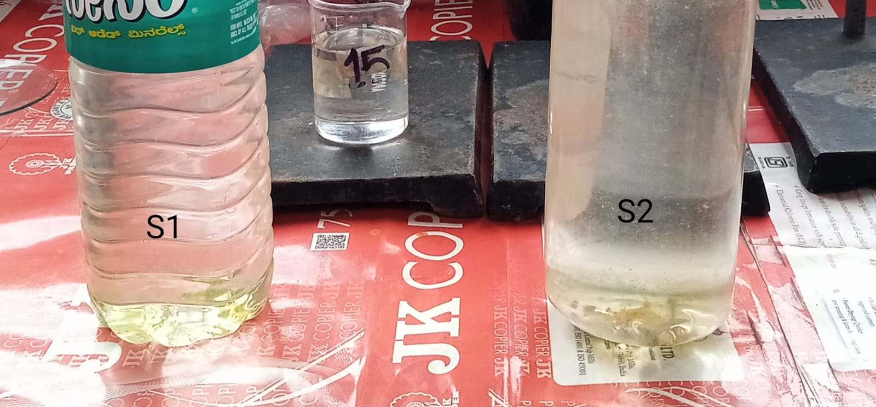
Materials and Methods
Materials Required
Sample 1 –ULLAL LAKE
Sample 2 –ANCHEPALYA LAKE
Water samples collected from both the lakes.
Compound Microscope
Water testing kit
WATER SAMPLES

Slide 5
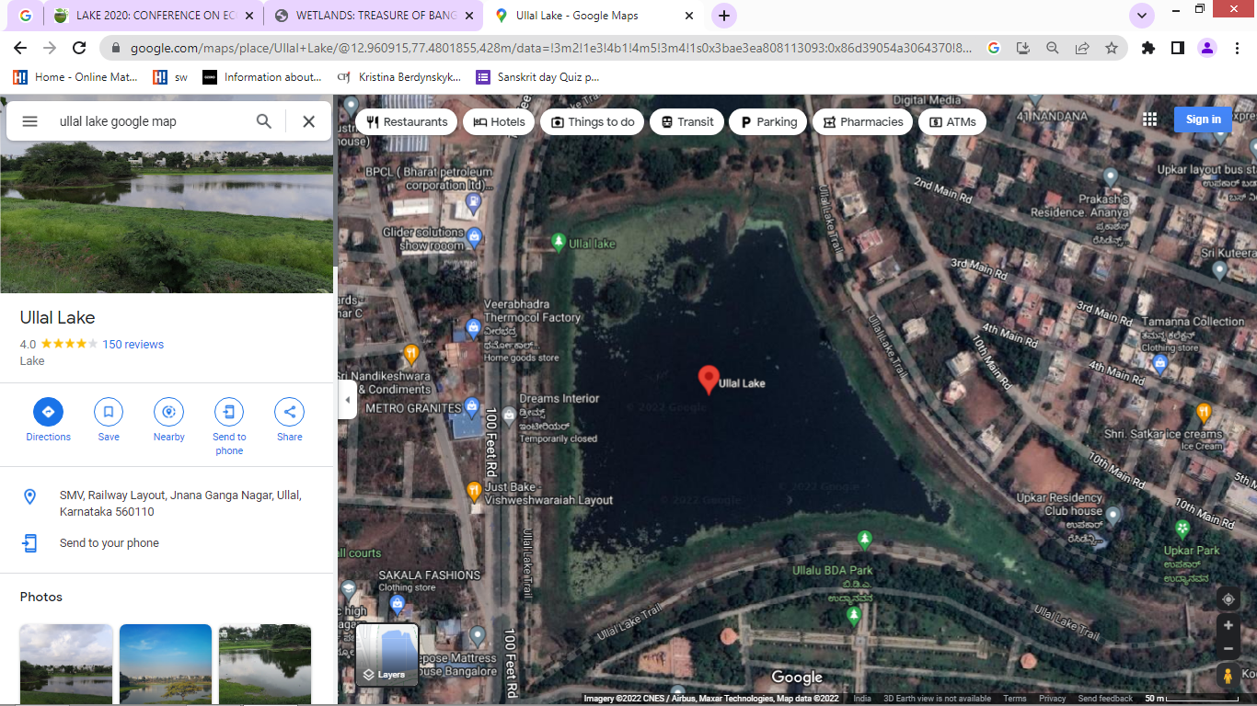
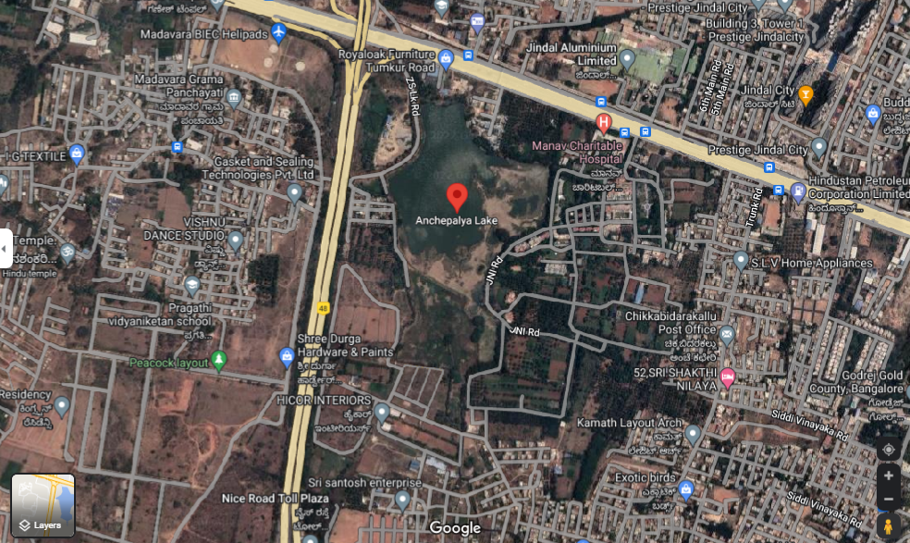
STUDY AREA (SATELLITE IMAGES OF THE LAKE )
12.961377667056343, 77.4810759513445 1 13.050274090702136, 77.47608188490726
ULLAL LAKE
ANCHEPALYA LAKE

Slide 6
Sample 1
To the North of Ullal lake (near inlet) there is a
coconut plantation, during rains the run-off into the
lake from this area will bring agricultural waste such as
plant debris, pesticides, fertilizers etc.
Sample 2
To the North –East of Anchepalya Lake there is Jindal Aluminium Ltd which manufactures Aluminium products and releases the solid waste and other scrap into the lake inlet.

Slide 7
Identification of Microbes
The sample is loaded in a cavity slide and the sample is observed under microscope for 10x and 45x magnification .
The observed microbes are identified with help of CBSE lab manual.

Slide 8
Sample collection method
The sample bottles are labelled and are rinsed downstream to remove any possible contaminants.
First, the inside of the bottle, cap and rim is rinsed using distilled water.
It is then rinsed using the sample.
The bottle is then immersed upright about 10cm deep and the sample is collected.
Once the sample is collected, the bottle is sealed immediately and placed in a zipper lock bag.

Slide 9
Experimental method
A preliminary round of qualitative analysis was conducted in the laboratory to determine the presence of organic, inorganic ions.
A standard method of water testing was then employed using the water testing kits to quantitatively determine the presence of certain ions in particular and other physiochemical parameters.

Slide 10
ANALYSIS (ROUND-1)

Slide 11
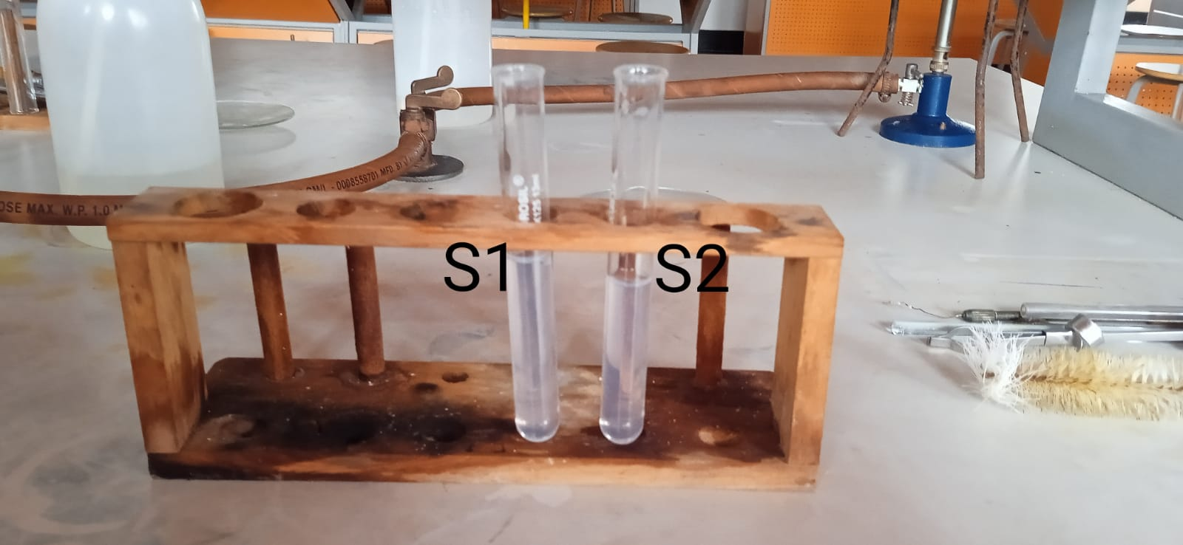
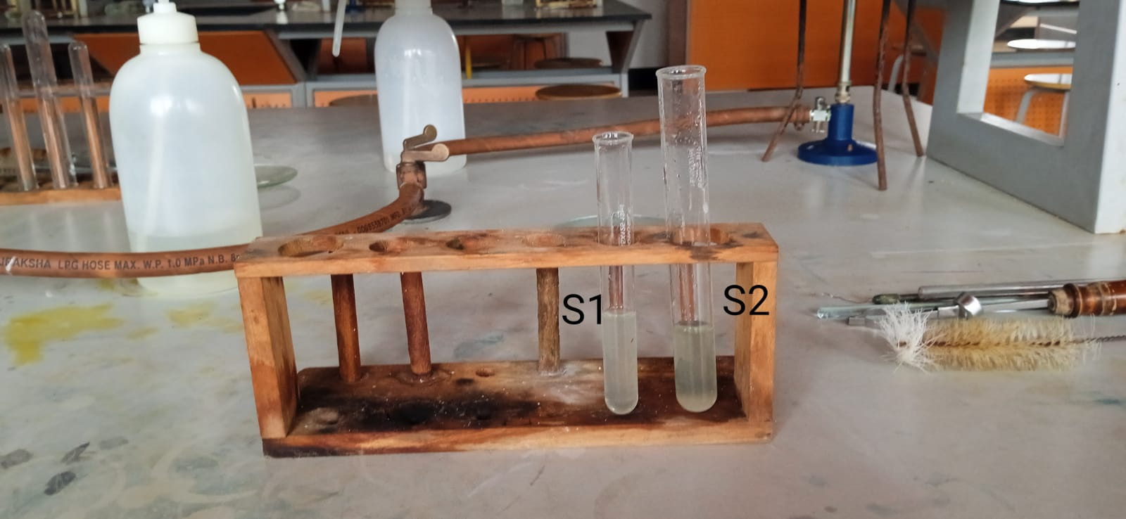
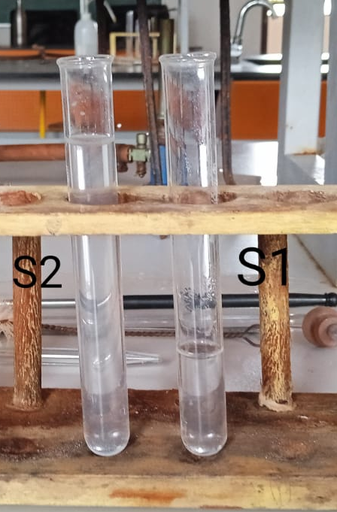
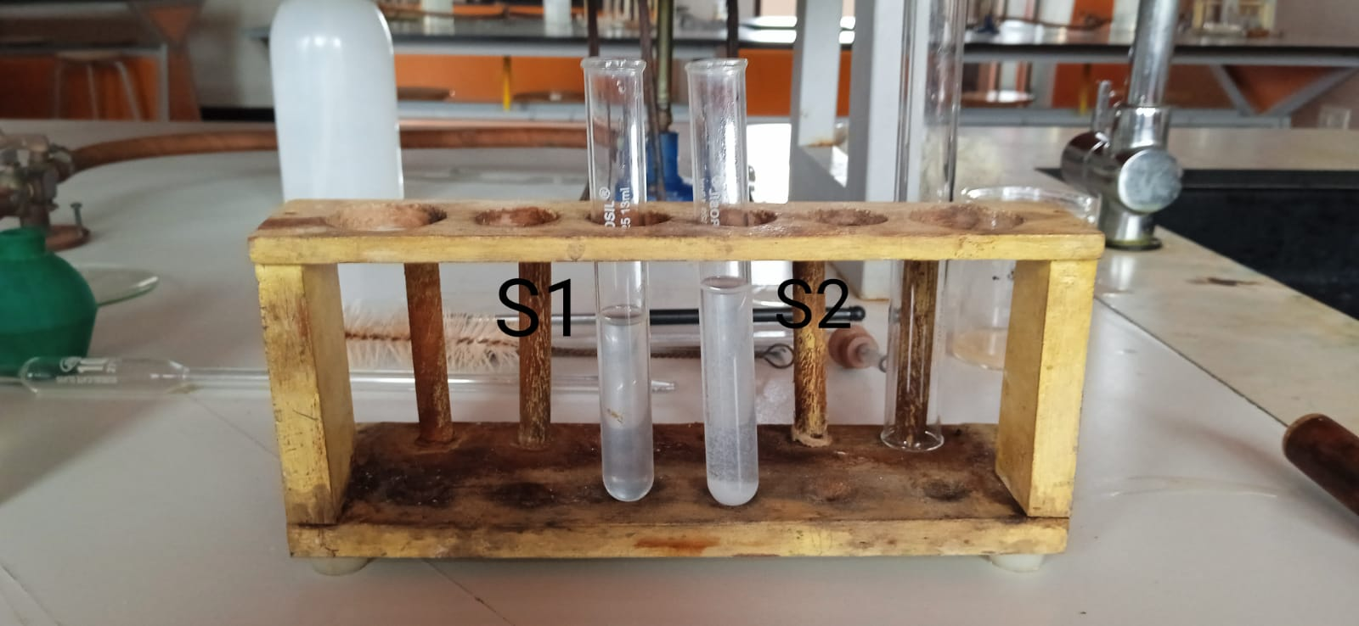
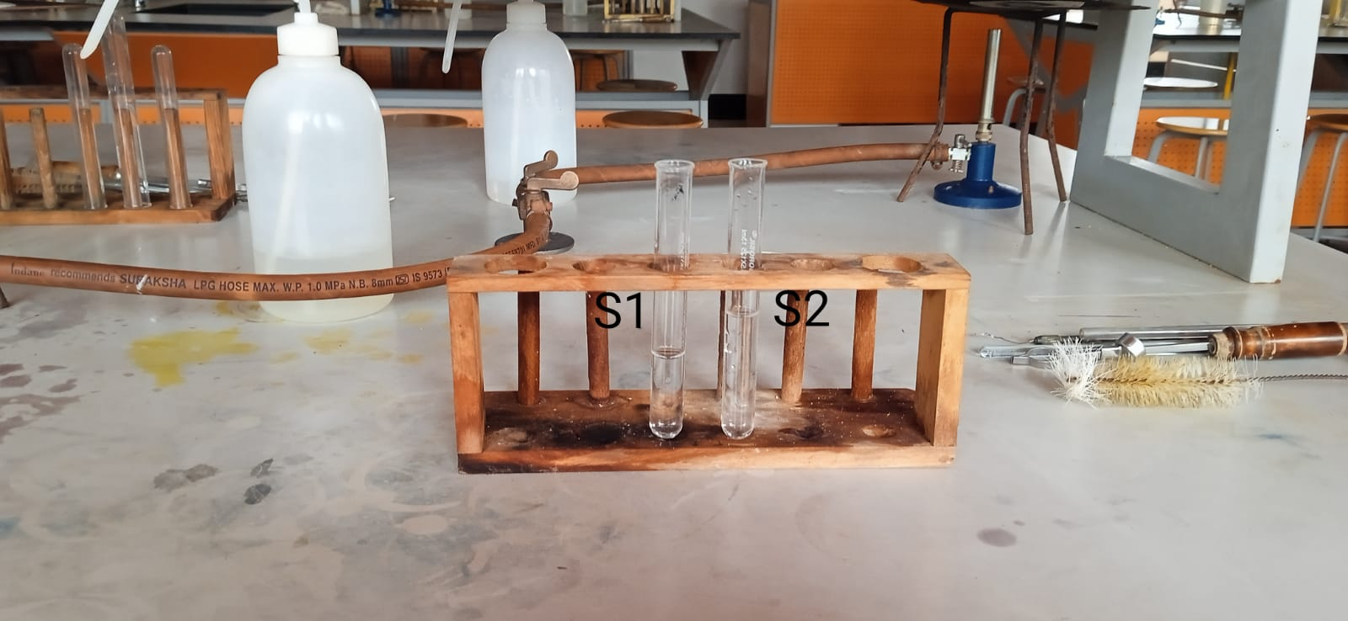
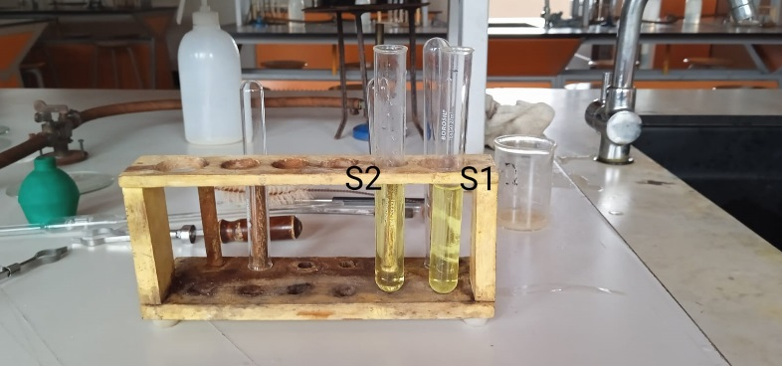
CHLORIDE TEST
NITRATE TEST
CALCIUM TEST
LEAD TEST
MAGNESIUM TEST
PHOSPHATE TEST

Slide 12
RESULT
PARAMETERS | S1 ULLAL LAKE | S2 ANCHEPALYA LAKE
pH OF THE SAMPLES | pH 9 | pH 10
CHLORIDE | ✓ | ✓
NITRATE | X | X
CALCIUM | ✓ | ✓
MAGNESIUM | ✓ | ✓
PHOSPHATE | ✓ | ✓
LEAD | X | X

Slide 13
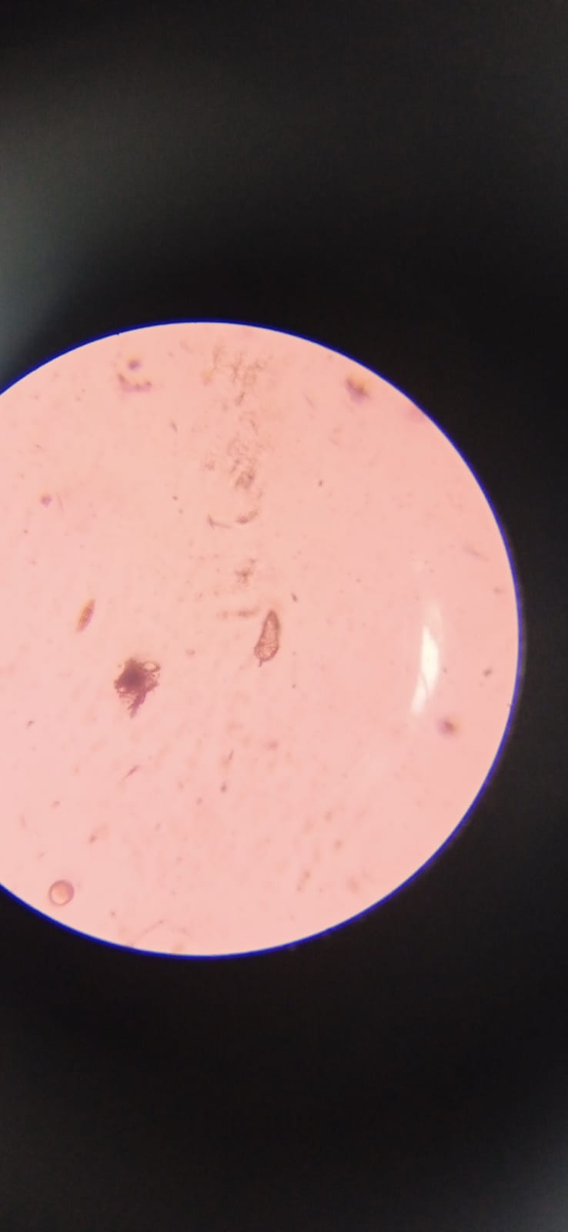
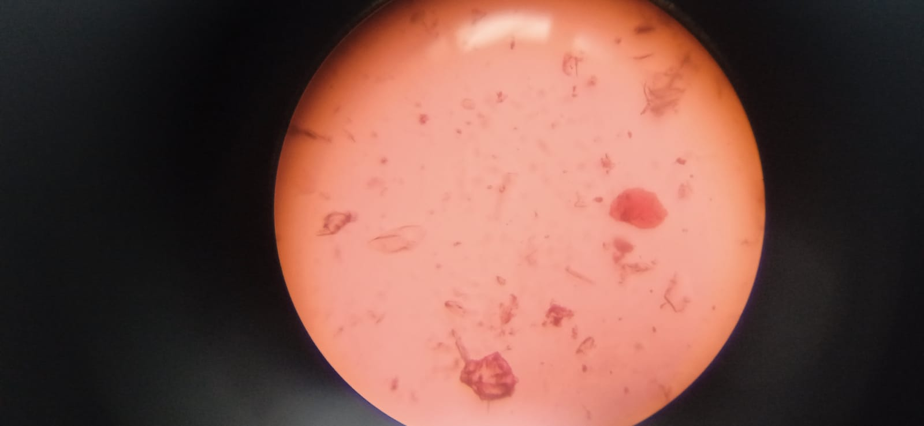
MICROBES IDENTIFIED
S1 ULLAL LAKE | S2 ANCHEPALYA LAKE
ROTIFER | EPITHEMIA
COPEPOD | ZOOPLANKTON
ZOOPLANKTON

Slide 14
ANALYSIS (ROUND-2)

Slide 15
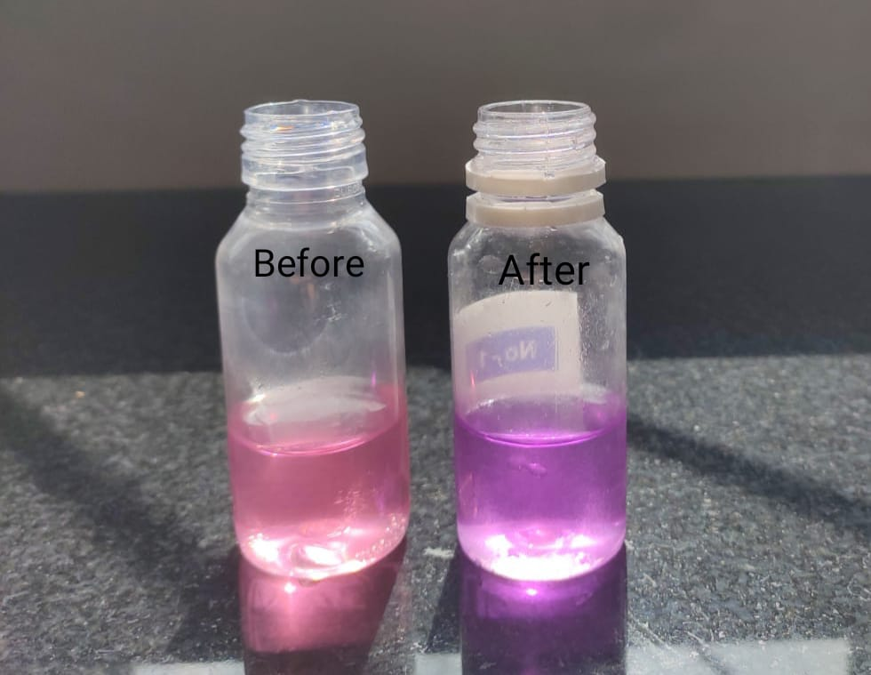
CALCIUM HARDNESS
Method:
1. Take 25ml of water sample in the test bottle.
2. Add 10 drops of Calcium Hardness Reagent-2
(CH-2) and mix.
3. Add 10 drops of Calcium Hardness Reagent-3
(CH-3) and mix.
4. Add few specs of Calcium Hardness Reagent-1
(CH-1) and mix until a distinct pink color
develops.
5. For hard/soft water, add Calcium Hardness Reagent-4
(CH-4), shake well after each drop until the color
CALCIUM HARDNESS

Slide 16

Changes from pink to purple. Count the number of drops of CH-4 required for color change.
RESULT:
Calcium hardness = no. of drops x 5(ppm in terms of ${CaCO}_{3}$)
S1
8 x 5 = 40 ppm
S2
12 x 5= 60 ppm

Slide 17
TOTAL HARDNESS TESTING
Method of Test:
1. Take 25ml of water sample in the test bottle (No-1)
2. Add 10 drops of Total Hardness reagent - 2 (TH-2) and mix.
3. Add few specs of Total Hardness reagent - 1 (TH-1) and mix until a distinct pink color develops.
For Hard water | For Soft water
Add Total Hardness reagent-3 (TH-3) shake well after each drop until the color changes from pink to blue. Count the no.of drops of TH-3 required for color change. | Add Total Hardness reagent-4 (TH-4). Shake well after each drop until the color changes from pink to blue. Count the no. of drops of TH-4 required for color change.

Slide 18
RESULT:
S1
Total Hardness = no.of drops x 5 (p.p.m. interms ofCaCO₃)
= 15 X 5
= 75 ppm
S2
Total Hardness = no. of drops x 2 (p.p.m. interms of CaCO₃)
= 24 x 2
= 48 ppm

Slide 19
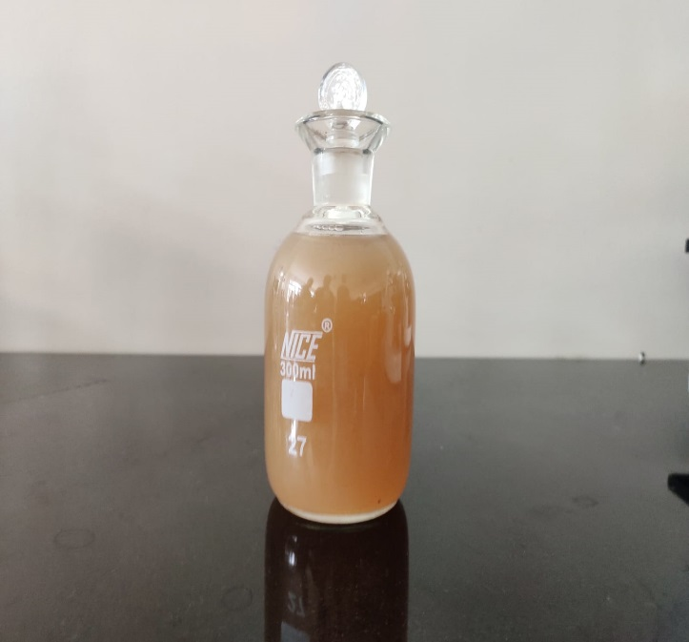
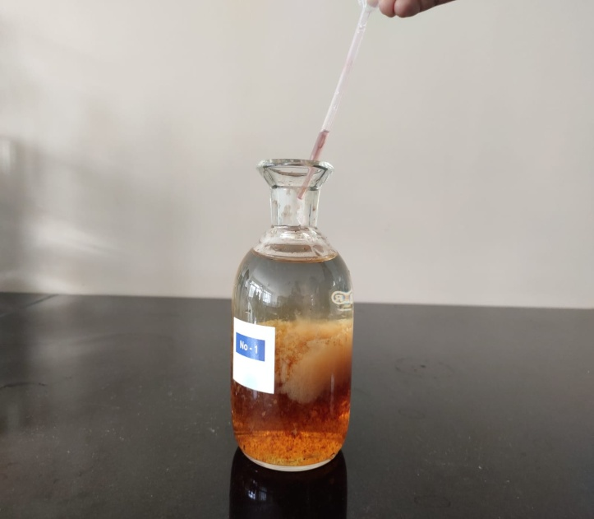
ESTIMATION OF DISSOLVED OXYGEN
Method:
1. Take 300ml of water sample in the test bottle
2. Add 2ml of Dissolved Oxygen Reagent-1(DO-1)
very carefully and tip of the filler is dipped
below the water level.
3. Then add 2ml of Dissolved Oxygen Reagent-2
(DO-2) very carefully and tip of the filler is dipped
below the water level.
4. Replace the stopper without inclusion of any air
bubble and thoroughly mix the content by shaking

Slide 20
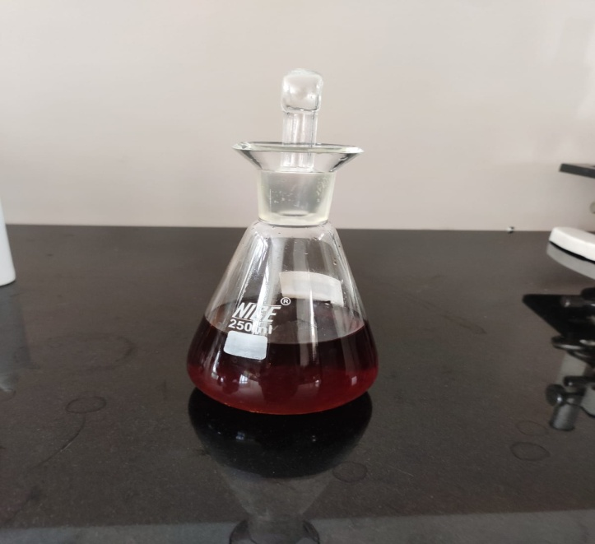
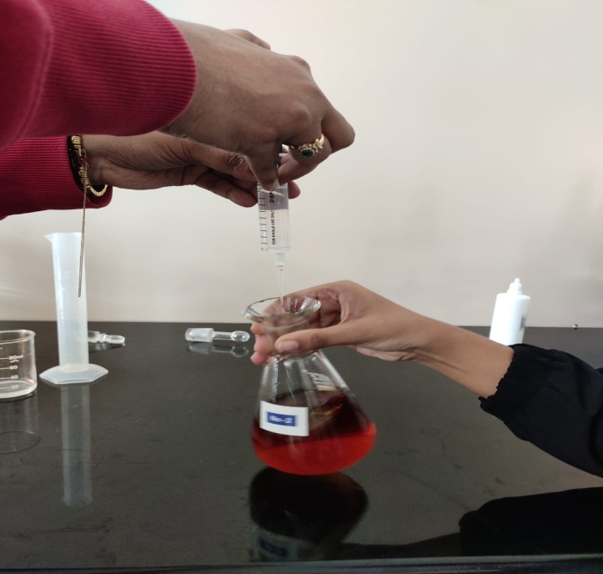
the test bottle several times and allow the ppt formed
to settle.
5. After 2-3 minutes of setting, carefully remove the
stopper of the test bottle and immediately add 2ml
of Dissolved Oxygen Reagent-3(D0-3) very carefully
by running the reagent down the neck of the bottle
and mix thoroughly to dissolve the ppt settled
completely.
6. Take 200ml of the solution in an iodine flask and add
4 drops of Dissolved Oxygen Reagent-4(DO-4)

Slide 21
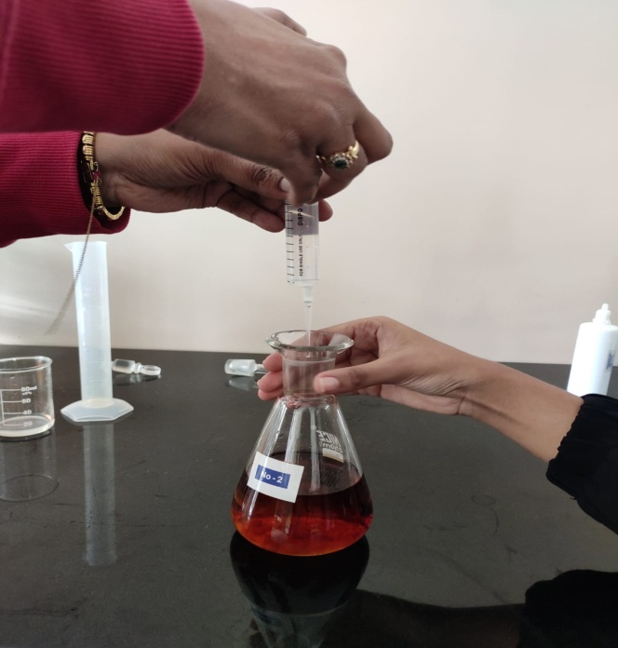
7. Titrate with Dissolved Oxygen Reagent-5(DO-5) taken
in a 10ml syringe until the color changes from blue
to colourless.
RESULT:
Dissolved oxygen = volume in ml of DO-5 used
for titration
S1
6ml
S2
12ml

Slide 22
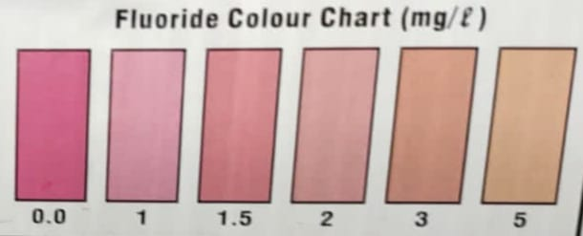
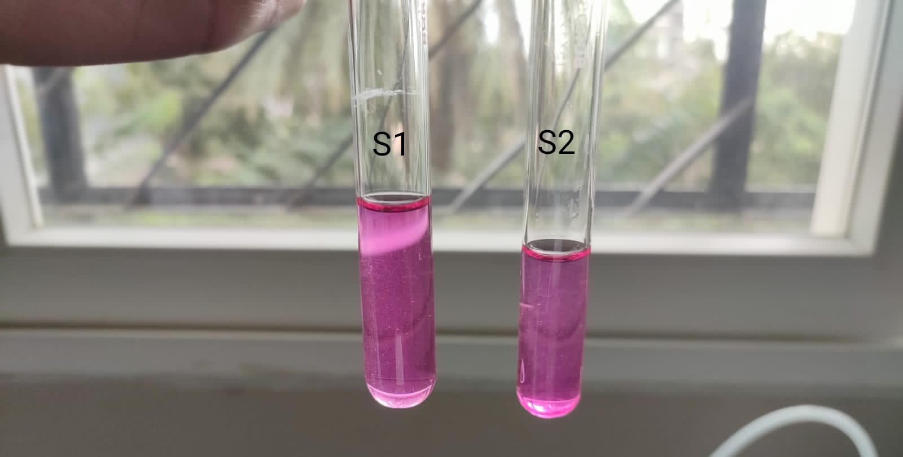
FLUORIDE
1. Take 5ml of water sample in the test tube
2. Shake well the Fluoride Reagent-1(F-1) and
then add 5 drops to the water sample. Mix
the content.
The color that forms is compared with the fluoride
color chart and record the fluoride value
RESULT:
S1- 1 mg/l
S2- 1 mg/l

Slide 23
CHLORIDE TESTING
METHOD
Take 25ml of water sample in the test bottle (No-1)
Add 5 drops of Chloride Reagent-1 (CI-1) and mix well until a distinct yellow color develops.
Add Chloride Reagent-2 (C1-2), shake well after each drop until the color changes to red. Count the no. of drops of Cl-2 required for color change .

Slide 24
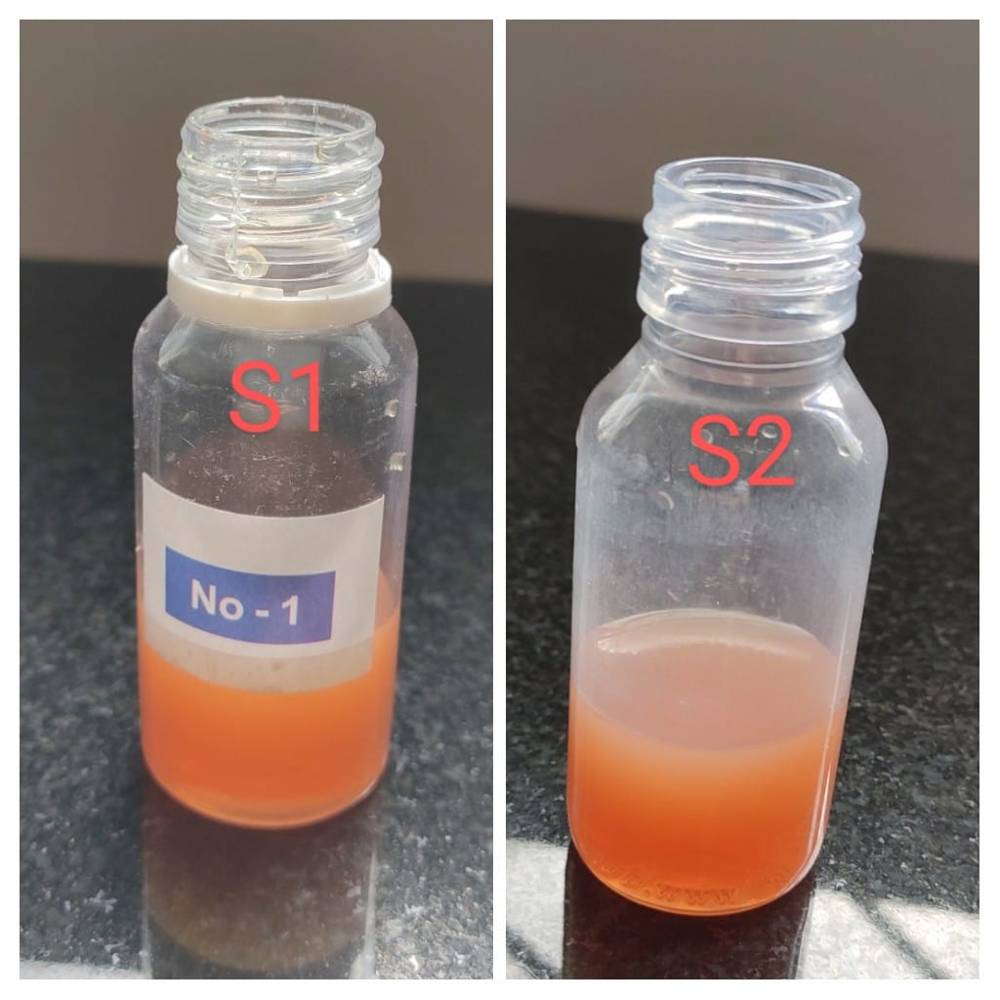
RESULT
Chloride (as Cl), mg/l =no. of drops x 10
S1 S2 X 10=
S1
8 x 10 = 80 mg/L
S2
14 x 10 = 140 mg/L

Slide 25
RESIDUAL CHLORINE TESTING
METHOD
1. Take 5 ml of water sample in the test tube.
2. Add 5 drops of Residual chlorine reagent-1 (RC-1) and mix well. The color that form is compared with the Residual chlorine color chart and record the Residual chlorine value

Slide 26
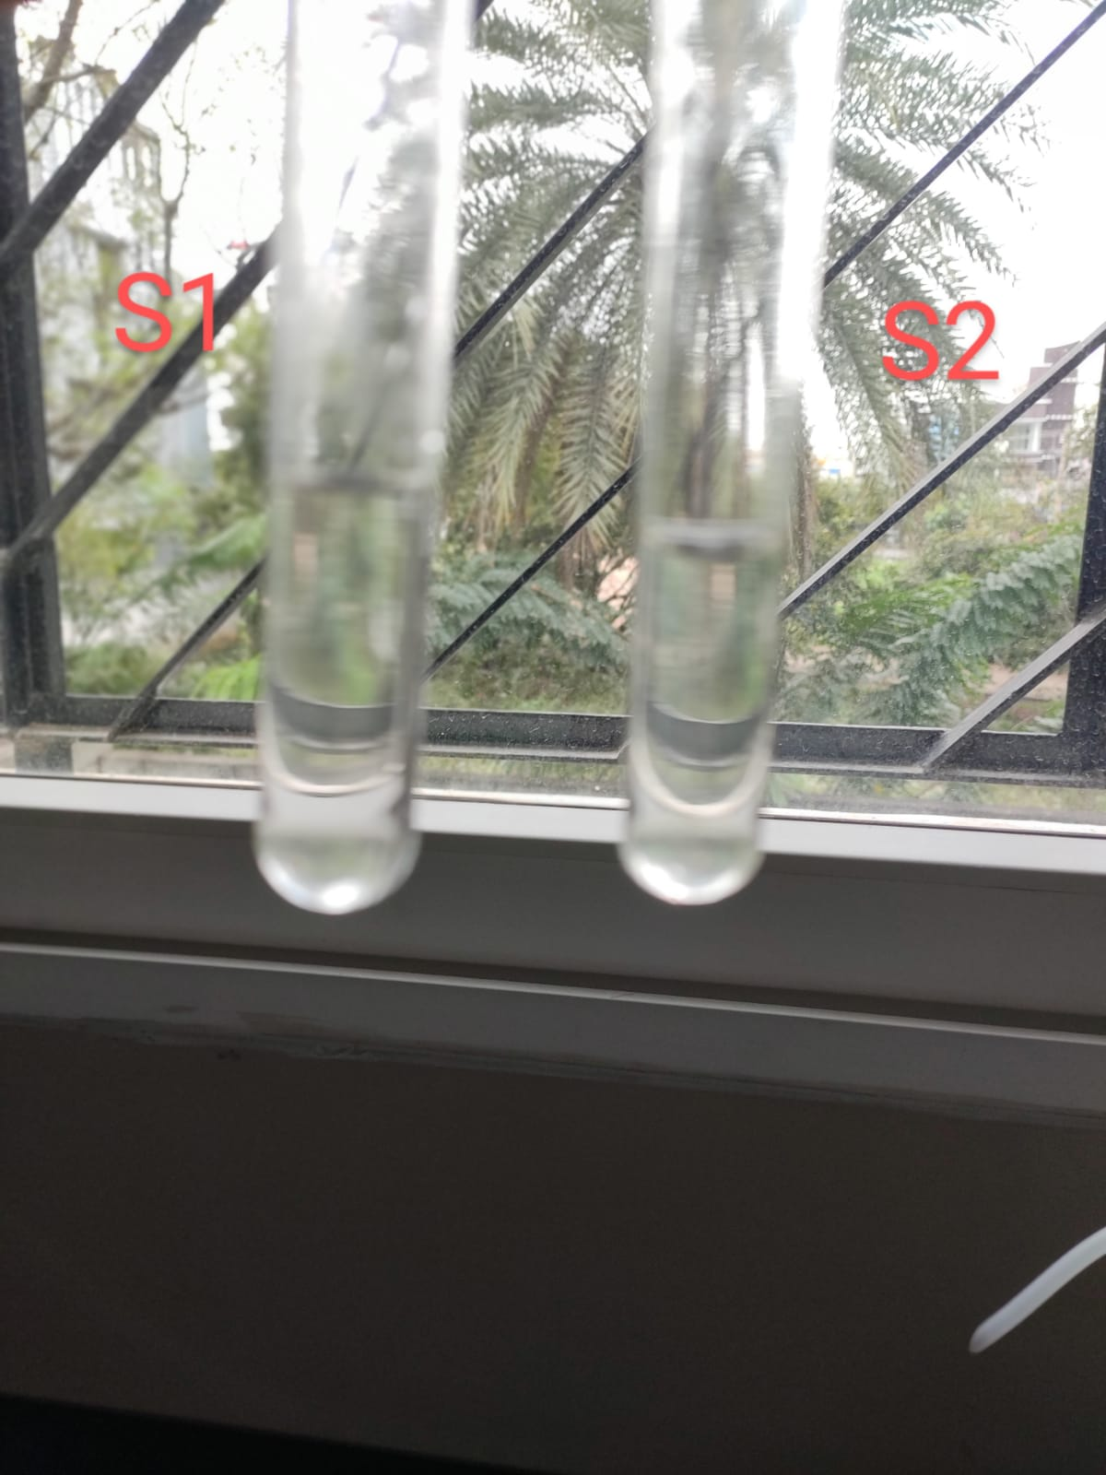
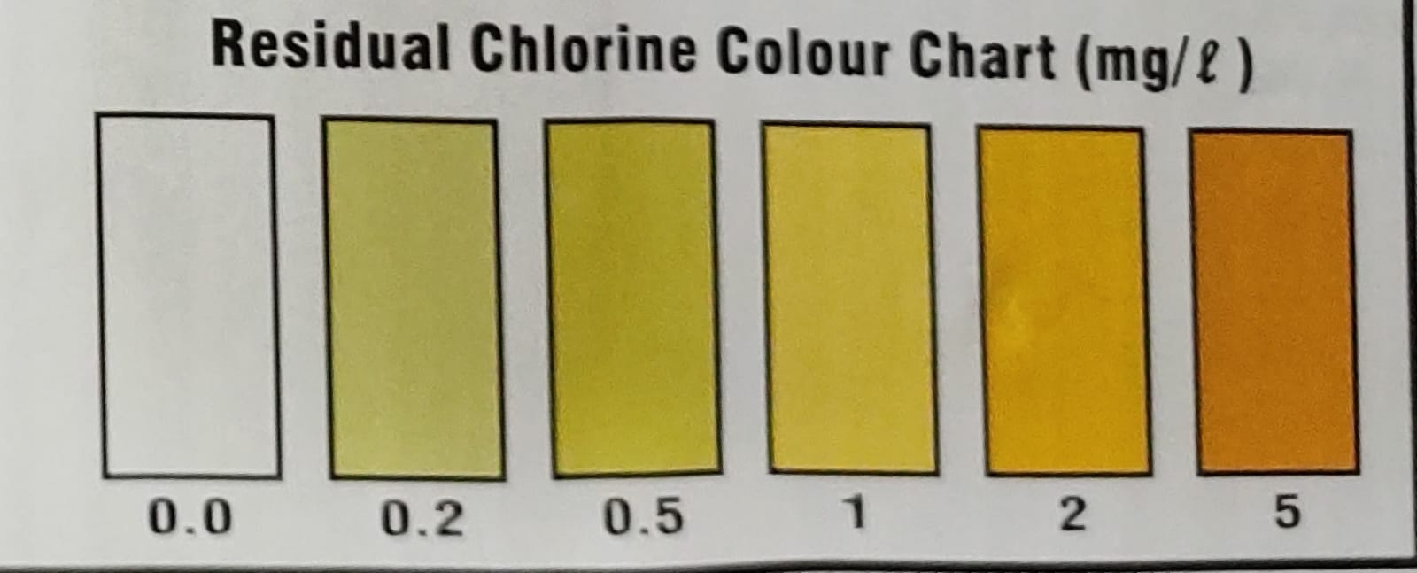
RESULT
S1 X10= S2 X 10=Residual Chlorine =0
Residual Chlorine =0
Residual Chlorine =0

Slide 27
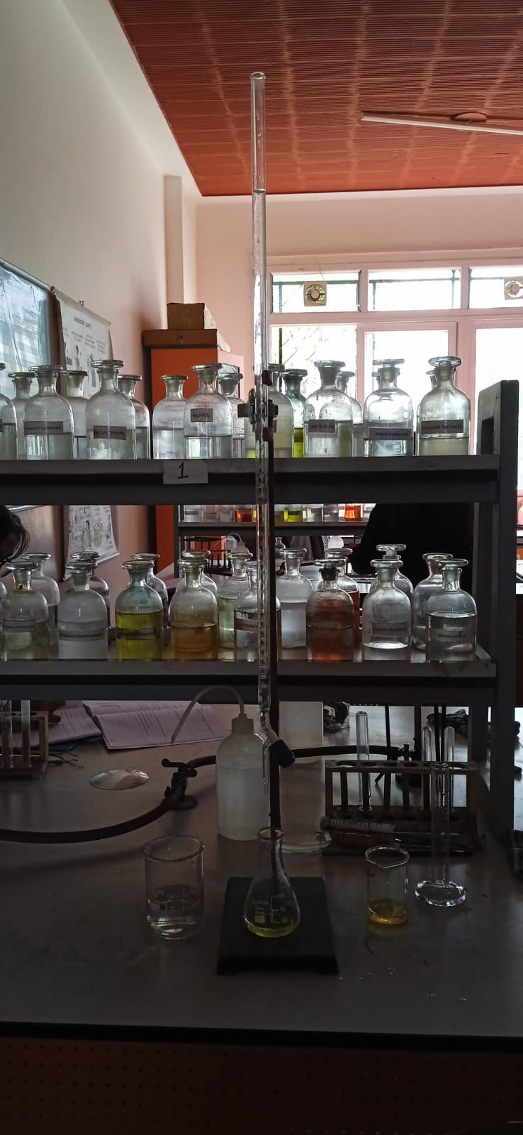
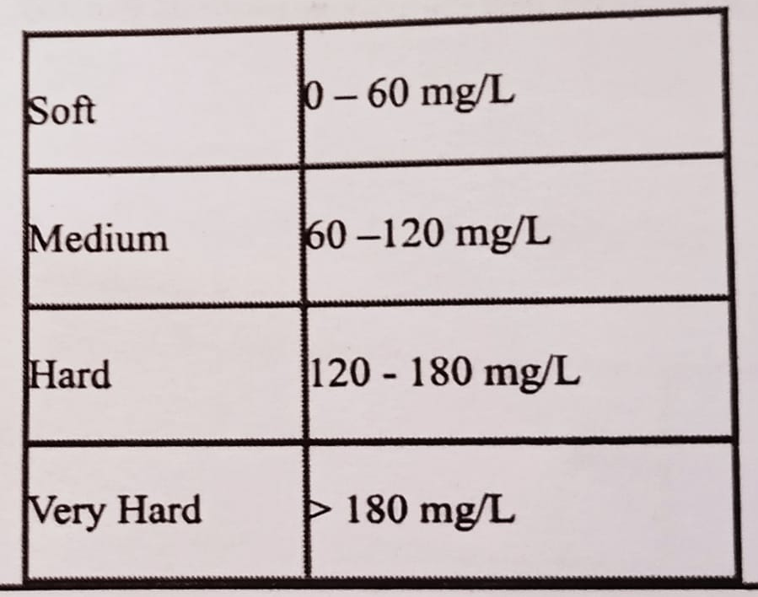
CHLORIDE CALCULATION
FORMULA:
(A-B) X N X 35.45 X 1000
S1
113.15 (Soft)
S2
133.0084 (hard)

Slide 28
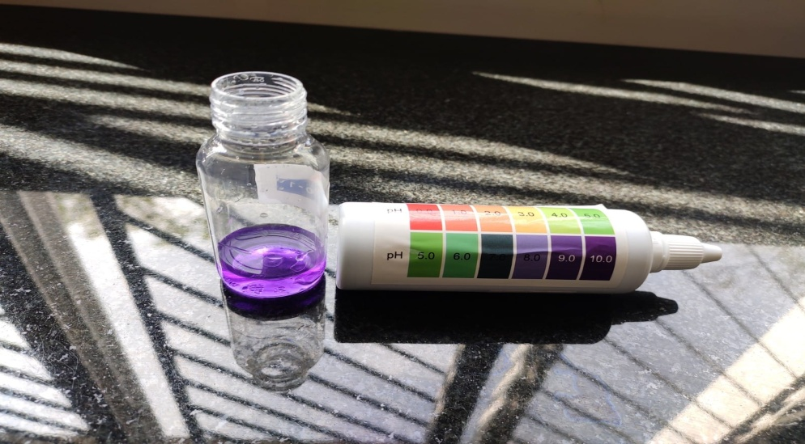
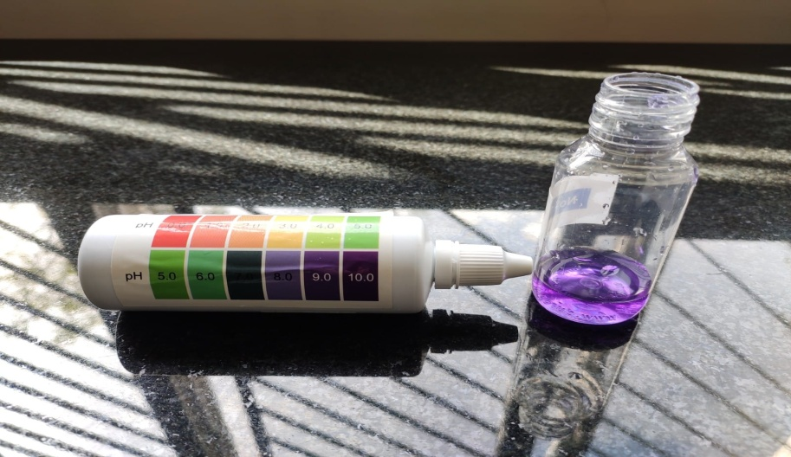
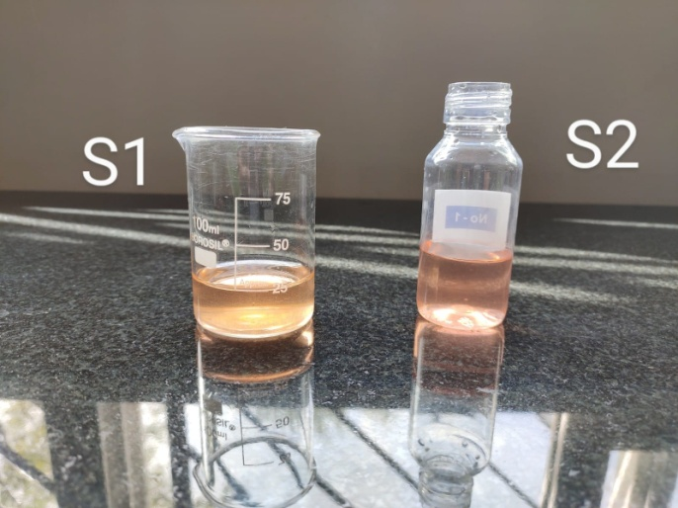
pH
S1 pH 9
S2 pH 10
ALKALINITY
FORMULA=No of drops X 5
S1- 28 Drops= 140mg/L
S2- 27 Drops=135 mg/L

Slide 29
RESULT
CRITERION | S1 | S2
CALCIUM HARDNESS (ppm) | 40 | 60
DISSOLVED OXYGEN(ml) | 6 | 12
FLUORIDE(mg/L) | 1 | 1
CHLORIDE(mg/L) | 80 | 140
RESIDUAL CHLORINE | 0 | 0
TOTAL HARDNESS(ppm) | Soft-75 | Hard-48

Slide 30
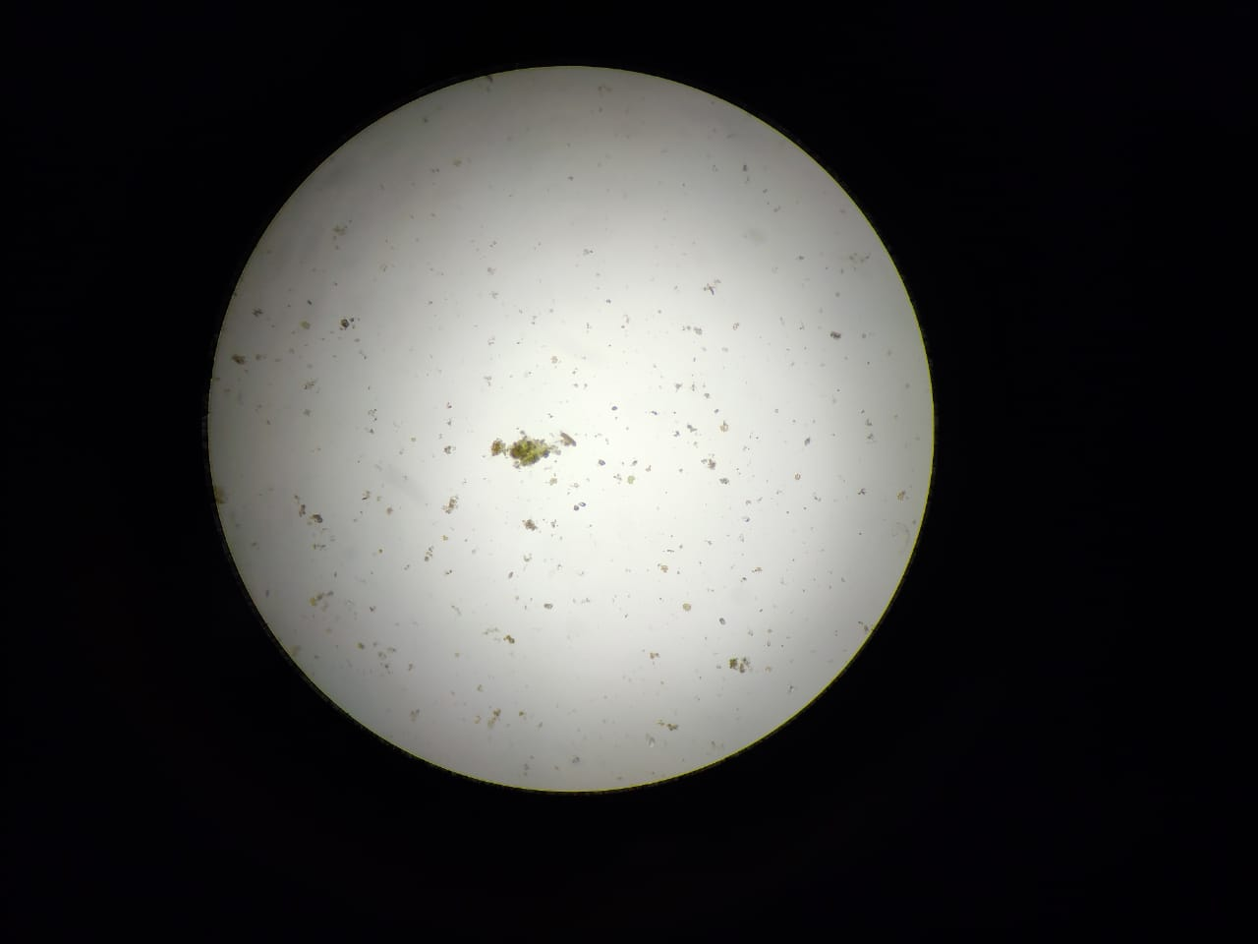
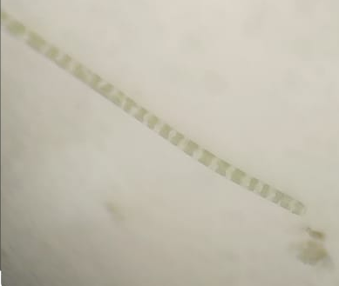
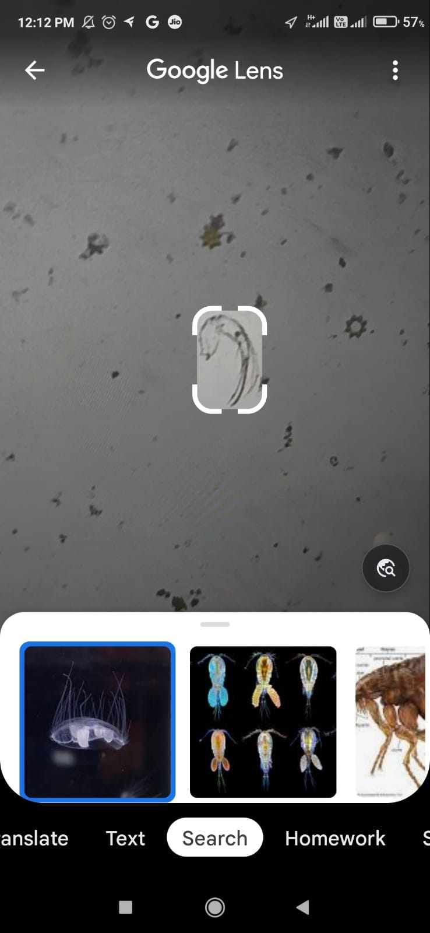
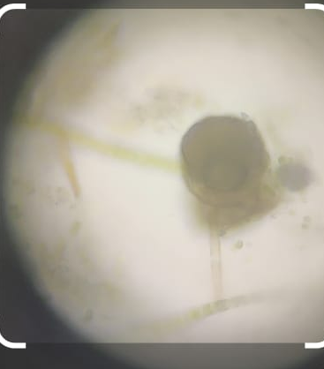
S1 ULLAL LAKE
S2 ANCHEPALYA LAKE
LIVERWORT
DIATOM
CRASPEDACUSTA SOWERBII
CHLAMYDOMONAS

Slide 31
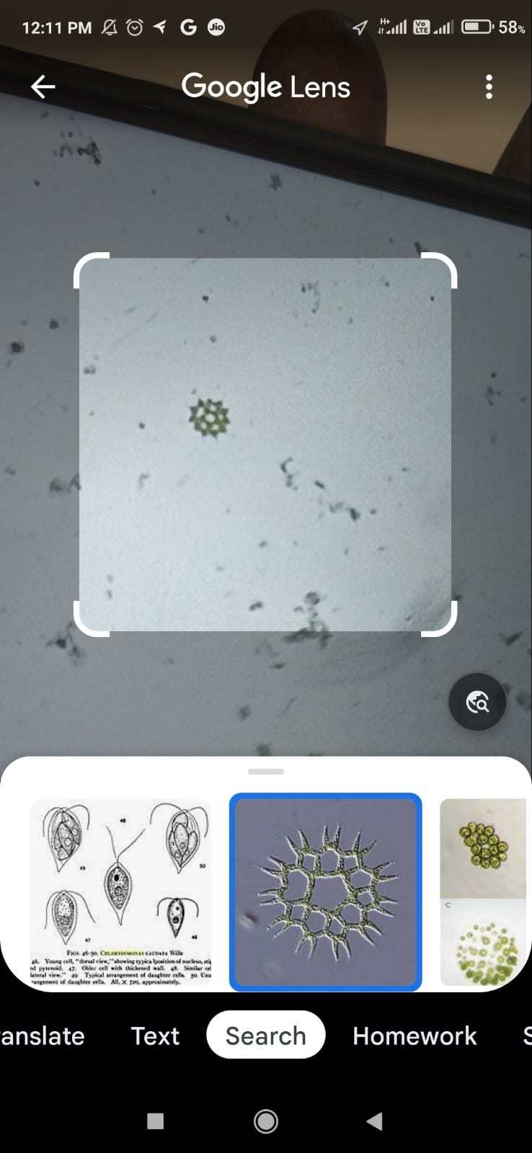
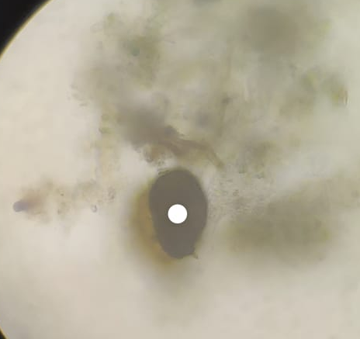
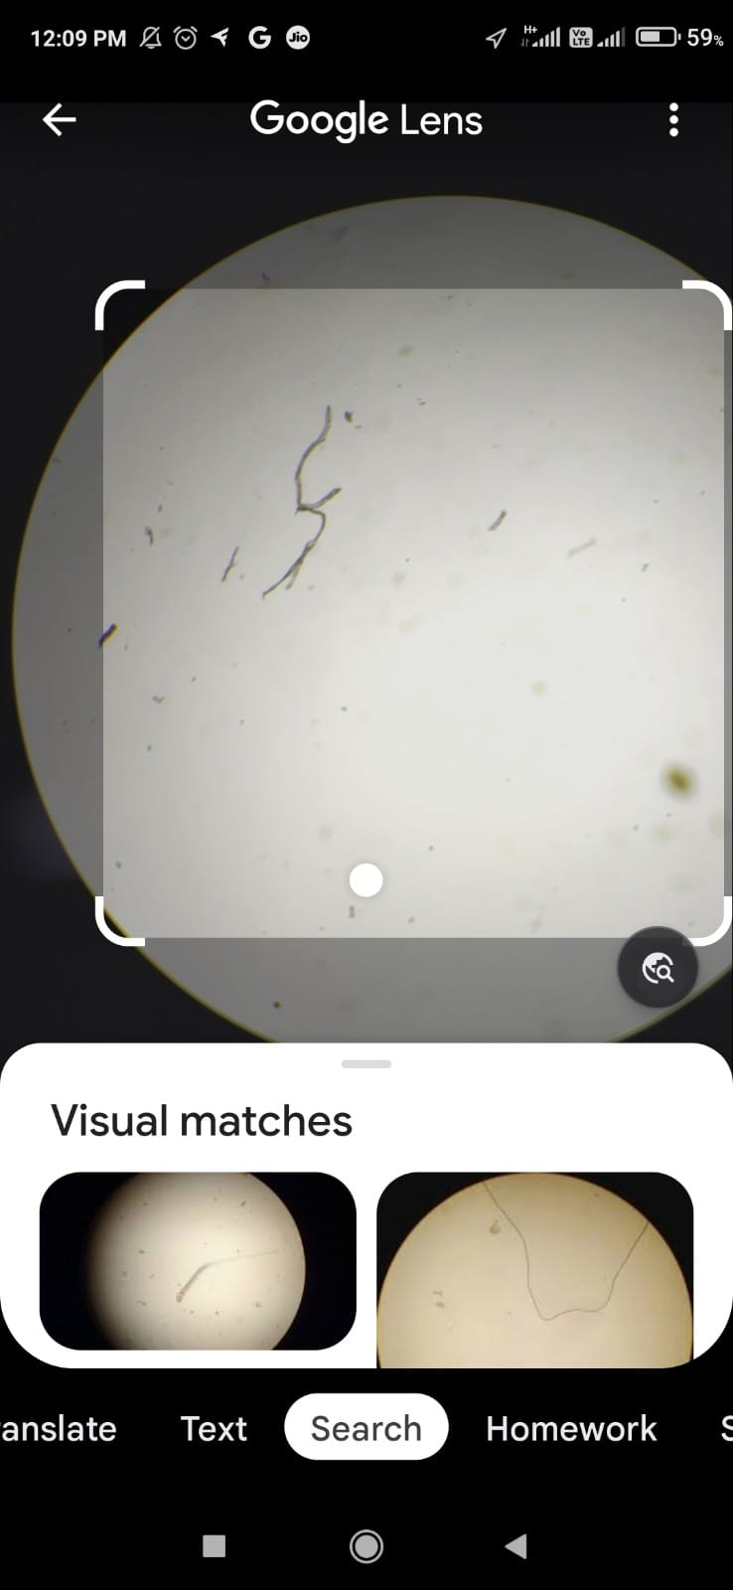
S1 ULLAL LAKE
S2 ANCHEPALYA LAKE
SCHLERODERMA
FLUKES
NEMATODE

Slide 32
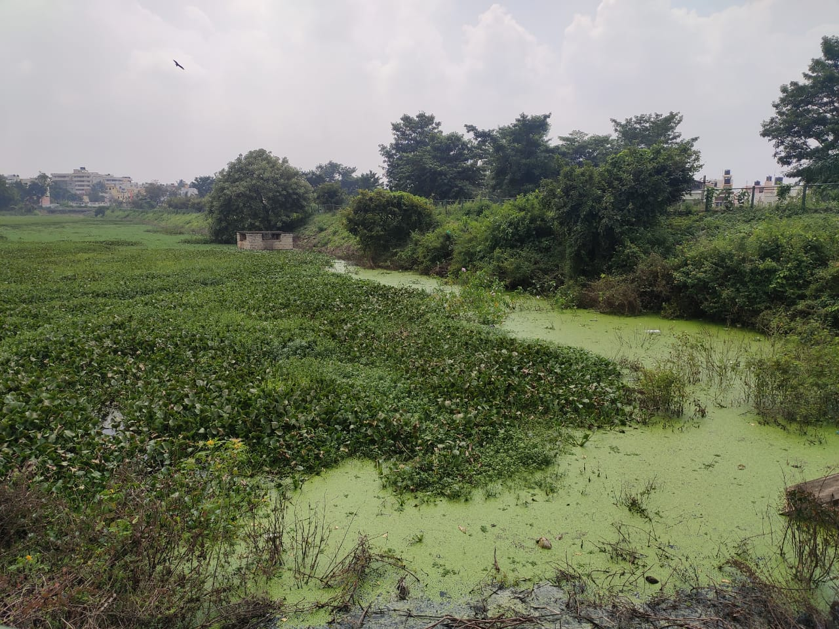
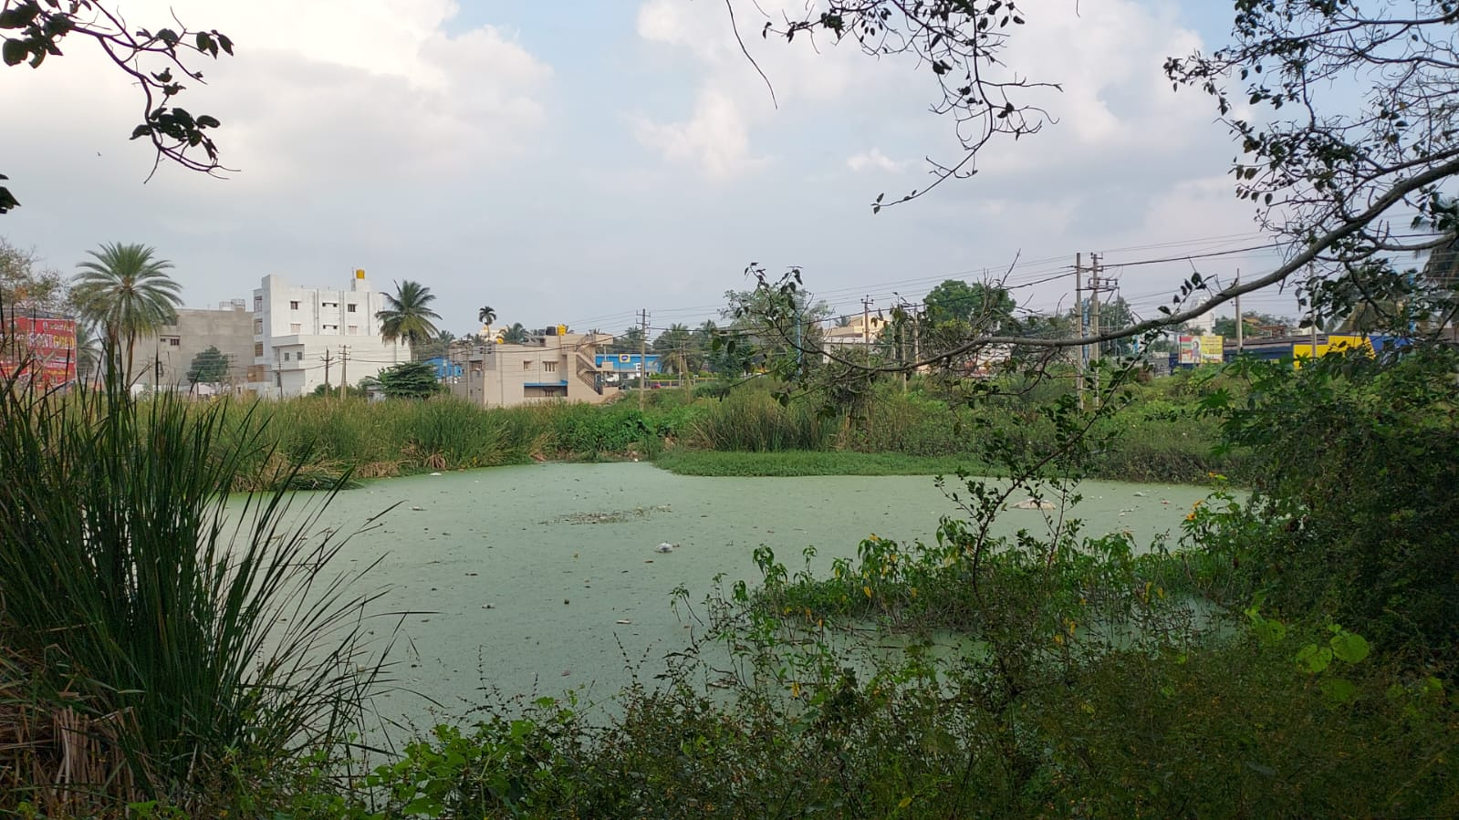
Discussion & Conclusion :
The physio-chemical parameters of both the lakes were assessed to understand the prevailing conditions of the water quality framework.
The results revealed that the Ullal lake had higher levels of organic pollution as compared to the Anchepalya lake.
ULLAL LAKE
ANCHEPALYA LAKE

Slide 33
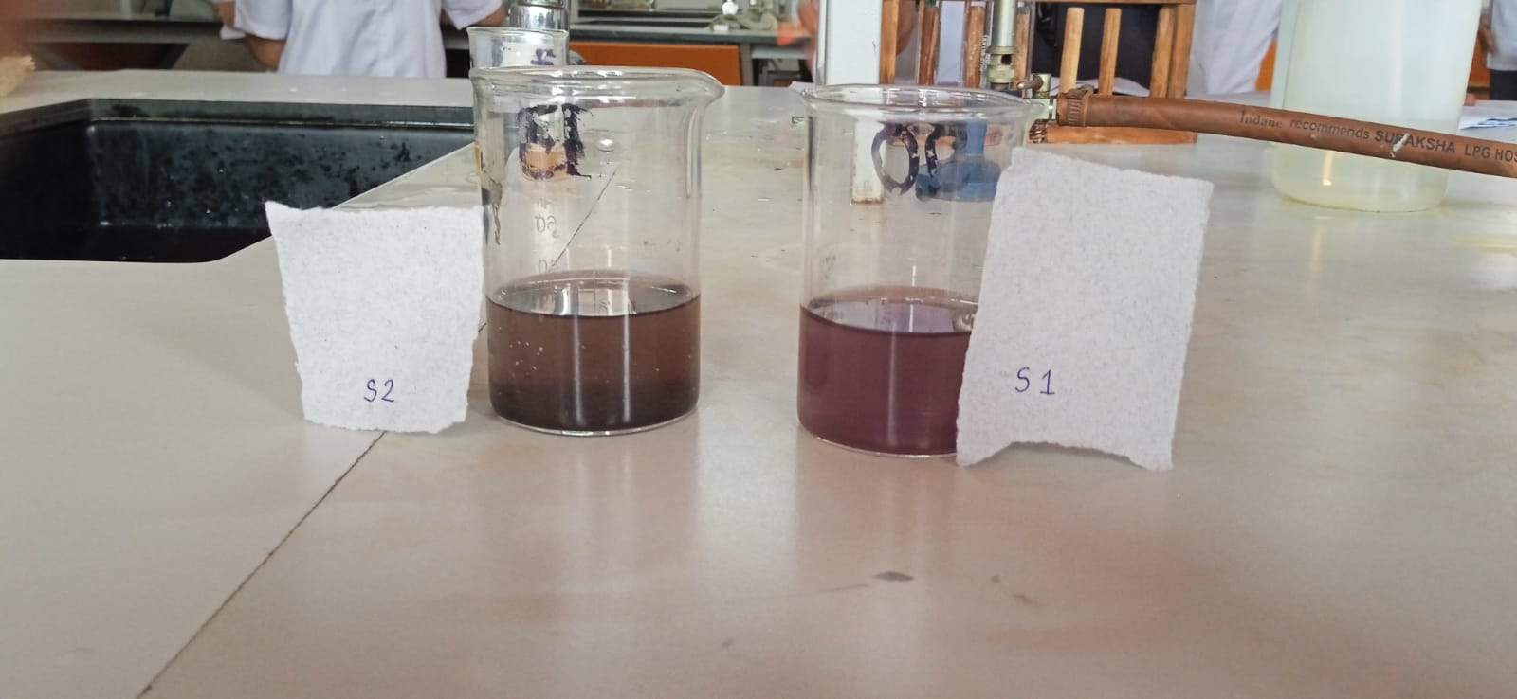
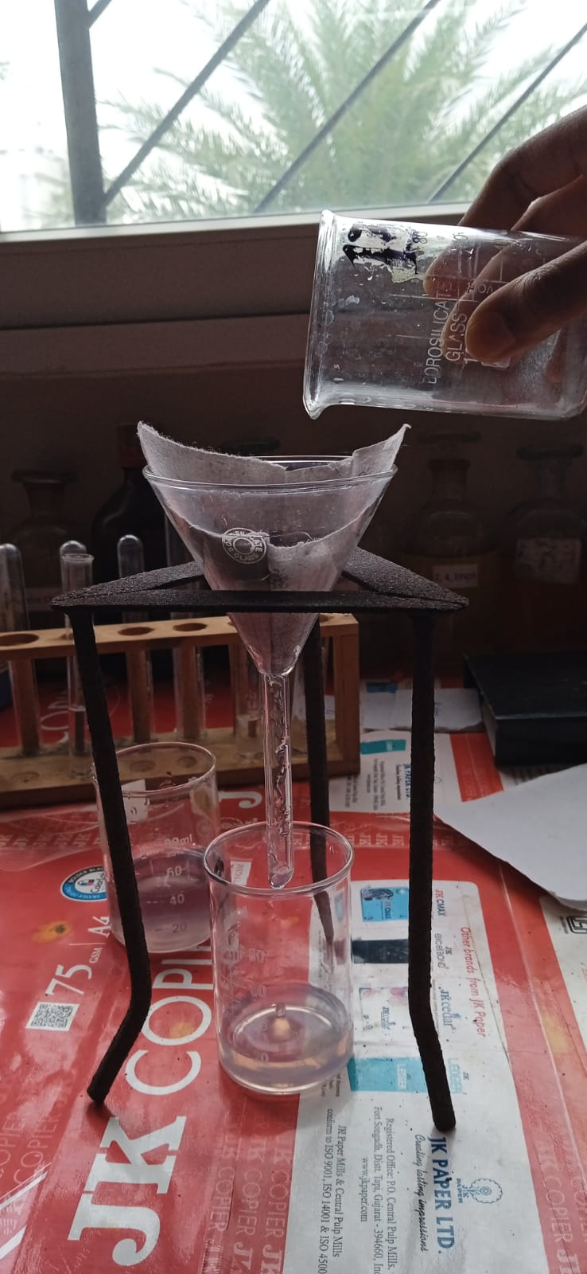
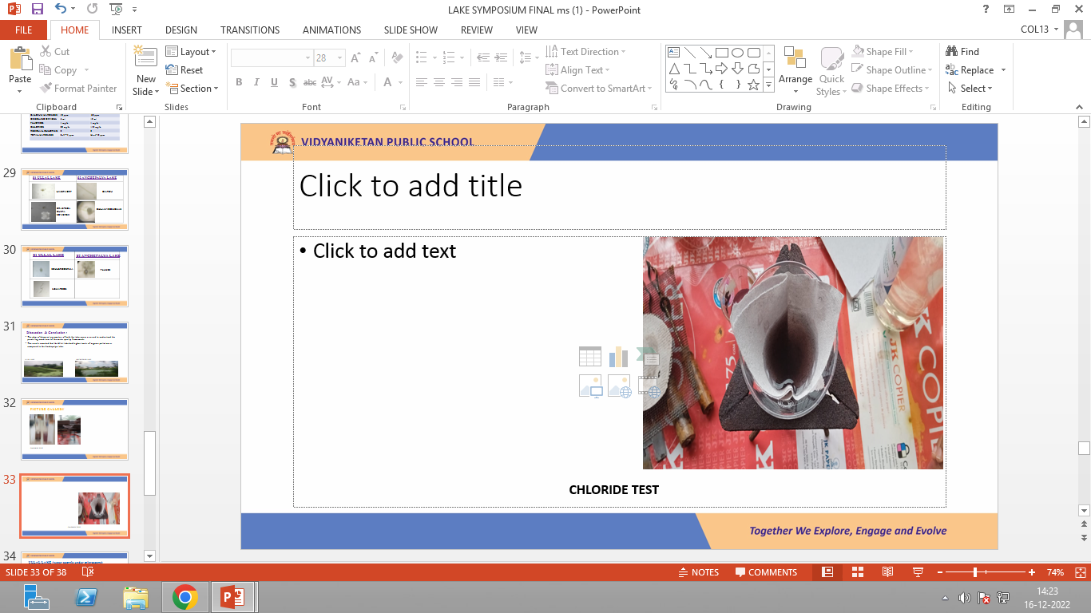
PICTURE GALLERY
CHLORIDE TEST

Slide 34
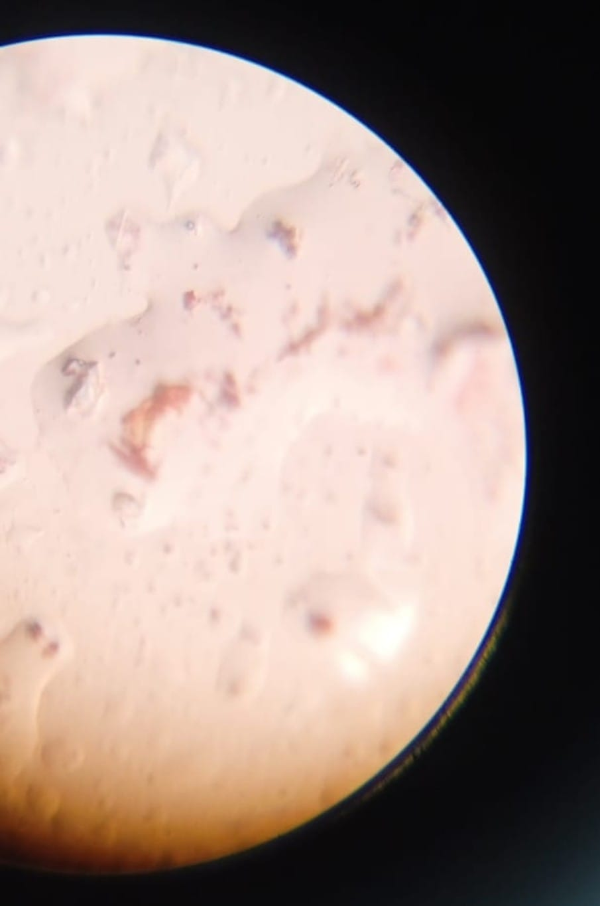
ULLAL LAKE (water sample under microscope)

Slide 35
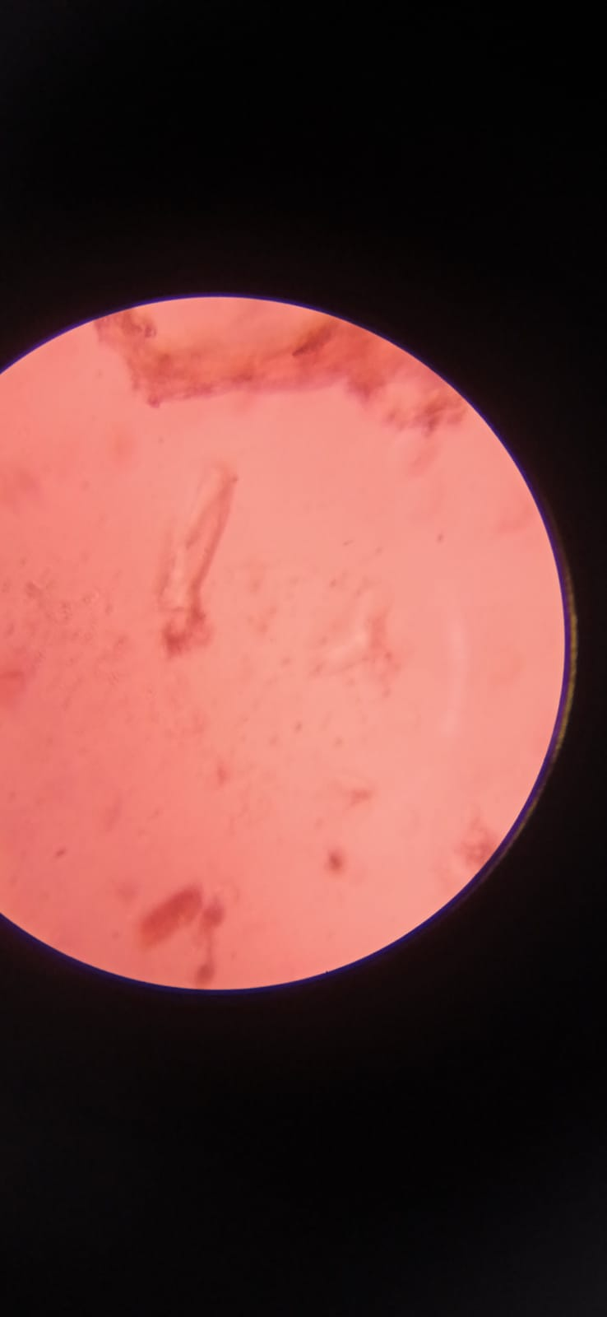
ANCHEPALYA LAKE (water sample under microscope)

Slide 36
ACKNOWLEDGEMENTS
We would like to express our special thanks of gratitude to our team of teachers and lab assisstants for their able guidance and support .
We would also like to extend our gratitude to IISc and our school management and who provided us with this amazing opportunity.

Slide 37
References
CLASS 11 CBSE LAB MANUAL
https://rscience.com/microscopic-organisms -pond-water/
https://www.semanticscholar.org/paper/Ecological-Assessment-of-Ullal-Lake%2C-Bangalore-A-Arafath-Hanjagi/d0a47753d4cec4d42d3fb694f67b238a9862fc8a
https://www.academia.edu/20273135/Seasonal_Variation_of_Phytoplankton_Diversity_in_Anchepalya_Lake_Bengaluru_Urban_India
https://www.researchgate.net/publication/340463834_Seasonal_Variation_of_Phytoplankton_Diversity_in_Anchepalya_Lake_Bengaluru_Urban_India_Corresponding_Author
https://kipdf.com/ecological-assessment-of-ullal-lake-bangalore-district-india-a-case-study_5b0e3fd57f8b9a78928b45fc.html
https://www.journalijar.com/article/5185/seasonal-variation-of-phytoplankton-diversity-in-anchepalya-lake,-bengaluru-urban,-india/
Notes:
https://kipdf.com/ecological-assessment-of-ullal-lake-bangalore-district-india-a-case-study_5b0e3fd57f8b9a78928b45fc.html

Slide 38
THANKYOU

