Slide 1
WATER QUALITY OF BEGUR AND GOTTIGERE LAKE
BY DISHA BALARAJ AND AYUSHI DUTTA
PRESIDENCY SCHOOL BANGALORE SOUTH
GRADE 8

Slide 2
Introduction
Lakes in South bengaluru, apart from being recreational areas, are home to biodiversity and are a source of livelihood.
Lakes supply many communities with water.
Artificial lake are used to store water in case of drought.
Most of the artificial lakes (tanks) in Bengaluru were made for the purposes of drinking water, irrigation, fishing and washing.
Begur lake and Gottigere lake are two artificial lakes (tanks) in South Bengaluru that are rain fed.
Both lakes are drying up slowly.
It is important to improve the conditions of the lakes so that ecological balance is maintained and biodiversity is preserved.

Slide 3
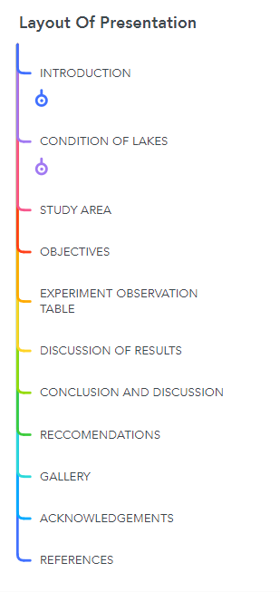
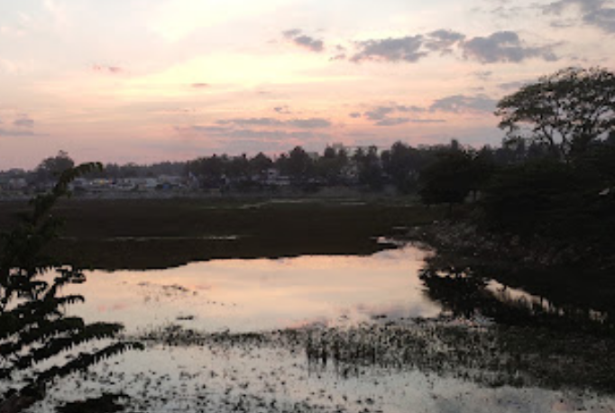

Slide 4
Condition Of Gottigere Lake
Gottigere lake, located at Gottigere village on Bannerghatta Road, is said to be more than 500 years old. It is a live tank and a source of discharge for downstream lakes like Hulimavu, Madiwala and Bellandur.
Despite hue and cry from environmentalists and citizen groups, and rulings by high court and pollution control boards, the authorities have failed to act against inflow of sewage water into the city’s lakes and other water bodies, thereby endangering their very survival. One such picture of glaring neglect is Gottigere Lake.
Residents around the area have spoken up about the worsening condition of the lake and the effects it has on the locals.

Slide 5
Reasons To Improve Lake Condition
1.Ten years ago, before the contamination of the lake villagers around the area used Gottigere Lake as a water reservoir and used the water from the lake daily. Now, the condition of the lake has deteriorated so much that it is being used as a garbage dump.
2. In fact there is a direct drainage pipe from the Basavapura village which dumps sewage water directly into the lake.
3.It is essential to rejuvenate this lake to ensure that there is ecological balance in the area and that water-borne diseases are prevented from rising.

Slide 6
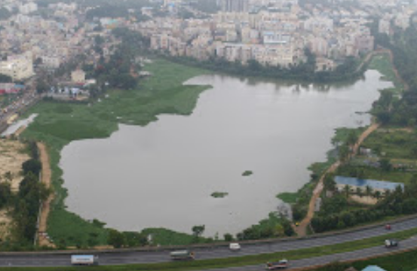
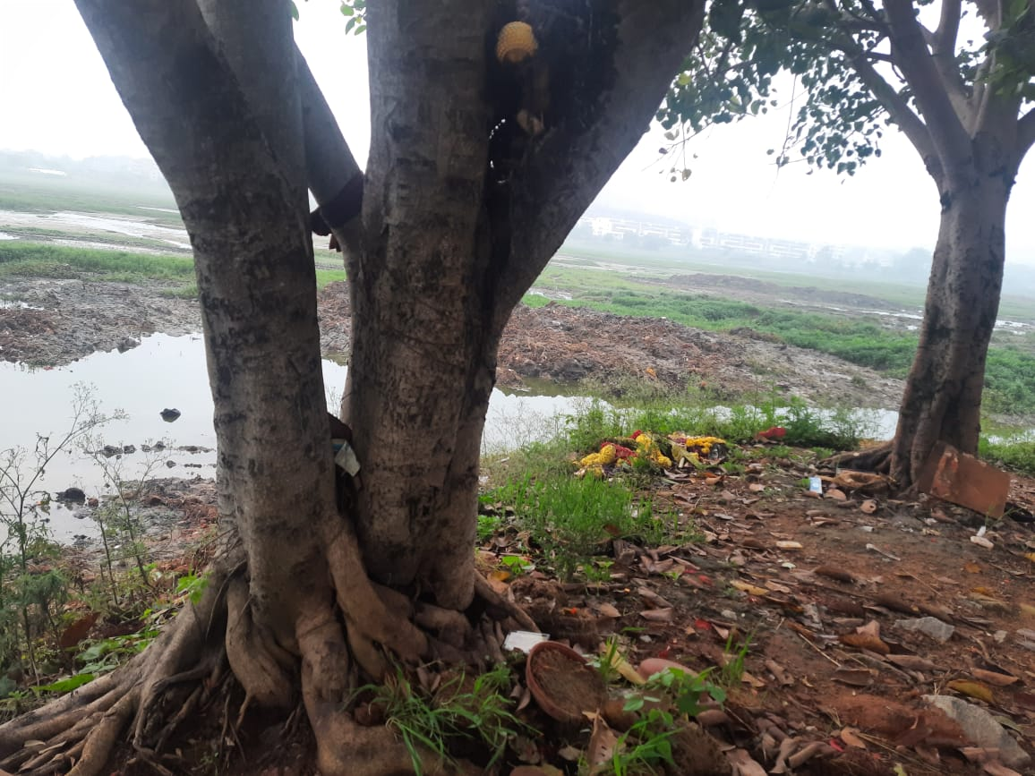
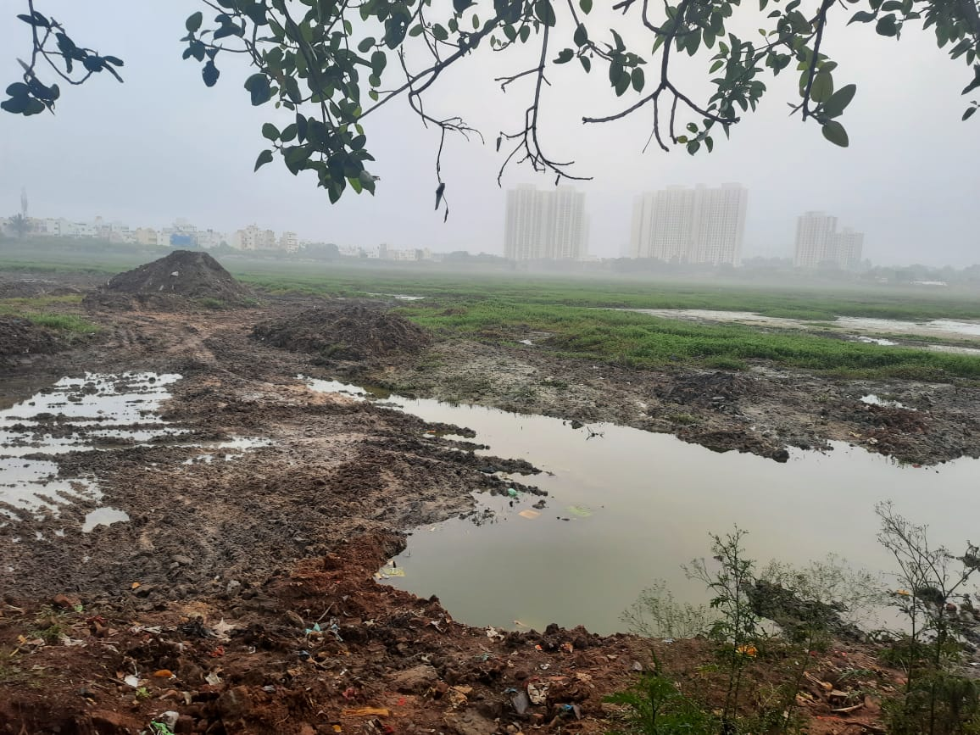
Pictures Of Gottigere Lake

Slide 7
Condition Of Begur Lake
Begur lake had a lot of importance during the Chola era.
The lake, once a source of drinking water for the surrounding villages, is now filled with sewage and garbage.
On March 17th 2018, then Home Minister Ramalinga Reddy inaugurated a project to revive the lake by removing silt and weeds from it.
The lake has two inlets and one outlet.
A joggers’ path will come up around the lake.
Two small islands will be created in the middle of the lake for birds, with different fruit trees such as mango.
A wired fence will be put up around the lake.
Plans to introduce boating in the lake is being decided to attract people.

Slide 8
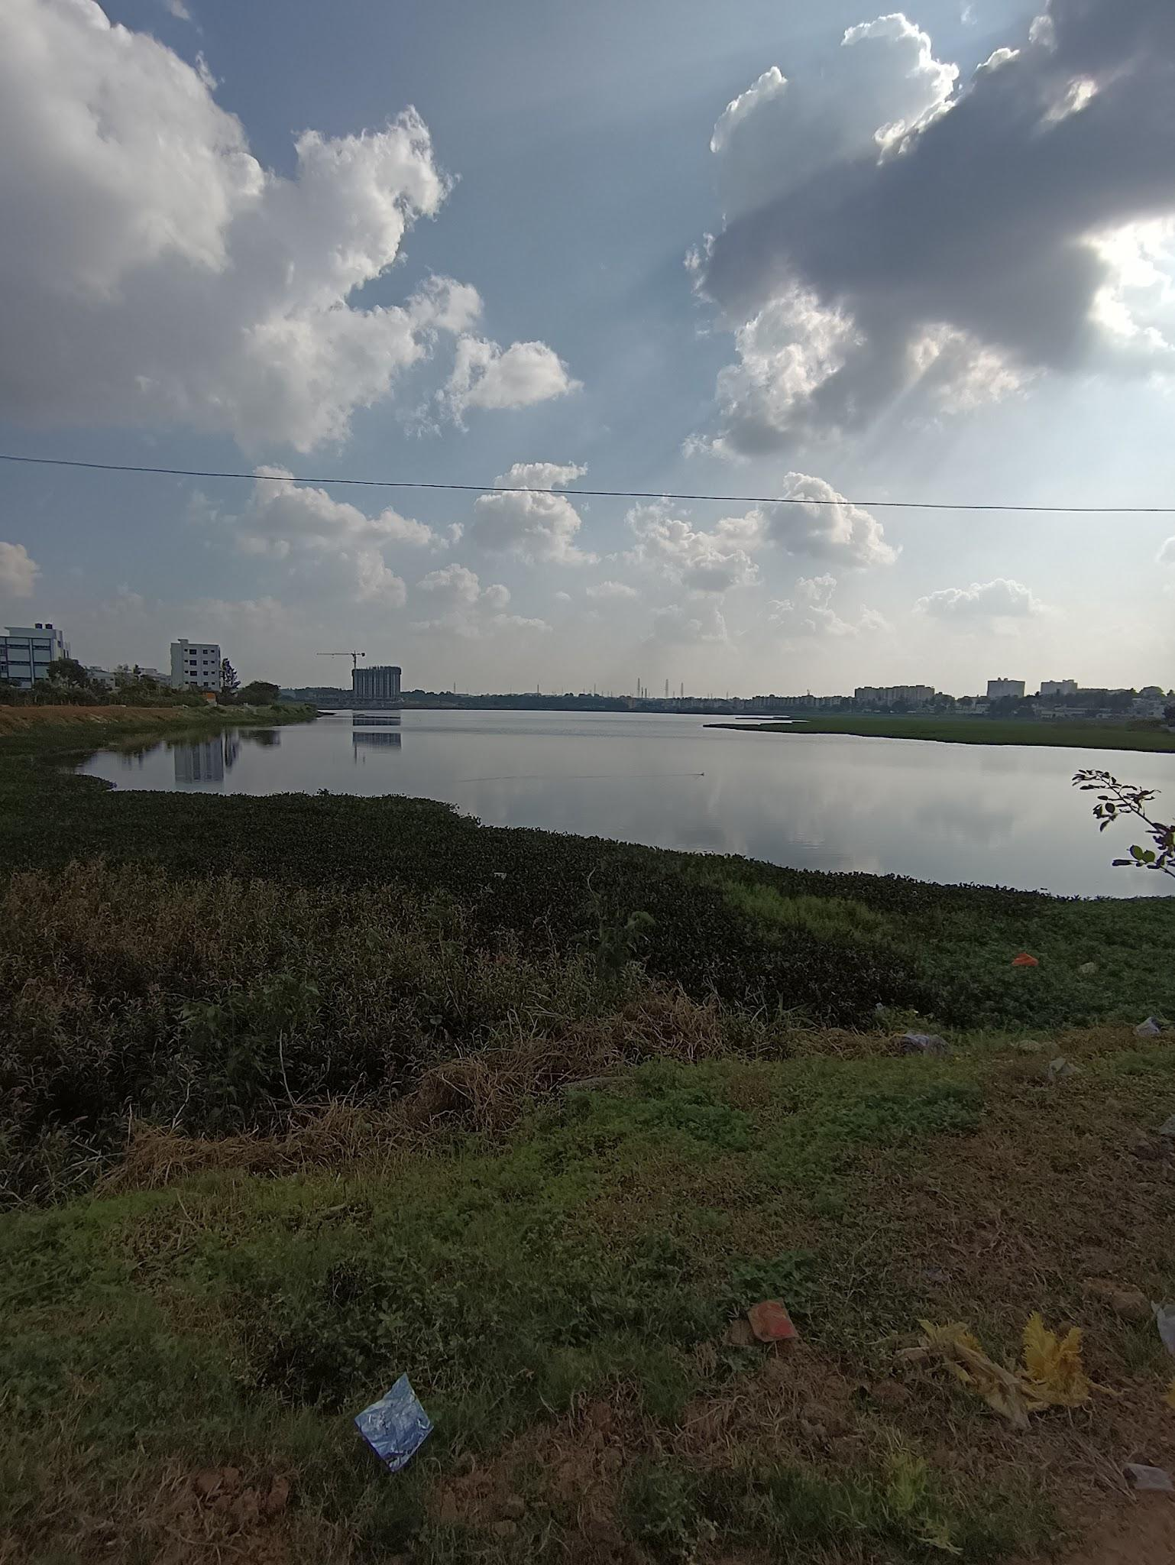
Condition Of Begur Lake (Contd.)
9. “With a number of apartments mushrooming near the lake, it is possible that the lake will get even more polluted with sewage water” says a resident.
10. The lake is being rejuvenated and cleaned and a new path around the lake and bunds around the lake is being constructed.

Slide 9
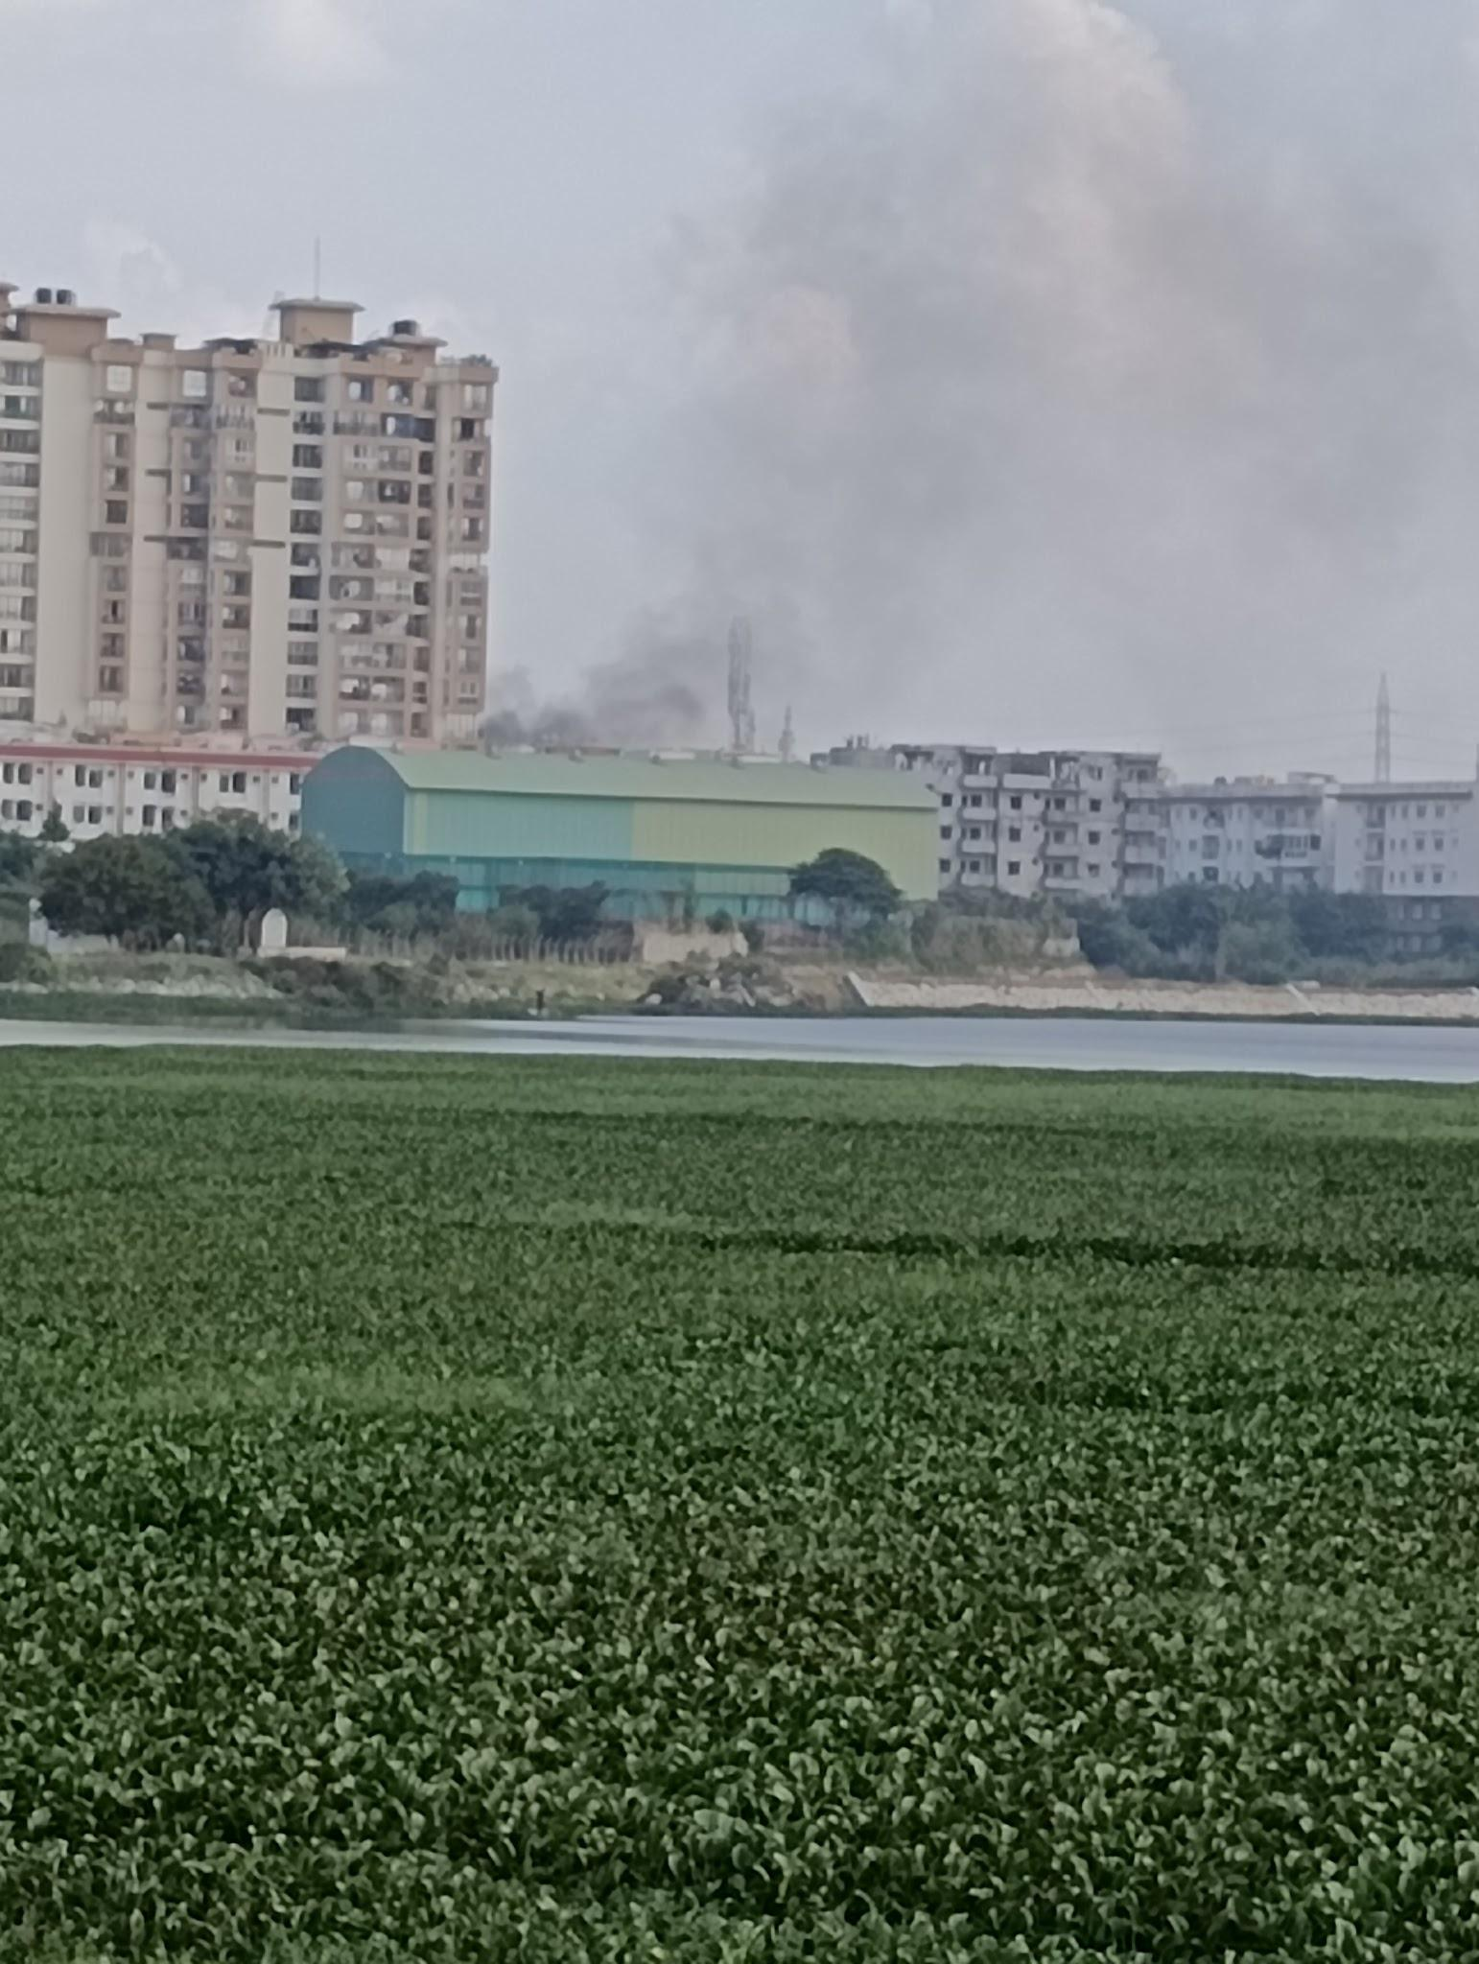
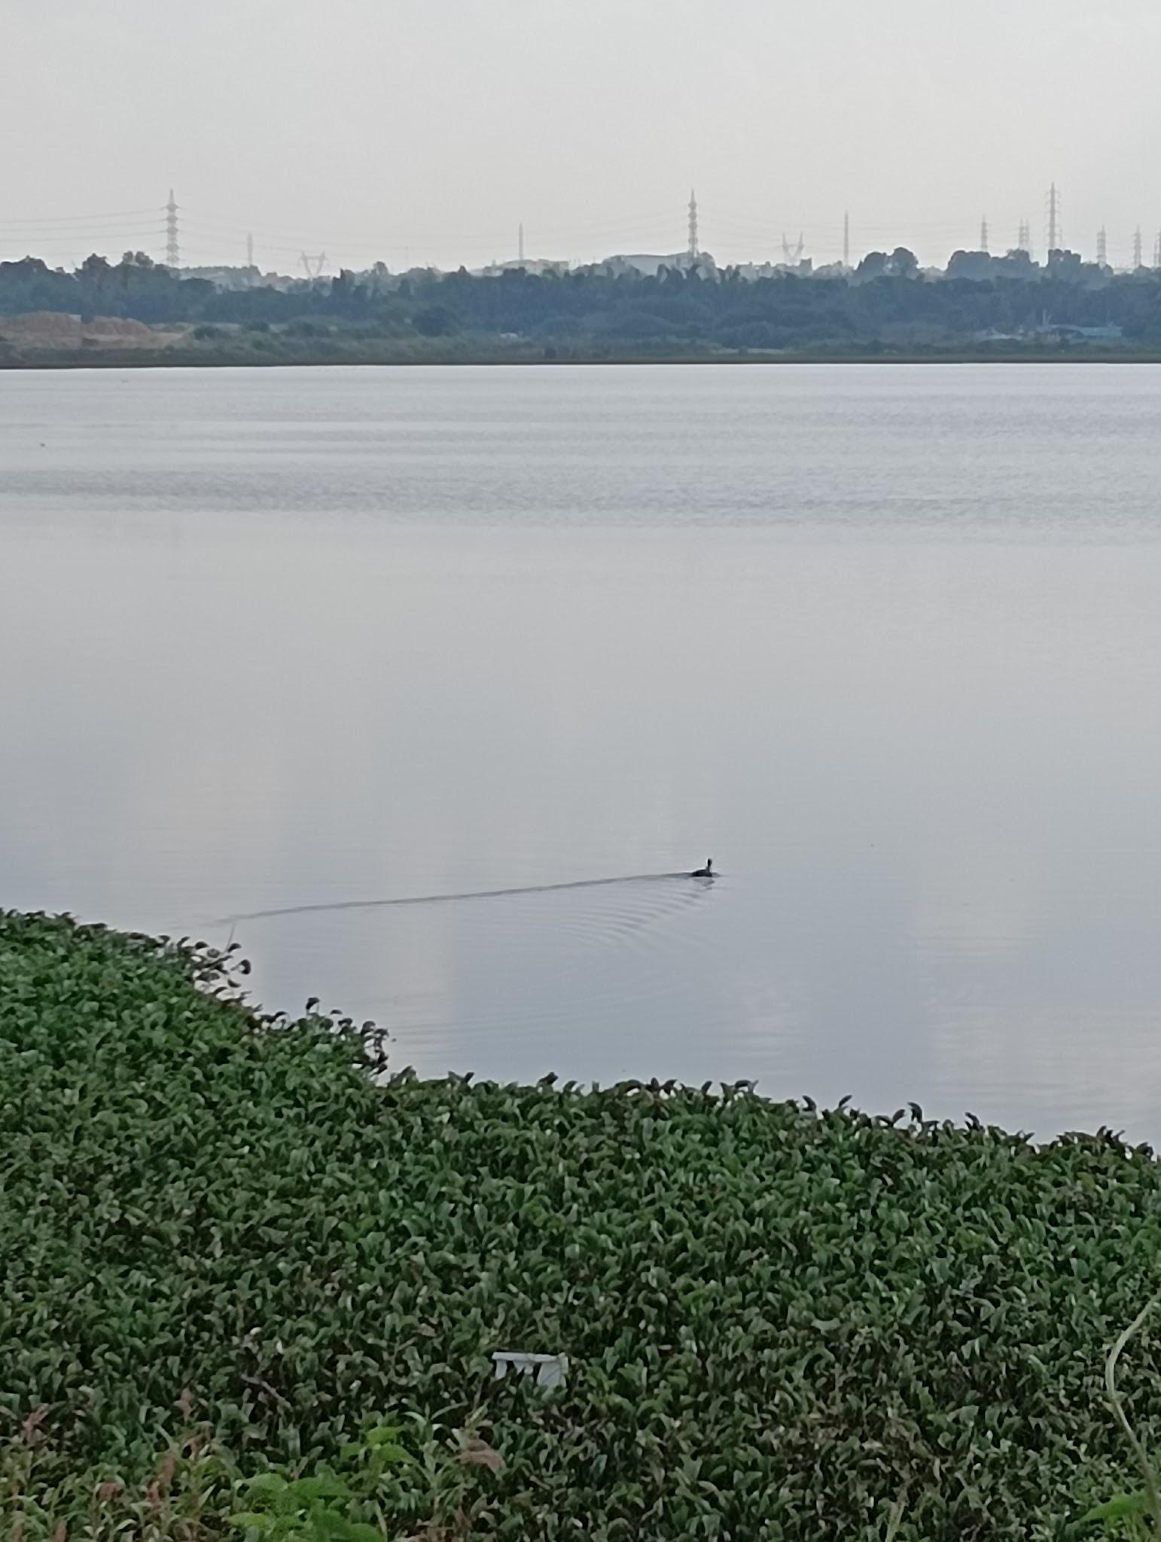
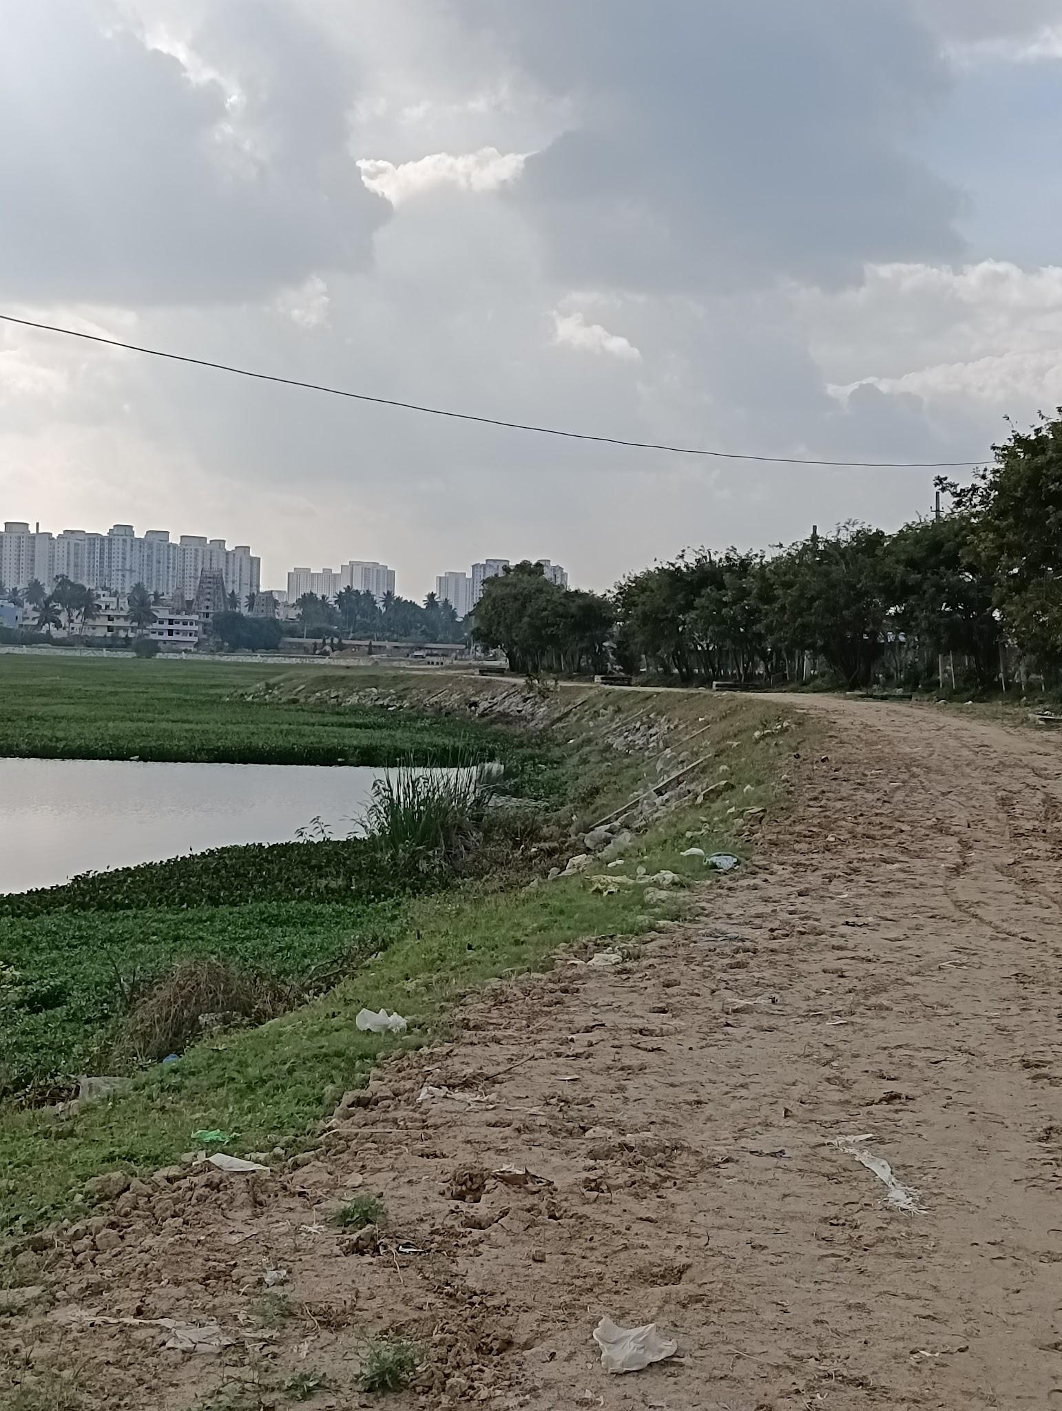
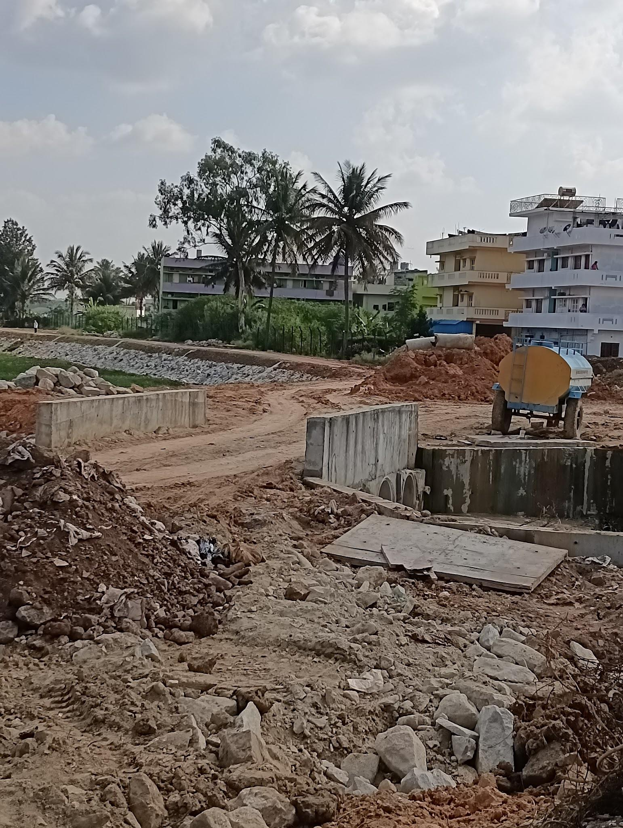
Pictures of Begur Lake
Construction is being done in the area to develop a jogger’s path around the lake.

Slide 10
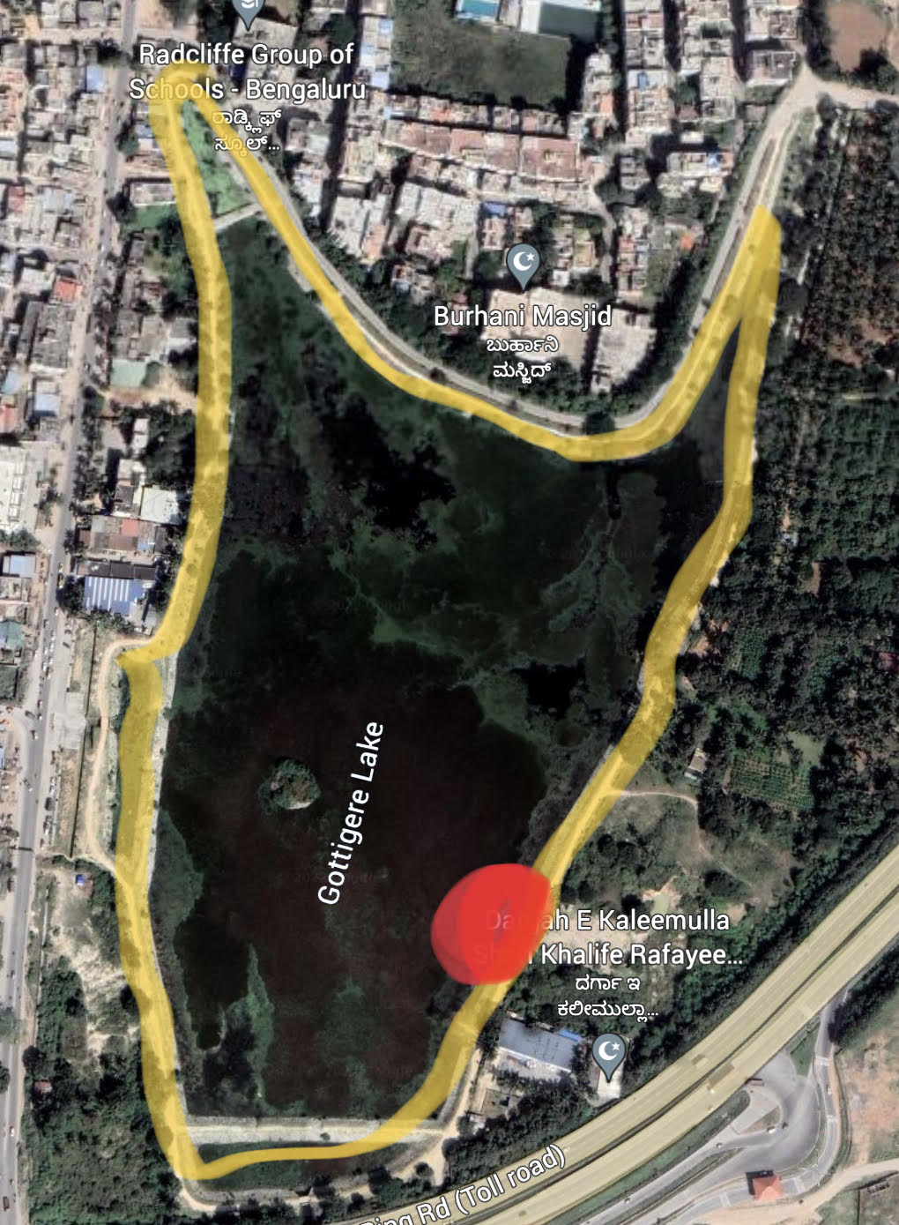
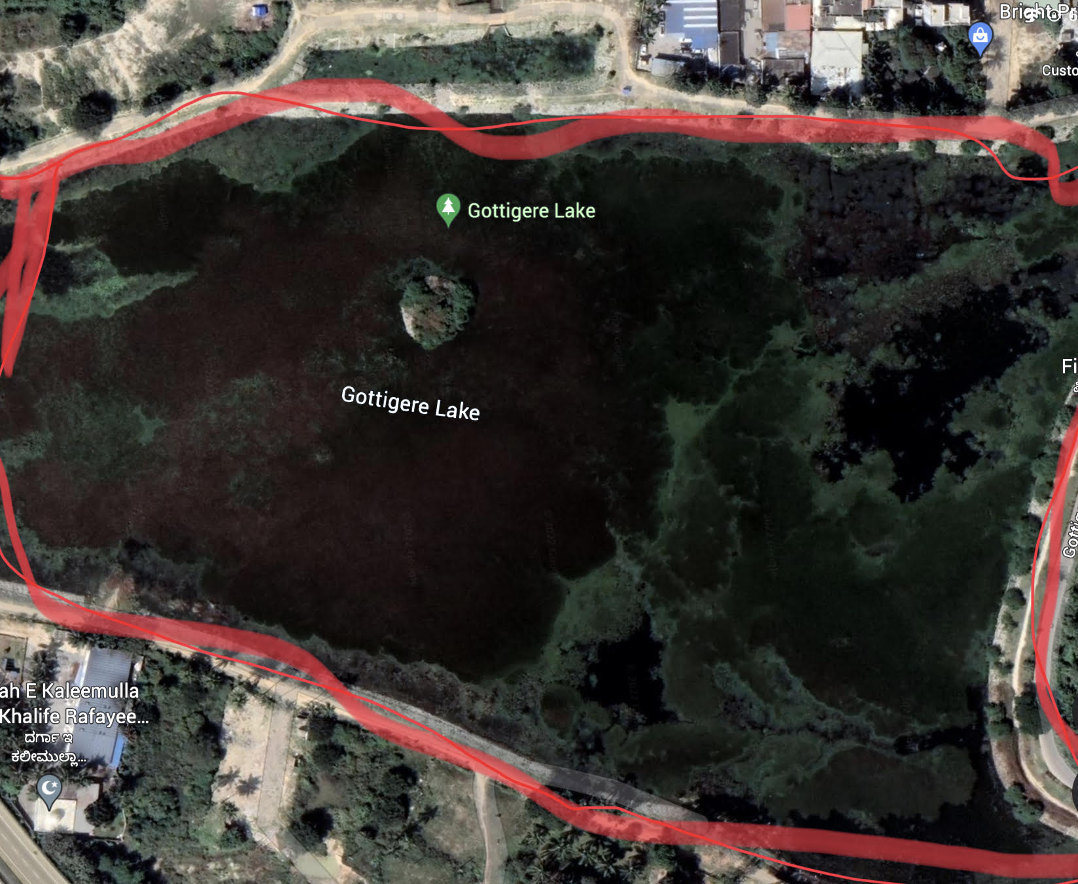
Study Area
Gottigere Lake - located off Bannerghatta Road. It is part of the Koramangala - Challaghatta valley. It continues in the eastward direction to join the Hulimavu and Madiwala. The area of this lake is 37 acres. Coordinates = 12.8530° N and 77.5901° E.

Slide 11
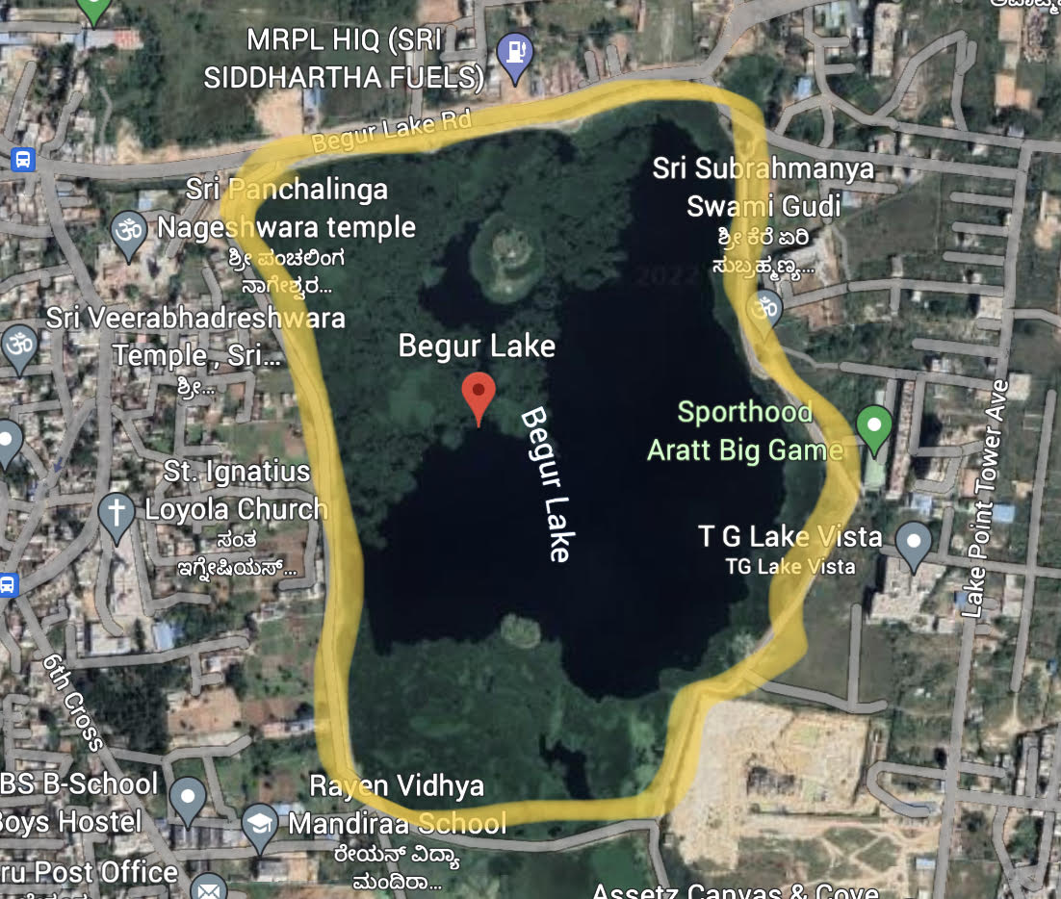
Study Area (Contd.)
Begur Lake - Located off Bengaluru Hosur highway in south - eastern part of Bangalore. Next to the Naganatheshwara temple. The area of this lake is 137 acres.
Coordinated = 12.8754°N and 77.6298°E

Slide 12
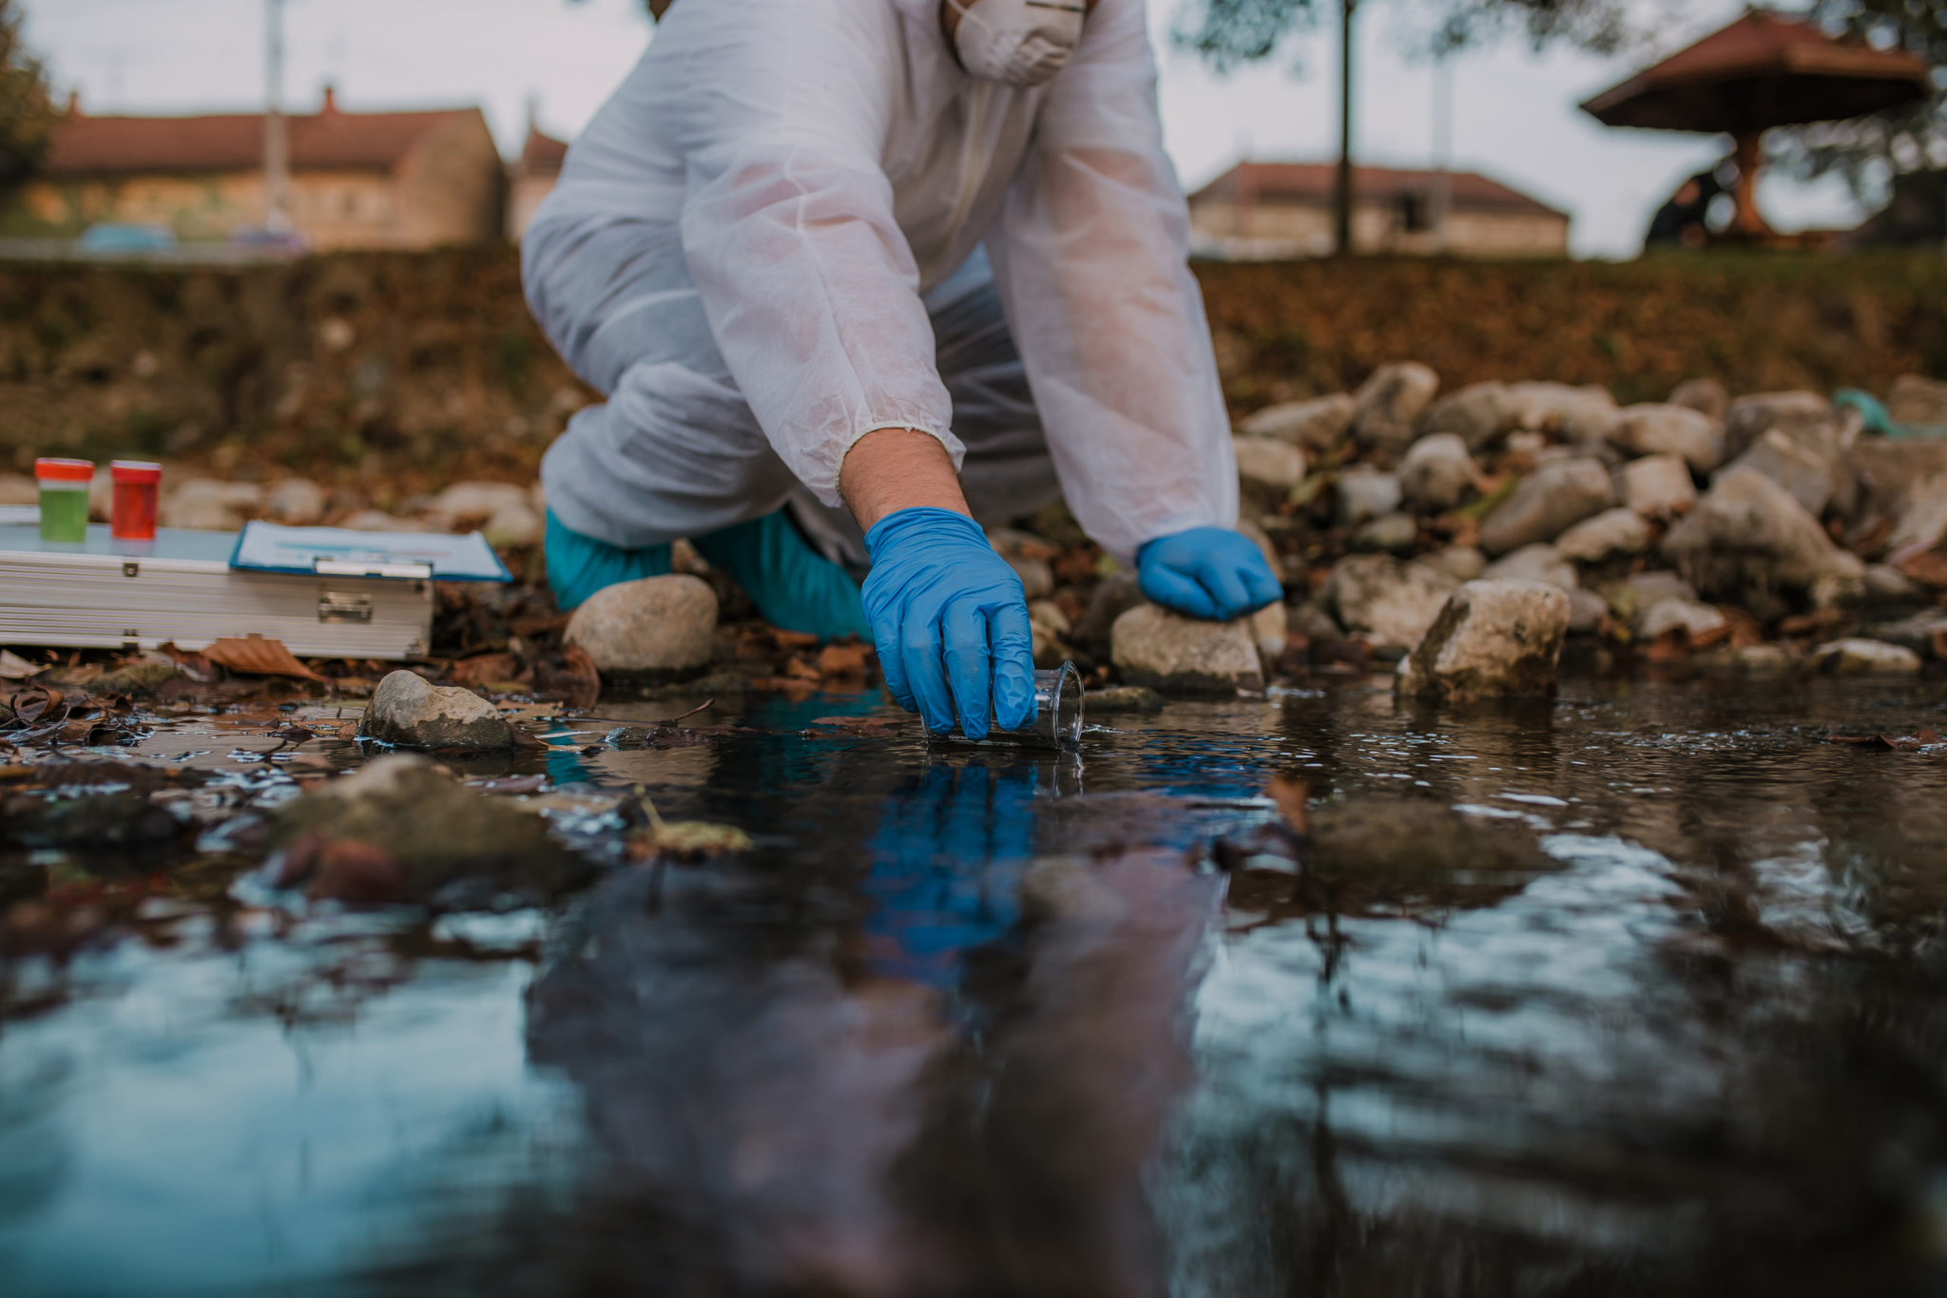
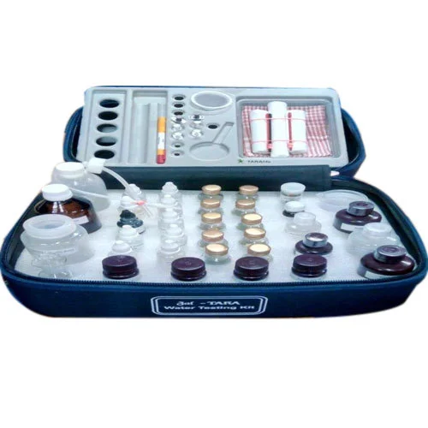
Objectives
Collecting Water Sample from Gottigere and Begur Lake
Using Jal-Tara water testing kit to check condition of water of lakes based on different physical and chemical parameters
Record measurements found and analyse the results and how it affects the conditions around the area

Slide 13
Parameters Tested | Materials And Methods
1) Dissolved Oxygen | DO bottle and titration using sodium thiosulphate
2) Phosphorous | Ammonium Molybdate, Stannous Chloride
3) Ammonia | Nessler’s Reagent
4) Residual Chlorine | Ortho Toluidine
5) Nitrate | Reagent NO3-A and NO3-B
6) Iron | Reagent Fe-A and Fe-B
7) Fluoride | Zirconyl Solution
8) Chloride | Potassium chromate and silver nitrate
9) Hardness | EDTA solution
10) Faecal Pollution | Aquacheck Bottle
11) Turbidity | Turbidity tube set
12) pH | pH paper

Slide 14
Parameters | Permissible Limit | Begur Lake | Gottigere Lake
pH | 6.5- 8.5 | 7 | 7
Nitrate levels | 45 mg/l | 100 mg/l | 45 mg/l
Iron | 0.3 mg/l | 0.3 | 1.0
Hardness | 200-600 mg/l | 180 ml | 320 ml
Chloride | 250-1000 mg/l | 106.35 | 248.15
Residual Chlorine | 0.2-1 mg/l | 1.0 | 1.0
Turbidity | 1-5 NTU | 10 NTU, Clear at 25 NTU | Turbide at greater than 100 NTU
Ammonia | 0.5 mg/l | 3 mg/l | 3 mg/l
Phosphorous | NA | 1.0 | 0.5
Dissolved oxygen | 5 mg/l | 6 mg/l | 6 mg/l
Fluoride | 1-1.5 mg/l | 1.5 mg/l | 1 mg/l
Faecal pollution | NA | Positive | Positive

Slide 15
Conclusion and Discussion
The High Nitrate Level in Begur Lake is caused by the domestic effluents and untreated sewage water which can cause health problems in humans and serious issues in animals and affect the biodiversity area.
The high Hardness levels, phosphorus and faecal pollution are generally from untreated sewage waste.
The Turbidity levels in the water makes the water unfit for domestic usage and industrial purposes thereby reducing the productivity of the lake. Efforts should be made to clean the lake and its impurities on a regular scale.
The High Ammonia municipal effluent discharges and the excretion of nitrogenous wastes from animals

Slide 16
Recommendations
Water quality can be better by :
Treating sewage water regularly
Cleaning of the lakes and their surroundings
Monitoring of the lakes to ensure proper and safe conditions for organisms to thrive
The environment of the lake should also be cleaned so that the surrounding is pleasing and attracts people
Awareness programs should be started to ensure the lakes are in good conditions

Slide 17
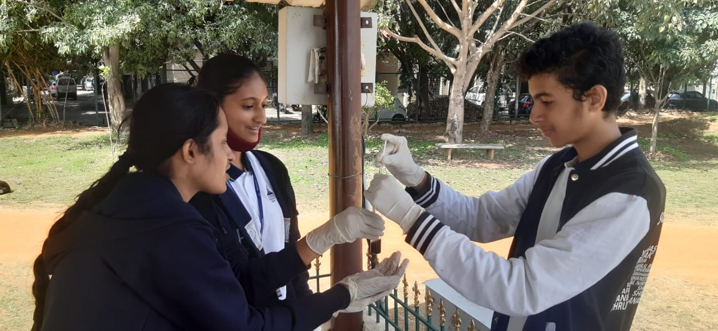
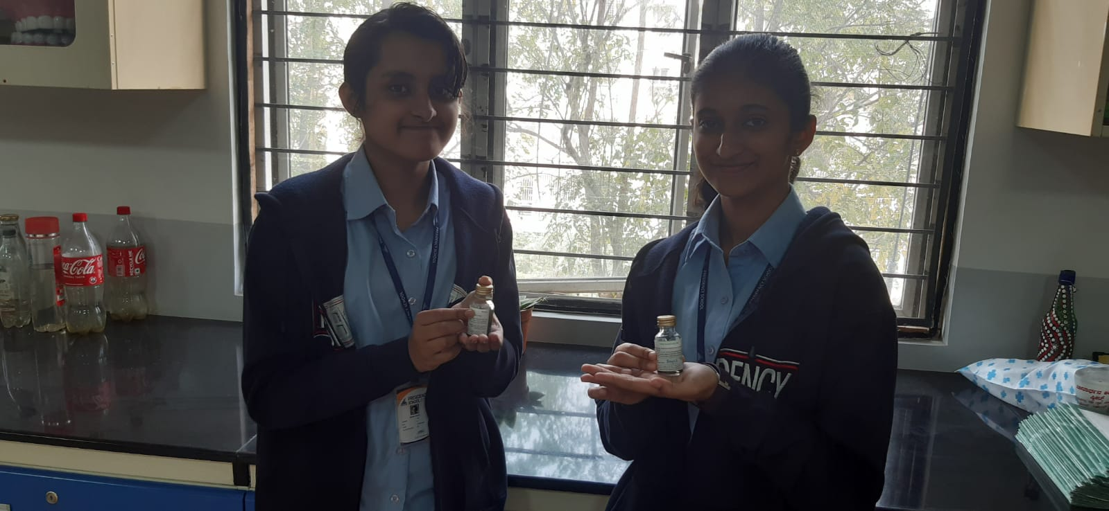
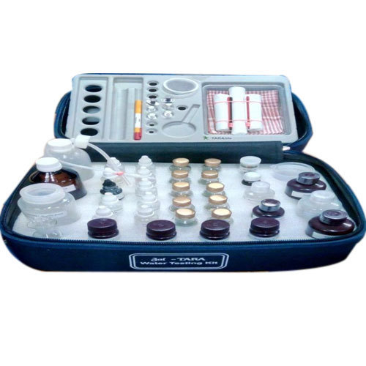
Gallery

Slide 18
Acknowledgements
We would like to thank IISc for hosting LAKE Conference 2022 and giving us this opportunity.
We also give our heartfelt thanks to our parents for taking us to the sites for data collection and testing

Slide 19
References
Location and maps:
https://www.google.com/maps/place/Gottigere+Lake/@12.8546704,77.58712,16.43z/data=!4m5!3m4!1s0x3bae6aea1c9ef195:0xcbebeb3fc5158f42!8m2!3d12.8529674!4d77.5902388
Google Earth Pro
News articles:
https://timesofindia.indiatimes.com/city/bengaluru/whats-gottigere-lake-issue-all-about/articleshow/3969969.cms
https://www.deccanherald.com/content/649128/green-warriors-gather-fight-save.html
Concepts and research:
https://www.youtube.com/watch?v=x8tCC4htgo4
https://wgbis.ces.iisc.ac.in/energy/water/paper/ETR101/encroachment-lakes/enc34.html
https://www.youtube.com/watch?v=R1uELmJuwTk&t=9489s
https://www.youtube.com/watch?v=B319MMQ8M84&t=155s
https://www.peninsulawater.com/is-iron-in-drinking-water-harmful/

Slide 20
THANK YOU

