Slide 1


SOIL NUTRIENT PROFILE:
Comparative study of wetland soil and neighborhood soil
By :Sahaana Padmanabhan Grade 11 Shreya MV Grade 11 | Presidency Bangalore South

Slide 2

Introduction
Soil
  Mixture of minerals, organic matter, and water
  Nutrient reservoir. Has nutrients like Zn,P,Cu etc
  Which aids plant growth and keeps ecosystem balanced.
  Building blocks of life;
  excellent bioindicator to assess the state of the environment near it.
  It is used for many purposes like contruction , agriculture

Slide 3
Planting plants every year in the neighborhood soil die
The plants growing on the soil near madiwala lake are lush , green and have a long life .
Problem
Study area: (Anugraha Layout and Madiwala lake ) are 1 km away from each other and thus have the same terrain and level of pollution/weather. Thus the soil found in the wetland must differ from that found in Billekalli

Slide 4
Study Area
Specific parameters of soil tested. These parameters are as follows:
PHYSICAL PARAMETERS :
Texture
Colour
PH
Soil from the following areas will be collected for the assessment.
Soil near Madiwala Lake.
Soil found in the school garden and its neighbourhood (Anugraha layout, Bilekahalli)
MICRONUTRIENTS
Cu
Zn
Mn
Fe
B
MACRONUTRIENTS
Electrical Conductivity
Organic Carbon
N
P
K
Ca
Mg
S

Slide 5
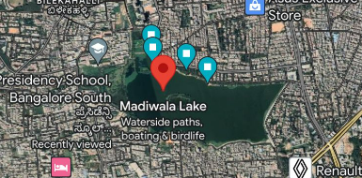
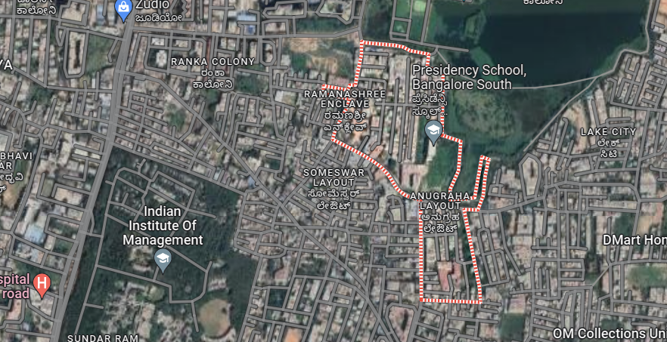
The Area
Madiwala Lake .
Anugraha Layout
.in the BTM Layout at 12° 54' 28" North, 77° 37' 0" East in Bangalore city.
Ramanashree Enclave, Bilekahalli Bengaluru, Karnataka
Coordinates : 13.00253,77.722

Slide 6
The First Objective
To collect and assess the soil sample collected from two areas : Madiwala lake and the school and its neighbourhood ( Anugraha Layout )
The Second Objective
Objectives
To draft a comparative analysis between the structure , chemical properties and various parameters of the soil
The Third Objective
To discuss the suitability of these soils for plants to suggest methods for improvement, and to find out why plants grow abundantly near Madiwala but very scarcely near Anugraha Layout

Slide 7
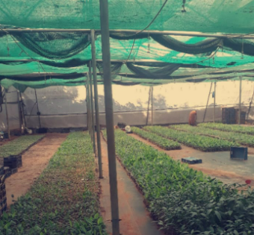
Methods
Information
A workshop conducted by the Biocentre in Hulimavu was attended to understand the process of soil collection and the various methods to analyze its parameters
Soil Collection
Dig 15cm deep into the soil in a v shape with a spade. Take thin slices of soil ( from top to down ). Remove roots, shrubs, rocks, or other small things. Take soil samples like this from 10-12 places and mix them using the quartering method .

Slide 8
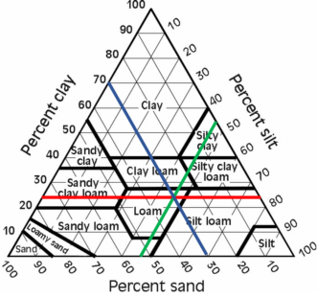
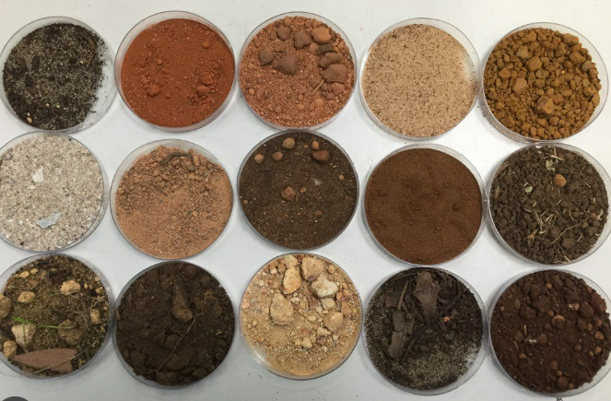
Physical Parameters
Texture
Measure it using jar method. The jar method follows: Take soil in a jar and allow it to settle. Using a ruler, measure and record the height of each layer and the total height of all three layers. Use the soil texture analysis worksheet below to record the results.
Colour
Take a sample of soil and compare It to a color scale like the Munsell scale or note down the standard color of the soil.

Slide 9
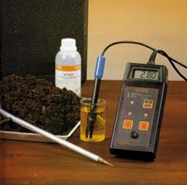
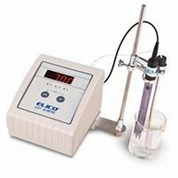
Major & Micronutrients
Electrical Conductivity
For this test, the solution is stirred and kept undisturbed for 1 hour. If salt increases, conductivity increases, and resistance decrease. Total dissolved salt should be less than 300 ppm.
Organic Carbon
The known weight of soil is treated with K2Cr2O7 in the presence of conc sulphuric acid. soil is oxidized to CO2. The excess of K2Cr2O7 unused I oxidation is titrated back against the standard ferrous ammonium sulphate solution in the presence of (indicator).
OC is calculated using a relation
1ml of 1N K2Cr2O7=0.003g of organic carbon.

Slide 10
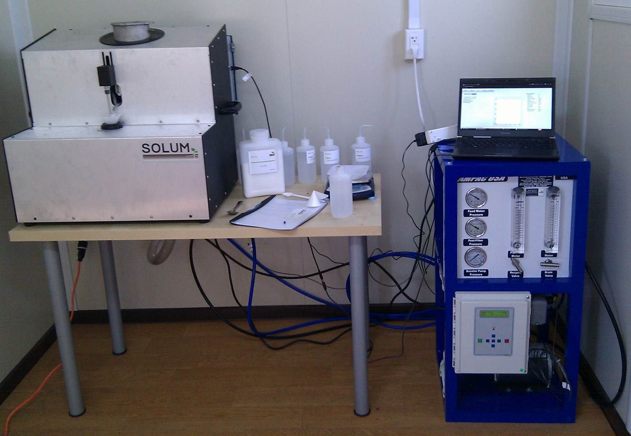
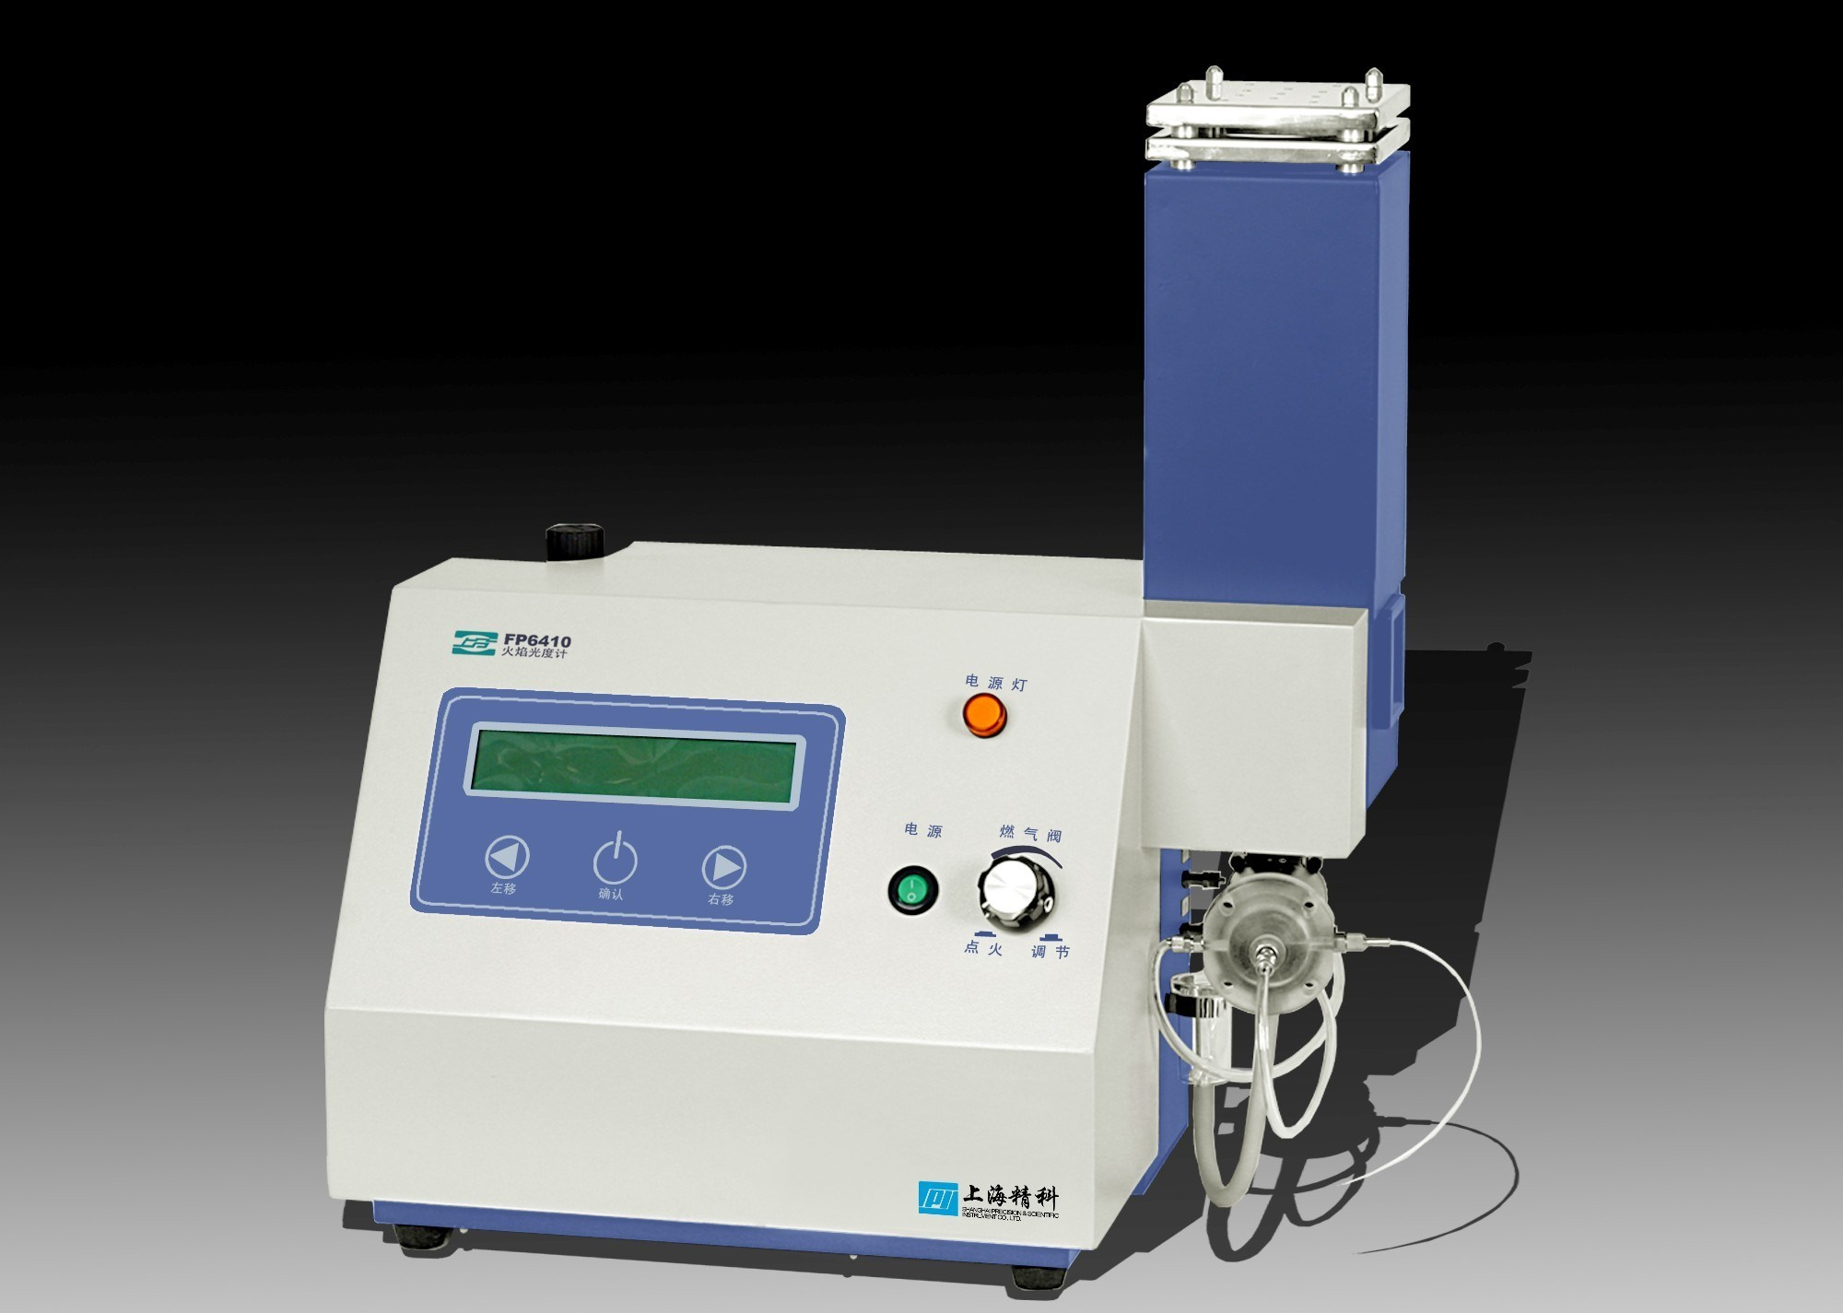
Zn,Cu,Mn,Fe
The soil samples are supplied dried and ground.
10 g of soil was weighed, and 20 mL of the DTPA
extraction solution was added. After shaking for 120
minutes, the sample was filtered using filter paper.
Ca and K
A flame photometer determines the concentration of Ca and K. This method is based on the intensity of light emitted when metal is introduced ithe into the flame.
P and S
UV Spectrometer
PH
Ph Paper

Slide 11

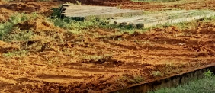
Results
1) Colour
Madiwala Lake
The soil was a dark brown indicating it has more organic matter
Billekalli
The ground was a pale yellowish–orange color indicating it has poor drainage and lesser nutrients

Slide 12
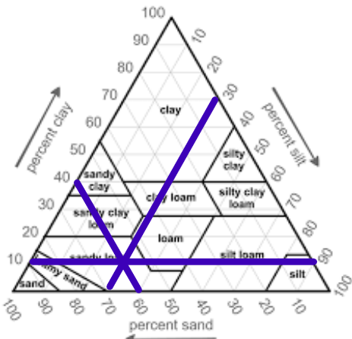
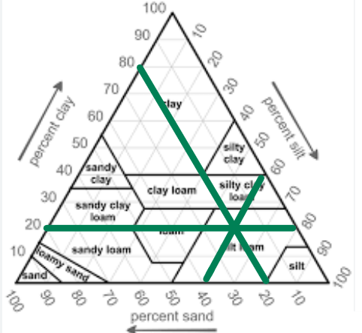
2 ) Texture
Madiwala lake
Anugraha Layout
The percentages of the components were are follows:
Clay: 10% Sand: 60 % Silt : 30 %
The soil is sandy loam soil
The percentages of the components were are follows:
Clay: 20% Sand: 20 % Silt : 60 %
The soil is silt loam soil

Slide 13
 | MADIWALA | NEIGHBOURHOOD
PH | 7.48 | 8.56
EC (S/m) | 0.26 | 0.10
OC (%) | 0.95 | 0.80
N (kg/ha) | 68.87 | 64.10
P (kg/ha) | 7.29 | 5.21
K (kg/ha) | 27.4 | 5.54
Ca (ppm) | 404.48 | 620.63
Mg (ppm) | 49.81 | 60.92
S (ppm) | 67.93 | 22.54
Cu (ppm) | 2.88 | 1.49
Zn (ppm) | 11.88 | 3.52
Mn (ppm) | 3.04 | 3.22
Fe (ppm) | 80.77 | 7.05
B (ppm) | 0.75 | 1.47
3) Nutrient Profile
25
20
15
10
5
Item 5
0
Item 1
Item 3
Item 4
Supported by data from analyses report by Hulimavu Biocentre Bangaluru
The following table shows the results of the parameters analysed for the soil found in Madiwala lake and the school garden

Slide 14
Major - pH
The soil at the lake is neutral, indicating that it is suitable for the growth of most plants.
The soil in the neighborhood is alkaline, which means it is less soluble and hence will not have many nutrients for the plants. Thus stunted growth can occur which was observable

Slide 15
Electrical
Conductivity ( S/m)
The EC of both the soils have ideal EC levels, where Madiwala has more EC than the neighbourhood soil, which suggests that it has more beneficial cations ( Fe, Mg ), etc, than the soil in the neighbourhood

Slide 16
Organic Carbon ( % )
Both soils have high organic carbon %. Madiwala soil has more OC %, which suggests that it has better soil structure ( soil clumps ), and this will have better permeability and water-holding capacity than the soil found in the nieghbourhood

Slide 17
Nitrogen ( kg/ha )
Since the nitrogen levels are low in both soils, The plants that grow there usually lack chlorophyll causing their leaves to be yellow. So the plants there will be in a shade of greenish–yellow. This deficiency happens because of high levels of organic carbon

Slide 18
Phosphorous
(kg/ha)
The concentration of P is low in both soils, indicating that the plants may have problems in shoot growth; the leaves may turn blue/green due to anthocyanin synthesis. Maturity is delayed

Slide 19
Potassium
( kg/ha )
Both soils are deficient in K. The levels of K in the neighborhood are much lower than the soil near Madiwala lake
The effects of K deficiency are not immediately seen. It results in slow necrosis and a slowed growth rate during the later stages of life.

Slide 20
Sulphur (ppm)
Sulphur content is high in both the soils and higher in the madiwala lake soil when compared to earth in the neighborhood
Excessive uptake of sulphur results in a decrease in soils PH making it acidic

Slide 21
MicronutrientsCopper (ppm)
The copper content in both soils is high. Madiwala lake has higher copper content, proving it has higher chlorophyll production and protein synthesis. The neighbour soil ( although it has higher than normal copper levels ) had lesser copper than Madiwala lake soil

Slide 22
Zinc (ppm)
Zinc content is high in both soils but madiwala lake soil has higher ppm of zinc content when compared to soil in the neighborhood. Toxixity can lead to stunted growth

Slide 23
Manganese
(ppm)
The manganese content is ideal in both the soils. And it is a little higher in the neighbourhood soil compared to madiwala

Slide 24
Iron (ppm)
Iron content is high in madiwala lake soil and ideal in soil from the neighborhood.
High Iron content – Chlorophyll structure changes hence less absorption of sunlight
If plants take in too much iron, it affects the chlorophyll itself, causing it to change and inhibiting its ability to absorb energy from sunlight properly.

Slide 25
Boron (ppm)
Based on the graph, it is observed that the boron level in both the soil exceeds the critical limit.
Boron toxicity causes the yellowing of leaf margin, tips, and sometimes between veins. This progresses to browning and premature drop in foliage.

Slide 26
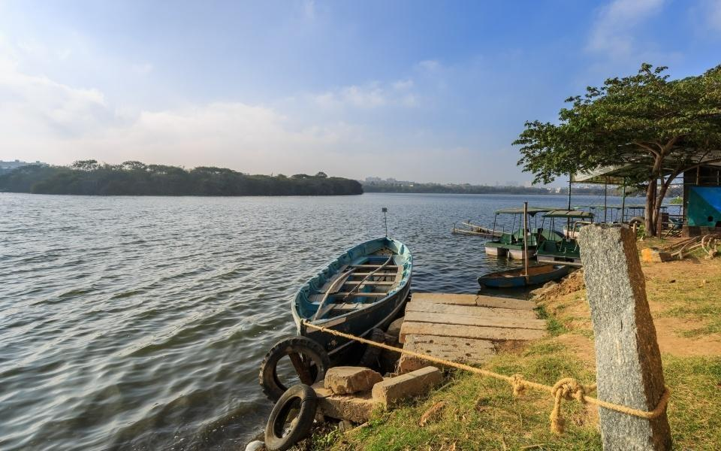
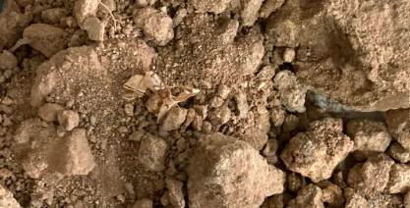
Discussion
Soil Near Madiwala lake
Soil near Anugraha Layout
This was found suitable to grow plants and would be better suited after the following external applications :
Nitrogen, Phosphorus Potassium Biofertilizers
.
The soil can support only a few species of plants and would require the following external applications:
Sulfur ( to lower PH), Nitrogen, Potassium , Phosphorous ,Biofertilizers and Farm Yard Manure ( FYM )

Slide 27

Conclusion
The soil found in our neighborhood has an alkaline soil and lesser EC, OC, P, K, S, Cu, Zn, and Fe than the soil found near Madiwala lake
Apart from this, The heavy constructions that take place near Anugraha Layout may be another reason as to why there is B toxicity in the soil
All of these factors bring us to conclude that the lack of nutrients in the soil is the reason why plants don’t grow in the neighborhood soil

Slide 28
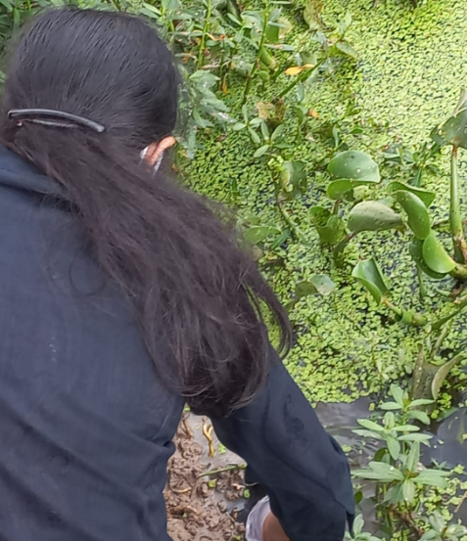
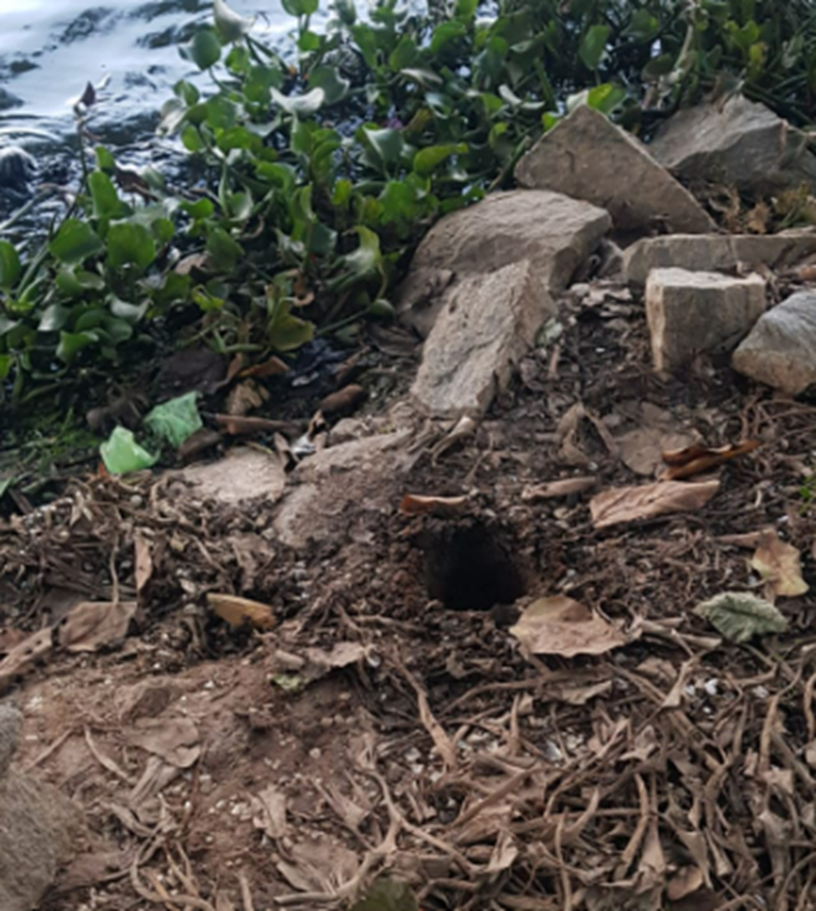
Gallery
.
.

Slide 29
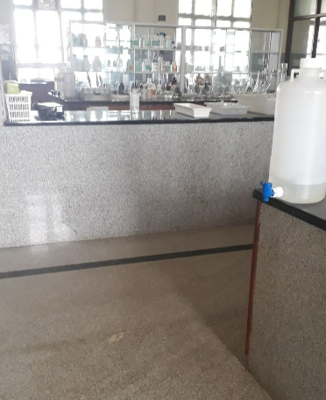
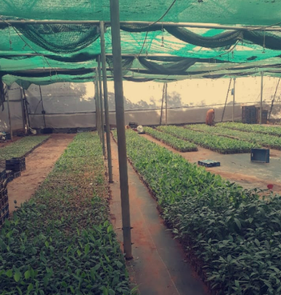

Slide 30
Acknowledgement
We are grateful to our school, PSBS, for giving us the golden opportunity to participate in this project from the school and to the Biotechnology Centre, Hulimavu, Dept. of Horticulture, Govt. of Karnataka, for helping us with testing the soil.
We would also like to thank our Biology teacher Indumathi maam, for giving us better insights on the project.
Lastly, we would like to thank IISC for hosting this event

Slide 31
01 | Nutrient Management Module No.9 Montana State University Extension
02 | Purdue Extension : Collecting Soil samples for Testing
03 | NCERT Biology Grade 11
04 | Recommended Chemical Soil Test Procedures Missouri Agricultural Experiment Station
05 | How To Take Samples And Read Results EOS Data Analytics
References

Slide 32


