Slide 1
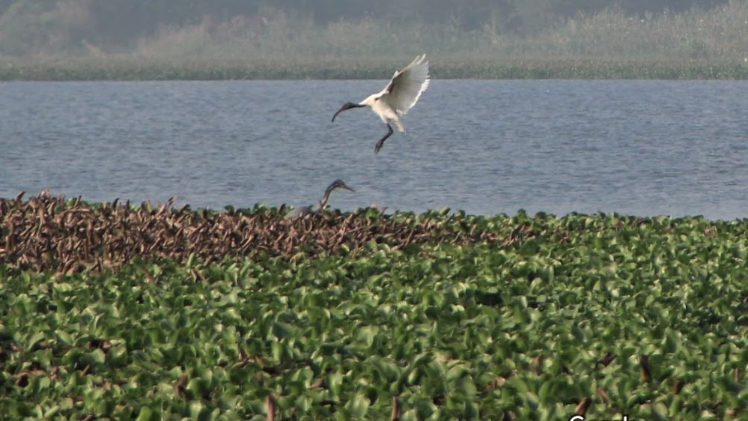
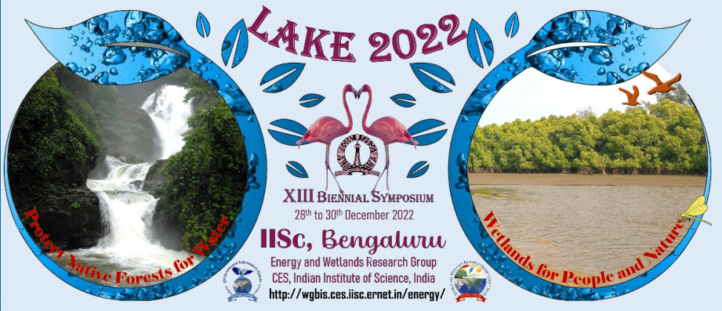

Comparative Study of water quality of Kalena Agrahara Lake and Hulimavu Lake
Hulimavu Lake
Gauri Sreekumar and Shaarav Raghu (Participated in LAKE 2020) of class 11, Presidency School Bangalore South

Slide 2
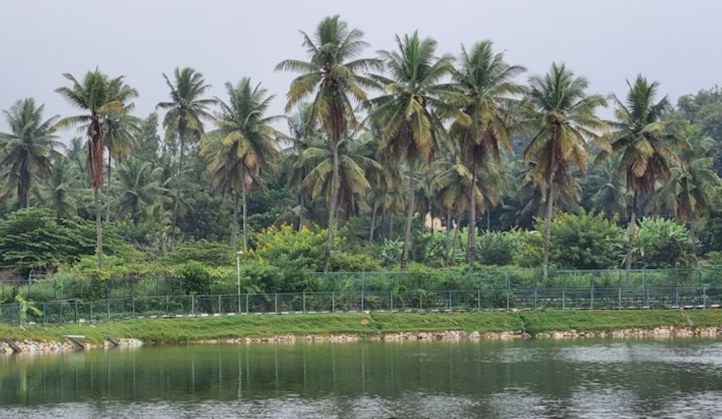
Introduction
We have historical and traditional links to lakes. They ease the impact of floods and droughts, replenish ground water, bring in recreation and tourism. Lakes provide environmental, social and economical services apart from suiting our domestic needs.
Rapid urbanization has impacted these lakes and its water quantitatively and qualitatively. Some lakes have completely disappeared, others reduced to pools, some encroached upon, some in stages of deterioration, some dried up, some have been leased.
Many lakes in the city lack adequate infrastructure like sewage treatment plants, waste management etc.
Kalena Agrahara Lake

Slide 3
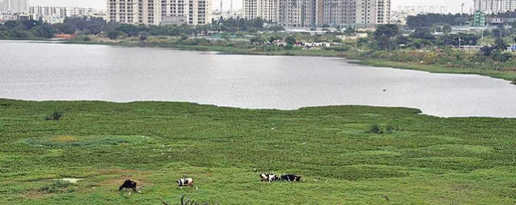
Hulimavu Lake
Kalena Agrahara Lake on Bannerghatta Road is a seven-acre lake with freshwater. It was once polluted, but is now redeveloped after consistent efforts of Kalena Agrahara Lake Association and FM Nirmala Sitharaman's MPLAD (Member of Parliament Local Area Development) Scheme.
Hulimavu Lake was once a serene, crystal-clear lake, present on Bannerghatta road. But is now polluted and is undergoing rejuvenation.
Introduction
Source – TOI

Slide 4
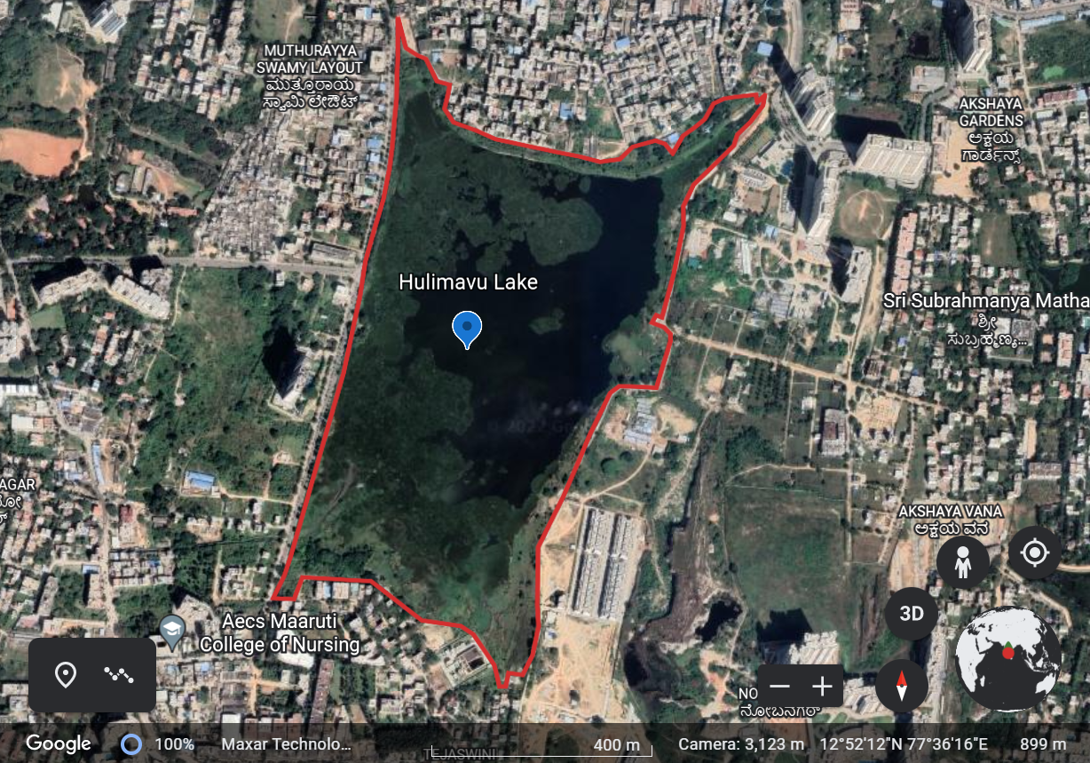

Hulimavu Lake Mapping
STUDY AREA
Perimeter- 3677 m
Area- 120 acres
Elevation- 899m
Coordinates – 12 °52'12.44''N
77°36'14.89''E
Sample Collection Point
Source - Google Earth

Slide 5
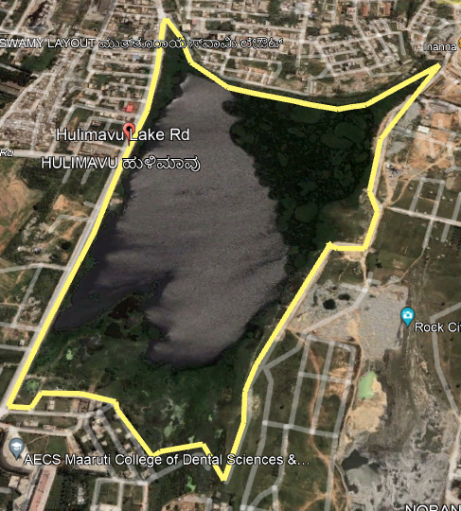
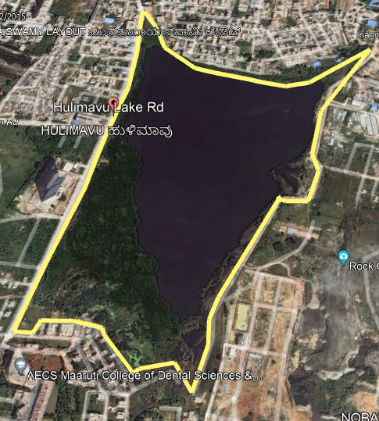
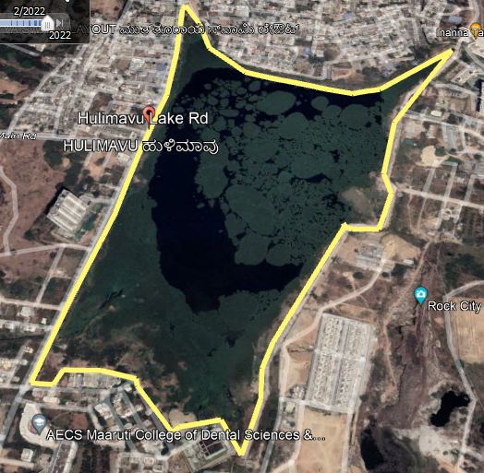
2010
2015
Present Day
(Before restoration work began in Nov 2022)
Source - Google Earth

Slide 6
Restoration of Hulimavu Lake
In November 2019, the lake breached, flooding the nearby areas. Temporary bunds were created by 300 truckloads of mud. BBMP, NDRF, fire and emergency services and quick response teams rushed to the spot where 800 houses were flooded. It is said to have happened due to the miscalculation of a contractor.
The Hulimavu lake is currently under restoration work. Lake rejuvenation is being funded by the 15th Finance Commision of BBMP, that has allocated about 8 crores for this project.
Source - TOI

Slide 7
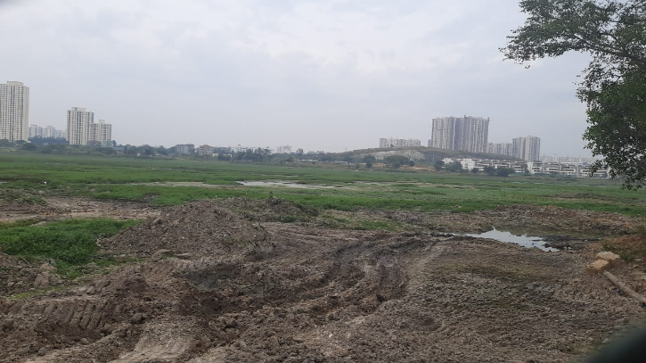
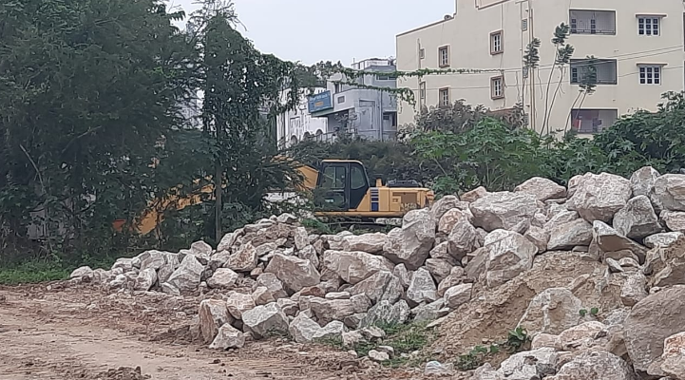
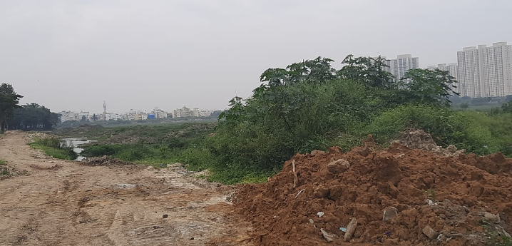
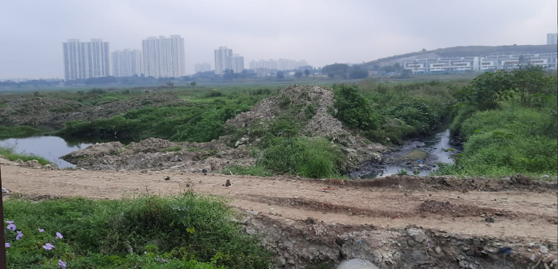
Undergoing Restoration Work

Slide 8
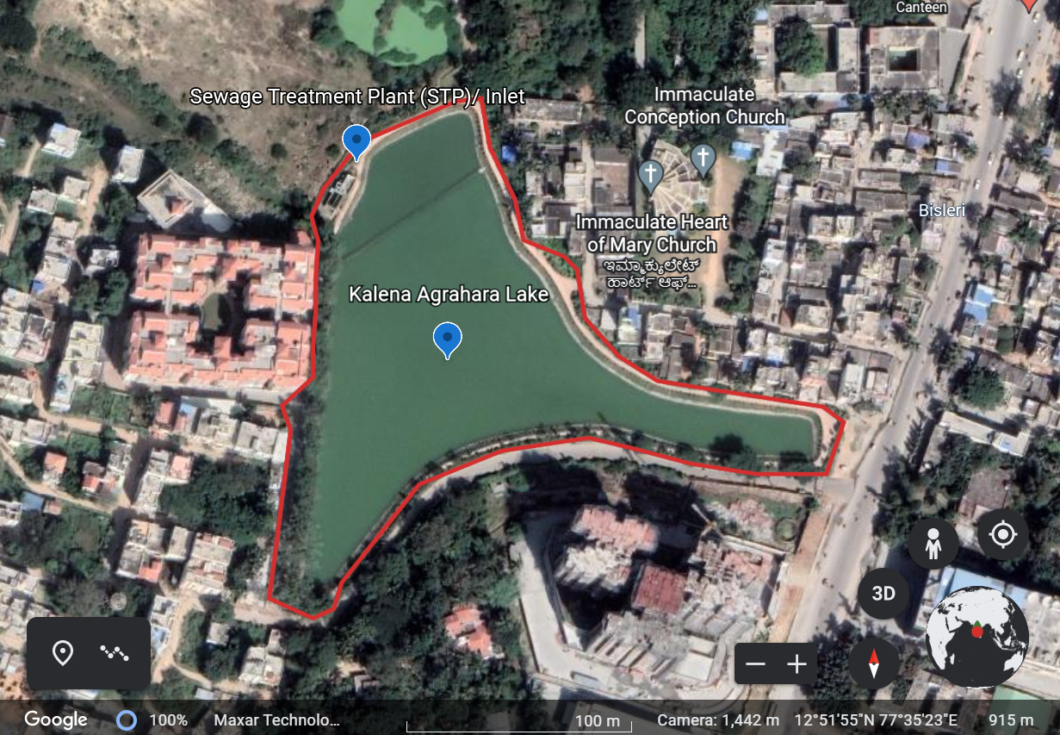


Kalena Agrahara Lake Mapping
STUDY AREA
Sample Collection Point
Perimeter- 740 m
Area – 7.3 acres
Elevation- 917 m
Coordinates-
12°51'56.20''N
77°35'22.77''E
Map Source – Google Earth

Slide 9
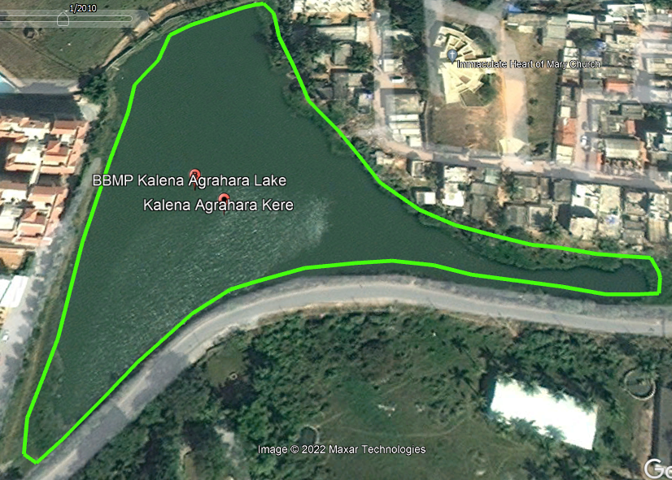
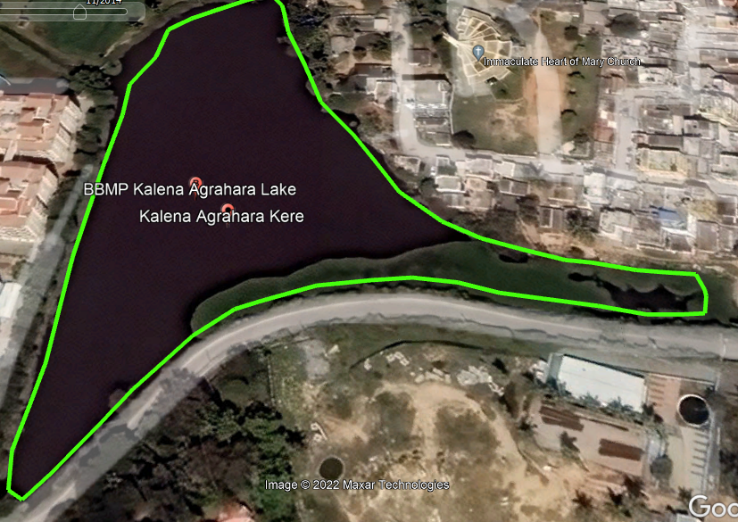
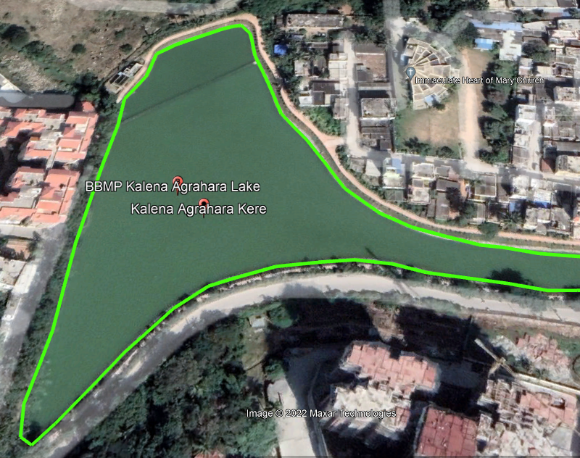
2010
2014
Present Day
Map Source – Google Earth

Slide 10
Rejuvenation
Finance minister Nirmala Sitaraman had visited the lake in May 2022. The lake was restored under the MPLAD Scheme at a cost of Rs 3 crore and consistent efforts by Kalena Agrahara Lake Association.
The funds were utilised for:
the removal of sludge from the lake bed to enhance the impounding capacity,
strengthening of main bund including revetment and turfing,
formation of ring bund using available desilted earth including revetment and turfing.
Source – Zee News

Slide 11
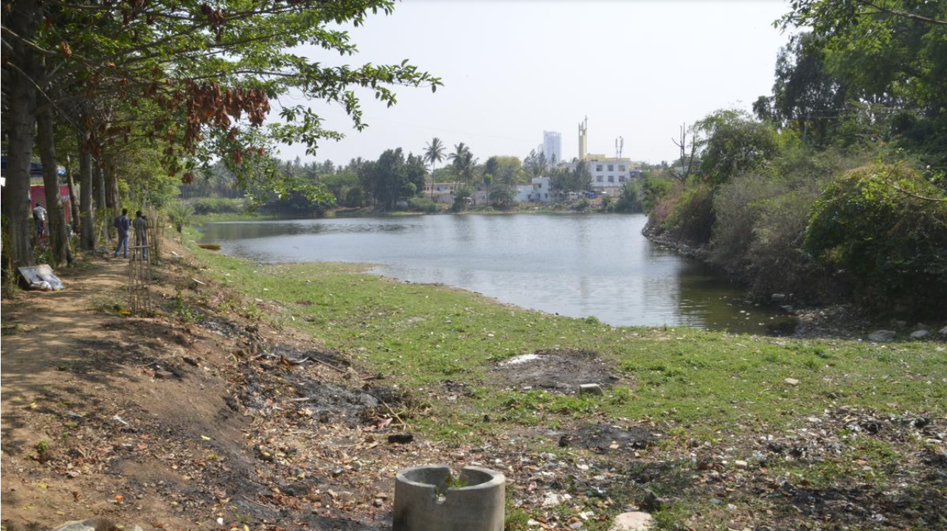
Before Rejuvenation
Image Source – The Hindu

Slide 12
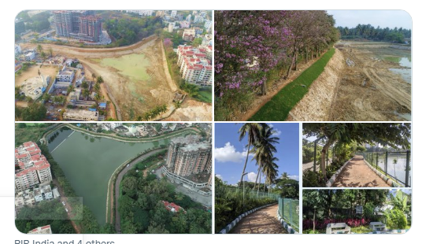
RESTORATION OF THE KALENA AGRAHARA LAKE
Source - Zee News, TOI

Slide 13
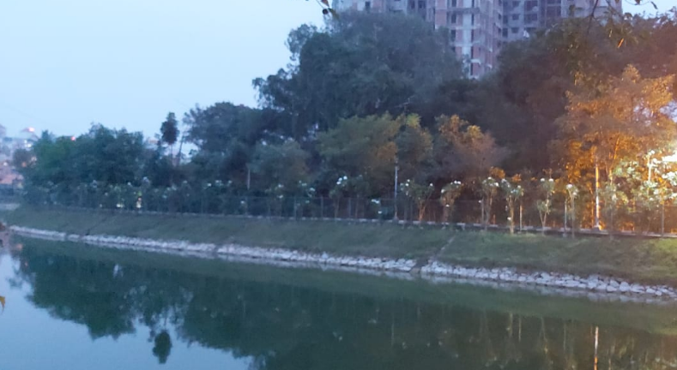
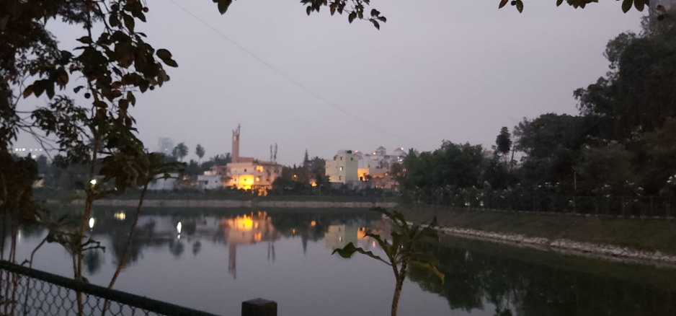
After Rejuvenation

Slide 14
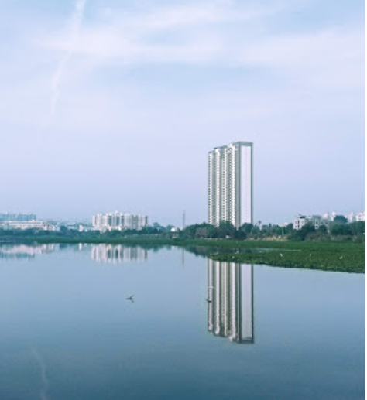
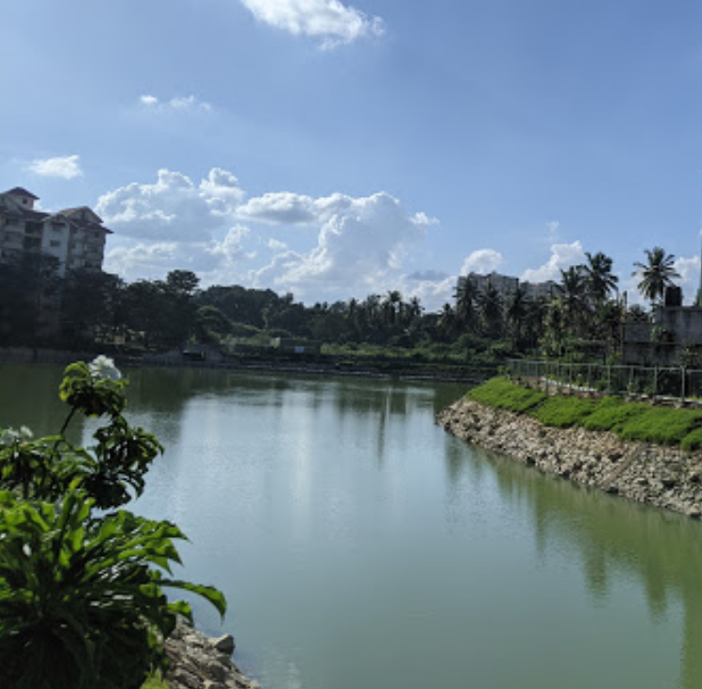
Objective
-To compare the water quality of Kalena Agrahara and Hulimavu lake.
- Understand the wider problem and suggest an approach to create an optimal lake that is sustainable in the urban landscape of Bengaluru.
Hulimavu
Kalena Agrahara

Slide 15
Water Quality:
Parameters
Physical and chemical parameters which include-
pH
Nitrate
Iron
Hardness
Chloride
Residual chlorine
Turbidity
Faecal Matter
Ammonia
Phosphorus
Dissolved oxygen
Fluoride
Temperature
Source – E-Workshop - 'Know your Ecosystem'

Slide 16
Materials and Methods
Collected Samples from periphery (29th OCT and 1st of DEC); tested samples with help of Jal-Tara Water Testing Kit (provided by Lohit-WWF).
Observations of pH, temperature, hardness, turbidity, nitrate, residual chlorine, fluoride, faecal matter, ammonia, phosphorous, iron and dissolved oxygen were noted.
Noted down the values in comparison between the 2 lakes; comparing it to the permissible limits (BIS) provided in the Kit Manual.
Surveyed the area around the lake and a few localities. Made inferences and conclusions from data collected.
Understood the wider problem and suggested a method to make an optimal lake that is sustainable in an urban landscape.

Slide 17
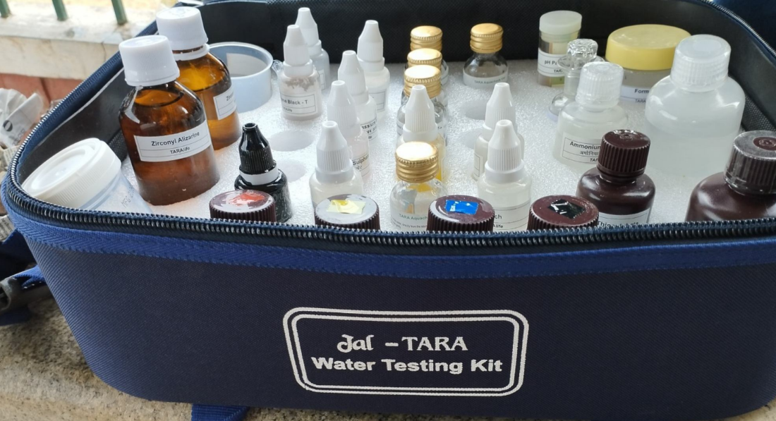

Slide 18
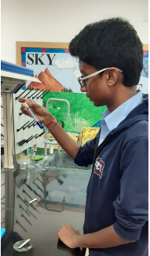
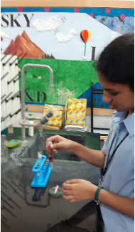

Slide 19
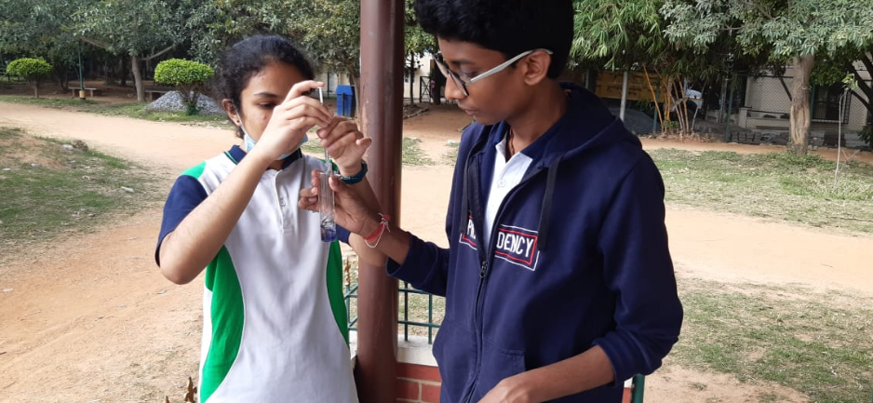

Slide 20
Results and Discussions (Comparative analysis of water Samples)

Slide 21
Parameters Comparison
Parameters | Permissible Limit (IS 10500 BIS) | Hulimavu Lake – 29th October | Kalena Agrahara Lake – 29th October | Kalena Agrahara Lake – 2nd December | Testing Methodology
pH | 6.5-8.5 | 7 | 7 | 7 | pH Paper
Nitrate | 45 mg/l | Below 10 mg/l | 45 mg/l | Below 10 mg/l | NO₃-A, NO₃-B
Iron | 0.3 mg/l | 1 mg/l | 0.3 mg/l | NIL | Fe-A, Fe-B
Hardness | 200 - 600 mg/l | 488 mg/l | 128 | 104 mg/l | EDTA solution
Chloride | 250 - 1000 mg/l | 212.7 mg/l | 70.9 | 78 mg/l | K₂CrO₄,AgNO₃
Residual chlorine | 0.2-1.0 mg/l | Below 0.2 mg/l | 0.2 mg/l | NIL | Ortho toludine
Turbidity | 1 – 5 NTU | Turbid at 100 NTU | Turbid at 25 NTU, not Turbid at 50 NTU | Turbid at 25 NTU, not Turbid at 50 NTU | Turbidity tube
Faecal Matter | Should be absent | Positive | Positive | Positive | Coliform test
Ammonia | 0.5 mg/l | 3 mg/l | NIL | Below 1 mg/l | Nessler's reagent
Phosphorus | NA | 0.5-1.0 mg/l | 0.5 mg/l | 0.1 mg/l | (NH₄)₂MoO₄ ,SnCl₂
Dissolved oxygen | Minimum 5 mg/l | 1 mg/l | 6.6 mg/l | 9.6 mg/l | Titration with sodium thiosulphate
Fluoride | 1.5 mg/l | 1 mg/l | 1 mg/l | 1 mg/l | Zirconyl solution
Temperature | 10-20 | 20 | 18º | 18º | Laboratory Thermometer
(Water sample collection couldn't be done for Hulimavu lake on 2nd December as restoration work was being done )

Slide 22
Data Interpretation
Observations and inference from testing-
-Dissolved oxygen levels were lesser than the permissible limit in the Hulimavu lake. This suggests that it is highly polluted due to human intervention.
-Ammonia and Iron are higher in the Hulimavu lake.
-Both the lakes have higher turbidity and tested positive for faecal contamination
Conclusion-The analysis reveals that the Kalena Agrahara lake is in a better condition compared to the Hulimavu lake along the discussed parameters.

Slide 23
Effective approach to create an optimal lake that is sustainable in the urban landscape of Bangalore

Slide 24
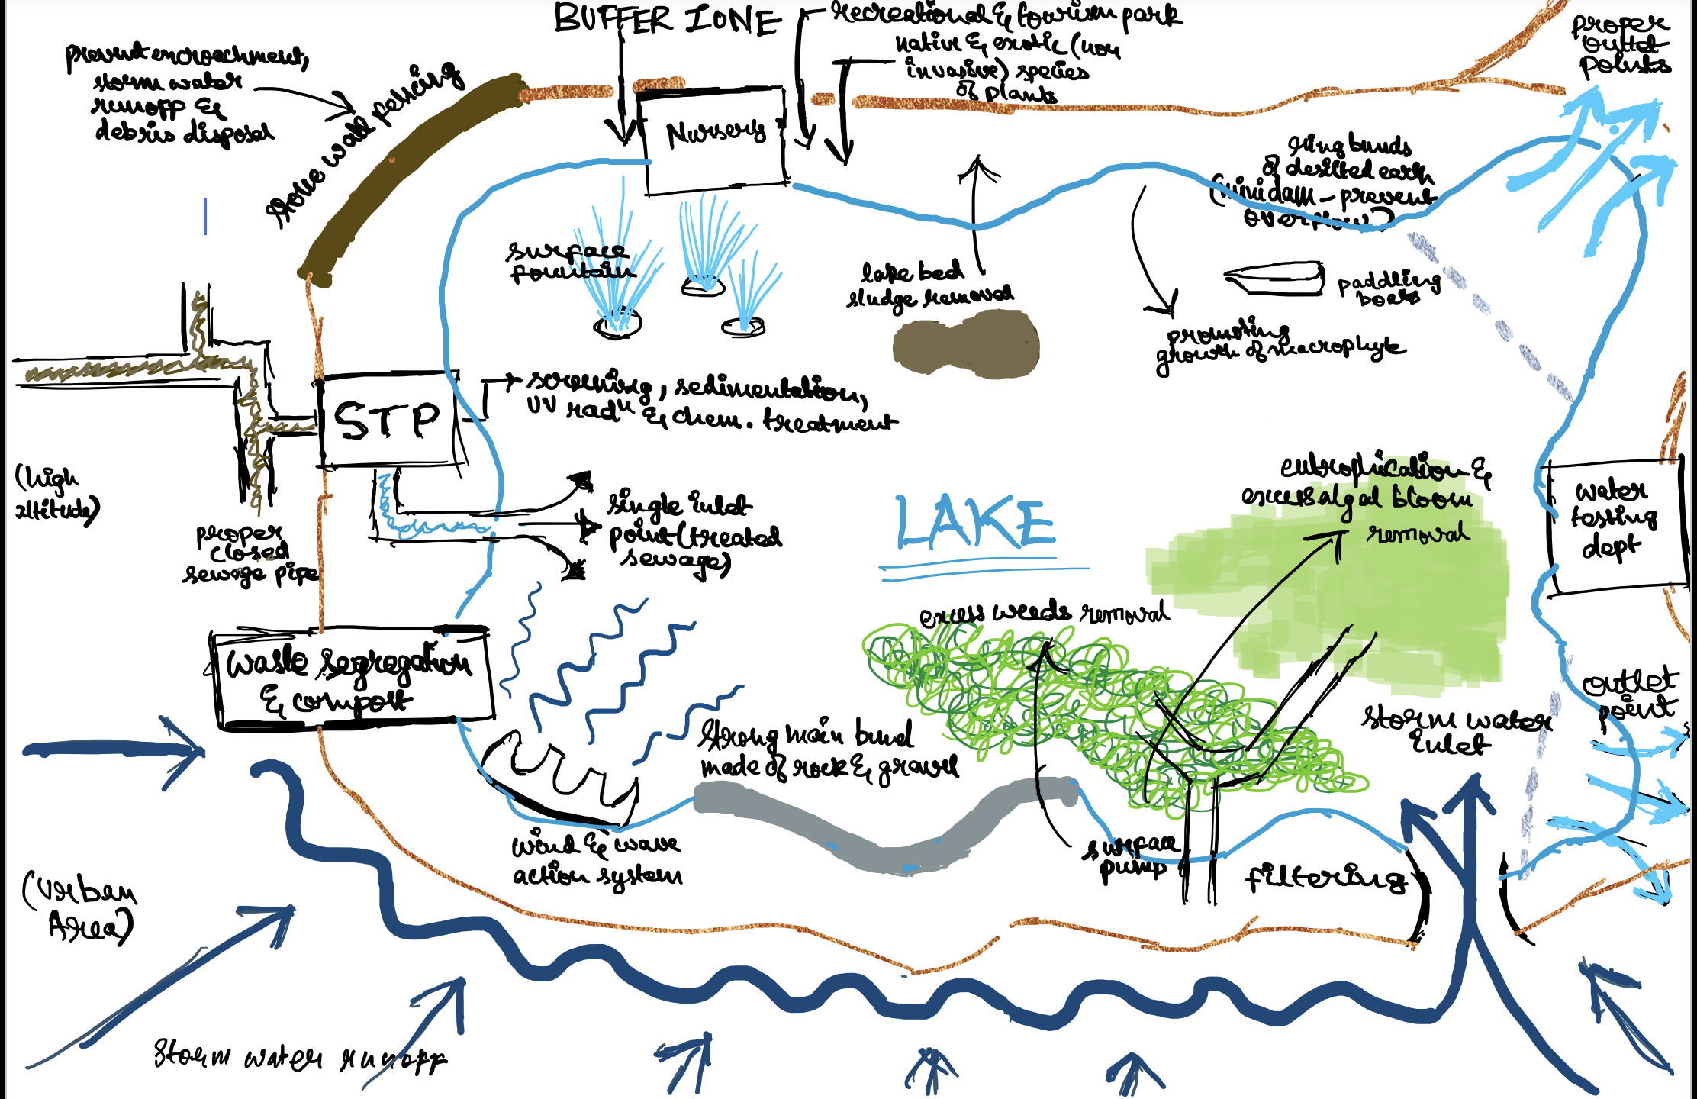
Source used to create the chart:
Site Visits of Kalena Agrahara, Madiwala and Hulimavu Lake
E-Workshop - 'Know your Ecosystem' - youtube
Research Paper cited – Efficacy of Rejuvenation of Lakes in Bengaluru

Slide 25
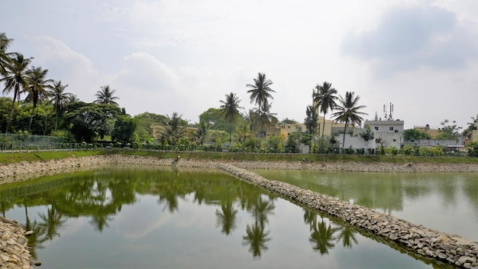
Conclusion
We have first looked into the lake mapping and the restoration work.
We looked into the water quality data and interpreted the issue.
We read about lake planning to suggest an idea for the creation of a sustainable lake in the urban landscape.
Lakes define Bangalore's identity, and lakes around us play a vital role in each one of our lives. It is important to conserve this very limited resource and we as residents of Bangalore should step forward to do so. It is the need of the hour to understand the issue and fix it in a timely manner. This is our joint responsibility.

Slide 26
Acknowledgement
We would like to thank IISc and the Ecological sciences department for providing us with this opportunity. Working on this project has given us practical experience and each day of work in the field gave us an opportunity to learn something new. This project has made us more concerned than before about these lakes.
We would like to thank Indumathi Ma'am and Ashwini Ma'am for guiding us through the project, organizing site visits, water quality testing, collecting samples etc. The project would not have been possible without the guidance and continual support of our teachers.
We would like to thank Lohit (WWF) for providing us the kit for testing.

Slide 27
References (Works Cited)
Report on Standards cited – IS 10500: 2012, Drinking Water – Specification (second revision) by Bureau of Indian Standards (BIS)
https://youtu.be/1wODs1bk1tk - Anaavarana- interview of Hulimavu Kere Tharanga (2021)
Research Paper cited – Efficacy of Rejuvenation of Lakes in Bengaluru – authored by TV Ramachandra, Sincy V and Asulabha KS (2020)
Research Paper cited – Wetlands Restoration and Conservation – authored by TV Ramachandra and N Ahalya (2001)
Research Paper cited – Impact of Urbanisation on the Interconnectivity of Wetlands – authored by TV Ramachandra and RS Deepa (1999)
Jal Tara Water Kit Manual – Lohit (WWF)
Research Paper cited – Restoration and Management Strategies of Wetlands in Developing Countries – authored by TV Ramachandra (2001)

Slide 28
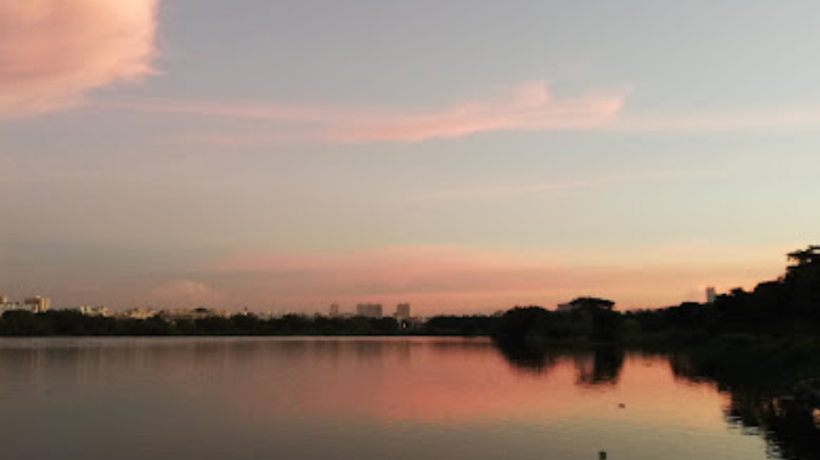
Thank You

