Slide 1

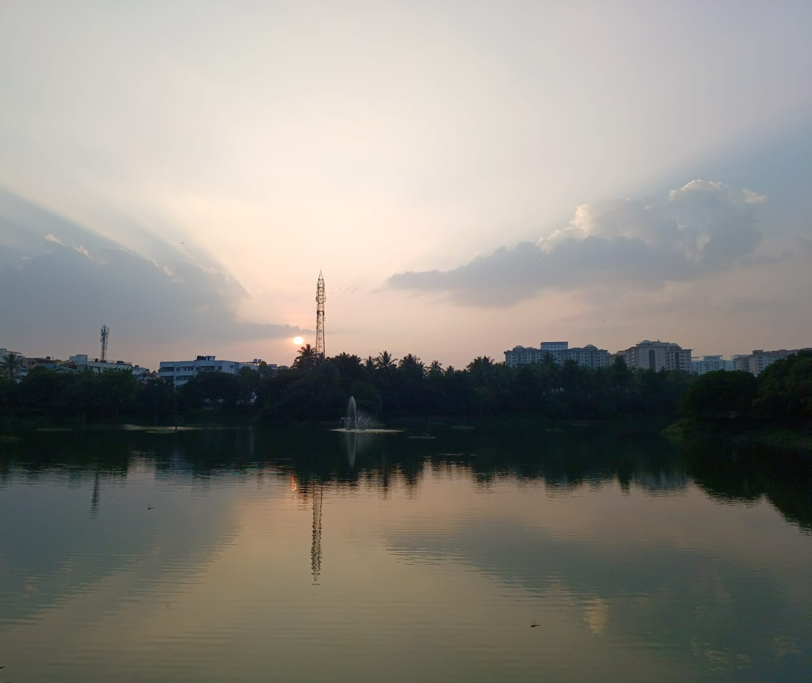

On The Birds of Puttenahalli Lake
Kaamesh MG
Grade11| Presidency School Bangalore South

Slide 2
Introduction
The use of Bioindicators in studying a particular environment is advantageous. In this study the birds of Puttenahalli Lake are the Bioindicators of the lake.
Birds are considered one of the most important indicators of the eco system because they are sensitive to climatic changes and with their food habits and their characteristics we can define the climatic conditions, other species they depend on in the environment and any environmental problems if seen.
Each bird specie has a different type of habitat, food habits and temperature ranges, this property of the birds makes it vital to study them to know more about the environment.
By studying the birds in the environment of interest we can precisely draw conclusions about the environment.
Notes:
This is the question that your experiment answers

Slide 3
Objective
To record the birds in Puttenahalli Lake
To study the species and to deduce how they act as a bio indicator.
To compare the activity of the birds and check the lake report.

Slide 4
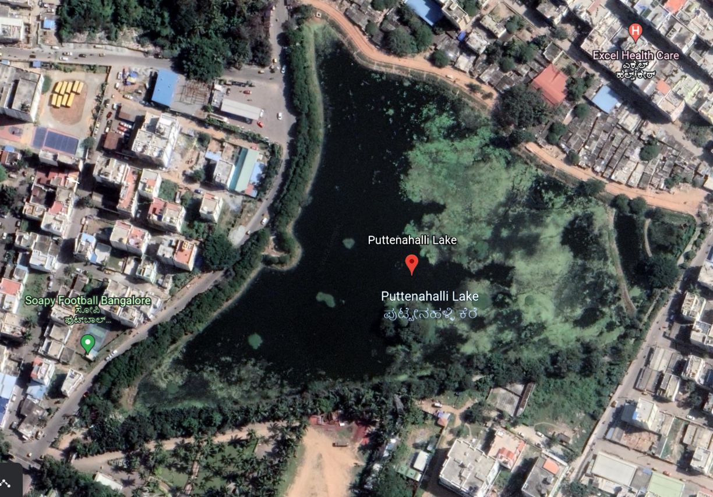

Study Area
Puttenahalli lake ( ಪುಟ್ಟೇನಹಳ್ಳಿ ಕೆರೆ) is a small, restored freshwater lake located in JP Nagar 7th Phase, South Bangalore. The area of the lake is about 13 acres. The primary water sources are rain and surface water diverted to the lake through channels. The lake is currently maintained by Puttenahalli Neighborhood Lake Improvement Trust (PNLIT) .The lake was on the brink of extinction, but due to the efforts of PNLIT, is now a haven for bird-watchers and on its way to being completely restored.
Puttenahalli Lake has a recorded area of 13 acres with a perimeter of 1.1 km (measured walking track perimeter 920 m).

Slide 5
Materials and Method
Camera, Samsung M53 108MP Quad Camera Setup
Observation – Visiting the Lake and making note of the count of birds and their behavior in that particular time period.
Identification – of the bird species and studying about the birds.
Conclusions/Inferences – With respect to the observational experiment conducted and the datapoints drawn from the above experiment, draw conclusions about the lake with the relationship of the birds with the lake

Slide 6
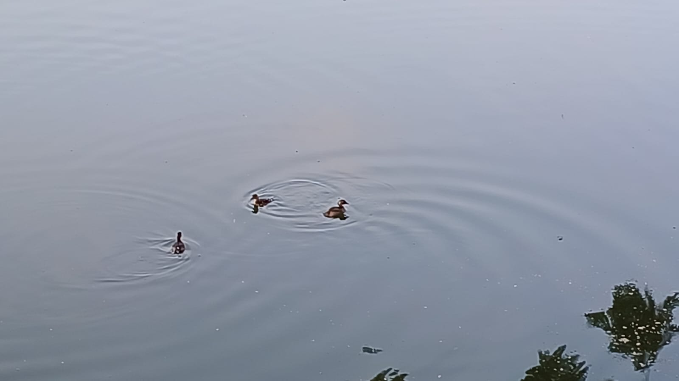
Little Grebe
This bird breeds in small colonies in heavily vegetated areas of freshwater lakes
The little grebe is an excellent swimmer and diver and pursues its fish and aquatic invertebrate prey underwater. It uses the vegetation skillfully as a hiding place.

Slide 7
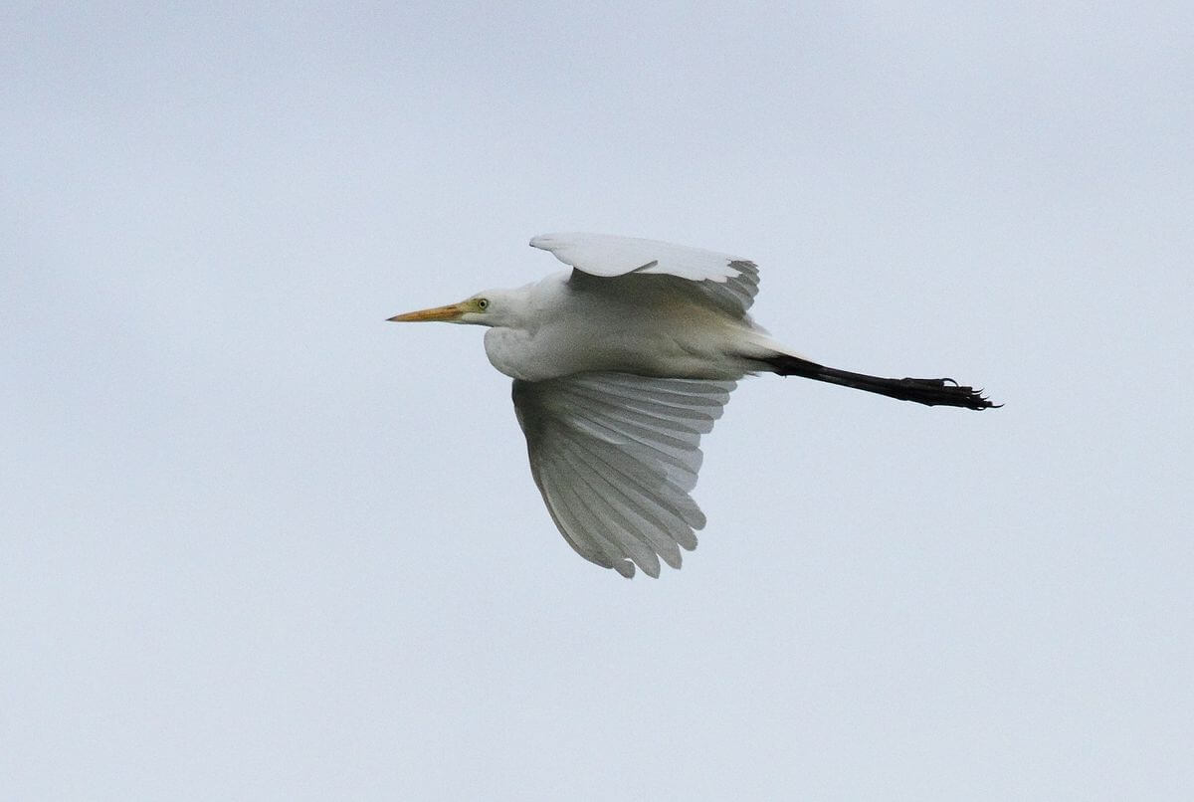
Egret
Egrets are herons, they are essentially non-swimming waterbirds that feed on the margins of lakes, rivers, swamps, ponds, and the sea.
Their diet includes a wide variety of aquatic animals, including fish, reptiles, amphibians, molluscs, and aquatic insects.
https://birdcount.in/wp-content/uploads/2016/12/Caegflight.jpg

Slide 8
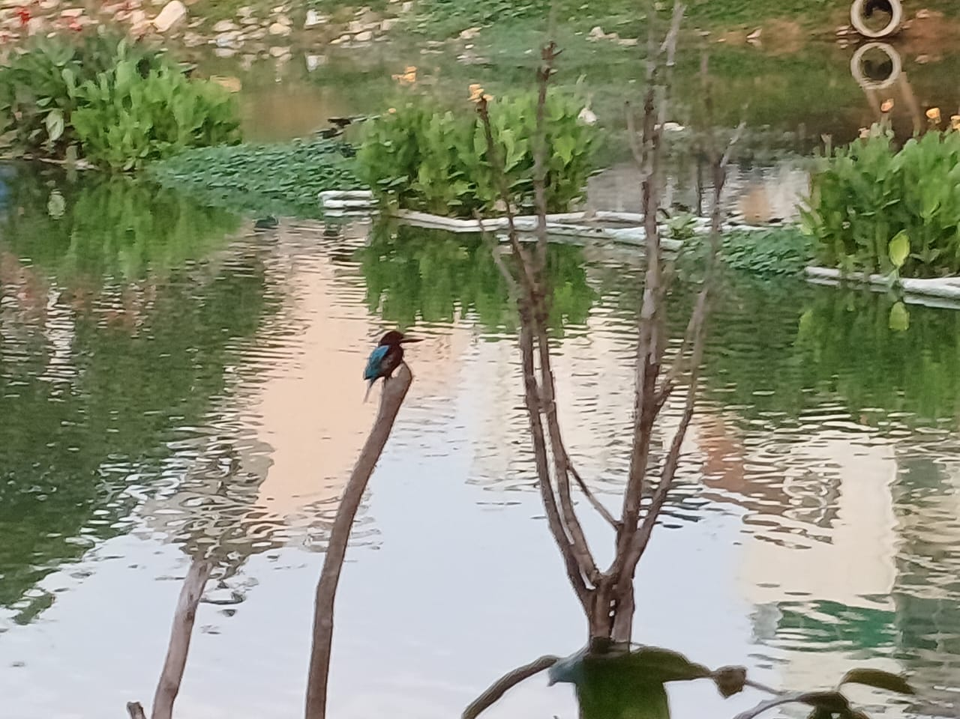
White-Throated Kingfisher
Habitat – swamps, ponds, lakes etc
White-throated kingfishers are carnivorous generalists that eat many organisms, including locusts, crickets, beetles, mantises, ants, termites, dragonflies, grasshoppers, centipedes, lizards, mice, frogs, small perching birds, and fish.

Slide 9
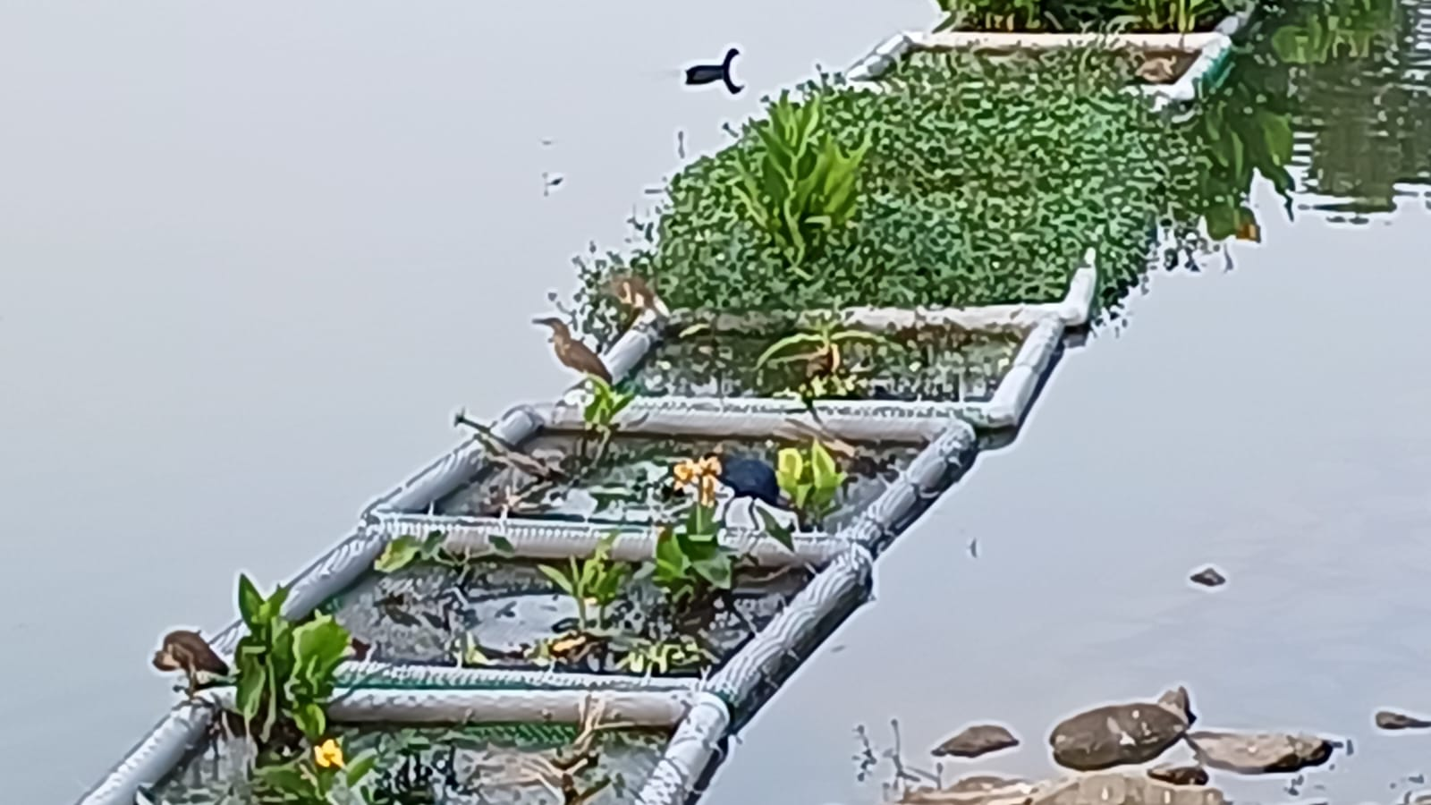
Indian Pond Heron
Habitat – Small Waterbodies
Usually solitary foragers but numbers of them may sometimes feed in close proximity during the dry seasons when small wetlands have a high concentration of prey.
Breeding – Monsoon

Slide 10
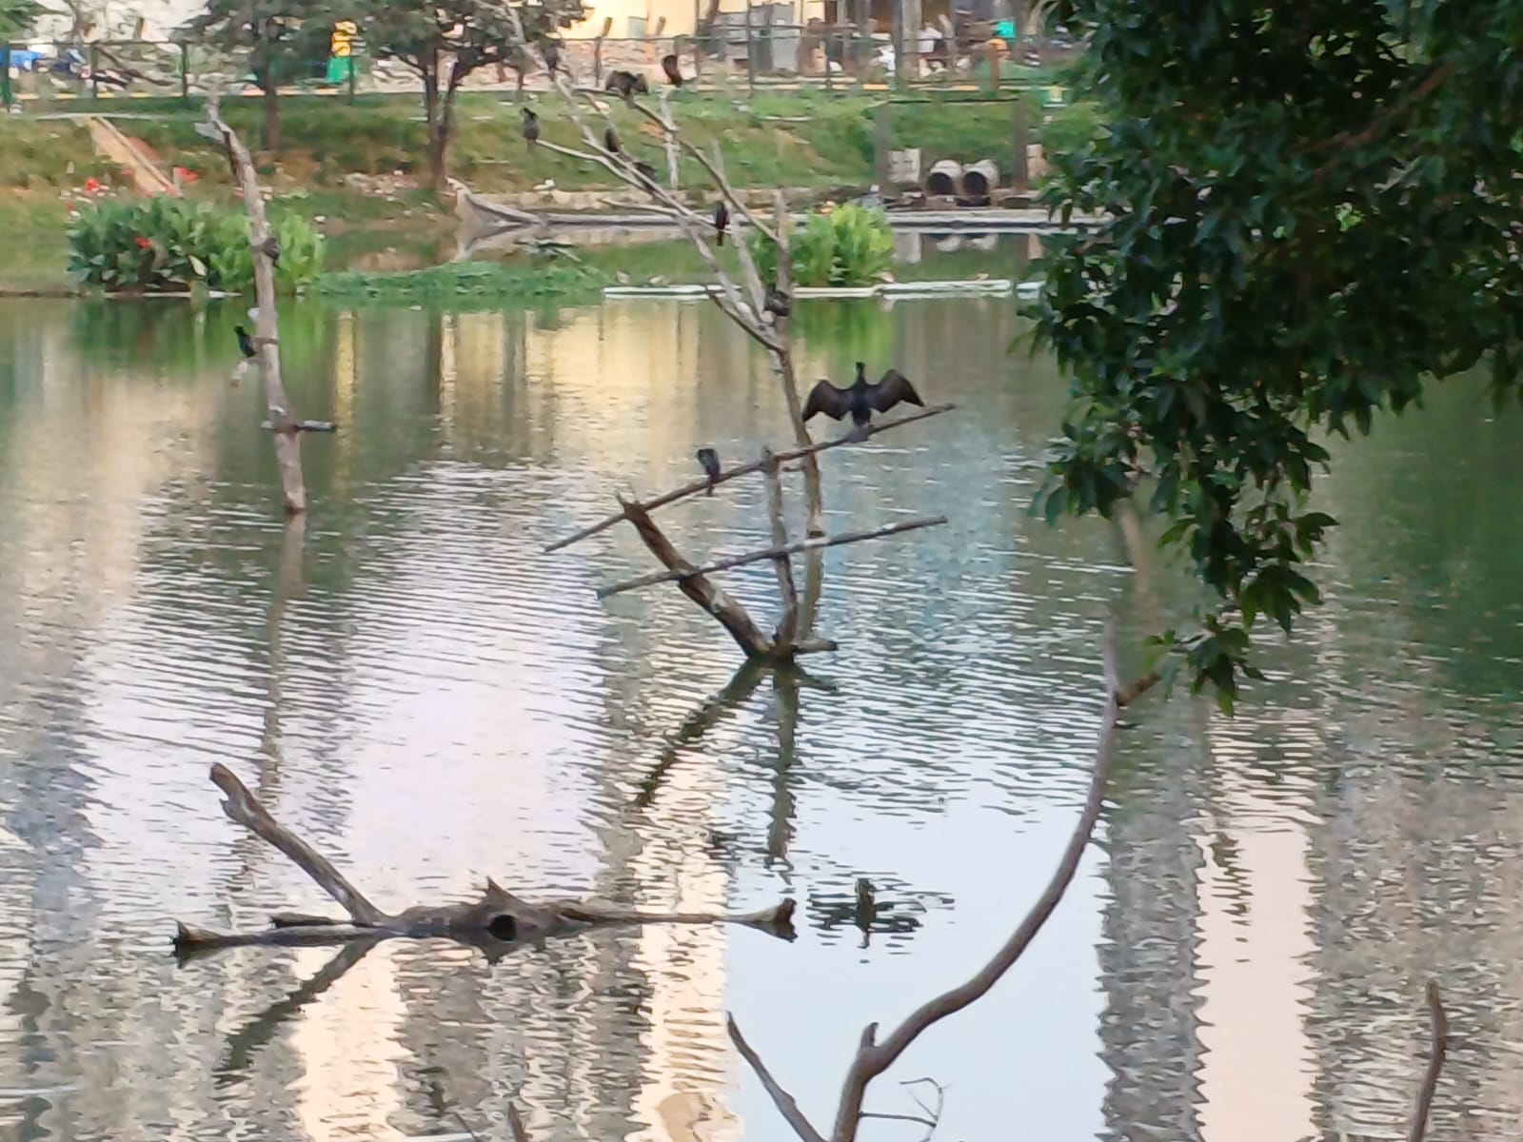
Indian Cormorant
Habitat – Live in lakes, oceans, rivers etc.
Behaviour – Dives for fish underwater and dries its wings by opening it letting the air to dry it
Breeding – In colonies around freshwater lake. July to February

Slide 11
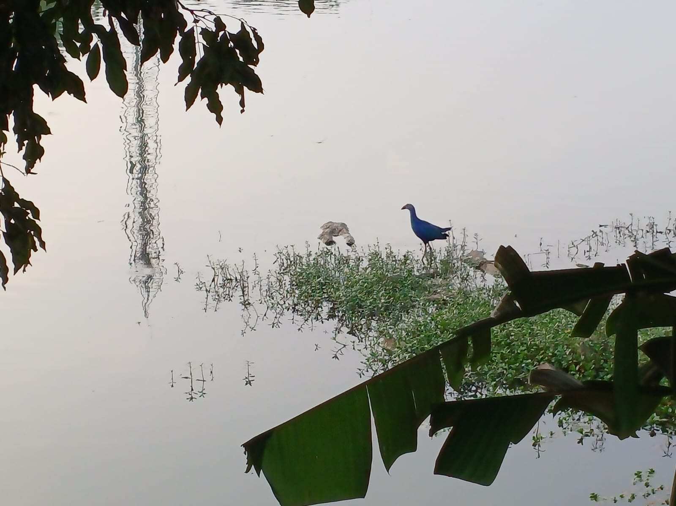
Grey Headed Swamphen
Habitat – Vegetated freshwater bodies such as lakes, rivers etc.
Usually in small groups and feeds on floating vegetation.

Slide 12
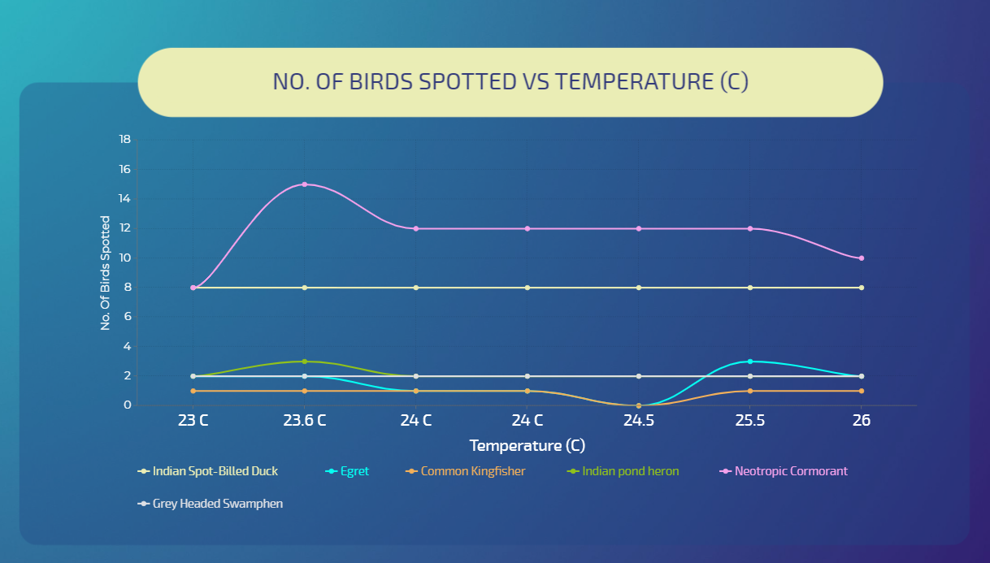
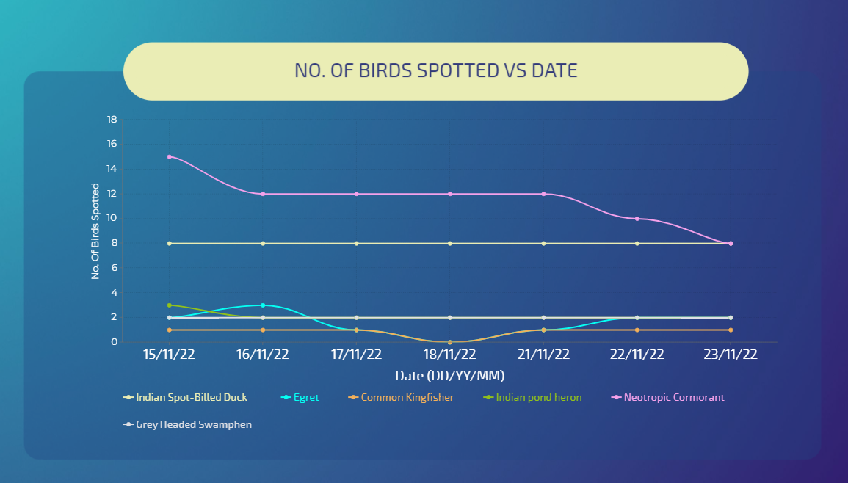
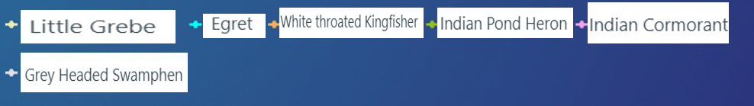
Results
Graph with respect to increase in the temperature
Variations seen but no plausible explanations explain the sudden increase and decrease in the bird count w.r.t. increase in the temperature
But if the graph is plotted against the date of the observations there is a relationship seen.

Slide 13





No. of Birds Spotted vs Date
In the above data there is a steady decrease in the number of Indian Cormorant.
The plausible explanation for this observation is that, the birds breed seasons are from July to February and their maturation and their Average time to independence together takes 15 weeks . If the birds procreated before 4 months i.e., July then they would have reached their time to independence and left the lake therefore resulting in the steady drop in the graph.

Slide 14
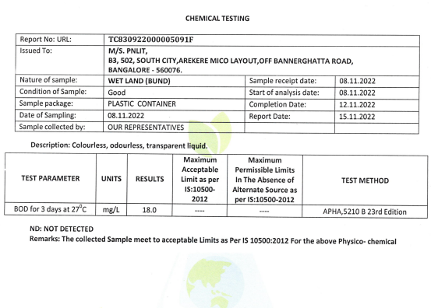
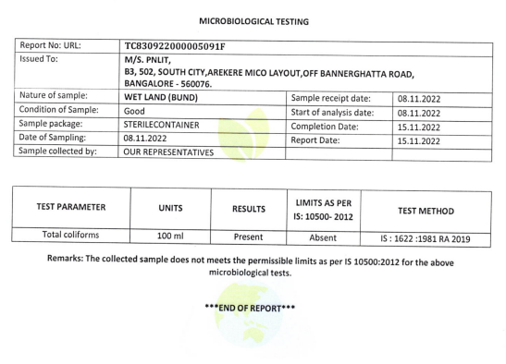
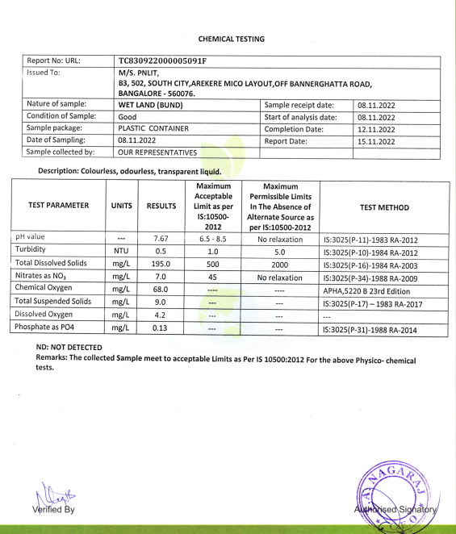
Bunds

Slide 15
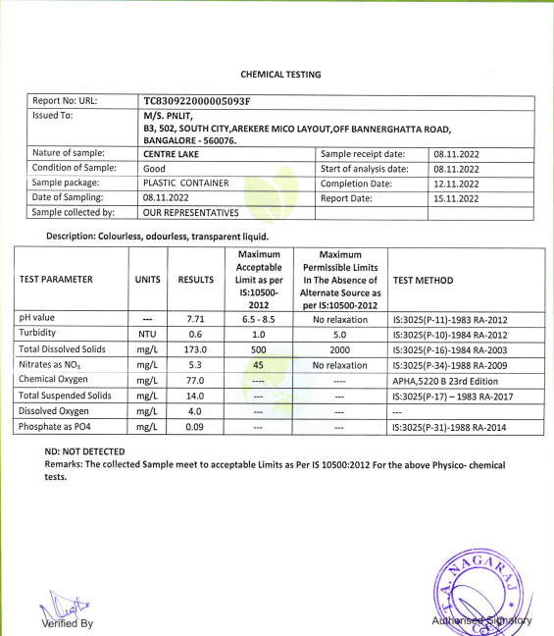
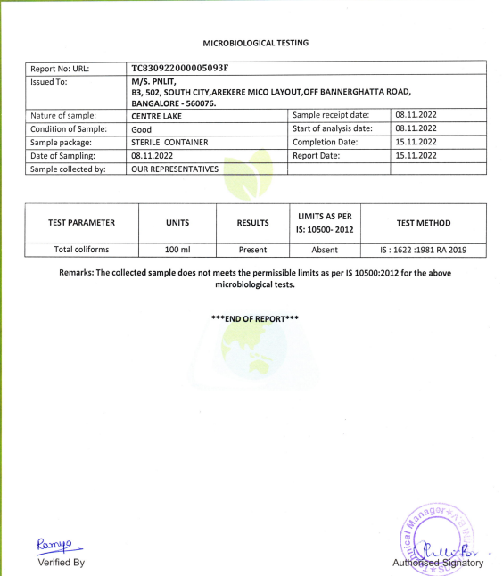
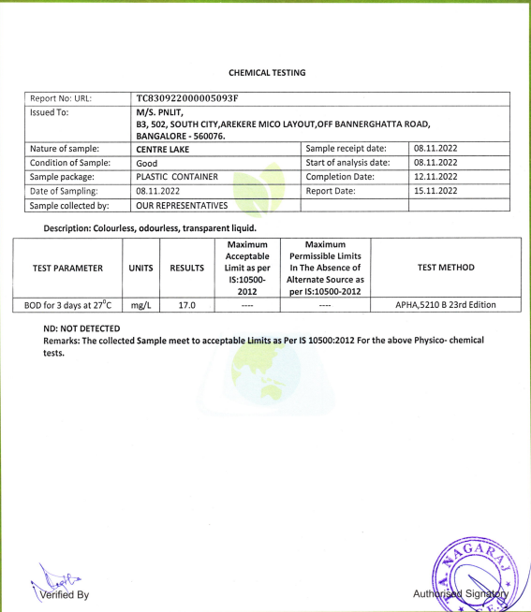
Central Lake

Slide 16
Conclusion
As Birds are excellent bioindicators the conclusions drawn from the observations are :
Puttenahalli is a freshwater lake, the water quality is good as several birds like Little Grebe, Grey Headed Swamphen, are present (which is also verified by the water testing data).
The lake is well maintained and the ecosystem of the birds and other species in the lake is not disturbed.
There is a lot of vegetation in the lake, not only floating vegetation but also vegetation on the bunds.
The numerous plants around the lake make it an amazing ecosystem for the bird.
The water entering the lake is properly treated.
There are many birds in this lake hence it is projected to have plenty of fish.
The lake is also an active site for breeding as it provides rich resources for the birds.

Slide 17
References
https://www.inaturalist.org
https://birdcount.in/cormorants-clarified
https://www.timeanddate.com
https://www.ebird.org
https://www.visme.co

Slide 18
Acknowledgement
I would like to thank IISc for hosting LAKE Conference 2022 and giving us this opportunity
I take this opportunity to thank my parents, my Biology teacher Ms. Indumathi and Puttenahalli Neighborhood Lake Improvement Trust (PNLIT) for their constant support and guidance for the successful completion of this study.

