Slide 1
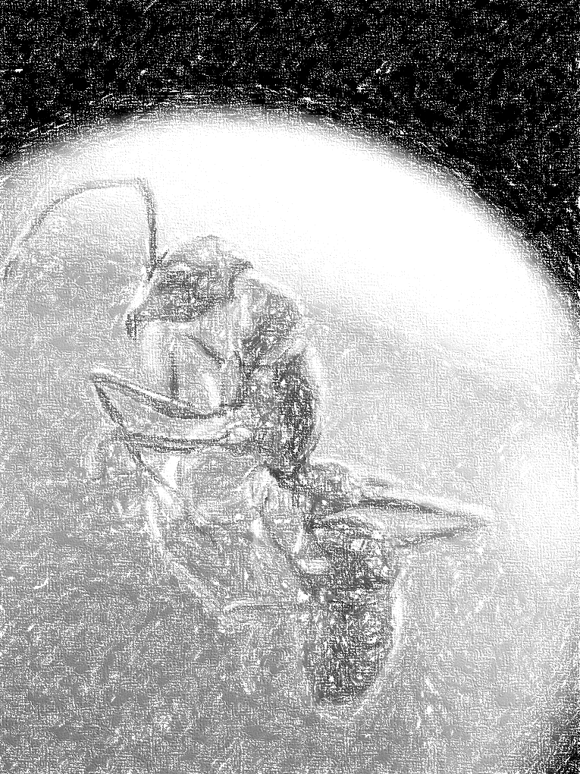
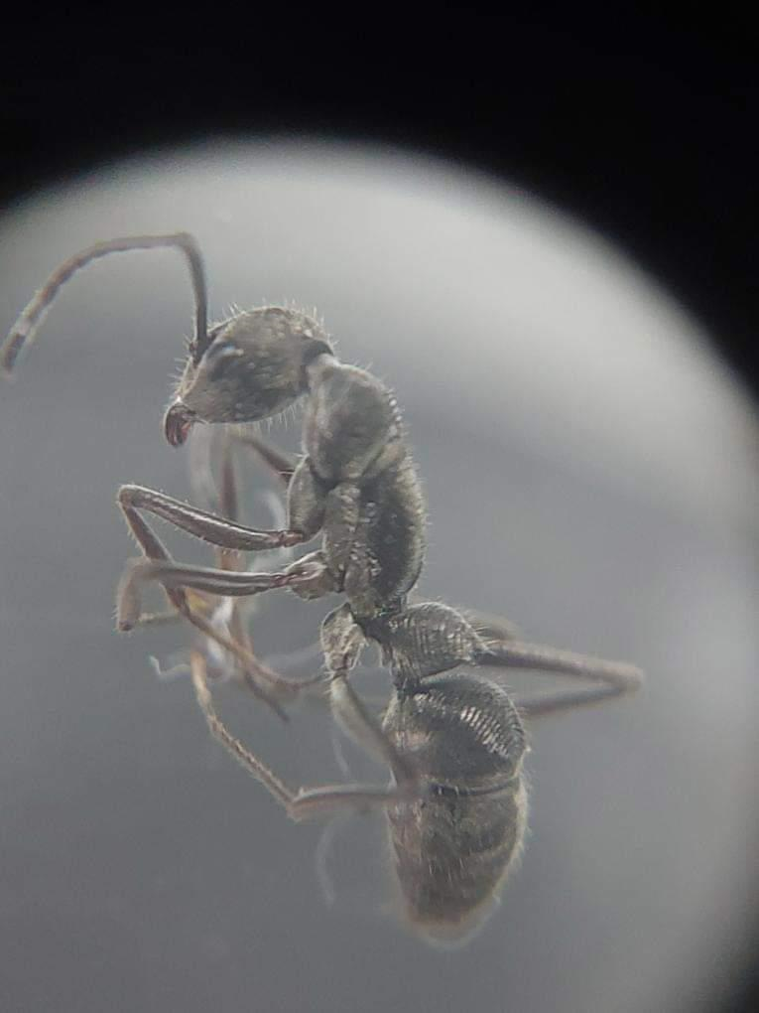


Study of Ants in Lake ecosystem
Invasive vs Local
By: Arjun R
Prarthita Dashsharma
Grade :11
Presidency school bangalore south

Slide 2
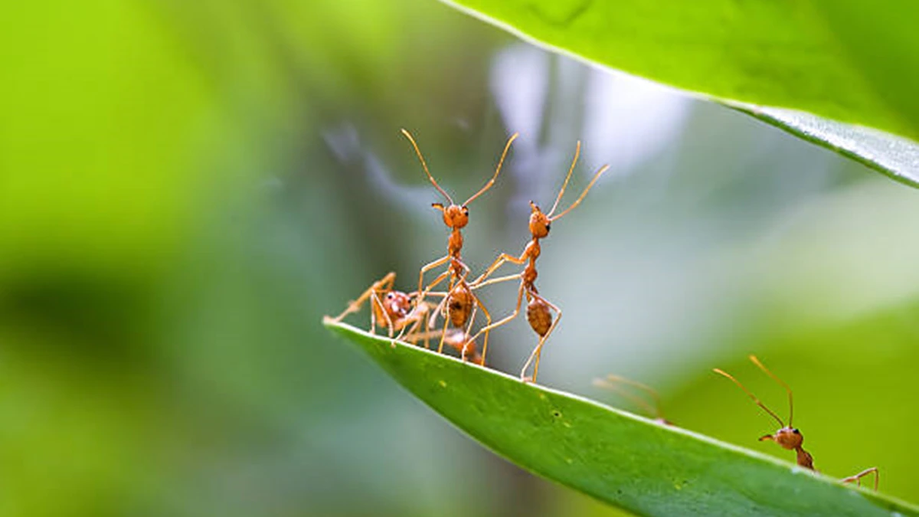
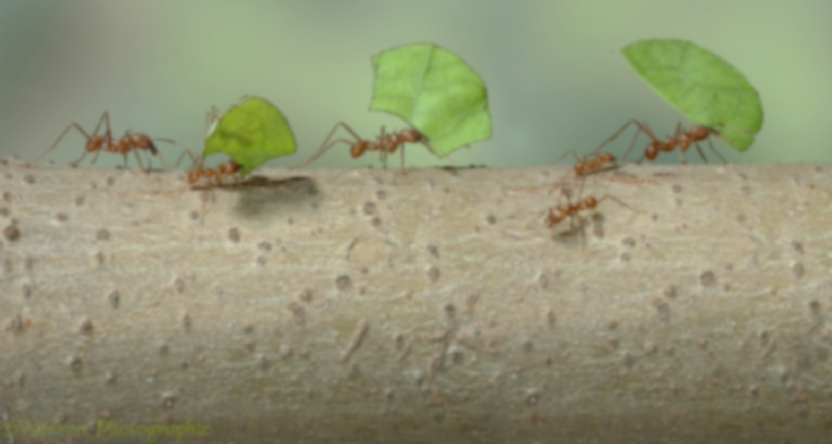

INTRODUCTION
Ants might look like they don’t do much contribute in our surroundings but these facts might surprise /everyone.
Ants are the largest scavengers in the worlds with no other competitors who come near to ants in cleaning up all our wastes.
Many modern technologies are inspired by this tiny creature. Inventions like internet , social media, guns, radar etc.
An ant nourishes the soil by making burrow in the soil and adds extra nutrients by its waste which is rich in nitrogen content.
Ants helps decomposition of plastic by breaking it down into smaller particles which makes it easier for nature to take its role( Carpenter and Pavement Ants are the ones involved in this process).
These arthropods help keep other pest and insects in control by exterminating their root cause.
Ants helps in colonizing many essential bacteria’s and micro insects.
Ants milk Mealy bugs for the sweet secretion for feeding it to their young ones with soft exoskeleton, this proves ants have started catling even before mammals existed.

Slide 3

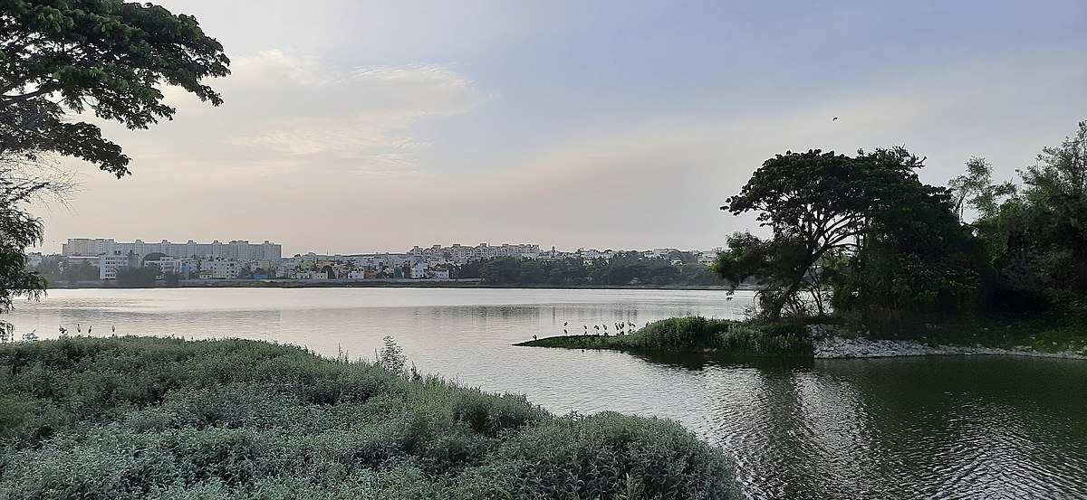
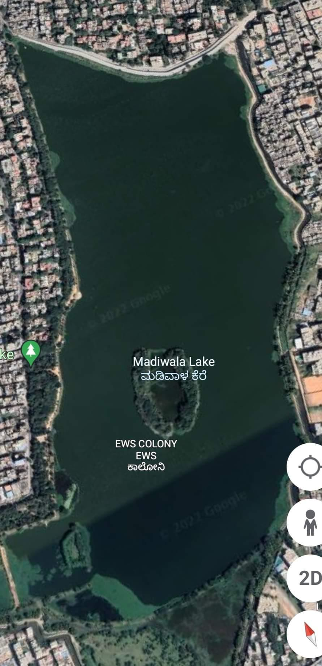
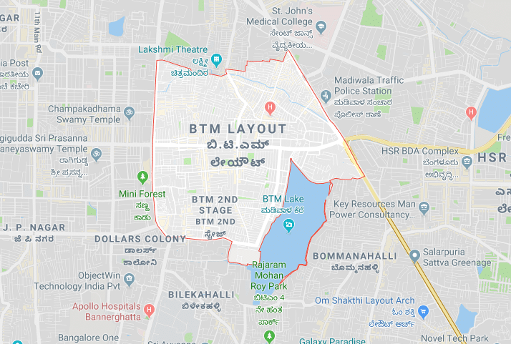
Study Area (Madiwala Lake)
All banks of Madiwala lake

Slide 4

Materials and Methods
Ant samples collected from east and west banks of the lakes.
The samples behavior observed in different condition.
Observed the reaction of ant species with each other
Pictures of ants taken when they were immobile.
Researched with using the help of a youtuber/myrmecologist for accurate information.

Slide 5
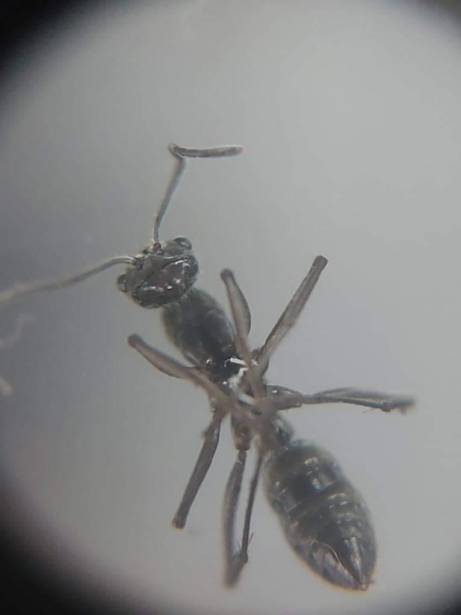
TYPES OF SPECIES FOUND IN MADIWALA
Vampire Ants
Adetomyrma venatrix
These ants are special as they let their larvae eat the food and then puncture their offsprings to drink their blood.
They have a long body and a very unique shaped face which is made to puncture the larvae cocoon to drink their blood as a food source.
They are the only ants with no stinger and are very shy in nature.

Slide 6

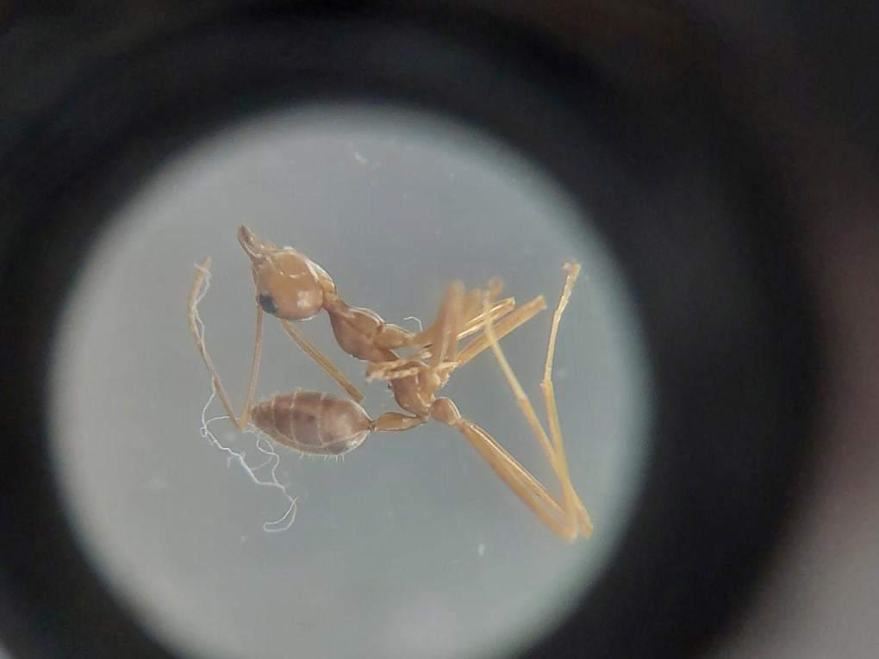
These ants make huge nests in trees using silk of the cocoon.
They have strange joints, long legs.
They are very aggressive and can shoot citric acid with their abdomen.
Their mouths are build like scissors which is used to cut through leaves and mushrooms and their long legs hold on to each other and act like living ropes.
Oecophylla smaragdina

Slide 7
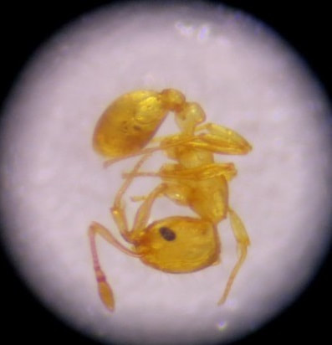
Fire Ants
Solenopsis Invicta
These ants are bright red in color and small.
They are aggressive in nature and dangerous to the environment.
They prefer dry areas.
During floods, they attach to each other to make a living raft, which is light enough to not break the surface tension and stay strong with the help of their leg structure.
They are small invasive species and have both stingers and a very intense bite which injects acid.

Slide 8

Pavement Ants
These ants have stinger and are mildly aggressive.
They have an inwardly bent body.
This is the species with more amount of creatine in it.
They have hard exoskeleton.
These have a longer body, shorter legs and have a stinger.
They are not at all aggressive.
Their jaws are made to penetrate other exoskeleton.
These are very good at cleaning up dead things.
Tetramorium caespitum

Slide 9
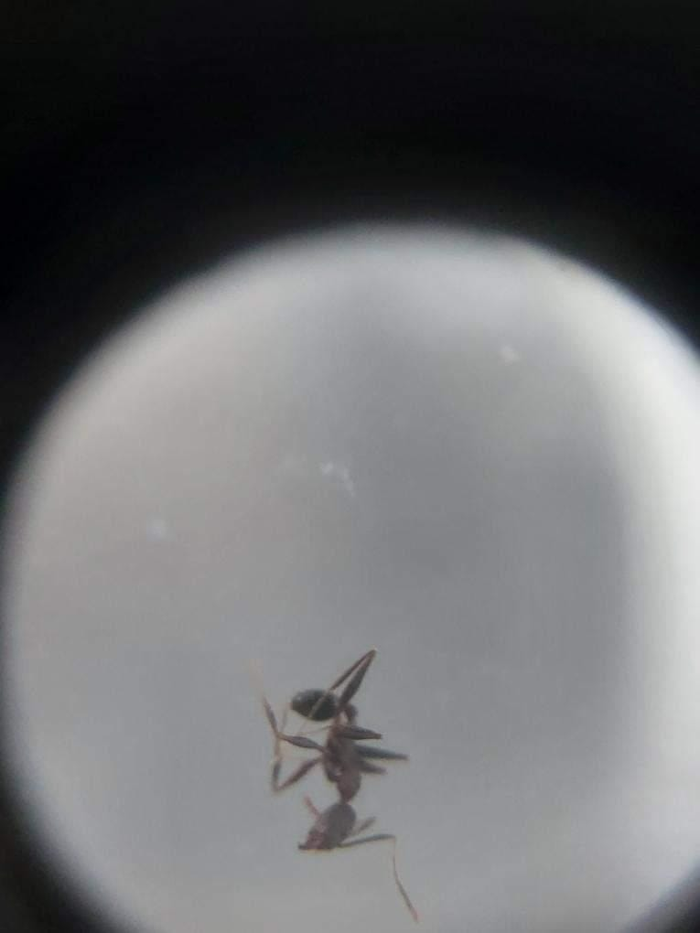
Black Crazy Ants
They are small and have a unique leg position which makes them the fastest ants and their thorax are shaped in such way that they can hide in the crevices of fruits and barks.
They lack a stinger and are not at all aggressive.
Paratrechina longicornis

Slide 10
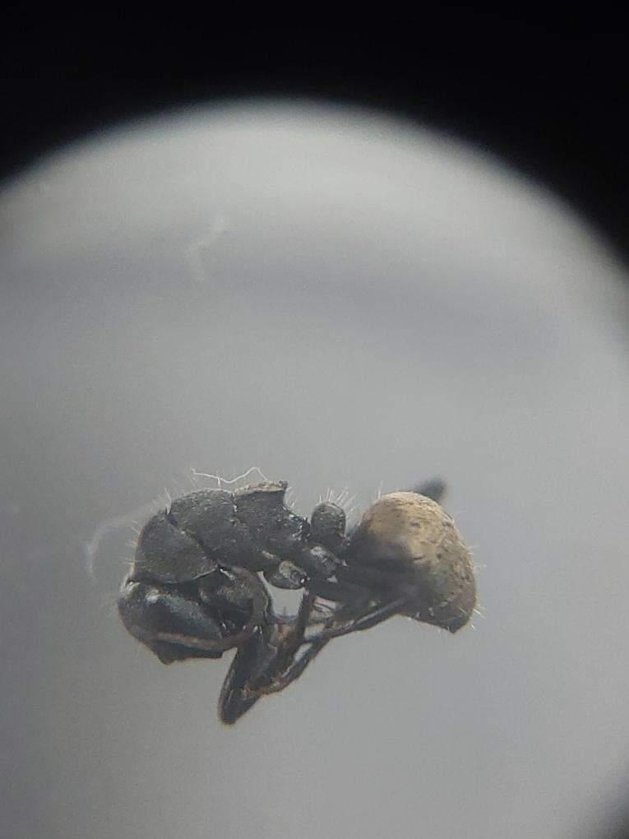

These ants are smaller than their cousin black carpenter ants.
They reside under barks and logs and have a fatter abdomen with a very unique golden color, which is reflective and used for path guidance.
They are not at all aggressive.
Polyrhachis ammon,

Slide 11
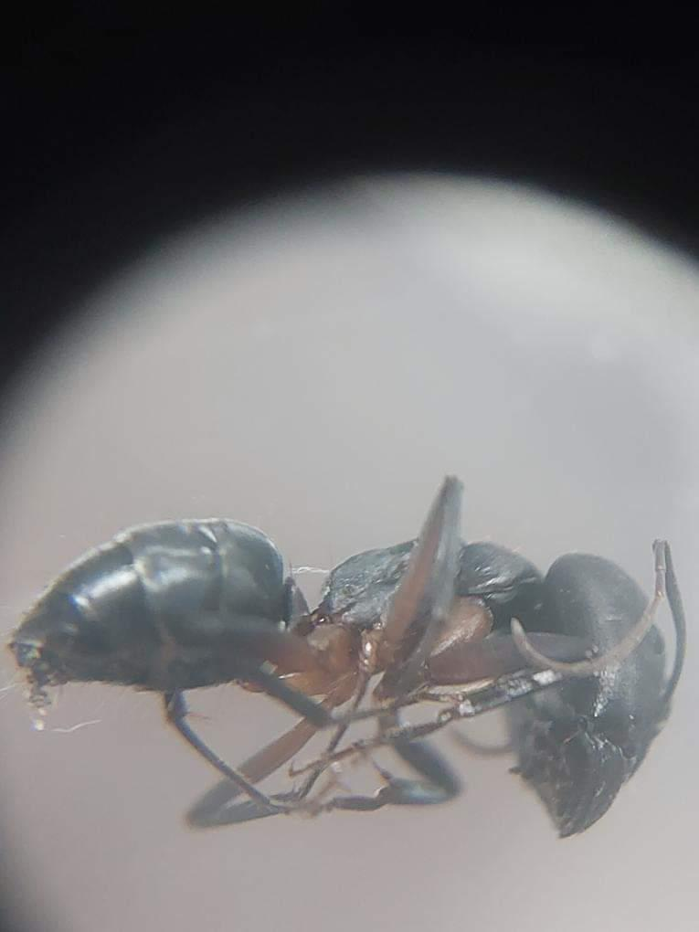
Black Carpenter Ants
These ants live in the woods and have strong jaws helpful in digging huge depths inside the wood.
They are non-aggressive, kind and don’t bite unless extremely required.
The black carpenter ants these are huge ants with no stinger but they have one of the strongest bite force which can drill through wood very easily.
Their exoskeleton is strong and the guard ants use their own hard-shelled body as the door of the tunnels.
Camponotus pennsylvanicus

Slide 12
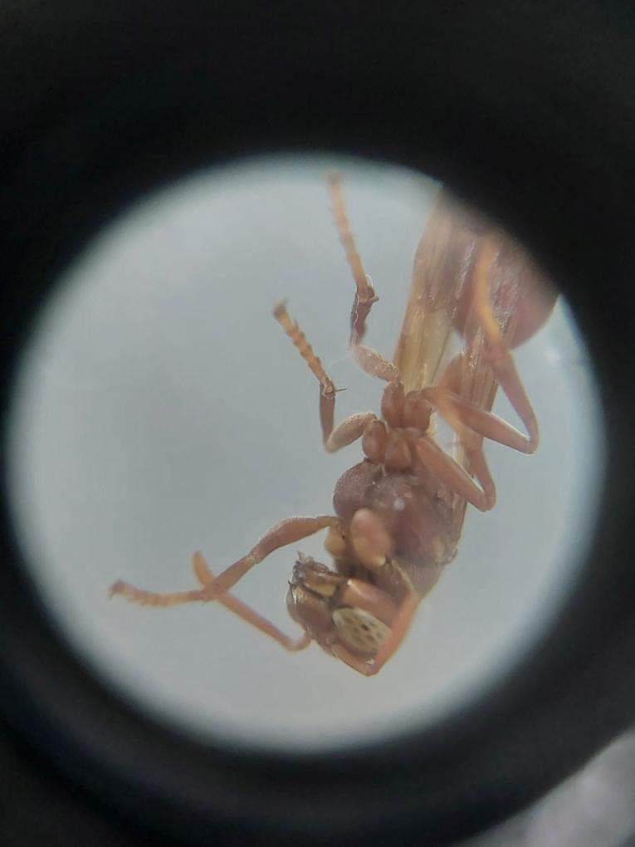

These ants are extremely tiny and hyperactive.
Their abdomens are transparent.
They live in very moist places.
They lack exoskeleton in the lower half.
Wasps
This was collected for the comparison with ants.
Their eyes have multiple lenses and a pulsing abdomen with stingers.
Vespidae

Slide 13
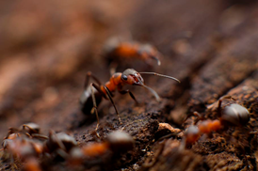

Results and Discussions (Madiwala Ants)
Structure Of Ant Colonies :-
The ants we found in Madiwala have many unique ant hill structures.
The pavement ants in the Madiwala lake have a hexagonal/circular ant hill shape which helps the ants in the wet soil and gives extra structural support.
The carpenter ants have made multiple highway systems from their colonies to their rich wood sources.
The golden striped carpenter ants are using the termite tunnels which they have exterminated.
The weaver ants made nest in a shallower part of the tree as the rain is more common over there.
Ghost ants and black crazy ants collect a pile of snail shells and reside in them as they provide stronger shelter.

Slide 14

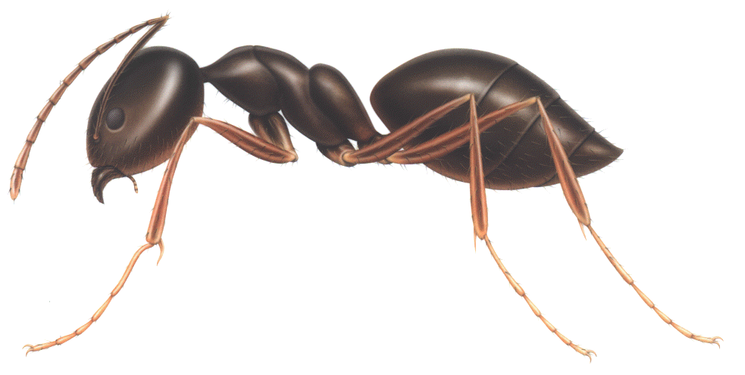
Life Cycle of Ants
Stage 1 : The journey of the ants start from the queen. These elites go through a ceremony called Nuptial Flight, where winged ants and wasps mate in the air. After the mating the male dies due to neural collapse. A single queen ant (elite) mates with multiple male wasps.
Stage 2 : The not virgin queen now seeks for shade and rips her wings apart and makes a queen chamber. The queen lays eggs in her chamber nurturing them by dissolving her own wing muscles. The queen eats nothing for the next 3-4 months until the first egg batch develops into larva, and then into young worker ants. The first batch of worker ants are called Nanitics.
This Photo by Unknown Author is licensed under CC BY-NC

Slide 15
Stage 3 : The ants goes for hunt for the first time to the outside world from the queen’s chamber. First, they eat in and transfer it using a method called trophallaxes, the safest way to transfer food from ants to ants as the saliva of these ants have an antibacterial property.The queen can lay up to 800 eggs per day if the conditions are favorable. After 1-2 years the colony reaches its ideal size which is about 30,000 ants.
Stage 4 : Elite carry their genes to the next generation. The ant world is female based; males have no big roles except carrying the genes. Males are nothing but unfertilized eggs. These males follow the same steps, they fly in the nuptial flights and pass the genes to another female.
Hence, this is a huge cycle which acts as a base in the ecosystem we live in.

Slide 16
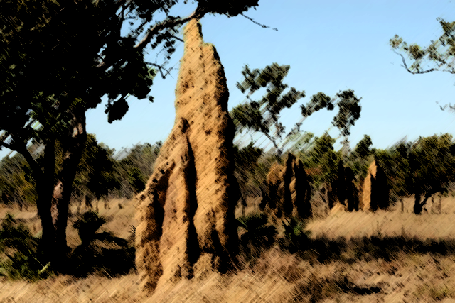
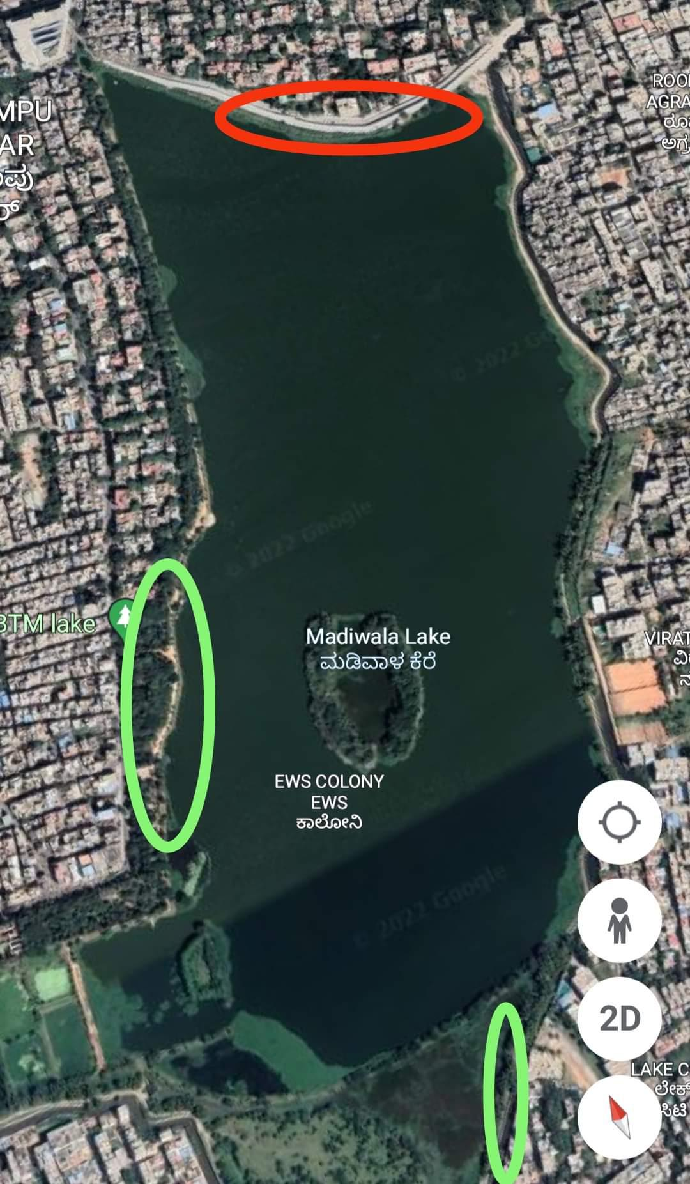
Creatine monohydrate found in Madiwala ants
Ants in Madiwala have a slight trace of creatine monohydrate in them, which is very rare and is a evolutionary trait by the local ants to have stronger jaw muscles and faster reflexes to fight of the invasive species. This is only found in the pavement ants.
Hierarchy among the ants
The majorly available ant species are pavement ants in the west Bank of the lake and weaver ants in the east which is a very good sign that the ecosystem is healthy because both of these species are local species.

Slide 17
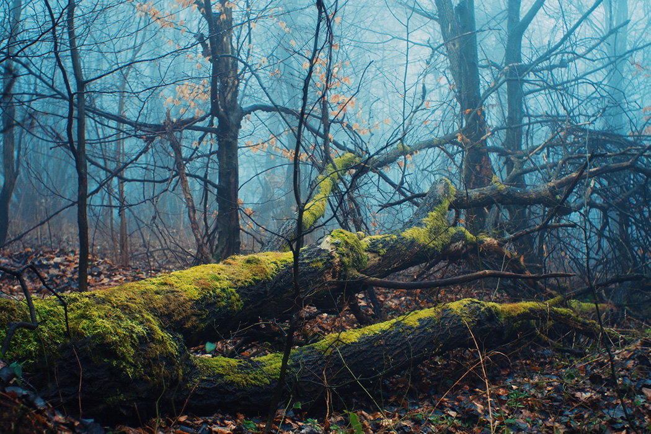
Impact of ants in Madiwala lake ecosystem
Ants help the madiwala lake ecosystem in the following ways
1.Ants acts as the base of the food pyramid and its absence will lead to the whole collapse of life on our world
2. Ants help in breaking up of construction and concrete waste, mixing them up into the soil and using them for building their own colonies.
3. Ants help in nourishing the soil with calcium by breaking up of the snail shells.
4. Ants keep the pest and critters in control.
5.Ants keep the area clean by consuming waste.
6.Ants also use the dust from main roads in their colonies and making the soil fertile.

Slide 18
Acknowledgement
I would like to express my special thanks of gratitude to my Biology teacher Mrs. Indumathi Mam for her able guidance and support in completing my research.
I would also like to extend my gratitude to the principal Mrs. J Bhuvaneswari for providing me with all the facilities that was required.

Slide 19

References
https://www.youtube.com (@AntsCanada)
The Hidden Worlds and Extraordinary Lives of Earth's Tiny Conquerors by Olaf Fritsche, Susanne Foitzik
Ants: Workers of the World by Eleanor Spicer Rice

