Slide 1
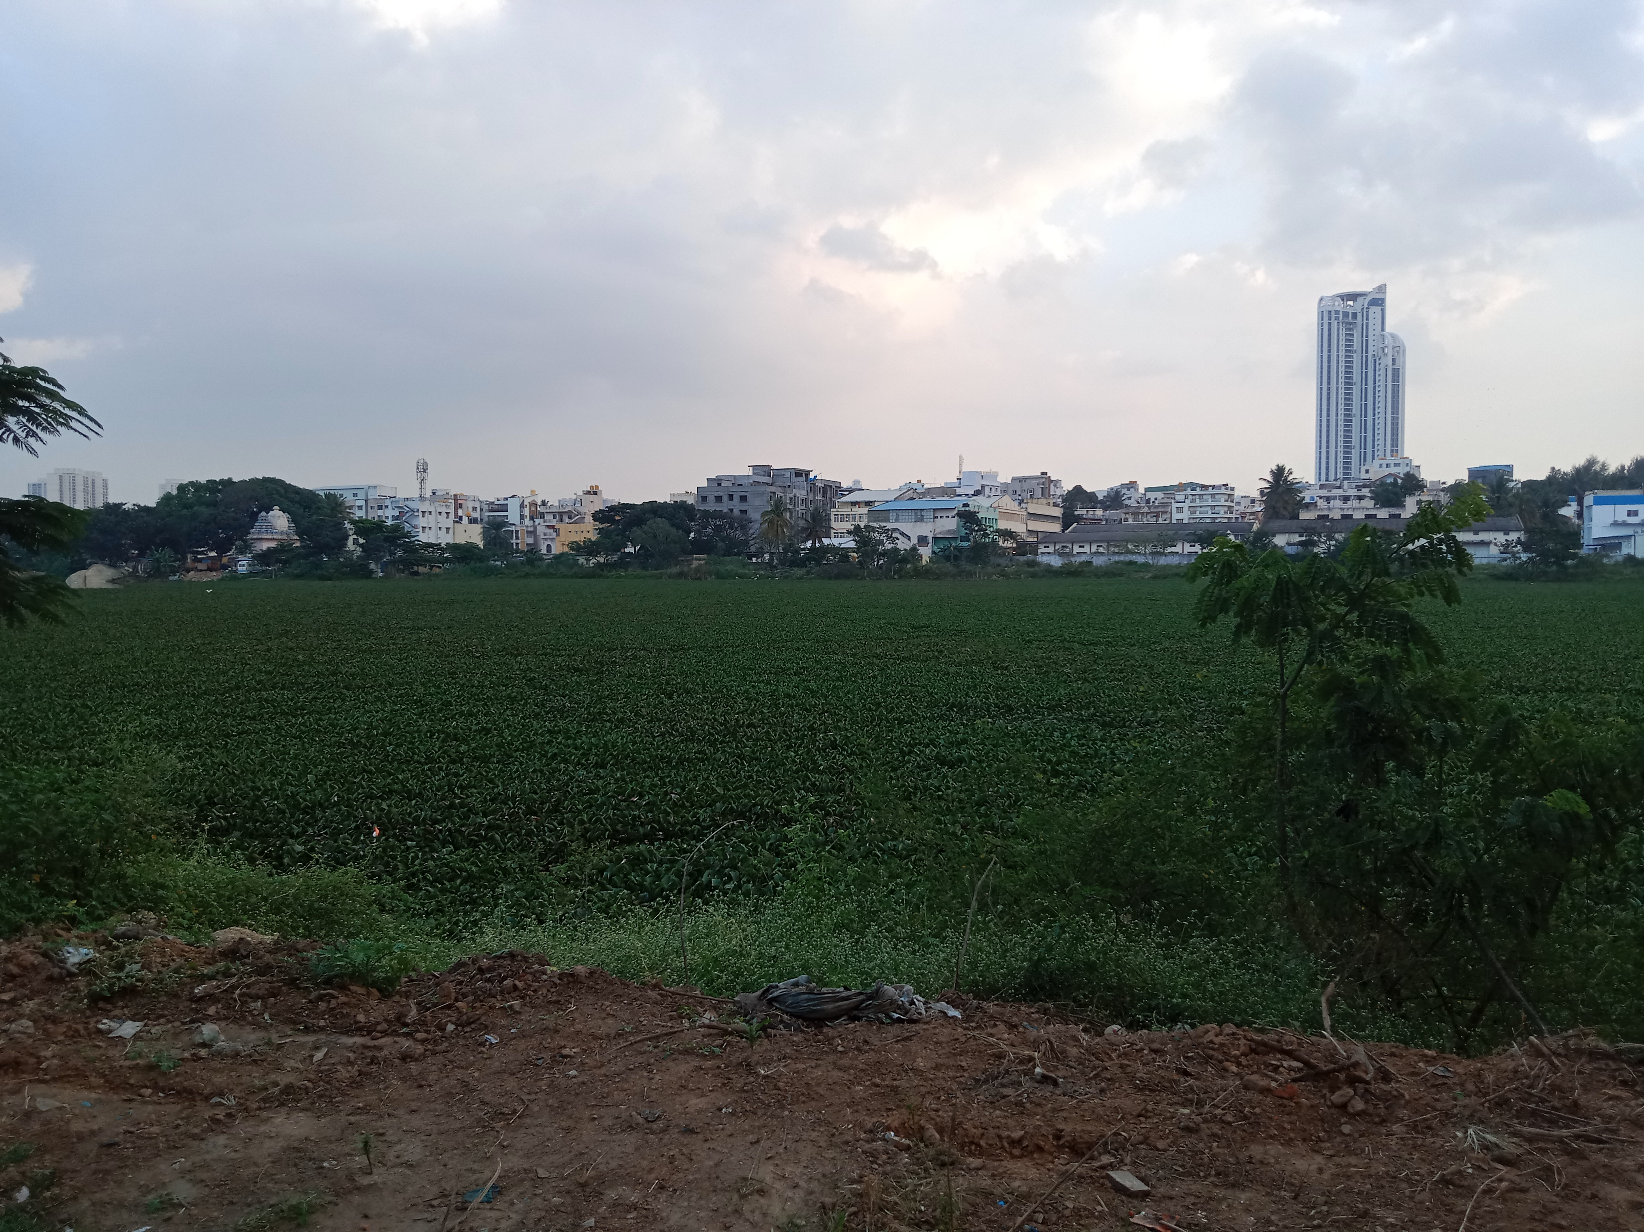
A study of the habitat of arekere lake
By:Jahnavi Bajaj and Aahana Ghosh
Grade:9
School:Presidency School Bangalore South

Slide 2
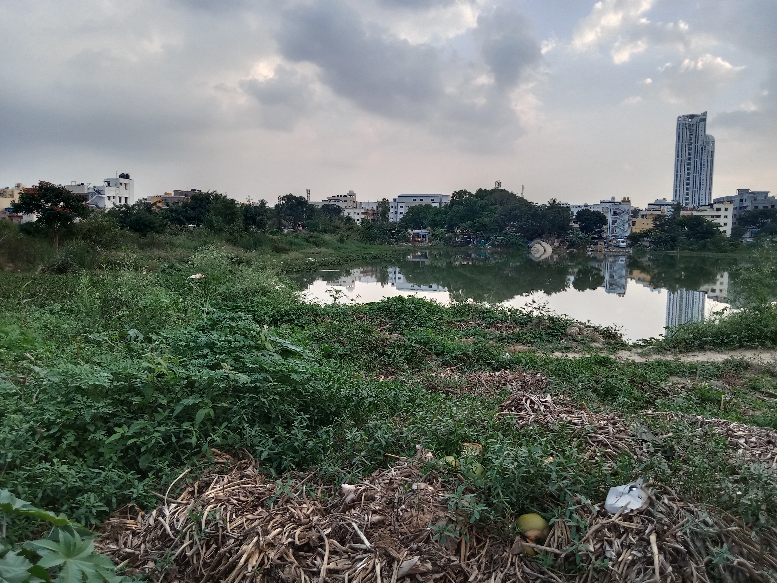
INTRODUCTION
It is a well-known fact that there are numerous lakes in Bangalore,Karnataka.
Most lakes in the region were constructed by damming natural river valley systems by the ancient and medieval rulers of this region.
Today,urbanization has impacted the lakes in various ways.Some lakes have completely disappeared, others reduced to pools, some encroached upon, some in various stages of deterioration, some dried up and some leased.
A 2016 study of 105 lakes in Bangalore found that 98% were encroached and 90% sewage-fed.
In this presentation,we analyse the habitat of Arekere lake by analysing water samples taken from the same.

Slide 3
OBJECTIVES
To analyse the habitat and water quality of Arekere lake by:
STEP 1
Visiting the lake to get an idea of the condition of the lake and its surroundings
STEP 2
Collecting water samples from the lake on a rainy and rainless day
STEP 3
Testing the water samples and analysing and comparing the results

Slide 4
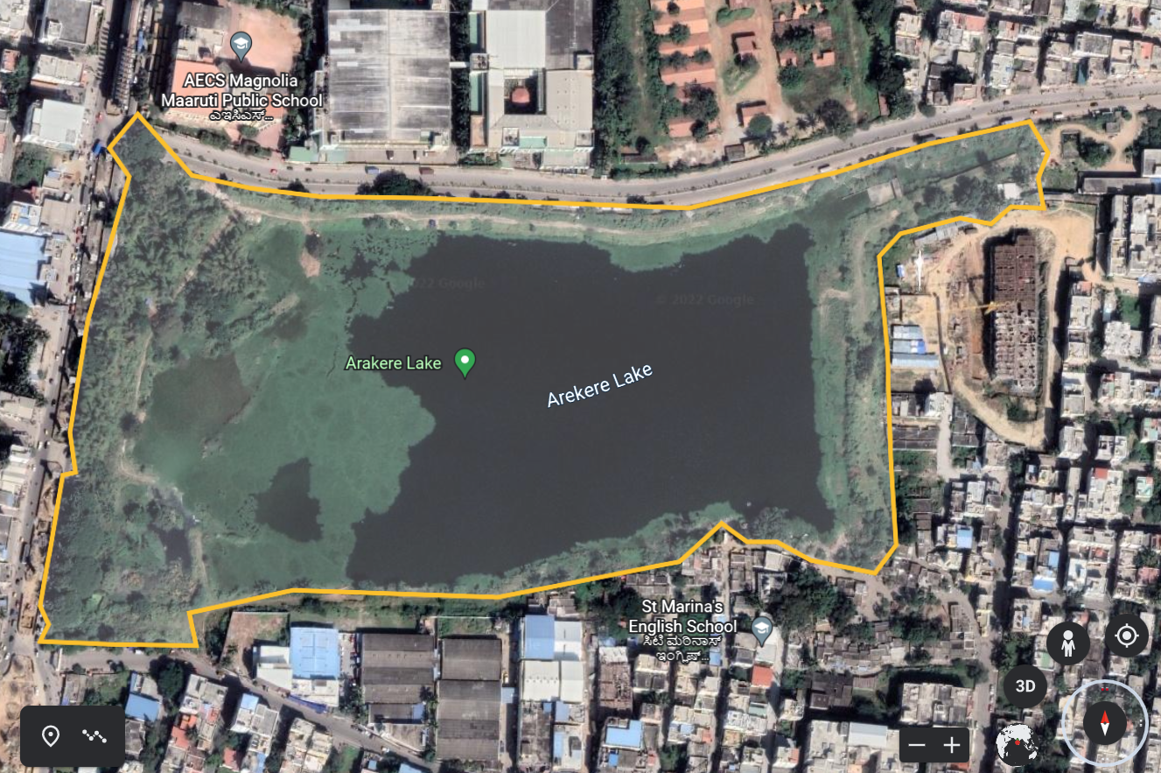
STUDY AREA:AREKERE LAKE
LOCATION:Latitude 12°53'05.22"N,77°36'08.87"E Longitude 12°53'05.49"N, 77°36'03.38"E
AREA AS PER RTC(2017):37.53 acres
PERIMETER(BBMP):3 km
Arekere Lake is situated in the Arekere- Hulimavu area of the city of Bangalore.
This lake is bounded on the west by Bannerghatta Road, on the north by BDA Eighty Feet Road, on the east by Shantinikethan Layout and on the south by Hulimavu Main Road.
It was possibly a manmade water reservoir created around a hundred years ago.
As is the case with many other lakes in Bangalore, in the last two decades Arekere Lake has been encroached upon by real estate developers.
In early 2015, BDA began work related to the development of Arekere Lake, along with 16 other lakes in Bangalore as a result of the campaigns of surrounding residents.
Arekere Lake in 2022
Source:Google Maps

Slide 5
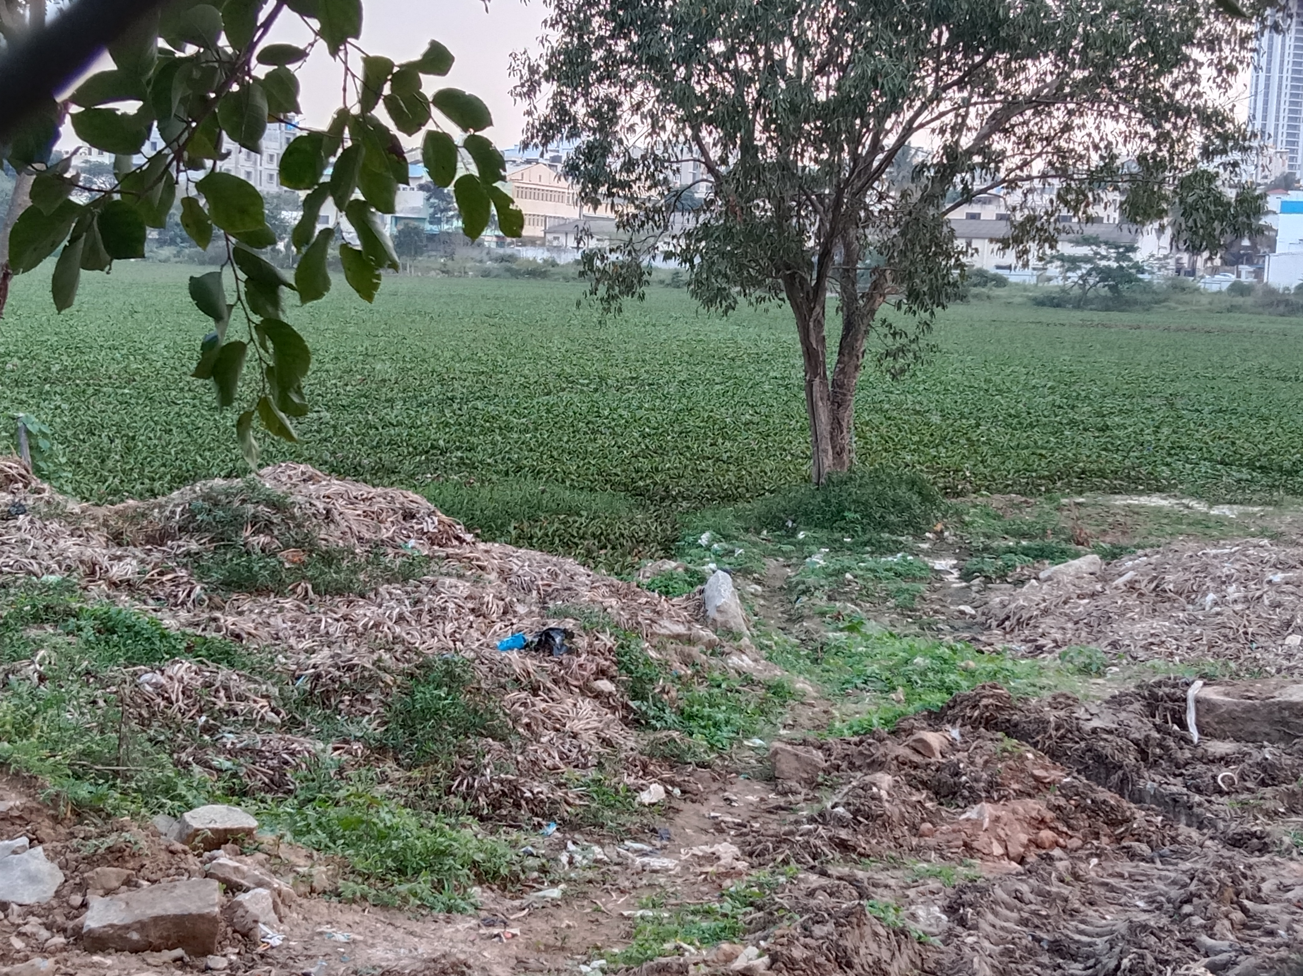
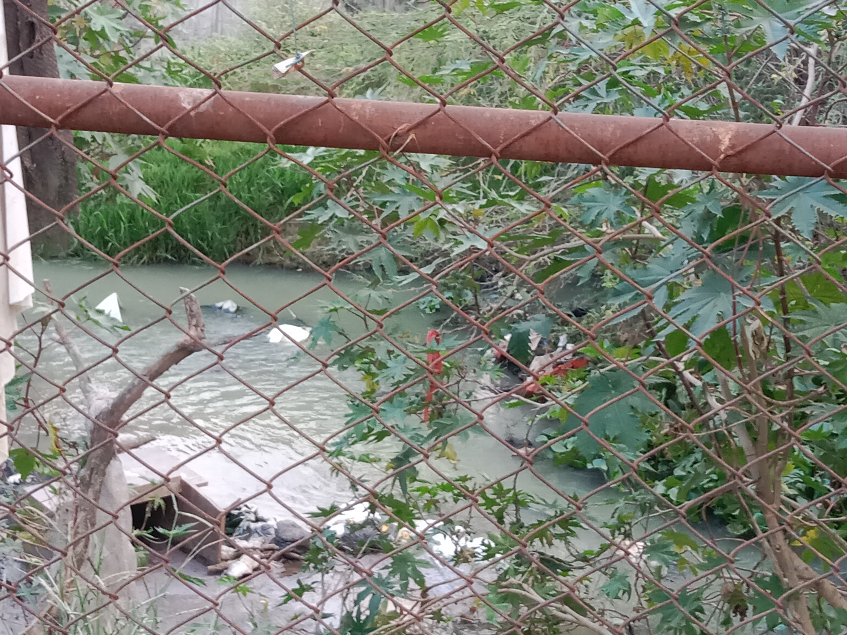
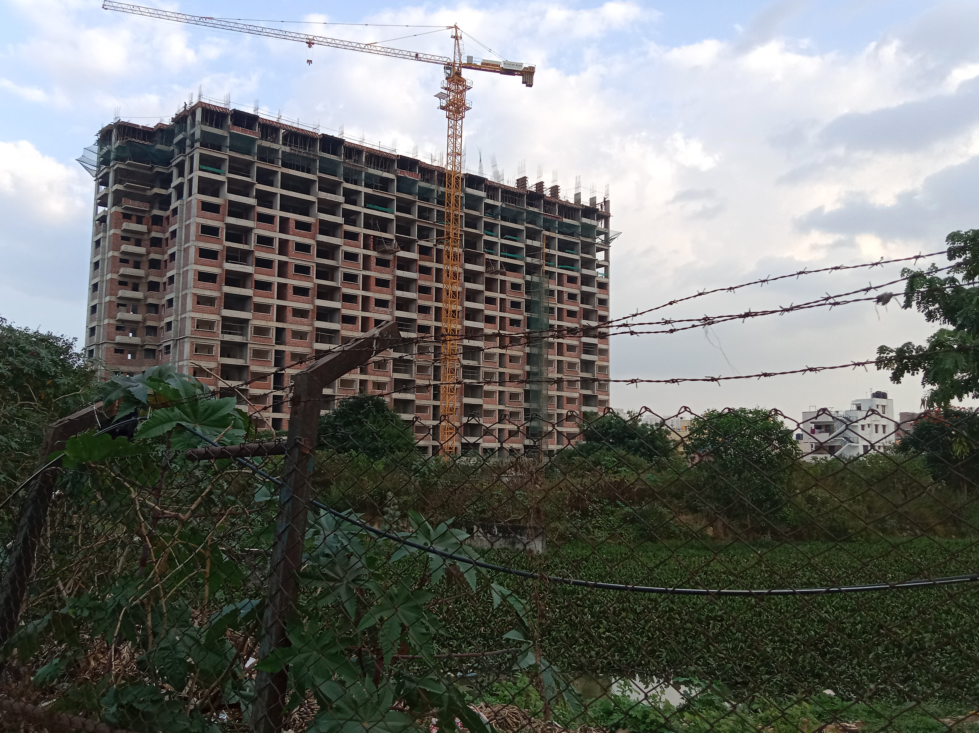
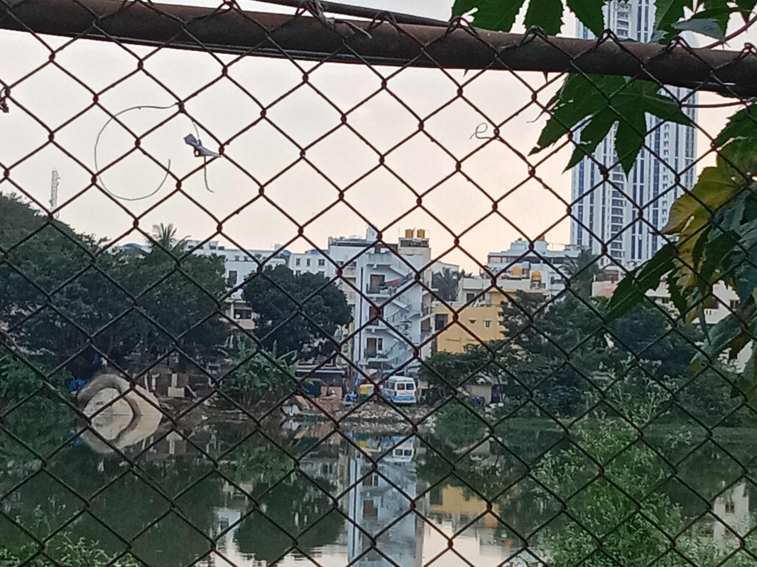
THE HABITAT OF AREKERE LAKE IN PICTURES

Slide 6
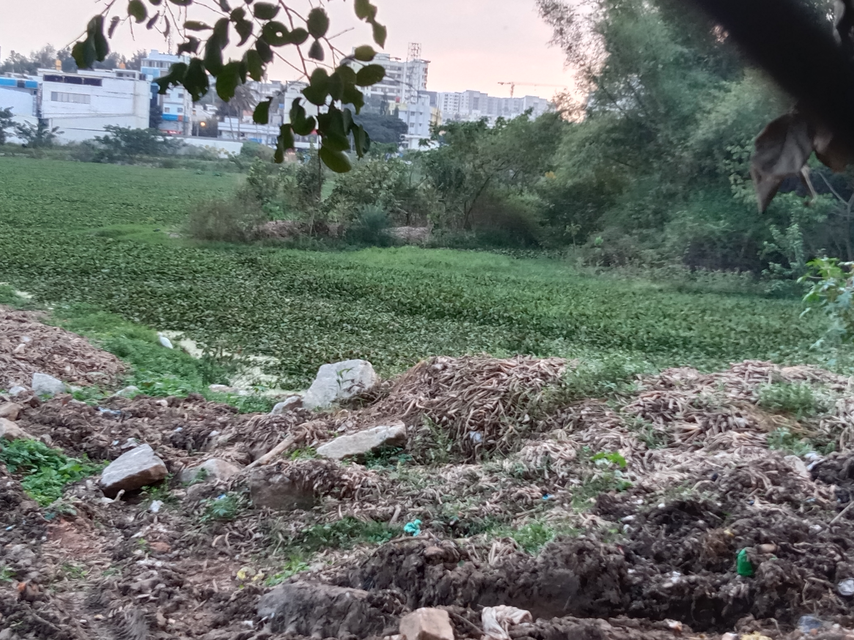
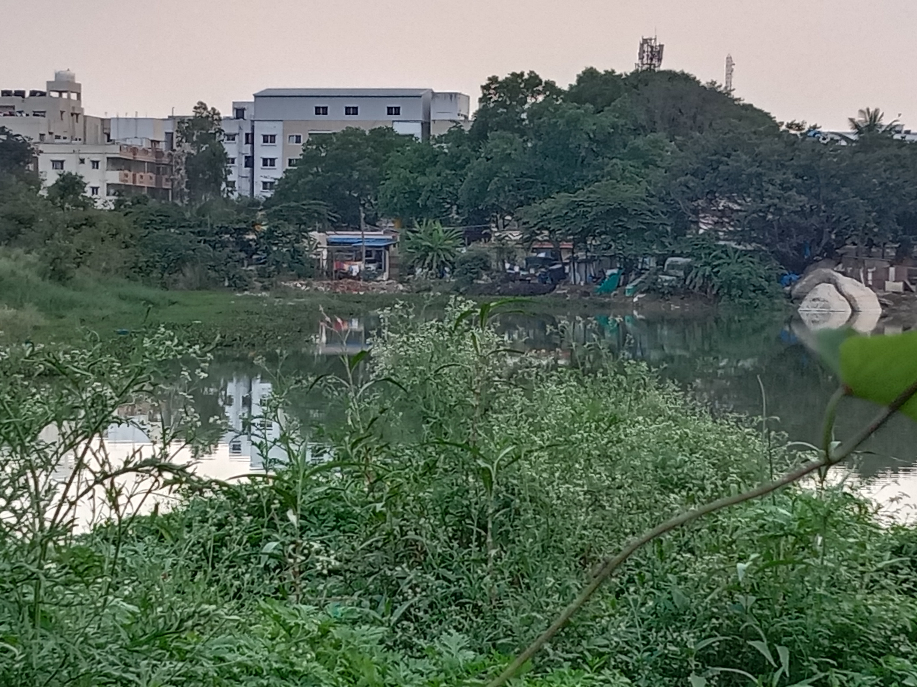
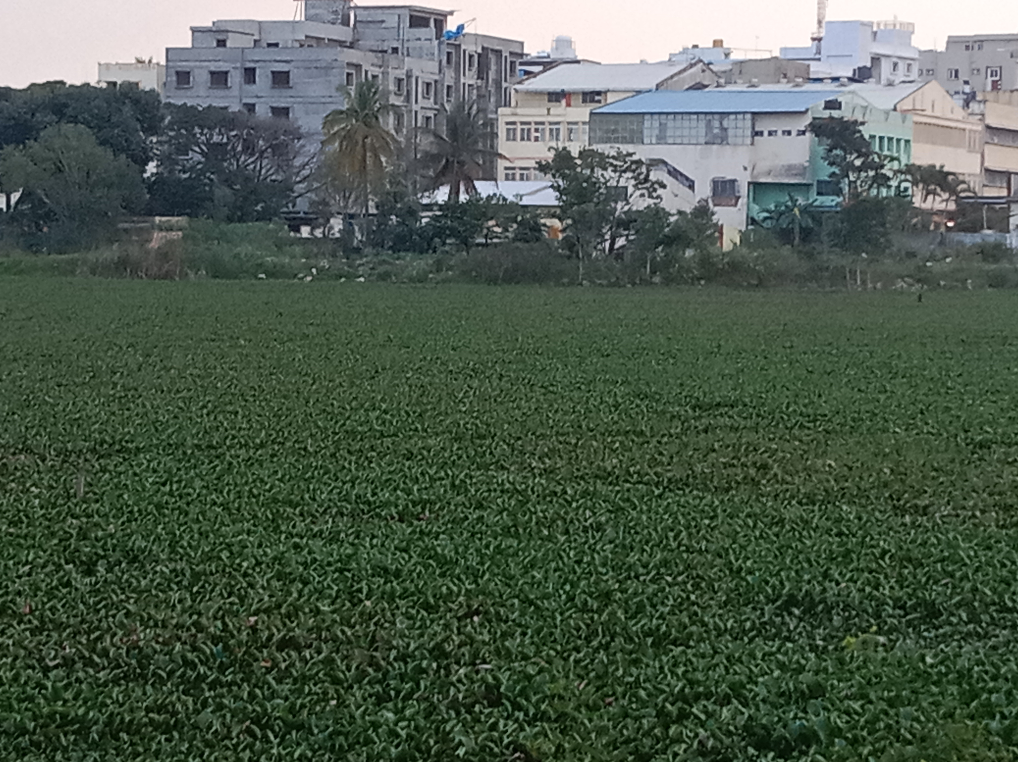
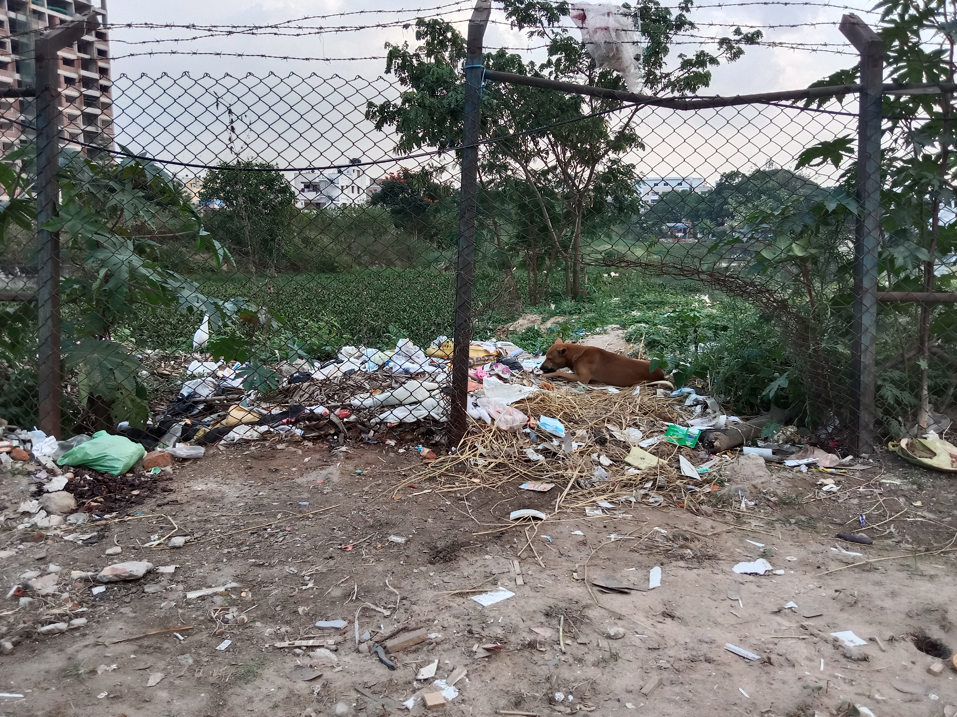

Slide 7
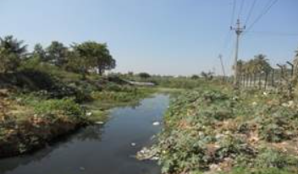
STATE OF THE HABITAT OF AREKERE LAKE
On visiting the lake,the following observations were made:
The lake was almost completely covered with plankton,algae and floating plants.Floating water was visible only in the center of the lake.
There was a strong pungent smell in the surroundings of the lake.
The barricade around the lake was not well-maintained and there were many gaps in the fence.
The banks of the lake functioned as a garbage dumping point.
Sewage rained directly into the lake without treatment.
There were many encroachments around the banks of the lake.
Water birds like pelicans,dogs and other animals were feeding on the garbage.
Not much diverse bird or plant life was observed around the lake.
The water of the lake was blackish and appeared to be highly polluted.
There was a construction site right beside the lake.

Slide 8
THE HABITAT OF AREKERE LAKE
AREA AS PER RTC
37.53 acres
ENCROACHMENT AREA
7.88 acres
CUSTODIAN
BDA
VALLEY TO WHICH LAKE BELONGS
STATUS
RESTORATION
CLASS
PERIMETER OF THE LAKE
3 km
KC Valley
Highly polluted
Under Restoration
Class E-Water used for irrigation,industrial cooling,uncontrolled waste disposal

Slide 9
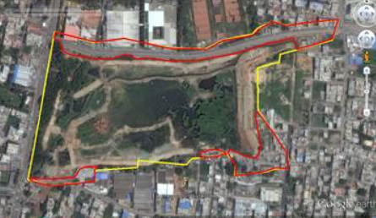
PROBLEMS: Dumping of solid waste and building debris, entry of untreated sewage water, covered with macrophytes. Lake water is black in colour with odour problem.
AQUATIC BIODIVERSITY:
Algae:Chlorella sp.; Chlorococcum sp.; Schroederia sp.; Oscillatoria sp.; Phormidium sp.; Planktothrix sp.; Macrophytes:Eichhornia crassipes; Alternanthera philoxeroides; Lemna gibba; Lemna minor; Typha angustata; Polygonum glabrum and Cyperus rotundus.
SURROUNDING LOCATIONS:AECS Magnolia Maaruti School,Shahi Exports Pvt Lt.,ICICI bank,evening market,apartments,Balamuri Ganesh Temple
Between 2011-2014,it was observed that the algae growth in the lake was less extensive and the lake was also bigger.More bird and animal life would frequent the lake.Since then,the condition has only worsened.In the last decade,no measures have been taken to prevent the worsening condition of the lake. Only recently,projects have been approved by BBMP for the restoration of the lake but the process must happen quicker. The detoriated and polluted surroundings of the lake led us to analyze the water samples of Arekere Lake.
Polygon in yellow represents outline of the lake.
Polygon in red shows encroachments.
Source:STATUS OF AREKERE WETLANDS0 (ernet.in)

Slide 10
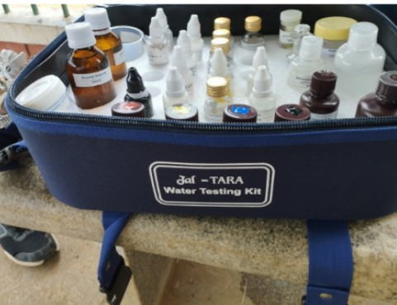
MATERIALS AND METHODS
Water samples were taken in bottles from Arekere Lake on a rainy as well as a rainless day from the banks of the lake during the morning.
The water samples were then tested using a Jal TARA water testing kit.
The water quality was assessed based on various parameters.
To assess the physical,biological and chemical properties of the samples,the following tests were conducted using various chemicals which indicated the presence and concentration of various minerals and contaminants:

Slide 11
WATER QUALITY PARAMETERS AND METHOD OF TEST CONDUCTION
PARAMETERS | PERMISSIBLE LIMITS | METHOD OF TEST CONDUCTION
pH | 6.5-8.5 | pH paper was dipped in the water sample
Nitrate | 45 mg/l | Reagent NO3-A and B were added and colour was observed after 10 min
Iron | 0.3 mg/l | Reagent Fe-A and B were added and colour of solution was observed after 5 min
Hardness | 200-600 mg/l in drinking water | Ammonia buffer solution and enchrome black T-powder was added.Then the ml of EDTA reagent added to the water sample to turn it blue was multiplied by 400
Chloride | 250-1000 mg/l | Potassium chromate was added and then the ml of silver nitrate used to turn the solution brick-red was multiplied by 354.5
Residual chlorine | 0-1 mg/l | Ortho toludine was added and colour of solution was immediately observed.
Turbidity | 1-5 ntu | Visibility of black cross on pouring water sample in turbidity test tube.
Faecal pollution | Should be absent in drinking water | Water sample was placed in aqua check bottle and colour was observed after 2 days.
Ammonia | 0.5 mg/l | Nesslers Reagent was added and colour was immediately observed.
Phosphorous | NA | Ammonium molybdate reagent and stannous chloride reagent were added and colour was observed after 10 min.
Dissolved oxygen | 5 mg/l | Sample was taken in DO bottle and manganous sulphate,alkaline potassium iodide, phosphoric acid and starch were added.Then ml of sodium thiosulphate used to turn solution colourless was multiplied by 20.
Fluoride | 1-1.5 mg/l | Zirconyl solution was added and then the colour of solution was observed after 1hr

Slide 12
WATER QUALITY TEST RESULTS ON A RAINY DAY AND RAINLESS DAY
PARAMETERS | PERMISSIBLE LIMITS | AREKERE (RAINY DAY) 13th December | AREKERE (RAINLESS DAY) 29th October
pH | 6.5-8.5 | 6.8 | 7
Nitrate | 45 mg/l | Less than 0.1 mg/l | 5 mg/l
Iron | 0.3 mg/l | 0.3 mg/l | 1.0 mg/l
Hardness | 200-600 mg/l in drinking water | 200 mg/l | 300 mg/l
Chloride | 250-1000 mg/l | 85.08 mg/l | 95.715 mg/l
Residual chlorine | 0-1 mg/l | Nil(no colour change) | 0.1 mg/l
Turbidity | 1-5 ntu | Turbid at 100 ntu | Turbid at 100 ntu
Faecal pollution | Should be absent in drinking water | Positive | Positive
Ammonia | 0.5 mg/l | 3 mg/l | 3 mg/l
Phosphorous | NA | 1 mg/l | 0.7 mg/l
Dissolved oxygen | 5 mg/l | 8 mg/l | 4 mg/l
Fluoride | 1-1.5 mg/l | Nil(no colour change) | 1 mg/l

Slide 16
CONCLUSIONS
Rainless day
The presence of less nitrate shows that the massive growth of aquatic plants and macrophytes has led to eutrophication.These plants have used up an excessive amount of nutrients.This can adversely impact aquatic life in the lake,leading to a reduction in their numbers or even possible extinction from the lake ecosystem.
The presence of excessive iron shows that construction activities beside the lake have adversely impacted water quality.This leads to high build-up of iron in aquatic life eventually leading to their death.It also promotes algae growth which prevents sunlight from penetrating the lake surface,further hampering aquatic life and underwater plants.
High ammonia concentrations show human contamination. Water with high concentrations of ammonia harms and even kills off aquatic life and produces harmful algal blooms.
High levels of turbidity show that there are a large amount of insoluble contaminants present in the water showing the impact of sewage and run-off draining directly into the lake.This affects the overall water quality of the lake.
Faecal pollution shows the impact of sewage draining directly into the lake and the dumping of garbage beside the lake.This may lead to the spread of various waterborne diseases like typhoid affecting the public health of the surrounding areas.
The dissolved oxygen is less showing that its levels have been reduced due to algal bloom and eutrophication in the lake.This leads to the death of aquatic life.
From the water sample tests,it was observed that nitrate,iron ammonia,turbidity,dissolved oxygen and faecal pollution levels were not within permissible limits.The following conclusions can be drawn:

Slide 17
Rainy day
As per the test results of the water sample taken from Arekere on a rainy day, the following conclusions may be drawn:
pH,although within the permissible limit,is found to be slightly acidic which was not observed when the water sample was taken on a rainless day.This shows that surface run-off from the soli around and acidic rain may have increased the pH
Turbidity remained at 100 ntu.Besides sewage, the run-off due to rain may also have contributed to high turbidity levels.
Faecal pollution remained positive,once again showing the polluted condition of the lake.
Ammonia levels remained high and was recorded to be the same on both a rainy and rainless day.
Fluoride was shown to be absent which shows that rain may have dilute fluoride levels.
Dissolved oxygen showed a significant increase and was found to be above the permissible limits.This shows that the rain has led to an increase in dissolved oxygen,a positive impact on aquatic life.
Iron was found to be within permissible limits when tested on a rainy day.This shows that rain may have diluted iron content.
Nitrate levels showed a significant decrease compared to the water sample taken on a rainless day.Rain may have diluted nitrate contents and the excessive plant growth may have further depleted nitrate levels.

Slide 18
During the COVID-19 lockdown,garbage dumping beside the lake had ceased and the lake condition had improved in the absence of human intervention.
Now,the lake has once again returned to a highly polluted state.
This shows that human activities are the root of the pollution of the lake.
It can therefore be concluded that Arekere lake is highly polluted and not well-maintained at all.The detoriated condition of the habitat and lack of timely action impacts the entire ecosystem and the quality of life of the people in its surroundings.Rainy days appear to improve the water quality of the lake with respect to oxygen and also dilutes constituents like nitrates and fluoride.Rainy days can also contribute to rise in pH,showing that the soil and atmosphere of the surrounding area of Arekere Lake may be in a polluted state.Lakes are essential to our well-being.A clean and well-maintained lake is beneficial to all lifeforms in its proximity.Therefore, immediate action must be taken by the citizens and government for the restoration of Arekere Lake.

Slide 19
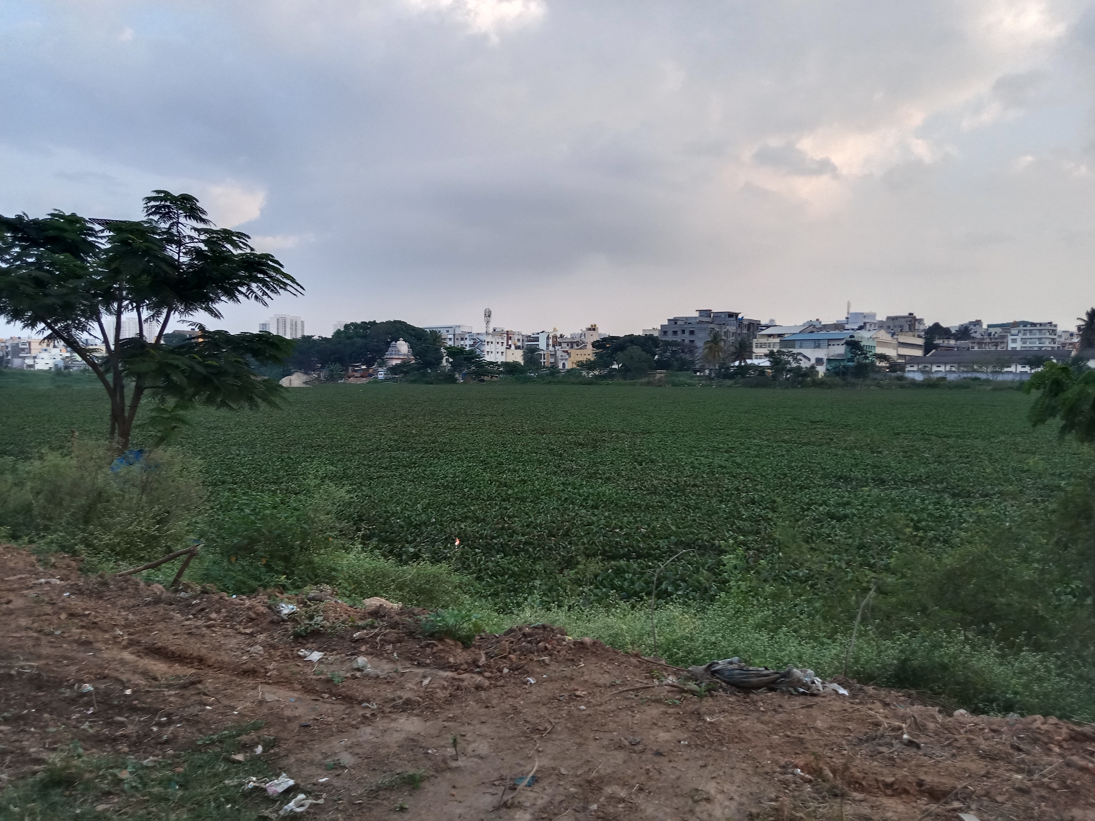
GENERAL SOLUTIONS
Based on the conclusions, the following general steps to improve the condition of the lake may be taken:
Regular removal and harvest of macrophytes on the lake surface
Construction of a proper barricade around the lake to prevent encroachment
Setting up a proper sewage treatment plant to ensure only treated wastewater drains into the lake
Banning construction activites and garbage dumping beside the lake
Removal of all encroachments
Planting native species around the lake to reduce run-off of silt and contaminants into the lake

Slide 20
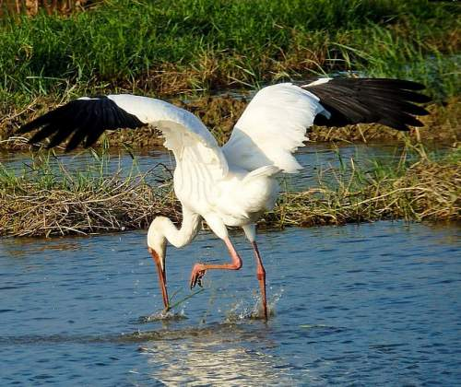
This project would not have been possible without the help of our teachers and fellow teammates.We would therefore like to thank our mentors for this project, Indumathi Mam and Ashwini Mam, for their valuable guidance and feedback during the course of this project.
We would like to extend our gratitude to Rohit Sir from WWF for lending us the water testing kit.
We would also like to thank our parents for their support and willingness to take us to the sites for research.
Last but not the least,thank you to all the IISc conference organizers and professors for giving us this wonderful opportunity.
ACKNOWLEDGEMENT

Slide 21
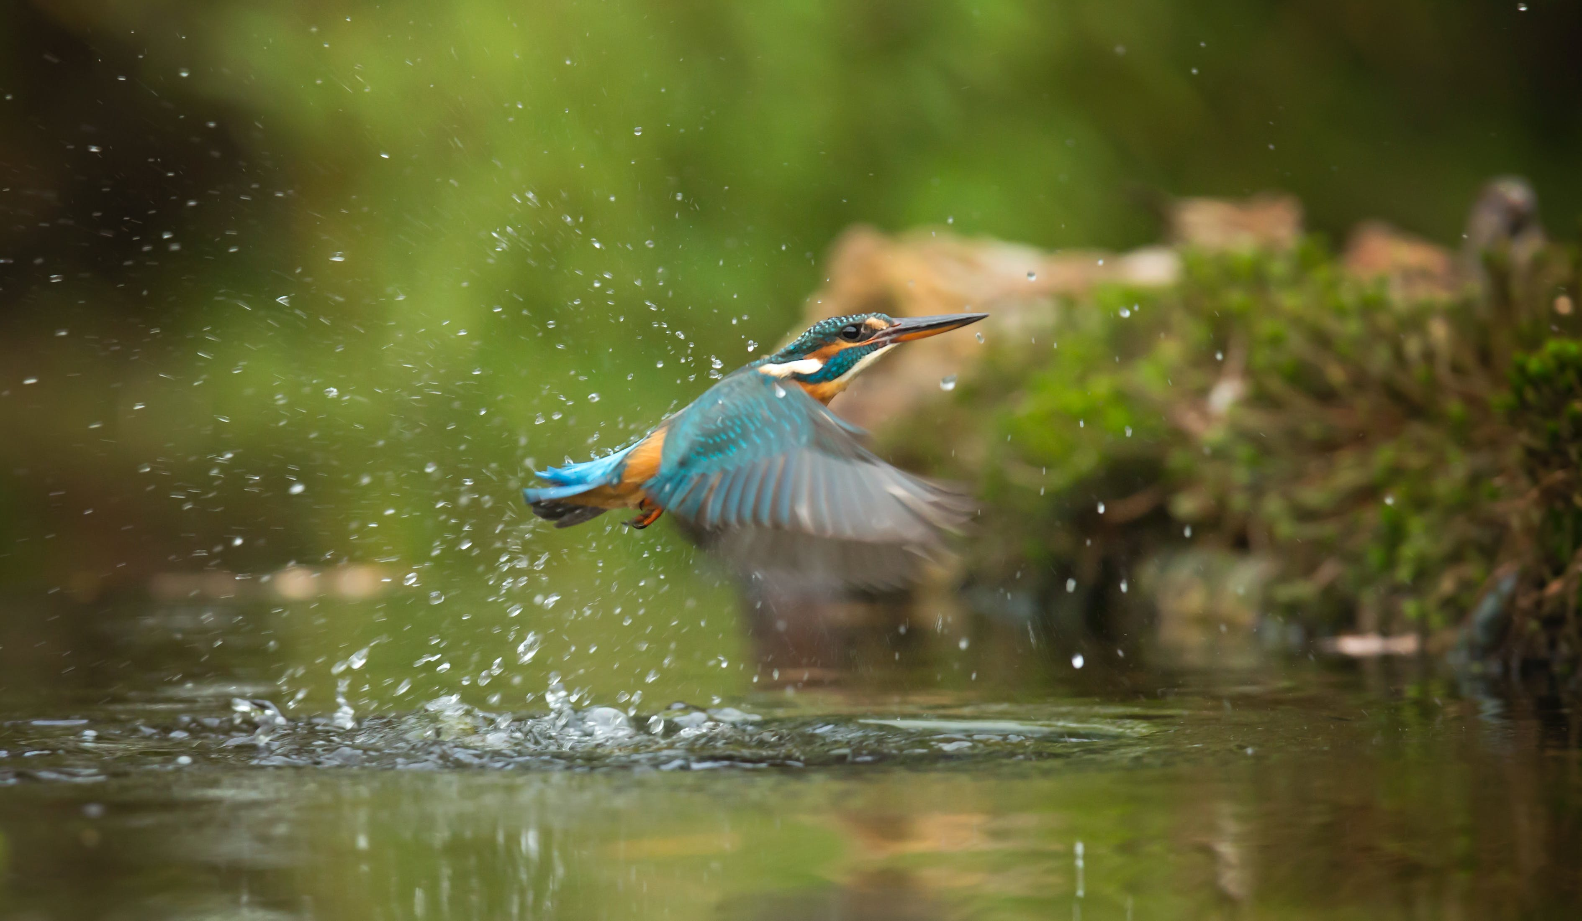
Arakere Lake In Bengaluru: BWSSB Says It Will Prevent Further Sewage Inflow Into Water Body Within A Month’s Time (swarajyamag.com)
Excessive Iron in Well Water: Hazards, Signs & Removal Techniques (actionwellandpump.com)
(PDF) Impact of construction activities on the environment. (researchgate.net)
https://www.deccanherald.com/content/667783/in-2-years-you-could.html
https://en.m.wikipedia.org/wiki/Lakes_in_Bangalore
NEWS TRAIL (newstrailindia.com)
https://www.element.com/environmental-testing/physical-chemical-properties-of-water
STATUS OF AREKERE WETLANDS0 (ernet.in)-IISC
Jal Tara Water Testing Manual
Google Maps
The Effects of Iron in Water on Aquatic Life | Cuteness
Ammonia in Water: The Struggle for Balance - Save the Water
Bwssb Proposes Drain Expansion To Stop Sewage Inflow Into Arekere Lake | Bengaluru News - Times of India (indiatimes.com)
REFERENCES

Slide 22
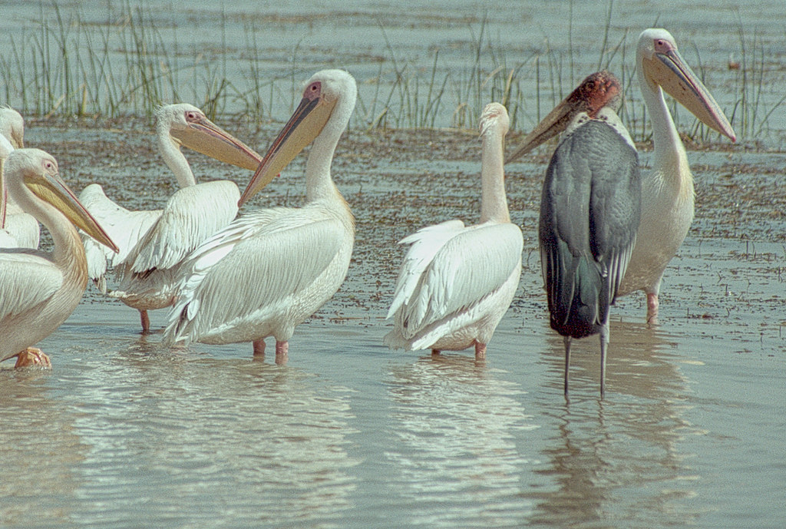
Thank you

