Slide 1
CRISPR : Gene Editing And Beyond
YUKTHA. L
CLASS XI
FREEDOM INTERNATIONAL SCHOOL, BANGALORE
CENTRAL BOARD OF SECONDARY EDUCATION, NEW DELHI

Slide 2
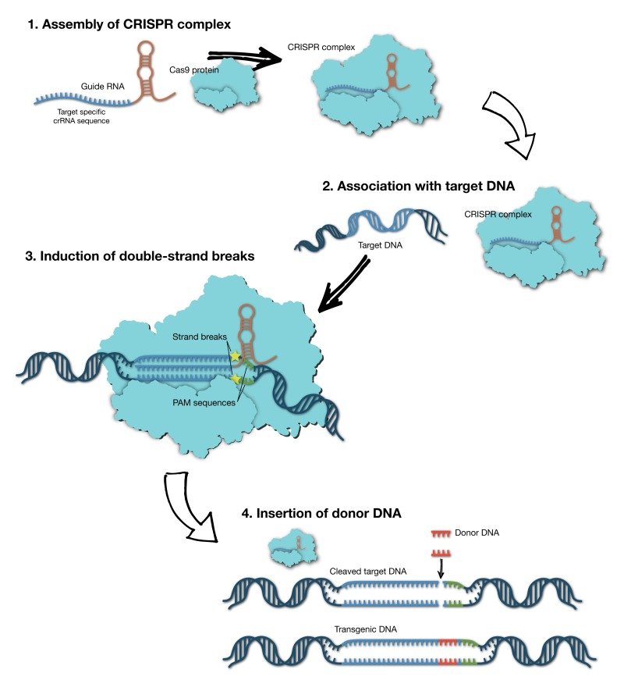
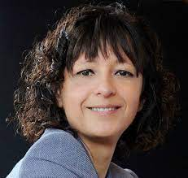
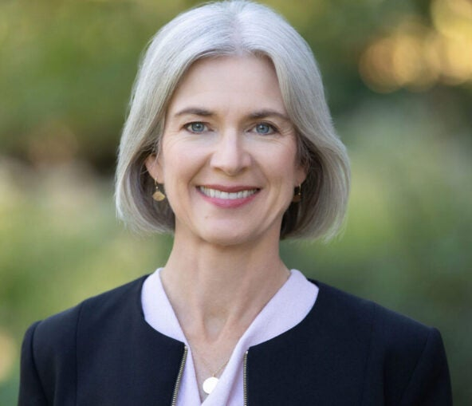
Introduction
Emmanuelle Charpentier and Jennifer Doudna

Slide 3
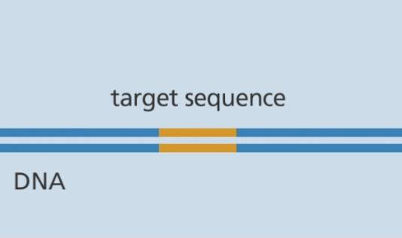
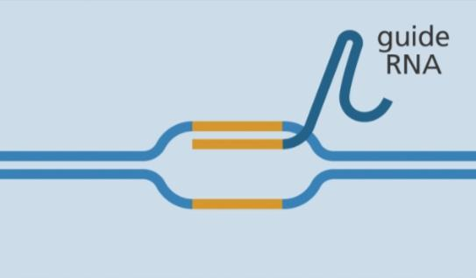
Mechanism of action
Target DNA Sequence
Guide RNA binds to target Sequence

Slide 4
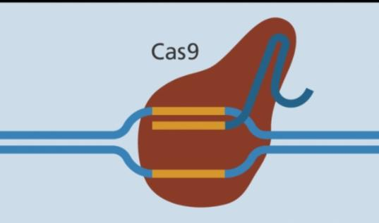
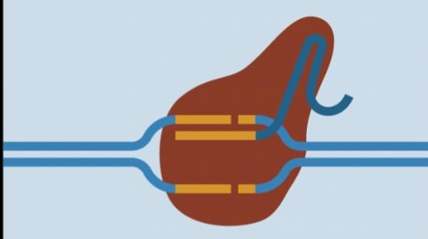
Cas 9 enzyme binds to guide RNA
Cas 9 enzyme cuts both strands of DNA

Slide 5
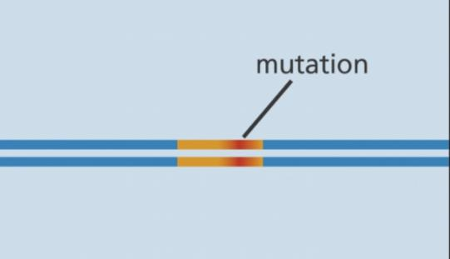
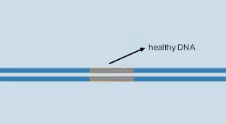
Mutation disables the gene.
Replacing the mutant DNA with healthy DNA.

Slide 6
APPLICATONS OF CRISPR
AGRICULTURE
MEDICINE
ENVIRONMENTAL STUDIES

Slide 7
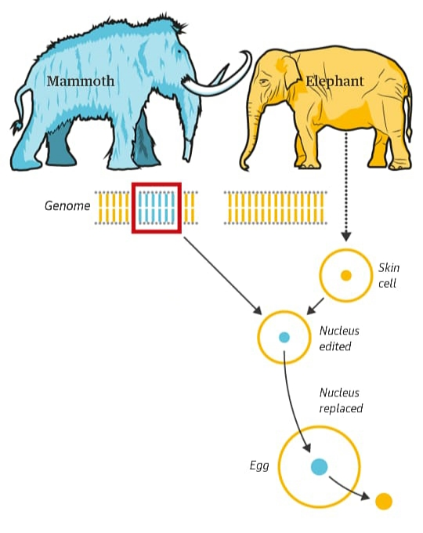
FUTURE RESEARCH PROSPECTS OF CRISPR TECHNOLOGY
CAN CRISPR BE USED TO REVIVE EXTINCT GENES?

Slide 8
Disadvantages of CRISPR technology
Chances of mutations
Ethical concerns
Genomic instability
Lack of accessibility
Research constraints

Slide 9
Conclusion
To conclude CRISPR system opens more possibility not only in medicine but also to save the environment.
Although ethical concern regarding CRISPR research has been placed, it is the future in many fields and investing in it now is adventageous to us in the long run.

Slide 10
THANK YOU

