Slide 1

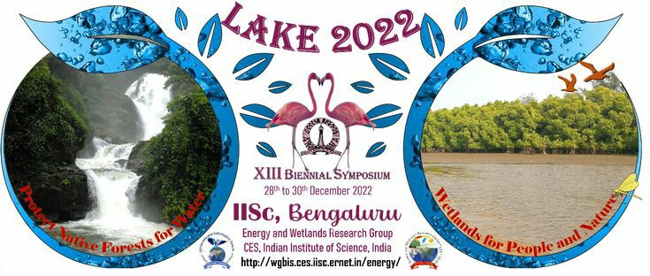

Assessing the Impact of Diets & Agriculture on the Environment and Health
By V G Layasree, 11th grade

Slide 2
Introduction
1.) We grow different crops such as grains, pulses, vegetables, fruits through agriculture to feed our ever growing human population.
2.) We will also understand how our diets and agriculture affect the environment and the health of the person that consumes the diet.
3.) We will explore other environmentally friendly agricultural methods such as food forestry and permaculture.

Slide 3
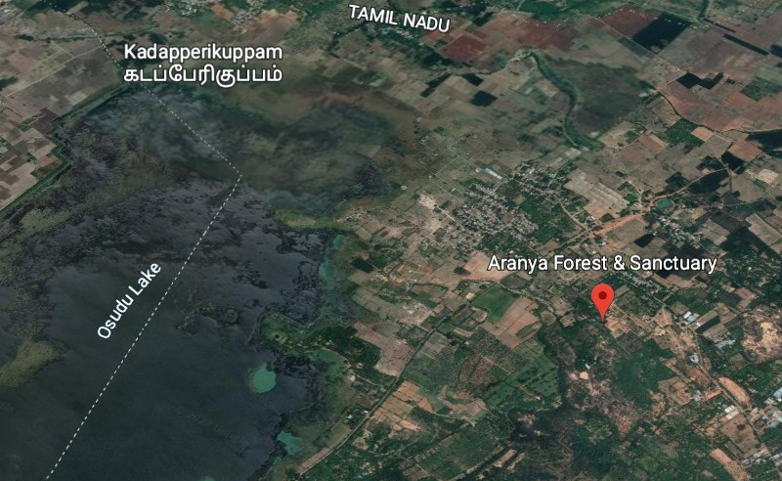
Area of Study

Slide 4
Objectives:
1.) To study the impact of diversified and non-diversified diets on the environment and
overall health by assessing and quantifying the impact based on set criteria.
2.) Exploring viable alternatives to commercial agriculture such as food forestry & permaculture.
3.) To create awareness on nutrition and environmental conservation

Slide 5
Methods for data collection:
1.) An online survey with Urban respondents
2.) Rural area survey & interaction
(In Rural villages of TN, KA & AP)
3.) Biodiversity & environmental status of Aranya
forest & Sanctuary data through official sources

Slide 6
What makes a diet "nutritious"? Guidelines
Source: https://www.nhp.gov.in/healthlyliving/healthy-diet
Criteria:
1.) Contains less then or equal to 50% grains, pulses and cereals.
2.) Consists of 20 % seasonal and local produce like vegetables, fruits.
3.) Doesn't have more than 30% of food which is highly refined or
processed.
4.) Contains an adequate amount of essential nutrients like dietary
fiber, vegetables & fruits, complex carbs and others.

Slide 7
Studying the impact of diets on Health
Age group surveyed: 15 to 70 years
Criteria:
1.) Any history of chronic illness
2.) Physical mobility
3.) Mental health & emotional well-being
Note: We use the above criteria as a metric to compare & contrast our findings and results.

Slide 8
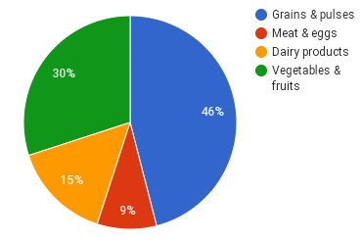
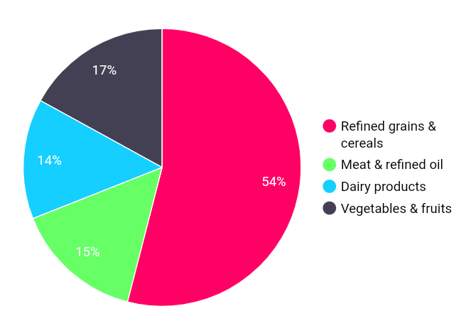
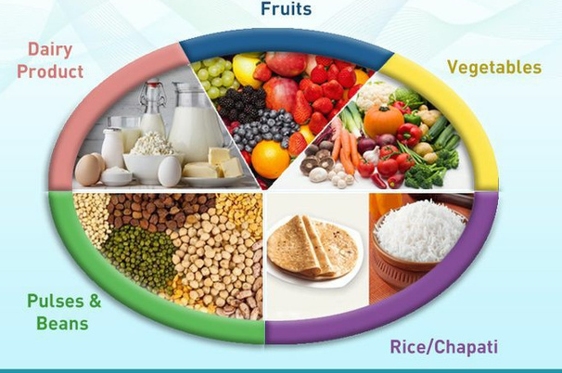
Results & Data Analysis
After acquiring the data through reliable sources, which was done In-person it was constituted together as the following:
Diversified diet
Rural
Non-diversified diet
Urban

Slide 9
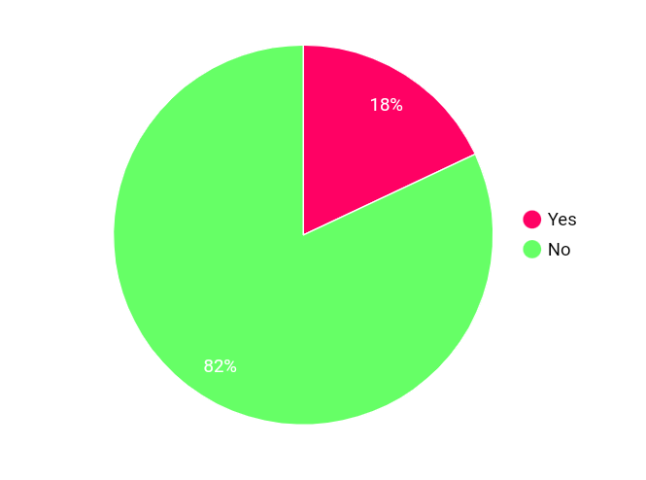
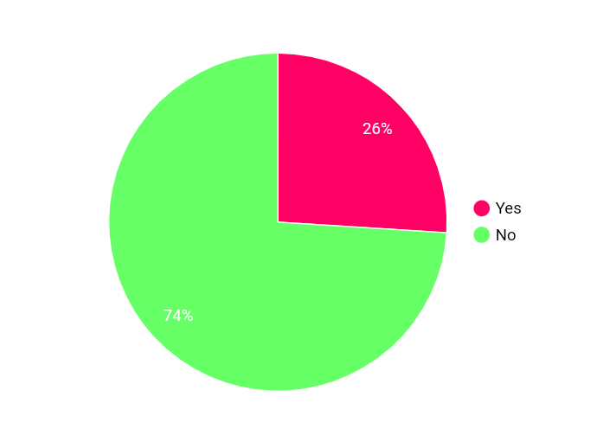
Have you ever had any record of chronic disease & illnesses like Blood Pressure, Sugar, cholesterol etc.?
Diversified Diet
Non-diversified Diet

Slide 10
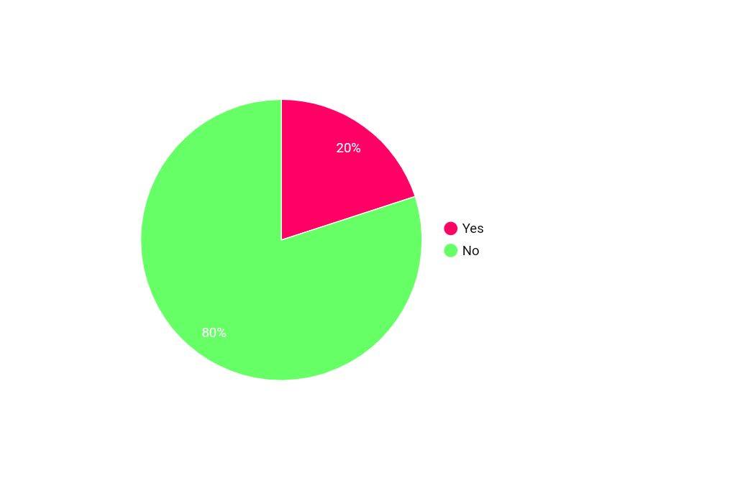
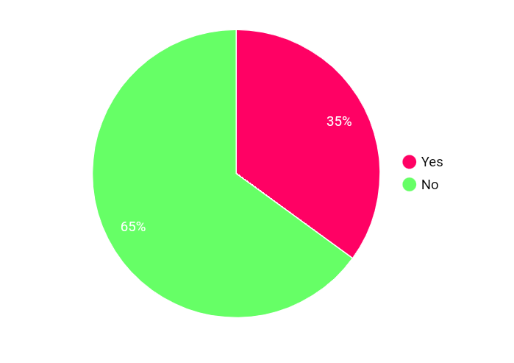
Is your physical mobility restricted or do you feel it difficult to be physically active?
Diversified Diet
Non-diversified Diet

Slide 11
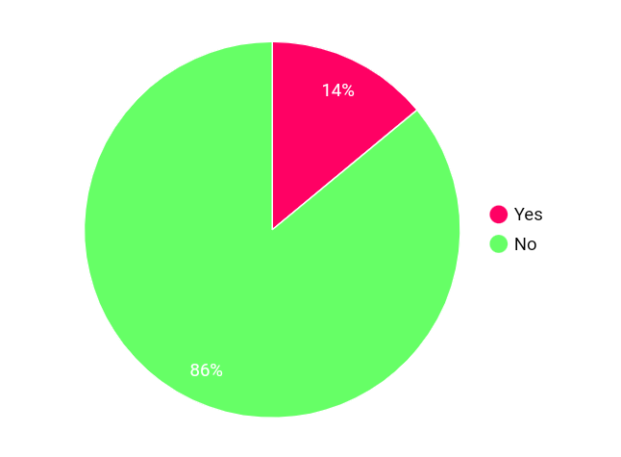
How is your overall mental health & emotional well-being? Do you suffer from stress, anxiety, overwhelmingness and others?
Diversified Diet
Non-diversified Diet

Slide 12
Impact of diversified, non-diversified diets and agriculture on environment
• Diversified diets are mostly composed of "Seasonal" and "Local" produce such as vegetables, fruits, pulses, millets and others.
• Therefore they have lesser food miles which means a low carbon footprint on the environment and fewer natural resources.
Advantages:
-Better Nutrition
-Environmentally friendly
-Economical
Environmental benefits:
- Less transportation
- no packaging
-lesser food waste
- low carbon footprint

Slide 13


Importance of millets
2023 is declared as the international year of millets
1.) Millets are nutritionally dense they provide
essential nutrients such as complex carbs, dietary
fiber, vitamins and minerals
2.) Millets is a superfood not only in terms of
nutrition but also for the environment.
3.) Millets can be grown in any region with no to slight
modifications with very few natural resources
4.) Millets are drought resistant as they're not water
intensive crops
5.) Millets are also pest resistant to some extent and
maintain soil health without depleting them
24

Slide 14
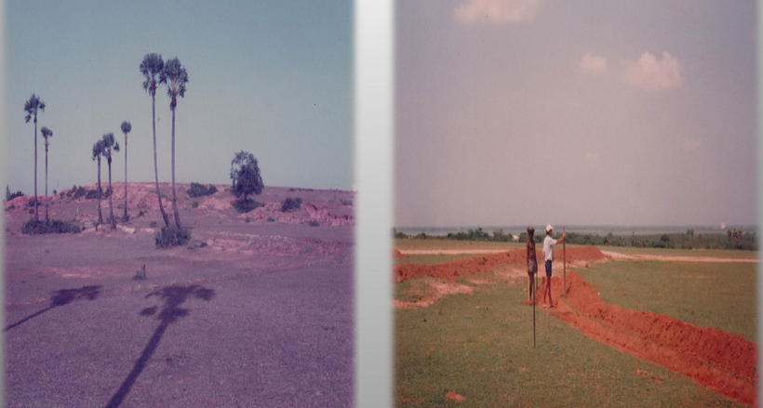
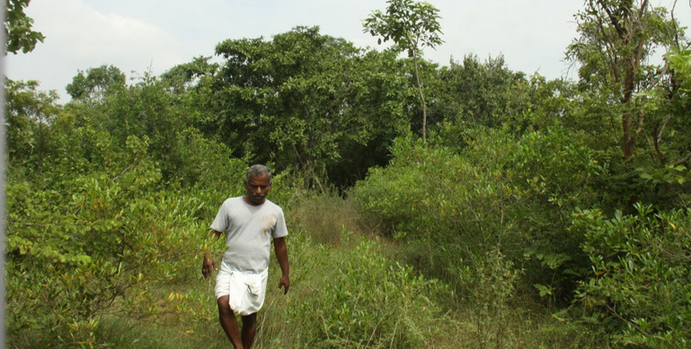
Exploring Alternatives: Food forestry & Permaculture
Aranya Forest
Before in the '80s
• Aranya is a regenerated indigenous forest it was converted from a 100 acre barren land to a thriving forest today
• At one point in time the whole area was an environmental
disaster zone - severely eroded with virtually no vegetative cover. The desiccated plateau and ravines were termed 'wastelands'
Now, present day
Practices adopted in the conver
-Plantation of indigenous and TDEF plant species
- Formation of water harvesting structures
- Soil and moisture conservation measures
- Permaculture principles for watershed management
- Use of alternate- renewable energies

Slide 15
Biodiversity of Aranya
• Today, Aranya is a scenic community spanning 100 acres, of which 80
acres are a man made indigenous forest , with TDEF Species numbering
about 251.
• The remaining 20 acres is canyons and grasslands, home to the rare
Horned Eagle Owl which nests in these canyons.
• The regenerated forest and lake create a unique combination of
ecosystems which is home to more than 240 bird species (migratory and
resident), 54 butterfly species, numerous reptiles and mammals like the
porcupine, civet, jackal, jungle cat and fox.

Slide 16
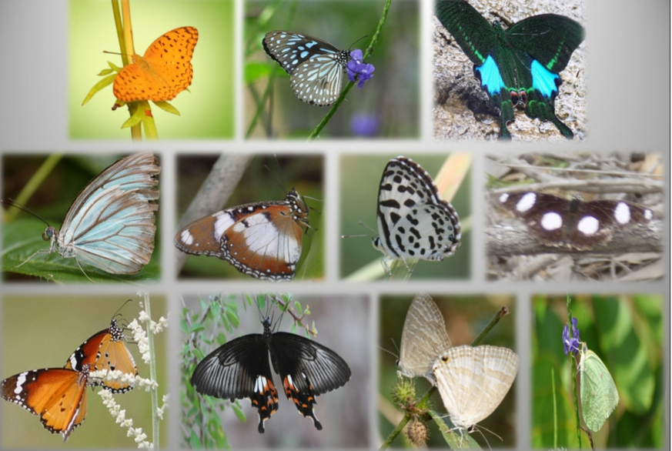
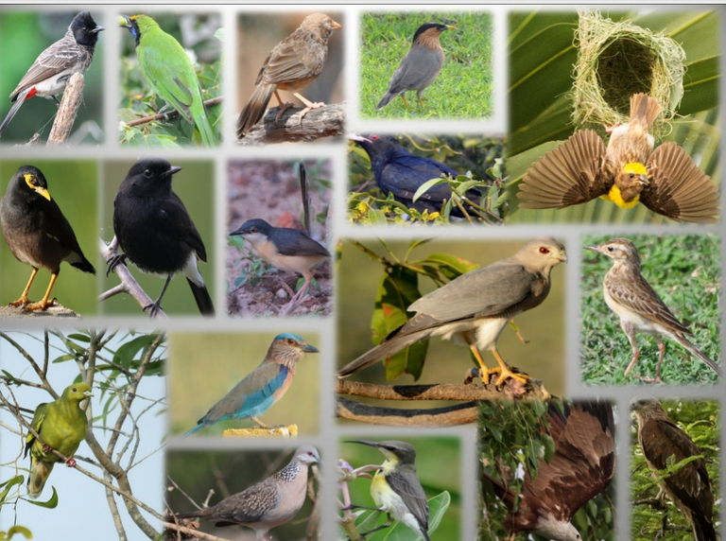
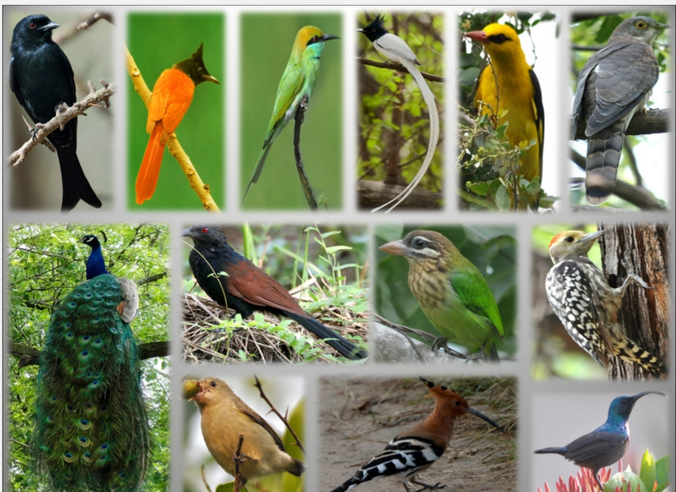
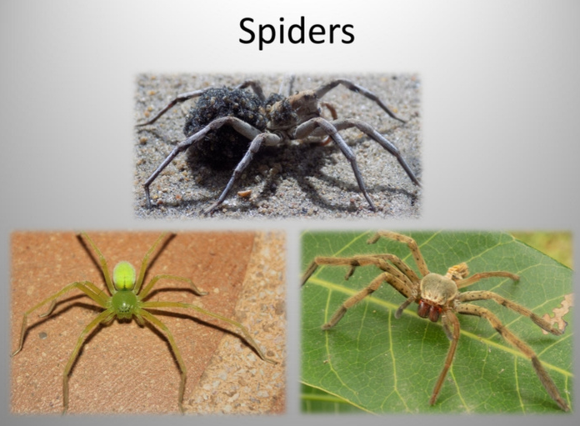
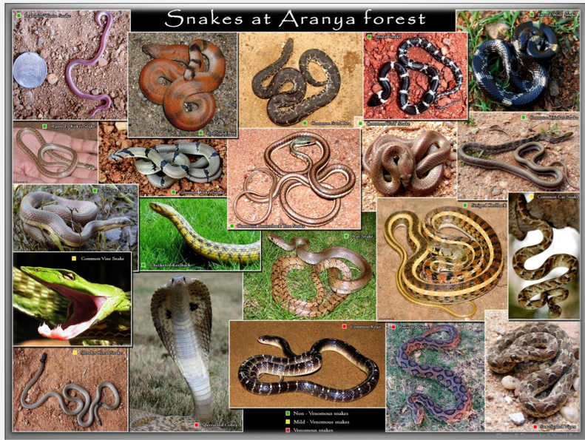
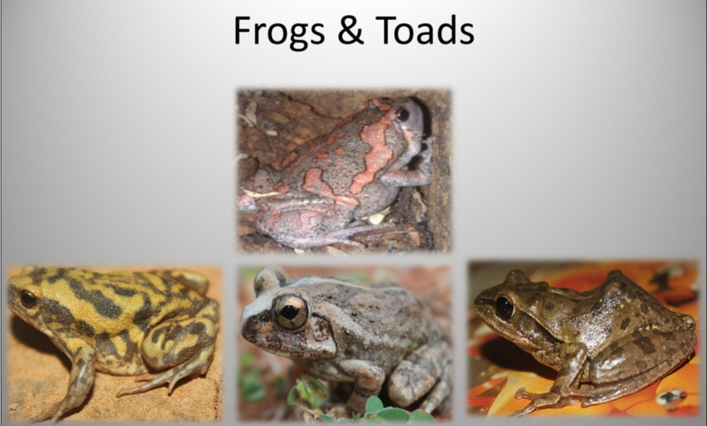
Butterflies & Birds

Slide 17
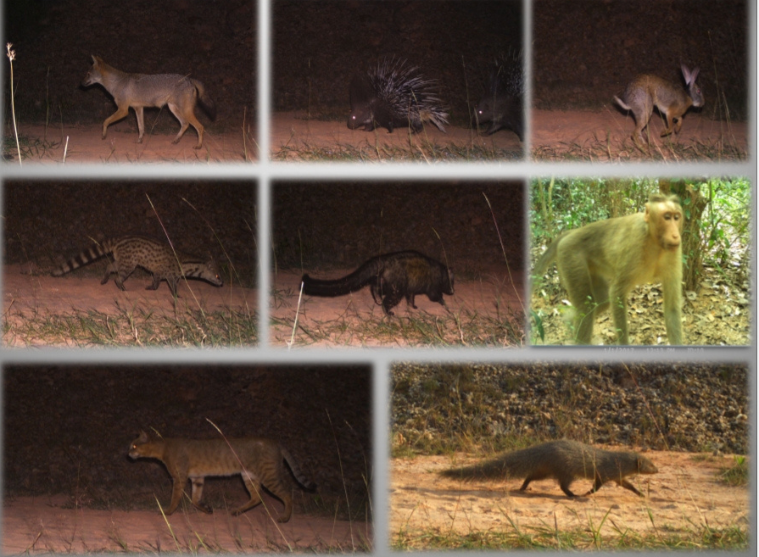
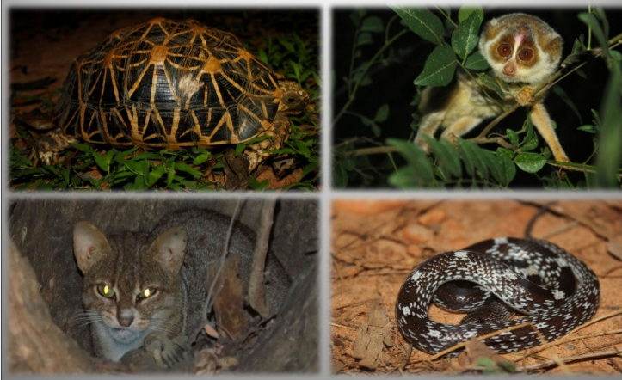
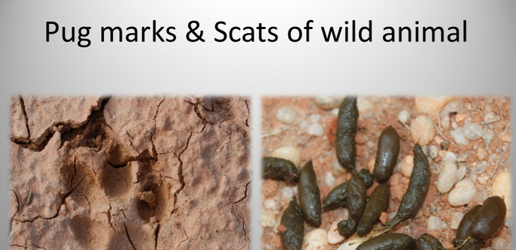
Wildlife of Aranya

Slide 18
Conclusion
1.) Diversified diet is directly linked to low carbon footprint impact
of agriculture on the environment because the diversified diet is
constituted with local and seasonal produce.
2.) Consumption of a diversified diet ensures optimum nutrition and
helps in maintaining overall health of a person.
3.) Commercial agriculture negatively impacts the environment
alternatives like food forestry and permaculture conserve
biodiversity, maintain soil health and have a low carbon footprint
helping in environmental conservation.

Slide 19

What can be done?
Earth Guardians Bangalore Non-profit organization
It is a Non-profit organization founded by me for spreading awareness & education on climate change and environmental issues locally & globally. I will use this platform to spread awareness on my research about diets and their impact on biodiversity, how to lead a sustainable lifestyle. Earth Guardians Bangalore is a youth-led community, where I document green spaces, volunteer and educate through "Eco-modules".

Slide 20
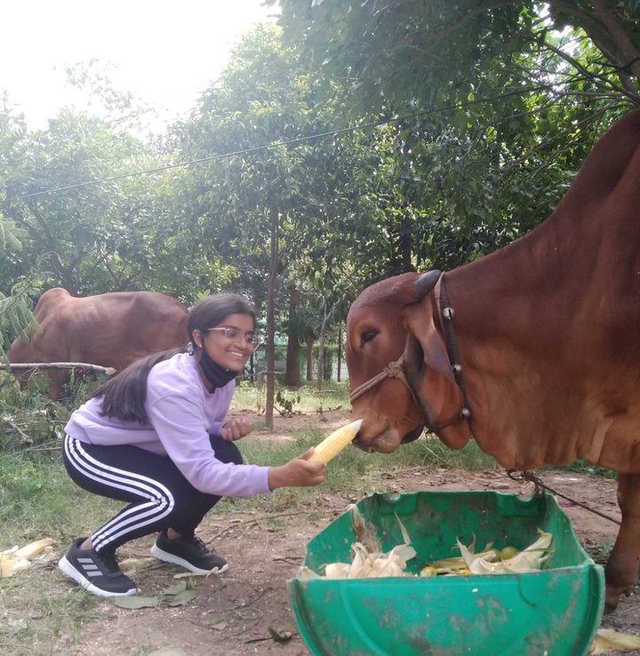
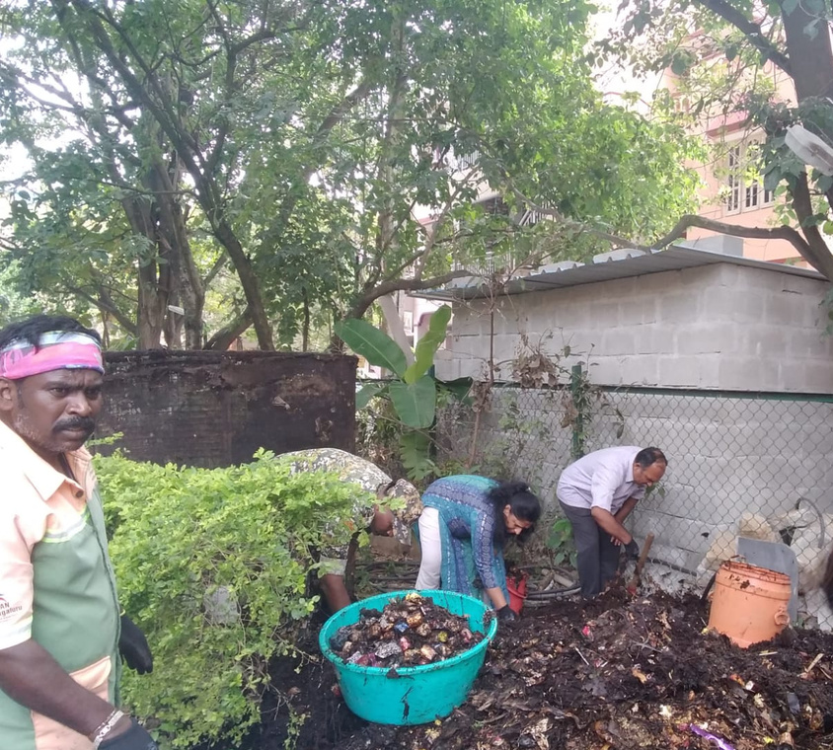
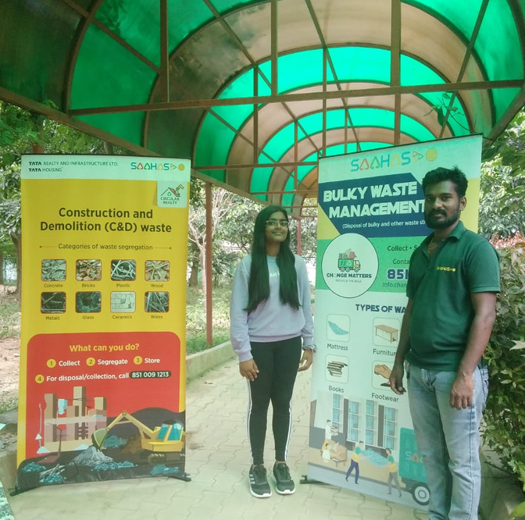
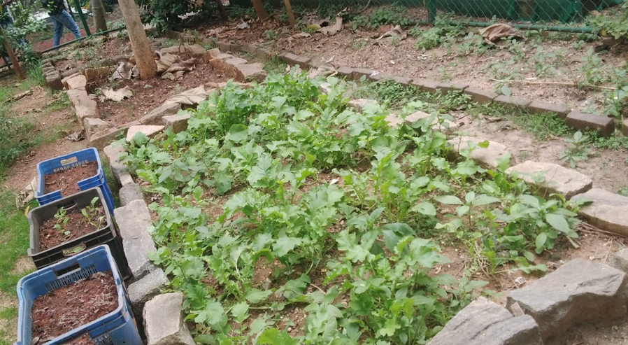
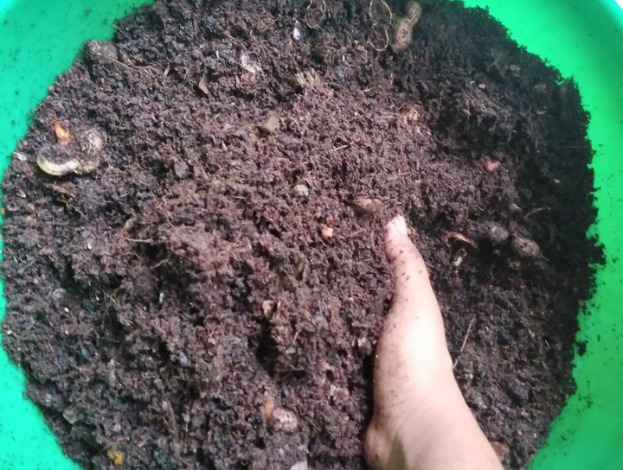
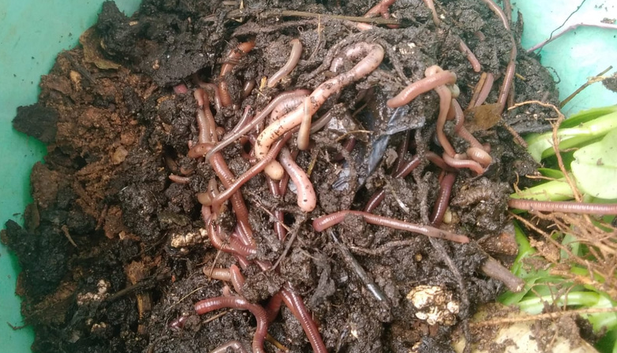
100+ hours of Volunteering & community service

Slide 21
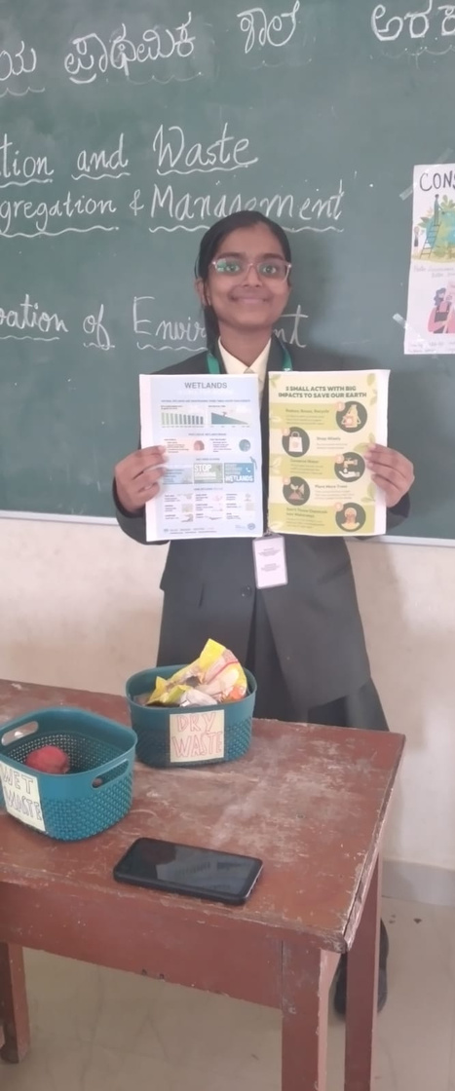
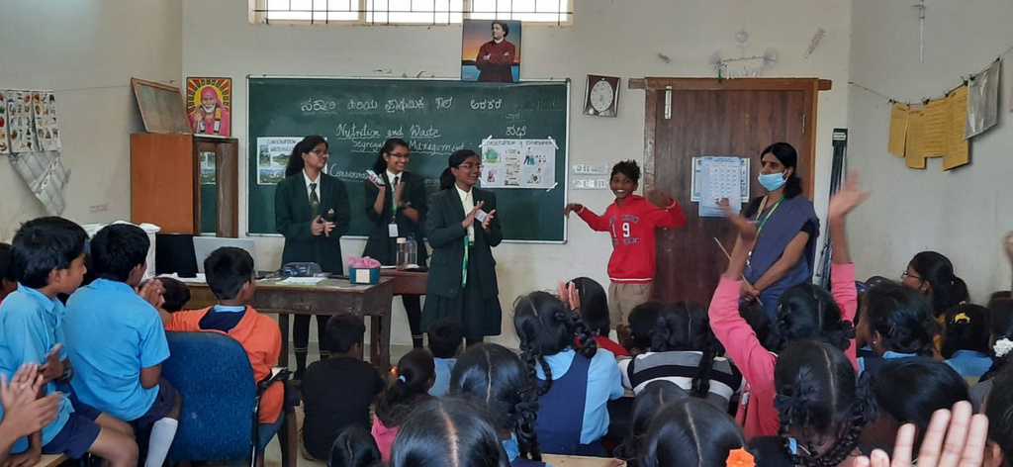
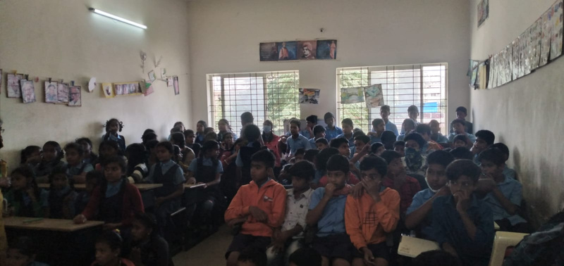
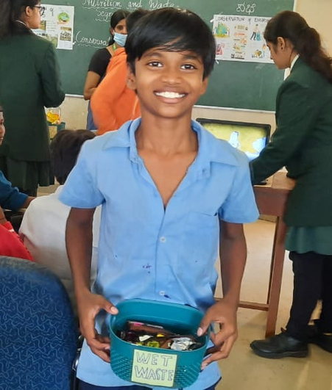
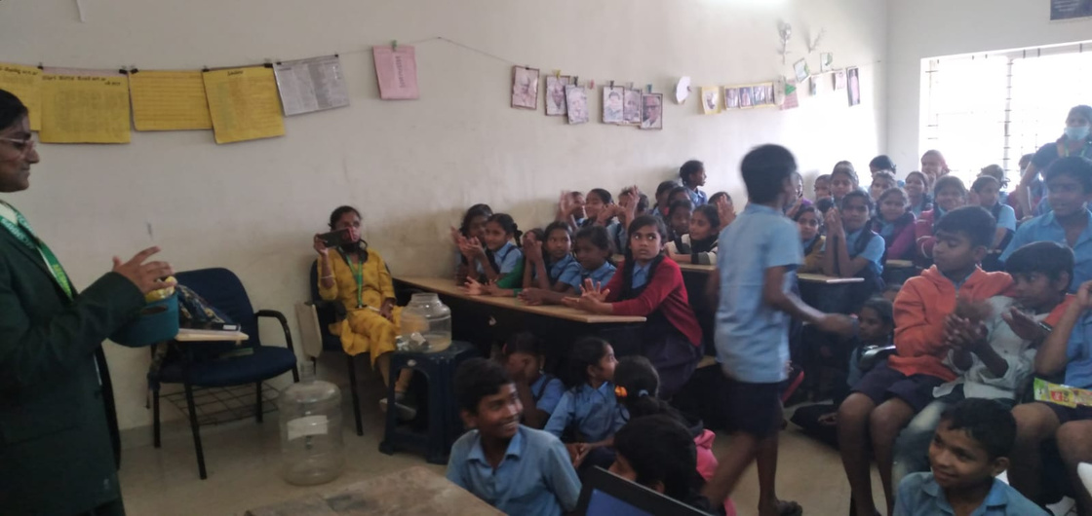
Awareness program on Nutrition & waste management in Government school, Arekere

Slide 22
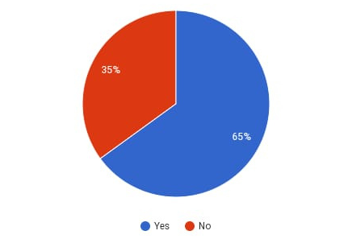
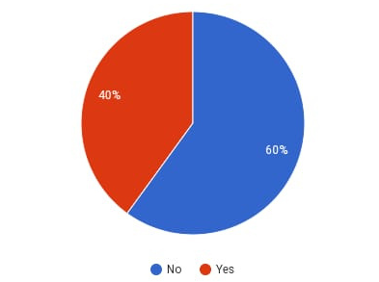
An interesting finding on research
Q1.) Do you think research is only for solving big problems?
Q2.) Do you think research can solve day-to-day problems that relate to you, me & everyone ?

Slide 23
Acknowledgements
I would like to thank IISc for providing me this opportunity to share my insights.
A very huge thank you to D. Saravanan sir from Aranya forest and Sanctuary for coordinating with me throughout the project and giving first hand data and insights.
Thanks to our director Dr. Seema Goel ma'am and management.
A huge thank you to Gayathri ma'am for guiding me with my project.
A special mention and thank you to everyone who took part in the survey & interactions .

Slide 24
Sources:
https://www.nhp.gov.in/healthlyliving/healthy-diet
https://www.fao.org/home/en
https://www.earthguardians.org/
https://www.ncbi.nlm.nih.gov/pmc/articles/PMC2805147/
https://www.unepfi.org/industries/banking/guidance-on-biodiversity-target-setting/
http://www.forests.ap.gov.in/

