Slide 1
EM 2018: Western Ghats District allocations - participant wise
COLLABORATIVE EFFORTS BY EM2018 Participants
Please cc your emails (to state coordinators, Overall coordinators) to
emram.ces@courses.iisc.ac.in

Slide 2
Objectives
Identification of Ecologically Sensitive Villages in the Western Ghats
Reasons for choosing Western Ghats: one among 35 Global Biodiversity Hotspots. Western Ghats ensures water and food security in the peninsular India. Western Ghats is aptly branded as ‘Water Tower of Peninsular India
This involves
Land use land cover dynamics in Western Ghats using temporal remote sensing data
Compilation of information (population, geo-climatic, demographic, land, etc.) as per the template sent herewith
Overlaying of all information (district wise)
Prioritising villages in the Western Ghats based on the levels of ecologically sensitiveness

Slide 3
Method
Collaborative approach – information compilation (district) by EM 2018 participants and submission to the respective State Coordinator (DUE DATE: 5OCT 2018)
Validation by the respective State Co-ordinators and Statewise compilation and submission to Overall Coordinators (DUE DATE: 15 Oct 2018)
Overall Co-ordinators to verify all information, sent by the state co-ordinators (Due Date: 3 Nov 2018) and pass onto IISc team
IISc team to carryout LULC dynamics analyses and identification of ecologically sensitive villages in the Western Ghats and review the outcome with Gadgil Committee report and HLWG report (Kasturirangan) apart from the Ministry of Environment, Forests and Climate change guidelines

Slide 4
District Coordinator
District Level (5 October 2018)
Information (demographic, geo-climatic, etc.) compilation (as per the template) by participants
State coordinators
State Level (15 Oct 2018)
Consolidation of information (compiled at district levels) and verification
Western Ghats
Western Ghats overall coordinators
Validation and submission by 3 Nov 2018

Slide 5
EM 2018 Course Participants are required to
Compile information for the respective district (listed state wise district per participant) as per the template sent herewith
Review of Scientific literatures to understand the status of ecology, biodiversity in the respective district
The respective district information (as per the template) to be submitted to the respective State Coordinators on or before 5 Oct 2018 .
State coordinators to verify each district information (submitted by participants) and mail to TVR (emram.ces@courses.iisc.ac.in) on or before 15 Oct 2018 with copies to overall co-ordinators. Details next..

Slide 6
Western Ghats: Overall– Coordinators:
Sara Kunnatt, Anirudh K
Responsibilities (overall Coordinators)
Verify the information compiled by the respective State Co-ordinators (with each district coordinator/participants)
LULC (land use land cover) dynamics analyses using temporal remote sensing data. Candidates who have acquired knowledge of GIS and RS are most welcome to help the State coordinators
Madumita, Anirudh, Sai Omkari with Dr. Vinay, and Dr. Bharath Settur will carryout analyses to identify Ecologically Sensitive villages in each district .
Consolidated report of Ecologically Sensitive Villages for the entire Western Ghats will be released at Lake 2018 (22-25 November 2018) and handed over to the respective State Governments as well as The Ministry of Forests, Environment and Climate Change (MoEFCC) .

Slide 7
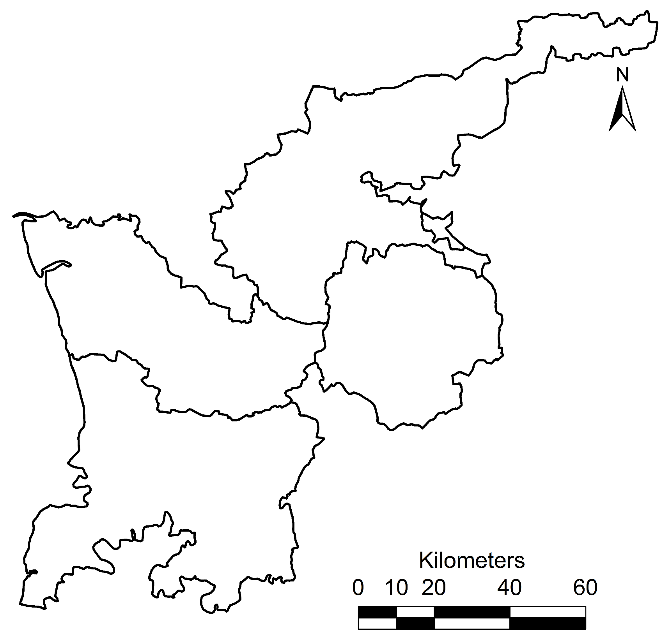
GUJARAT
TAPI
COORDINATOR
YADAV
Yadav
THE
DANGS
NAVASI
Ribhu
Rajput
VALSAD
Aashka

Slide 8
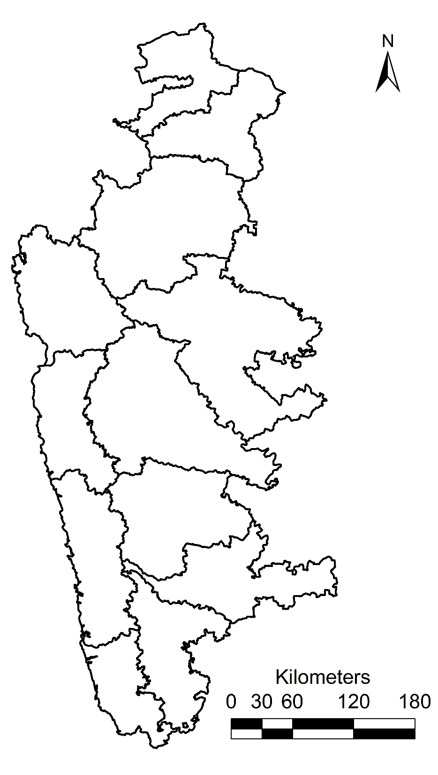
MAHARASHTRA
NANDURBAR
Praveen Kumar
DHULE
NASIK
K V Singh
COORDINATORS
SMITA & AMRUTHA
Smita
THANE
Patil
AHMADNAGAR
Rajdeep
RAIGHAR
K V Singh
PUNE
Amrutha
SATARA
Shaik
RATNAGIRI
Purohit
SANGLI
Arun
KOLHAPUR
Sanghamitra
SINDHUDURG
Mishra

Slide 9
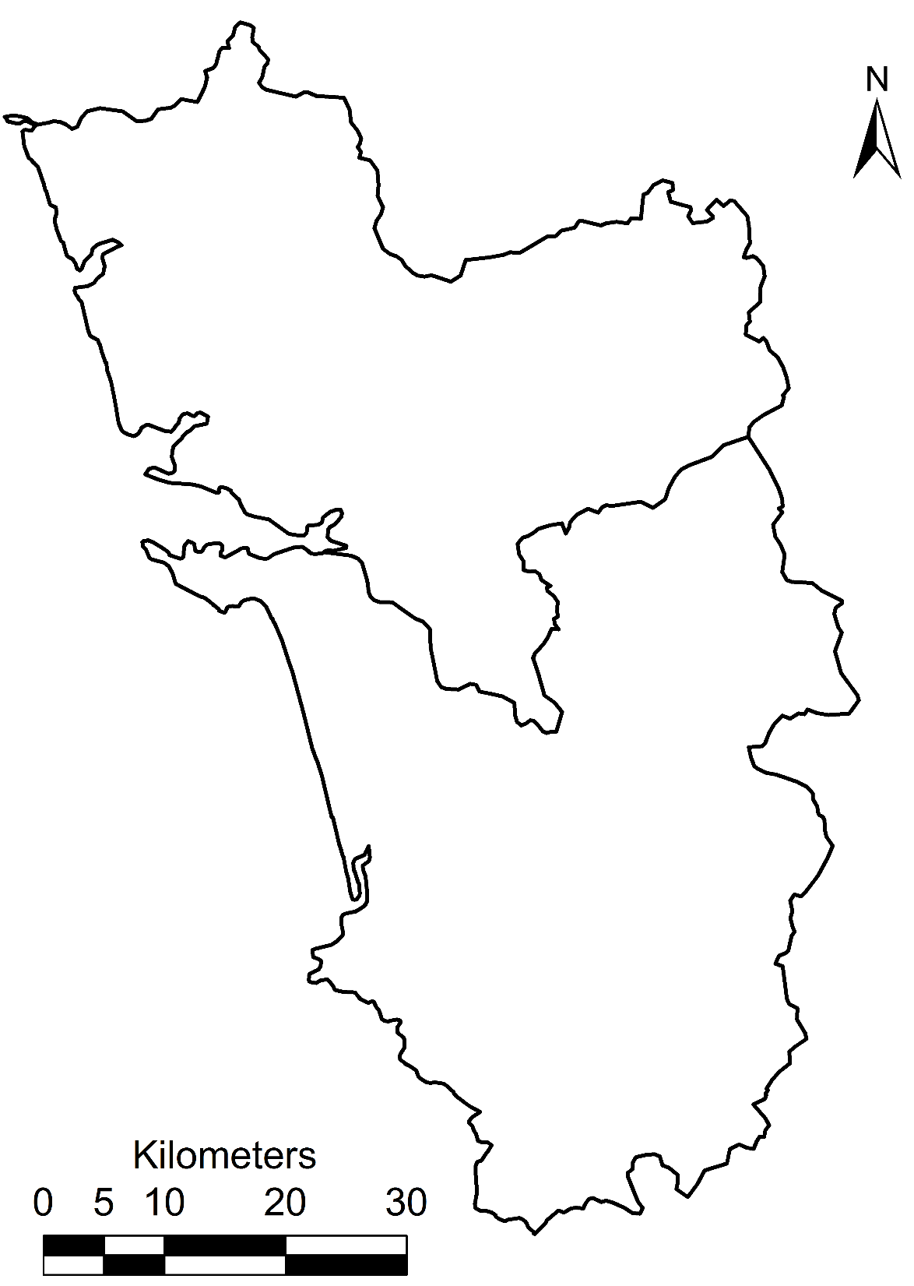
GOA
DADRA & NAGAR HAVELI
NORTH GOA
COORDINATOR
AADITYA
Aaditya Ashok
Aaditya Ashok
SOUTH GOA
Neha Kishor

Slide 10
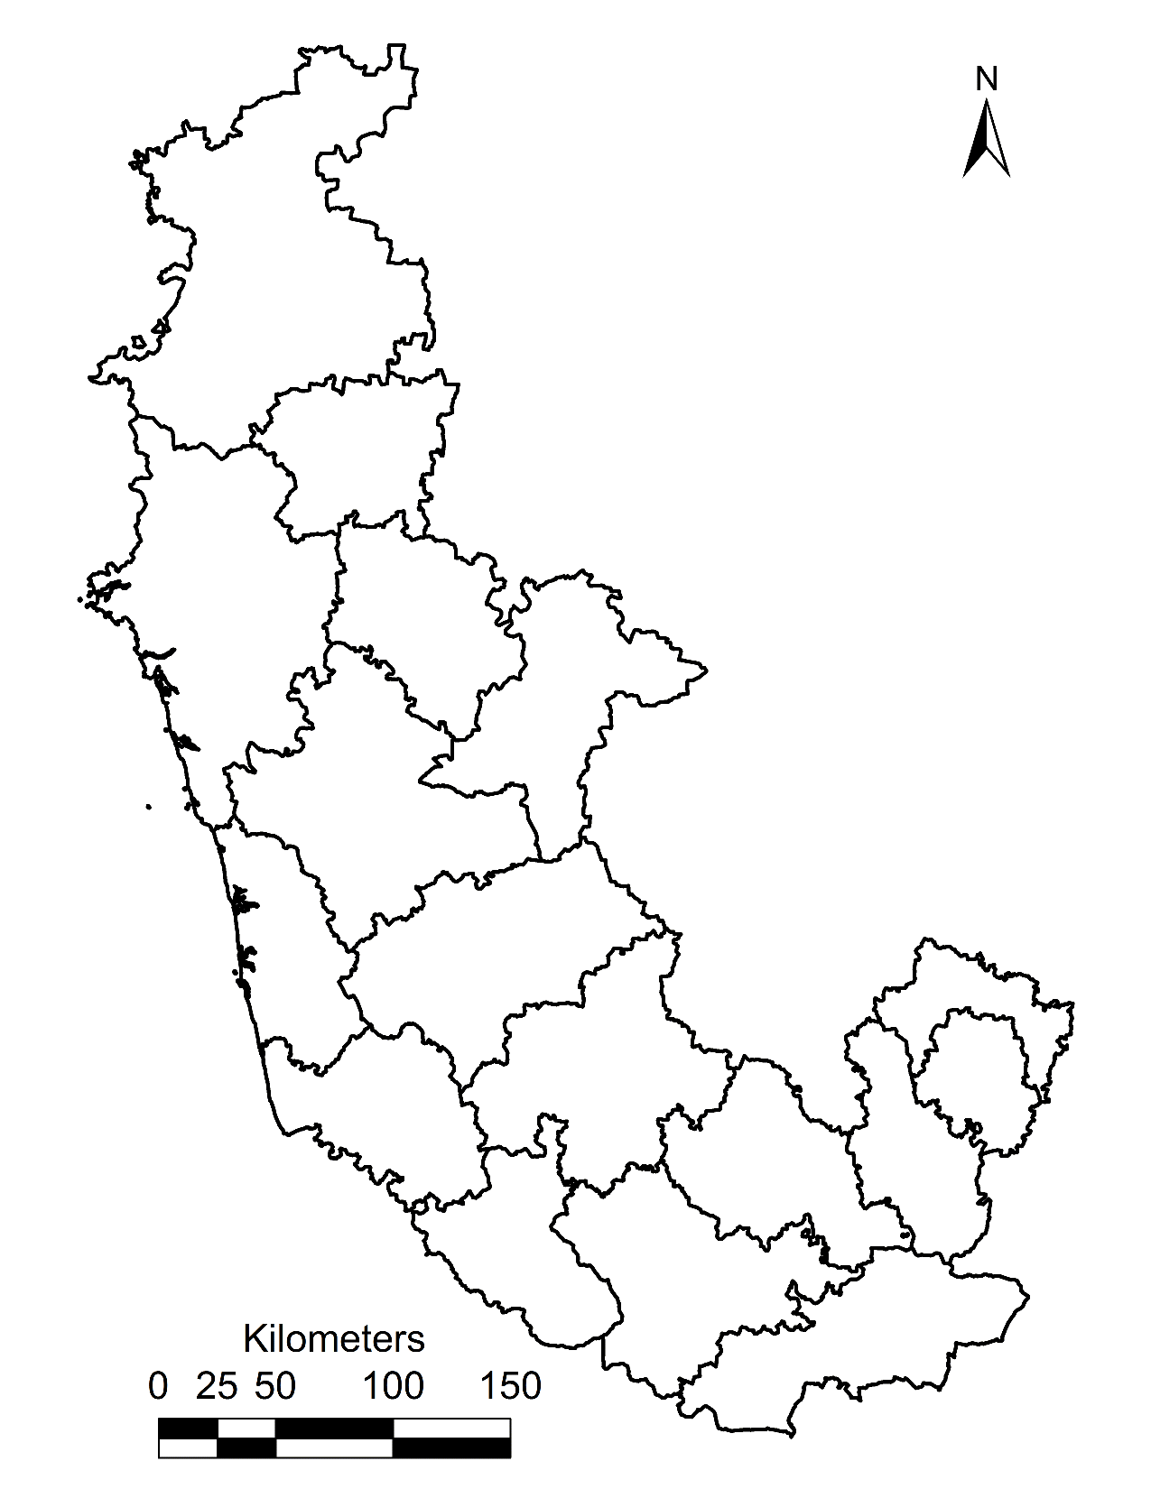
KARNATAKA
BELGAUM
Apoorva A
DHARWAD
Apoorva A
COORDINATORS MADHUMITA, SAI OMKARI & SHANTANU
UTTARA KANNADA
HAVERI
Sai Omkari
Madhumita
DAVANAGERE
Sowmya G S
SHIMOGA
CHICKMAGALUR
Madhumita
Madhumita
HASSAN
Girish
UDUPI
Deepika Shetty
BANGALORE RURAL
Sai Omkari
DAKSHINA KANNADA
Deepika Shetty
BANGALORE
Amaresh
RAMANAGARA
Girish
Amaresh
KODAGU
CHAMARAJNAGAR
Sowmya G S
MYSORE and MANDYA
Shantanu

Slide 11
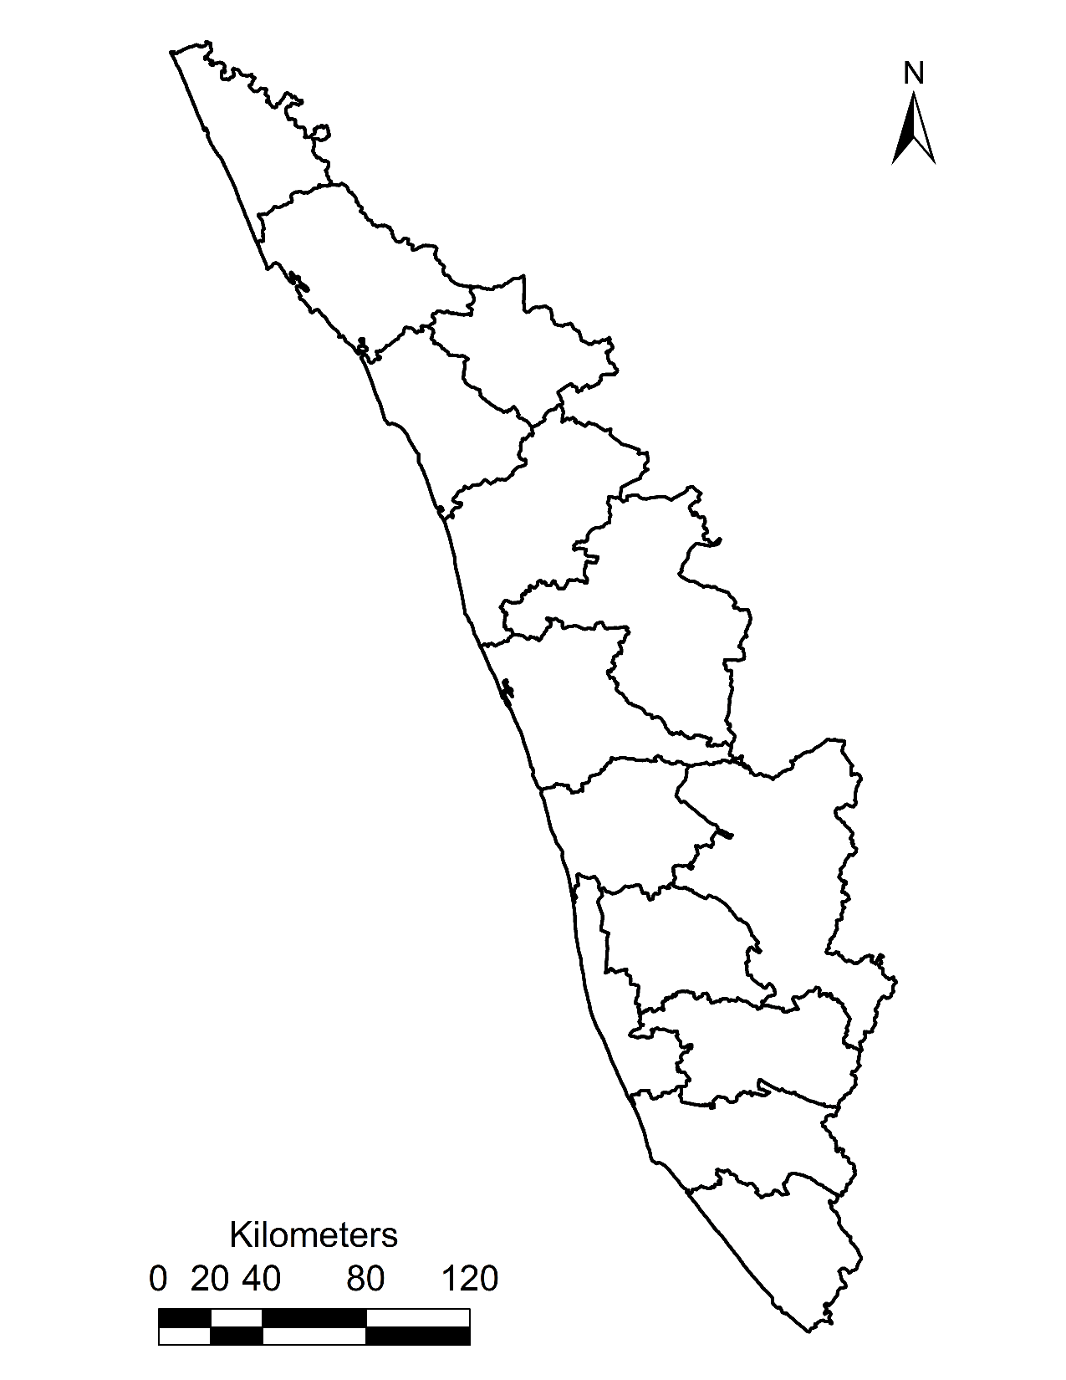
KERALA
KASARGOD
Arpitha M S
KANNUR
WAYNAD
Madhusudan
COORDINATORS SARA & MADHUSUDHAN
Anirudh
KOZHIKODE
Madhusudan
PALAKKAD
MALAPPURAM
Chathura
Anirudh
THRISSUR
Chathura
IDUKKI
ERNAKULUM
Sara Kunnath
Sara Kunnath
KOTTAYAM and ALAPPUZHA
Padmakumar C T
PATHANAMTHITTA
Anjana
KOLLAM
Anjana
THIRUVANANTHAPURAM
Anirudh

Slide 12
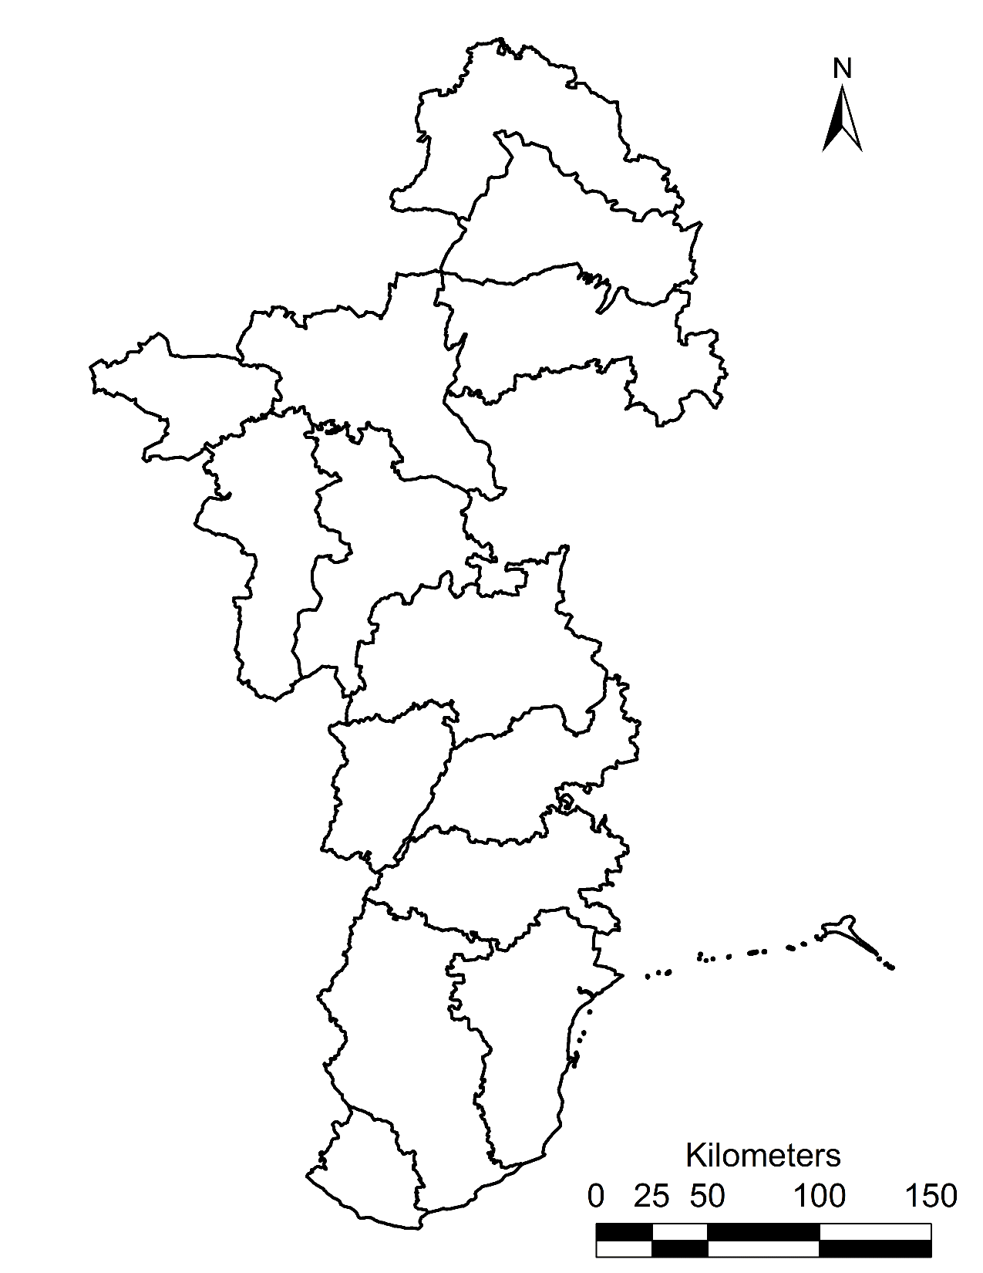
TAMIL NADU
KRISHNAGIRI
Surekha
COORDINATORS SANDHYA & SENKAATHIRVANAN
Smrutiprava
ERODE
DHARMAPURI
Surekha
THE NIGLIRIS
SALEM
Smrutiprava
Sandhya
COIMBATORE
TIRUPPUR
Rakesh Behera
Sandhya
DINDUGAL
Hirak
MADURAI
Priyadarsini
THENI
Senkathirvanan
VIRUDUNAGAR
Priyadarsini
TIRUVANVELI
Senkathirvanan
THOOTHUKUDI
Sandhya
KANYAKUMARI
Neha Tanwar

Slide 13
STATE | DISTRICT | PARTICIPANT | COORDINATOR
Gujarat | Navsari | Ribhu Chowdhury | Droupti Yadav
Gujarat | The Dangs | Hari Krishna Rajput | Droupti Yadav
Gujarat | Valsad | Aashka Tarun Patel | Droupti Yadav
Gujarat | Tapi | Droupti Yadav | Droupti Yadav
Maharashtra | Ahmadnagar | Rajdeep Chatterjee | Smita & Amrutha
Maharashtra | Nandurbar | Praveen Kumar Tiwari | Smita & Amrutha
Maharashtra | Thane | Patil Gajanan Suresh | Smita & Amrutha
Maharashtra | Kolhapur | Sanghamitra Guhathakurta | Smita & Amrutha
Maharashtra | Nashik | Smita Sharma | Smita & Amrutha
Maharashtra | Pune | Chavare Amrutha Jagadish | Smita & Amrutha
Maharashtra | Raigarh | Karam Veer Singh | Smita & Amrutha
Maharashtra | Sindhudurg | Devendra Kumar Mishra | Smita & Amrutha
Maharashtra | Dhule | Karam Veer Singh | Smita & Amrutha
Maharashtra | Ratnagiri | Dinesh Kumar Purohit | Smita & Amrutha
Maharashtra | Sangli | Arun Kumar Tummala | Smita & Amrutha
Maharashtra | Satara | Shaik Mazaruddin | Smita & Amrutha
Dadara & Nagar Havelli | Dadra & Nagar Haveli | Aditya Ashok Battin | Aditya Ashok
Goa | North Goa | Neha Kishor Katkar | Aditya Ashok
Goa | South Goa | Aditya Ashok Battin | Aditya Ashok

Slide 14
STATE | DISTRICT | PARTICIPANT | COORDINATOR
Karnataka | Bangalore | Amaresh | Madhumita & Shantanu
Karnataka | Belgaum | Apoorva A | Madhumita & Shantanu
Karnataka | Dharwad | Apoorva A | Madhumita & Shantanu
Karnataka | Hassan | Girish | Madhumita & Shantanu
Karnataka | Kodagu | Amaresh | Madhumita & Shantanu
Karnataka | Mandya | Shantanu Kalambi | Madhumita & Shantanu
Karnataka | Mysore | Shantanu Kalambi | Madhumita & Shantanu
Karnataka | Ramanagara | Girish | Madhumita & Shantanu
Karnataka | Bangalore Rural | Sai Omkari P | Madhumita & Shantanu
Karnataka | Chamrajnagar | Sowmya G S | Madhumita & Shantanu
Karnataka | Chikmagalur | Madhumita | Madhumita & Shantanu
Karnataka | Dakshina Kannada | Deepika Shetty | Madhumita & Shantanu
Karnataka | Davanagere | Sowmya G S | Madhumita & Shantanu
Karnataka | Haveri | Sai Omkari P | Madhumita & Shantanu
Karnataka | Shimoga | Madhumita | Madhumita & Shantanu
Karnataka | Udupi | Deepika Shetty | Madhumita & Shantanu
Karnataka | Uttara Kannada | Madhumita Dey | Madhumita & Shantanu

Slide 15
STATE | DISTRICT | PARTICIPANT | COORDINATOR
Kerala | Alappuzha | Padmakuar C T | Sara & Madhusudan
Kerala | Kasaragod | Arpitha M S | Sara & Madhusudan
Kerala | Kollam | Anjana Krishnamurthy | Sara & Madhusudan
Kerala | Kottayam | Padmakuar C T | Sara & Madhusudan
Kerala | Thiruvananthapuram | Anjana Krishnamurthy | Sara & Madhusudan
Kerala | Ernakulam | Sara Kunnath | Sara & Madhusudan
Kerala | Idukki | Sara Kunnath | Sara & Madhusudan
Kerala | Malappuram | Anirudh K | Sara & Madhusudan
Kerala | Palakkad | Chathura Viswanath | Sara & Madhusudan
Kerala | Pathanamthitta | Anirudh K | Sara & Madhusudan
Kerala | Thrissur | Chathura Viswanath | Sara & Madhusudan
Kerala | Wayanad | Anirudh K | Sara & Madhusudan
Kerala | Kannur | Madhusudan Phalgun | Sara & Madhusudan
Kerala | Kozhikode | Madhusudan Phalgun | Sara & Madhusudan

Slide 16
STATE | DISTRICT | PARTICIPANT | COORDINATOR
Puducherry | Mahe | Madhusudhan P | Sara & Madhusudhan
Tamil Nadu | Dharmapuri | Surekha Ramineni | Sandhya & Senkathirvanan
Tamil Nadu | Dindigul | Hirak Sarkar | Sandhya & Senkathirvanan
Tamil Nadu | Erode | Smrutiprava Mohanty | Sandhya & Senkathirvanan
Tamil Nadu | Krishnagiri | Surekha Ramineni | Sandhya & Senkathirvanan
Tamil Nadu | Salem | Smrutiprava Mohanty | Sandhya & Senkathirvanan
Tamil Nadu | Tiruppur | Rakesh Behera | Sandhya & Senkathirvanan
Tamil Nadu | Coimbatore | Sandhya G | Sandhya & Senkathirvanan
Tamil Nadu | Kanniyakumari | Neha Tanwar | Sandhya & Senkathirvanan
Tamil Nadu | Madurai | Swadhina Priyadarsini | Sandhya & Senkathirvanan
Tamil Nadu | The Nilgiris | Sandhya G | Sandhya & Senkathirvanan
Tamil Nadu | Theni | Senkathirvanan K | Sandhya & Senkathirvanan
Tamil Nadu | Thoothukkudi | Sandhya G | Sandhya & Senkathirvanan
Tamil Nadu | Tirunelveli | Senkathirvanan K | Sandhya & Senkathirvanan
Tamil Nadu | Virudunagar | Swadhina Priyadarsini | Sandhya & Senkathirvanan

Slide 17
CHAPTERS

Slide 18
EM 2018 Course participant Chapter allocation
PDCA: Plan, Design, Check and ACTIVELY participate

Slide 19
Coordinators per Chapter – as session Moderators
4 Co-ordinators’ per chapter
Co-ordinator shall conduct e-sessions: announce questions, compile answers of all participants (including co-ordinator), evaluate (10 or 100 scale) and consolidate marks as below
Chapter 1: Environment Management – Introduction
Assignment announcement date: 10 Sept 2018 |  |  | Submission date: 17 Sept 2018
Candidate-wise mark
Candidate | Co-ord 1 | Co-ord 2 |  | Co-ord 3 | Co-0rd 4

Slide 20
Co-ordinators’ Responsibilities as teachers
Design questions (in consultation with all respective chapter coordinators)
Sending the respective chapter question paper (assignments – chapter wise) to all participants on the dates indicated next.
Participants to submit answers to the respective chapter coordinators (before the due date)
Each Coordinator of the respective chapter to correct every participants’ answer scripts and assign marks
Good questions (similarly apt answers) will carry bonus marks
Teachers (coordinators) need to be unbiased while evaluating answer scripts
Respective chapter’s resource persons and TVR will also evaluate and assign marks
Mail consolidated answer scripts with marks details to TVR: emram.ces@courses.iisc.ac.in

Slide 21
Coordinators and Final contact session
Two coordinator s’ (out of 4) will present assigned chapter (PPT slides)
Other two will enrich the session with examples and case studies
Duration: 90 minutes per chapter (presentation, Evaluation, Discussion)
All coordinators shall suggest for improvement of the chapter content
Each of these chapter session will have Chair and Co-chair (chosen from participants – refer next slide) to evaluate (i) the content, (ii) quality of the presentation, (iii) design of slides, (iv) level of inter-active session and (v) maintenance of time

Slide 22
Chapters – dates for announcement and circulation of questions and submission of answer scripts
Chapters | Assignments announcement date By the respective Co-orindators | Submission Dates To the respective chapter co-ordinator | Submission to TVR*
1 | 10 Sept 2018 | 16 Sept 2018 | 17 Sept 2018
2 | 17 Sept 2018 | 23 Sept 2018 | 24 Sept 2018
3 | 24 Sept 2018 | 30 Sept 2018 | 1 Oct 2018
4 | 1 Oct 2018 | 7 Oct 2018 | 8 Oct 2018
5 | 8 Oct 2018 | 14 Oct 2018 | 15 Oct 2018
6 | 15 Oct 2018 | 21 Oct 2018 | 22 Oct 2018
7 | 22 Oct 2018 | 28 Oct 2018 | 29 Oct 2018
8 | 29 Oct 2018 | 4 Nov 2018 | 5 Nov 2018
9 | 5 Nov 2018 | 11 Nov 2018 | 12 Nov 2018
10 | 12 Nov 2018 | 18 Nov 2018 | 19 Nov 2018
* Consolidate answers (all participants including co-ordinators) and consolidated marks sheet

Slide 23
Chapter | Coordinators
Chapter 1 | Padmakumar C T, Arpitha M S, Aashka Tarun Patel, Madhumita
Chapter 2 | Sara Kunnath, Anirudh K, Chathura Viswanath, Smita Sharma
Chapter 3 | Surekha Ramineni, Hirak Sarkar, Smrutiprava Mohanty, Rakesh Behera
Chapter 4 | Sandhya G, Swadhina Priyadarsini, Senkathirvanan K, Anjana Krishnamurthy
Chapter 5 | Madhusudan P, Neha Kishor, Aaditya Ashok, Sowmya G S

Slide 24
Chapter | Coordinators
Chapter 6 | Rajdeep Chatterjee, Praveen Kumar Tiwari, Patil Gajanan Suresh, Amrutha Jagadish
Chapter 7 | Karam Veer Singh , Sai Omkari P , Sanghamitra Guhathakurta, Devendra Kumar Mishra
Chapter 8 | Neha Tanwar, Dinesh Kumar Purohit, Arun Kumar Tummala, Shaik Mazaruddin
Chapter 9 | Deepika Shetty , Ribhu Chowdhury, Hari Krishna Rajput, Droupti Yadav
Chapter 10 | Amaresh, Apoorva A, Girish, Shatanu Kalambi.

Slide 25
Coordinators as TEACHERS & SESSION CHAIRPERSONS Disseminate Knowledge, Moderate and Evaluate

Slide 26
Chapter | Presented by | Chairpersons
Chapter 1 | Padmakumar C T, Arpitha M S, Aashka Tarun Patel, Madhumita | Rajdeep Chatterjee, Praveen Kumar Tiwari, Patil Gajanan, Amrutha
Chapter 2 | Sara Kunnath, Anirudh K, Chathura Viswanath, Smita Sharma | Karam Veer Singh , Sai Omkari P , Sanghamitra Guhathakurta, Devendra Kumar Mishra
Chapter 3 | Surekha Ramineni, Hirak Sarkar, Smrutiprava Mohanty, Rakesh Behera | Neha Tanwar, Dinesh Kumar Purohit, Arun Kumar Tummala, Shaik Mazaruddin
Chapter 4 | Sandhya G, Swadhina Priyadarsini, Senkathirvanan K, Anjana Krishnamurthy | Deepika Shetty , Ribhu Chowdhury, Hari Krishna Rajput, Droupti Yadav
Chapter 5 | Madhusudan P, Neha Kishor, Aaditya Ashok, Sowmya G S | Amaresh, Apoorva A, Girish, Shatanu Kalambi.

Slide 27
Chapter | Presented by | Chairpersons
Chapter 6 | Rajdeep Chatterjee, Praveen Kumar Tiwari, Patil Gajanan, Amrutha | Padmakumar C T, Arpitha M S, Aashka Tarun Patel, Madhumita
Chapter 7 | Karam Veer Singh , Sai Omkari P , Sanghamitra Guhathakurta, Devendra Kumar Mishra | Sara Kunnath, Anirudh K, Chathura Viswanath, Smita Sharma
Chapter 8 | Neha Tanwar, Dinesh Kumar Purohit, Arun Kumar Tummala, Shaik Mazaruddin | Surekha Ramineni, Hirak Sarkar, Smrutiprava Mohanty, Rakesh Behera
Chapter 9 | Deepika Shetty , Ribhu Chowdhury, Hari Krishna Rajput, Droupti Yadav | Sandhya G, Swadhina Priyadarsini, Senkathirvanan K, Anjana Krishnamurthy
Chapter 10 | Amaresh, Apoorva A, Girish, Shatanu Kalambi. | Madhusudan P, Neha Kishor, Aaditya Ashok, Sowmya G S

Slide 28
Co-ordinators, Students
Discipline, Punctuality, Honesty & Sincerity are the hallmark of a good teacher and also of a student
Share your knowledge and make this session (EM 2018) memorable

